Slide 1
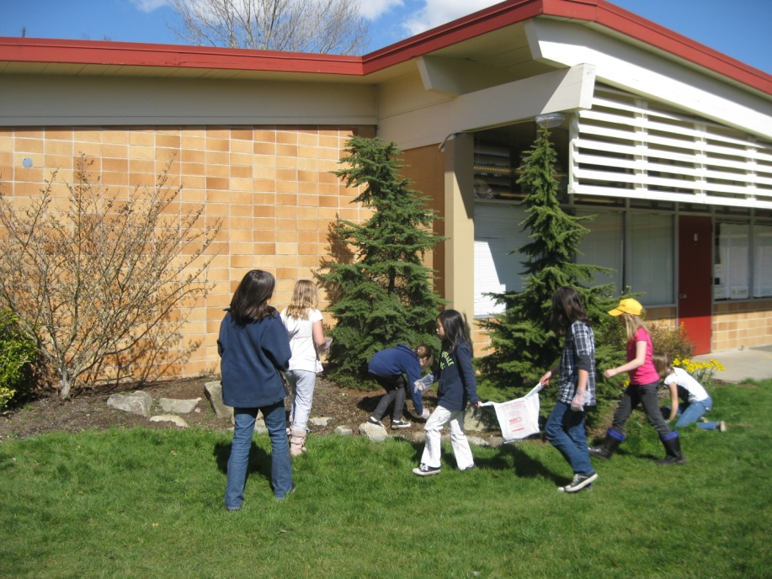
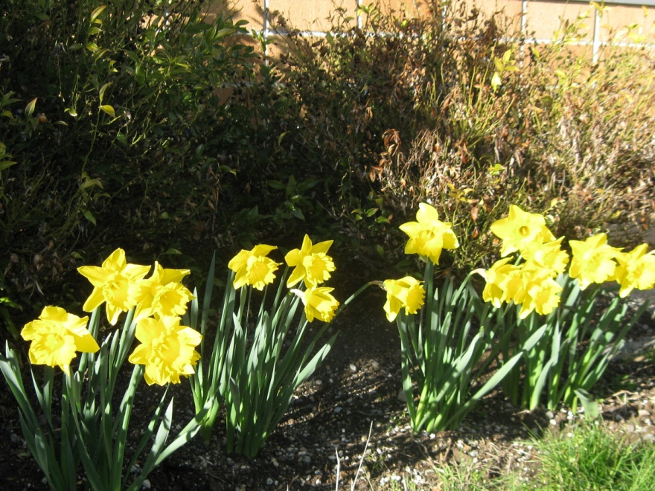
Spring at Lynnwood Elementary, WA, USA April 2011

Slide 2
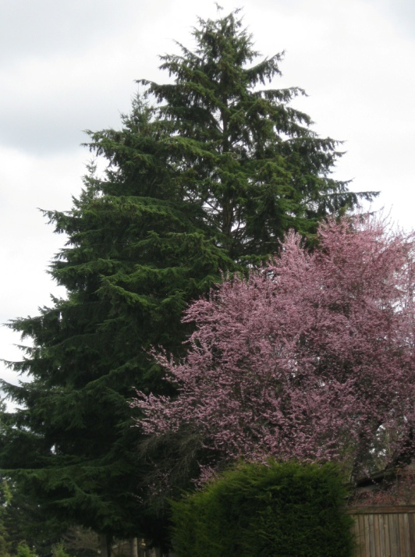
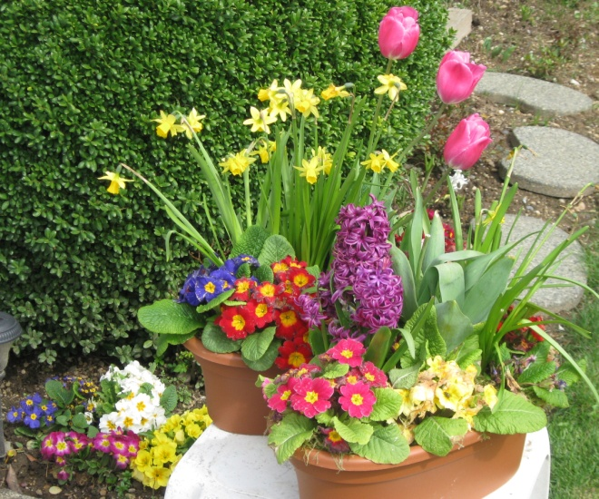
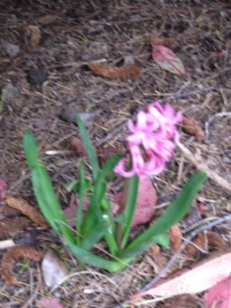
Signs of spring around our school
Buds
Trees blooming
Hyacinth
Tulips, Daffodils and primroses

Slide 3
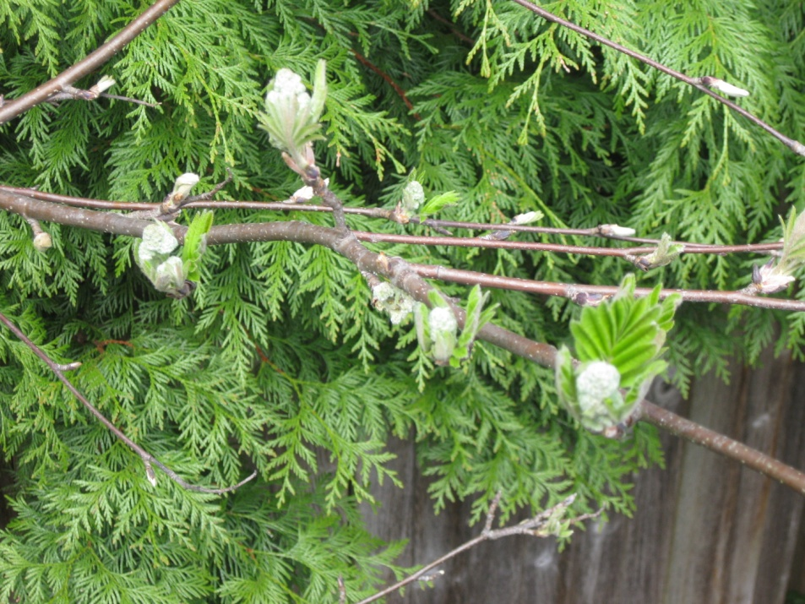
Signs of spring
Ash tree buds with cedar tree behind it
Cedar is a tree that stays green all year .
It is a typical tree around our region.
Forsithia blooms first, then gets leaves

Slide 4
A guest speaker came to talk to us about Gutemberg and the first printing press

Slide 5
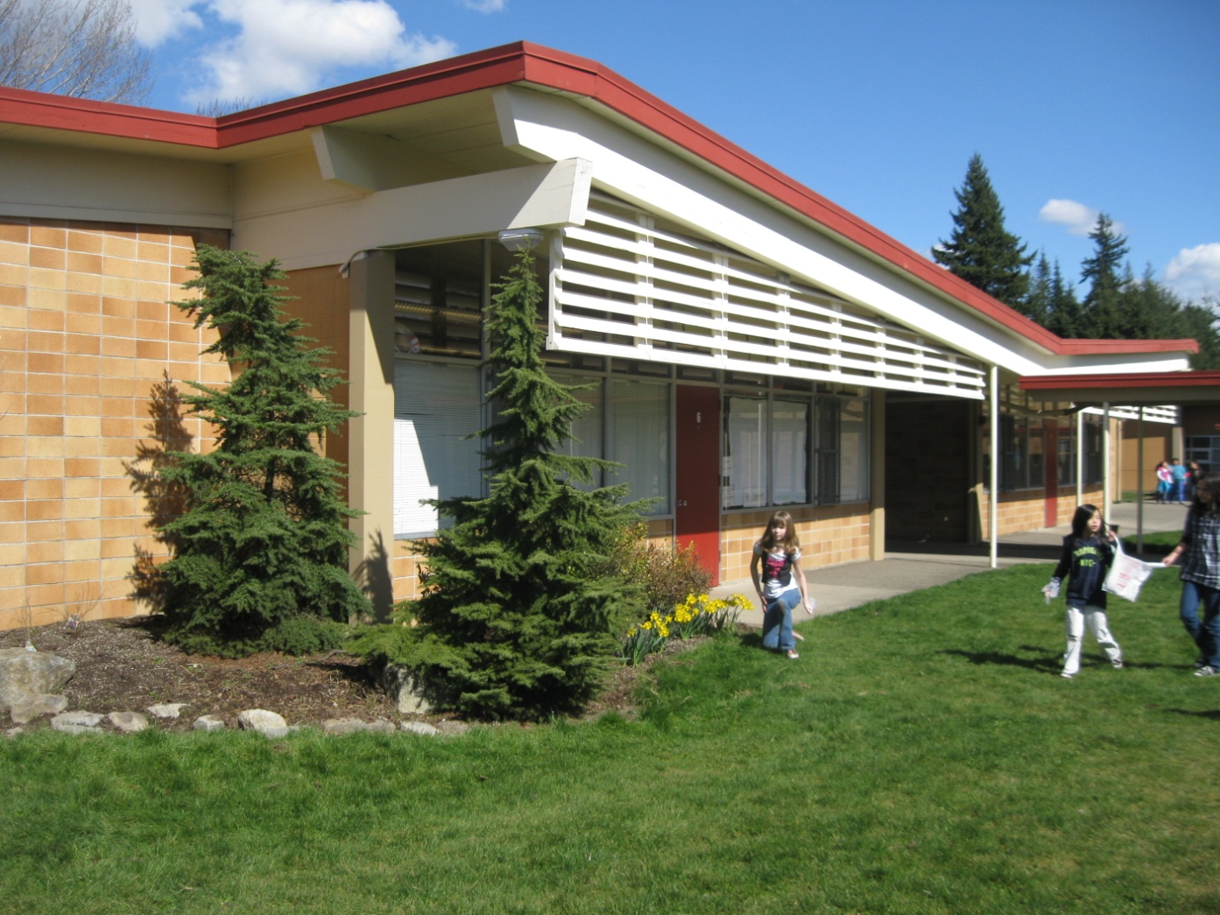
Garden club plants flowers

Slide 6
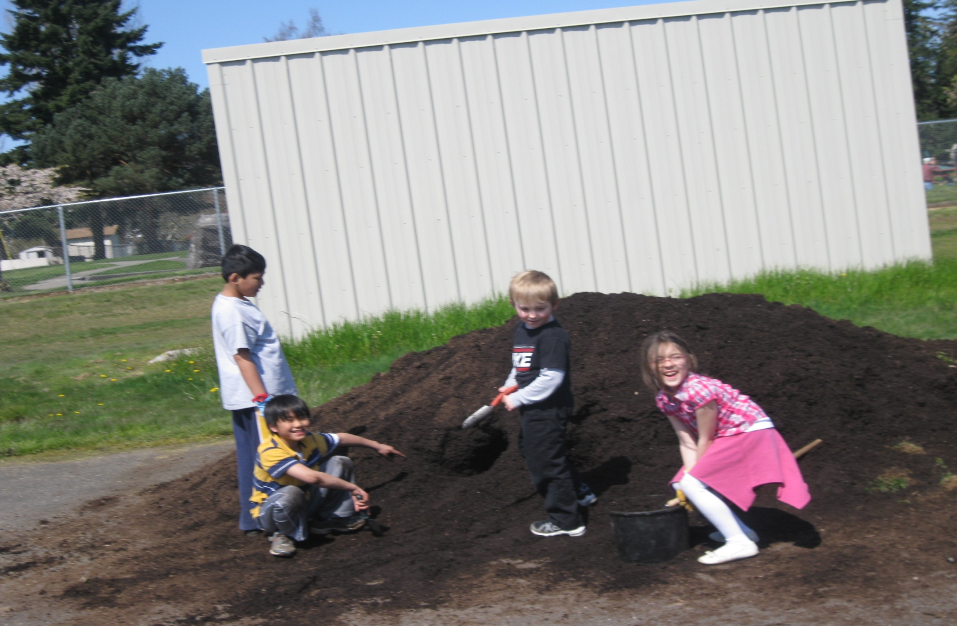
First graders love to help

Slide 7
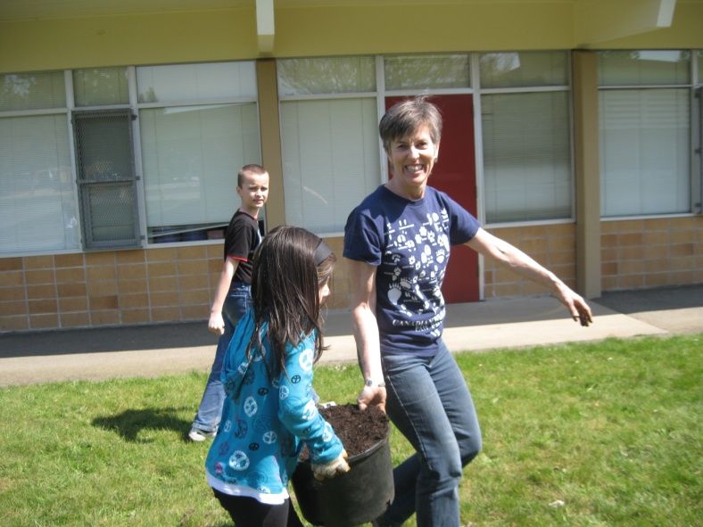
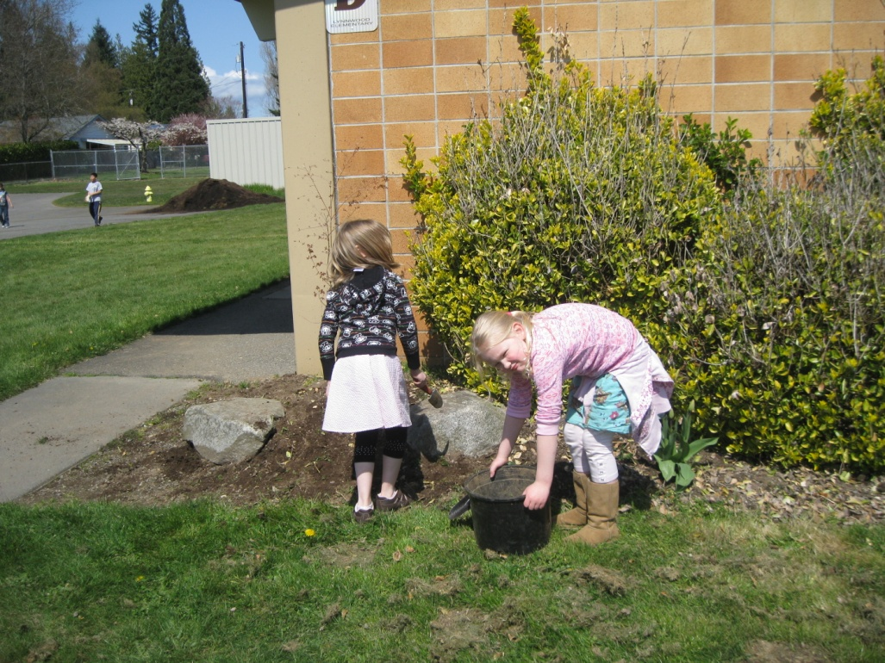
Getting the beds ready for planting

Slide 8
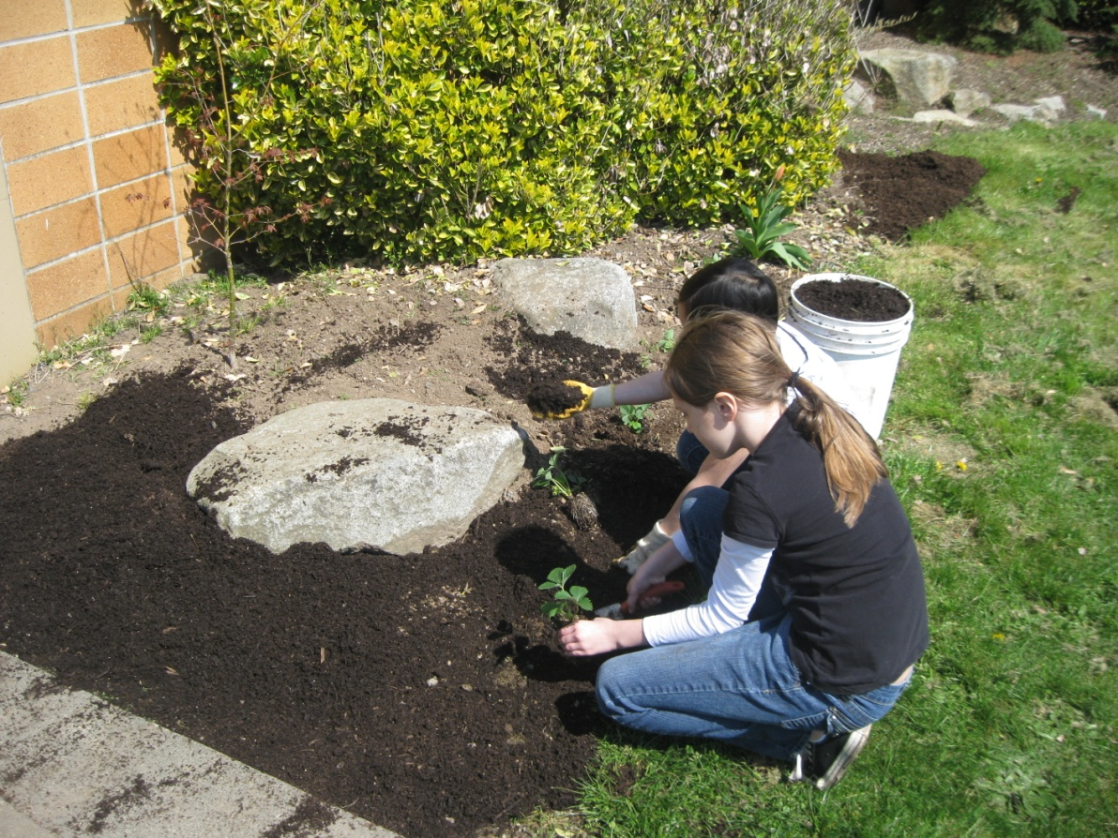
Dragon park in background
Lynnwood students bringing the compost, then planting flowers

Slide 9
We write poetry about Spring

Slide 11
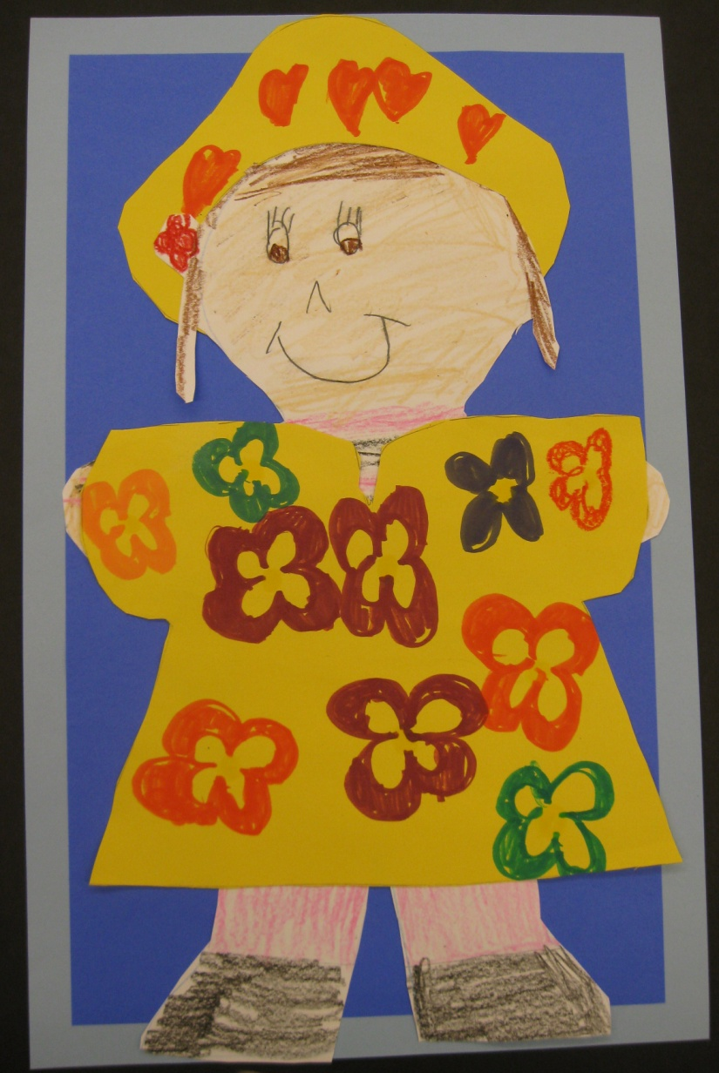
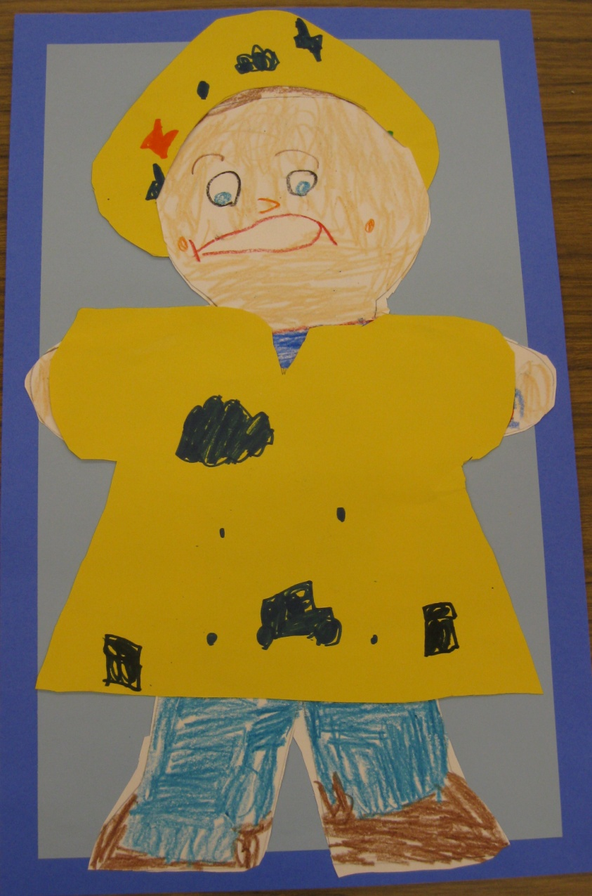
It rains a lot…
Lynnwood is located on the West side of the Cascade Mountains
When the weather front comes in from the sea, it goes around the Olympic mountains and converges around Lynnwood and Everett.

Slide 12
Salmon start their journey up the river
Salmon is a very important resources in Washington and it is an important cultural symbol for Washington Native American Tribes

Slide 13
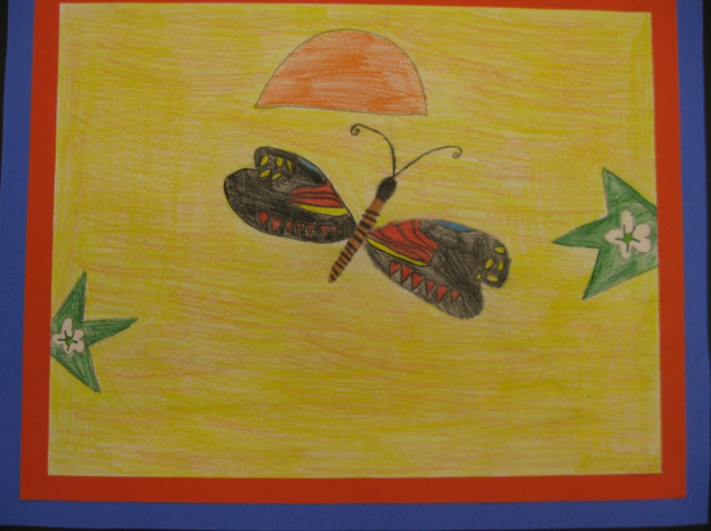
Butterflies come back

Slide 19
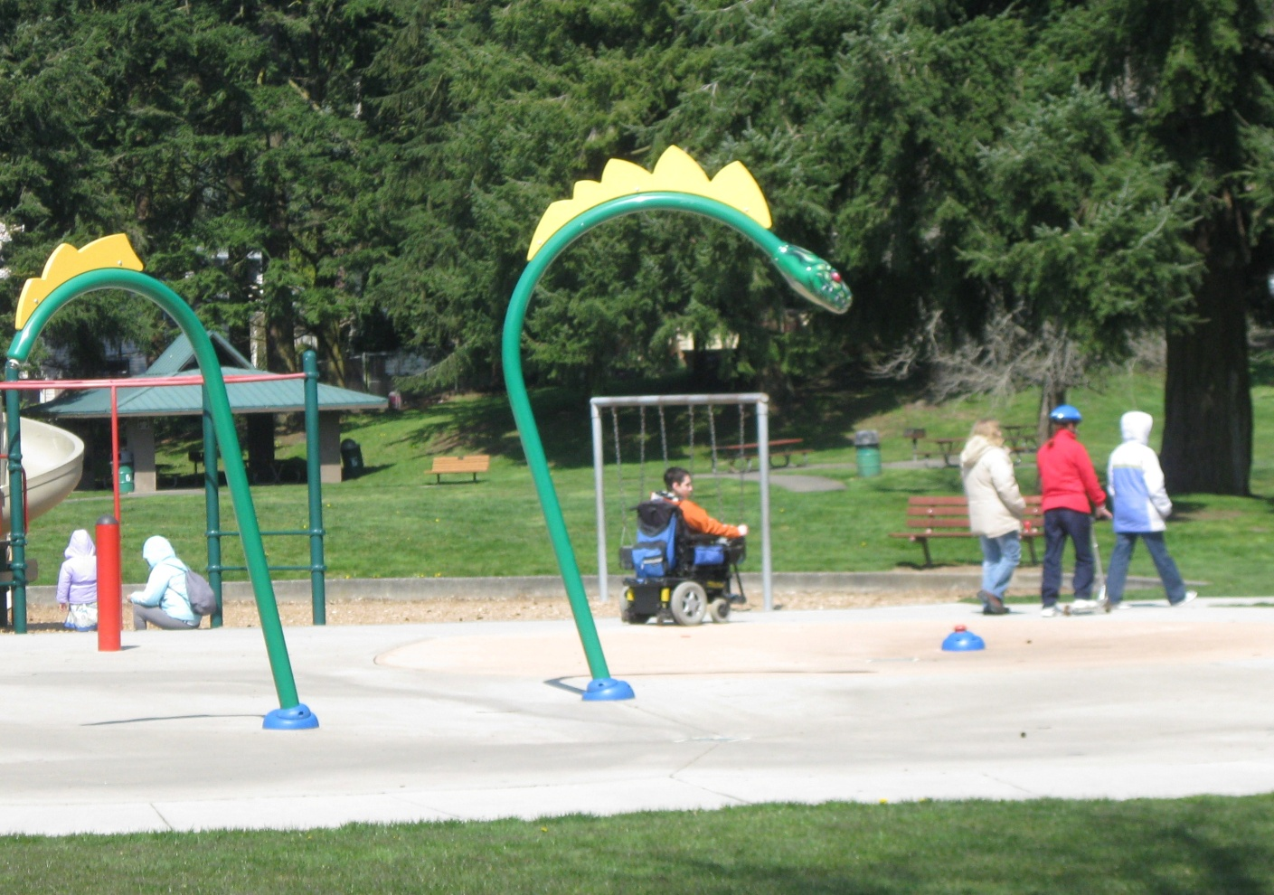
Children play in Dragon Park near our school

Slide 20
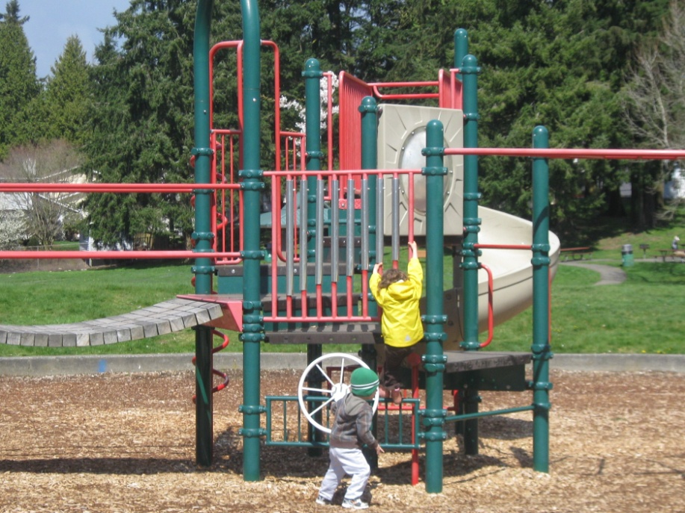
Dragon Park

Slide 21
Squirrel stops to eat
There are many squirrels around, mostly grey squirrels, but the Northwest native squirrels are the brown squirrels

Slide 22
Birds come back: Here a red robin in a tree

Slide 23
Happy Spring!

