Slide 1
Fall Leaves
Lynnwood Elementary
by Room 3 First Graders
With Fourth Grade Buddy Help
Fall 2011

Slide 2
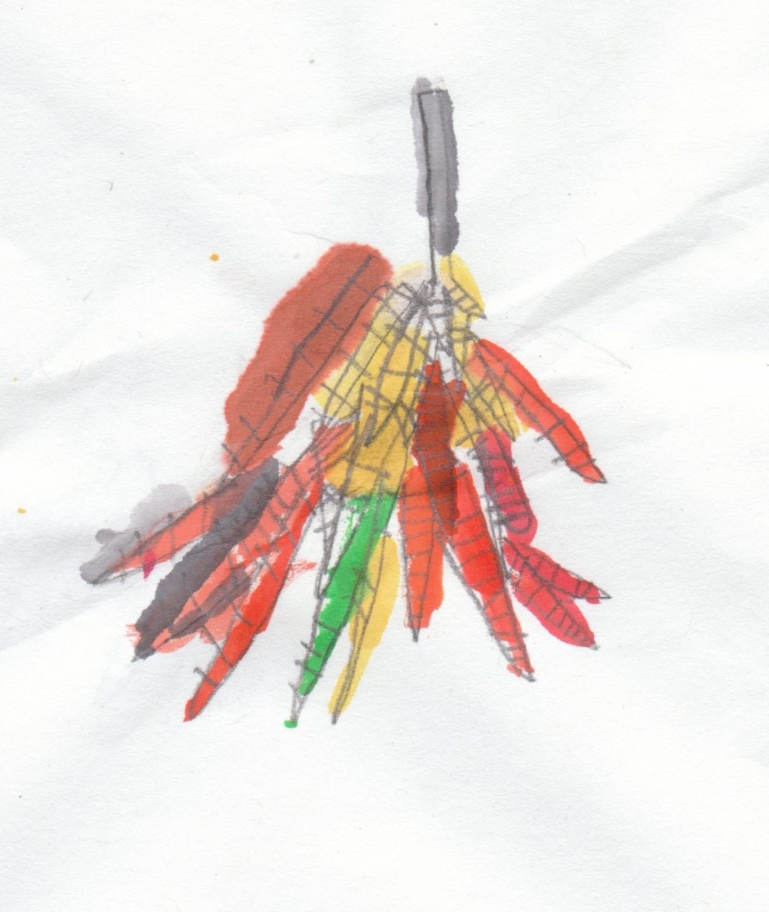
My Leaf
by Yafett
My leaf is colorful.
The leaf goes slowly
to the ground.
It makes a whish noise.
It feels soft and crumbly.
The leaf falls
to the green grass.
It feels wet.

Slide 3
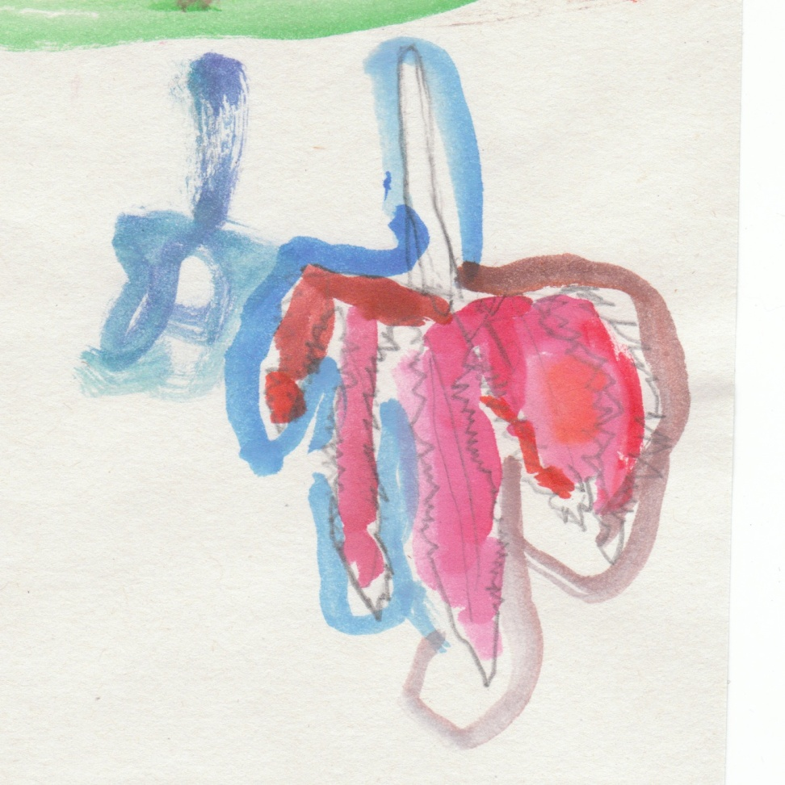
Cricket
by Aakifah
My leaf is colorful in the tree,
and it hit the other leaves and fell.
“Chomp.”
It made the cricket happy.
After,
it smelled like nothing.

Slide 4
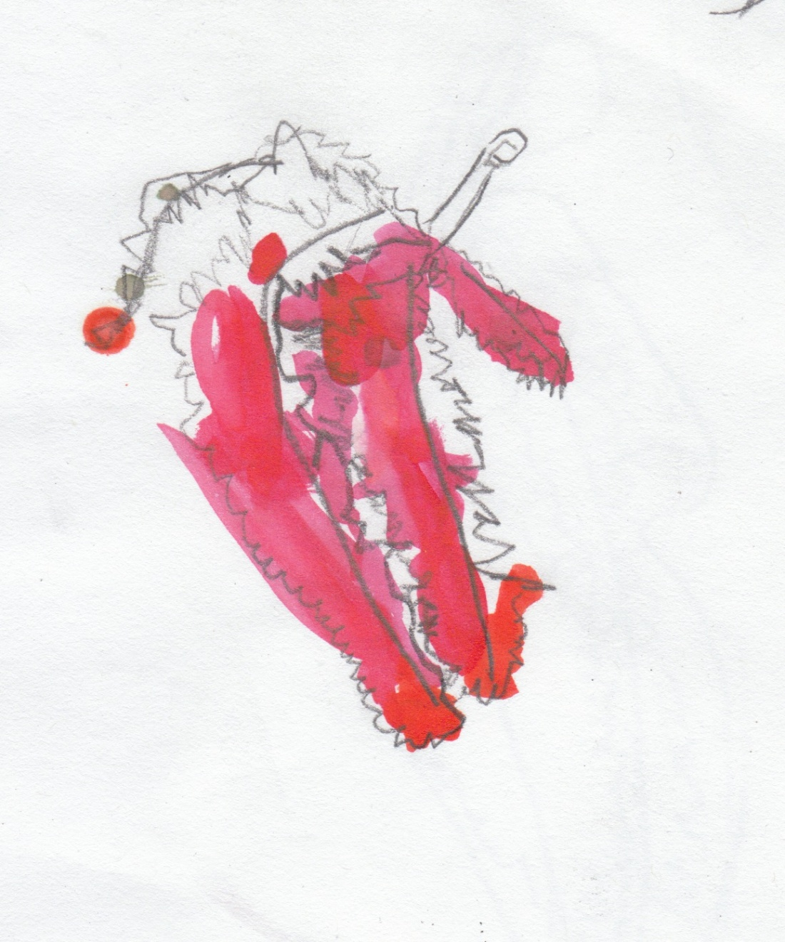
Red Leaf
by Andy
My leaf’s tree is red
and warm.
The leaf falls down
from the tree.

Slide 5
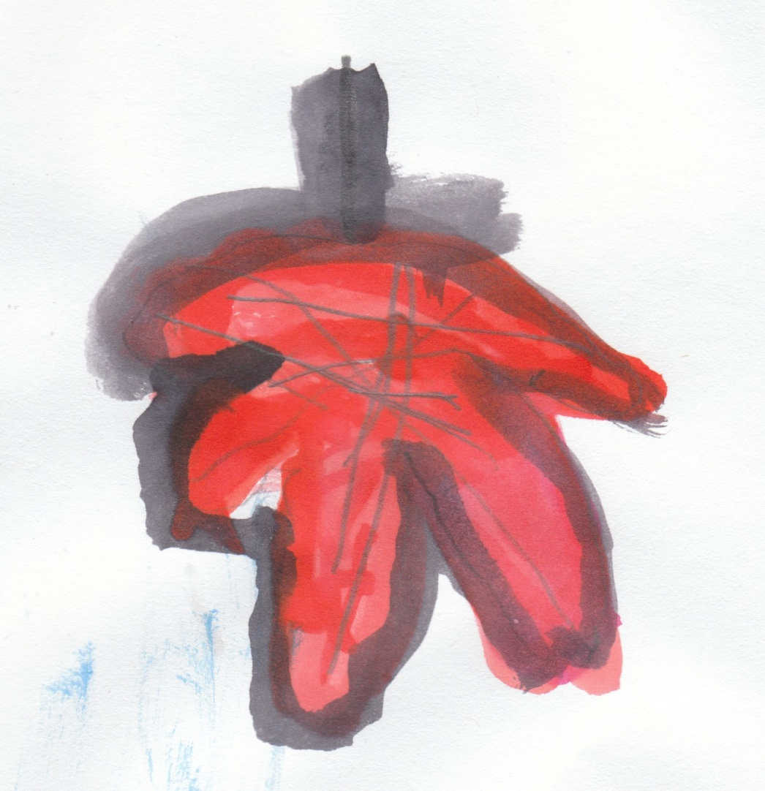
Until the Wind Blew
b y Anthony
My leaf was in a tree
until the wind
blew it away
on the grass,
and it turned green
and red,
and the ground was wet.

Slide 6
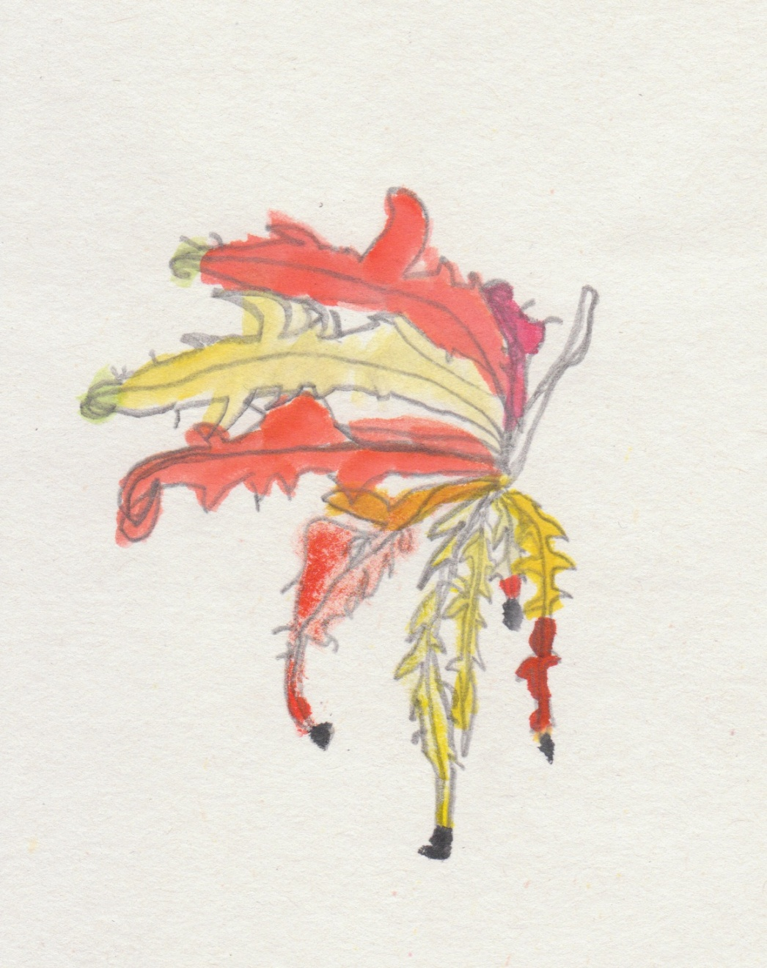
Color Change Leaf
by Aurelia
My leaf is big and pretty,
and it is a Japanese leaf
of different colors.
It changes like a chameleon.

Slide 7
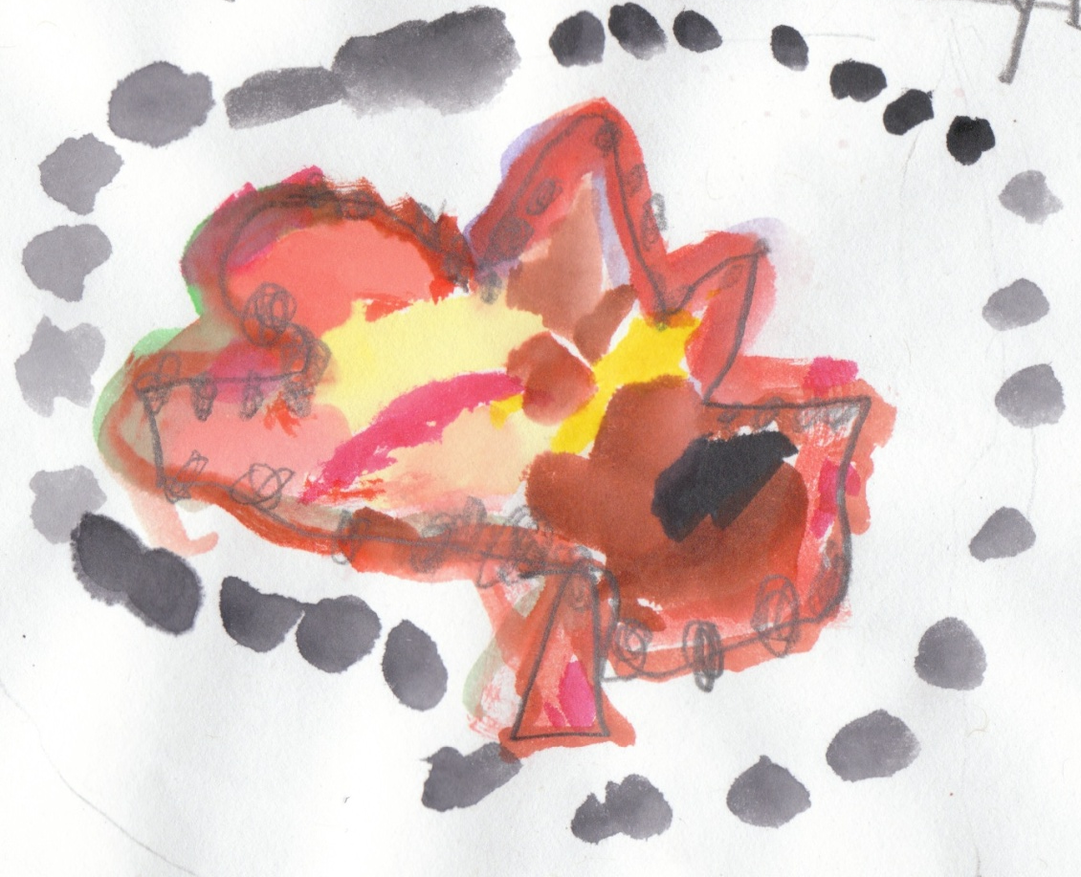
Big Red Leaf
by Blake
My leaf is red, big and hanging.
One day,
my leaf was gone.
My leaf was over the fence.
Then the wind blew it
over to the other fence.
Then someone
picked it up and said,
“That leaf is mine.”

Slide 8
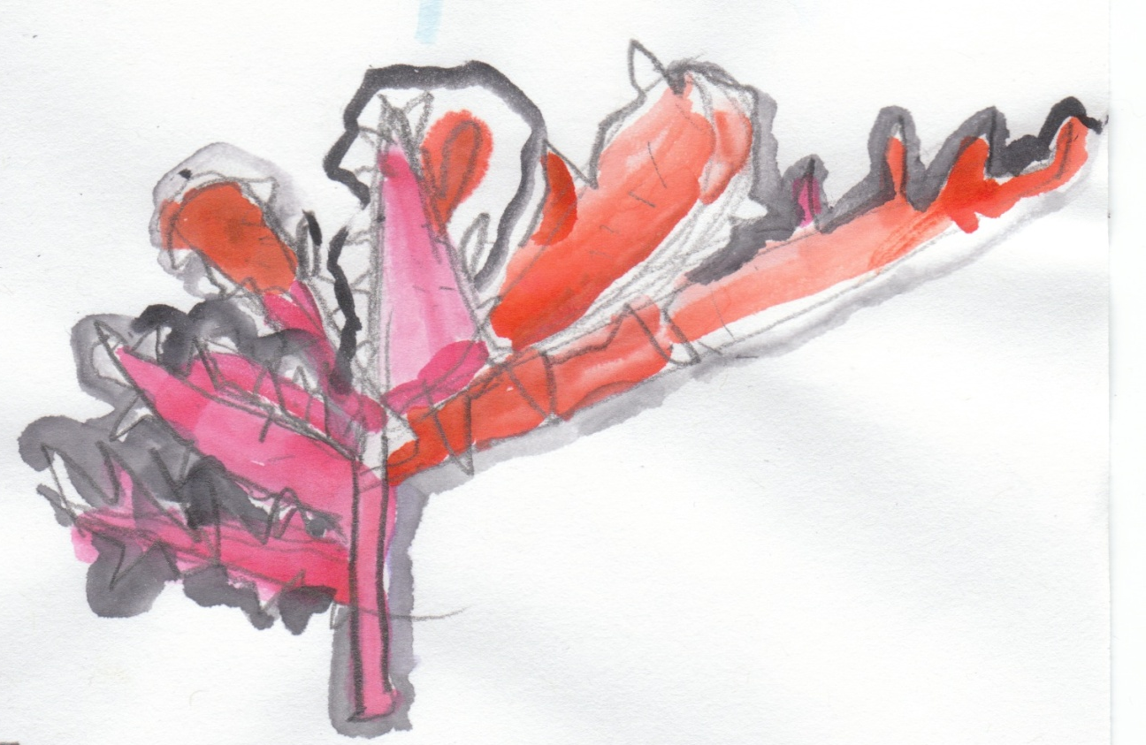
Crashing Leaf
By Bryan
My leaf is in a tree.
It is crashing into more leaves,
and it makes a sound.
It is crash.
Crash and crash.

Slide 9
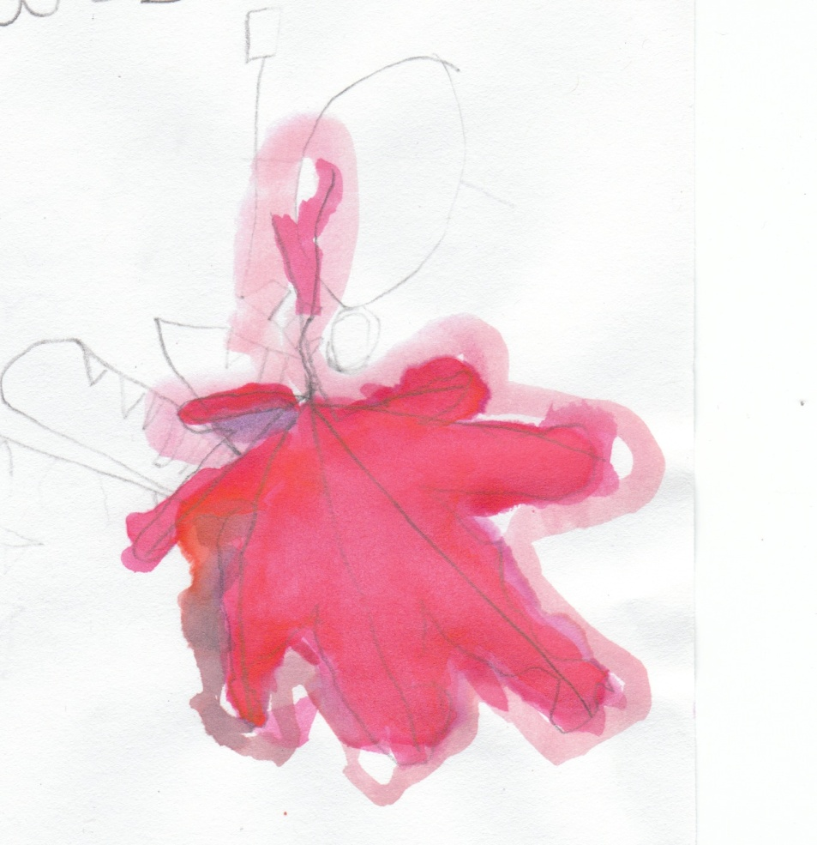
Monkey Leaf
by Christopher
My leaf is swinging
around in a tree
like a monkey.
When it’s autumn,
it will fall gently
to the ground
with all
the other leaves.

Slide 10
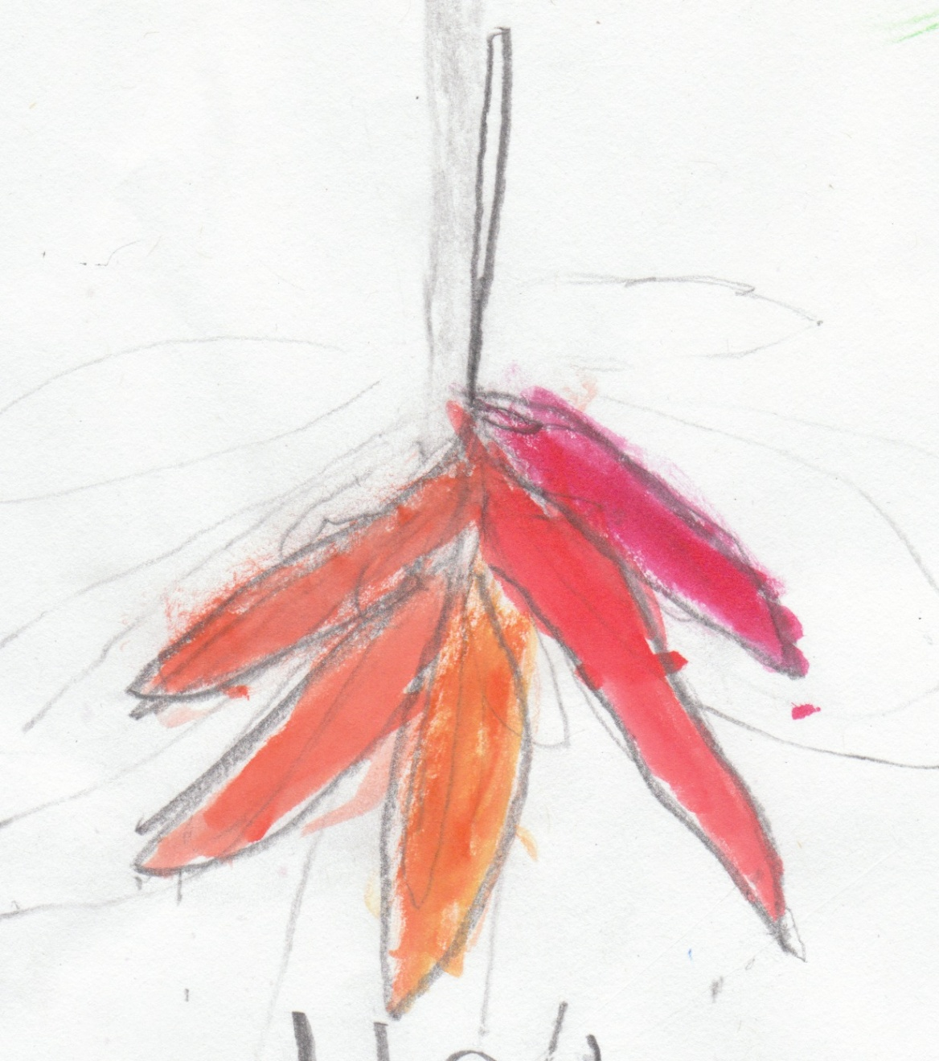
Leaf Trapped in Grass
by Damarion
My leaf is green!
It is wet and soft!
My leaf is trapped in the grass.
The grass is hungry for a leaf.
The grass got the leaf.
That leaf was yummy for the grass!

Slide 11
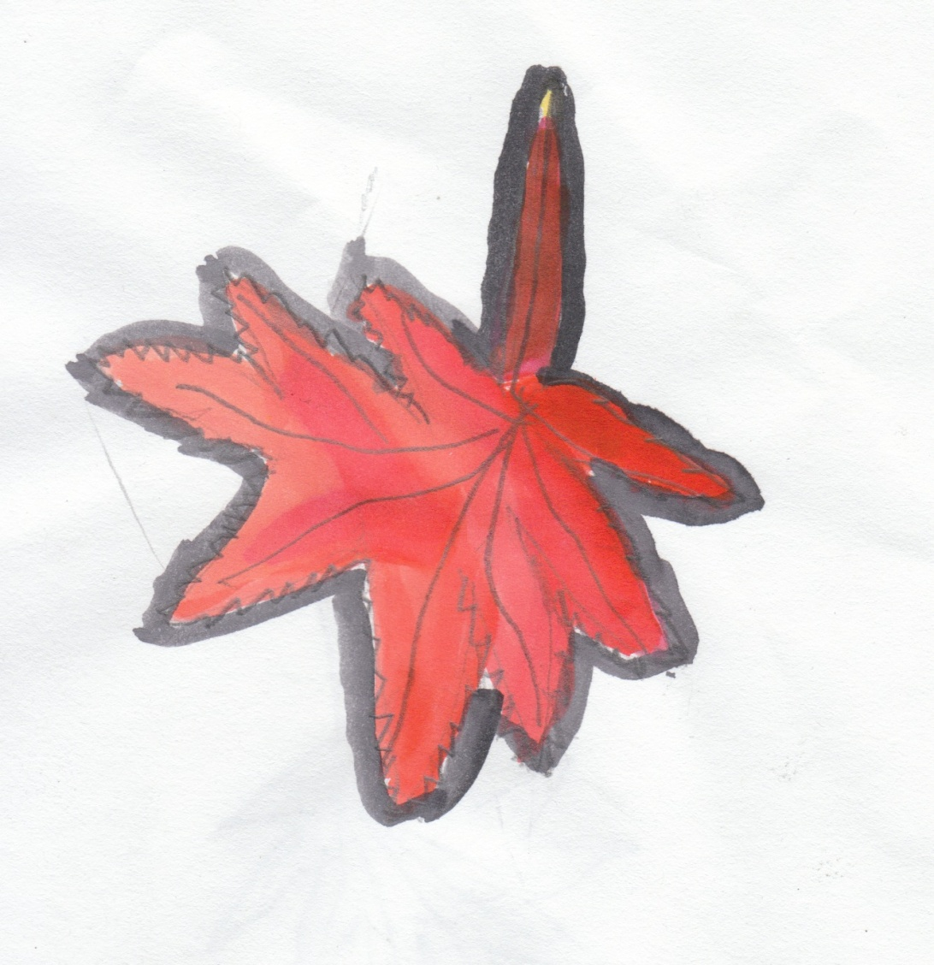
Window Leaf
by Daniela
My leaf is red.
My window was open,
and it fell on my bed.
The sky is gray,
and there it lay.

Slide 12
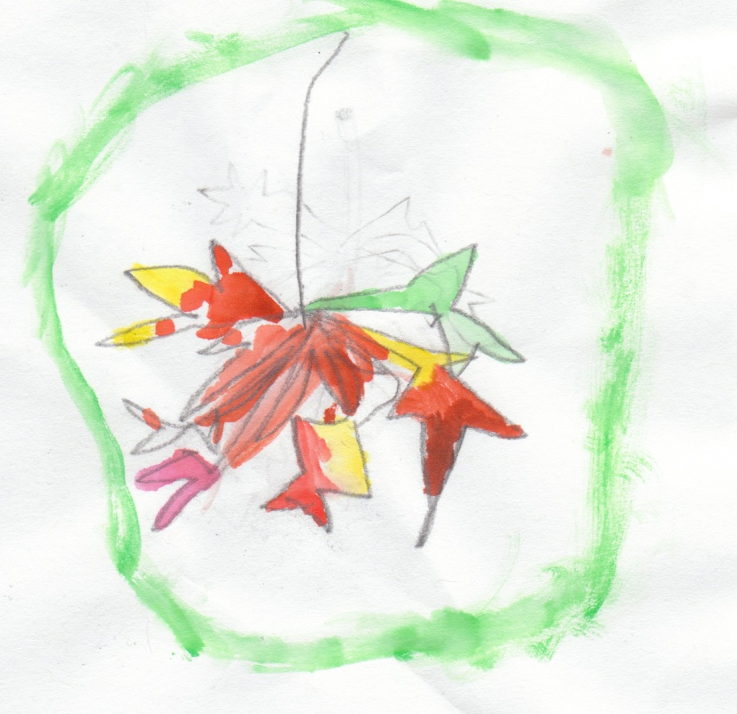
Plane Leaf
by Ethan
The wind blows a leaf out of a tree.
It lands on the ground
like a plane.
The leaf is green,
yellow, orange,
red, and brown.
It is soft and smooth.
The ground welcomes the leaf.
The leaf wiggles around and around
down to the ground.
The leaf is special to me,
because it is a leaf.
When a leaf is in a tree,
it wiggles,
and it falls
to the ground.

Slide 13
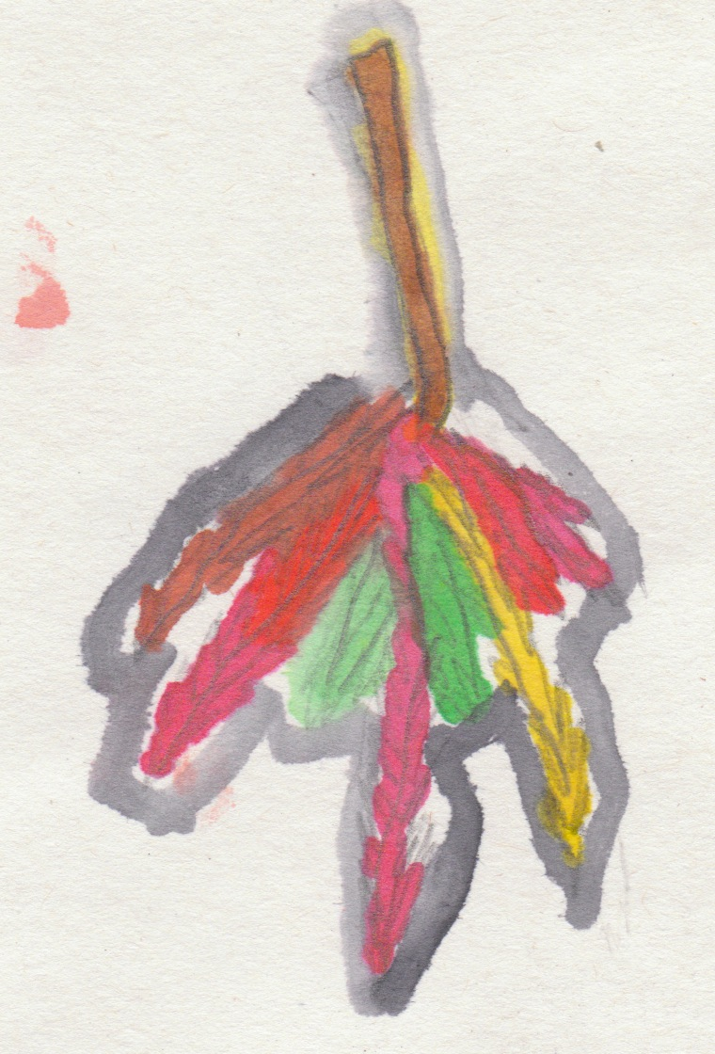
Wriggle Swish Leaf
By Harmony and Jackie
Leaves red, gold, and green.
Pretty under my feet.
They wriggle,
swish, swish,
and they fall from the trees
in a swirly mess.
I pick it up and make a wreath,
because it’s a Thanksgiving leaf.
It looks pretty,
because of its reds, oranges, yellows,
and greens.

Slide 14
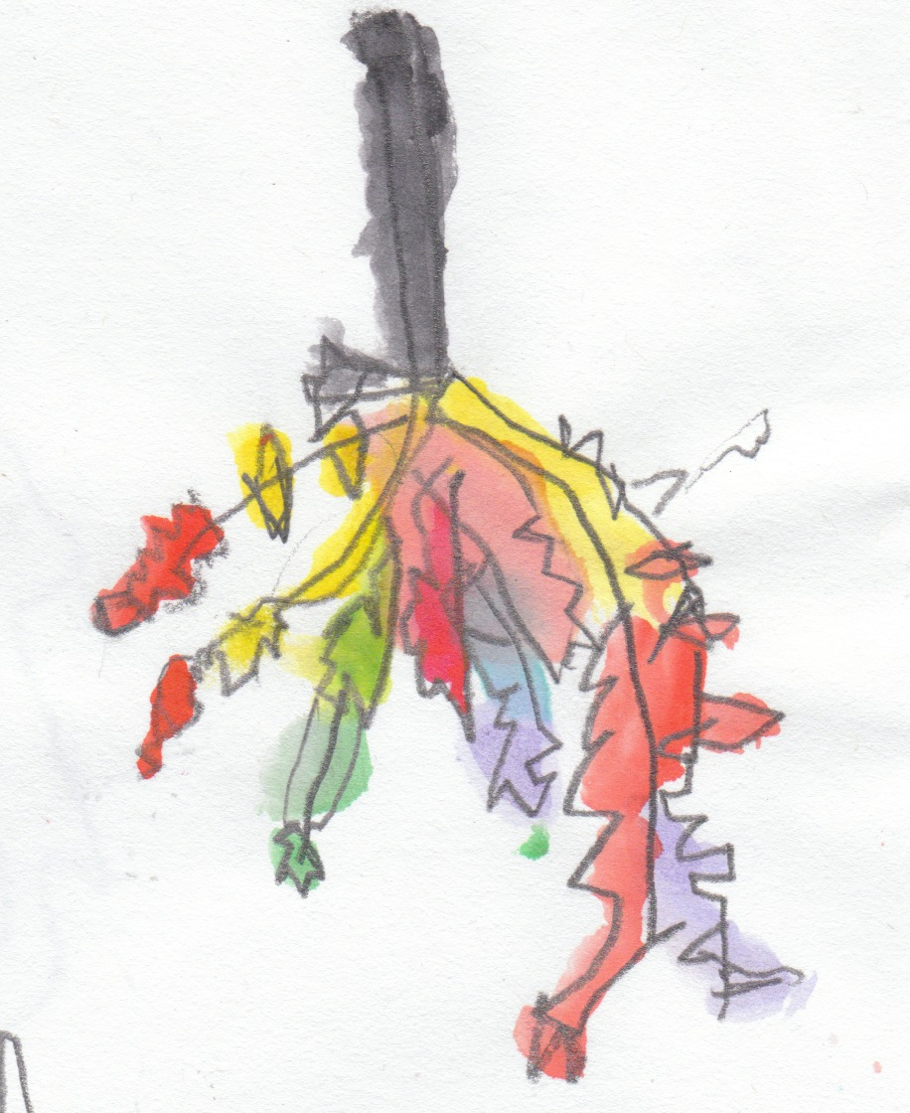
My Leaf, My Leaf
by Jaden
My leaf, my leaf!
So beautifully green.
Leaf, leaf
in a tree,
shaking,
cracking,
and swishing!
CRACK!!!
Uh-oh.
Now it’s falling towards
the great green grass.
Now I am playing
in the cracking leaves.

Slide 15
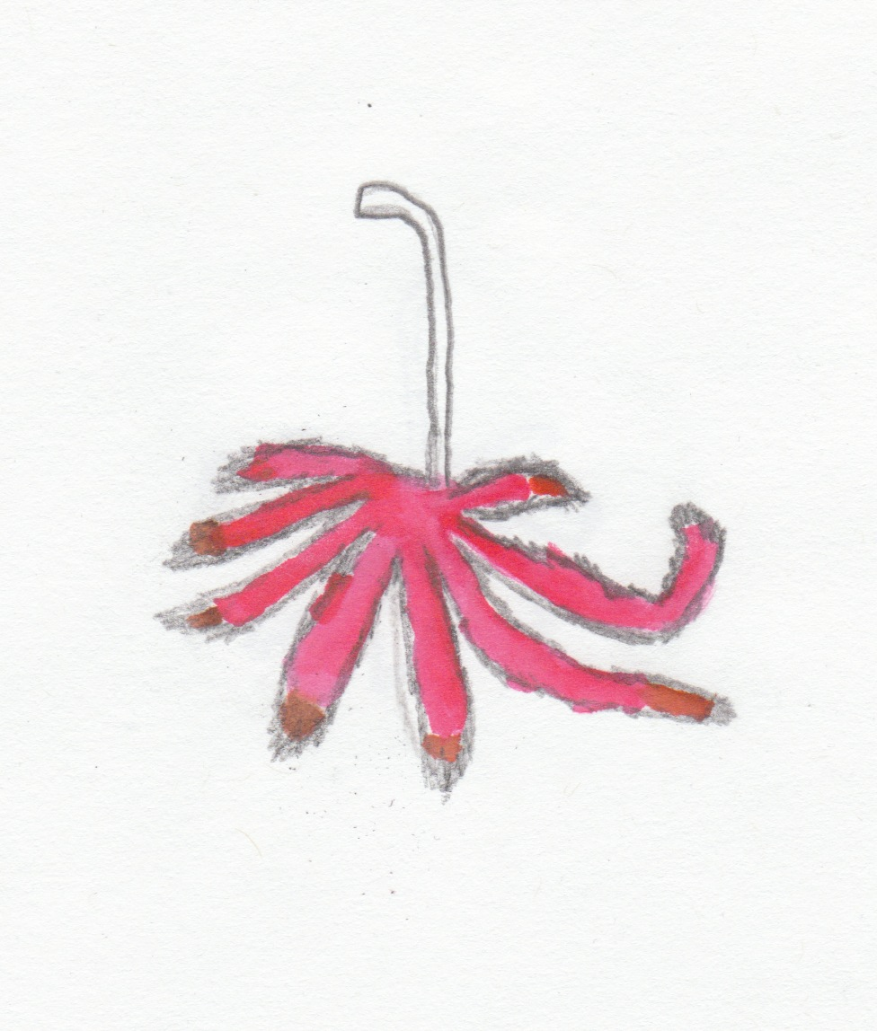
Leaf Food
by Jin
The leaf falls down the tree.
It falls to the ground.
The grass feels cold.
The leaf covers the grass,
and the grass is wet.
The colors are green,
red, yellow, and orange.
The leaves are plants.
They feed big bugs
and small bugs.

Slide 16
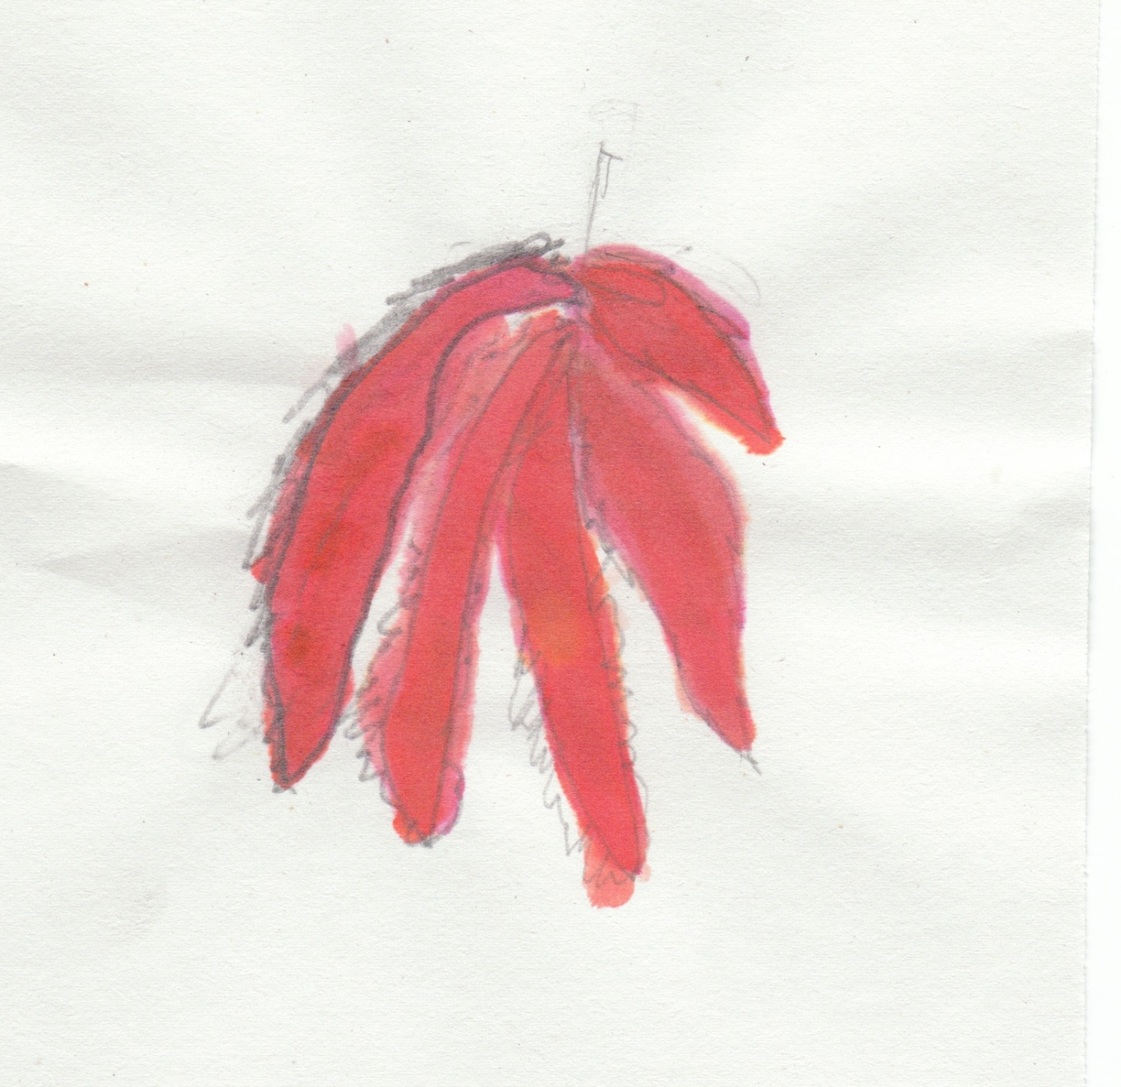
Dancing Down Leaf
by Joania
My leaf is on a tree.
It is dancing down.
My leaf is red.
It’s on the ground now.
“Yum,” said an ant.
It’s good.

Slide 17
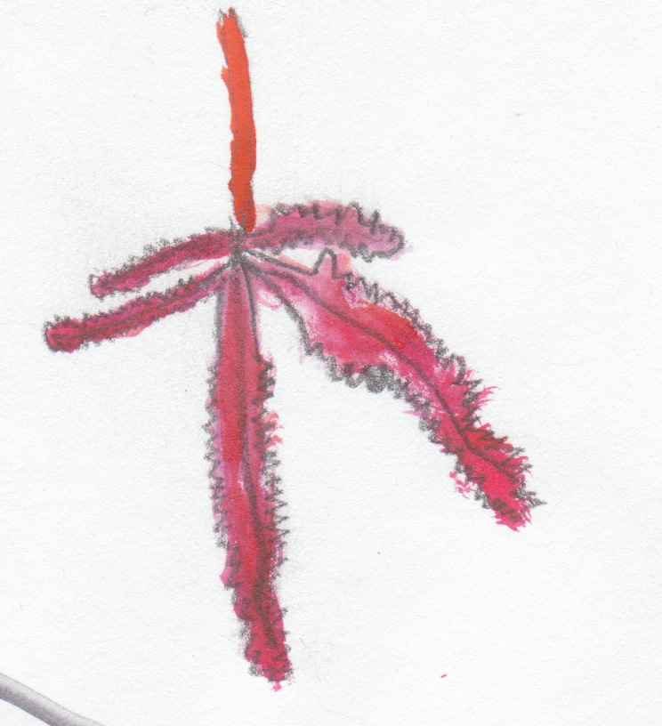
Dancing on the Grass
by Jocelyn
I go outside.
I see the leaves
that are falling down
to the ground,
dancing
on the grass.
It is so beautiful.

Slide 18
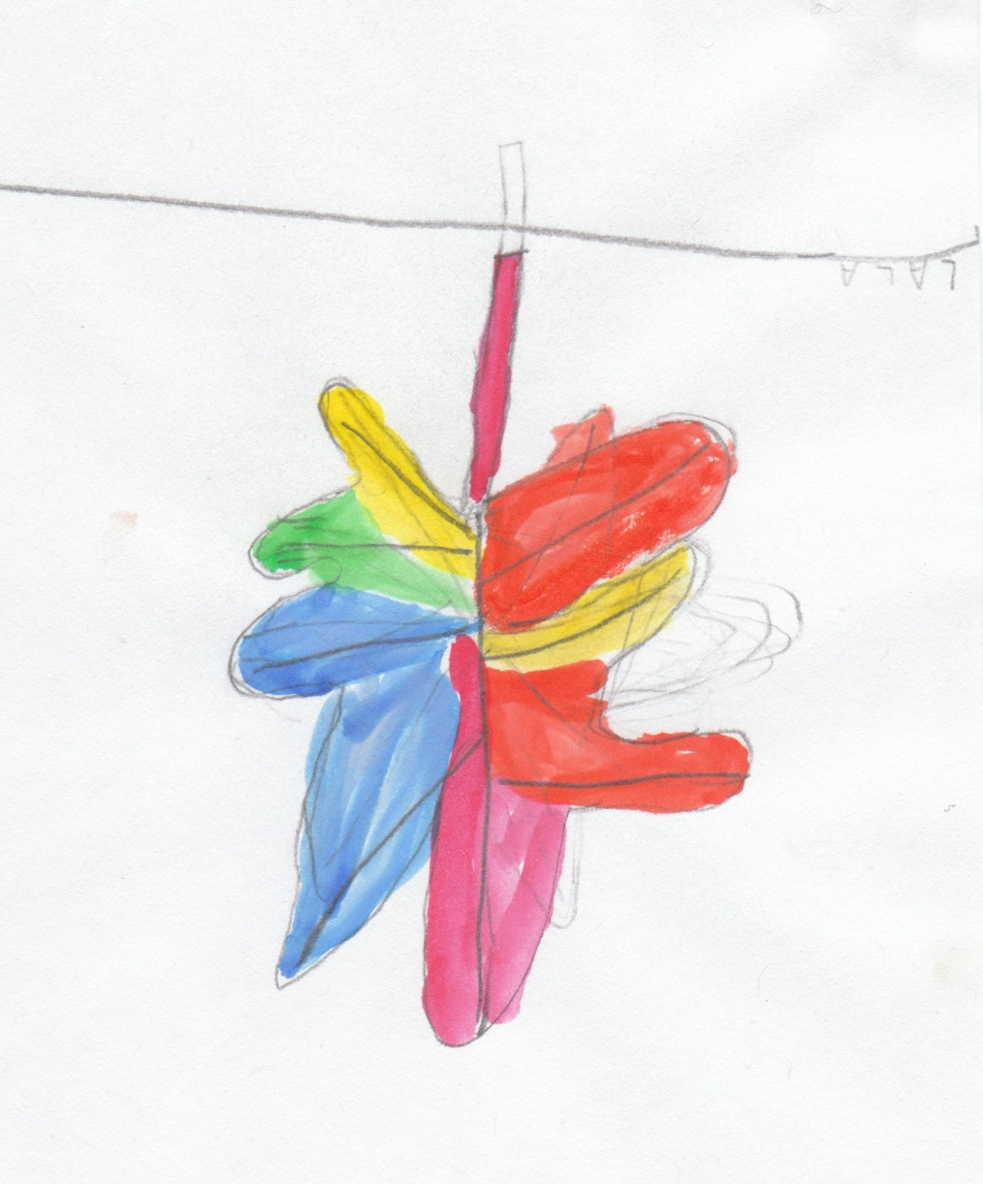
My Leaf is Red
by Lala
My leaf is red.
It’s on a tree,
but sometimes
it falls on the ground.
I like my leaf,
because it is red.

Slide 19
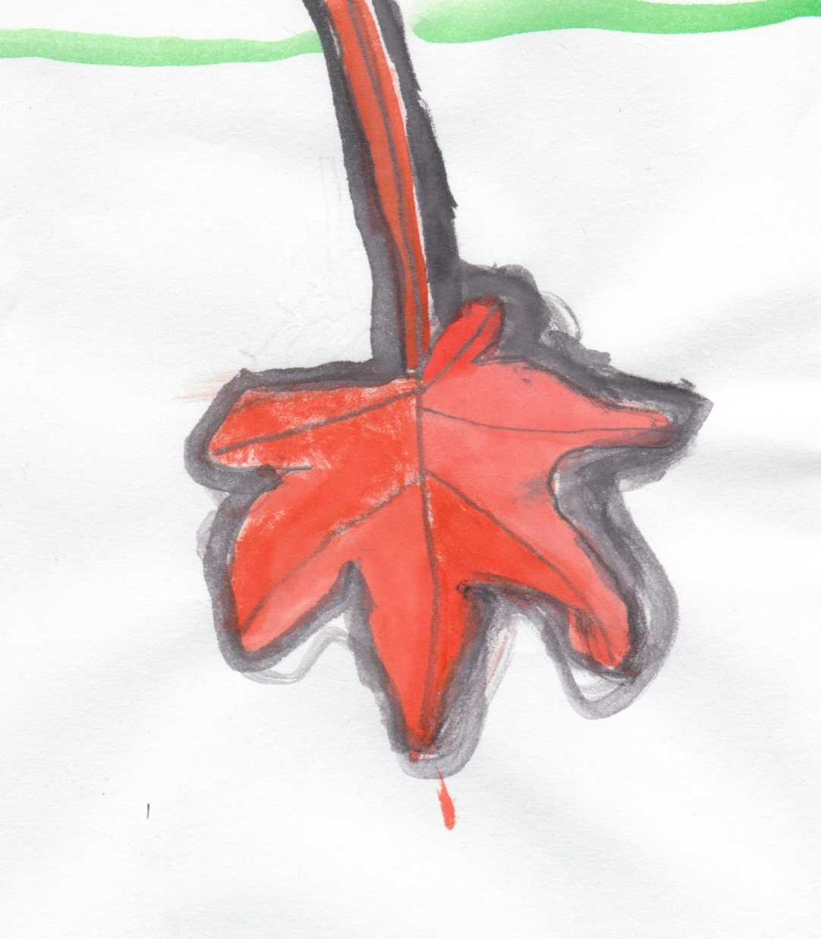
Slow Falling Leaf
by Kiril
My leaf is red.
It comes from a tree.
It falls from the trees.
It falls slowly
to the ground.

Slide 20
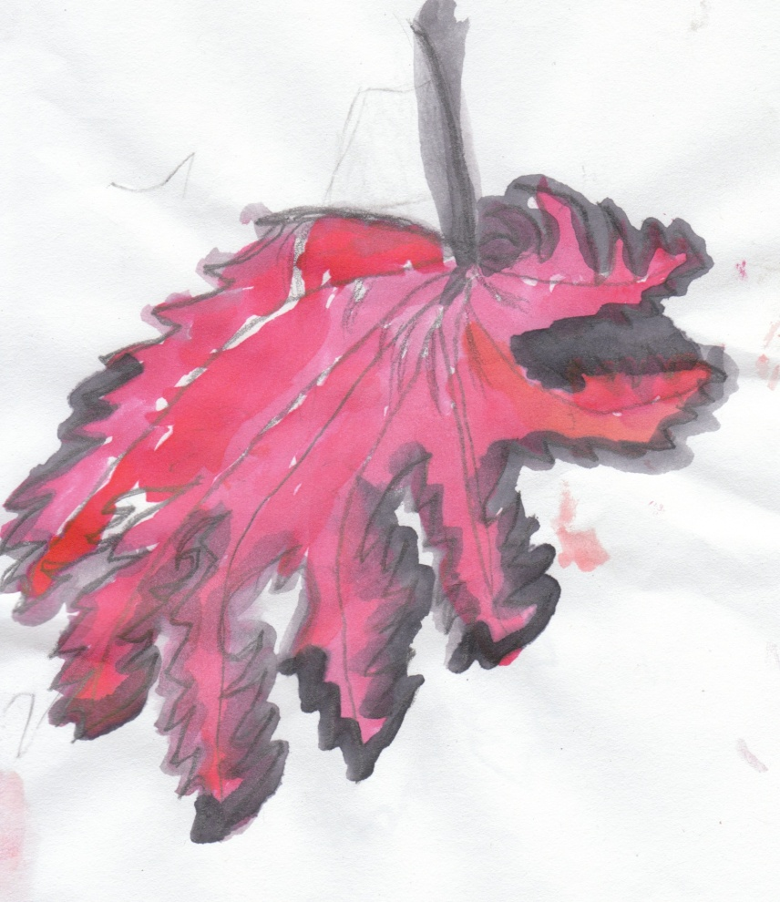
Small, Happy Leaf
by Malachi
I have a red leaf,
and my leaf is small!
My leaf is happy.

Slide 21
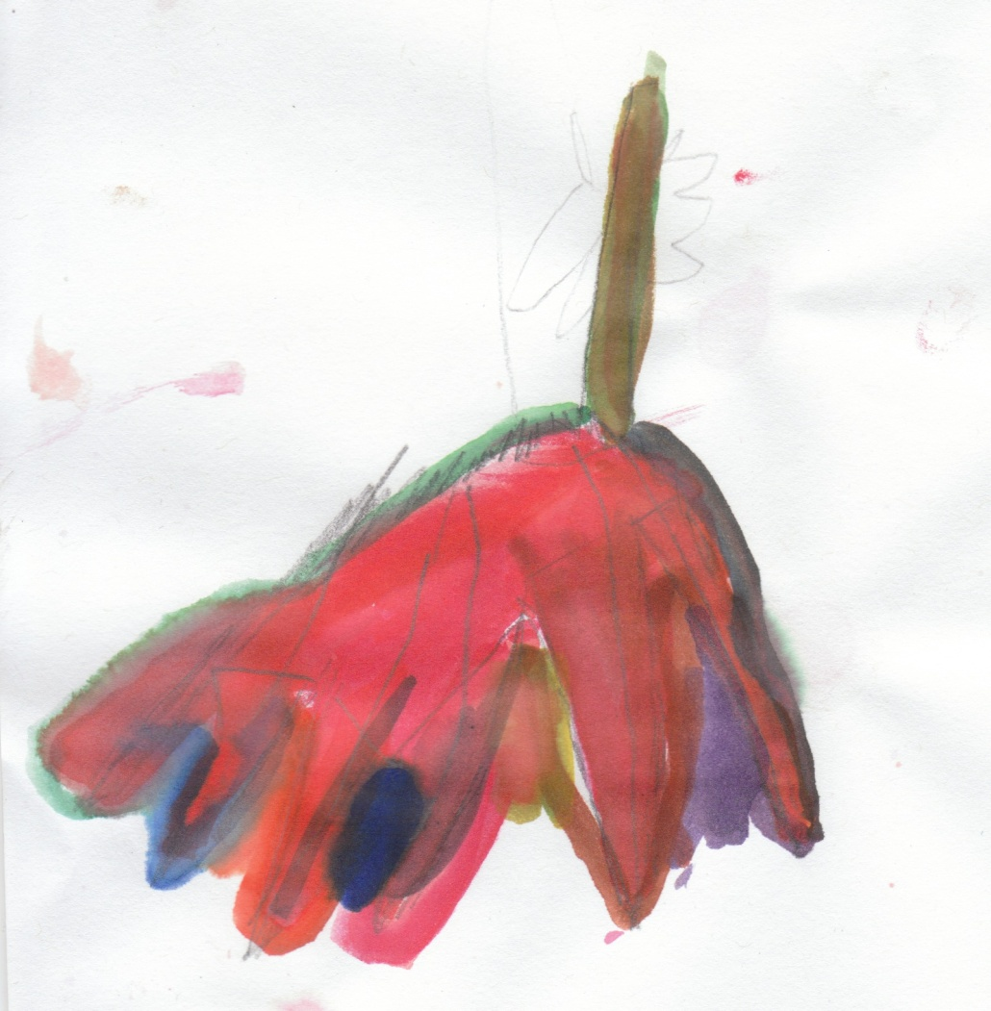
Twirled Leaf
by Maya
My leaf is red.
It’s on the ground,
and that’s where I found it.
The wind twirled it to the ground.

Slide 22
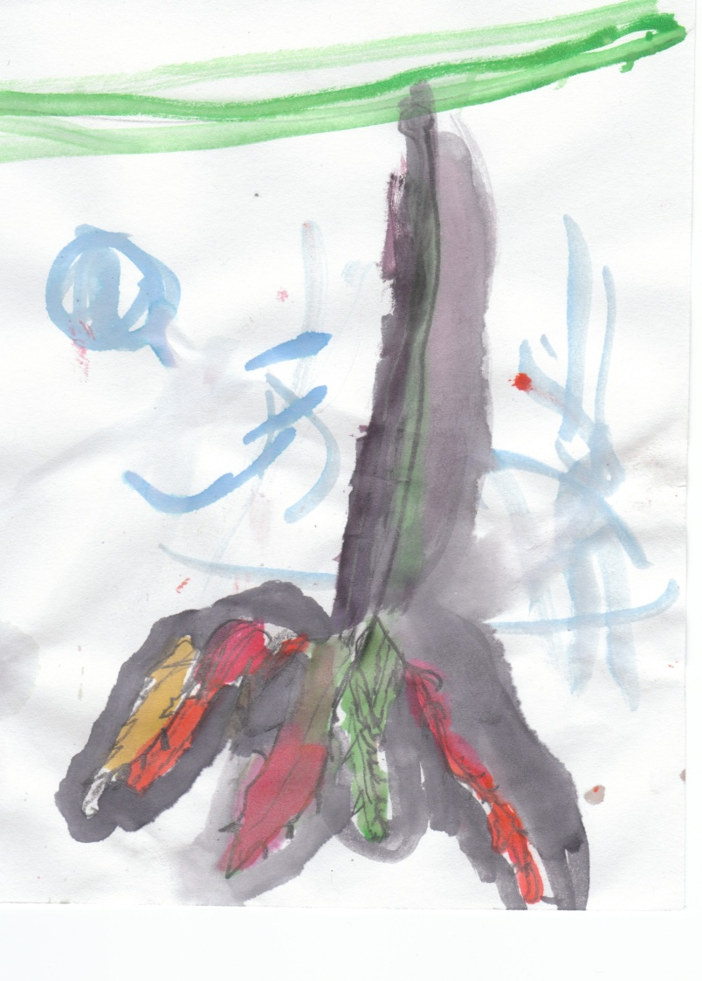
Hungry Leaf
by Parsa
The leaf is hungry.
The leaf dances around
all over.

Slide 23
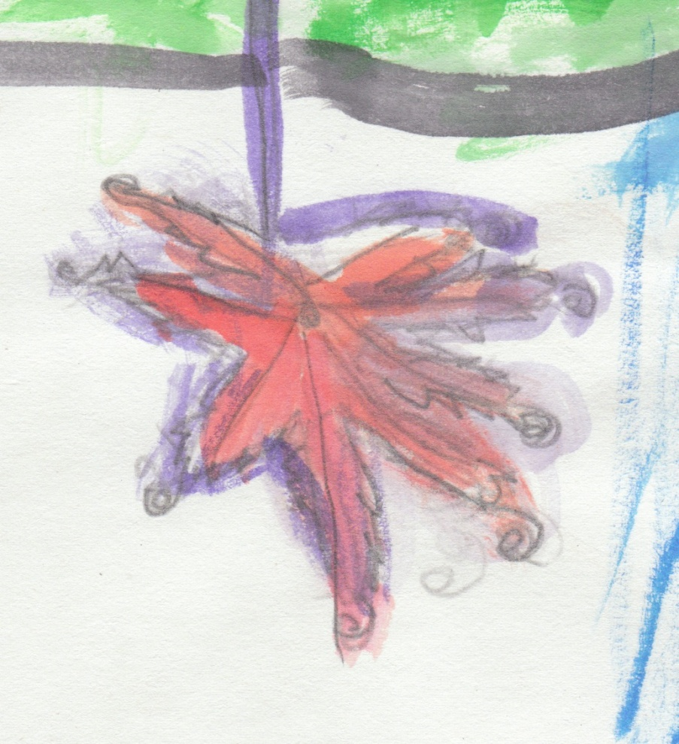
Rainbow Leaf
by Sarina
My leaf is as colorful
as a rainbow.
It’s shiny colors,
yellow and red,
fall down
to the ground
and crunch.

Slide 24
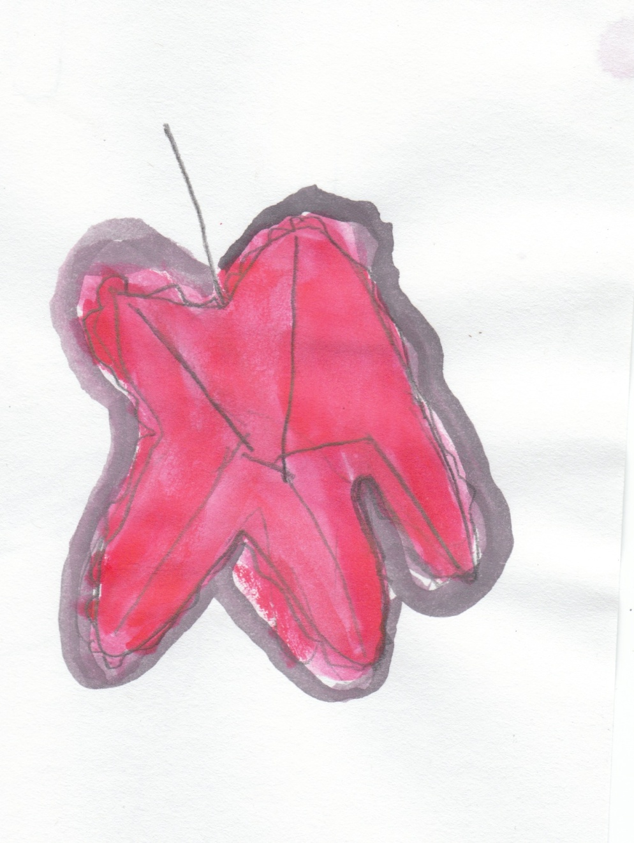
Quiet Leaf
by Selena
My leaf is red.
It’s quietly sitting on a tree,
but when the wind comes,
the leaf gently falls
to the ground.

Slide 25
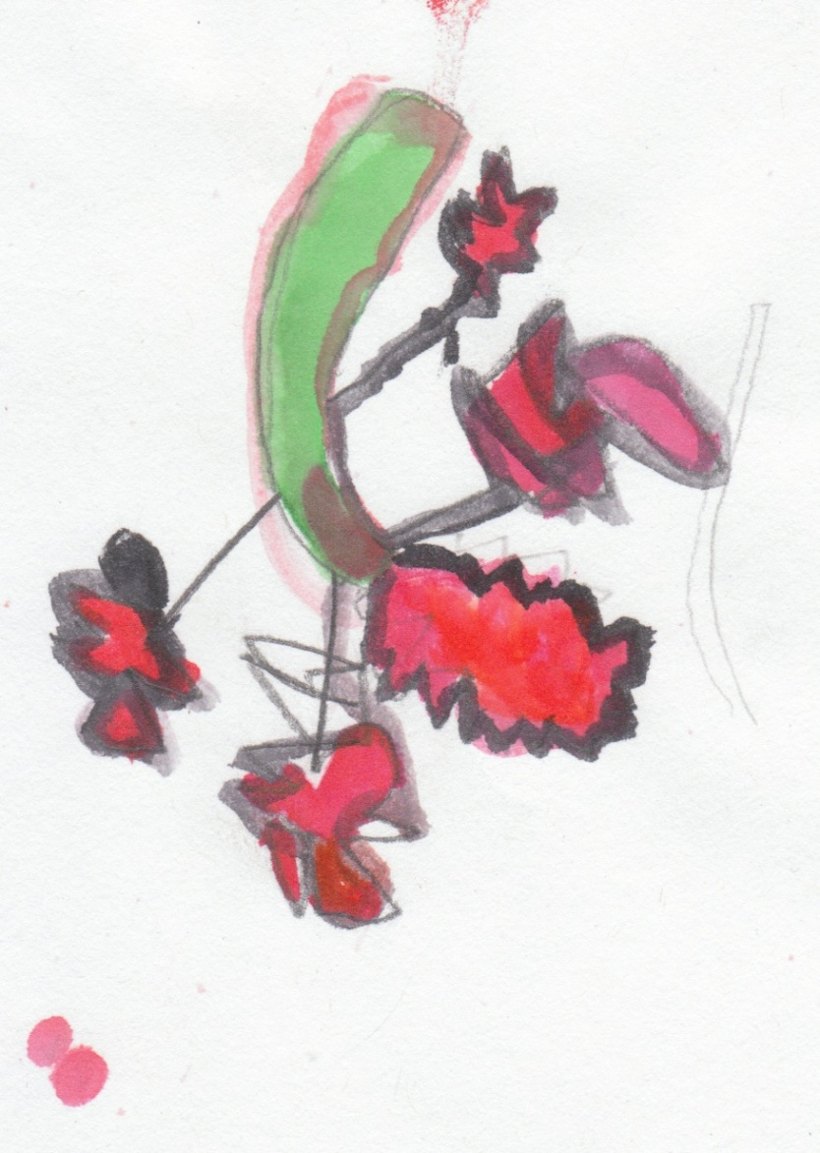
Big Tree Leaf
by Tayden
My leaf is red.
It is in a big tree.
Then the wind knocked
it out of the tree.

Slide 26
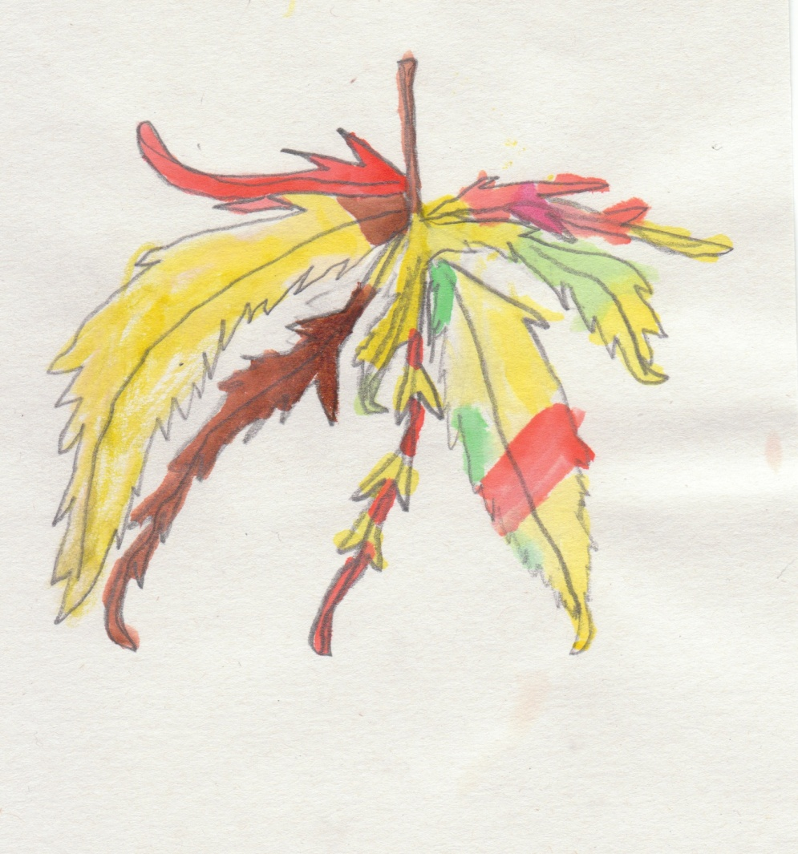
Chinese Maple Leaf
by Taylor
My leaf is from a Chinese maple tree.
It is really colorful.
It is yellow
and brown
and orange.

