Slide 1
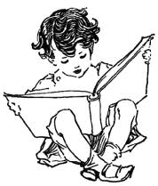
Books
Our Eternal Companions
Learning Circle Group: Computer Chronicles(Middle)
Sponsoring Teachers: Uma Parasuraman, Navjot Kaur, Nupur Paul,
Class :VII, Budding Stars
Sponsor School: Sri Sri Academy
City: Kolkata
Country: India

Slide 2
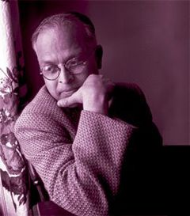
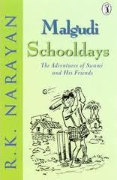
R.K.NARAYAN

Slide 3
ABOUT THE AUTHOR
Rasipuram Krishnaswami Narayanswami, who preferred the shortened name R.K. Narayan, was born in Madras, India, on Oct. 10, 1906. His father, an educator, travelled frequently, and his mother was frail and Narayan was raised inMadras by his grandmother and an uncle. His grandmother inspired in young Narayan a passion for language and for people. He attended the Christian Mission School, where, he said, he learned to love the Hindu gods simply because the Christian chaplain ridiculed them. Narayan graduated from Maharaja's College in Mysore in 1930. In 1934 he was married, but his wife, Rajam, died of typhoid in 1939. He had one daughter, Hema.

Slide 4
BOOKS OF R.K.NARAYAN
THE GUIDE,SWAMI AND HIS FRIENDS,
WAITING FOR MAHATMA,
THE MAN EATER OF MALGUDI,
THE ENGLISH TEACHER,
THE FINANCIAL EXPERT,
UNDER THE BANYAN TREE AND OTHER STORIES,
PAINTER OF SIGNS,
MALGUDI DAYS,
THE WORLD OF NAGARAJ
FAVOURITE BOOK :MALGUDI SCHOOLDAYS.

Slide 5
LITERARY ACHIVEMENTS OF R.K.NARAYAN
R.K. Narayan won numerous awards and honors for his work. These include: Sahitya Akademi Award for The Guide in 1958; Padma Bhushan in 1964; and AC Benson Medal by the Royal Society of Literature in 1980; R.K. Narayan was elected an honorary member of the American Academy and Institute of Arts and Letters in 1982. He was nominated to the Rajya Sabha in 1989. Besides, he was also conferred honorary doctorates by the University of Mysore, Delhi University and the University of Leeds.

Slide 6
HOW HAS THE AUTHOR’S BOOK MALGUDI SCHOOL DAYS INFLUENCED SOCIETY ?
The book narrates the story of the child Swami ,his fantasies and his earnest efforts to enjoy the time spent in school .Since the book is written from a child’s point of view, we could relate easily and enjoy the experiences of Swami in his school. It reflects the need of a child being given an opportunity to observe, learn and innovate, and then ask questions, to make learning interesting.

Slide 7
WHO IS YOUR FAVOURITE CHARACTER AND WHY ?
The central character in this story is W.S. Swaminathan alias Swami. He is a popular character among children. We like him because he doesn’t like Mondays that come after fun weekends. We have similar feelings about Monday.

Slide 8
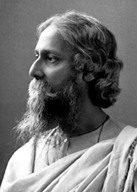
RABINDRA NATH TAGORE

Slide 9
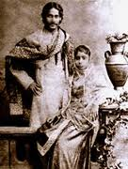
PERSONAL LIFE
He was the youngest of 13 surviving children. He was mostly raised by servants, as his mother died early and his father Maharishi Debendranath Tagore, a wealthy religious reformer, was constantly travelling. Tagore largely looked away from classroom-based education. Young Rabi read biographies and was educated at home in history, astronomy, modern science, and Sanskrit, and he examined the poetry of Kālidāsa. On 9 December, 1883 he married Mrinalini Devi (born Bhabatarini, 1873–1902) and had five children, two of whom died before reaching adulthood.

Slide 10
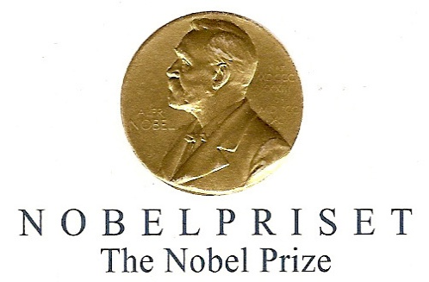
WORK AND ACHIEVEMENTS
Rabindranath Tagore (7 May 1861 – 7 August 1941) was a Bengali poet, novelist, musician, painter and playwright, who reshaped Bengali literature and music. He authored the Gitanjali known for its profoundly sensitive, fresh and beautiful verse. He was also the first non-European who was awarded the Nobel Prize for Literature in 1913. His poetry in translation was viewed as spiritual, and this together with his mesmerizing persona gave him a prophet-like aura in the West. His "elegant prose and magical poetry" still remain distinct. Tagore began writing poems at the age of eight. At 16, he published his first substantial poetry under the pseudonym Bhanushingho (Sun Lion) and wrote his first short stories and dramas in 1877. Tagore was noticed when he denounced the British Raj to support India’s fight for independence.

Slide 11
WORK AND ACHIEVEMENTS
Tagore’s novels, stories, songs, dance-dramas and essays spoke about political and personal topics. Gitanjali (Song Offerings), Gora (Fair-Faced), and Ghare-Baire (The Home and the World) are his best-known works, and his verse, short stories, and novels were acclaimed for its lyricism, colloquialism, naturalism and contemplation. Tagore was perhaps the only literateur who penned anthems of two countries -- Jana Gana Mana, the Indian national anthem and Amar Shonar Bangla, the national anthem of Bangladesh.

Slide 13
KABULIWALA
Kabuliwala is a story written by Rabindra nath Tagore. The main characters in this story are a girl named Mini and Rahmat, the kabuliwala. The kabuliwala is from Afghanistan; he goes door to door selling his wares. During one such journey, he met Mini, the talkative five-year-old girl. Back home, the man also had a daughter who was of Mini’s age. The two developed a very good friendship. The kabuliwala used to bring dry fruits for Mini as present and patiently listened to Mini. They used to tease each other about “going to in-law’s house”. For some reason the man was imprisoned for eight years. After leaving jail he returned to meet Mini. However, at that time Mini’s marriage ceremony was going on. In the past eight years she had forgotten her friend, the kabuliwala. She felt shy seeing him after all these years. The kabuliwala felt the growing distance and wanted to return home where his daughter had also grown up and was ready for marriage.

Slide 14
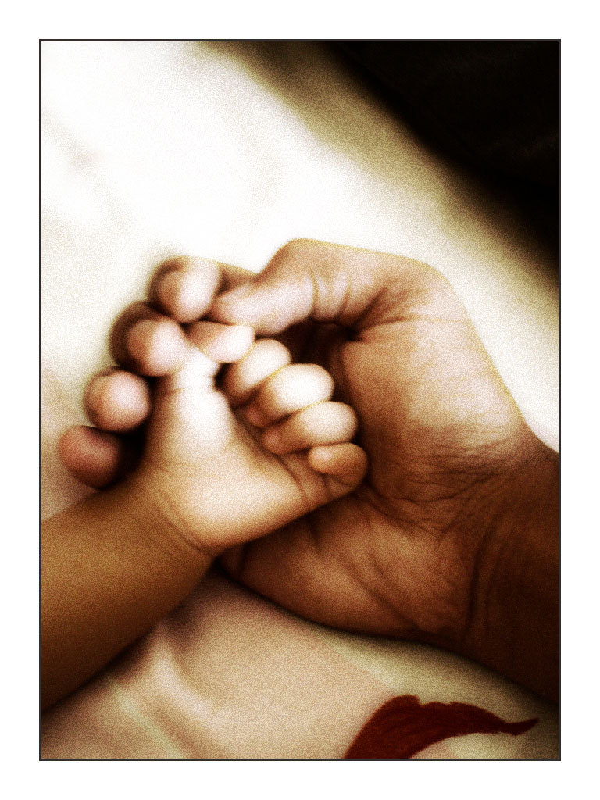
KABULIWALA
KABULIWALA deals with the sensitive relationship between a father and daughter. It almost makes one cry when one realises the pain of separation that the kabuliwala experiences. This was once a reality in olden times when people from Kabul came to India to earn a living by selling dry fruits.

Slide 15
KABULLIWALA
If we ever get a chance to change anything about the story it would be the ending in which Mini forgets her dear friend, kabulliwala . We would like the story to have a happy ending .

Slide 16
HOW DID SOCIETY INFLUENCE RABINDRANATH TAGORE?
In his time the poor people from Kabul came to Bengal to sell dry fruits to earn a living. This influenced Rabindranath Tagore to write a story based on a Kabulliwala, or the fruit seller from Kabul.

Slide 17
Canadian Authors By: 8 Nevers Class Florenceville Middle School, New Brunswick , Canada

Slide 18
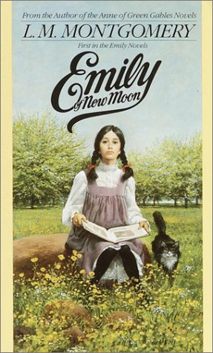
Her Books
Anne of Green Gables (1908)
Anne of Avonlea (1909)
Kilmeny of the Orchard (1910)
Story Girl, the (1911)
Golden Road, the (1913)
Anne of the Island (1915)
Anne's House of Dreams (1917)
Rainbow Valley (1919)
Rilla of Ingleside (1921)
Emily of New Moon (1923)
Emily Climbs (1925)
Blue Castle, the (1926)
Emily's Quest (1927)
Magic for Marigold (1929)
Tangled Web, a (1931)
Pat of Silver Bush (1933)
Mistress Pat (1935)
Anne of Windy Poplars (1936)
Jane of Lantern Hill (1937)
Anne of Ingleside (1939)
http://www.iblist.com/author.php?id=135

Slide 19
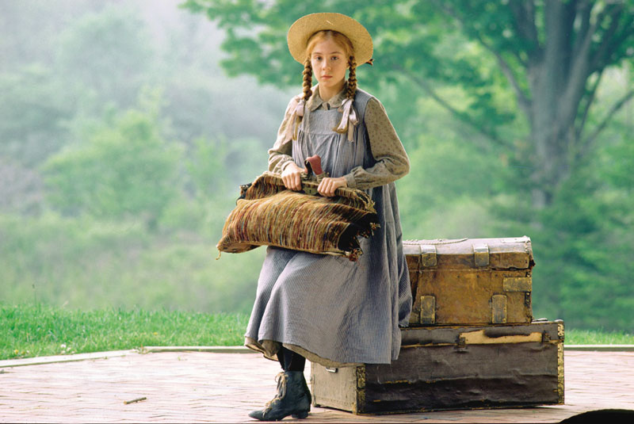
Book Cover Summary
Anne of Green Gables
The Cuthberts of Green Gables had decided to adopt an orphan, a nice sturdy boy to help Matthew with the farm chores. The orphanage sent a girl instead -- a mischievous, talkative redhead who'd be no use at all. She would just have to go back.
But the longer Anne was there, the more no one could imagine Green Gables without her.

Slide 20
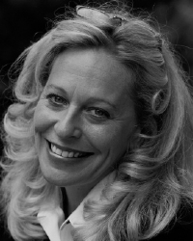
Sheree Fitch

Slide 21
Biography
“Sheree Fitch is an educator, literacy activist and author of award-winning poetry, picture books, nonfiction, plays and novels for all ages. Her first book, Toes in My Nose, illustrated by Molly Lamb Bobak, was published in 1987.
Her work as a poet and literacy educator has taken her to the Arctic as eight-time poet laureate for Peter Gzowski's fundraisers for literacy and to Bhutan where she taught writing and participated in that country's first national reading week. She has done author readings in countries such as Uganda, Tanzania, Kenya, Belize and Mexico.
Currently, she is Honorary Spokesperson for the New Brunswick Coalition for Literacy. The club recently started the Sheree Fitch Adult Learner Scholarships. Each year she sponsors a writing competition for New Brunswick Youth.
Fitch lives with her husband, Gilles Plante, and divides her time between Washington D.C. and River John, Nova Scotia. In demand as a visiting author, workshop leader and keynote speaker, she is currently working on an adult novel. She has two children.”
- http://www.writers.ns.ca/writers/F/fitchsheree.html

Slide 22
Children's Books
Kisses Kisses, Baby-O Peek-a-Little Boo Pocket Rocks If I Had a Million Onions
Persnickety Pete (The Cleanest
Boy in the World) No Two Snowflakes If I Were The Moon The Other Author, Arthur The Hullaballoo Bugaboo Day There's a Mouse in My House If You Could Wear My Sneakers! Mabel Murple I Am Small There Were Monkeys in My Kitchen! Merry-Go-Day Sleeping Dragons All Around, Toes in My Nose and Other Poems, Mabel Murple
Adult Books
Kiss the Joy As It Flies
In this House Are Many Women
Young Adult Books
The Gravesavers One More Step Pluto's Ghost

Slide 23
Review of There Were Monkeys in my Kitchen!
“Our young heroine awakens one morning to total chaos when she discovers hordes of chimpanzees, gorillas and orangutans have taken over her home. "Baboon catastrophe" continues despite her valiant efforts to restore order, until help arrives -- and something else!” –
http://books.google.ca/books?id=qo9gOwAACAAJ&dq=there+were+monkeys+in+my+kitchen&hl=en&ei=0i3NTrqzOKra0QHEhZkH&sa=X&oi=book_result&ct=result&resnum=1&ved=0CC4Q6AEwAA

Slide 24
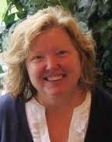
All about Wendy Kitts !

Slide 25
WENDY KITTS
Wendy Kitts lives in Moncton, New Brunswick, Canada.
Wendy has been a professional writer since 2000 and has published over 200 articles for magazines such as Reader’s Digest, the Globe & Mail, More, Canada’s History Magazine (formerly The Beaver), and Saltscapes. Wendy was a regular reviewer of children's book for the Canadian Children's Book News, the Globe & Mail, Atlantic Books Today and the New Brunswick Reader (weekly column). For two consecutive years, Wendy was chosen for the judging committee to select the best in Canadian children's literature for Our Choice magazine (now Best Books for Kids & Teens), an annual publication of the Canadian Children's Book Centre.
http://www.wendykitts.ca/writing

Slide 26
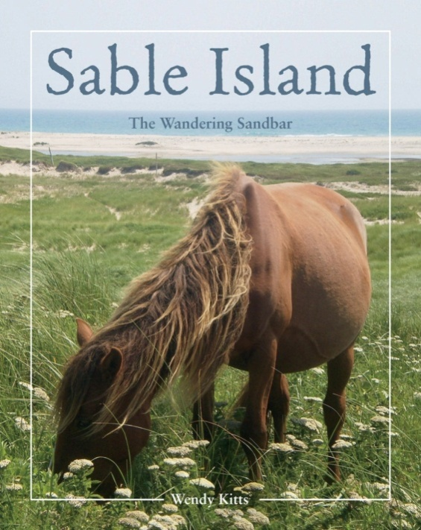
HER BOOKS
Wendy has written a book titled Sable island: The wandering sandbar, published October 15, 2011. She also co-authored Breaking the word barrier: Stories of adults learning to read.
SABLE ISLAND: the real thing
“Though it was discovered almost five hundred years ago, few people have visited Sable Island. Despite modern navigational tools, excessive fog and stormy weather still make travelling to Sable a challenge. But the island is part of Maritime lore—dubbed the “graveyard of the Atlantic” because of the number of ships wrecked on its shores, Sable Island also hosts wild horses, tens of thousands of seals, and enchanting “singing” sands and “wandering” dunes. With eighteen species of shark patrolling Sable Island’s waters and the regular fights between bands of horses, not to mention treacherous patches of quicksand, the island is as dangerous as it is alluring. In this colourful book, author Wendy Kitts introduces the wonders and stark realities of this wild place. Full of photographs and sidebars, Sable Island: The Wandering Sandbar is an accessible and exciting look at this protected, untamed ecosystem.”
http://www.amazon.ca/Sable-Island-Wandering-Wendy-Kitts/dp/1551098652

Slide 27
SABLE ISLAND: the real thing
Though it was discovered almost five hundred years ago, few people have visited Sable Island. Despite modern navigational tools, excessive fog and stormy weather still make travelling to Sable a challenge. Add government restrictions limiting visitors to the remote island and prohibitive travel costs, and Sable is virtually inaccessible to most. But the island is part of Maritime lore—dubbed the “graveyard of the Atlantic” because of the number of ships wrecked on its shores, Sable Island also hosts wild horses, tens of thousands of seals, and enchanting “singing” sands and “wandering” dunes. With eighteen species of shark patrolling Sable Island’s waters and the regular fights between bands of horses, not to mention treacherous patches of quicksand, the island is as dangerous as it is alluring. In this colourful book, author Wendy Kitts introduces the wonders and stark realities of this wild place. Full of photographs and sidebars, Sable Island: The Wandering Sandbar is an accessible and exciting look at this protected, untamed ecosystem.

Slide 28
American Writers By: Kelly, Wheeling ,West Virginia United States

Slide 29
Top 10 American Writers
Harper Lee
Mark Twain
Scott Fitzgerald
J.D. Salinger
John Steinbeck
Edgar Allan Poe
Robert Frost
Ray Bradbury
Nathaniel Hawthorne
Arthur Miller

Slide 30
Harper Lee
Harper Lee is best known for writing the Pulitzer Prize-winning bestseller “To Kill a Mockingbird” (1960). It was her one and only published novel.

Slide 31
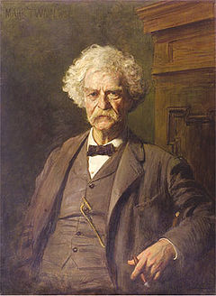
Mark Twain
Mark Twain was famous both as a writer and a performer, having toured many years as a lecturer. His cynical witticisms earned him a reputation as one of America's foremost personalities. He wrote the most loved “Adventures of Huckleberry Finn.”

Slide 32
Emily Dickinson
By the time of her death, no more than seven Dickinson poems had been published, but her legacy of 1776 poems eventually brought the full extent of her work to the world. Today, Dickinson is not only considered one of the most accessible poets of all time but one of the best.

Slide 33
The End
References for pictures:
http://www.google.com/imgres?imgurl=http://www.csustan.edu/english/reuben/pal/chap10/lee_harper.gif&imgrefurl=http://www.csustan.edu/english/reuben/pal/chap10/lee_harper.html&usg=__N4kQAIhDYweo0NDSVqkQOquhu3g=&h=315&w=215&sz=27&hl=en&start=2&zoom=1&tbnid=0mBLwX8dzgsptM:&tbnh=117&tbnw=80&ei=e9jwTsK6DYru0gGijenHAg&prev=/search%3Fq%3Dharper%2Blee%26um%3D1%26hl%3Den%26safe%3Dactive%26sa%3DN%26gbv%3D2%26tbm%3Disch&um=1&itbs=1&safe=active&surl=1
http://www.google.com/imgres?imgurl=http://www.csustan.edu/english/reuben/pal/chap10/lee_harper.gif&imgrefurl=http://www.csustan.edu/english/reuben/pal/chap10/lee_harper.html&usg=__N4kQAIhDYweo0NDSVqkQOquhu3g=&h=315&w=215&sz=27&hl=en&start=2&zoom=1&tbnid=0mBLwX8dzgsptM:&tbnh=117&tbnw=80&ei=e9jwTsK6DYru0gGijenHAg&prev=/search%3Fq%3Dharper%2Blee%26um%3D1%26hl%3Den%26safe%3Dactive%26sa%3DN%26gbv%3D2%26tbm%3Disch&um=1&itbs=1&safe=active&surl=1
http://www.google.com/imgres?imgurl=http://amusejanetmason.com/all%2520images/Emily_Dickenson.gif&imgrefurl=http://amusejanetmason.com/Emily_Dickenson.htm&usg=__tMXlQiMe08_SGIuJlN-O6uE07HM=&h=234&w=202&sz=22&hl=en&start=3&zoom=1&tbnid=lqD2jg0ulBz4HM:&tbnh=109&tbnw=94&ei=UdrwTu72EYbw0gGi6MCOAg&prev=/images%3Fq%3Demily%2Bdickenson%26um%3D1%26hl%3Den%26safe%3Dactive%26gbv%3D2%26tbm%3Disch&um=1&itbs=1&safe=active&surl=1

Slide 34
Authors By: Amy Lovestrand , Nature way middle school Taiwan

Slide 35
Stanley Yen sometimes called the “godfather of the hotel industry” in Taiwan. He is a famous hotelier and the author of the popular non-fiction book, The Future I Saw.
Yen was born in 1947 in China. He came to Taiwan when he was only one year old. As an adult, he went to work for a travel company in the U.S.A. At first, he was just a messenger in the company. A few years later, he was promoted as a manager in the Taiwan section of the company because of his hard work and passion. He cares not only about his own career; he cares about the tourism development and about education in Taiwan.
(By Brian and Anson)

