Slide 1
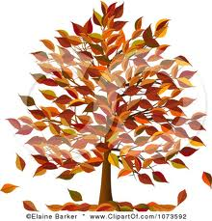
FALL IN BALTIMORE
By Gilman School 2B class
Mrs. Erica Hudson, Mrs. Margaret Olgeirson, and Mrs. Eppler

Slide 2
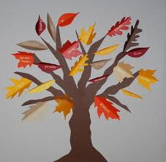
Fall in Baltimore
By
2B Gilman School, Baltimore, USA
Fall in Baltimore is beautiful. The weather is cooler during fall here. There are many colorful leaves on the trees and on the ground. The crisp wind blows the leaves off the trees. We love fall in Baltimore

Slide 3
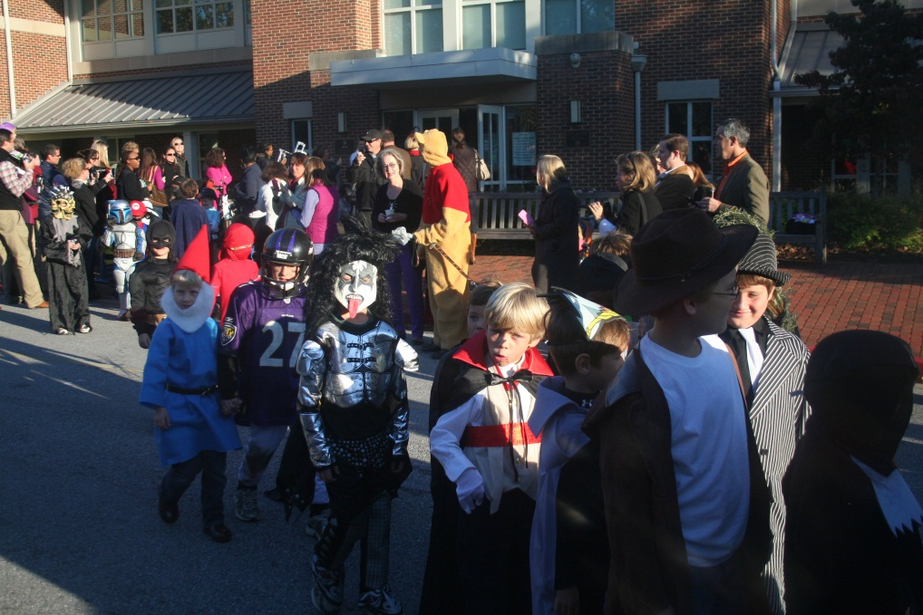
During the fall season we have several
celebrations in Baltimore
We celebrate Halloween on October 31st. We get dressed in costumes, and we go house to house asking for candies by saying “trick or treat”. It is so much fun!

Slide 4
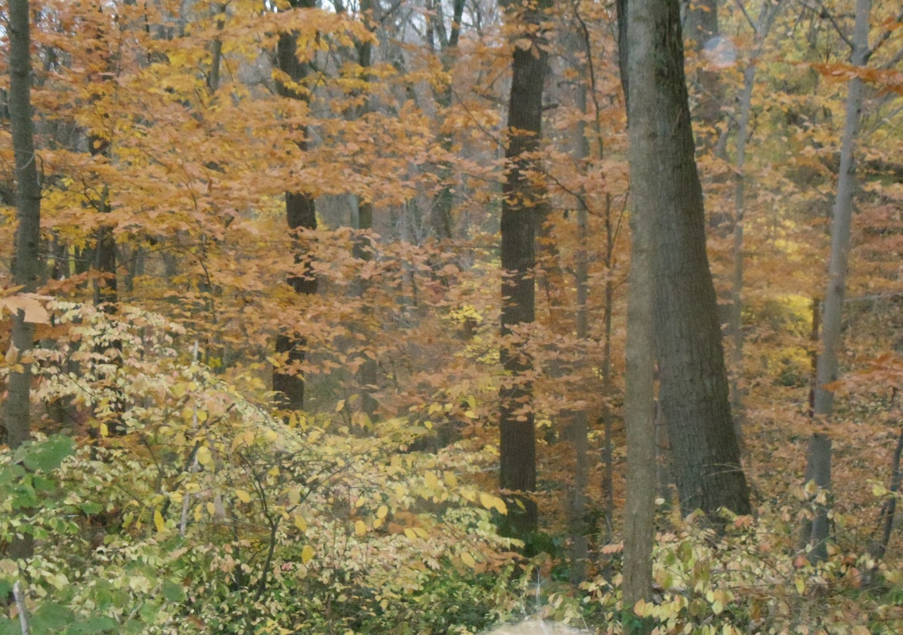
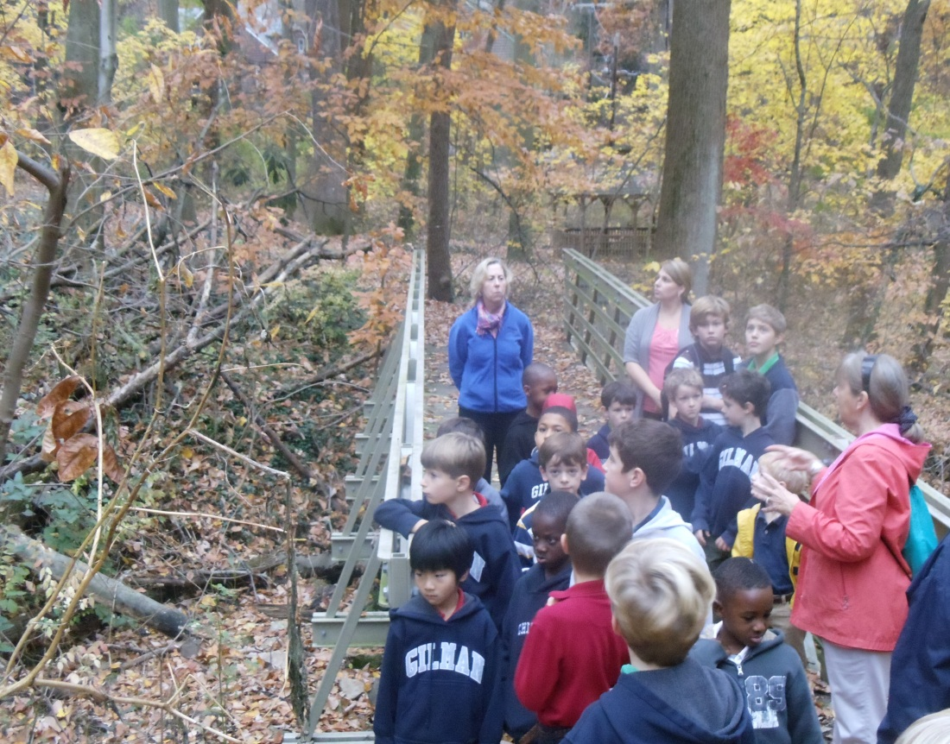
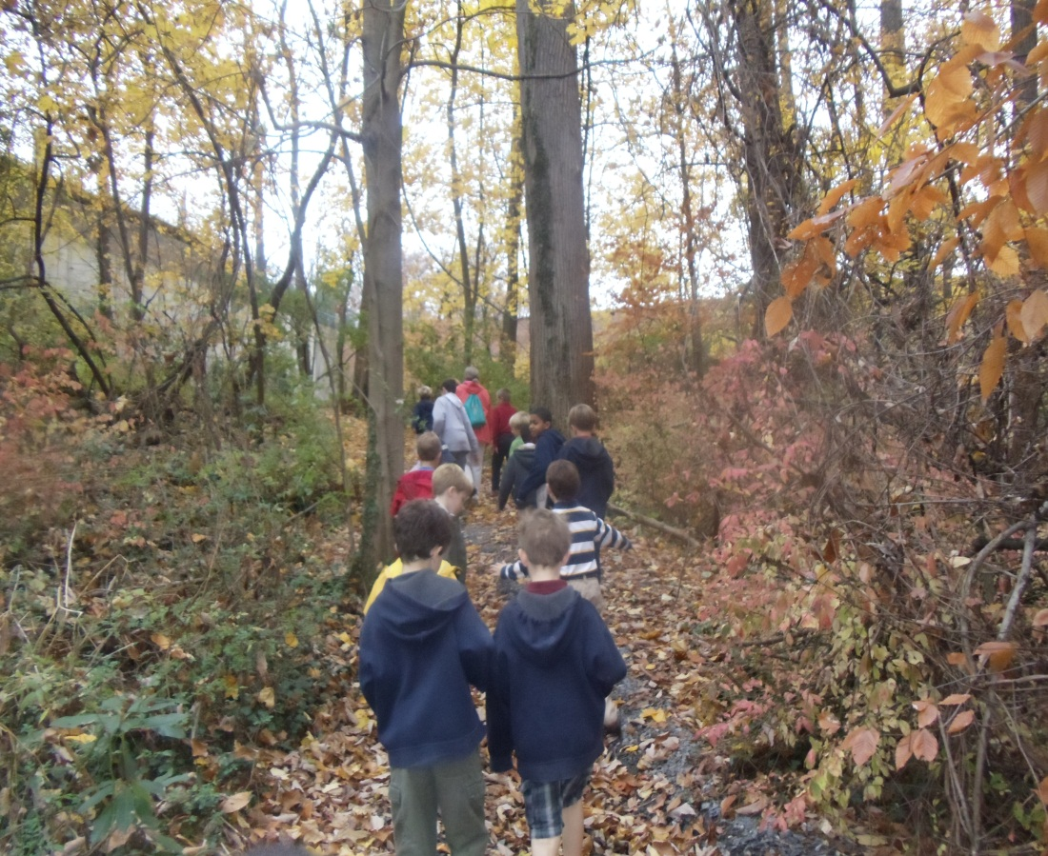
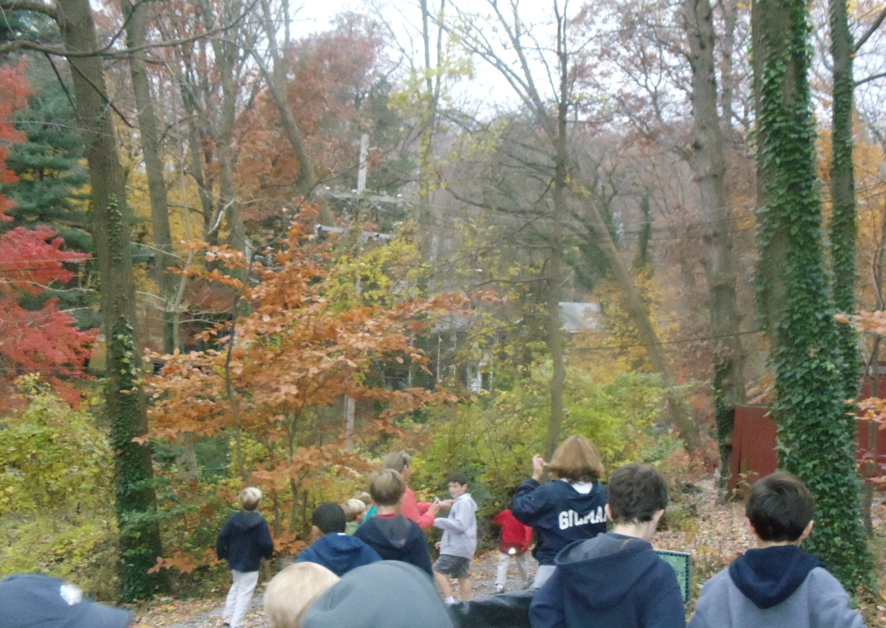
Fall at Gilman School
We take nature walks with Mrs. Olgeirson

Slide 5
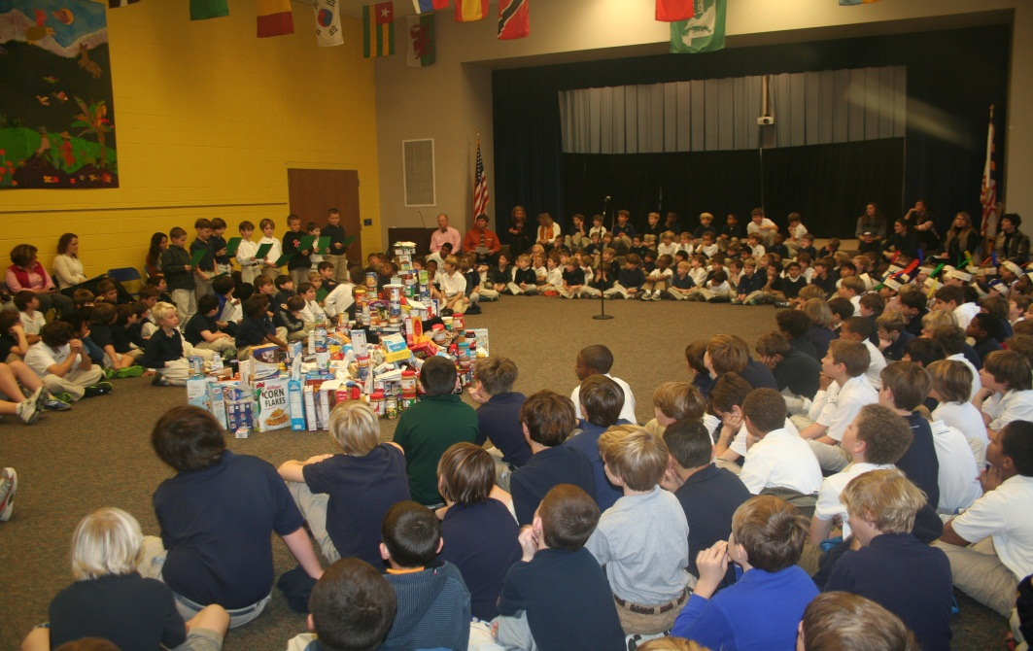
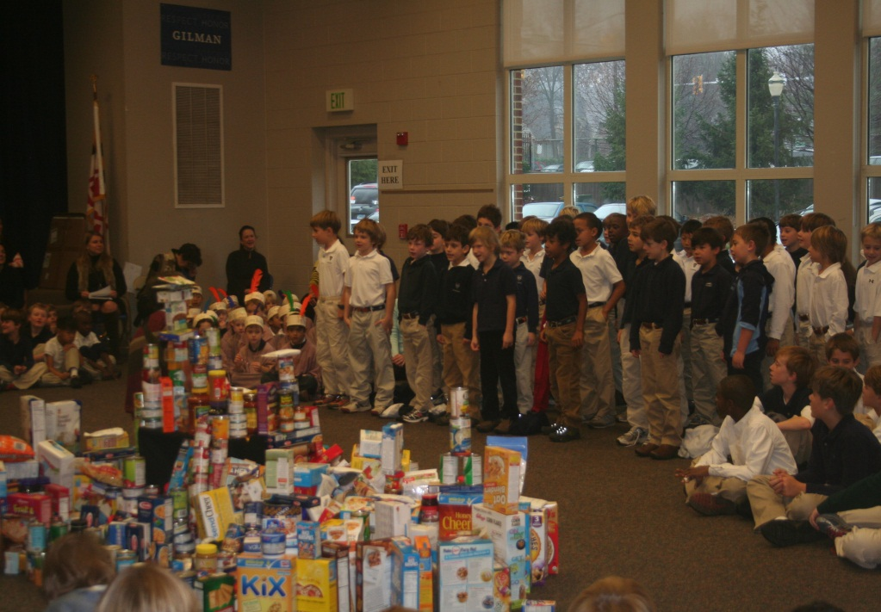
On the last Thursday in November we celebrate Thanksgiving.
At school we all get together in an assembly, and we give thanks for what we have and for the people that love us, and that we love too. We bring food, place it in the center as we come in, and then we sit down to share different activities. Second Grade had to sing Alburquerque Turkey (see next slide for the words). The food is donated to a soup kitchen to help people in need. At home we celebrate with our families, we eat turkey, mashed potatoes, pumpkin pie, corn bread, and many other yummy treats!

Slide 6
Albuquerque Turkey
Albuquerque is a turkey
And he’s feathered and he’s fine
And he wobbles and he gobbles
And he’s absolutely mine.
He’s the best pet that you can get
Better than a dog or cat.
He’s my Albuquerque turkey
And I’m awfully proud of that.
He once told me, very frankly
He preferred to be my pet,
Not the main course at my dinner,
And I told him not to fret.
Now my Albuquerque turkey
Is so happy in his bed…
‘Cause for our Thanksgiving dinner
WE HAD EGG FOO YOUNG INSTEAD!

Slide 7
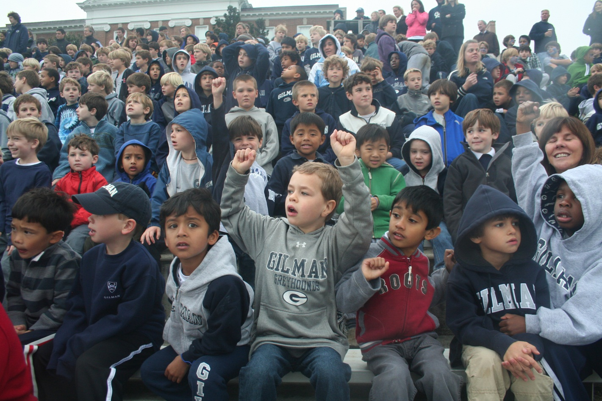
During the fall in Baltimore, we do many other things. We have the soccer season, the football season, pep rallies to cheer for our school teams, and we are in full swing at school. We love fall!

Slide 8
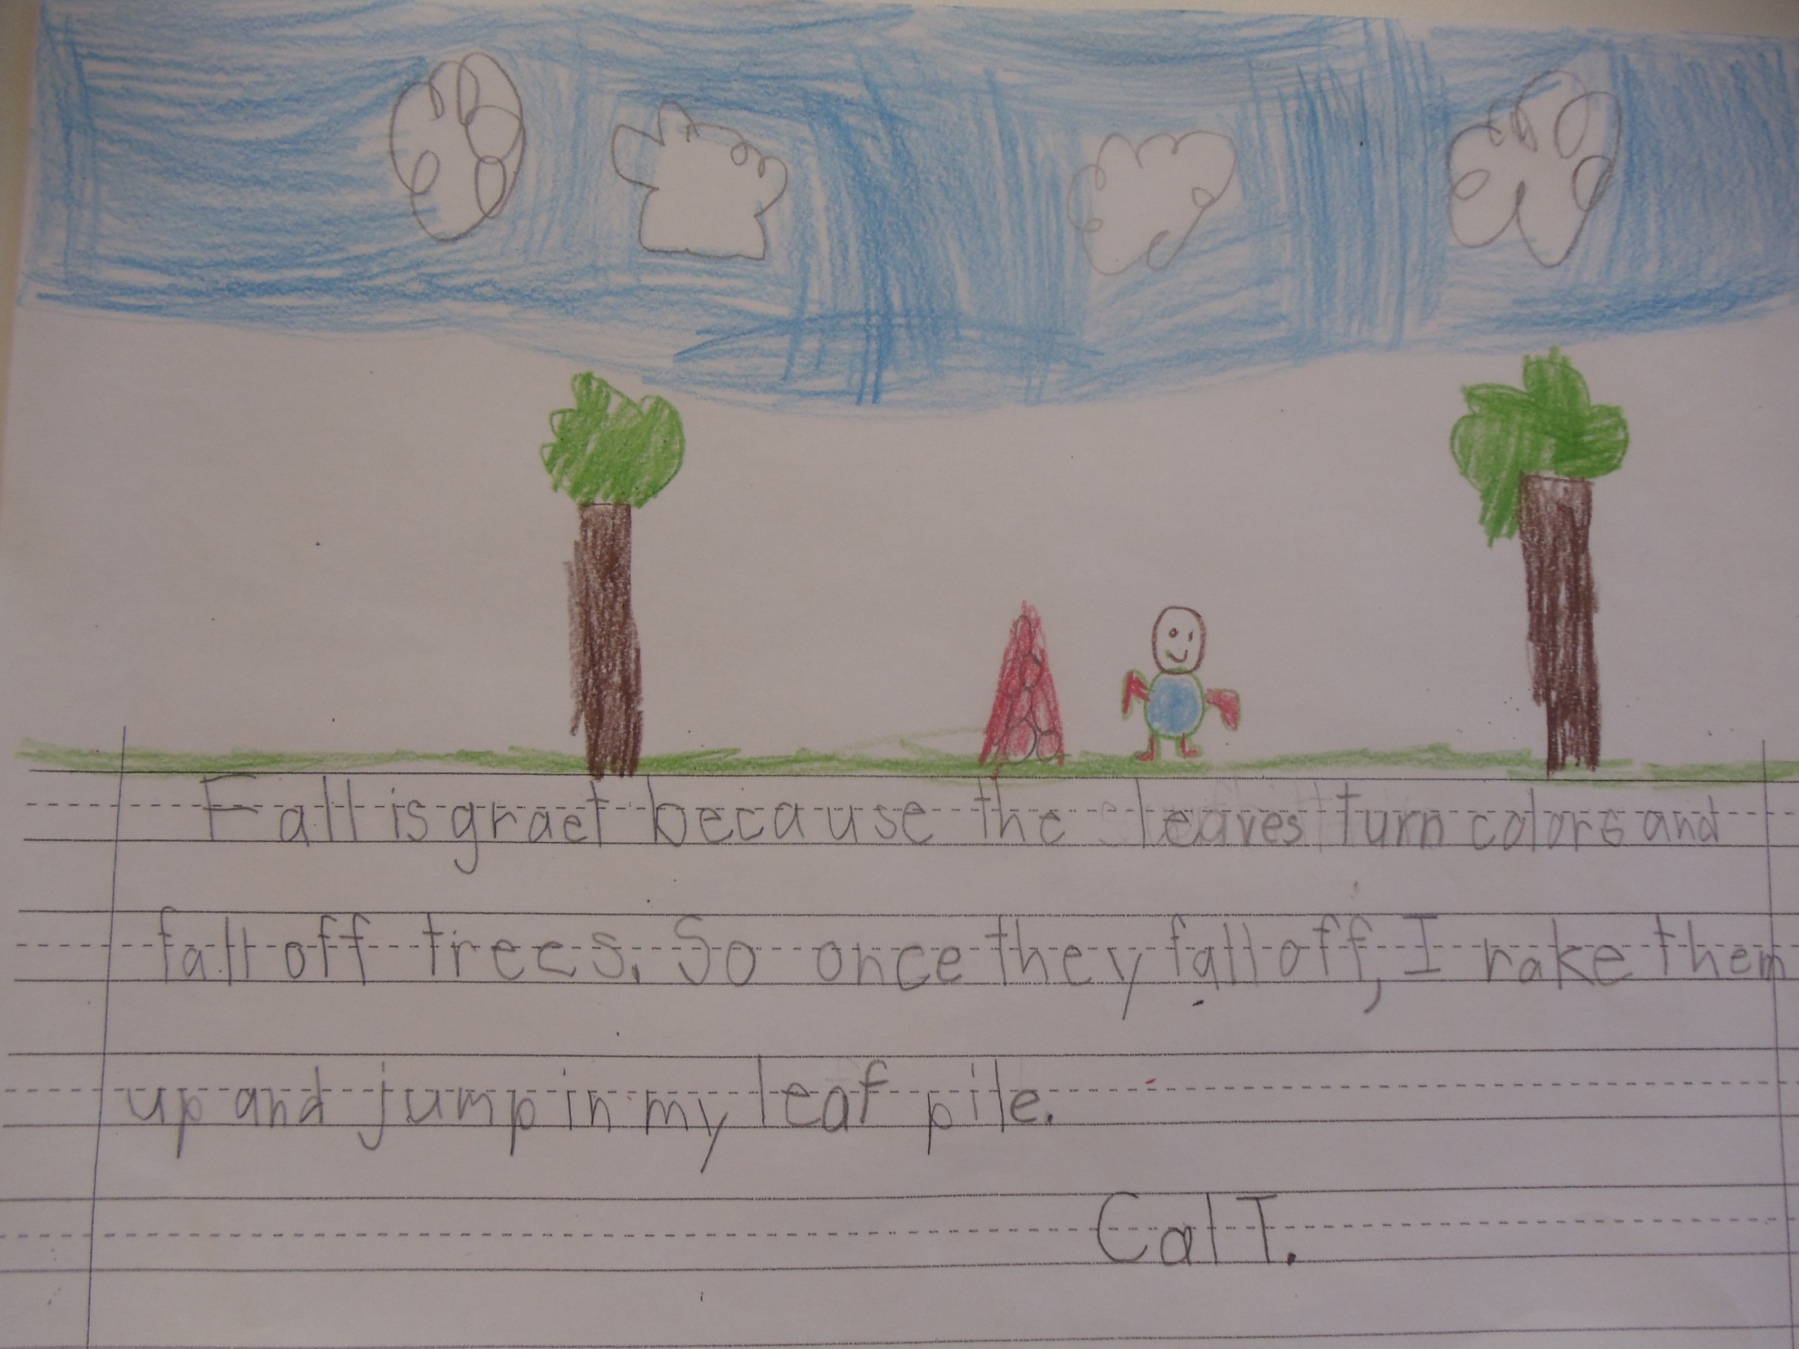

Slide 9
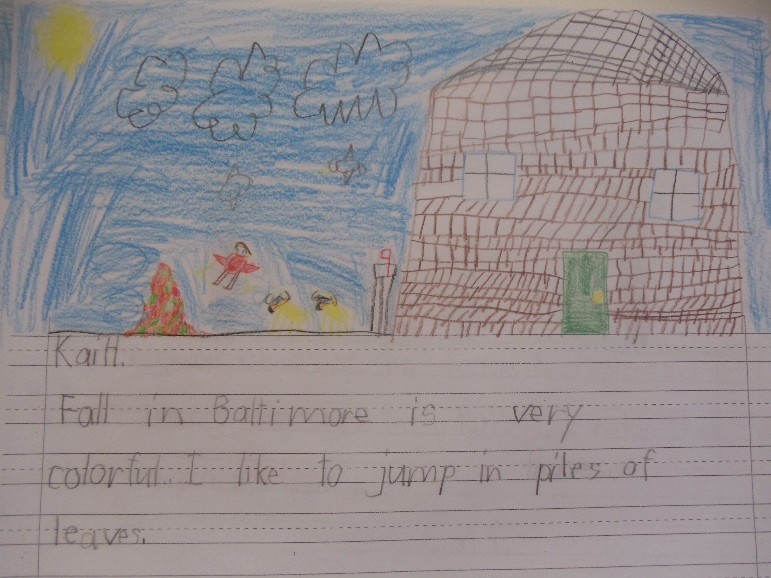

Slide 10
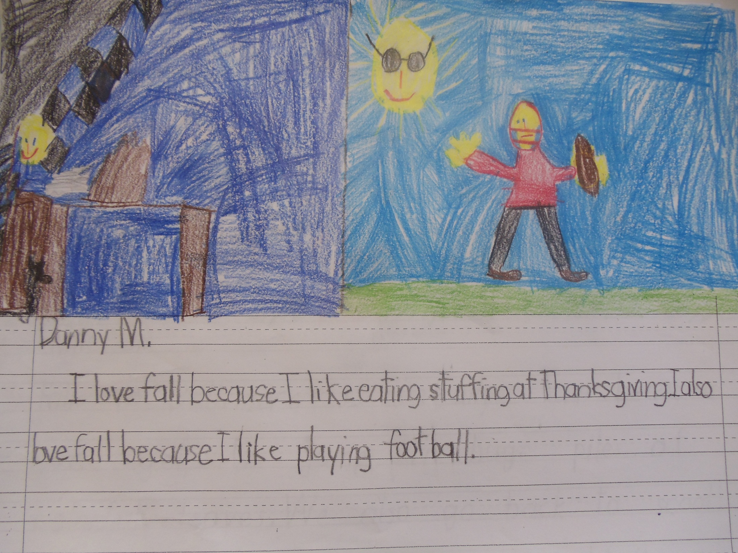

Slide 11
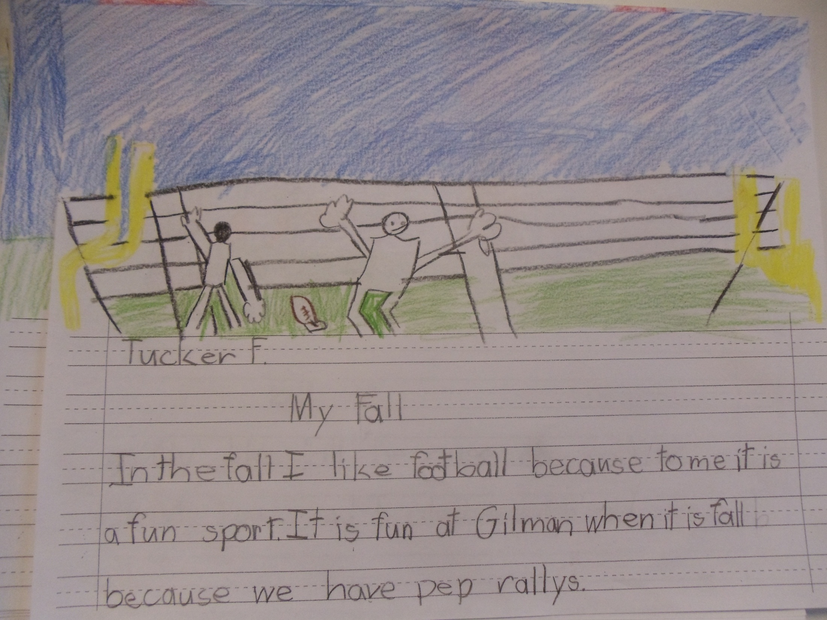

Slide 12
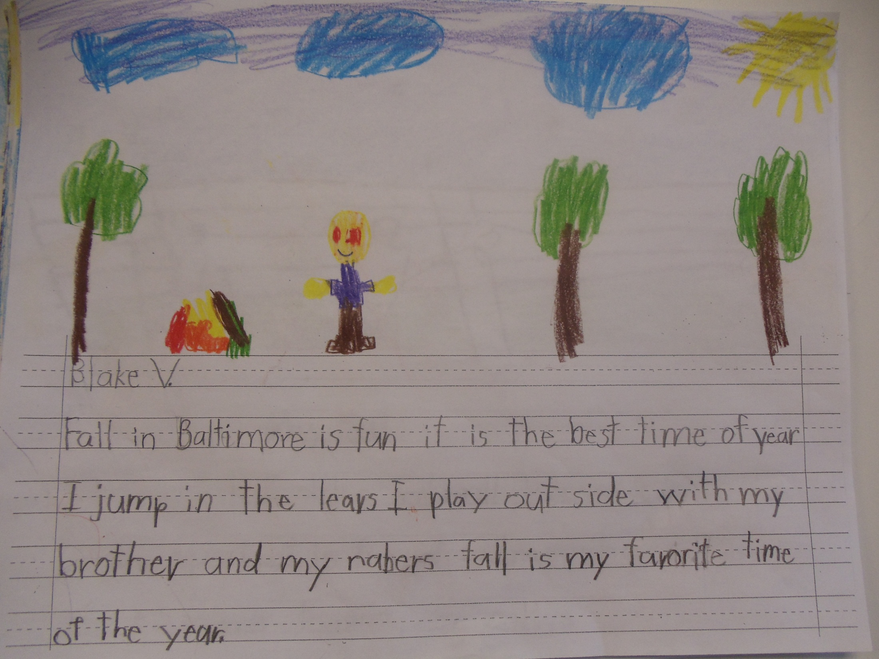

Slide 13
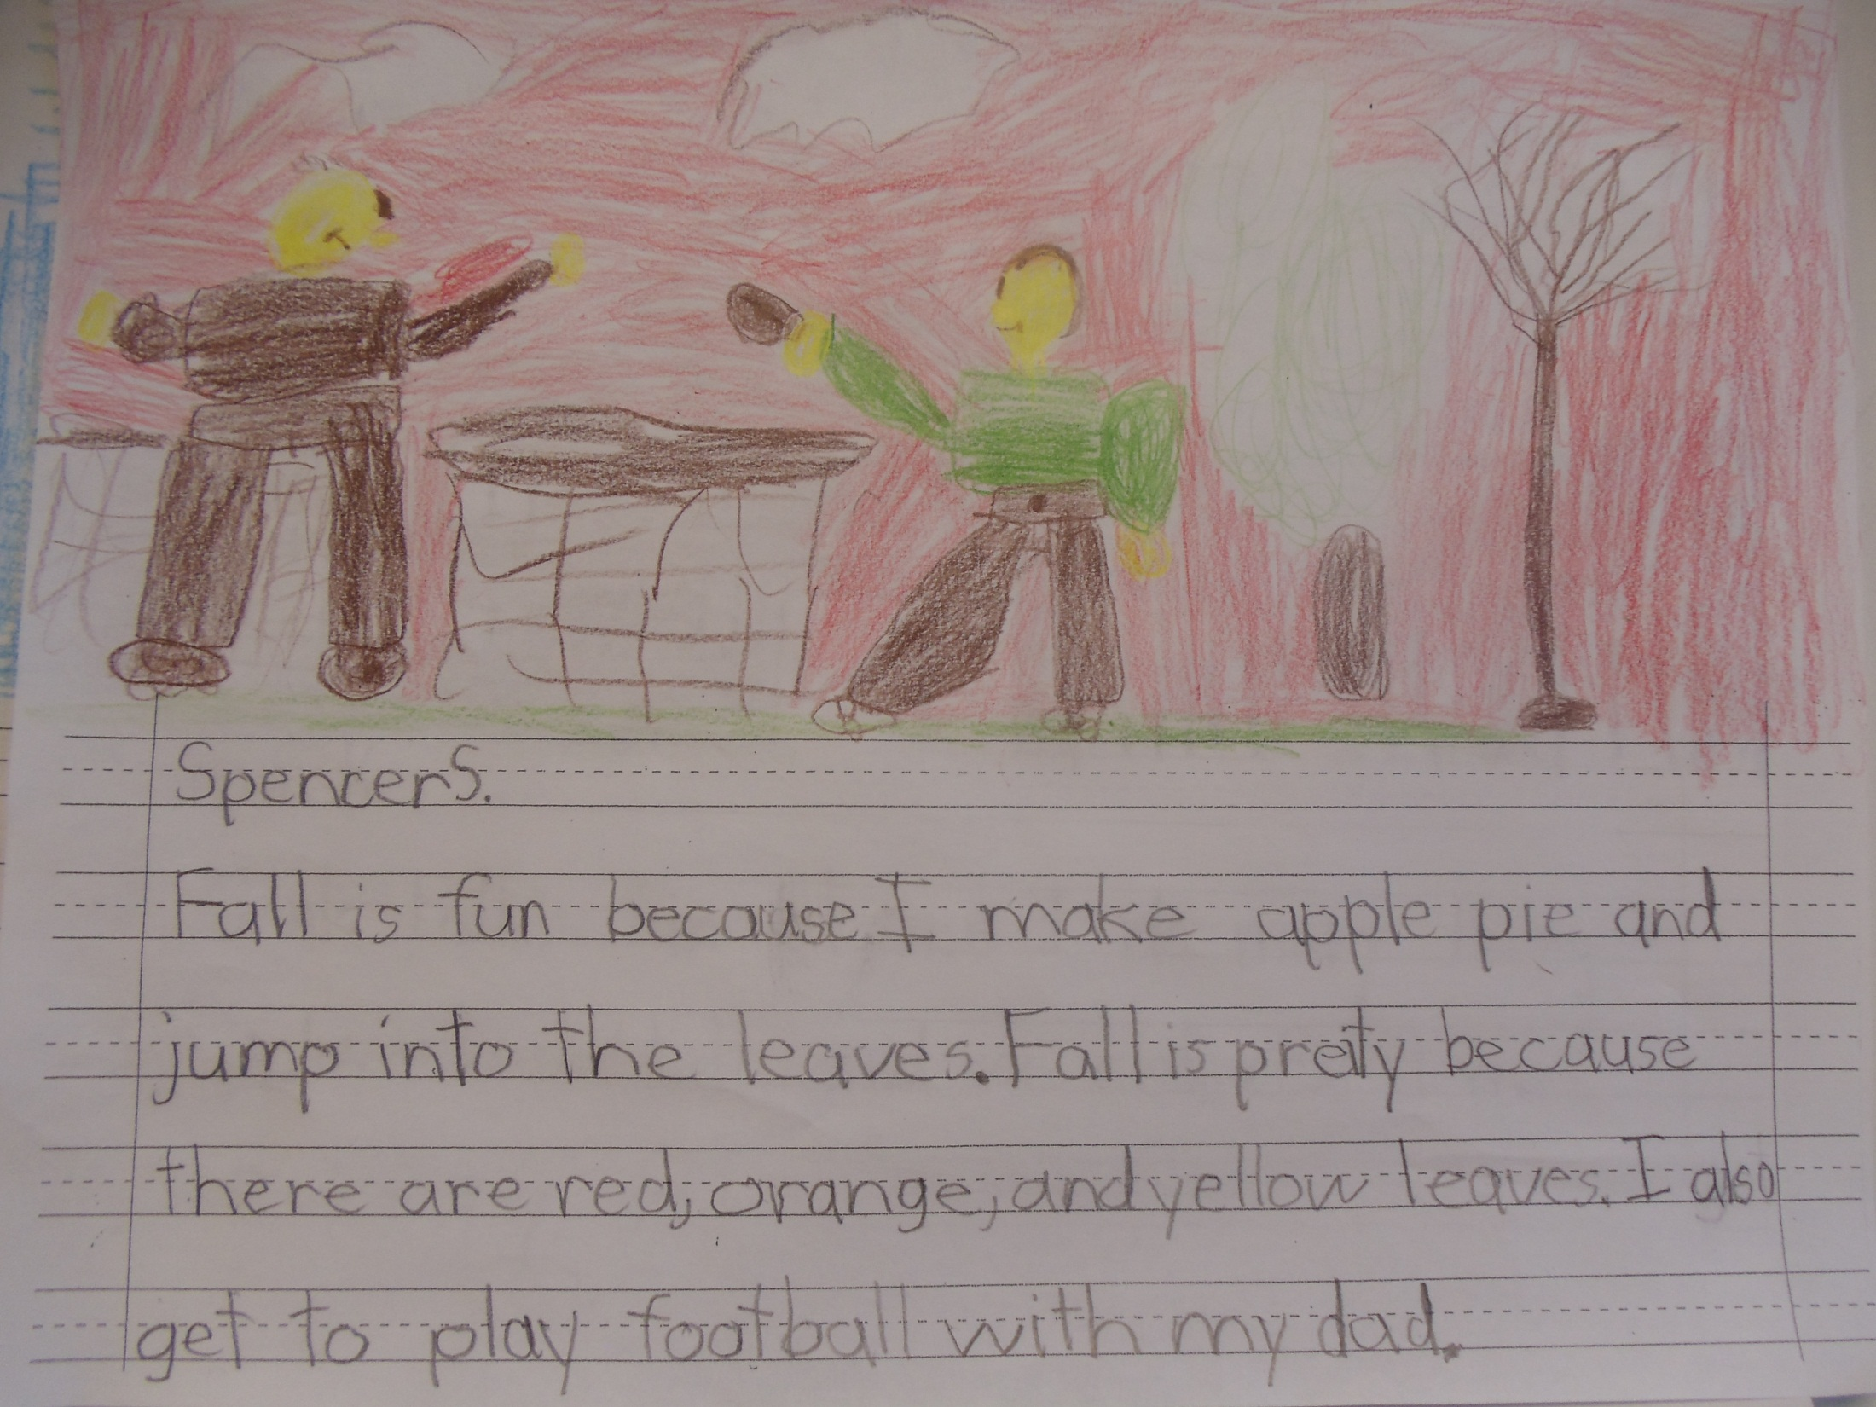

Slide 14
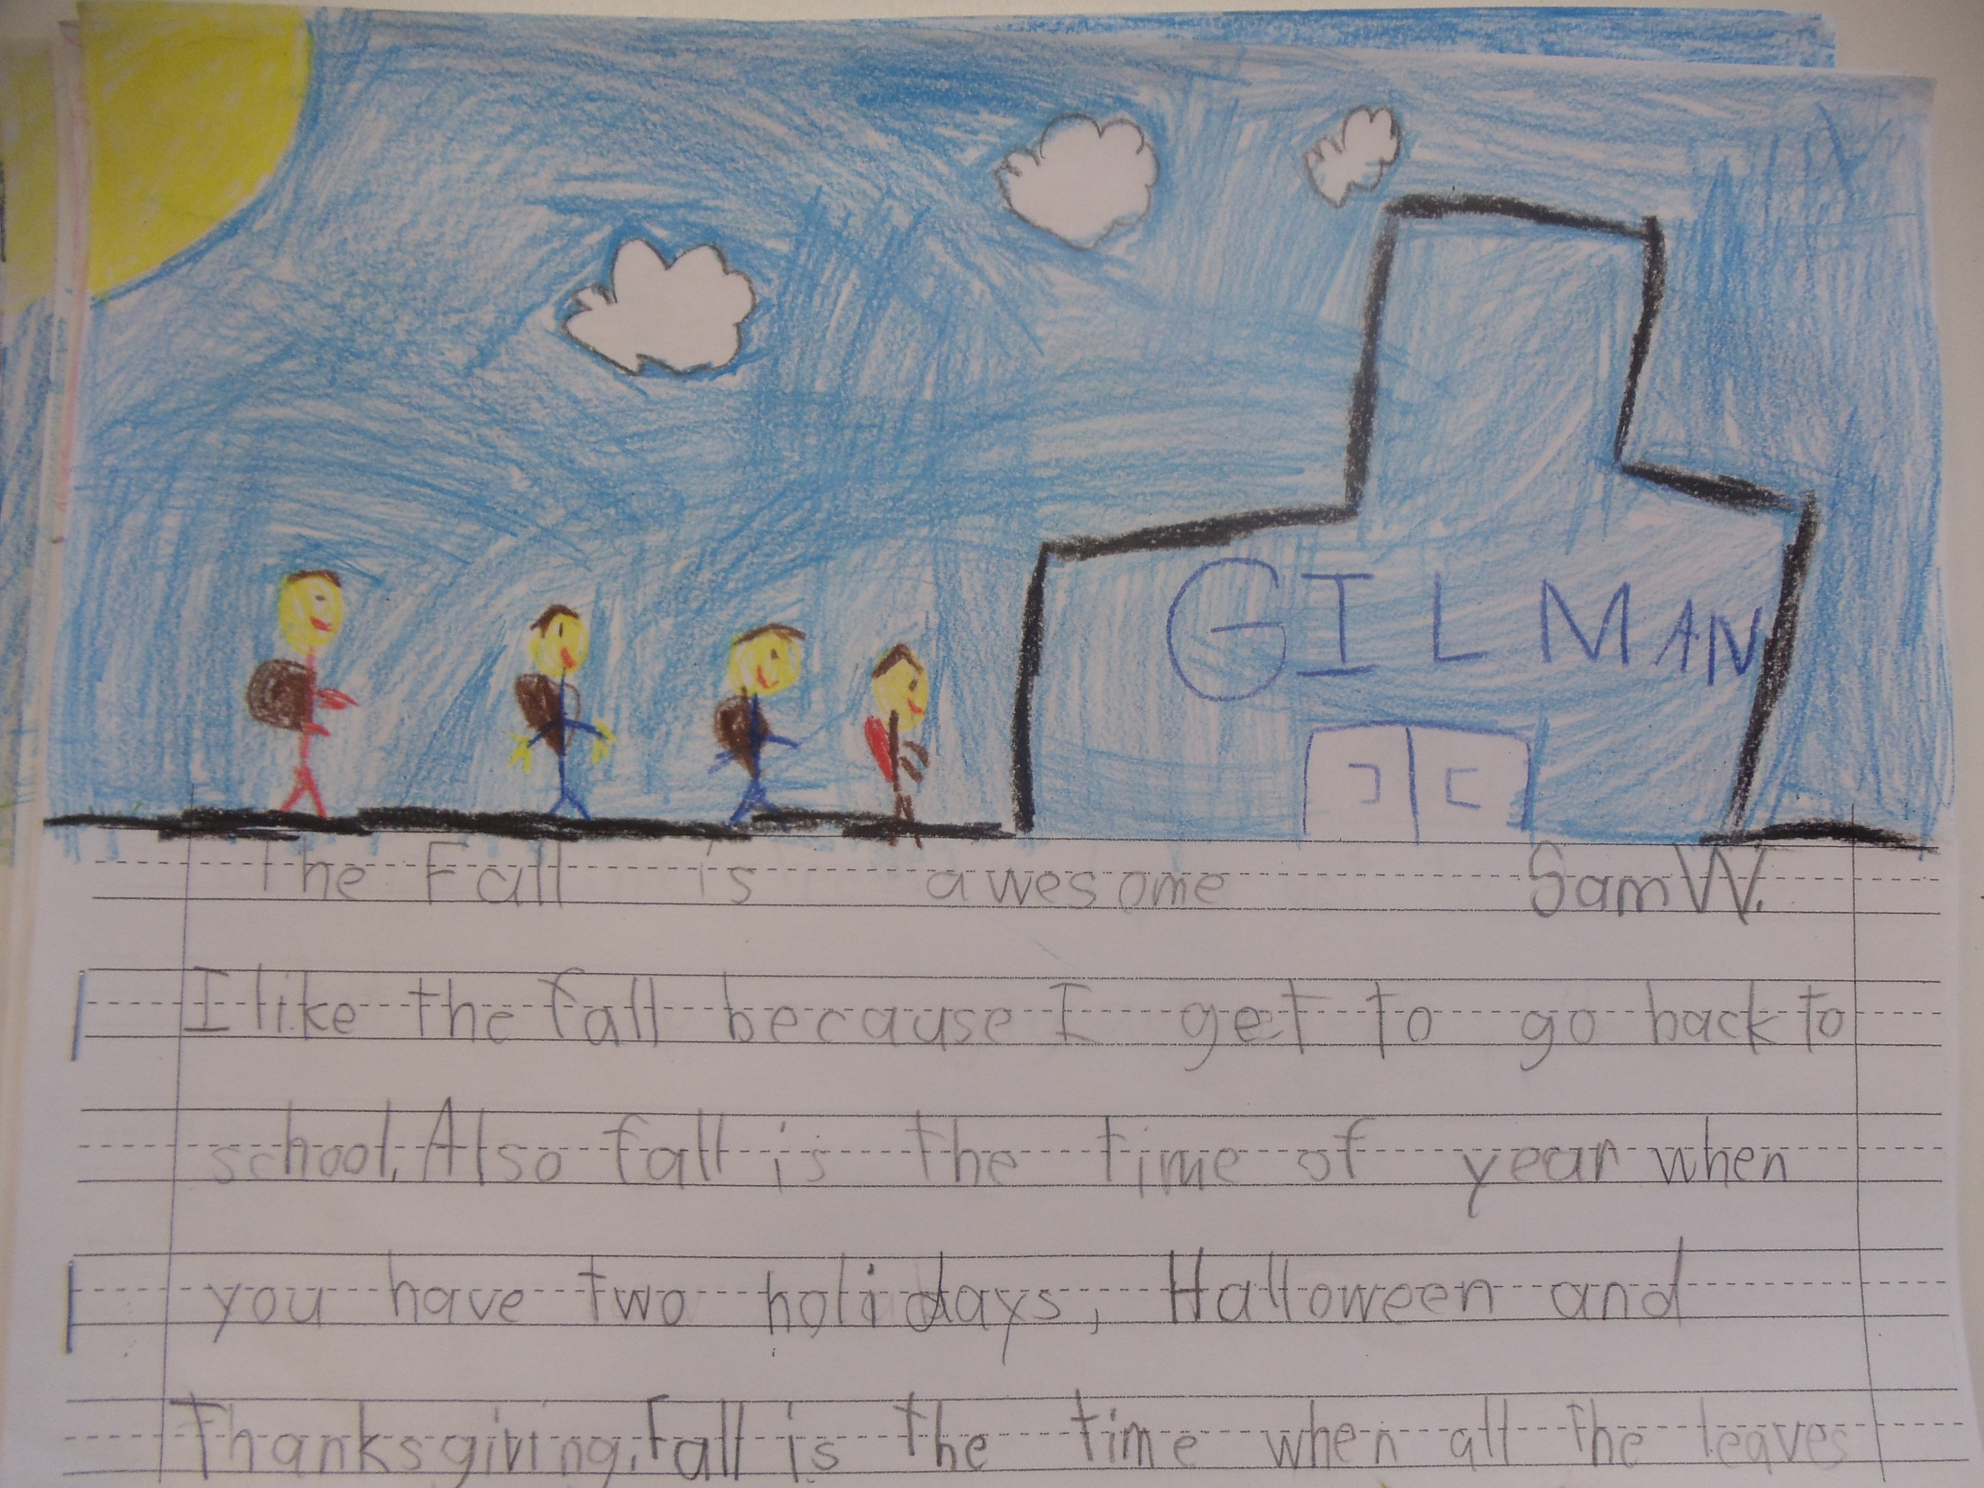

Slide 15
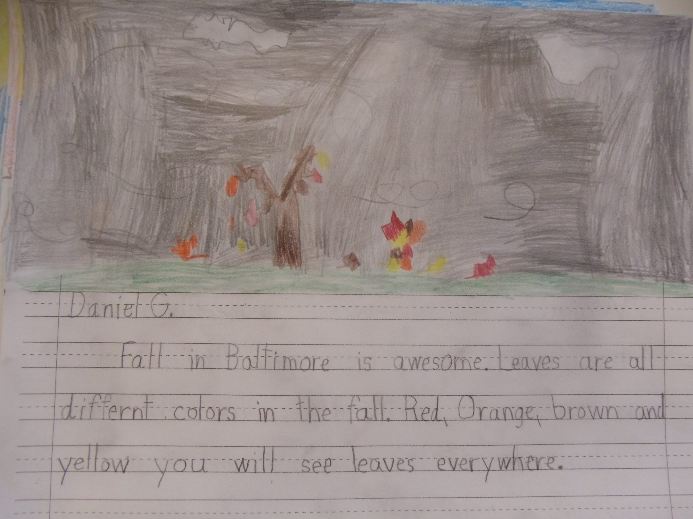

Slide 16
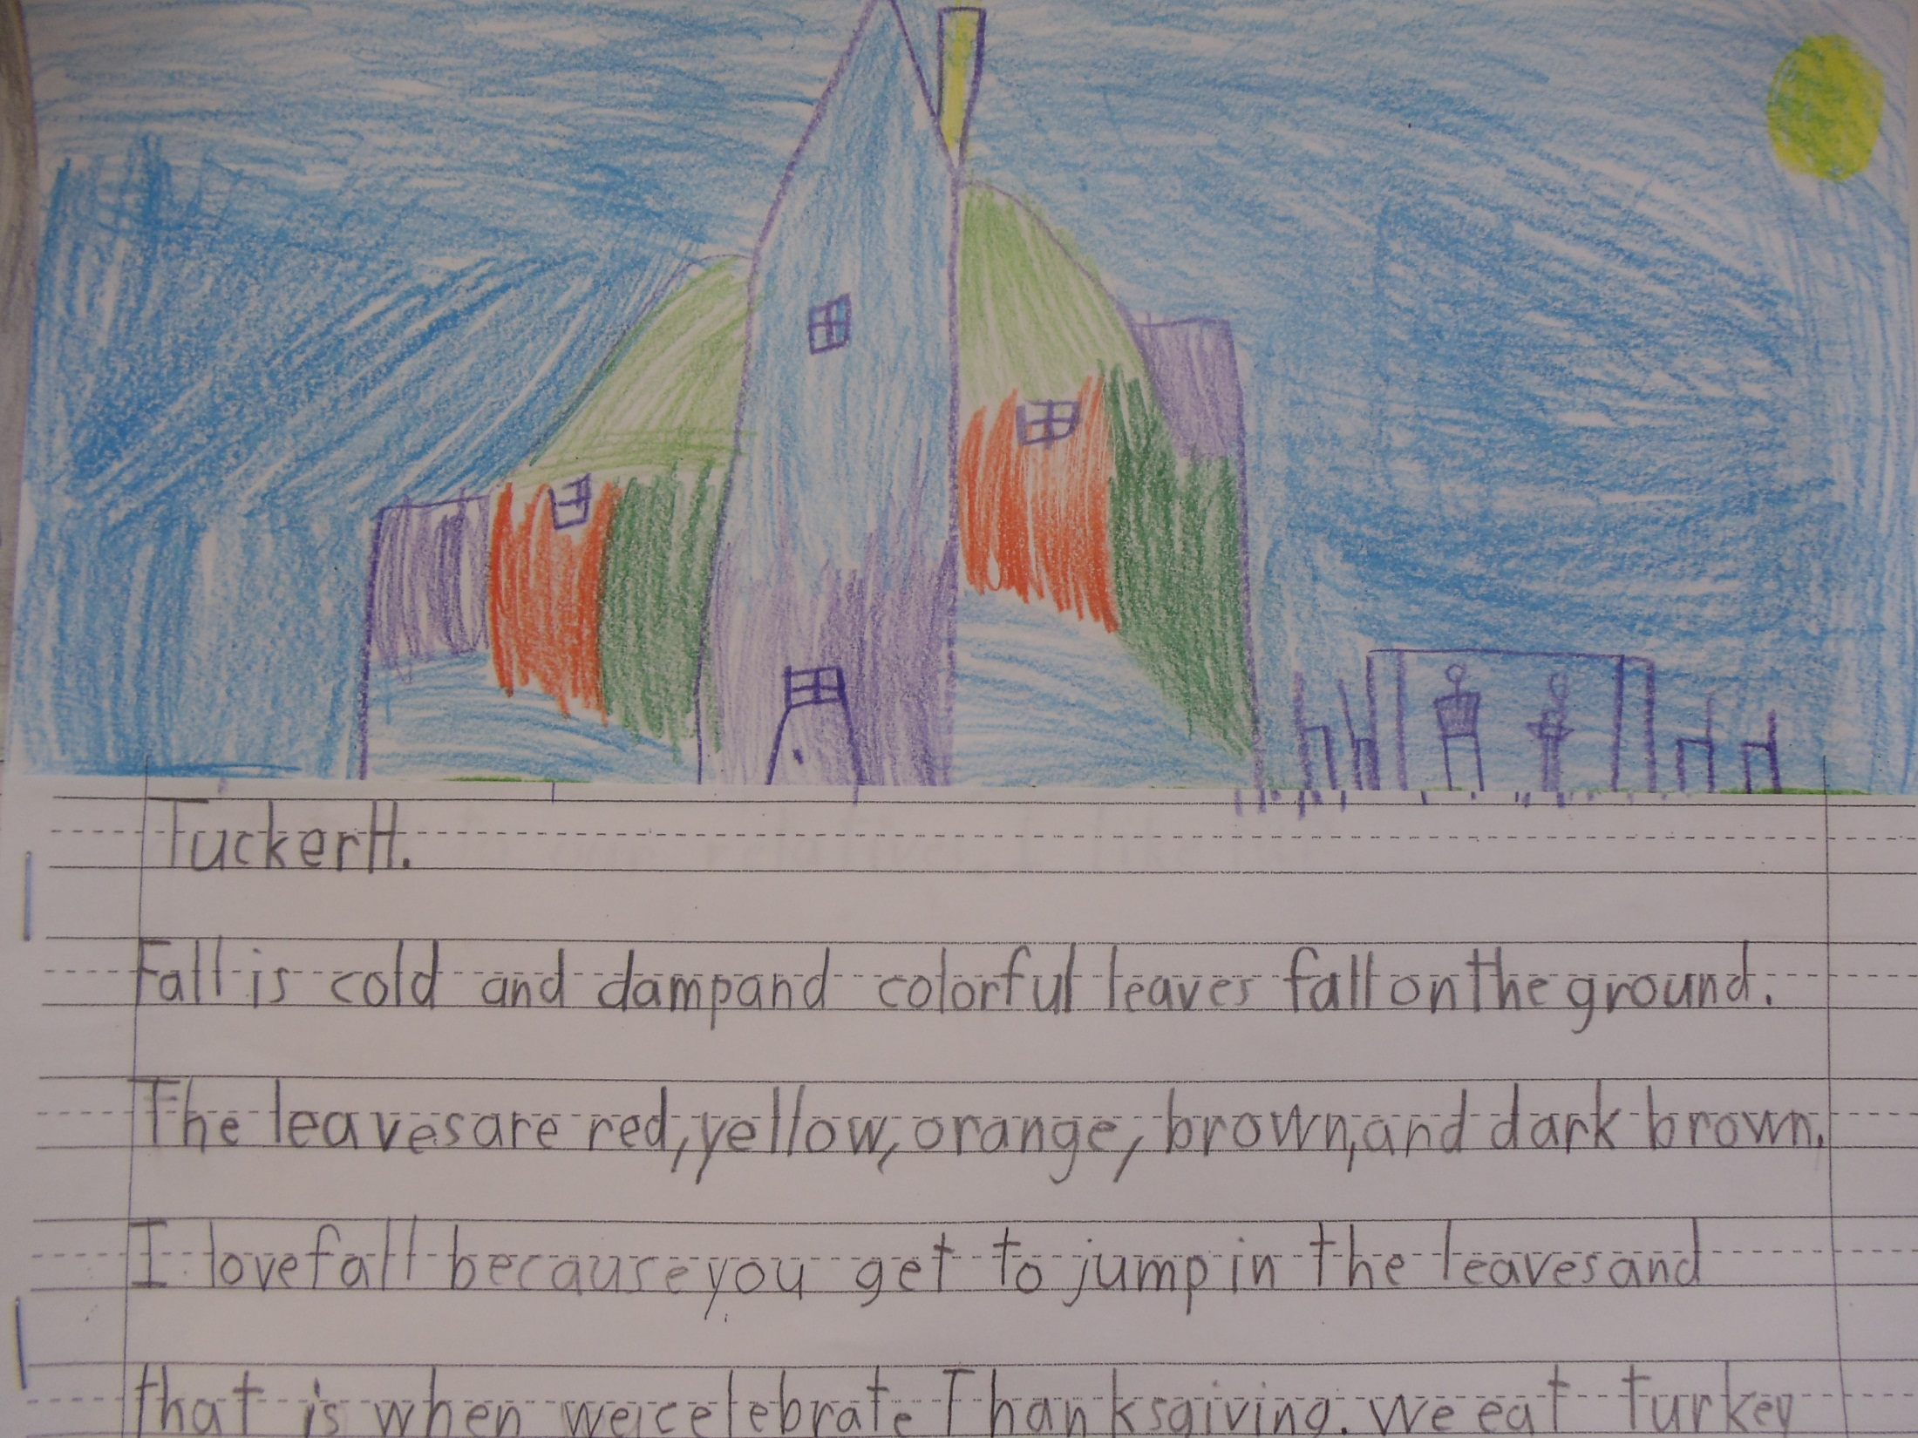

Slide 17
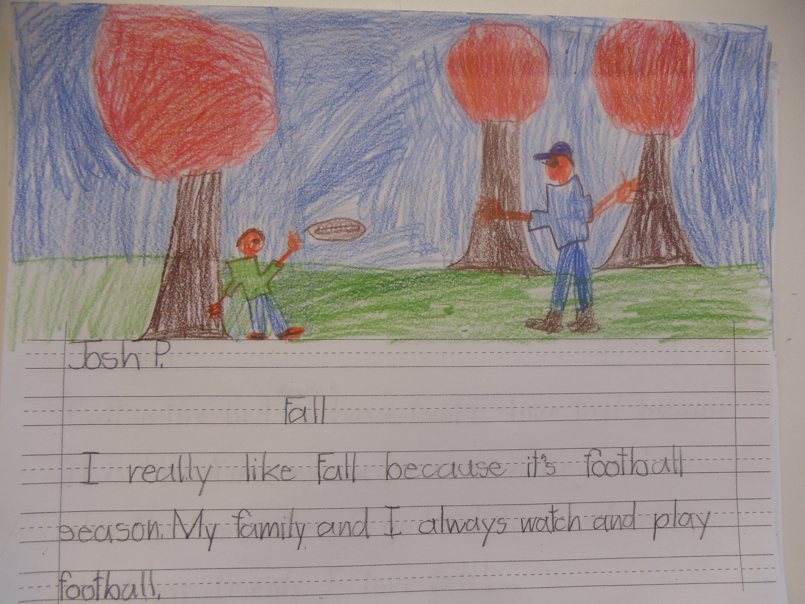

Slide 18
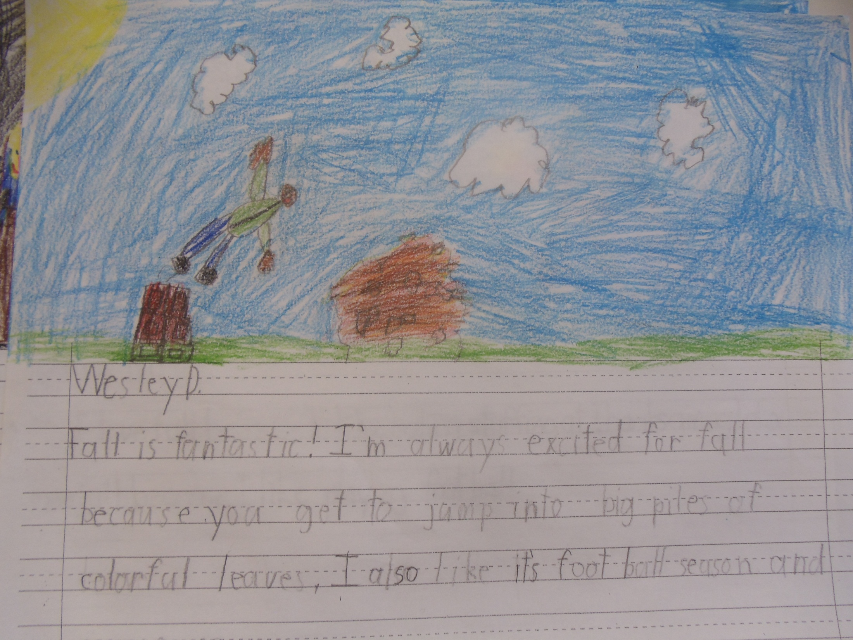

Slide 19
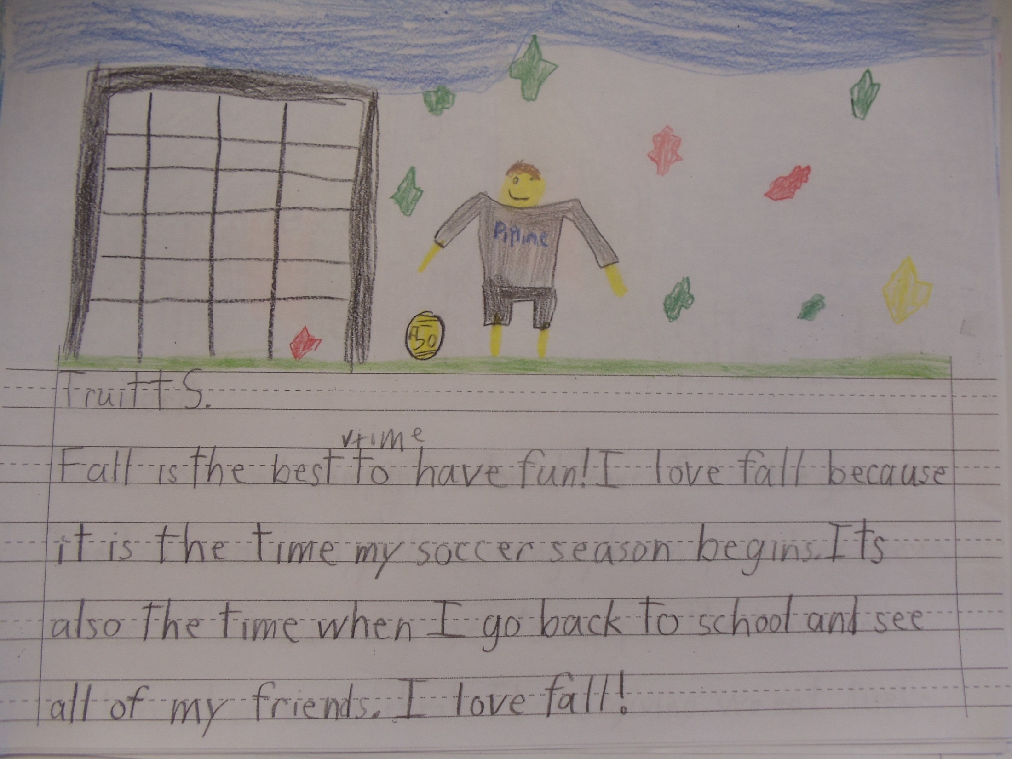

Slide 20
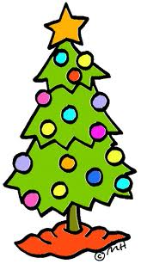
As fall comes to and end, we can’t help but feel a little sad for it is so much fun. However, we are now getting so excited for all the that we have coming ahead. December is full of fun things to do too. So be Merry, and may all of you be always healthy and in peace.
Happy Winter and Happy Holidays to all of you!!!

