Slide 1
Differences Between the City and the Country
By 2B Gilman School
Baltimore, Maryland USA

Slide 2
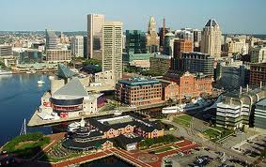
The City of Baltimore
Baltimore was founded in 1729.
The name Baltimore comes from Lord Baltimore, the founder and proprietor of the colony of Maryland. The name "Baltimore" translates from the Irish language as meaning "Town of the Big House”.
During the 1800s, Baltimore was the second greatest port of entry by immigrants to the USA.
The city of Baltimore is an independent city, meaning that it is not part of any county in Maryland. It was at one time part of Baltimore County that now borders it.

Slide 3
The 2B boys got together and thought about characteristics of the City that they like. Here
is what they came up with:
Baltimore has many stores
There are many different places
We have a Zoo, a Science Center, many museums, and the National Aquarium.
We have many friends
We have many beautiful parks
It is easy to meet a lot of people
We have a lot of boats because we have a big harbor.

Slide 4
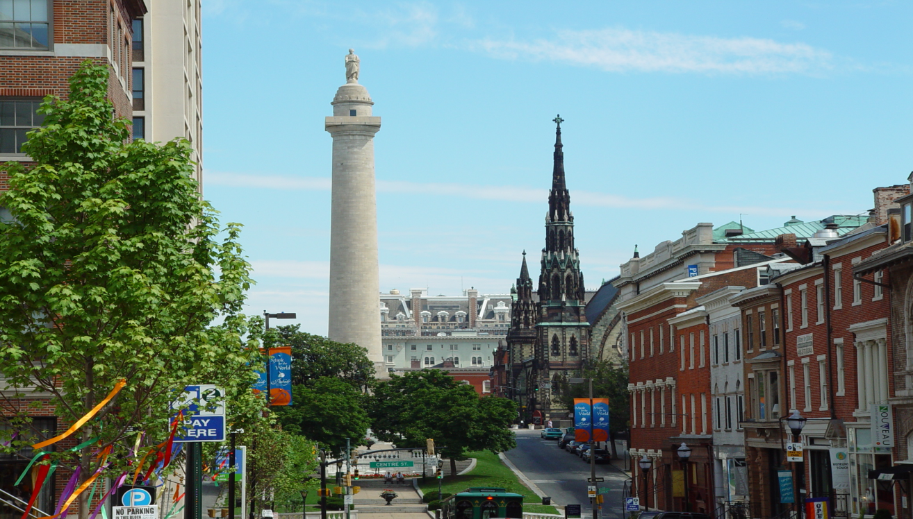
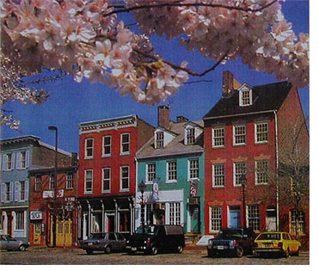
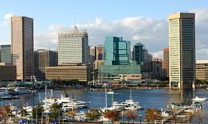
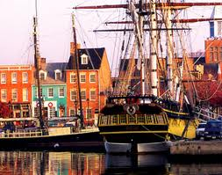
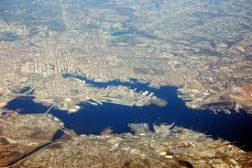
Baltimore City
Our harbor

Slide 5
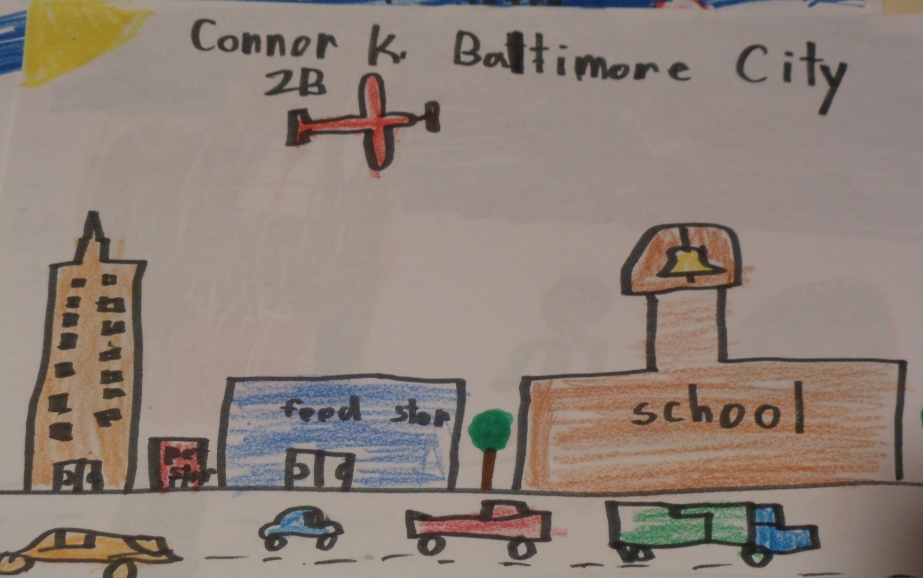
In our city we have many schools and stores

Slide 6
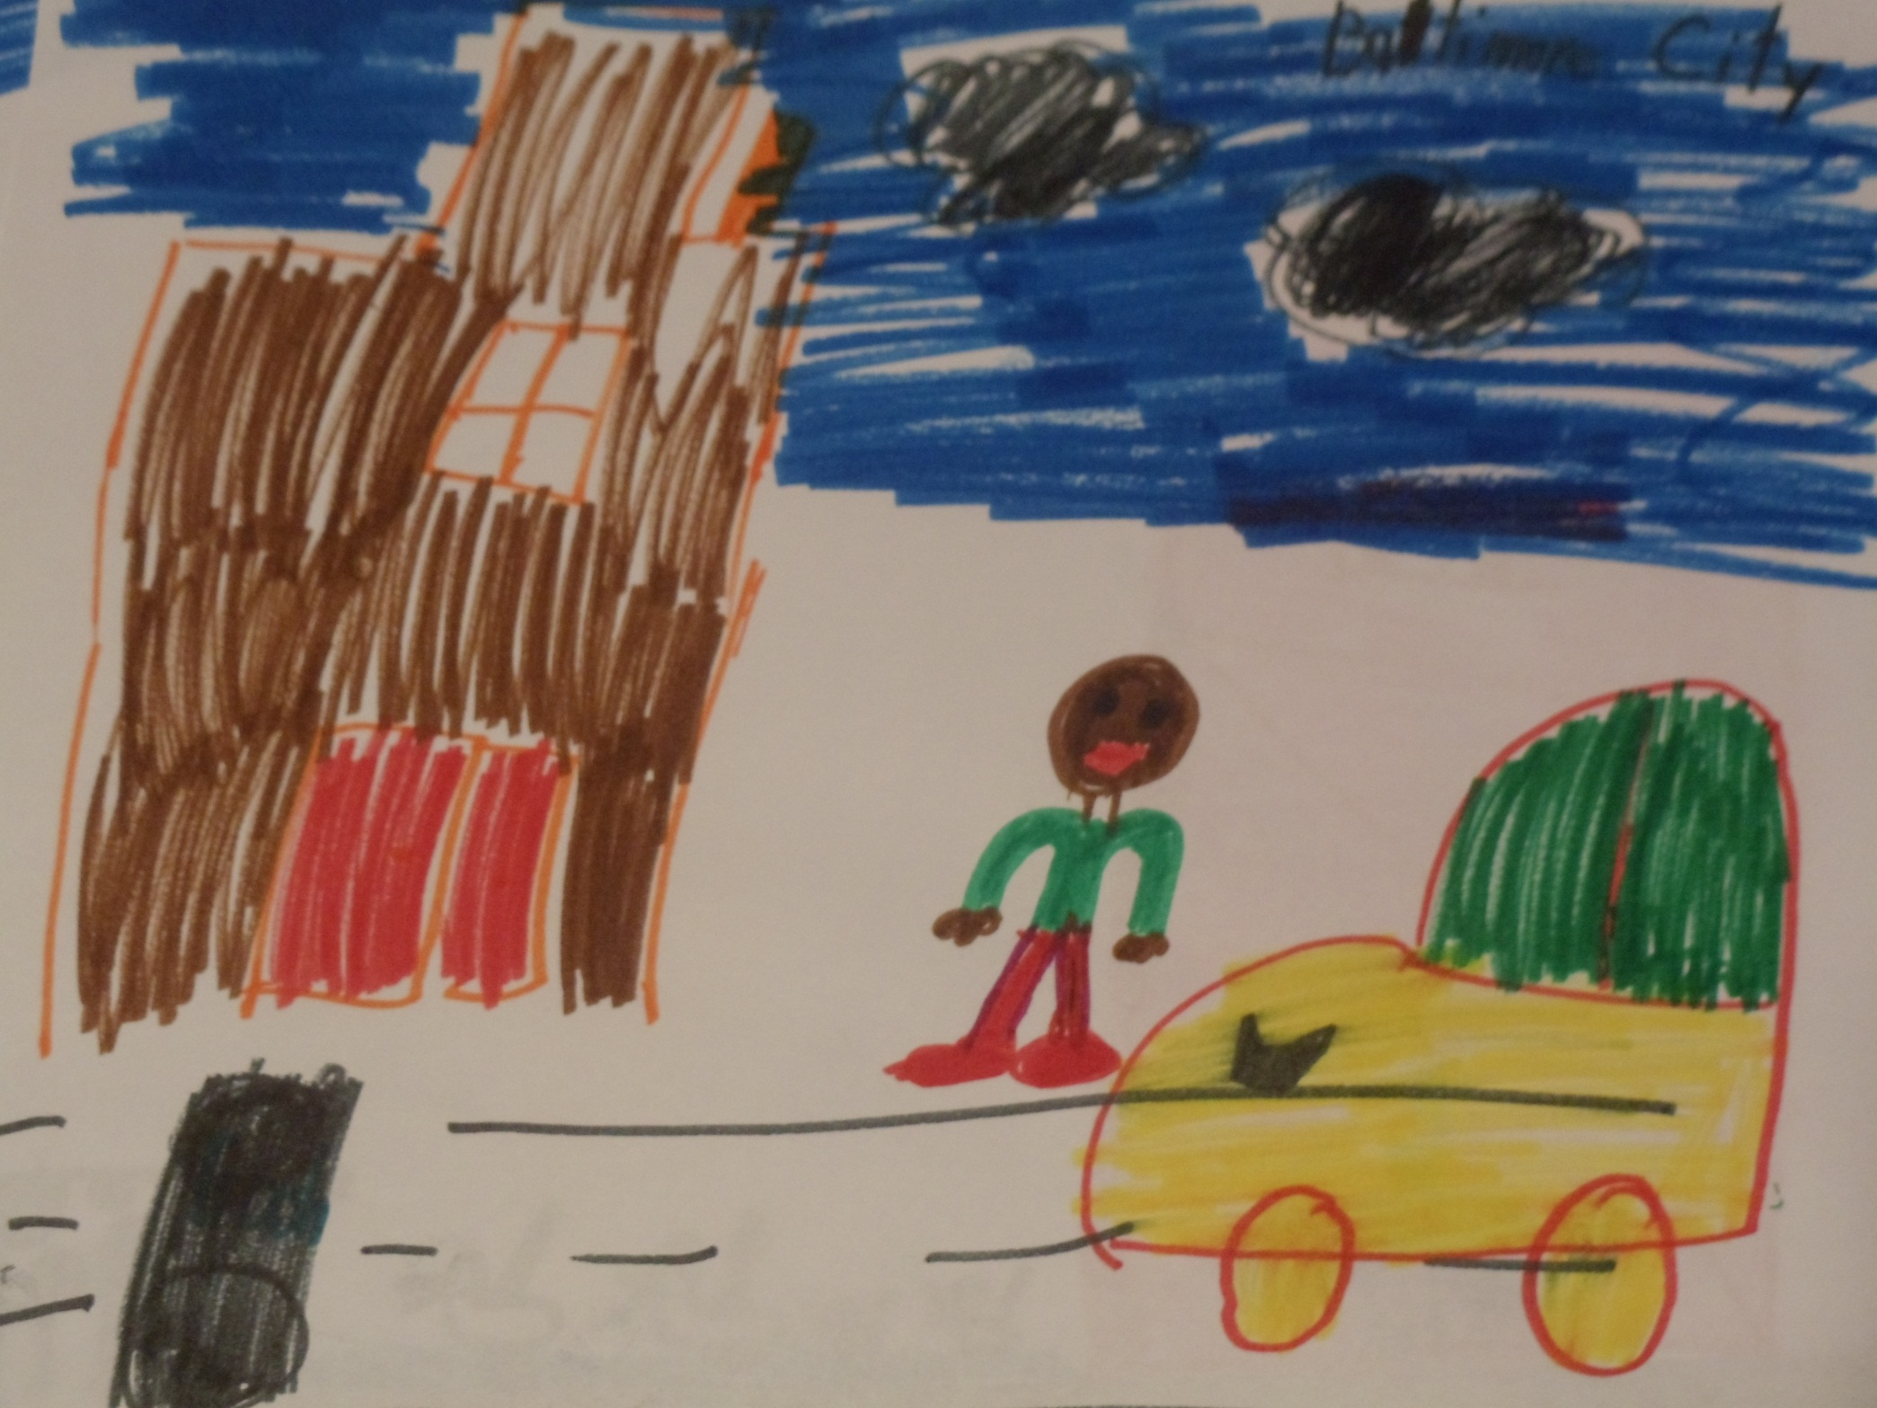

Slide 7
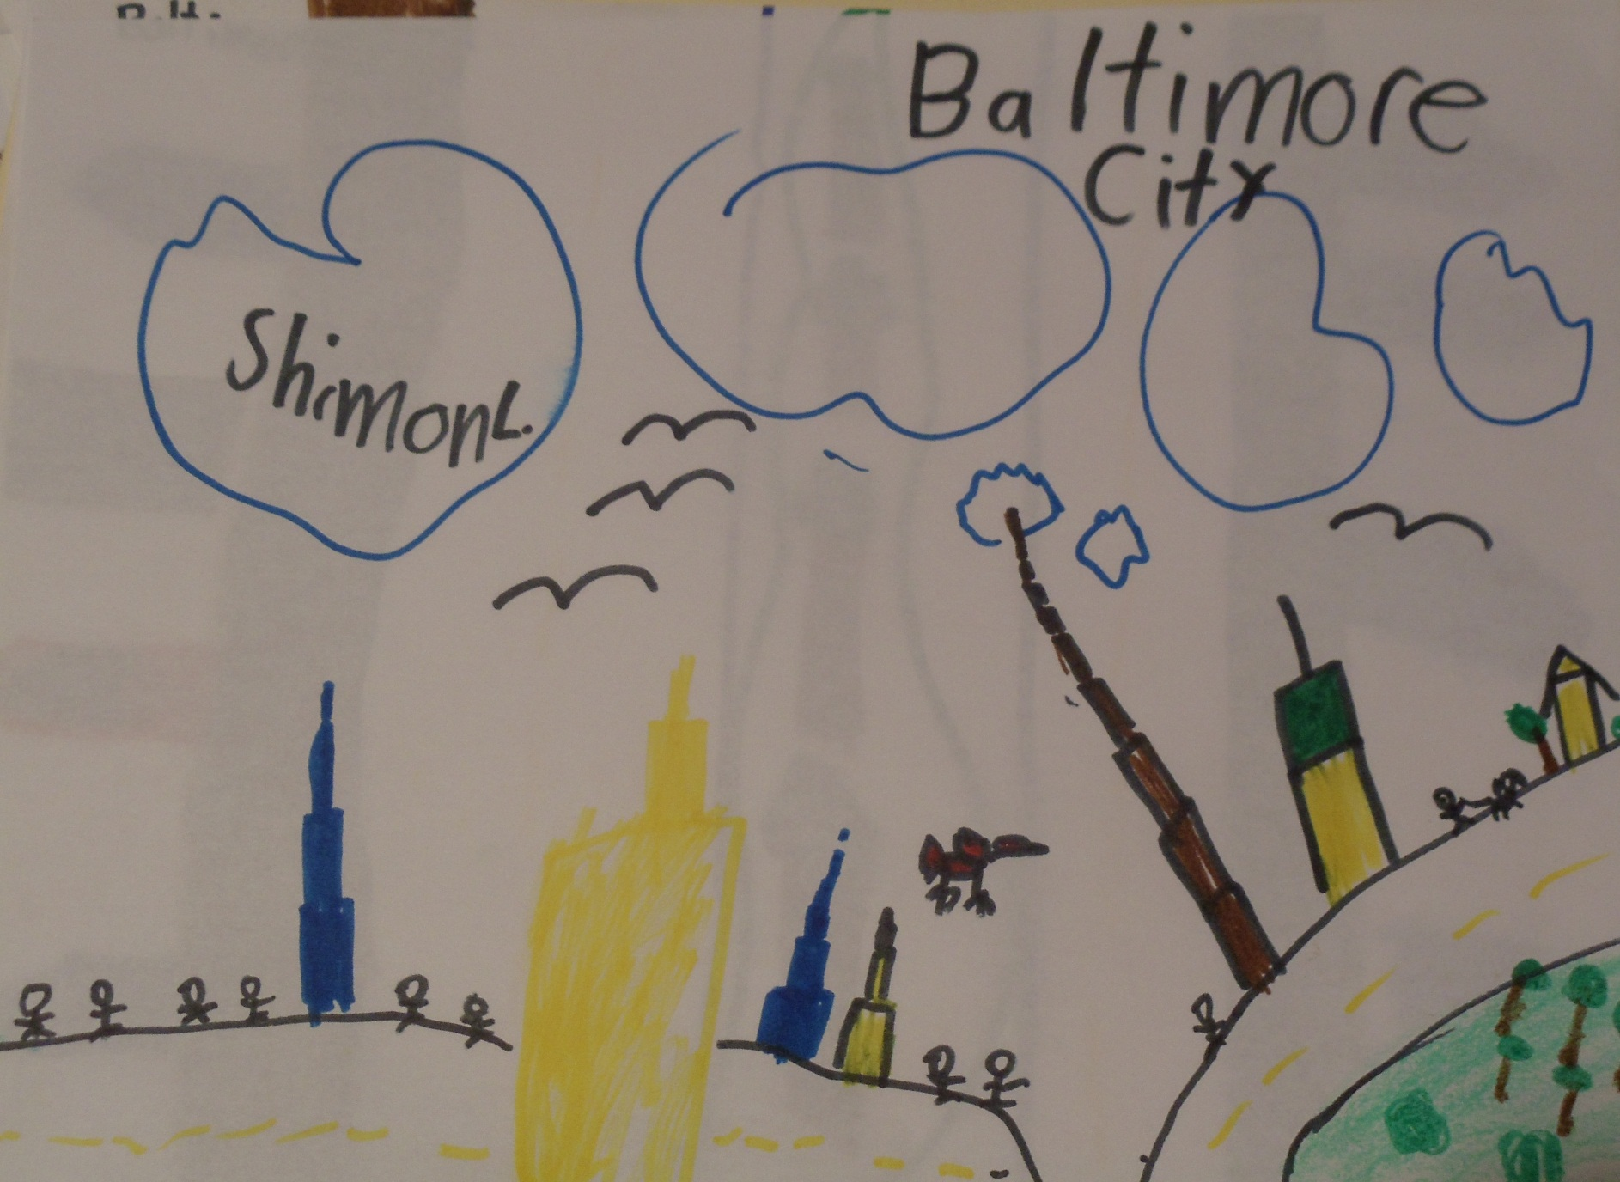
Baltimore city has many tall buildings

Slide 8
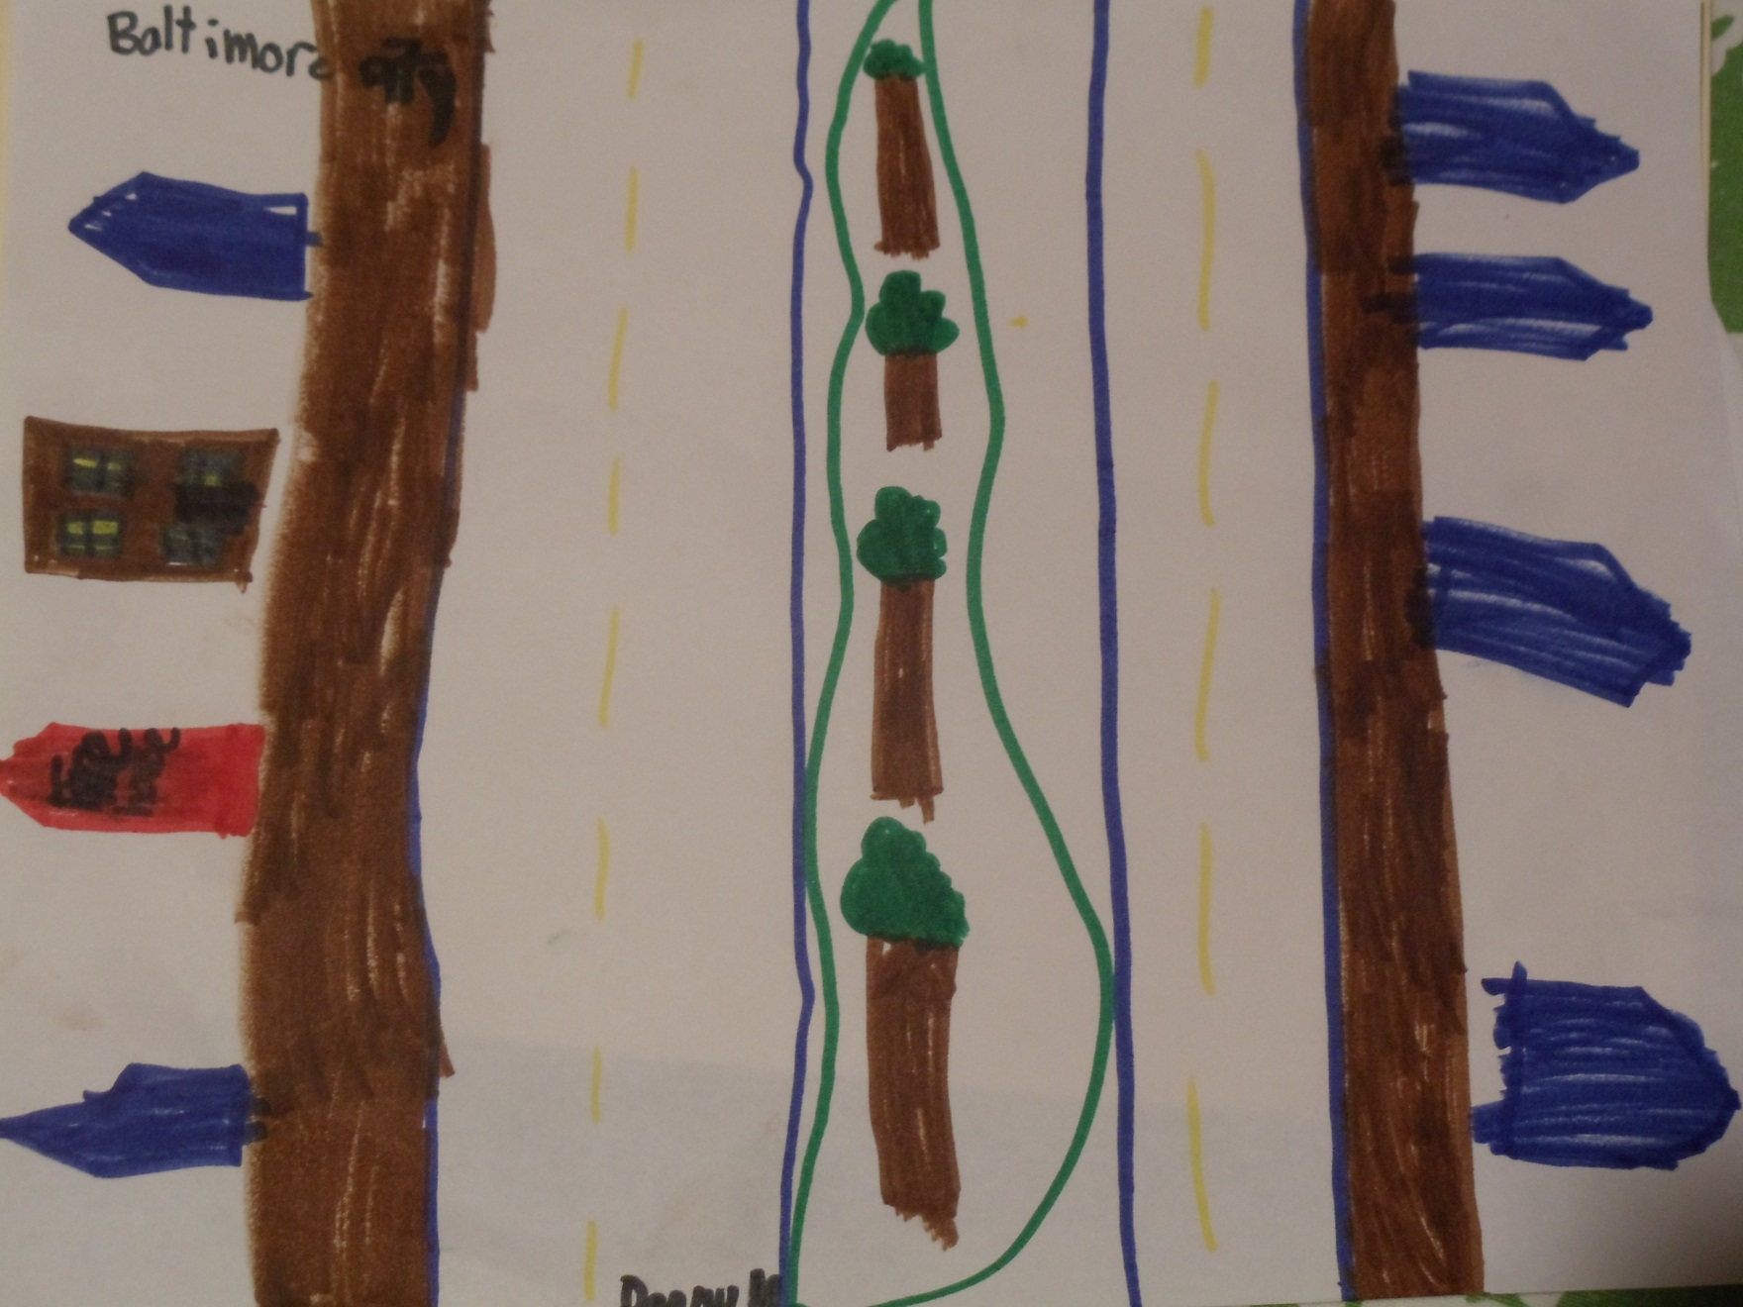
In our city we have a lot of streets

Slide 9
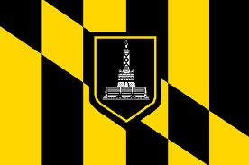
We even have a Baltimore city flag!

Slide 10
The Maryland countryside
Our countryside is very beautiful
It is peaceful
There are trees everywhere
We have many farms
We have many forests with very tall trees
We have marshes and rivers
We have a bay
We have less people, less cars, and less noise than in the city
We have more animals than in the city, like Geese, squirrels, deer, ducks, and rabbits

Slide 11
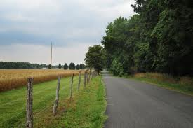
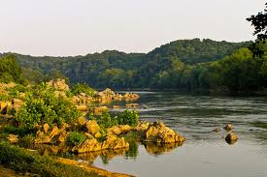
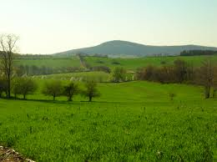
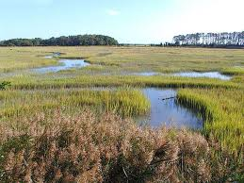
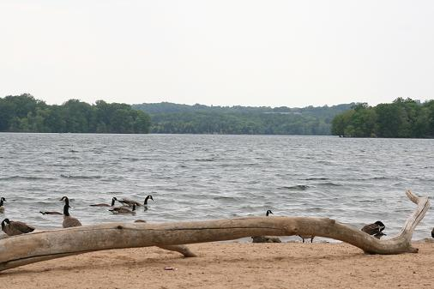
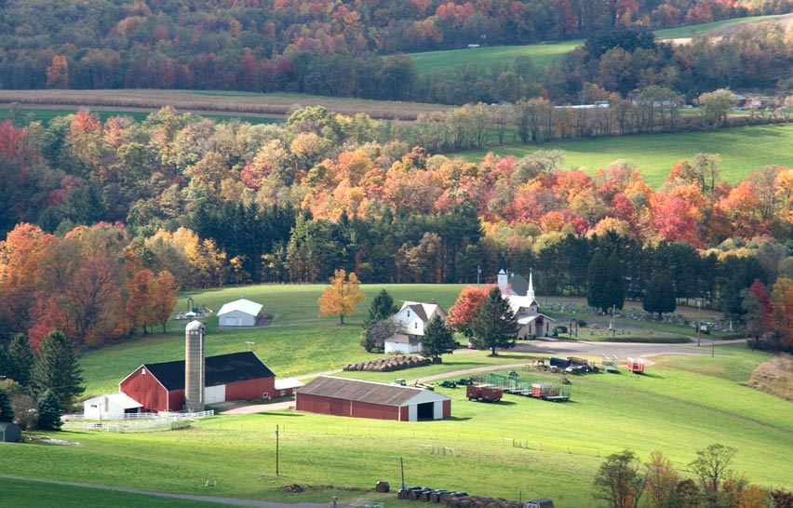
The countryside in Maryland

Slide 12
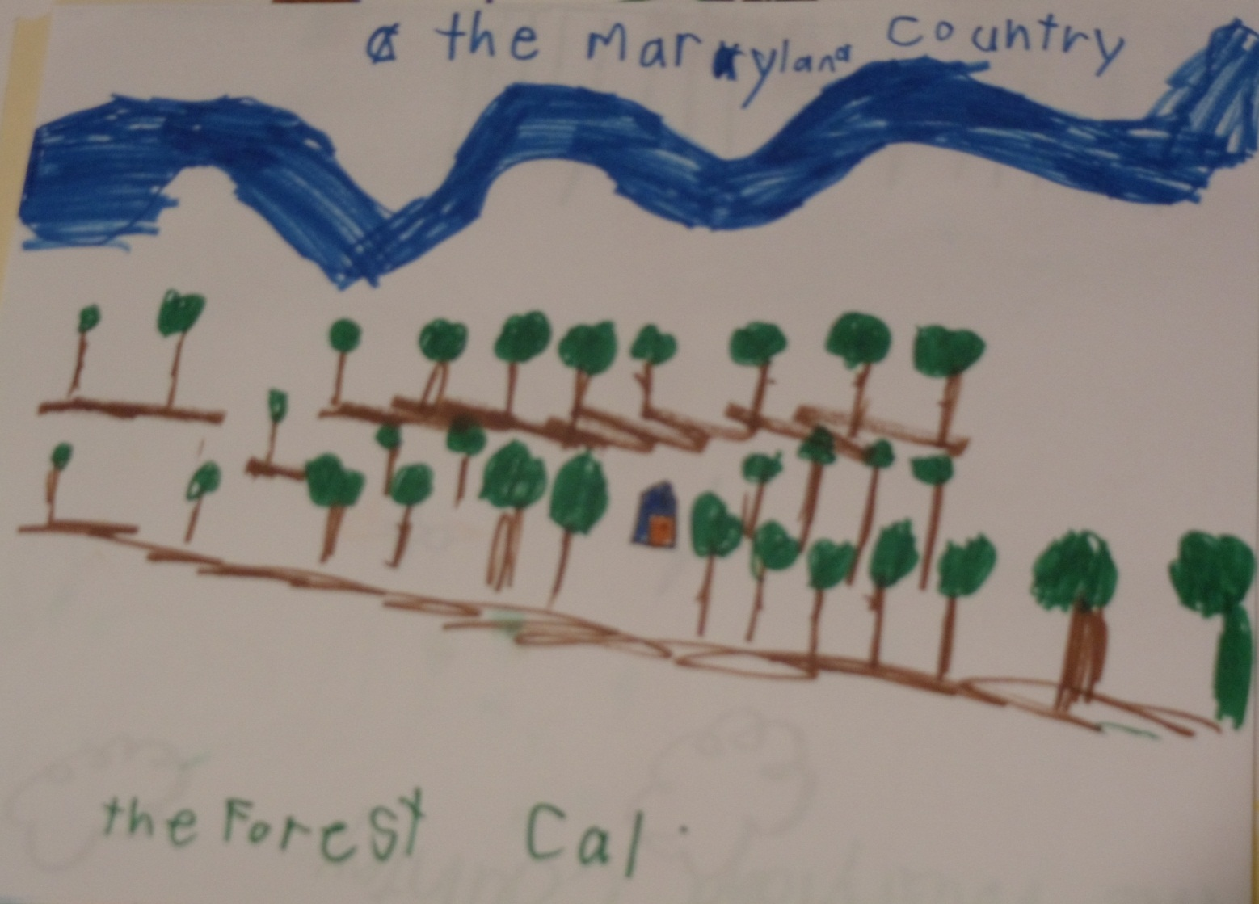
In the countryside we have many forests and rivers

Slide 13
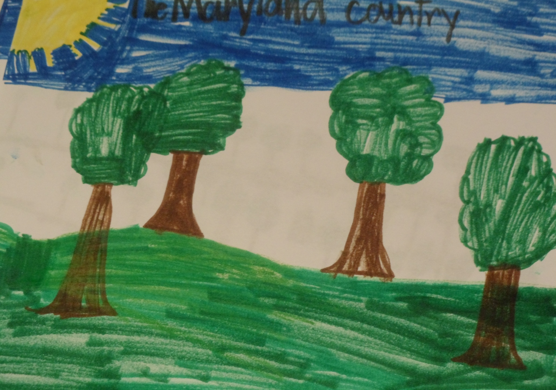

Slide 14
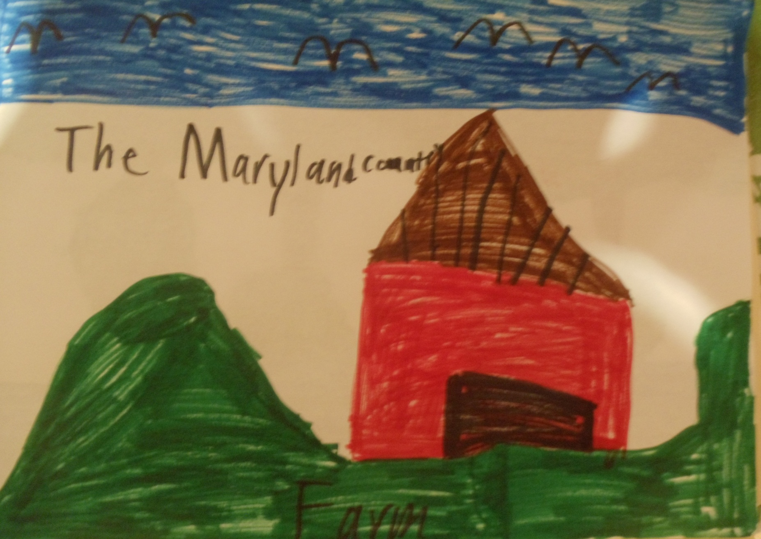
In the country we have many farms

Slide 15
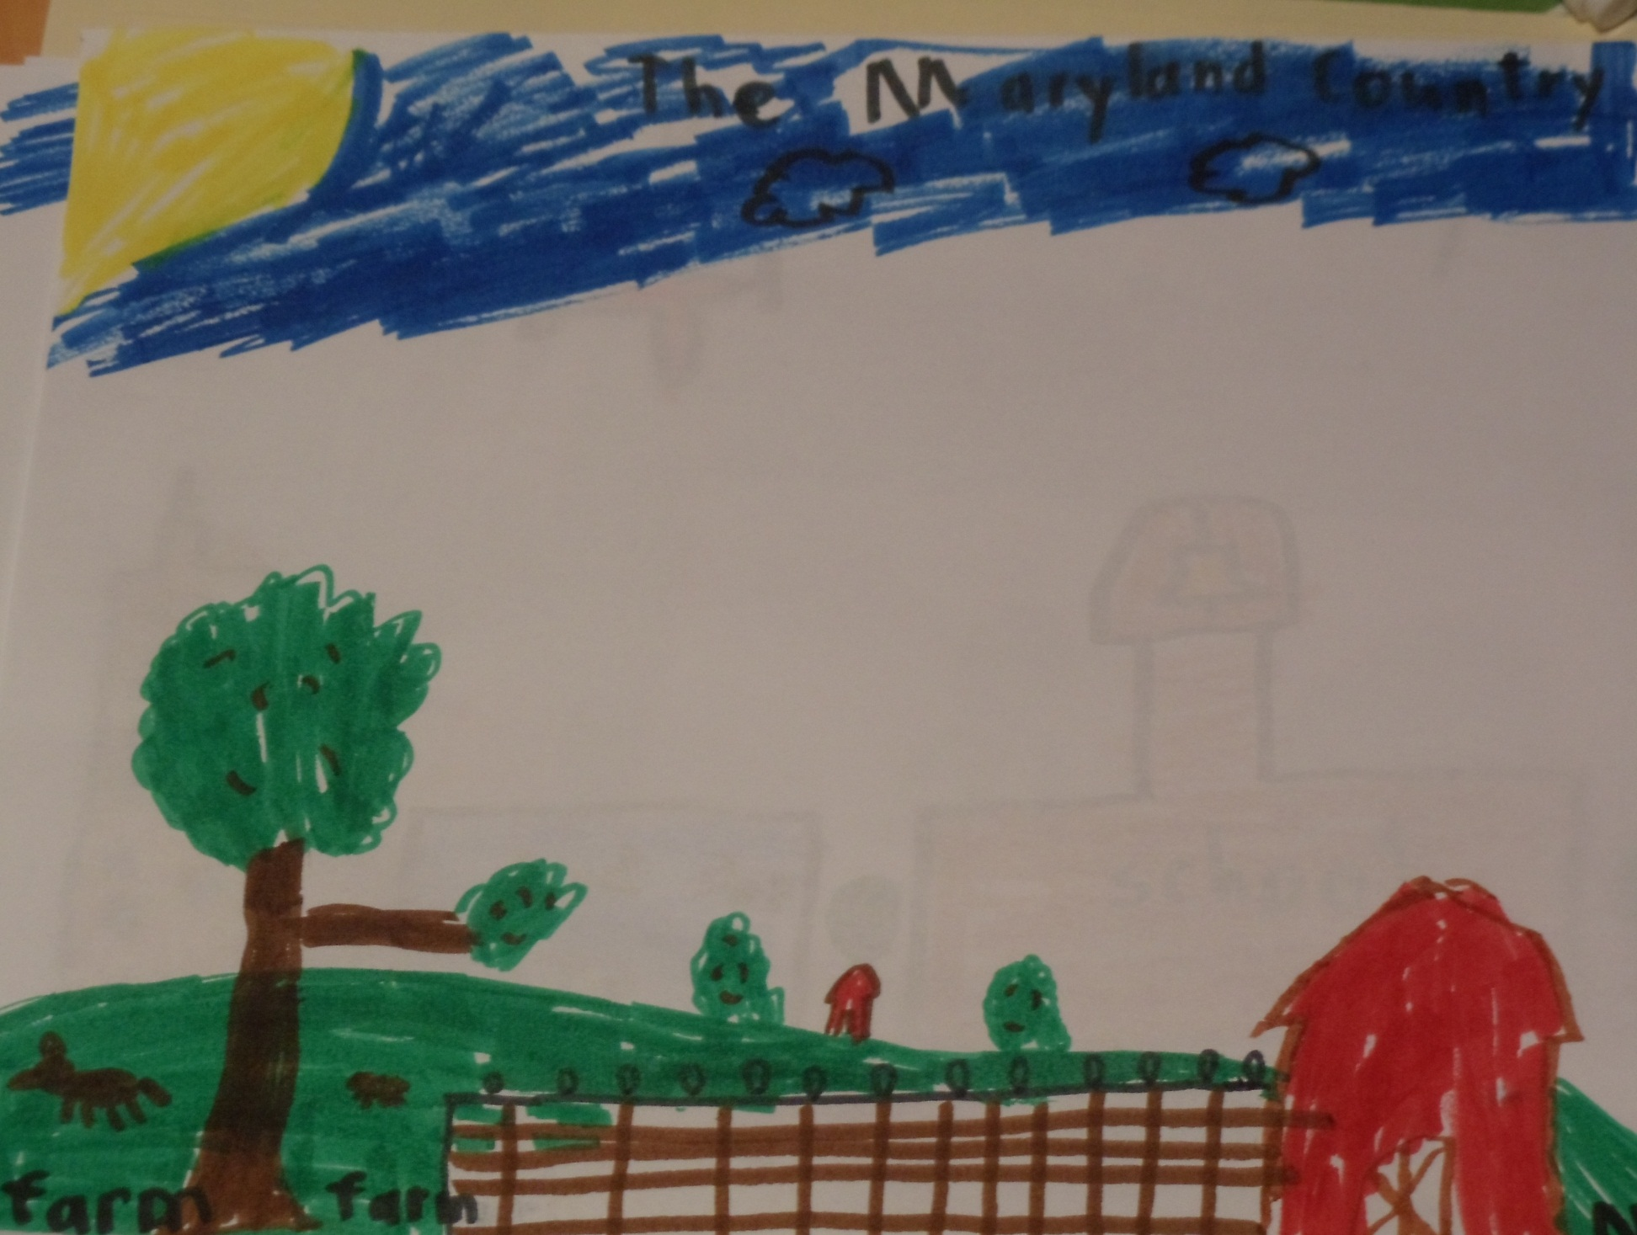

Slide 16
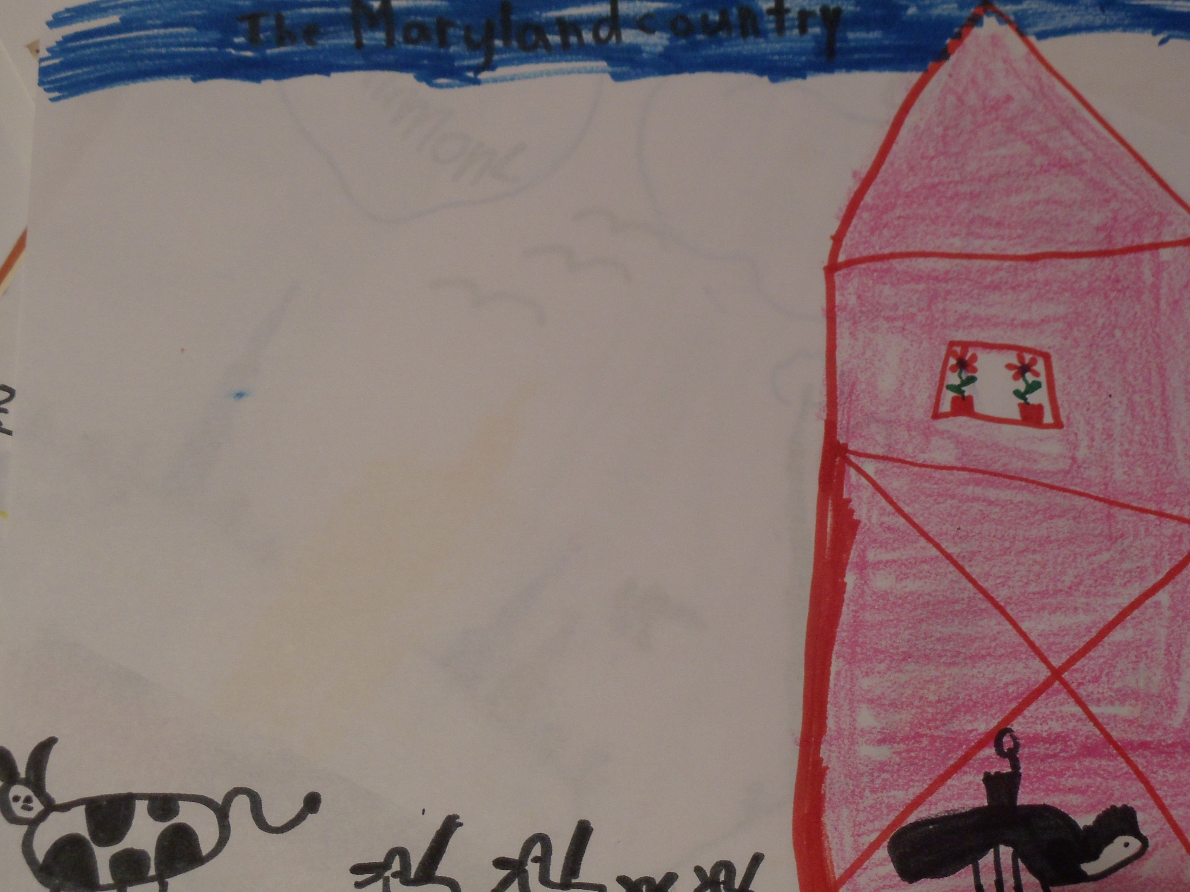

Slide 17
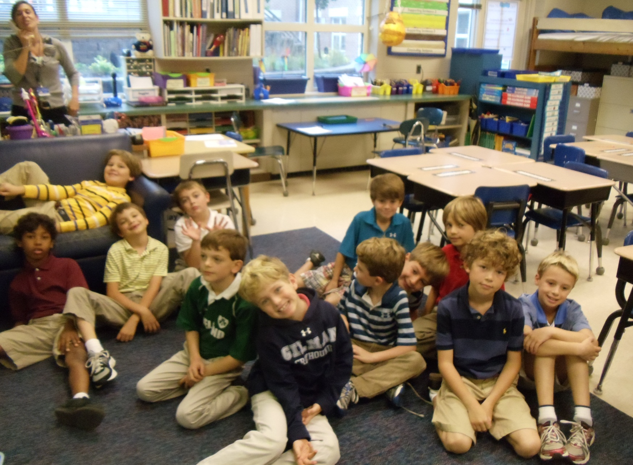
We hope you enjoyed getting to know our city and our countryside!

