Slide 1
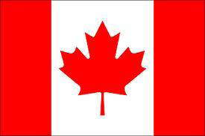
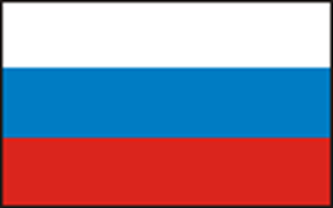
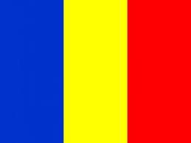
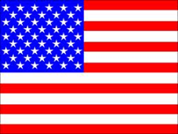
Differences between the city and the country: Canada, Romania, Russia, USA.
Learning with the word , not just about it ...
Learning Circles
2011-2012
Places & Perspectives: Elementary, Fall 2011 (PPE1)
Compiled by: Nadejda Salikhova School #10,Almetyevsk,Tatarstan,Russia

Slide 2
In the city of Saint John:
There are apartment buildings and condominiums.
There are hotels.
Go shopping at stores and eat at special restaurants.
Visit people.
Downtown Saint John
at night.

Slide 3
In the country surrounding Saint John
There are lots of trees.
We have lawns and lots of grass for playing outside.
Lots of houses and some farms with horses and cows.
The airport is across the road from our school.
Loch Lomond
Elementary School,
just outside of the
city of Saint John

Slide 4
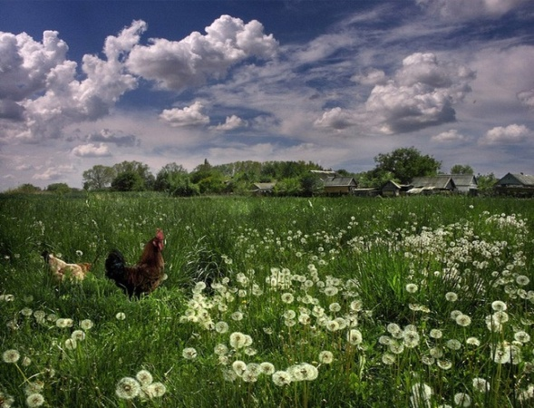
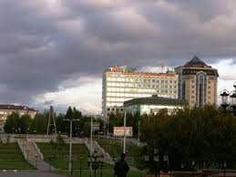
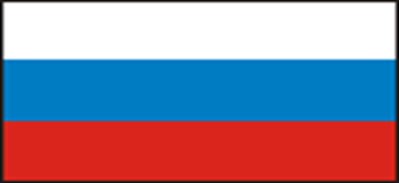
Differences between Almetyevsk city and Tatarstan villages

Slide 5
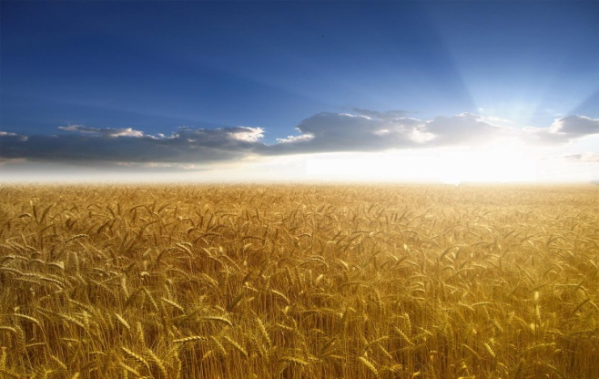
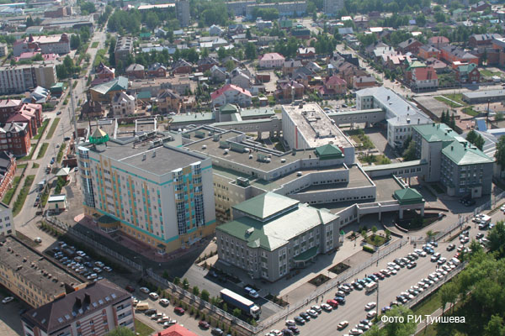
There are in village fields, in a city they aren't present

Slide 6
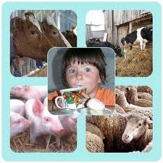
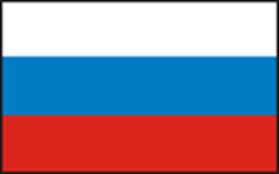
In villages are engaged in cattle breeding.In the city are parks, shops and tall buildings

Slide 7
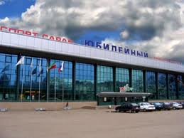
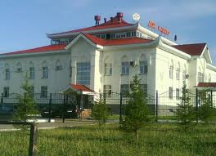
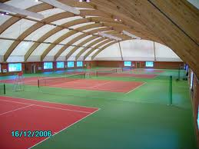
There are no unfortunately, modern sports complexes in the country.

Slide 8
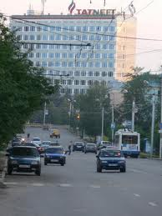
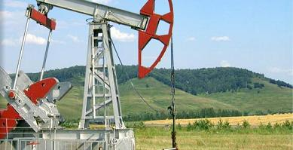
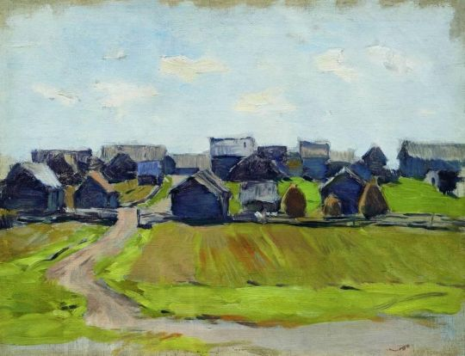
There are in our aria industrial enterprises in the country and in the city.

Slide 9
Differences being in the city and in the country in Romania
Class 2nd A, Coordinator teacher: Alina Theodorescu
"Carmen Sylva" School, Eforie Sud, România

Slide 10
In our class there are pupils who live in villages:
Diana in 23 August;
Roxana in Costineşti;
Bianca and Ender in Tuzla.
Others of us have grandparents at the village: Mihai, Ştefan, Irina, Costin, Mihnea-Nicolae, Liviu.

Slide 11
Differences village/ country - city:
Number of inhabitants;
Surface;
An occupation of the inhabitants is agriculture;
Infrastructure.

Slide 12
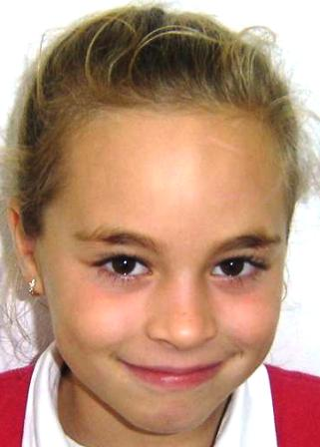
My name's Diana. I'm eight years old and I live in 23 August, a commune in Constanţa County, România, situated at the distance of twenty-five km of the town Eforie. The commune includes three villages: 23 August, Dulceşti, Moşneni.
My village is clean and quiet. The inhabitans are hardworking. Population by ethnicity is: 4 802 Romanians, 487 Tatars.
I love my village!

Slide 13
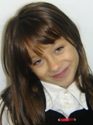
My name is Roxi (Roxana). I am eight years. I live in a small but a beautiful village and resort, Costineşti (Population: 2 536), located on the shore of the Black Sea, about 15 kilometres south of the Eforie Sud.
My adoptive parents are nice people. I love them. When I can, I play with my friends or go a trip with my family.
In summer a lot of students come in my village because there is a youth camp here. Here is the same as in Eforie Sud! It's very lovely, believe me!

Slide 14
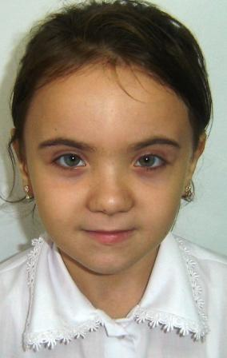
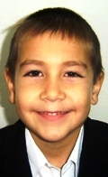
We are Bianca and Ender and we are eight years old.
We live in Tuzla, a village in Constanţa County, România. Its name means "salty" in Turkish. Its population is 6252.
Tuzla is a big, nice and clean village, on the shore of the Black Sea.

Slide 15
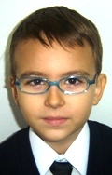
My name is Mihnea-Andrei. I live in Constanţa, but I learn in Eforie Sud, where my grandparents live.
Constanţa is one of the oldest cities in România, founded around 600 BC. The city is located on the Black Sea coast. It is the capital of Constanţa County and the largest city in the region.
The city of Constanţa is one of the most important in România. The Port of Constanţa is the largest port on the Black Sea and one of the largest ports in Europe.
In Constanţa there are living 8724 Tatars (2.8%).

Slide 16
The closest big City is Seattle
Seattle is the biggest city in Washington state. On a nice day you can see Mount Rainier in the background. There are lots of tall building. The most famous landmark in Seattle is the Space Needle. Seattle on a nice sunny day

Slide 17
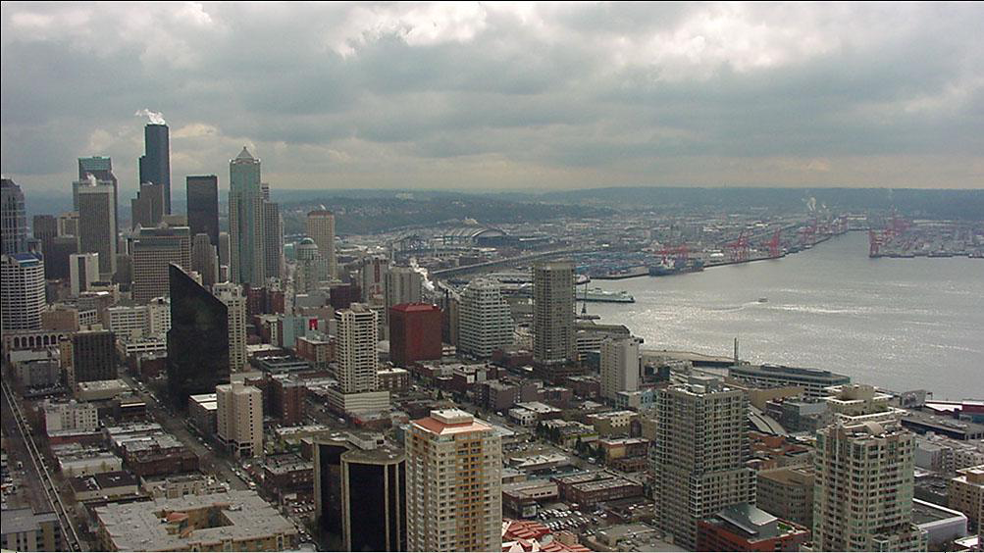
Most of the days it is cloudy and gray.
Seattle is a port and you can see boats and ferries

Slide 18
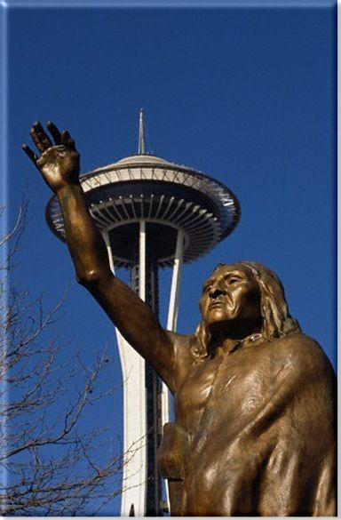
A little history of Seattle
Native American lived in the area long before the white settlers arrived in 1851.
Seattle got its name from Chief Sealth, Chief of the Duwamish/Suquamish Tribe.
The statue of Chief Sealth and the Space Needle next to each other symbolize the old and the new.
The Space Needle was built for the 1962 World’s fair, a big exposition that brought many people around the world to Seattle

Slide 19
The class talked about what we can find in Seattle
•Lots of tall buildings
•Streets with lots of cars
•Museums
•Space Needle
•Lots of shops and Cafes
•Waterfront has some shops and Ferries
•Big port and industries

Slide 20
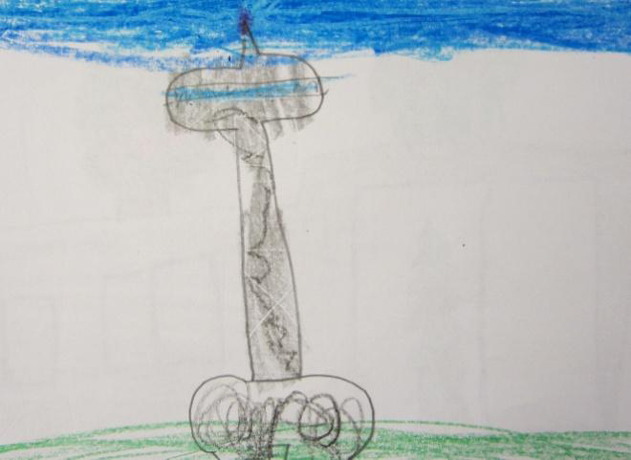
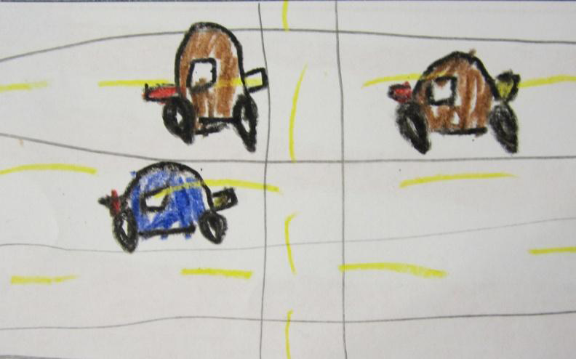
In Seattle I can see

Slide 21
In the Washington Countryside we can see
•Barns and fields
•Animals: Horses, cows, sheep
•Pumpkin patches
•Berries and vegetables
•Mountains and Lakes
•Many trees: trees with needles and trees with leaves

Slide 22
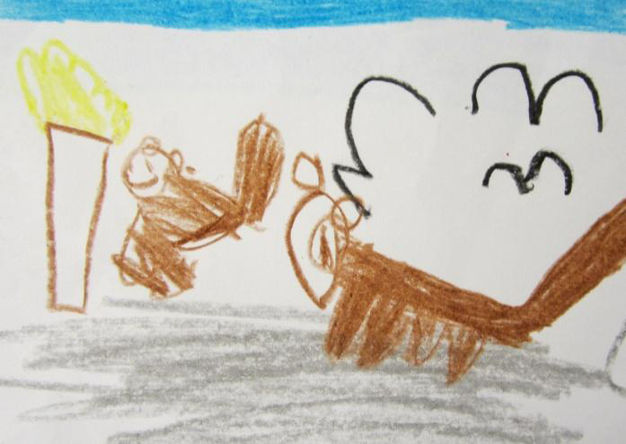
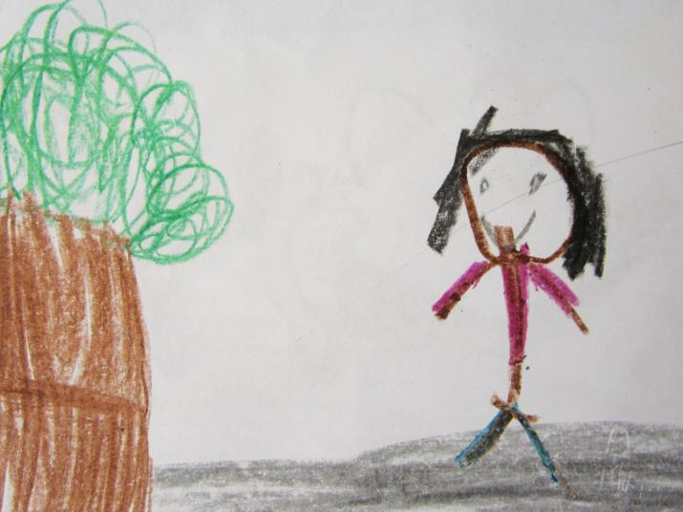
In the country I can see

Slide 23
Thank you for sharing your work. We learned a lot! Thank you to everyone for the wonderful projects that you sent to us. We loved them and we learned a lot about you, and your countries. We wish you happiness, love, health and peace.
Christine Kolstoe & Kelly Kerani & Joyce Bonney
Lisa Gross & Megan Etherton & Amy Mobile
Cecilia Eppler & Erica Hudson & Margaret Olgeirson
Tiffany Crealock
Nadejda Salikhova
Alina Theodorescu
~ teachers of PPE1 and their students,
Fall, 2011

