Slide 1
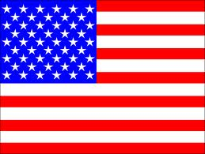
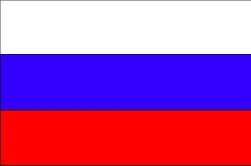
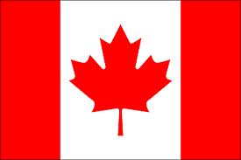
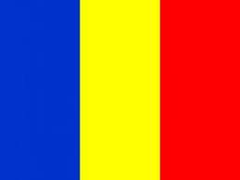
International Project Flags and National Symbols
iEARN
(International Education and Research Network)
Places & Perspectives: Elementary, Fall 2011 (PPE1)
Compiled by: Cecilia Eppler, Erica Hudson and Margaret Olgeirson
Gilman School, Baltimore, Maryland, USA.

Slide 2
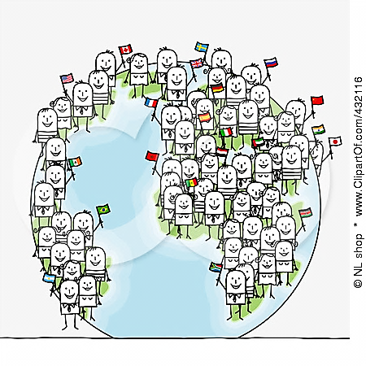
The goal of our project:
To understand the symbolism of a flag and what it represents for the people that choose it.

Slide 3
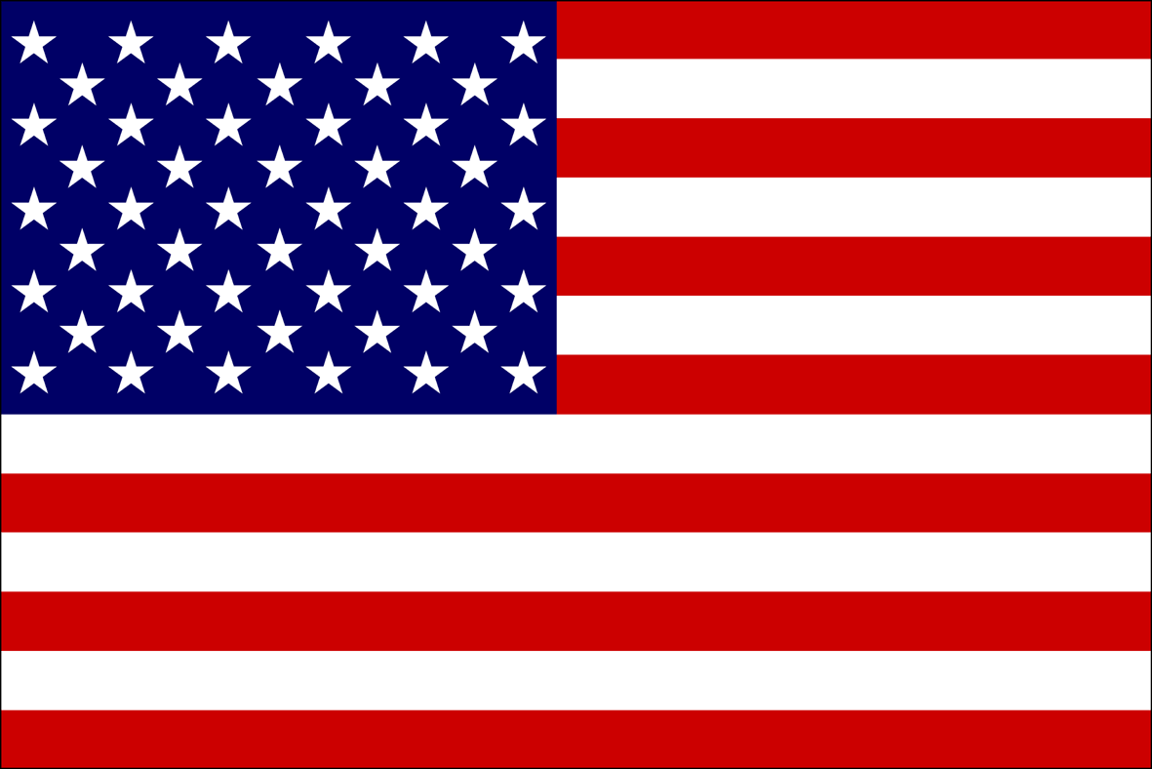
This is the flag of the United States of America
The stripes represent the 13 original colonies.
The 50 stars represent the number of states.
Red symbolizes hardiness and valor.
White symbolizes purity and innocence.
Blue represents vigilance, perseverance and justice

Slide 4
Interesting facts about our flag
The national anthem of the United States of America was written by Mr. Francis Scott Key, whose poem was inspired by the prevailing presence of the American Flag, flying over Fort McHenry, in Baltimore, Maryland, after the Battle of 1812 against British forces. Mr. Scott Key was in a British ship that overlooked the Fort, when the battle started. As the night turned into dawn, he could not wait to see which flag was displayed at the Fort. If the American flag was there, that meant that the British had been defeated. As daylight approached, Francis Scott Key could see that the American flag was still displayed at the Fort. He was so overcome by emotion that he wrote the poem that we know as the Star Spangled Banner, the national anthem of the United States of America. An interesting fact is that this is one of the few national anthems in the world that is dedicated to a flag.

Slide 5
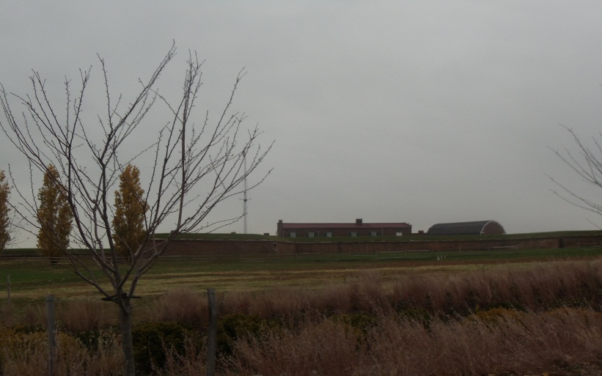
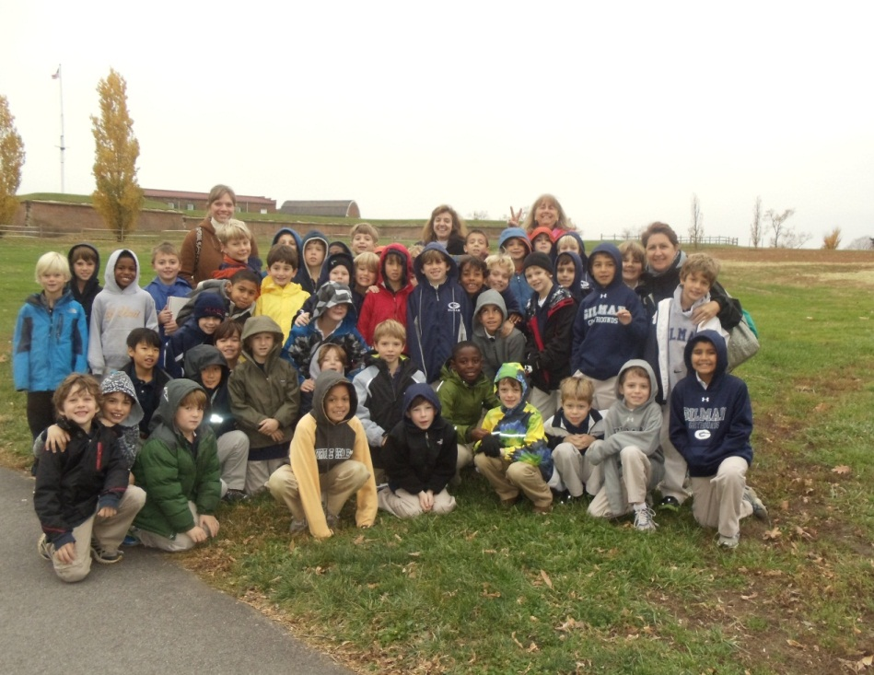
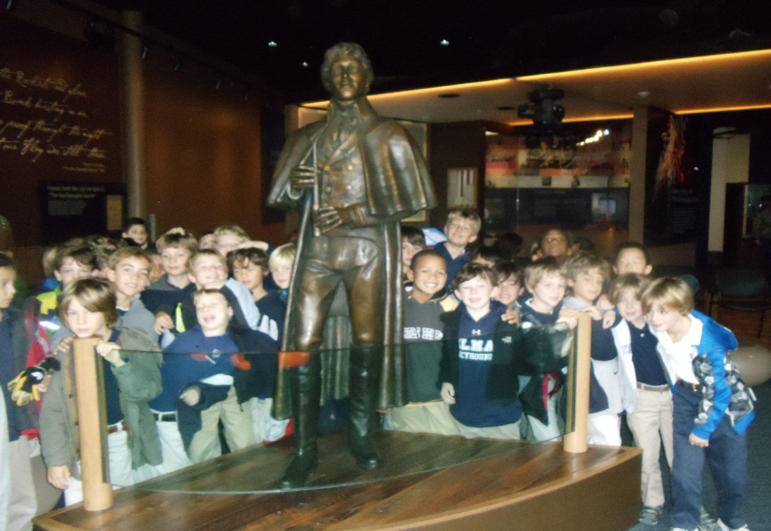
Our Second Grade Students traveled to historical
Fort McHenry
We visited the fort, and had a chance to unfold the flag that will fly at the fort. It was a cold and cloudy day, but we all had a lot of fun.
Mr. Francis Scott Key

Slide 6
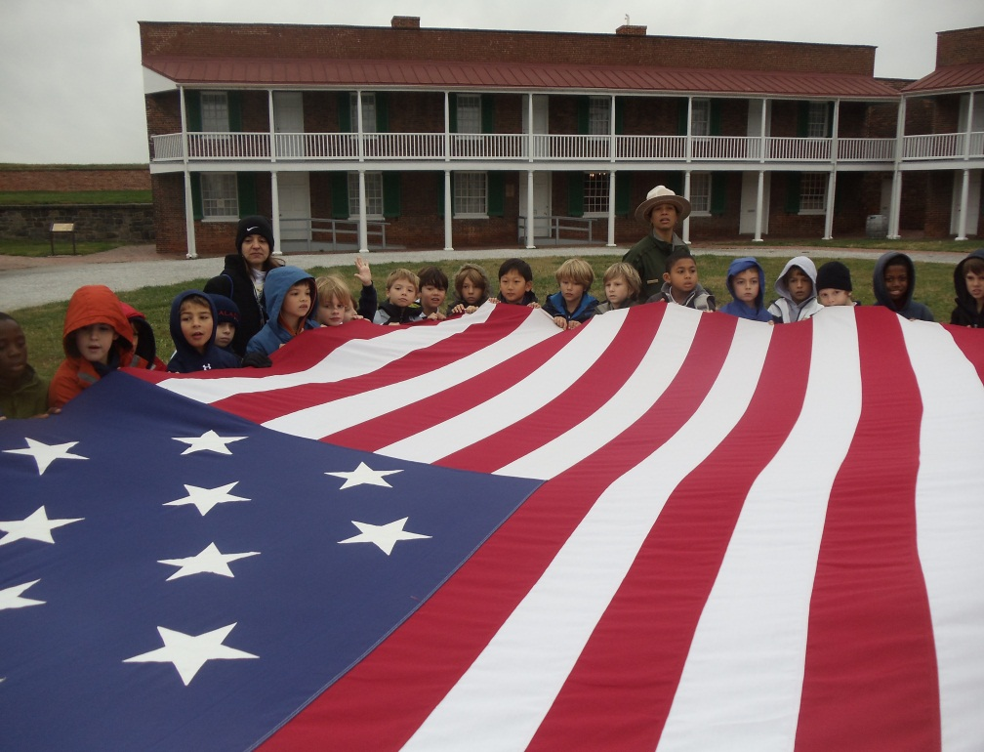
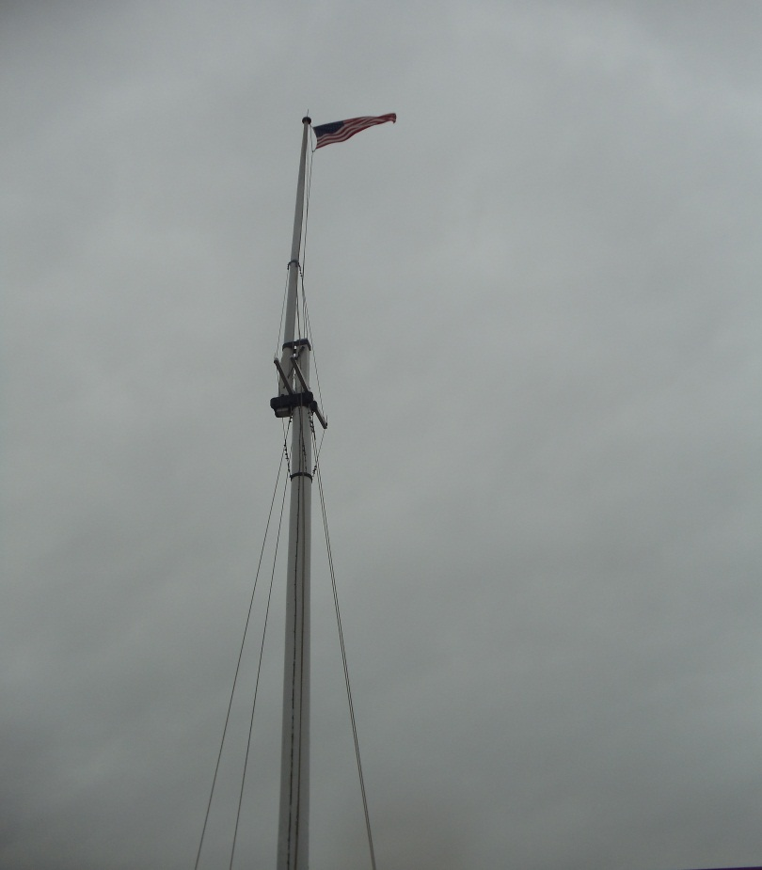
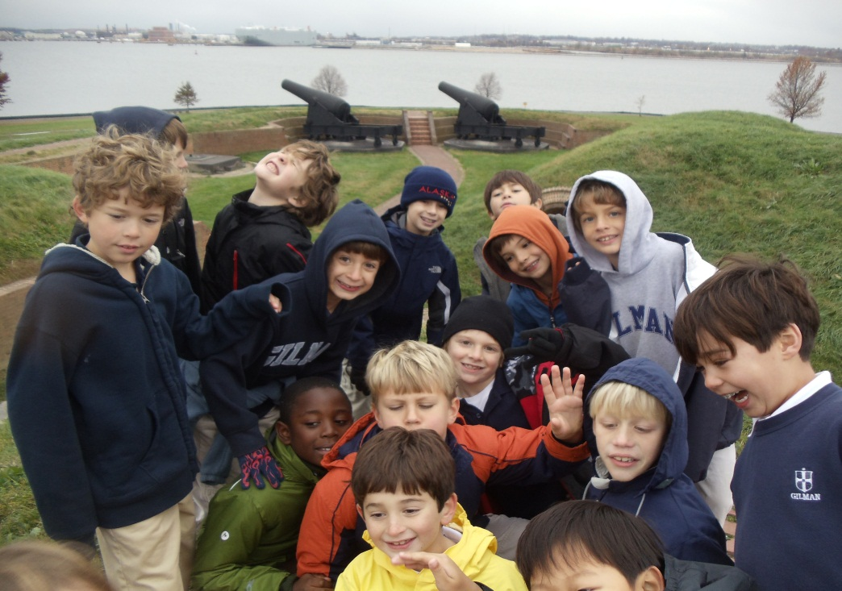
We unfolded the flag. It was huge!
The flag at Fort McHenry

Slide 7
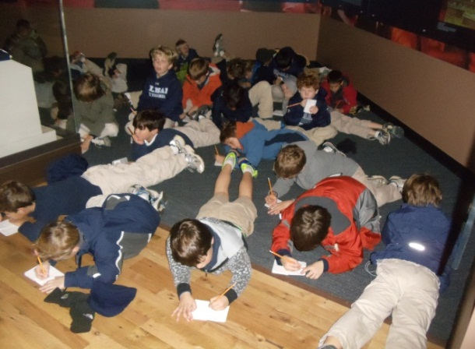
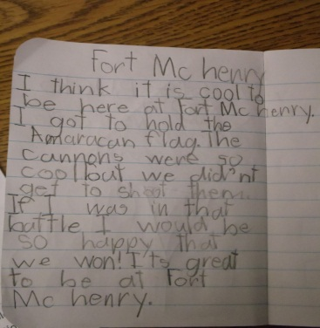
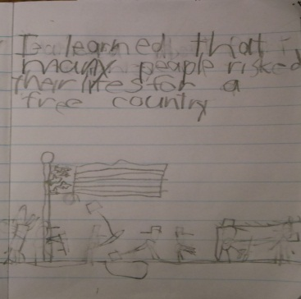
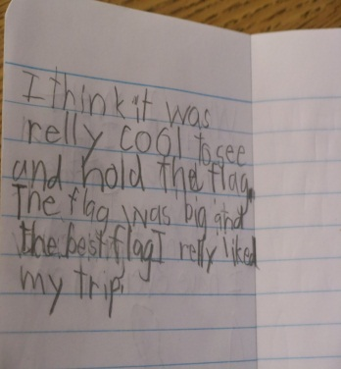
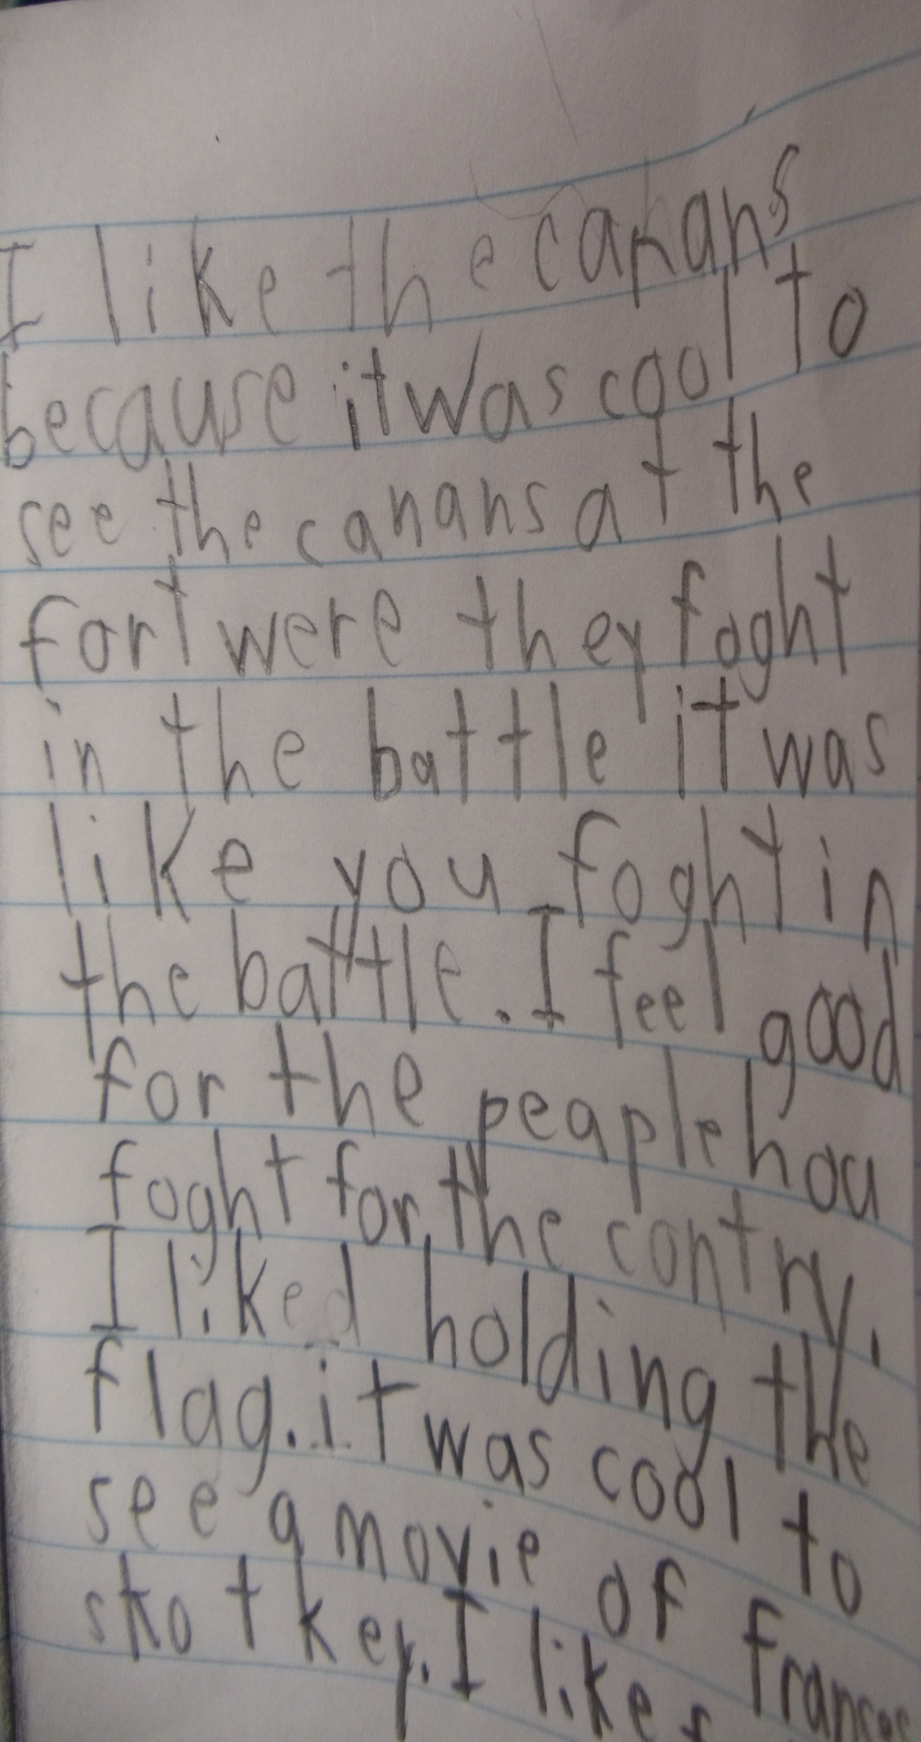
Our students reflected on their feelings while at the Fort. They wrote their feelings in their journals.

Slide 8
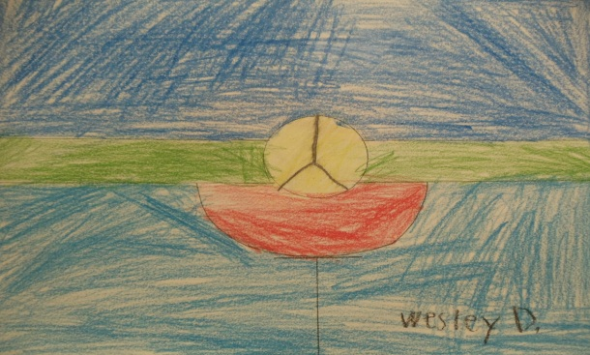
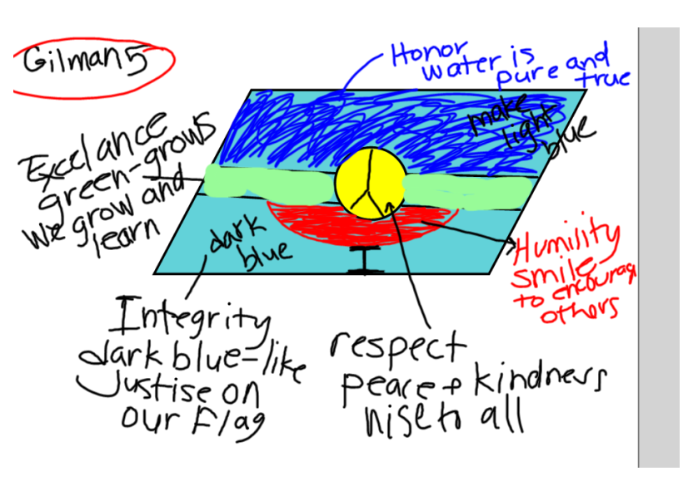
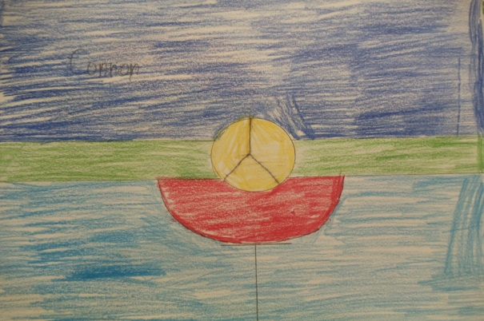
The students created a class flag that would represent all of them
Gilman’s 2B flag is colorful and awesome. Our flag represents the “Gilman Five”. In our school we call the Gilman Five: Respect, honor, humility, excellence and courage. Peace is important in our country so the yellow circle in our flag reminds us to treat others with respect. Humility is represented by the red smile. It is important to compliment others with a smile. The light blue color stands for honor. It looks like fresh pure water and reminds us to be true. Integrity is the dark blue, just like our American flag with the white in the middle. It is important to always be yourself. Growth symbolizes excellence and always trying your hardest. Green represents growing in as many ways as we can. We try to live by the “Gilman five” each day at home and in school.
This was our rough draft

Slide 9
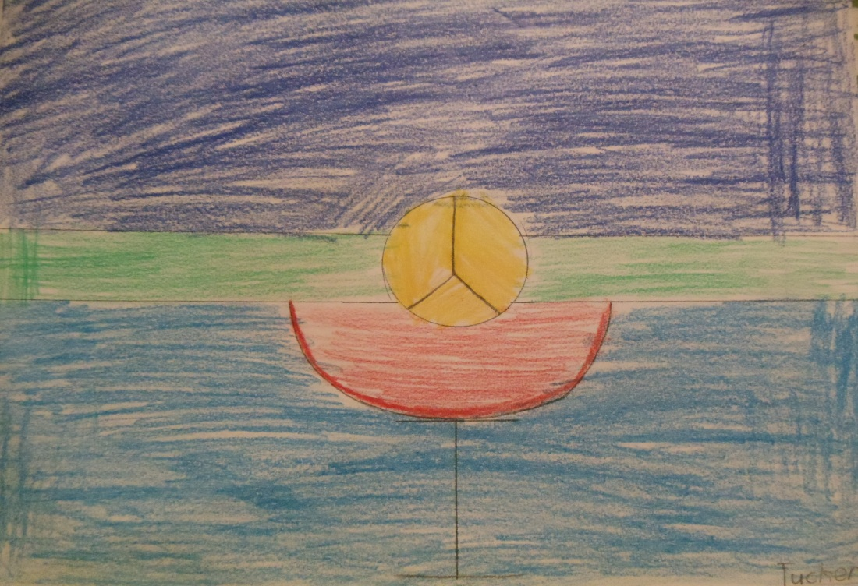
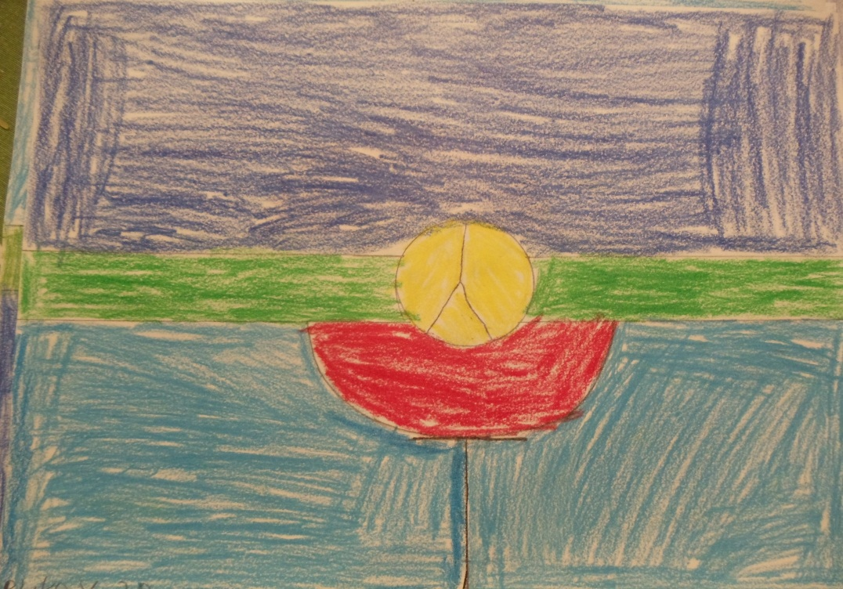
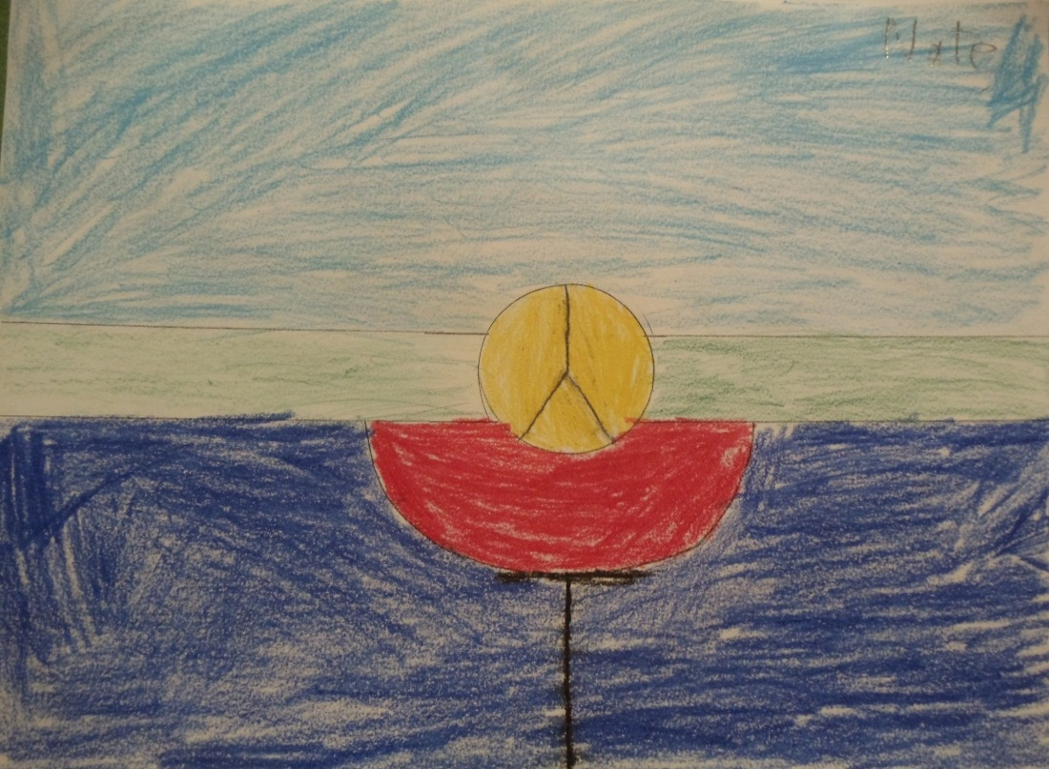
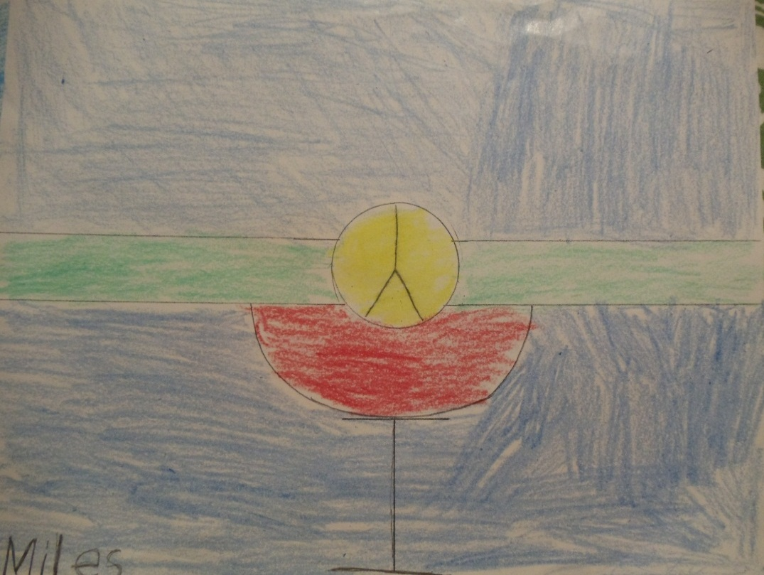
We drew and colored our class flags

Slide 10
Mrs. Crealock’s Kindergarten
Loch Lomond Elementary School
Saint John, New Brunswick, Canada
2011
Symbols of the Canadian Flag
The maple leaf has been a symbol of Canada since the 18th century. The flag contains a stylized 11 point red maple leaf in the center of the flag.
Throughout history, red and white are found as the colors of France or of England – both countries are significant in Canada’s heritage.
Red and white were approved as Canada's official colors in the proclamation of the royal arms of Canada in 1921 by King George V.

Slide 11
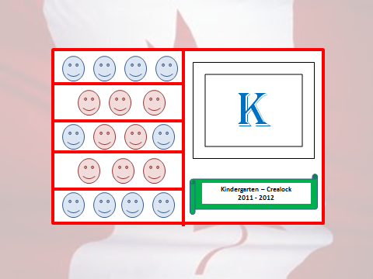
Mrs. Crealock’s class flag
There are 5 rows of students because most of the children are 5 years old.
There are 10 blue faces representing the 10 boys in our class and 8 pink faces representing the 8 girls.
Our flag is outlined in red with a white background to represent our Canadian colours.
The “K” stands for our grade, kindergarten.
The K is in blue representing the French heritage of some of our students (the Acadian flag is red, white and blue with one yellow star).
The banner under the letter K identifies our class within the school and the green symbolizes how our class tries to be “green” by participating in recycling at our school.

Slide 12
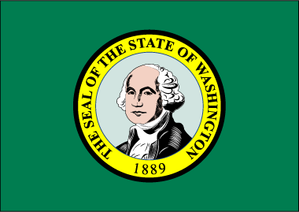
Washington State Flag
Lynnwood Elementary
4th Grade students
Washington State, USA
Fall 2011
The state flag is green with the state seal in the middle. The state is named after our first president George Washington. According to law, “the flag of the United States and the flag of the state shall be prominently installed, displayed and maintained in schools, court rooms and state buildings.” For further information about the state flag, check the Secretary of State's web site.

Slide 13
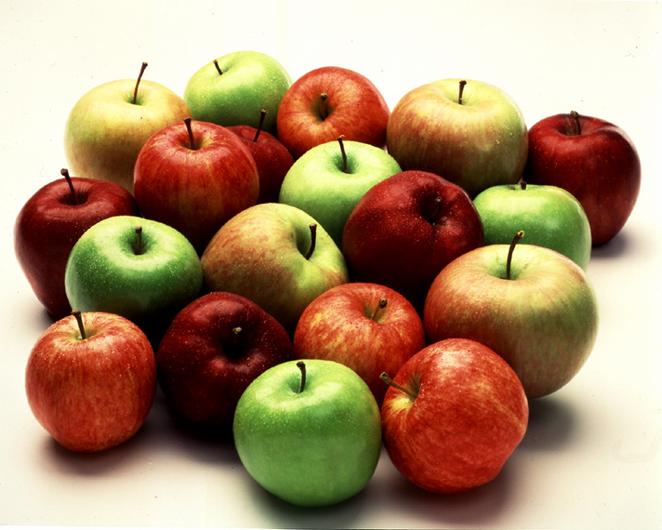
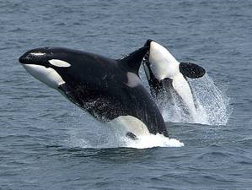
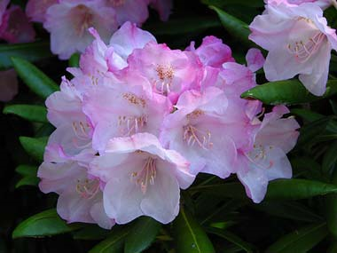
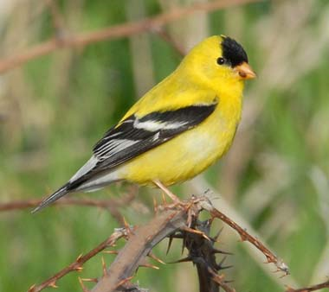
Our class flag represents our region
Lynnwood Elementary
4th Grade students
Washington State, USA
We live in a beautiful region with a variety of plants and animals,
Native Americans have been living here for a very long time even before the white men came.
Many students were involved in drawing this flag. We feel it is a good representation of what is found in our region.

Slide 14
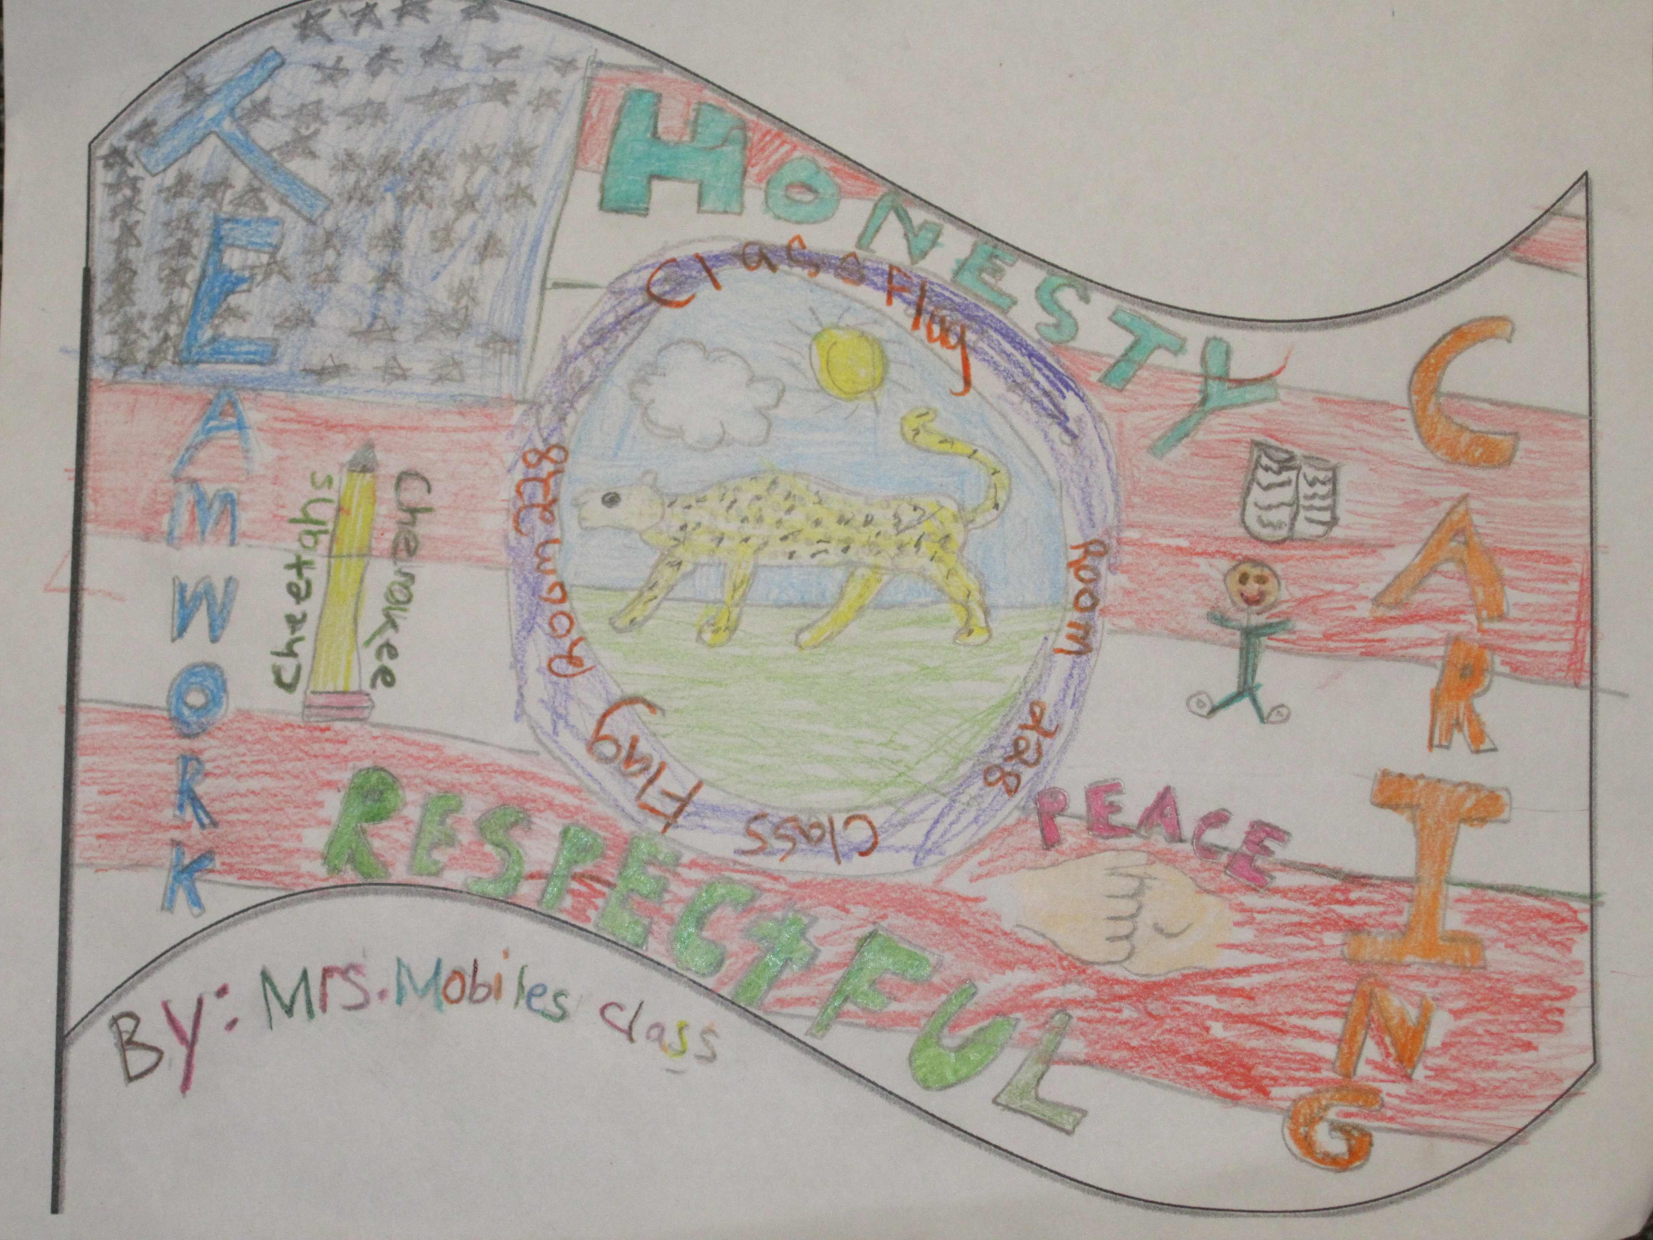
Mrs. Mobile’s 4th Grade Class
Cherokee Elementary School
Lake Forest, Illinois USA
The main background of our class flag includes red and white stripes along with blue stars. This represent that we are American and proud of our country
The pencil represents what great writers we are and how much we enjoy writing
The book represents how much we enjoy reading on our own and in class
The hands shaking represents that we are nice and caring to others
The cheetah represents our school Cherokee, as it is our mascot

Slide 15
Mrs. Mobile Class Flag
The last part of our class flag are words that represent us!
Teamwork-We work well with each other and listen to each other
Honesty- We are honest with one another and our teachers
Respectful- We are respectful of others’ feelings and ideas
Caring- We care for each other and make sure everyone is happy

Slide 16
Class 2nd A, Coordinator
teacher: Alina Theodorescu
"Carmen Sylva" School, Eforie Sud, România

Slide 17
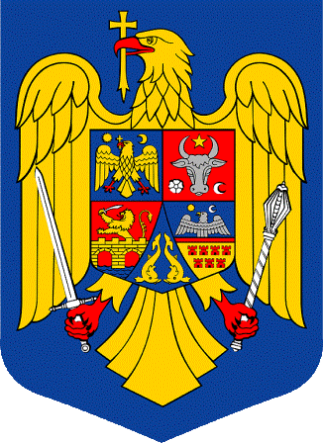
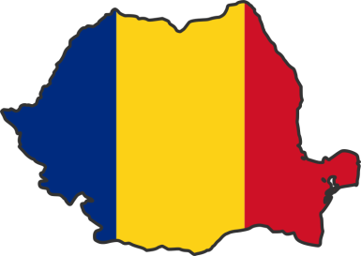
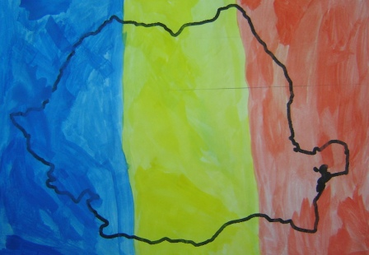
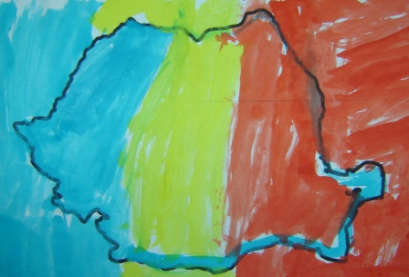
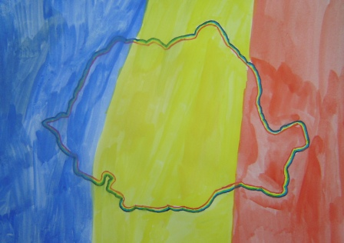
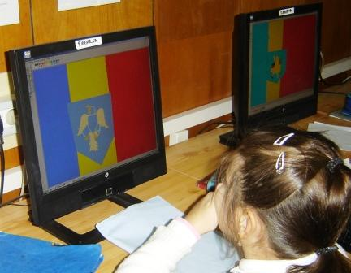
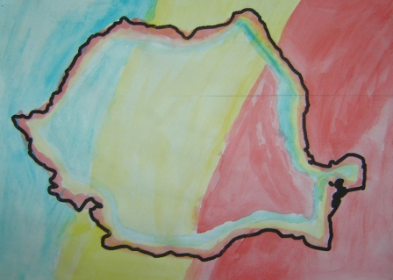
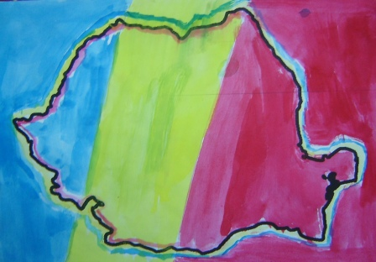
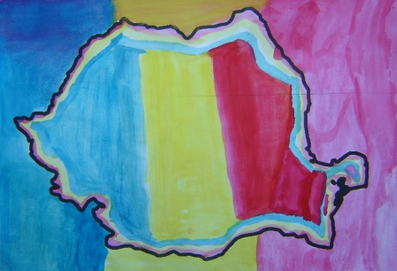
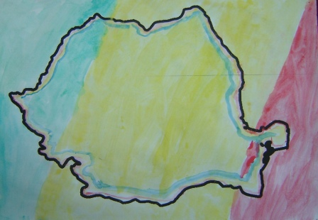
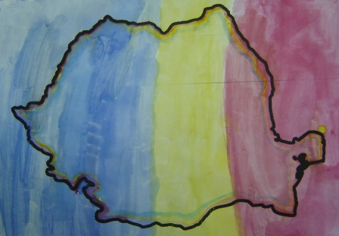
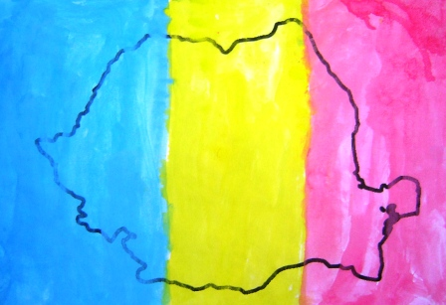
Flag and Coat of arms of România
We read stories about the flag of our ancestors, the Dacians, about today's flag of România. We have learned patriotic poems, we painted, we drew ...

Slide 18
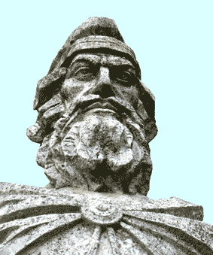
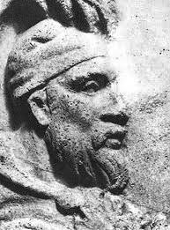
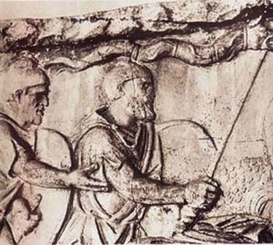
Our ancestors were the Dacians and Romans. The most important Dacian kings were Burebista and Decebal.
Dacian flag was a wolf's head. The wolf, a symbol of intelligence, justice and disobedience, occurs very often in life Dacians. They used the heads of wolves and snakes to battle flags, amplifying the sound produced while running sound resonance.
Burebista
Decebal

Slide 19
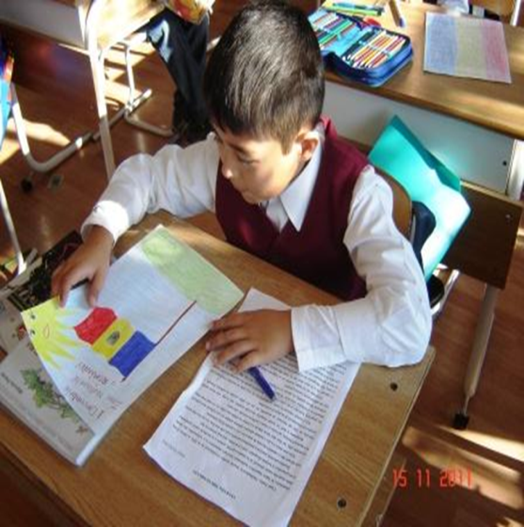
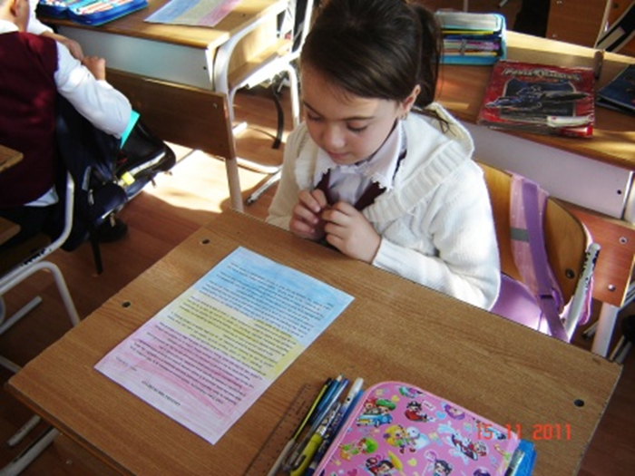
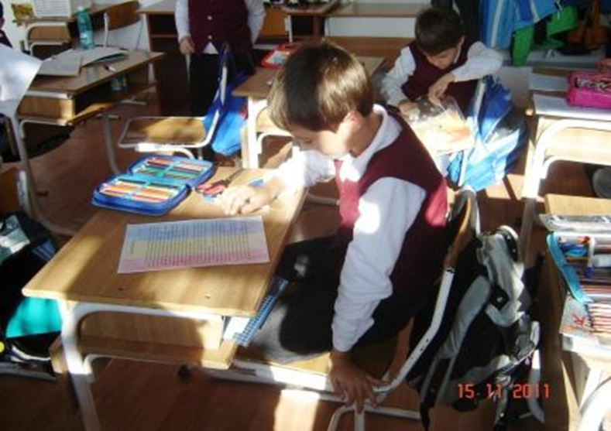
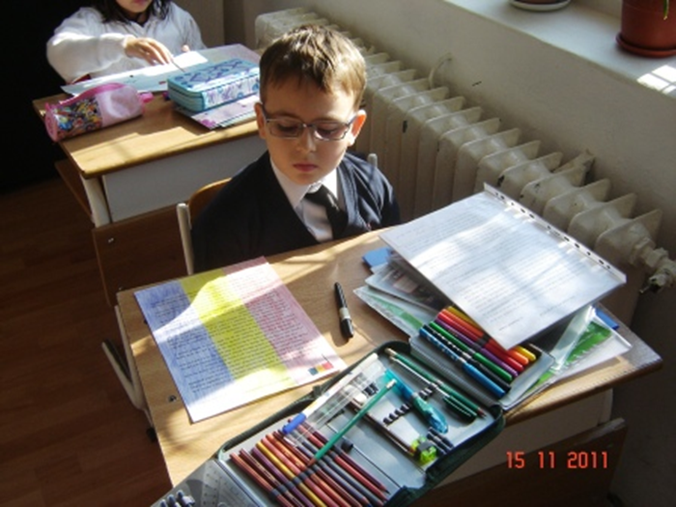

Slide 26
Nadejda P. Salikhova
School #10
Almetyevsk, Tatarstan ,Russia
Russian Flag
In ancient times the colors had specific meanings:
White meant nobility and honesty;
Blue meant fidelity, honesty, purity and chastity;
Red - meant courage, generosity and love.

Slide 27
Another interpretation of these colors is that white is a symbol of the Orthodox Faith; blue is a symbol of the royal power, and red is the symbol of the Russian people.

Slide 28
State Flag of the republic of Tatarstan
The state flag of the Republic of Tatarstan is rectangular with horizontal green, white and red stripes.
Green means spring, rebirth.
White is the color of purity
Red means maturity, energy, power, and life.

Slide 29
The state emblem of the Republic of Tatarstan
represents the image of a winged snow leopard with a round shield on its side, with a raised right forepaw on the background of the solar disk, placed in the framing of the Tatar national ornament, at the bottom of which there is the inscription “Republic of Tatarstan", the wings consist of seven feathers, socket on the shield consists of eight petals.
The Coat of Arms of the Republic of Tatarstan is made using the colors of the flag of Tatarstan and it has a round shape.

Slide 30
Emblem continued….
The central image of the coat of arms – the winged leopard, in ancient times was the deity of fertility, and the patron saint of children. In the coat of arms of the Republic of Tatarstan the leopard is the protector of citizens of the republic and its people. The leopard is depicted on the background of a red disk of the sun. The sun in ancient times, the main deity of many nations. The red sun on the emblem of Tatarstan means good sign, success, happiness, and life. On the left side of the leopard – a round shield, meaning the legal, economic and power security of the citizens of the Republic of Tatarstan. In a color image of the State Emblem of the Republic of Tatarstan the sun is red, a leopard, his wings and outlet on the shield - white-frame - green, shield, the ornament on the frame and the inscription "republic of Tatarstan" - golden color. Flower asters with an even number of petals symbolize the eternal source of life, longevity, the wish of longevity. Raised right front paw of the leopard - this is the traditional heraldic gesture that emphasizes a good beginning of the movement of Tatarstan on the path of renewal.

Slide 31
The sharp teeth and claws of a leopard mean its ability to stand up for itself and for those whom he befriends, whom he protects. Seven feathers of the wings of the leopard symbolize the space of the impact of покровительствующей force leopard - and on earth and in heaven.
The position of the leopard’s tail means good mood and friendliness. Popular Tatar plant ornament and the tulip flower represent nature’s spring awakening and the revival of Tatarstan. Three golden circles cover the coat of arms on three levels. They express the idea of unity, infinity and the highest perfection .
Symbolic meanings of colors:
- Gold: grace, beauty, wealth, land of Tatarstan;
- Green : greens of spring, the revival of Tatarstan;
- White :purity of thoughts citizens of Tatarstan;
- Red : maturity, energy, power, life, vitality of Tatarstan;
The emblem of the Republic of Tatarstan claims such universal, moral values, like kindness, justice and prosperity of its citizens, friendship among people, peace, and progress.

Slide 32
Student work

Slide 33
Student’s work by
Eldar Davletshin and Kamil Galiev
The sun - is our teacher, our school, our Native land, our family, our city.
The Rays - are the students. Boys and girls of our class.

Slide 34
Thank you to everyone for the wonderful projects that you sent to us. We loved the flags, and we learned a lot about you, and your countries and states. We wish you a wonderful New Year, filled with happiness, love, health and peace.
Happy New Year!

