Slide 1
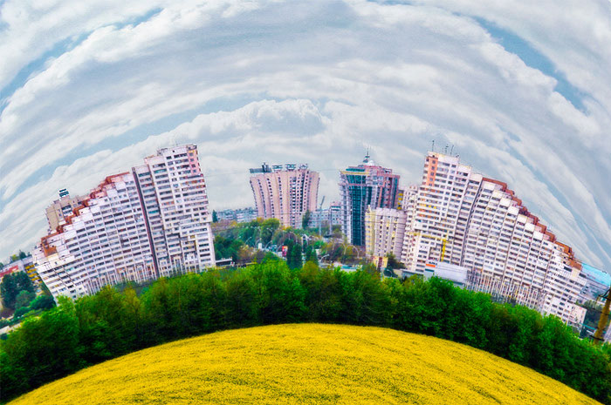
FUNNY PLACES IN CHISINAU
MADE BY ACCESS-CHISINAU

Slide 2
City Hall- a funny place where city laws are created…

Slide 3
CIRCUS-the place of joy and fun…

Slide 4
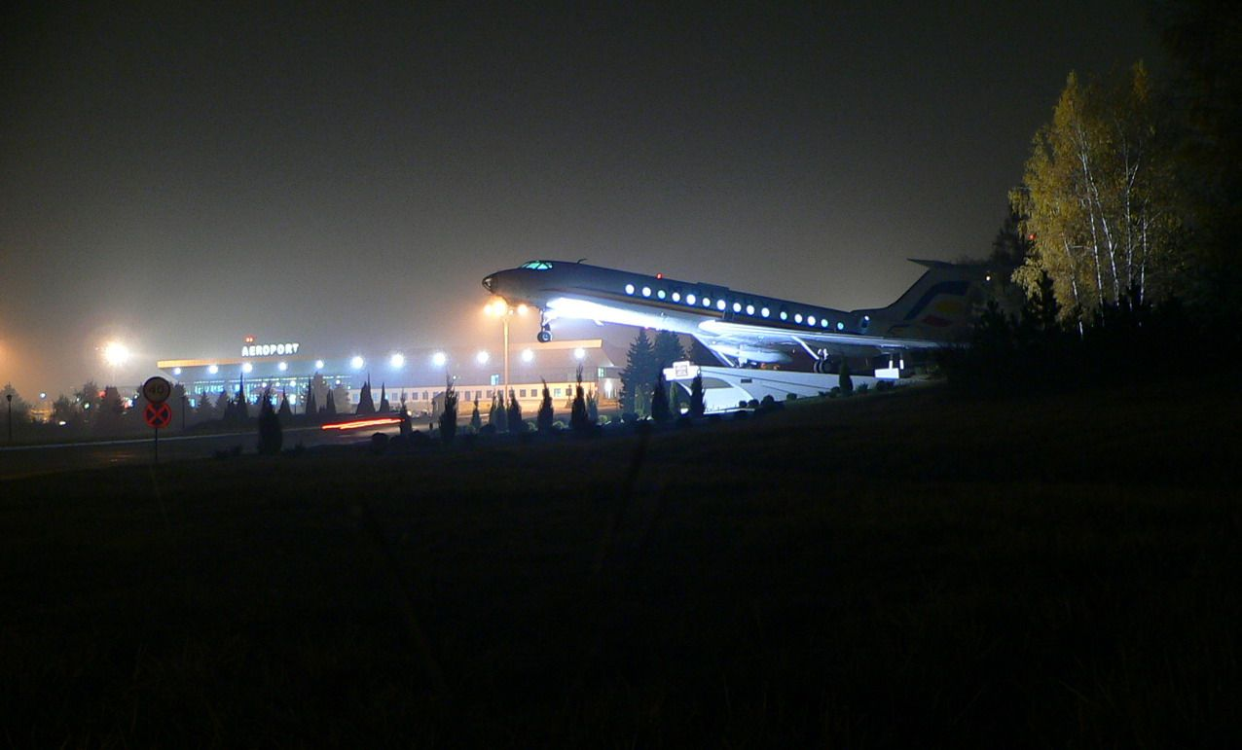
FUNNY WAY to admire AIRPORT at NIGHT

Slide 5
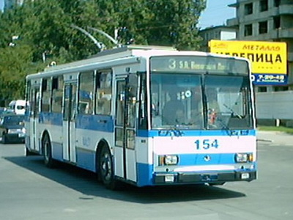
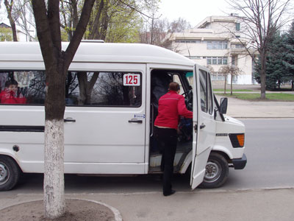
THE FUNNIEST MEANS OF TRANSPORT

Slide 6
SATIRICUS THEATRE “I.L. Carageale’

Slide 7
FUNNY AND MISTERIOUS PIECE OF NATURE

Slide 8
FUNNY WAY TO PRACTICE SPORT… VELO HORA, 2009

Slide 9
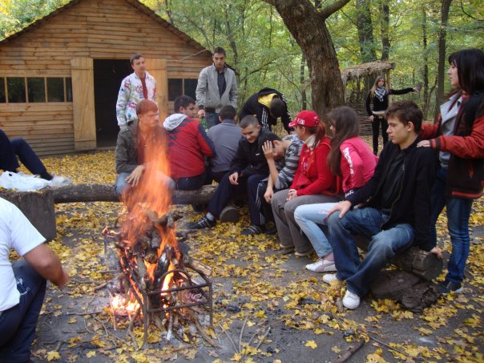
IN THE MIDDLE OF NATURE…

Slide 10
ENJOYING TIME AT MAXIMUM...

Slide 11
WE LIKE PARTIES…

Slide 12
WE FIND BEAUTY IN ALL AROUND…

Slide 13
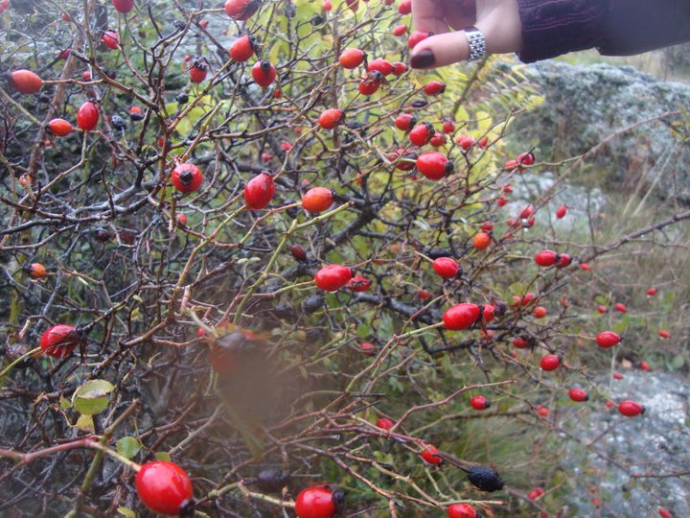
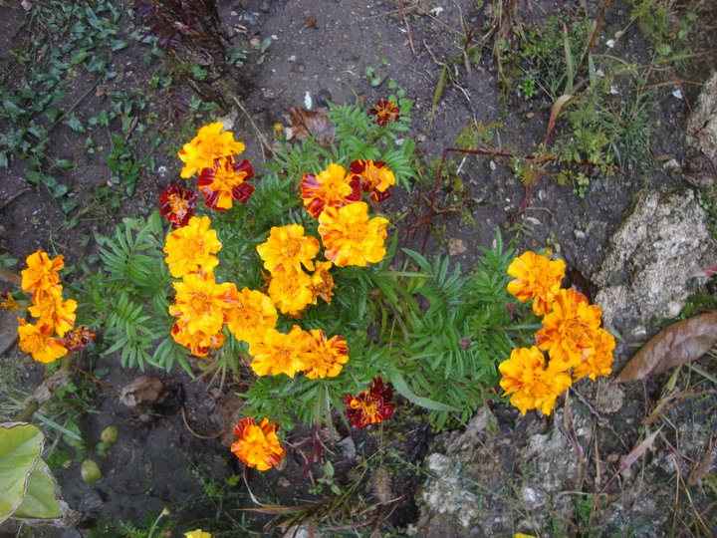
LAST CALL OF COLORFUL AUTUMN…

