Slide 1
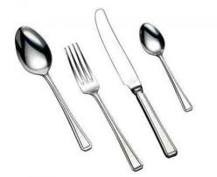
International Celebration Cookbook
iEARN (International Education and Research Network)
Places & Perspectives: Elementary, Fall 2011 (PPE1)
Compiled by:
Mrs. Crealock, Saint John, New Brunswick, Canada

Slide 2
Goal of project: Celebration Cookbook
To have students learn about foods and celebrations of children around the world.
United States
of America
Canada
Russia
Romania

Slide 3
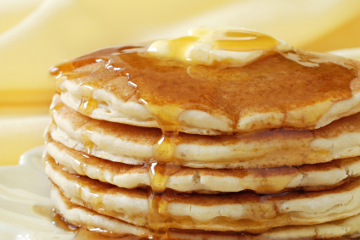
The U. S. A. - Pancakes
Submitted by:
Gilman School -
Baltimore, Maryland
In the USA pancakes are a very popular dish. Most people like to have them for breakfast, but some people like to have them for lunch or dinner. They are served hot, with a little butter, and maple syrup.

Slide 4
Pancake recipe
Ingredients
1 1/2 cups all-purpose flour
3 1/2 teaspoons baking powder
1 teaspoon salt
1 tablespoon white sugar
1 1/4 cups milk
1 egg
3 tablespoons butter, melted
Directions
In a large bowl, sift together the flour, baking powder, salt and sugar. Make a well in the center and pour in the milk, egg and melted butter; mix until smooth.
Heat a lightly oiled griddle or frying pan over medium high heat. Pour or scoop the batter onto the griddle, using approximately 1/4 cup for each pancake. Brown on both sides and serve hot.

Slide 5
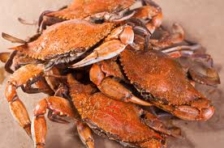
U.S.A. - MARYLAND CRAB SOUP
Submitted by:
Gilman School -
Baltimore, Maryland
Maryland is well known for its crabs, so in our state we have a lot of delicious recipes with crab meat. A very popular recipe is the Maryland Crab Soup, and we want to share it with you.

Slide 6
MARYLAND CRAB SOUP
Ingredients
2 (14.5 ounce) cans stewed tomatoes
3 cups water
1 cup fresh lima beans
1 cup frozen corn kernels
1 cup sliced carrots
2 tablespoons chopped onion
2 tablespoons Old Bay Seasoning TM if you don’t have it you can just add 1 tsp. of pepper
2 cups beef broth
1 pound blue crab crabmeat
10 blue crab claws, steamed (optional)
1 gallon water
Directions
Place whole tomatoes, water, lima beans, corn, sliced carrots, chopped onion, Old Bay seasoning, and beef broth, in a 4 quart pot. Heat to simmer, cover, and cook for 5 minutes.
Bring 1 gallon water to boil. Add crab claws and boil 6 minutes. Drain crab and set aside
Stir crabmeat (and crabs claws, if desired) into tomato and vegetable mixture. Cover and simmer 10-15 minutes longer. Serve hot.

Slide 7
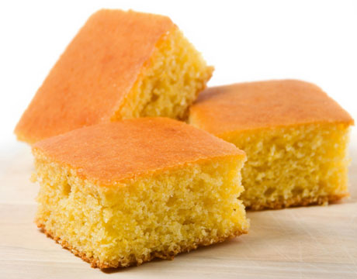
U. S. A. - CORN BREAD RECIPE
Ingredients
1/2 cup butter
2/3 cup white sugar
2 eggs
1 cup buttermilk
1/2 teaspoon baking soda
1 cup cornmeal
1 cup all-purpose flour
1/2 teaspoon salt
Directions
Preheat oven to 375 degrees F (175 degrees C). Grease an 8 inch square pan.
Melt butter in large skillet. Remove from heat and stir in sugar. Quickly add eggs and beat until well blended. Combine buttermilk with baking soda and stir into mixture in pan. Stir in cornmeal, flour, and salt until well blended and few lumps remain. Pour batter into the prepared pan.
Bake in the preheated oven for 30 to 40 minutes, or until a toothpick inserted in the center comes out clean.
Submitted by:
Gilman School -
Baltimore, Maryland

Slide 8
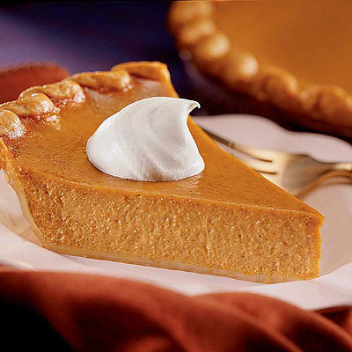
U. S. A. – Thanksgiving Pumpkin Pie
Submitted by:
Grade 4 students
Lake Forest, Illinois, USA
Cherokee Elementary
At almost every Thanksgiving table is the traditional pumpkin pie. In 1621, Plymouth colonists and Wampanoag Indians shared an autumn harvest feast that is known today as one of the first Thanksgiving celebrations in the United States. For more than two hundred years, thanksgiving was celebrated by individual colonies and states. It wasn't until 1863, that President Abraham Lincoln declared a national Thanksgiving Day to be held each November. It is not known whether pumpkin was one of the dishes served at the first Thanksgiving dinner. However, pumpkin was a part of all traditional meals long before the arrival of pilgrims. Pumpkin is one of the important symbols of the harvest and has been an American –favorite for over four hundred years.

Slide 9
Thanksgiving Pumpkin Pie
Directions
Place 1 piece of pre-made pie dough down into a (9-inch) pie pan and press down along the bottom and all sides. Pinch and crimp the edges together to make a pretty pattern. Put the pie shell back into the freezer for 1 hour to firm up. Fit a piece of aluminum foil to cover the inside of the shell completely. Fill the shell up to the edges with pie weights or dried beans (about 2 pounds) and place it in the oven. Bake for 10 minutes, remove the foil and pie weights and bake for another 10 minutes or until the crust is dried out and beginning to color.
For the filling, in a large mixing bowl, beat the cream cheese with a hand mixer. Add the pumpkin and beat until combined. Add the sugar and salt, and beat until combined. Add the eggs mixed with the yolks, half-and-half, and melted butter, and beat until combined. Finally, add the vanilla, cinnamon, and ginger, if using, and beat until incorporated.
Pour the filling into the warm prepared piecrust and bake for 50 minutes, or until the center is set. Place the pie on a wire rack and cool to room temperature.
Cut into slices and top each piece with a generous amount of whipped cream.
Ingredients
1 (8-ounce) package cream cheese, softened
2 cups canned pumpkin, mashed
1 cup sugar
1/4 teaspoon salt
1 egg plus 2 egg yolks, slightly beaten
1 cup half-and-half
1/4 cup (1/2 stick) melted butter
1 teaspoon vanilla extract
1/2 teaspoon ground cinnamon
1/4 teaspoon ground ginger, optional
1 pre-made pie dough
Whipped cream, for topping
Preheat the oven to 350 degrees F.

Slide 10
U. S. A. - 4th of July Hot Dogs
Submitted by:
Grade 4 students
Lake Forest, Illinois, USA
Cherokee Elementary
The 4th of July is a HUGE celebration in the United States of America. It is the day when people remember the signing of the Declaration of Independence in 1776 when Americans said we want to be separate from England. Basically, it is America’s birthday party. Americans feel proud on the 4th of July. There are parades and fireworks, and especially picnics with good food like hotdogs and hamburgers.
Here is a recipe for Chicago Hotdogs. They are different from other hot dogs and sausages because of the way they are cooked and because of the toppings. Street vendors, with hot dogs in their carts, started this tradition back during the Great Depression when times were really hard.

Slide 11
4th of July Hot Dogs
Ingredients:
1 all beef hotdog (like a Vienna beef)
1 poppy seed hot dog bun
1 Tbsp yellow mustard
1 Tbsp sweet green pickle relish
1 Tbsp chopped onion
4 tomato wedges
1 dill pickle spear
2 hot peppers
1 dash celery salt
Directions:
Bring a pot of water to boil. Reduce heat to low, place hot dog in water and cook 5 minutes. Remove and place hot hog in bun. Pile on the toppings in the order listed above. The tomatoes should be nestled between the hot dog and the top of the bun. Place the pickle between the hot dog and the bottom of the bun.
DON”T EVEN THINK ABOUT PUTTING ON KETCHUP!
Lots of other cities have their own version of the hotdog. Some eat their hotdogs with chili, cheese, and even sauerkraut! These versions reflect all the different places Americans have come from. If you ever come to America, you’ve got to have a hotdog, and we personally think Chicago’s are best!

Slide 12
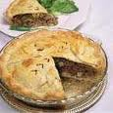
Canada - AUNTIE EL’S TORTIERE
Submitted by:
Brett Daigle - Saint John,
New Brunswick, Canada
Every Christmas Eve we celebrate with family and lots of food and our menu would not be complete without this delicious tortiere. Tortiere is a meat pie which comes from French Canadian background. Brett’s mom grew up in Quebec and this recipe was a favourite with the entire family. It has been in the family since the early 1900’s.

Slide 13
AUNTIE EL’S TORTIERE
Ingredients:
1 ½ pound of ground beef
1 pound ground pork
2 red onions
1 white onion
Salt and pepper
2 tablespoons of ground summer savory
Directions:
Mix together and add a little bit of water in a big pot and bring to a boil. Add lots of salt and pepper then the onions. Then add the summer savory. Once the mixture is cooked let it cool completely and skim fat from the top, then add to an uncooked pie shell. Top it off with pastry and cook in oven at 400 f degrees for 15-20 minutes and then at 350 f degrees until the crust is golden brown (about 20-25 minutes more). Enjoy!

Slide 14
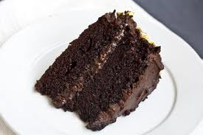
Canada - CHOCOLATE OATMEAL CAKE
Submitted by:
Brett Daigle – Saint John,
New Brunswick, Canada
This recipe has been in our family for 3 generations. It is the one that we turn to for special occasions such as birthdays and anniversaries. Brett’s great grandmother was the first to use this recipe. She then passed it on to Brett’s grandmother and now Brett’s mom uses this recipe for everyone’s birthdays. We all love the moist chocolaty taste and Brett really enjoys helping out in the kitchen while we bake and decorate this cake. We hope that Brett will pass this along to his family when he is older and has a family of his own.

Slide 15
CHOCOLATE OATMEAL CAKE
Ingredients:
½ cup oatmeal
1 cup boiling water
Mix the 2 above ingredients and let stand
2 eggs
1 1/3 cup brown sugar
1 cup flour
1 pinch salt
3 heaping tablespoons cocoa powder
1 teaspoon baking powder
1 teaspoon baking soda
1 teaspoon vanilla
½ cup vegetable oil
Directions:
Mix eggs and sugar. Slowly add in dry ingredients. Finally, mix in oil, vanilla and oatmeal mixture. Pour into a greased 8x10 pan and bake at 350 f degrees for 30 minutes. This recipe can be doubled if using a 9x13 pan or two round pans for a double layer cake. Enjoy!

Slide 16
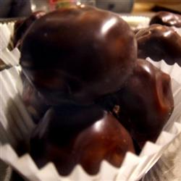
Canada - Peanut Butter Ball Recipe
Submitted by:
Evie Hargraves – Saint John,
New Brunswick, Canada
These Peanut Butter Balls are made in advance and were made by my mother, Evie’s Nana. These are made only for Christmas, our family gathering on Christmas Eve after we come back from church. All kids love chocolate and peanut butter. It was a big deal to get these for a treat.
The food is part of the celebration because we have made them for every Christmas. But they are extra special now because Nana (mom) is in heaven and we try to make them for the grandchildren.

Slide 17
Peanut Butter Ball Recipe
Ingredients:
4 tbsp melted butter 3/4 cup peanut butter 1 cup coconut 1 cup icing sugar 1 1/2 cup rice krispies cereal ( I use a little less depending on texture of mix)
1 package of chocolate chips.
Directions:
Mix all ingredients together. Form into balls and drop into melted chocolate chips. Place on wax paper and let set.

Slide 18
Romania - Aşure - Muslim recipe
Ashure or Noah's Pudding is a dessert that is made of a mixture consisting of grains, fruits and nuts. It is served during the first month of the Islamic calender, on the Day of Ashure.
In anecdotal history, it is claimed that when Noah's Ark came to rest on Mount Ararat in northeastern Turkey, Noah's family celebrated with a special dish. Since their supplies were nearly exhausted, what was left (primarily grains, dried fruits and the like) was cooked together to form a pudding, what is now call Ashure.
Day of Ashura also marks the end of the Battle of Karbala and is a special day. Among Muslims, the ashure pudding is prepared with special prayers for health, healing, safety, success and spiritual nourishment.

Slide 19
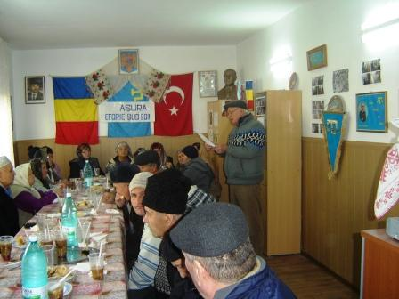
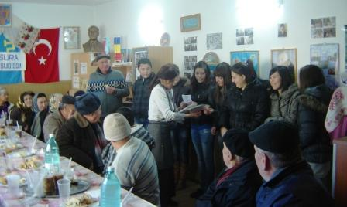
Ashure continued…
Traditionally, Ashure is made in large quantities to commemorate the ark's landing and is distributed to friends, relatives, neighbors, colleagues, classmates, etc. without regard to the recipient's religion or belief system as an offering of peace and love.
Ashure was traditionally made and eaten during the colder months of the year as it is calorie rich fare, but now it is enjoyed year-round.
Ashure pudding does not have a single recipe, as recipes vary between regions and families.
Traditionally, it is said to have at least seven ingredients.
Photos from:
Eforie Sud (Romania)
Mosque
9.12.2011

Slide 20
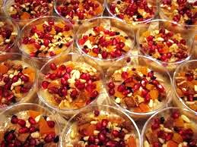
Aşure - Muslim recipe
water
sugar
salt
walnut
lemon
beans
almonds
peanuts
figs
pineapple
kiwi
apple
grapes
Submitted by:
The class of Alina Theodorescu
Eforie Sud, Constanta, Romania

Slide 21
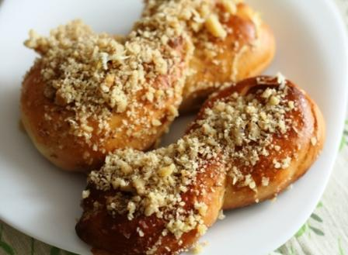
Romania - Mucenici
Sweet cookies shaped like "8", made of boiled or baked dough, garnished with walnuts, sugar or honey, eaten on a single day of the year, on 9 March.
Submitted by:
The class of Alina Theodorescu
Eforie Sud, Constanta, Romania
Mucenici is a Christian feast of the 40 Martyrs of Sebaste, a traditional holiday in Romania and Moldova. It coincides with the start of the agricultural year. Those who observe this holiday clean their households and light fire to garbage collected from their homes, to bring warmth outside.
Some believe that when the Martyrs were drowned, flowers rose to the surface. As a result, the desserts are made in the figure 8 to look like garlands. Others believe that the figure 8 denotes a stylized human form of the martyrs themselves.
In some regions, dough in the shape of the figure 8 is baked, then smeared with honey and walnuts, in the other, the dough is smaller and cooked in water with sugar, cinnamon and crushed nuts, symbolizing the lake where the Martyrs were cast.

Slide 22
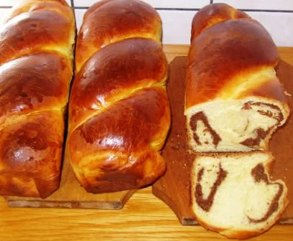
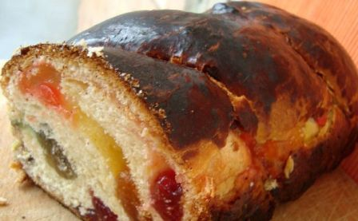
Romania - Cozonac
Submitted by:
The class of Alina Theodorescu
Eforie Sud, Constanta, Romania
Cozonac (Romanian pronunciation: [kozonak]) or Kozunak (Bulgarian: козунак) is a traditional Bulgarian, Romanian and Albanian sweet bread. It is usually prepared for Easter in Bulgaria and Albania, and mostly for every major holiday (Christmas, Easter, New Year, Pentecost) in Romania.
Cozonac is a sweet bread, to which milk, sugar, eggs, butter and raisins are added. In Bulgaria, the kozunak is prepared by adding lemon zest to the dough mixture. The Italian Panettone is very similar to the basic cozonac, the most visible difference being their shapes.
In Romania, the recipes differ rather significantly between regions in what concerns the trimmings. The dough is essentially similar throughout the country: a plain sweet bread made with flour, eggs, milk, butter, sugar and salt. Depending on the region, one may add to it any of the following: raisins, grated orange or lemon, walnuts or hazelnuts, vanilla or rum flavour. Cozonac may be sprinkled with poppy seeds on top.
Other styles dictate the use of a filling, usually a ground walnut mix, cocoa powder, rum essence and raisins. The dough is rolled flat with a pin, the filling is spread and the whole is rolled back into a shape vaguely resembling a pinwheel. In the baked product the filling forms a swirl adding to the character of the bread.

Slide 23
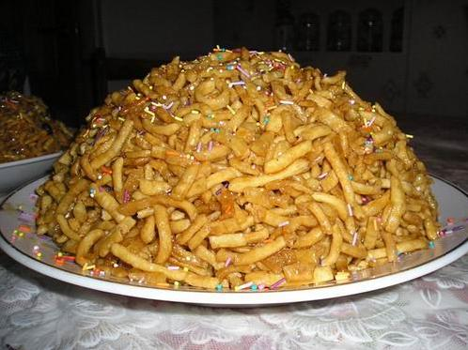
Russia - Chuck-chuck Tatar dish
The Ingredients.
*2,5 cup flour
*2 eggs
*30-60 g of sour cream or milk
*pinch of salt
*10 g sugar
*20 g butter
*for syrup:
*1 cup honey
*2-4 tablespoons of sugar
for cooking:
*1 piala melted butter or fat
The way of cooking.
Eggs, sugar, butter carefully grind, add salt, milk or water, add flour and knead the dough. Let stand for 40 minutes, then roll it out into a thin layer of thickness up to 4 mm. Cut across the strip length of 15mm and a width of 4 mm. Chuck-chuck fry in hot melted butter until golden color, fold in the sieve, drain off. Honey cook with sugar until the half of the solid ball (a drop of honey, slipped into the water, not soluble, and hardens in the form of a ball). In the ready syrup lower chak-chak, all mix well and place in greased with butter dish, giving the dish the form of slides. Chuck-chuck you can decorate the nucleus of walnuts or candy.
Submitted by:
Igul Murtazina - Almetyevsk,
Tatarstan, Russia

Slide 24
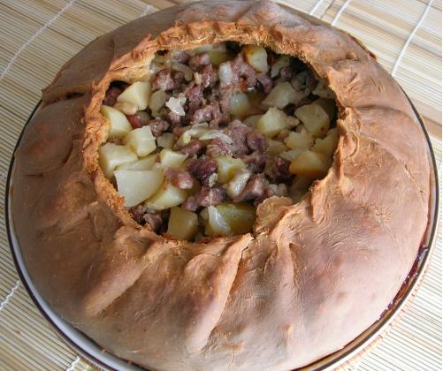
Russia - Balish Tatar dish
Ingredients:
Dough:
*flour-300 g.
flour-300 g.
*milk - 100 gr.
*sugar - 15 gr.
*oil age. - 50 gr.
*egg - 1 pc.
*salt
The way of cooking:
1.Dough: In a bowl pour the milk, add sugar, salt, eggs and oil. All to mix. Add sifted flour and knead the dough. The dough should not stick to your hands and easy to keep up with the walls of the cookware.
2.Filling. Chop onion. Cut the meat into small cubes mix, add salt and pepper to taste.
The potato is cut into small cubes.
3.Dough divided into 2 parts. One part of the roll out and put on a frying pan. Put the filling in a frying pan. Butter, cut into thin slices and spread in a single layer on top of filling.The second part of the rest unroll and put on the cake,grapple region and lubricates the yolk.
4.Put in the oven, preheated to 180O. Prepare 1.5 - 2 hours.
Submitted by:
Igul Murtazina - Almetyevsk,
Tatarstan, Russia
Filling:
*meat (any) 300-400 gr.
*potato - 5 medium-sized pcs.
*onions - 2 pcs.
*butter. - 100 gr.
*salt
*pepper
*yolk - 1 pcs.

Slide 25
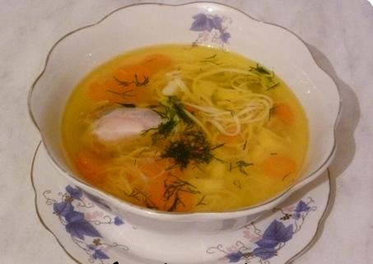
Russia - Soup Tokmuch Tatar dish
Ingredients:
*600 grams of meat with bone
* 150 g of potatoes
*60 g of carrots
* 50 g onions
* salt and pepper to taste.
Dough:
*500 g wheat flour, 100 grams of water, 1 egg, 15 g of salt.
Meat fill with cold water and bring to a boil over high heat. Remove the foam, add salt and continue to cook at low boil 2-2,5 hours. Boiled get the meat from the broth. Strain the broth, bring to a boil. Cut onion into rings - sliced carrots, potatoes cut into large pieces. All put in boiling broth.
While the cooked meat, you can prepare Tokmuch. Sifted flour pour on the board mound, to make it hollow into which to pour cold water or cold broth, add the egg, salt and knead the dough. Divide the dough into small balls, to roll out the thickness 1,5-2 mm and leave for 10-15 minutes for dry, after which cut into strips of 4-5 cm. The tape to put on each other and chop fine strips. Tokmuch can be cut diamonds of polished, triangles or squares.
25-30 minutes later, when the vegetables cooked, add Tokmuch, pepper. When Tokmuch pop up, cook for another 2 minutes, then remove the pot with fire. Boiled meat cut into small pieces, put in the dish and pour the hot soup.
Submitted by:
Igul Murtazina -
Almetyevsk,
Tatarstan, Russia

Slide 26
Thank – You,
Everyone who participated made this a wonderful learning experience for our students!
Christine Kolstoe & Kelly Kerani & Joyce Bonney
Lisa Gross & Megan Etherton & Amy Mobile
Cecilia Eppler & Erica Hudson & Margaret Olgeirson
Tiffany Crealock
Nadejda Salikhova
Alina Theodorescu
~ teachers of PPE1 and their students,
Fall, 2011

Slide 27
