Slide 1
MONEY
Matters
in Belarus, Canada,
Pakistan, Portugal,
Slovenia, Ukraine, Russia and Uganda

Slide 2
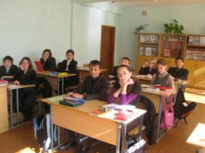
Prepared by
Students of the 8th form
Gymnasia #1
Starye Dorogi
Belarus
Teacher Natasha Belozorovich

Slide 3
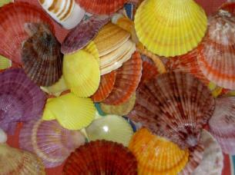
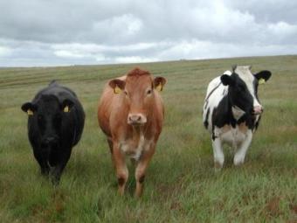
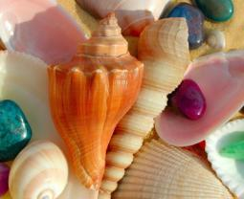
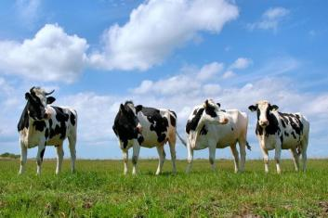
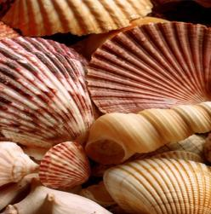
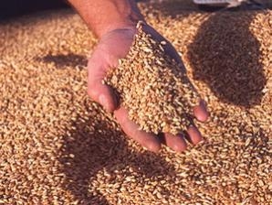
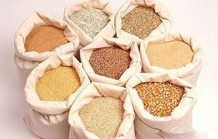
Long ago ,when people hadn`t money, they used different things:
shells , cattle , seeds and even tooth! Because people needed food, clothes and many other things.

Slide 4
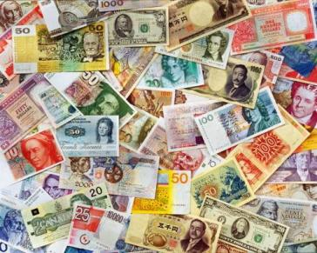
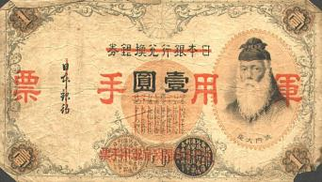
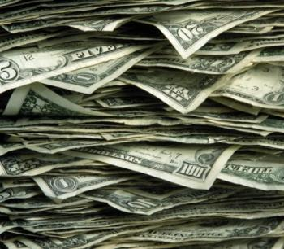
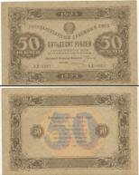
So money was invented. At firsts they were coins from a mixture of gold and silver but as they were too heavy and big and they were difficult to carry , banknotes were invented.
They are more comfortable, but some countries have coins too.

Slide 5
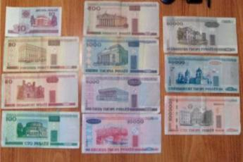
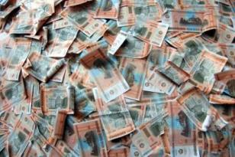
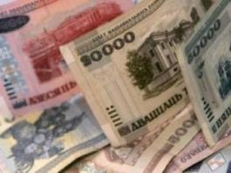
1. What money are there in your country?
Every country has its own banknotes and coins.
Belarus:
10 roubles
20 roubles
50 roubles
100 roubles
500 roubles
1000 roubles
5000 roubles
10000 roubles
20000 roubles
50000 roubles
100000 roubles

Slide 6
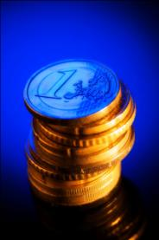
Canada
Canadian money colors are
Brown
Silver
Gold
Red
Blue
Green
We have
Coins and bills…..

Slide 7
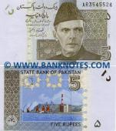
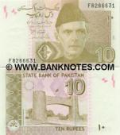
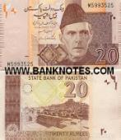
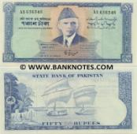
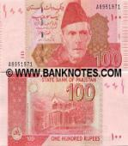
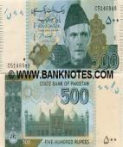
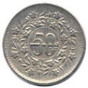
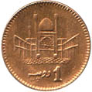
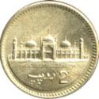
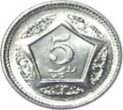
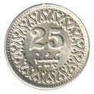
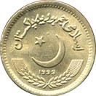
The unit of currency in Pakistan is the Rupee (R). The Rupee (R) equals 100 paisa. $1.00 (US) is about 60 Rupees.
All banknotes other than the 1 and 2 rupees feature a portrait of Muhammad Ali Jinnah (Father Of the Nation) on the front along with writing in Urdu (National Language).
Notes (Paper Money) is available in the following denominations: 5, 10, 50, 100, 500, 1000 and 5000 rupees.
Coins are available in the following denominations: 1, 2, 5, 10, 25 and 50 paisa and of 1 rupee.

Slide 8
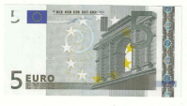
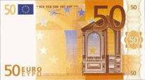
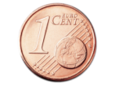
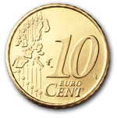
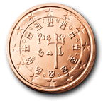
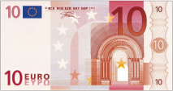
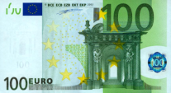
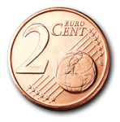
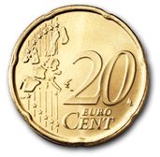
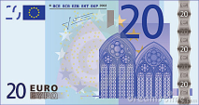
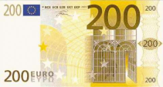
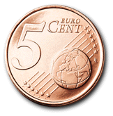
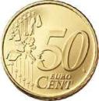
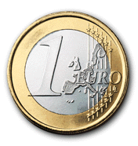
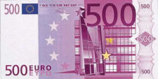
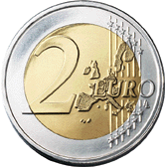
In Slovenia and Portugal people have Euros. Coins for 1, 2, 5, 10, 20 and 50 cents. They have 1 and 2 Euros in coin too. They have banknotes for 5, 10, 20, 50, 100, 200 and 500 Euros. In EU every country has a Euro and every country has different pictures on coins.

Slide 9
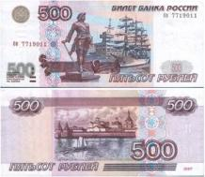
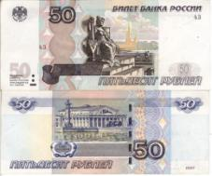
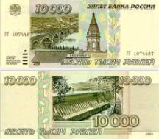
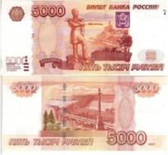
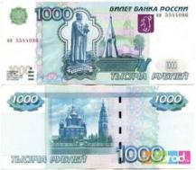
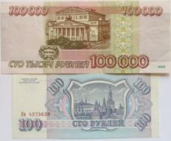
Since 1996, the Russian paper money is traditionally depicted with various landmarks of Russian cities. So, on a five-ruble banknote Novgorod is depicted , on a ten - Krasnoyarsk, a 50-ruble - St. Petersburg, 100-ruble - Moscow.
A 500-ruble - Arkhangelsk, on the 1000 ruble - Yaroslavl, and in 5000 - Khabarovsk.

Slide 10
COINS
In Uganda in 1966, coins were introduced in denominations of
5, 10, 20 and 50 cents and 1 and 2 shillings.
In 1998, coins for 50, 100, 200 and 500 shillings were introduced.
Denominations currently circulating are 50, 100,200 and 500 shillings.
BANK NOTES
In 1966, the Bank of Uganda introduced notes in denominations of 5, 10, 20 and 100 shillings. In 1973, 50 shilling notes were introduced, followed by 500 and 1000 shillings in 1983 and 5000 shillings in 1985.
In 1987, notes were introduced in the new currency in denominations of 5, 10, 20, 50, 100 and 200 shillings. In 1991, 500 and 1000 shilling notes were added, followed by 5000 shillings in 1993, 10,000 shillings in 1998, 20,000 shillings in 1999, 50,000 shillings in 2003 and 2000 shillings in 2010. Banknotes currently in circulation are 1000, 2000, 5000, 10,000, 20,000 and 50,000 shillings. In 2005, the Bank of Uganda was considering whether to replace the low value notes such as the 1000 shilling with coins. The lower denomination notes take a battering in daily use, often being very dirty and sometimes disintegrating.

Slide 11
Hryvnia is an official money in Ukraine (abbreviation: UAH, commonly pronounced "grivna" — from Russian). It has become the national currency of Ukraine since September 2nd, 1996. Bills come in denominations of 1, 2, 5, 10, 20, 50, 100, 200, and 500 hryvnias (higher values may exist but are impractical as cash money), and coins exist in denominations of 1, 2,5, 10, 20, and 50 kopecks, as well as 1 hryvnia. Bills show historical figures on the front and famous buildings on the back.

Slide 12
2. Pocket money
In Belarus children get pocket money every week: 15.000=
It`s about 1 €. We spent them on sweets, cosmetics, books, copybooks, CDs, closes.
In Pakistan
11 = No amount fixed as pocket money parents buy things of use and pay for shopped items
6 = pocket money= daily for school no fixed weekly or monthly allowance

Slide 13
In Slovenia children have pocket money. They get pocket money from their parents or grandparents. They get 5 to 10 euros per month. They spend them on candy or we put it in a bank.
In Uganda
Their school is a boarding school so children are given pocket money. Mostly people are given pocket money between 10,000 to 30,000 Ugandan shillings. Those with richer parents are given 50,000 Ugandan shillings and above.
Children mostly spend it buying breakfast and other meals. They also use some to pay for clubs in school like drama club, ICT club, wildlife club, red cross club and other clubs.

Slide 14
3. What is the parity of your money to euro?
What can you buy in your country on 1 euro?
1 euro = 11 000 Belarusian roubles
1euro = 1.3 Canadian dollar
1 euro=118 Rupees
1 euro = 11 hryvnias
1 euro = 41. 240 Russian roubles
1 euro = 3365.97224658 Uganda Shilling

Slide 15
In Portugal on 1 euro you can buy:
2 Kg onions;
1 Kg apples;
1 Kg bread;
1 Kg oranges;
1,5l lemonade;
1 Kg tomatoes;
2l milk;
1 Kg potatoes;
2 yogurts;
1 Kg rice;
500g spaghetti;
500g white beans;
150g chips;
Coffee;
Blocks of paper;
3 pencils;
1 Pen;
1 notebook;
1Kg cucumbers;
In Slovenia people can buy a lots of things on 1 euro: candy-chewing gum, small chocolate, sorrel, a scoop of ice-cream, a doughnut, drinks-water, small juice(orange, apple and grape), ice-tea then yoghurt, bread, tea, socks, magnets, school items: pen, pencil, ruler, eraser, rubber and lots of other small things.

Slide 16
In Canada children can buy 7 pieces of gum
or 1 stamp for mailing on 1 Canadian dollar.
In Pakistan
Buys Food for two times only at 60 Rs per meal (bread + veg or chicken no meat) (from road side vendors)
Milk at 60 Rs Kg
Eggs 95 Rs dozen
Chicken Quarter Kg
Cooking oil Quarter Kg
Vegetables (any) 70-120 Rs Kg
In Ukraine you can buy for 1 Euro , for example, three loaves of bread, or 1 bar of chocolate, 2 bottles of mineral water, 2 ice-creams, 5 tickets to metro, 3 pens, a magazine etc.

Slide 17
4. Money Proverbs
1. Money doesn't grow on trees.
7. If the money is smiling/laughing, the justice is crying.
2. Money doesn't change people, it mainly exposes them.
8. Money is a good servant and a bad master.
3. Greed is the biggest witch.
4. If you see someone riding a horse, and don't have the money to buy one don't get a donkey for yourself.
9. We do not have that much money that we would buy cheap stuff.
10. Money is the root of all evil.
5. Time is money.
6. Cash is king.
11. Money makes money.
12. Riches have wings.

Slide 18
5. Interesting facts about money
1.Bank Banka Monte dei Paschi di Siena is the oldest bank in the world.
It was founded in 1472.

Slide 19
2. Banknote 10000$ (1934) is the biggest one.
3. Kalvin Kulidzh was the first president whose portrait was in the coin while he was alive.
4. 1000000$ in 100$ banknotes weigh about 10 kg.

Slide 20
5. 1000000$ in 1-cent coins weigh about 246 pounds
2
Sign of 1$ was invented in 1788 by
Oliver Pollon.

Slide 21
7. We have ATM machines, ATM machines help us get money when we need it. What you do is take your debit card and stick it in a hole and type in how much money you want and you will receive the money through a slot. Its like
Taking money off your debit card .
8. When Pakistan was in its infancy after India-Pak separation in 1947, they used Indian currency with "Pakistan" stamped on it for the first few months till there was enough circulation of Pakistani notes.
9. Pakistan is primarily a cash-based society. Few establishments take credit cards, and virtually no establishments take traveler's checks. So be sure to bring plenty of cash, while taking necessary precautions. In the city of Gujranwala, for example, you will find no place to obtain cash from credit cards or traveler's checks, though this city is the fifth largest city in Pakistan.

Slide 22
10. The Euro is the common currency adopted by sixteen of the twenty-seven countries of the European Union (EU), and six countries outside the bloc tinhampolítica not monetary. Of these, the Vatican, Monaco and San Marino have formal agreements with the European Union to issue their own currencies, and Andorra is negotiating a similar agreement. Kosovo and Montenegro, in turn followed Germany since before 2002 adopted the German mark. The euro is the currency currency in seventeen countries in Europe and its overseas territories.
11. On October 1, 2009 the Central Bank of Russia put into circulation new coins of 10 rubles.

Slide 23
12. In Slovenia before the euro people had other money - tolar. 1 euro was 239, 64 tolars. There were coins for 1, 2, 5, 10, 20, 50 tolars. There were banknotes for 10, 20, 50, 100, 200, 500, 1.000, 5.000 and 10.000 tolars.
13. It is illegal to put coins in your ears in Hawaii.
14. If you drive 10 miles to buy a lottery ticket, you are more likely to die in a car accident than to win the lottery.
15. If you leave an unpaid balance on a credit card charging 18% interest, the amount you owe will double in just four years and three months.

Slide 24
16. Why are the portraits on coins almost always profile (sideways) views, while paper money is almost always frontal views? Profiles are easier to stamp into coins. Since the coin surface is actually a 3D portrait, there isn’t enough room to add the nose onto the coin in a frontal portrait.
17. Have you ever wondered how many times you could fold a piece of currency before it would tear? About 4,000 double folds (first forward and then backwards) are required before a note will tear.

Slide 25
18. Coins of ancient Kyivska Rus’- dirhams, Kuns, Nogat, hryvnia
Anciant currency
The anciant women’s necklace grivna

Slide 26
The End

