Slide 1
Our Environment
2B Gilman School
Mrs. Olgeirson, Mrs. Hudson
and Mrs. Eppler

Slide 2
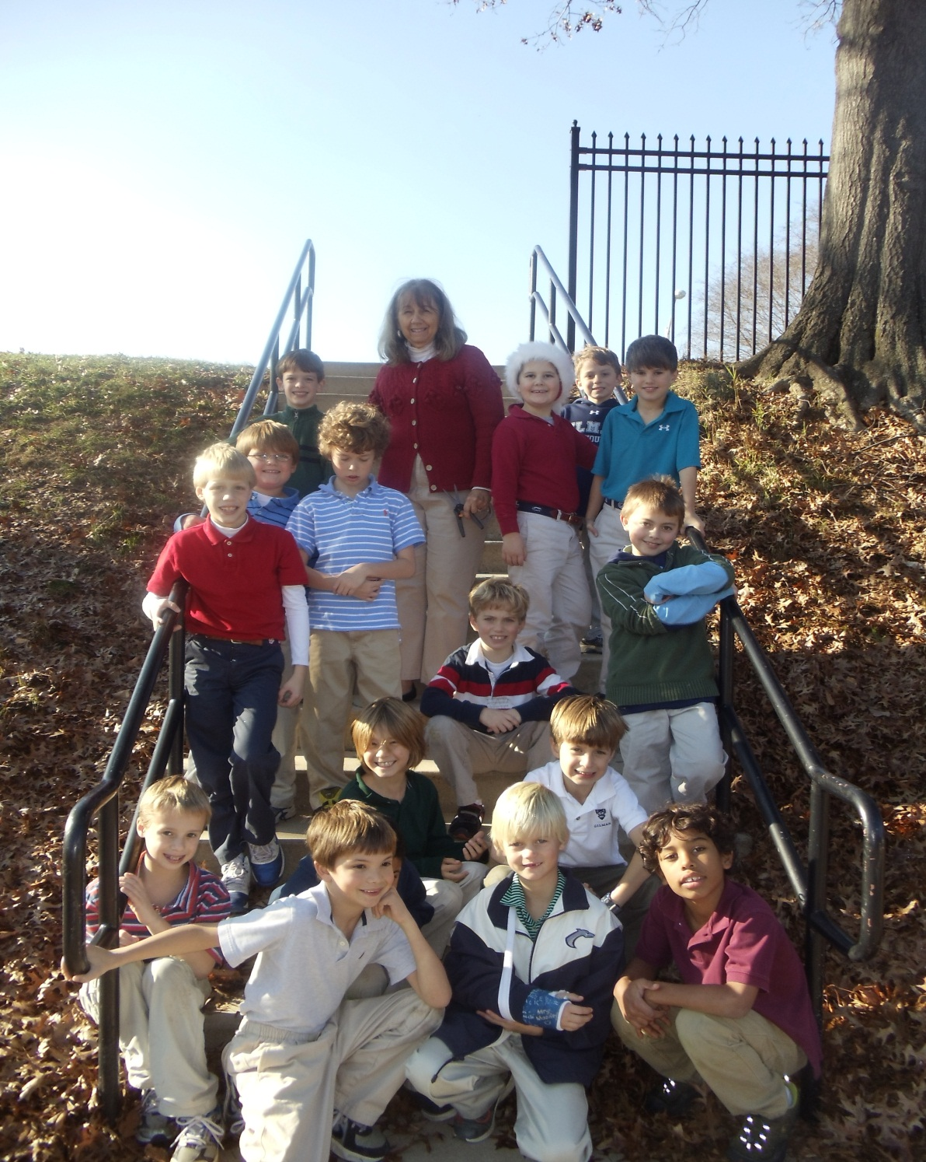
Hello from Gilman School

Slide 3
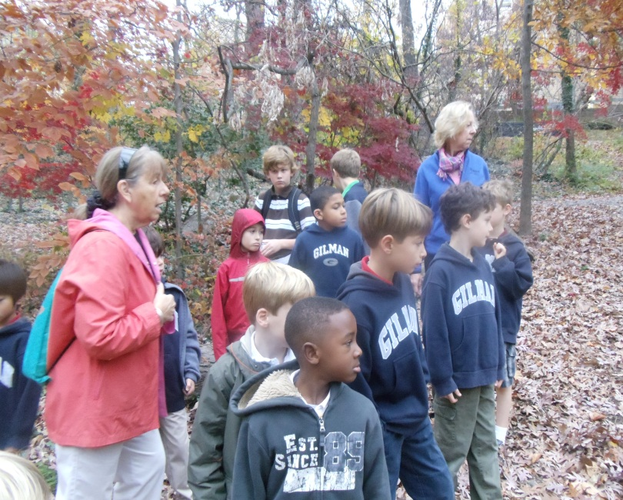
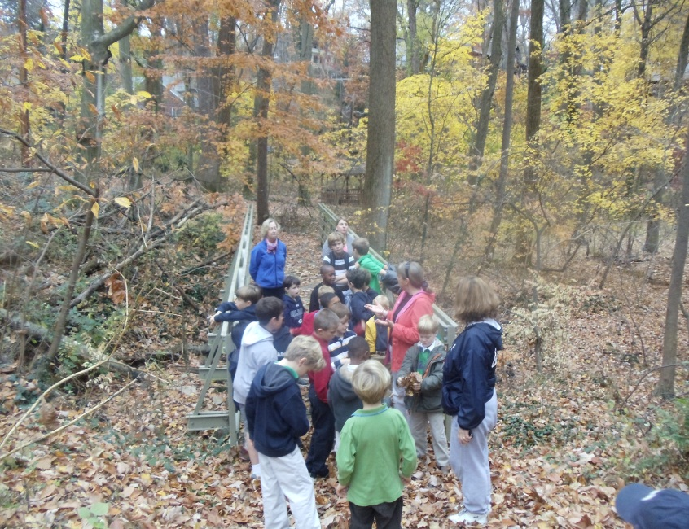
The boys in the Gilman Lower School are very environmentally conscious. Through our units of study we connect to protecting our environment. We want our students to recognize issues facing us at school, and also in the larger world.

Slide 4
In second grade we studied air and our atmosphere
After learning about air’s make-up and its importance to life, we investigated human activities that are causing problems for its health.

Slide 5
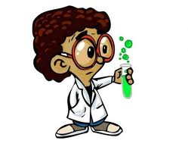
The boys brainstormed ways they might change to help the quality of air we all breathe. Our school is located at the intersection of two very busy roads, with a high level of traffic. Knowing that the emission from these cars is hurting the air, we conducted an experiment to see how bad our air is as a result.

Slide 6
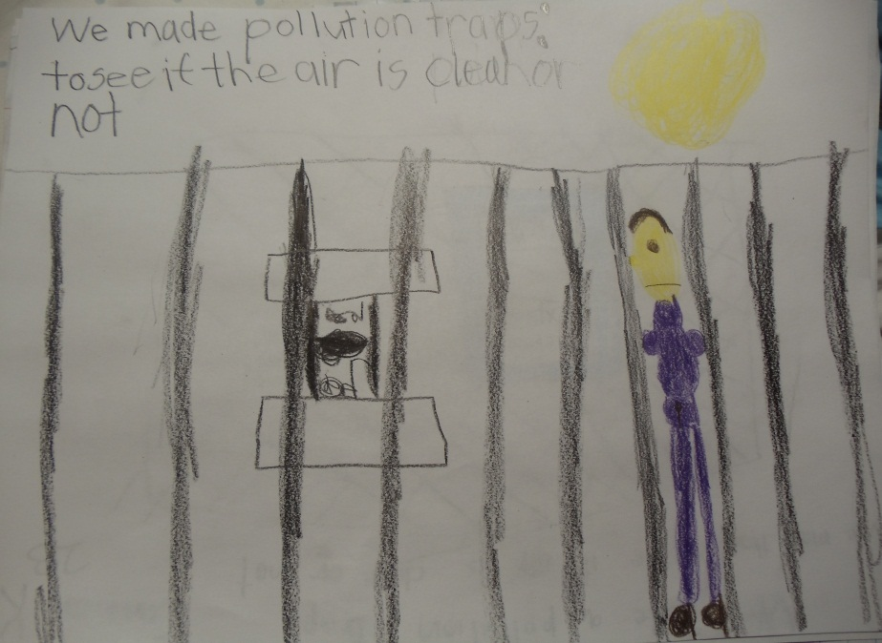
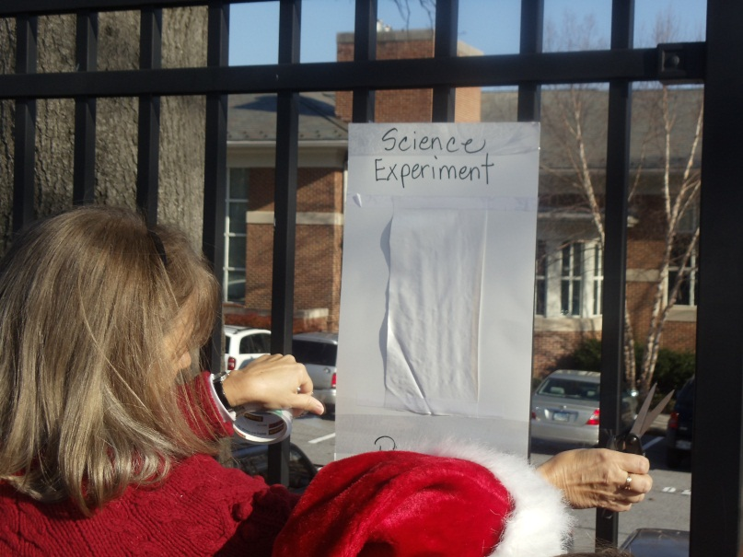
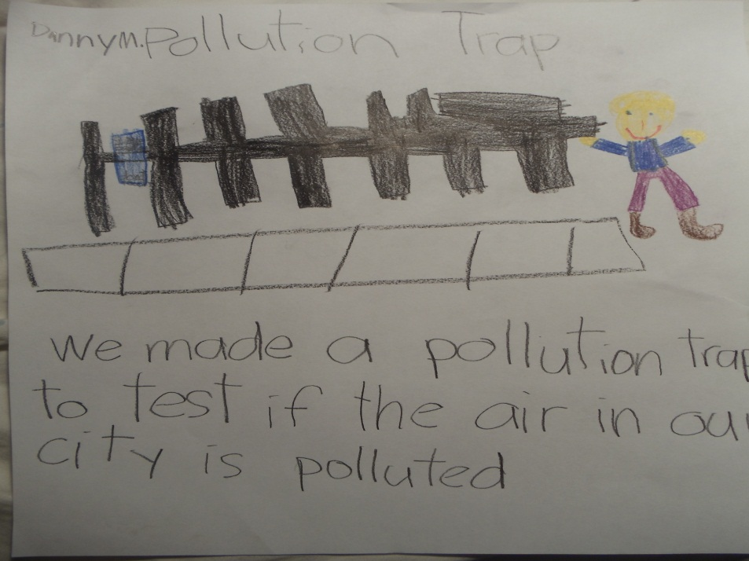
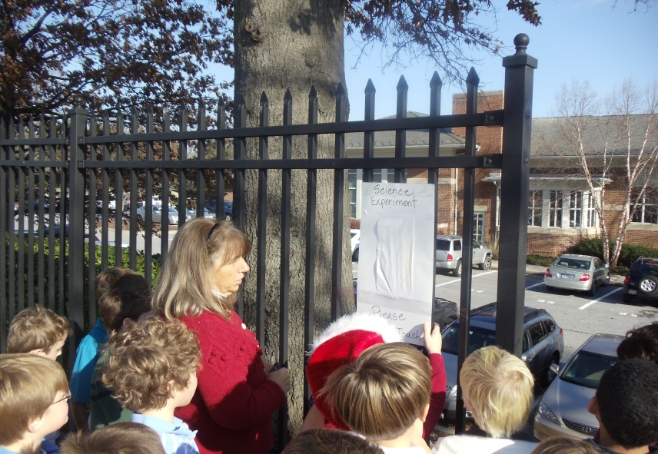

Slide 7
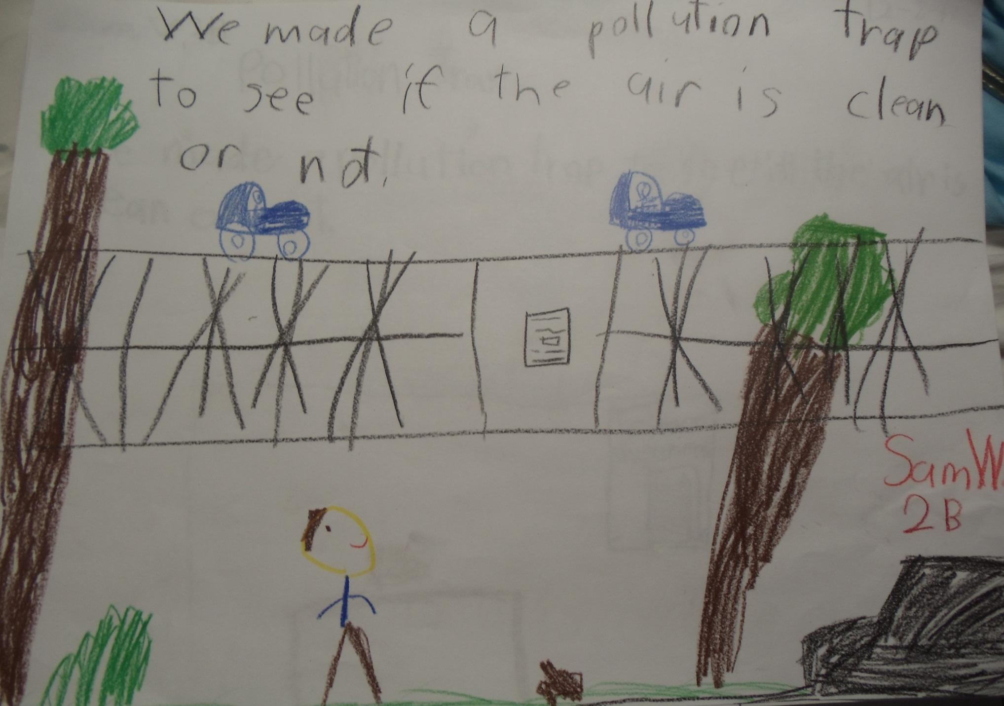

Slide 8
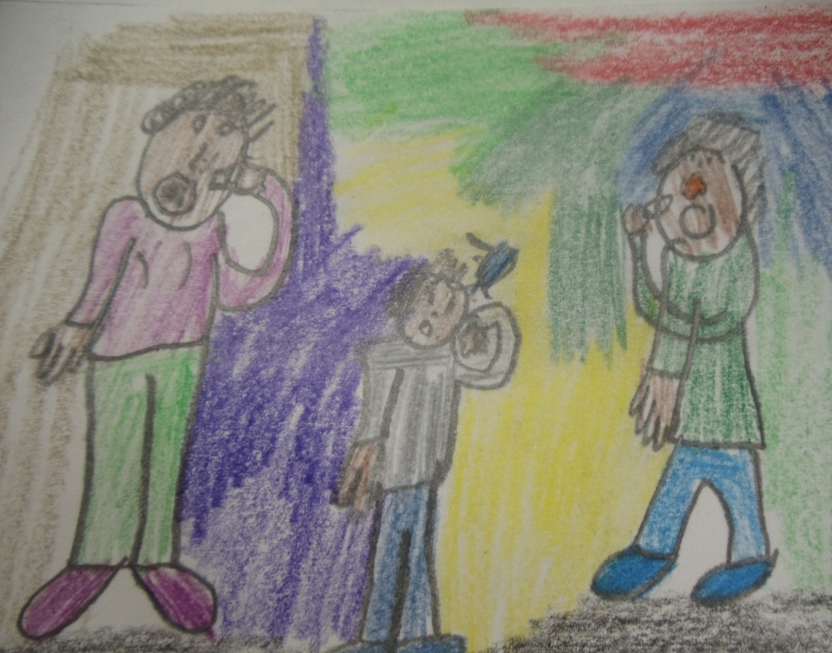
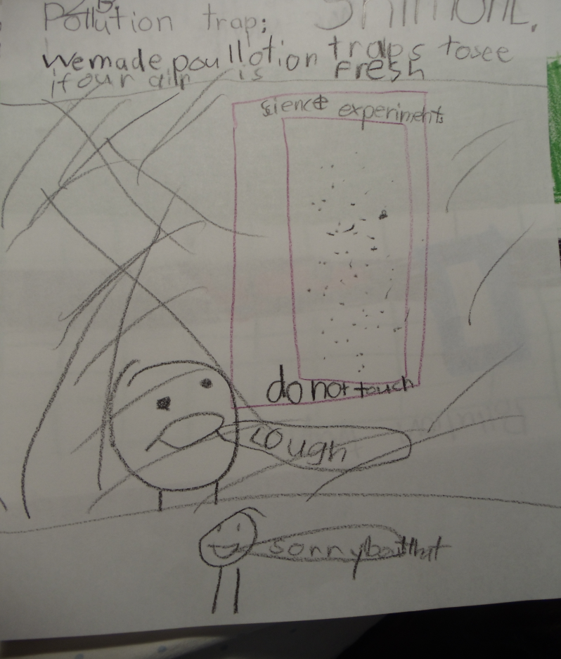

Slide 9
We do many other activities to strengthen our awareness of the environment. We have set-up rain barrels, composting stations, a garden, solar panels, a green roof, and an environmental club in the Lower School that many of the boys join. We love this planet and want to help sustain it for our lives and those in the future.

Slide 10
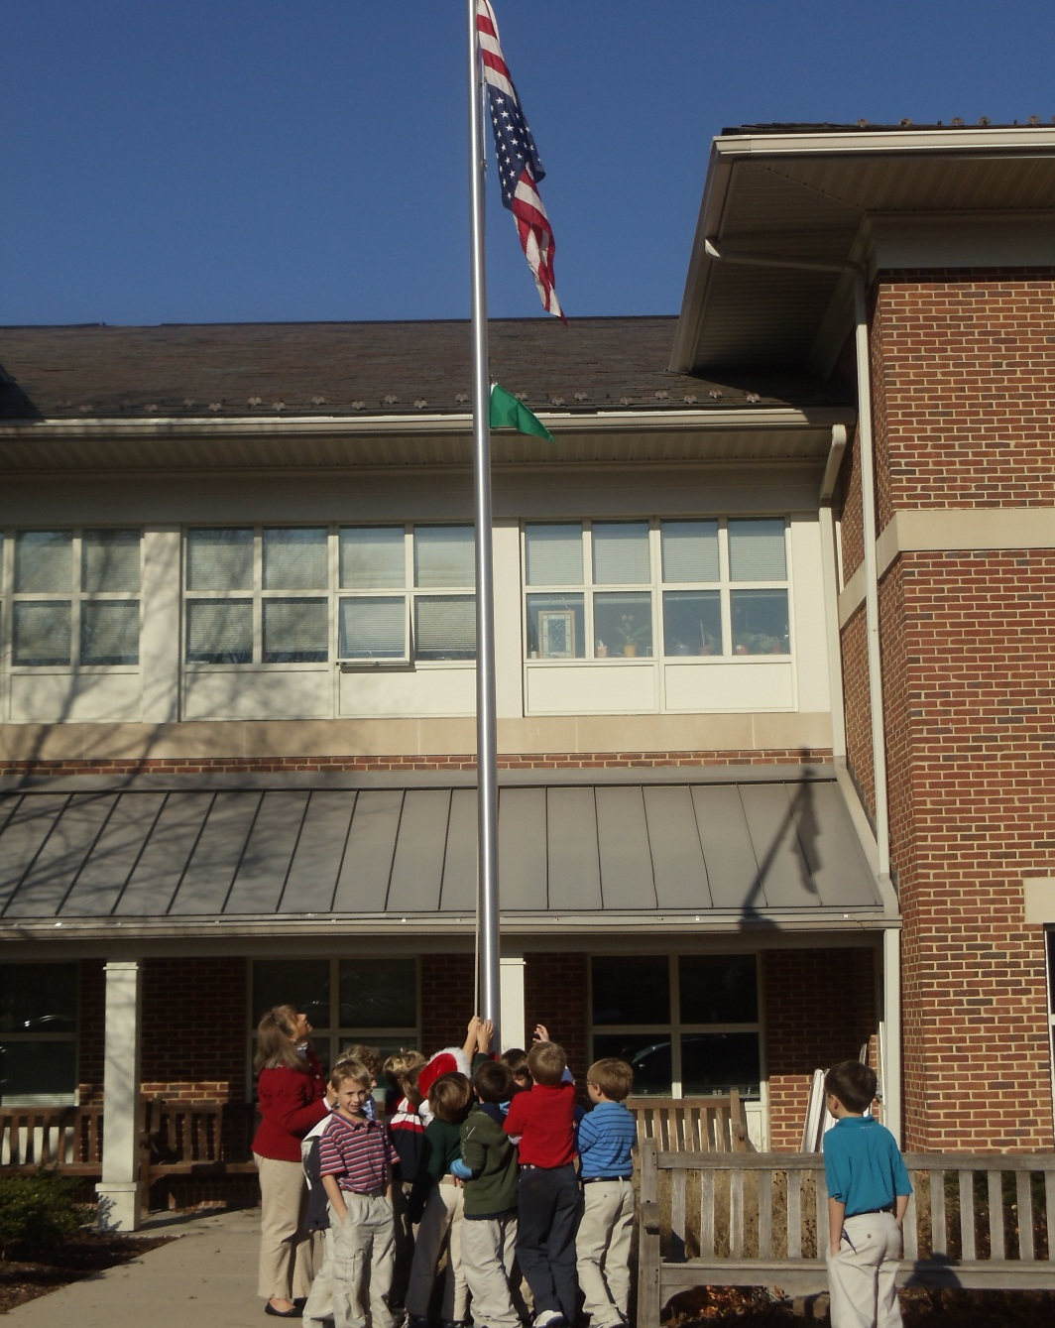
We decided to check the official air quality report for Baltimore and now raise a flag each day to advise our community of the index. So far we have been able to raise the green flag, indicating the quality of air in Baltimore is very good. We hope we don’t see the yellow or red flags, but will know what to do if they are flying.

Slide 11
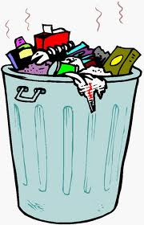
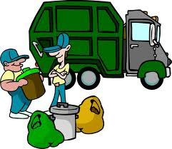
When the boys were in first grade, we were concerned about litter and the effects it has on our community. The boys made monster litter bags and planted a litter sock to check later in the year for decomposition. Now the boys make every effort to put trash in the proper place and recycle whenever possible.

Slide 12
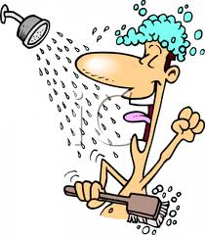
In the third grade the boys will investigate the properties of water and its importance to life. The students will test the water in the stream that runs through our campus. We will have stream clean-up days, to help ensure the health and beauty of this area. The boys conduct two experiments at home to examine how they use water in their own life. In the first experiment they can use only one gallon of water for a day and they are usually shocked to learn this is definitely not enough water to cover their necessities. They get to predict which would use more water, a shower or a bath, and once they learn how much water is wasted on a daily basis, they will hopefully make every effort to protect and conserve water.

Slide 13
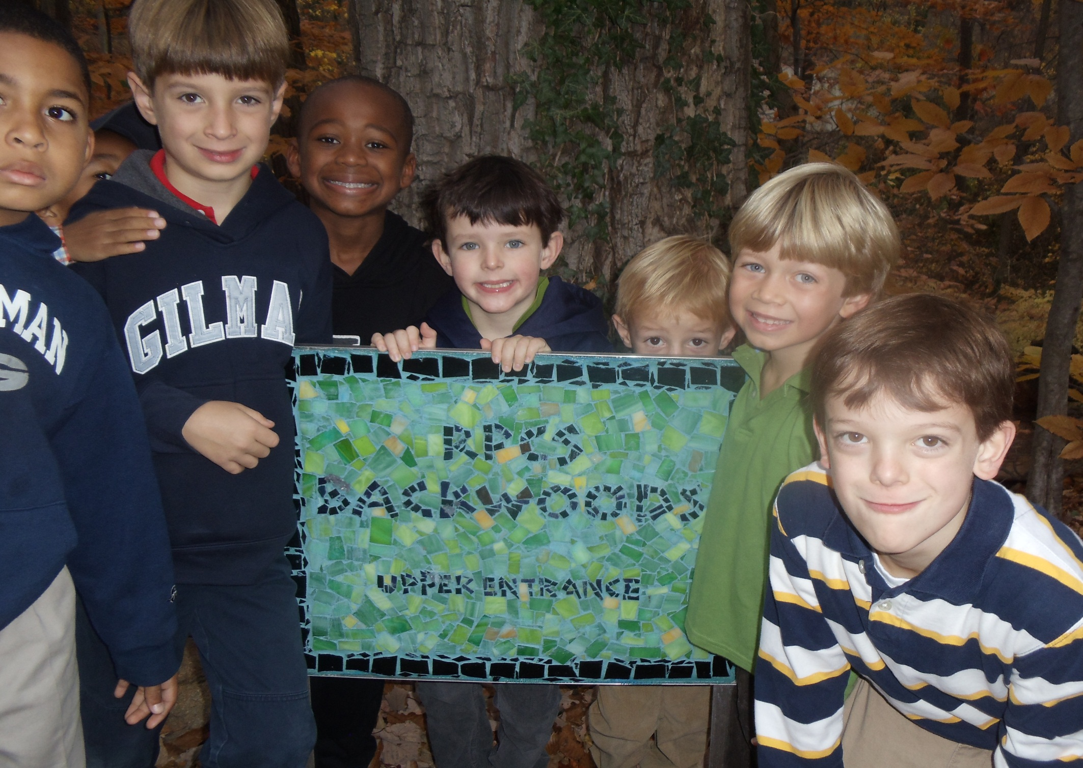
It was fun sharing our ideas with you!

