Slide 1
Places to visit in Uganda

Slide 2
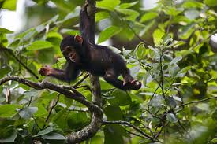
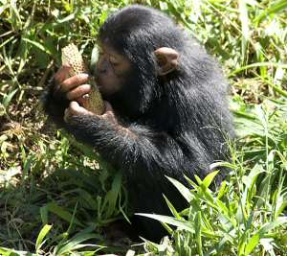
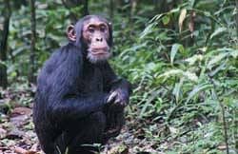
Budongo forest
Budongo Forest is home to some 600-700 chimpanzees.
Activities: Chimpanzee tracking and birding.

Slide 3
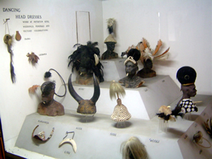
Uganda Museum
The Uganda Museum: A display of Uganda's cultural heritage where one can see ethnological and natural-historical exhibitions.

Slide 4
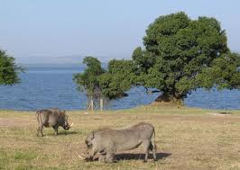
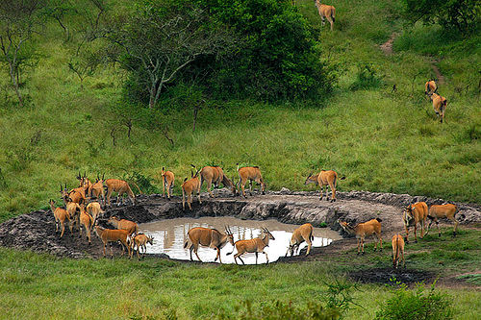
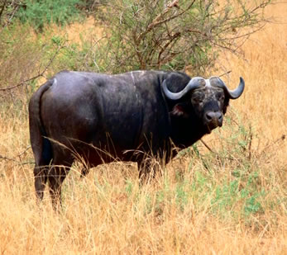
Lake Mburo
Two brothers, Kigarama and Mburo lived in a large valley. One night, Kigarama dreamt that they were in danger. When he awoke the next morning, he told his younger brother Mburo of his dream and said they should move. Mburo ignored this advice, but Kigarama wisely moved up into the hills. The valley flooded and a lake was formed, drowning Mburo. Today the lake is named after him, and the hills are called Kigarama after his brother.
It is the only place where the impala still occurs and it is the best place to see the eland, Africa's largest antilope. Large herds of buffalo and zebra's are common in this park but there are no lions (they are extinct), elephants or giraffes.

Slide 5
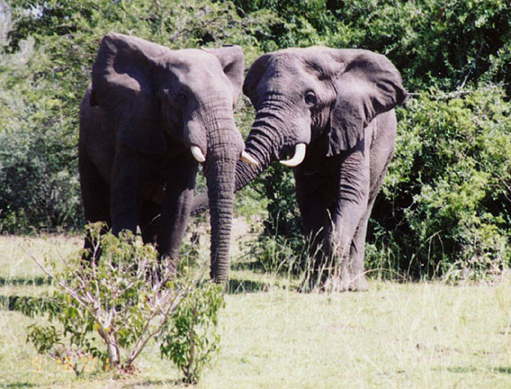
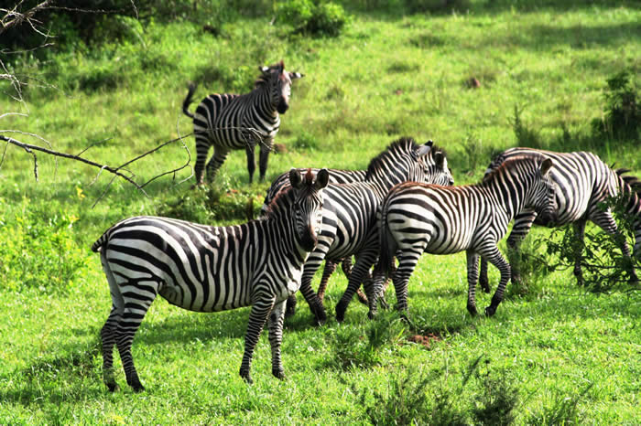
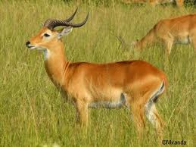
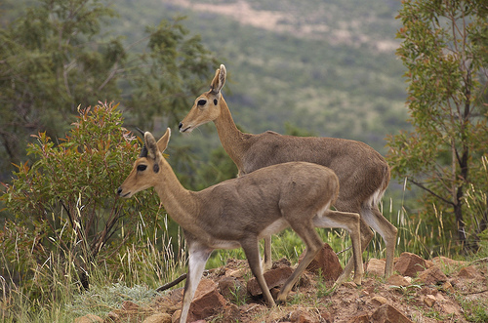
Kidepo Valley Park
Kidepo is one of the most spectacular parks in Uganda (1,344 sq.km). The Park possesses scenery unsurpassed by any other park in East Africa. In the vast panorama you can watch a constant parade of wildlife: elephant, zebra, buffalo, countless antelope and over 200 species of birds. As Kidepo Valley is quite remote, it is easily the most tranquil park. Tucked into the corner of Uganda's border with Sudan and Kenya, the Park contains sensational mountain and savannah landscapes.
Elephants
Zebras
Antelopes
Reedbucks

Slide 6
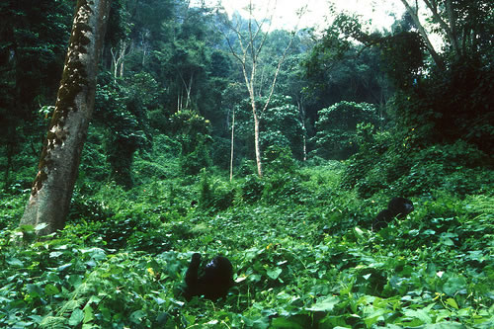
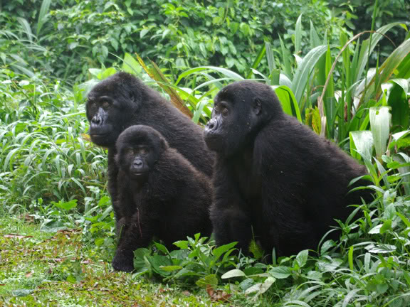
Bwindi Impenetrable Forest
Bwindi Impenetrable National Park, located in southwestern Uganda on the edge of the western Rift Valley lies on the Zaire border adjacent to the Parc National des Virungas. It is one of the largest (331 sq. km) natural forests in East Africa and contains both montane and lowland forest. It supports a large number of plants and animals endemic to the region, but most notably half of the world's population of Mountain Gorillas. The more than 300 Mountain Gorillas, divided into a dozen groups, make up the largest surviving population. The other half is split between Zaire and Rwanda, where they used to roam freely until they were separated by encroachment and farming.

Slide 7
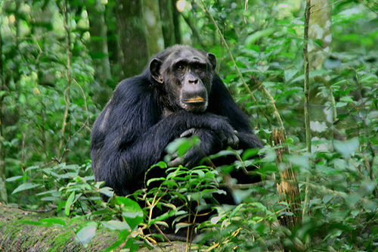
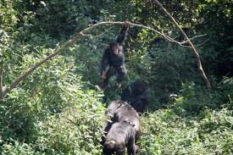
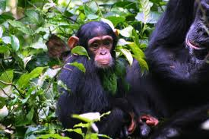
Kibale National Park
Some 35km south of Fort Portal lies a vast piece of equatorial rainforest, the Kibale Forest National Park. This recently established reserve is home to the highest concentration of primates in the world. Eleven different species have been counted there, including Black-and-White and Red Colobus, L'Hoest's Monkeys and Galagos. The main attraction, however, are the 500 Chimpanzees, which have been habituated to human visitors since 1992

Slide 8
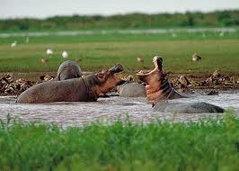
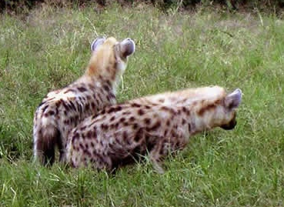
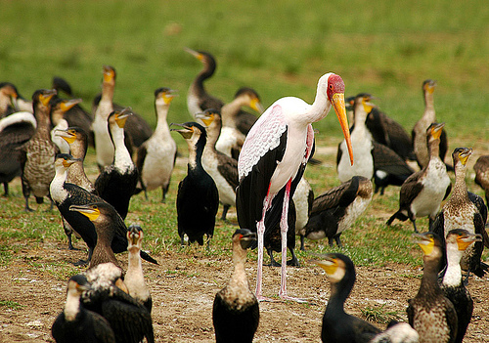
Queen Elizabeth National Park
This is a wonderful national park, sometimes dubbed 'the Pearl of Africa or Switzerland of Africa'. Quite simply this fertile equatorial area is especially scenic, with two lakes connected by a channel overlooked by a high peninsula. You will also find volcanic craters, grassy plains and tropical forest. As a result it has one of the highest biodiversity ratings in the world.
Hippos
Hyenas
Birds

Slide 9
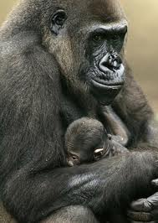
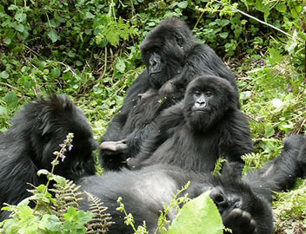
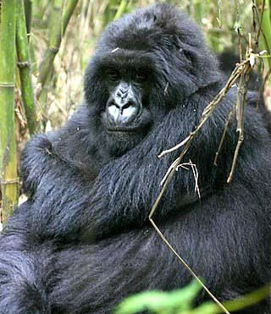
Mgahingha National Park
It is the smallest Park but one of the most significant because like Bwindi, it is home to the endangered gorilla.
Gorillas aside, the park is habitat to buffaloes, elephants, bushbucks, the golden monkeys, jackal, porcupine and many more. There are also unique species of birds - Rwenzori turaco, Crowned Crane and others. Tracking in the park takes 3 - 8 hours
There are three extinct volcanoes, which offer a good hiking experience to those in good physical health. No specific mountaineering gear is required. The park is very scenic offering great phonographic opportunities. There is a wide range of accommodation facilities in Kisoro.
Gorillas

Slide 10
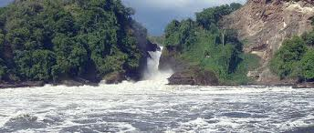
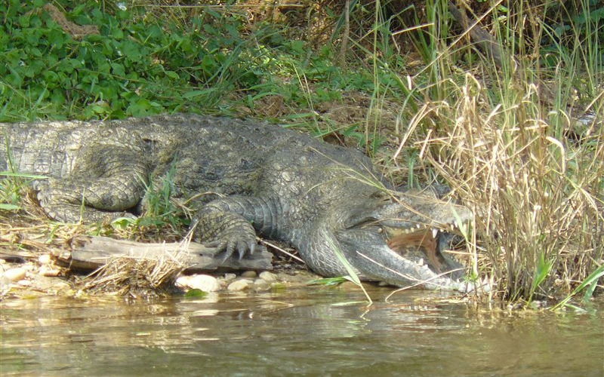
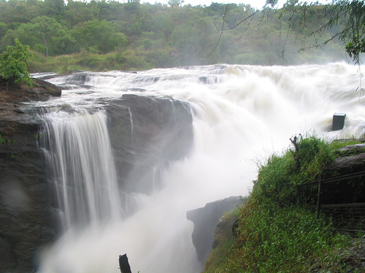
Murchison Falls National Park
Murchison Falls National Park, with 3,840 square kilometers is Uganda's largest National Park. The park is cut in half by the Nile and its landscape varies from dense rainforest on the hilly ranges in the South-West, to undulating savannah in the North-West. The forest shelters many primate species, including Chimpanzees, while the river attracts various Antelopes, Buffalos, Rothschild-Giraffes and Elephants.
The most impressive view is at the top, where the Nile forces its way through a 7 meter gap in the rocks and tumbles 40 meters down. A path leads from the parking above the falls all the way to the bottom and offers spectacular views of the foaming waters rushing into the gorge, with a deafening roar.

Slide 11
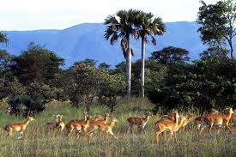
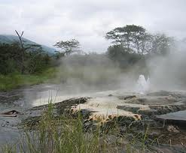
Semuliki Park
Semuliki National Park contains a secluded forest area at the base of the "Mountains of the Moon" - Mount Rwenzori on the border of Congo. The out of the way location makes it an ideal place to spend a few days relaxing away from the rest of the world. Semuliki is the only park in Uganda composed primarily of tropical lowland forest. The land is quite flat, creating a startling contrast to the rugged Rwenzori Mountains nearby, and the forest is very dense. It contains a mosaic of different micro habitats, which provide for a diversity of wildlife. The Semliki River is a watering point for many animals.
There are a number of natural hot springs in the area, which attract large numbers of shorebirds, and supply salt for other animals. There are grasslands and wetlands and bamboo forest in the park as well. You may also come across the small Pigmy culture living nearby.
Some of the animals present include elephant, buffalo, leopard, civet, scaly tailed flying squirrel, and bush baby. There are 8 species of primate, roughly 400 species of bird, and almost 300 species of butterflies.
Hot springs

Slide 12
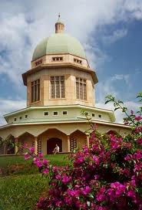
The Bahai Temple
It is called the 'Mashriqu'I-Adhkar', the Persian translation for 'the dawning place of the praise of God'. It is also the Mother Temple of Africa. Built about 40 tears ago on Kikaya Hill, four miles from Kampala on the Gayaza Road, the Bahai Temple soars above every other landscape.
The sublime architectural design of the Temple is not merely a marvel to her visitors and people who catch sight of it from a distance. Its design is based on a spiritual vision. The nine doors that stand open during prayer and sessions of meditation speak of the all-embracing nature of God. All are to usher in people to meet and adore God under this dome that symbolizes His divine uniting force. Built in harmony with the Bahai principles, the 124 feet high and 44 feet diameter temple has because green conical dome shape. The interior screams with an air of piety and natural respect.

Slide 13
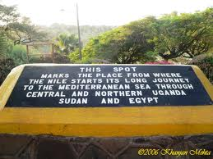
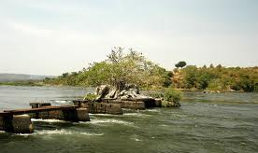
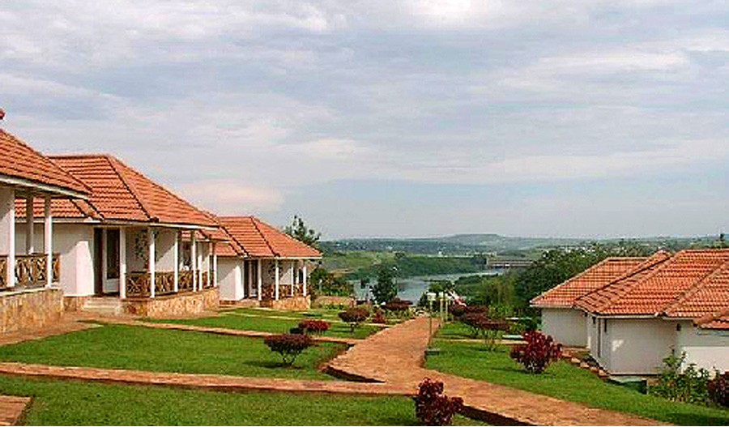
The source of River Nile
THE END

