Slide 1
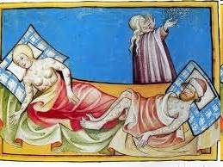
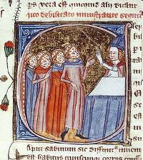
THE MEMORIAL TO THE PLAGUE VICTIMS

Slide 2
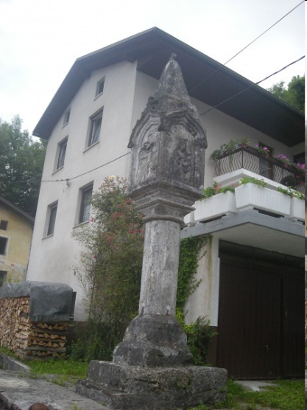
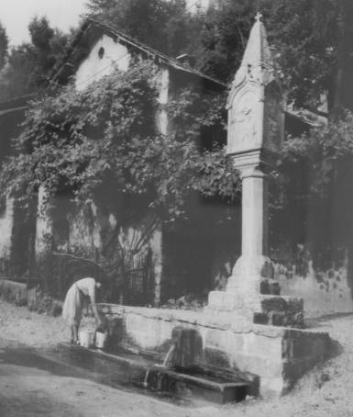
The Memorial in Volče, near Tolmin

Slide 3
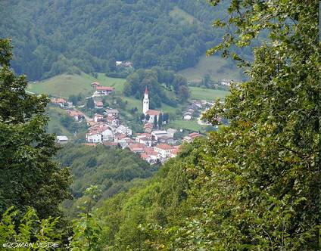
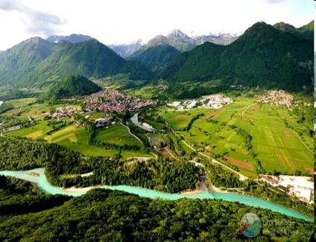
This memorial to the plague victims is in Volče and this is the largest village on the right bank of the Soča River, in the municipality of Tolmin.

Slide 4
The plague
Plague is a deadly infectious disease that is caused by the entrobacteria Yersinia pestis, named after the French-Swiss bacteriologist Alexandre Yersin. Primarily carried by rodents (most notably rats) and spread to humans via fleas, the disease is notorious throughout history, due to the unrivaled scale of death and devastation it brought. Until June 2007, plague was one of the three epidemic diseases specifically reportable to the WHO (the two other ones were cholera and yellow fever).
Depending on lung infection, or sanitary conditions, plague also can be spread in the air, by direct contact, or by contaminated undercooked food or materials. It is treatable if detected early. Plague is still epidemic in some parts of the world.
The memorial to the plague victims in Volče is a monument which was built in memory of the end of plague in our area. It is one of the most beautiful monuments in Slovenia.
The plague killed one third of the population of Evrope in the 17th century.

Slide 5
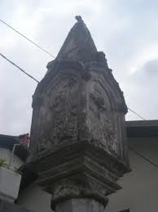
The reliefs
The monument has four reliefs :
Ressurection of Christ (That one is best preserved)
Crucifixion with Mary and Joseph
Maria with Jesus in her arms
Saint figure (it’s not iconographic solvable)

Slide 6
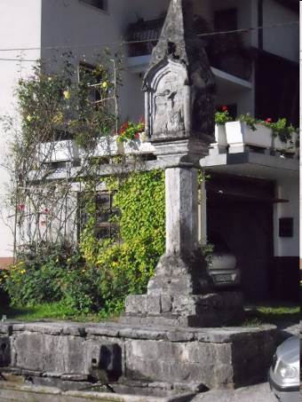
The most beautiful memorial to the plague victims in Slovenia
It’s not known when the monument was built but it is believed that it was erected around the end of the 15 th century.
There are several memorials to plage victims in Slovenia but the one in Volče is probably the most beautiful one.

