Slide 1
Our Park through Times
Kirovograd Collegium
Form 8 D
Kirovograd 2012

Slide 2
Descriptive Words

Slide 3
Park is
Place where people can rest.
Place where I may fun with my friends.
Trees.
Area of trees and flowers.
Attractions.
A beautiful place.
A magic place.

Slide 4
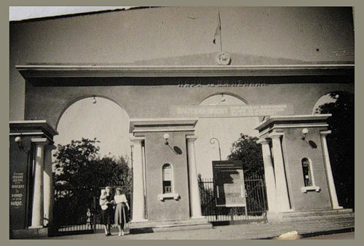
1951
2012
Notes:
Resource: http://fotki.yandex.ru/users/lyu16/view/237444/?page=0

Slide 5
Has the park changed?
Students’ Essays

Slide 6
Park
was changed through centuries. At the beginning it was like a garden. There was nothing, except trees and flowers there. After some time appeared branches and slides for children. People already can go to the park and rest. But people wanted to improve this magic place. They made attractions for children to they be happy. During every year attractions became numerous. In this year was established skate park. Now the park is very beautiful, more beautiful than in 19 century. I think the park was changed and it is changing every year. Undoubtedly, this additions are in the best way. But, of course, not all.
Masha P.

Slide 7
Park
Has been changed with help of people. Some of people have changed it to the best and some of them to the worst way. For some time park was very dirty. Then people start to change park and for several period of time park began to changed in the best way. We have pretty branches, trees are very green (in spring, and yellow-red in autumn). In winter this park very-very white. With help of people park is clean. Near this park is new theater. It’s very beautiful and big. I like this park!!!!
Dasha K.

Slide 8
Our Park
Was built in 50th years XIX century. It was built for army needs. But the time changes. Park had great fountains and other architecture. It was quiet place to rest. Many famous people found their inspire there. Then, there was built some attractions. They were not big and very cheap. But now this park is changing. I do not like this changes. Trees are cutting off. Many new attractions are build. Park was quiet and pretty, now it is dirty and noisy. I do not like changes, what happened to the park, but we must accept it and live, looking in the future.
Denis L.

Slide 9
Park Kovalevskiy
When my grandpa died, I didn’t know what to do some days. I was coming to the park. Each day when I came there, I was sitting on the bench and reading a book .That park was like my second home, or a dot of inspire. I have been coming there every day. But all of this was going just for a year.
I was it’s visitor, so as I remember, there were no too much attractions or some tents with souvenirs. I liked it because of it’s beauty. All there was so alive, and blooming. While that year, I didn’t notice how it was changing/it was usual to me.
And there, I met my best friend. He was so strange to me ,but later, he was my savior. He helped to forgot all my trouble, so I changed all my life point, so I forgot about my second home.
Years passed, and I came back to the fountain I was sitting two years ago. I walked through the park, and it was new for me . All, all was changed. Especially, it was beautifully, some new groundings .New attractions. To my opinion, it looks better today than it was in the past.
Maybe time changing it, maybe time)
Julia S.

Slide 10
The park
Has been changed by people through times. Now we have there attraction, many beautiful flowers tulips and roses. But many years ago there were nothing. There were only trees and not very green grass. Now our park is clean. There are many monuments in our park. When I come to this park and always have inspire. Some times I play with my dog or with my best friends in this ecology park. I think this park is good to have rest there, and nice mood.
Sonya N.

Slide 11
Park
Yes, I think time changes the park. But not only the time men too. Men can think about ecology and make it from trees. Or build there many attractions. Men can make it dirty or they can keep it clean. Attractions are break through the time. Park can became more popular or soon few people can know about them. It can be rebuilt, or it can be destroyed and fashion center can be built on this place. I think people and time are changing the park. We need to think carefully how to change the park.
Andrew K.

Slide 12
Park
I think park changes. All with one time became more modern then was. But it can change slower on faster. We can make faster changing with our help. But how? All people have his owns ideas that he can realize in live. We are owners our life, we can change it in better way. But we must want it.
Bohdana B.

Slide 13
Park
Changes with time and people. People cut trees. They destroy gates. I like this park, but I can’t stop it.
Anton B.

Slide 14
The Park
All is changing through times. Our park isn’t an exception. Some things change to a worse way, but park “Kovalevskiy” changed in another – better way. We have beautiful flowers and new playground for children in the park now. Also, there are some sports grounds and attraction for skaters. And every time I come through the park, I can see a lot of people there. Some of them are enjoying the beautiful nature, some are playing on the playground and some are simply enjoying a walk.
So, I can make conclusion. All that is done, all the better.
Valeria B.

Slide 15
Park
How beautiful to go for a walk through it’s sunny streets and feel light breathe. People are the most clever creature in the hole world. Park need something to create. So people occupied territory of the future park and start to create. At the beginning they made garden. After some time there appear branches and play yard for children. Park can’t exist without people and people can’t exist without park.
Polina C.

Slide 16
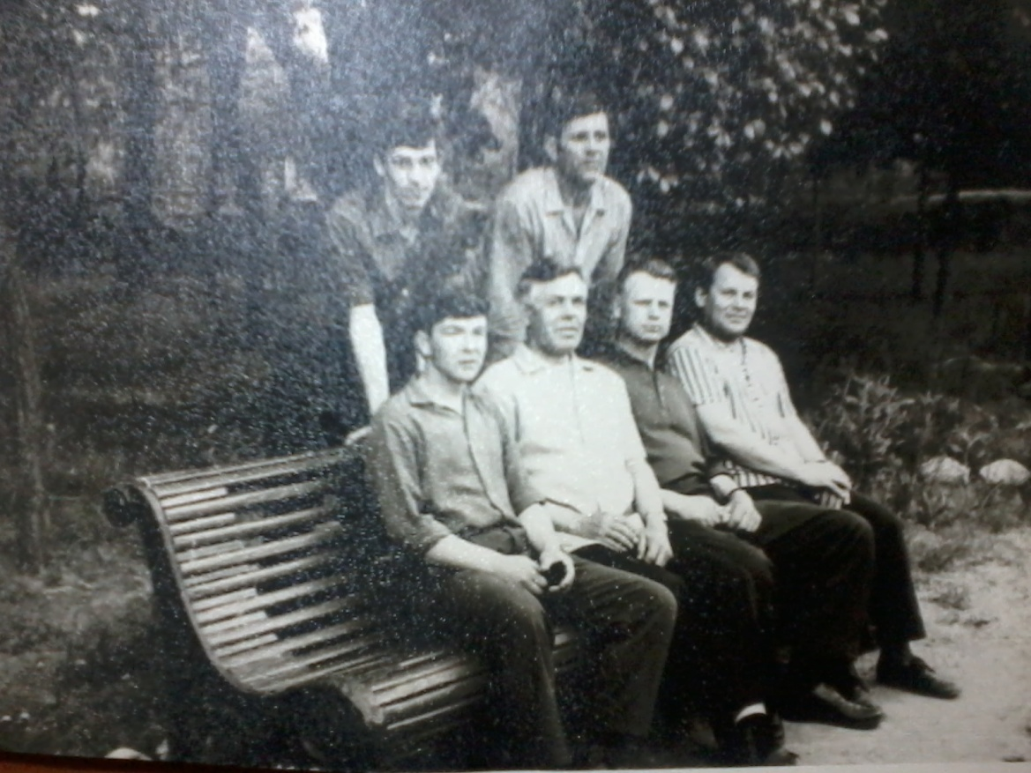
We are in our park
This is my great-grandfather Vasiliy Semenovich Usoltsev with his friends in our park.
Andrew K.

Slide 17
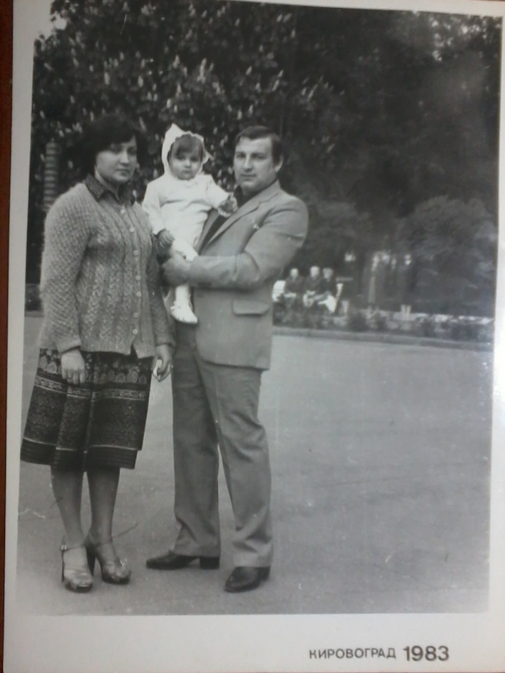
We are in our park
This is our teacher Iryna Mukolaivna Taran with her parents in our park.

Slide 18
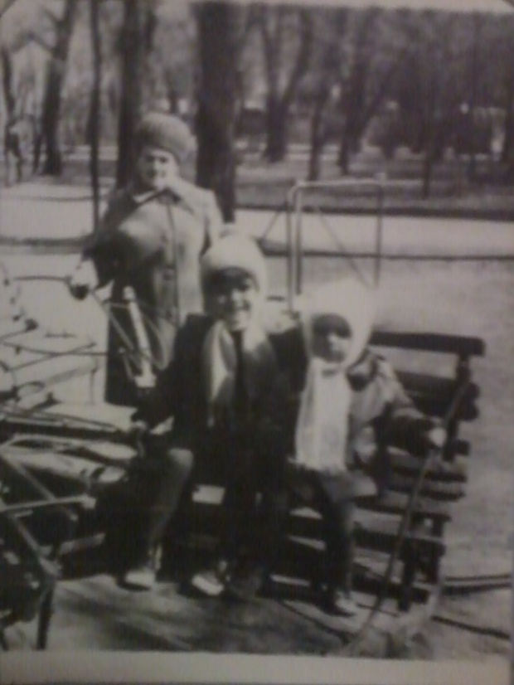
We are in our park
This is our teacher Margaryta Volodymyrivna Kalyuzhna with her mother and sister in our park.

Slide 19
Our Conclusion
Our park has been changed by people who lived in that times.

Slide 20
Find us
http://www.facebook.com/events/207007809434587/

