Slide 1
Extracurricular activities
Created by 6 grade, school №7, Korolyov, Russia
Sponsoring teacher Margarita Astakhova
Students: Liza Aleinicova, Alya Sergeeva, Kseniya Kalinkina, Elya Khanumyan, Nastya Soldatova, Anna Novicova, Alina Paripa, Iliya Popov, Demid Doroginin
Contributions from
countries: teachers:
Belarus. Starye Dorogi Natasha Belozorovich
Pakistan. Abbottabad Bushra Anwar
Belarus. Slomin Irina Volynets
Canada Kim Sadler Davis
ppm 1 September 2012 – December 2012

Slide 2
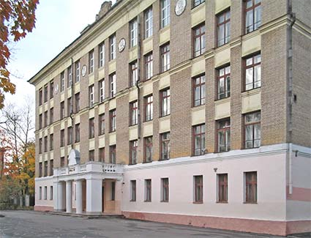
Extracurricular activities
School №7
Korolyov
Russia

Slide 3
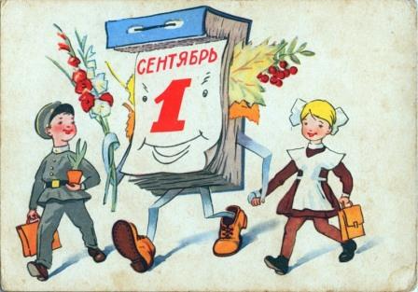
September
The 1st of September
is the first day of school
and a great holiday. We
call it the Day of Know-
ledge. We have only
one lesson which is devoted to important events in our country. This year we talked about the victory over Napoleon’s invasion.

Slide 4
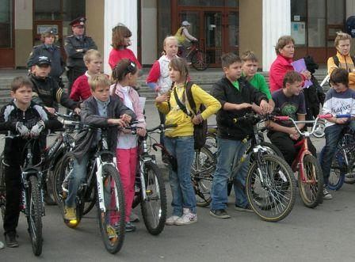
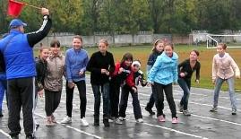
September
The first Friday of September is the Day of Health.
We don’t have classes. We go to the city stadium and have sports competitions.
The city competition “Safe Wheel”.

Slide 5
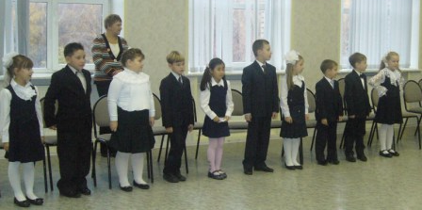
October
At the end of October we traditionally accept our first graders as members of our school brotherhood.

Slide 6
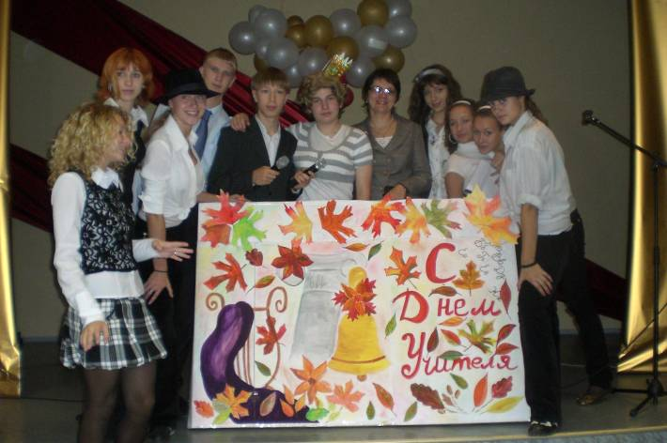
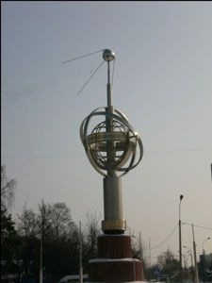
October
4th of October
5th of October
We celebrate the launch of the first artificial satellite which was built in our city.
The Teachers’ Day.

Slide 7
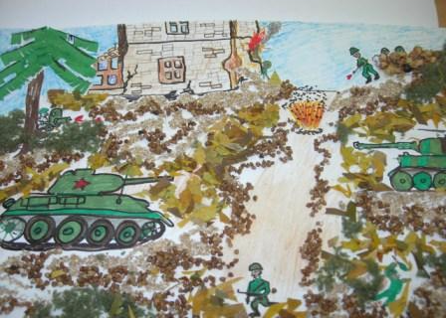
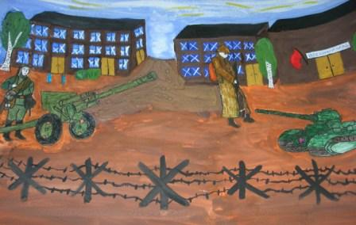
November
In November we have a school round of the city Olympiads in all subjects.
We also have a newspaper competition.

Slide 8
December
The battle for Moscow
The battle for Moscow was the turning point in the history of the II world war.
Every year we commemorate this event with singing festivals, conferences and meetings with the veterans of the war.

Slide 9
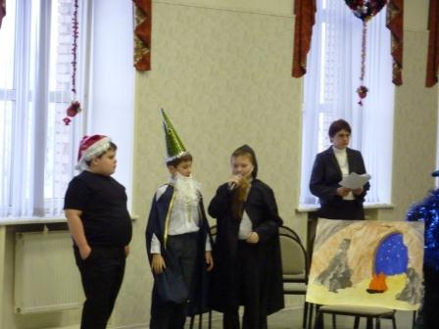
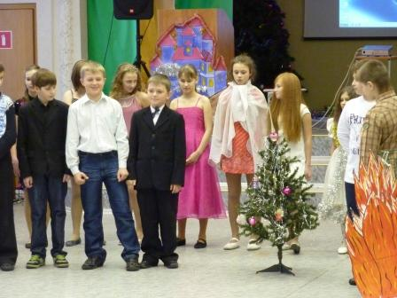
December
New Year is our favourite holiday.
Students from 11 grade prepare a performance for primary students.

Slide 10
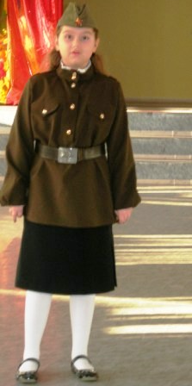
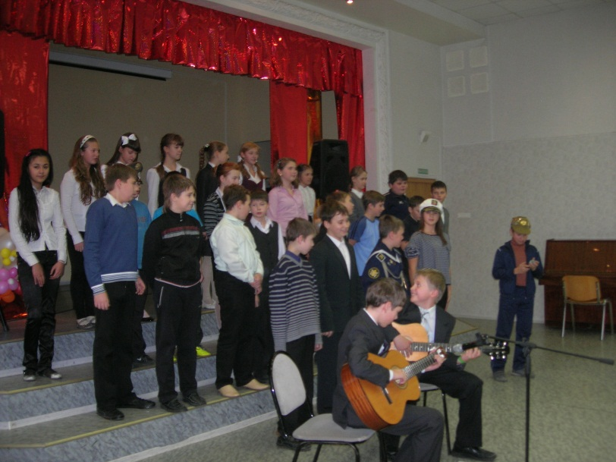
February
On the 23rd of February we celebrate Defenders’
Day and commemorate soldiers who perished in
wars and those who defend us nowadays.
We have singing and poem competitions.
We congratulate all men and boys on this holiday.

Slide 11
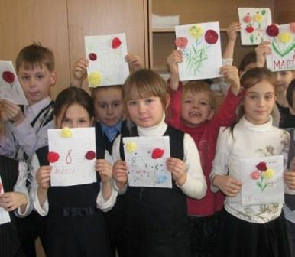
March
On the 8th of March we celebrate Women’s Day.
We give a concert for our
teachers and mums, make
cards, give them flowers.

Slide 12
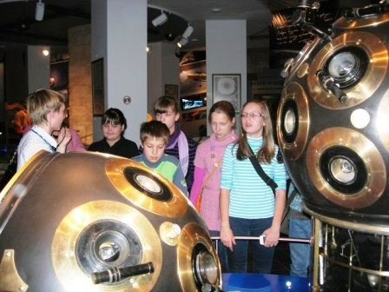
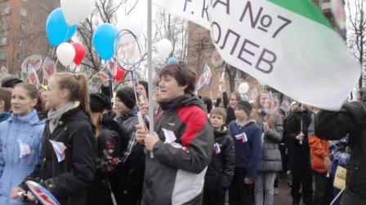
April
April is devoted to the first man in space.
We have conferences, meet interesting people who work in rocket-building industry, visit space museums.

Slide 13
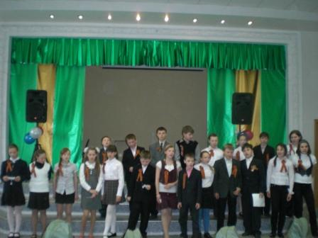
May
9th of May is one the greatest holidays in our country.
We give a concert for the veterans, take part in the victory parade in our city,
Collect and give cards and presents for our veterans.

Slide 14
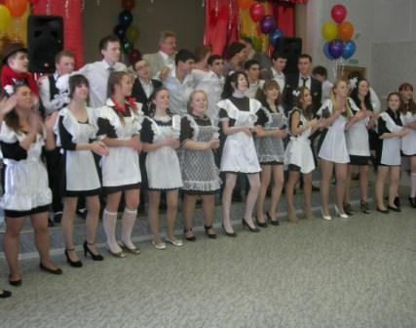
May
On the 25th of May our 11th graders have their last bell ring.

Slide 15
School Activities Canada
By: Madison, Zach, And Breanne
Room 22!

Slide 16
Chess Club
This is a club where students meet during lunch hour to play chess. In our school we play just for fun, but at the end of the year the chess club goes to a chess tournament and compete against others people from other schools.

Slide 17
Volleyball
In our school we are taught volleyball during gym. When we are in grades 7 and 8 we get to sign up for our school team. Our team plays against other schools for the divisional championships.

Slide 18
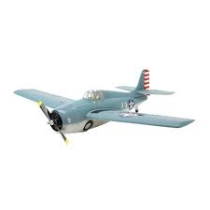
Model Club
The model club is not for fashion it’s for building. We use materials such as paint, glue, plastic, etc. Last year we built model airplanes.

Slide 19
Basketball
Basketball is similar to our volleyball program. The students are taught it in gym class same as volleyball. Also in grades 7 and 8 you can sign up for basketball.

Slide 20
Drama Club
Drama club is when we go to the music room and we learn plays and song and a bunch of other stuff. We also go perform at the Drama Festival.

Slide 21
Cross Country
Cross Country is a running club where students meet in the morning before school to train for track meets. At the end of the year grades 5 and 6 go to the University of Manitoba for a city wide track meet.

Slide 22
Sports Club
Sports Club is when you meet before school and learn a bunch of sports and how to play them correctly.

Slide 23
Choir
Choir is where you sing at lunch time and go to sing in front of people on stage with other schools in Louis Riel School Division. Choir starts when you are in grade 5 etc.

Slide 24
Photo Club
In Photo Club you go all around Winnipeg and take pictures of things you find interesting. And sometimes the Photo Club gets to show their photos at assembly's on the power point.

Slide 25
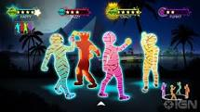
Dance Club
Dance Club is held at lunch time in the MPR (Multi-purpose room). At ance club we go in the in the MPR room all lunch recess and dance to Just Dance 3!

Slide 26
Extracurricular activities
in Slonim gymnasium 1
BELARUS
Kate Risunova
Kate Dyatlova
Kate Sinits
Teacher- Irina Volynets
ppm1
September- December 2012

Slide 27
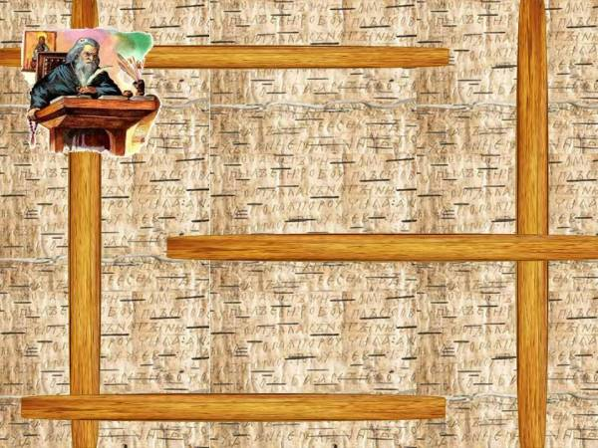
SEPTEMBER
The Day of Knowledge
Peace Day
ENO Tree Planting Day
Travelling Around the World Party

Slide 28
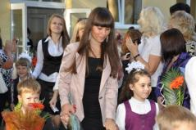
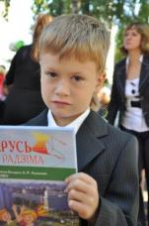
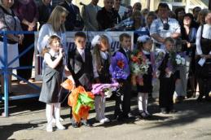
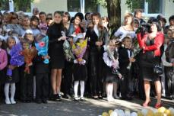
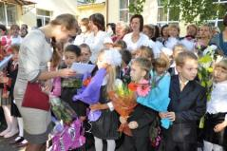
The Day of Knowledge
We start our school year on September 1. On that day at the beginning of the academic year Knowledge Day is traditionally marked in our school and all over Belarus. We’ve got a meeting in the school yard where all teachers, students and their parents, special guests gather to celebrate this holiday. New students, the first graders are welcomed. There is the first bell ringing to begin the new school year. There is also a great performance at the meeting. This year the first lesson has been “Your Land, your Motherland is named Belarus”. It was focused on the education of citizenship, patriotism, respect to the past and the present of the Motherland, pride for the Belarusian people and their achievements.

Slide 29
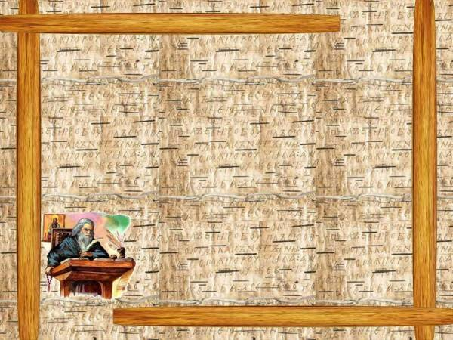
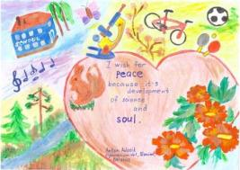
The students of our school have been participating in the Peace One Day project for several years and it's become a tradition to celebrate Peace Day on September 21. This year we have had Peace Week that started on September 21 and was full of different events and activities. There was an art contest for students to choose the best drawing for the School's International Peace Quilt.

Slide 30
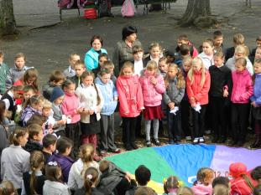
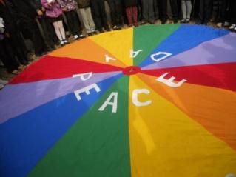
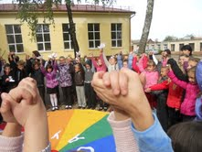
At noon the students of 4, 5 , 6 and 7 grades together with teachers( total 210 people) went in our school yard and joined their hands to be part of the International circle of peace. They sent their best wishes to the world and prayed for peace all over the world.

Slide 31
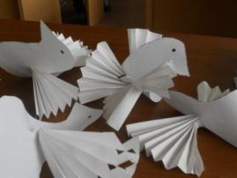
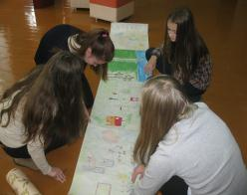
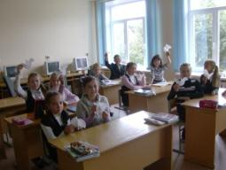
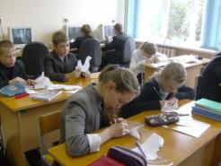
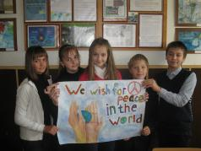
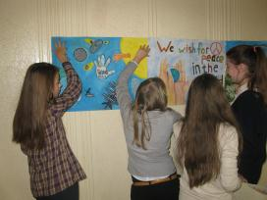
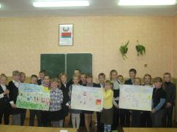
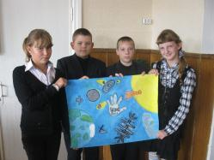
We also made peace doves with the help of origami, wrote wishes to the world, drew posters and pictures. 4 and 6 - graders participated in Peace Art Mile.

Slide 32
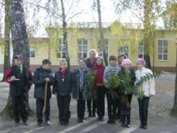
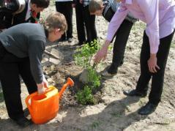
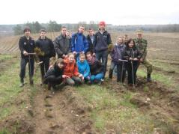
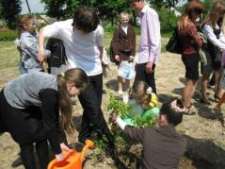
Tree Planting Days
We celebrate ENO Tree Planting Days on September 21 and May 22. You can join us and register your school on the website: treeday.enoprogramme.org .
Notes:
32

Slide 33
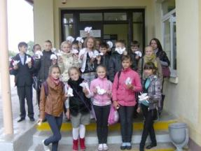
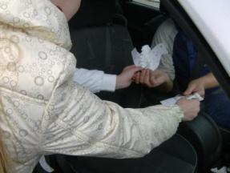
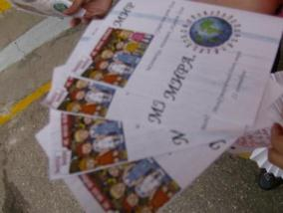
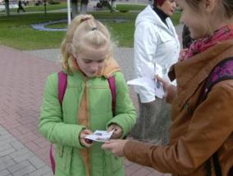
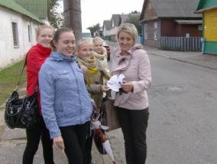
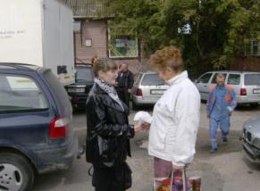
OCTOBER
Peace march “Give a smile to the world” was held in our town. We wanted the inhabitants of our town to know about Peace Day and gave them paper oeace doves, flyers and our smiles. It was a success!
The Day of students’ government
Teachers’ Day
The Day of Gymnasium Brotherhood
Pokrovskaya Charity Fair and concert

Slide 34
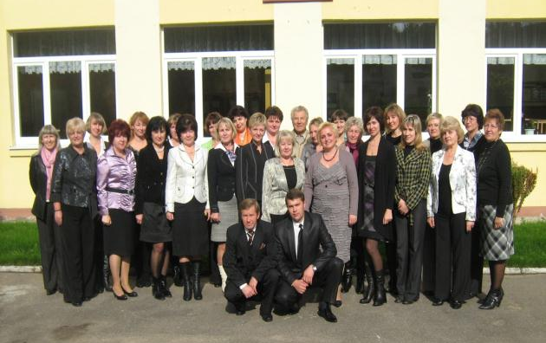
We celebrate Teachers’ Day on the first Sunday in October. Our teachers are always very special. They make learning a wonderful experience for us. On that day we express our love and appreciation and thank these wonderful people. There is a special cultural programme in our school: singing, dancing and performances. The lessons are given by senior students. Flowers, greeting cards, laughter and smiles the whole day.
TEACHERS’ DAY

Slide 35
Last year we entered the gymnasium and joined a large family of the students of the gymnasium. It was a great holiday. The ceremony of our dedication to the gymnasium brothehood was held in our town’s House of culture. Our parents and grandparents, our teachers and all the students were present. We swore to do well at school and follow all the rules of our school. We were greeted by the senior students -winners of different contests and competitions. It was an unforgettable event in our lives. It was cool!!

Slide 36
November
Great sports festival "Autumn Marathon"
Intellectual games "What-Where-When?"
Birthday of our school newspaper "BOOM"
Ahtisaari Day

Slide 37
AHTISAARI DAY
As ENO school we take part in celebrating Ahtisaari Day globally with our partners from other countries. Its aim is to increase knowledge how to avoid and solve confilicts at schools and in the community as well as on the international level. It is essential to take responsibility and work together to avoid quarrels and to find a solution that all the counterparts agree. We need to work for peace in our daily lives.

Slide 38
December
Christmas parties "Christmas mood“
“Winter Tale” party for 3-4 graders (in English)
ECO fir-tree contest
Christmas card exchange

Slide 39
At the end of December
Christmas parties are held in our school.
. We put on costumes and masks,
sing, dance and play games. Winter Tale
Party is held in English. It’s fun for junior students.

Slide 40
Eco fir-tree contest

Slide 41
January
Subject week "I want to know everything"
Reunion Day
Tatyana’s day

Slide 42
FEBRUARY
Valentine’s Day
Days of Science and Culture

Slide 43
Days of science and culture
The students of our gymnasium take an active part in scientific- research work and the interregional scientific conference “Stairs to science” is held here every year.

Slide 44
MARCH
The March of frogs
Environmental project “Let’s flourish my country!"
Open Interregional Scientific and Practical Conference "Stairs to science"

Slide 45
THE MARCH OF FROGS
As our school has participated in ENO for several years, Climate Change Campaign and the March of Frogs have become our school tradition. As a rule, the whole school , its teachers and students take part in it. During this campaign the students learn more about the impacts of climate change on our weather, flora and fauna and the development of agriculture in Belarus. They make Frank the Frogthe – the mascot of the campaign from papier-mâché, cardboard, plastic bottles. They draw masks and create posters. It is an exciting process of creating frogs which the kids like very much.

Slide 46
APRIL
Earth Day
Intellectual marathon
The top student of the year in the gymnasium Final
Starry Night owl Holiday

Slide 47
May
Memory look-out
Conference for primary school students “A step to science”
Spring Song Spirit party
Last Bell

Slide 48
My Gymnasia
Traditions
Starie Dorogi
Belarus
Natasha Belozorovich

Slide 49
the first call rings
Our school year begins on September 1.

Slide 50
In the middle of November in our school passes autumn ball

Slide 51
At the end of December we celebrate New Year

Slide 52
On February 23 - Defender’s Day of the Motherland. Girls congratulate boys with the holiday and give presents.

Slide 53
On March 8 - the World Women's Day. Boys congratulate girls and give them presents.

Slide 54
On May 31 – Last bell

Slide 55
A Project by
EESHA SHABIR
From
Army Burn Hall school Pakistan

Slide 56
The Importance of Extracurricular Activities
In the past few decades, our school have emphasized a broad educational mission: to develop a "whole student." In secondary schools, extracurricular involvement is a key tool in this personal development. For the majority of students, involvement in extracurricular activities plays an important role in the school experience. Students become involved in extracurricular activities not only for entertainment, social, and enjoyment purposes but most important, to gain and improve skills. A wide range of extracurricular activities exist at our school, meeting a variety of student interests. The primary goals of extracurricular activities focus on the individual student level, the institutional level, and the broader community level. These activities exist to complement the school's academic curriculum and to enhance the student's educational experience

Slide 57
1. Romeo and Juliet stage drama
Most of the people are familiar with this famous play of Shakespeare. He was a respected poet and his dramas are still in the form . To present his drama was an honor. Our whole class had participated in this drama and presented it very well. The practices of this drama were the most enjoyable part of all because during the practice of the drama everyone showed the unity and tried their best to make the drama a good one.
The play was presented in front of the principal ,faculty members and the students. Everyone in the audience had felt those feelings which we were trying to convey. The play had gone well and everyone had appreciated the drama and the talent of the students. Through this drama the confidence level of the participants had increased and the new talent of acting has also came up.

Slide 58
Science modeling
We had a science model making day in our school in which students had made different types of models which were representing different techniques used in different appliances and the things which are working naturally. Many of the models were working and some were still. Students made these models according to their mental level and also with the help of the teachers . This was held from grade two to grade tenth.

Slide 59
Activities through which we learn a lot
All types of extracurricular activities are very positive for addition of knowledge ,especially the declamations.
Declamations are way to learn accent and improves skills of writing and expression it also enhance the confidence level of the student.
The quiz competition brings change in speed and enhance knowledge.
Art and craft seems only drawing but it improves writing and neatness of the work.

Slide 60
Most enjoyable activities
The most enjoyable activities are those in which student could find the fun and enjoys it while doing , according to our class the most enjoyable activities are :-
Drawing competitions
Flower arrangements
Sports
in which we could express our creativity and people could see
The depth of involvement, so its better to participate in one or two activities than a large number of extracurricular activities that reflect superficial involvement.
The fun in the game, what you love to do, doing it well, and taking the lead in the activity,
Passion.

Slide 61
Activities which are not enjoyable
All activities which are related to studies are not enjoyable . Our school is having many clubs mostly in these clubs pupils enjoy a lot but sometimes they put burden on the students especially when there are activities near exams. Including iearn club, although, we enjoy and see it as an interesting activity but after this year we would like to appear in the march session because in December we have our final exams.

