Slide 1
Homes and Houses Belarus Russia Pakistan canada
Prepared by Students of the 10th form, Gymnasia #1
Starye Dorogi, Belarus
Teacher Natasha Belozorovich

Slide 2
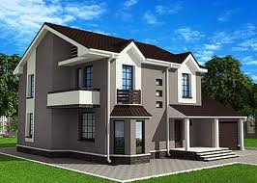
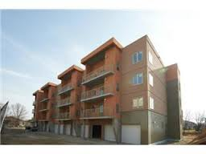
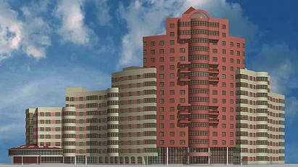
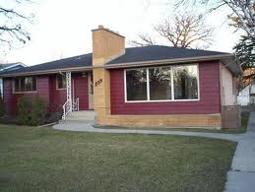
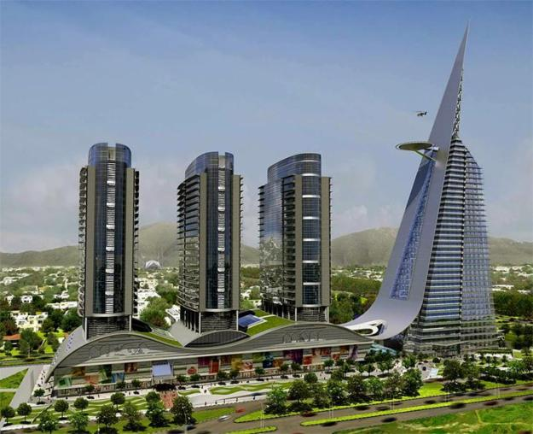
What Types Of Houses We Have In Our Communities.
In our communities we have blocks of flats, apartments, townhouses, bungalows and condos.
In our homes we usually have basements.

Slide 3
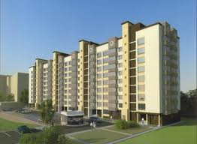
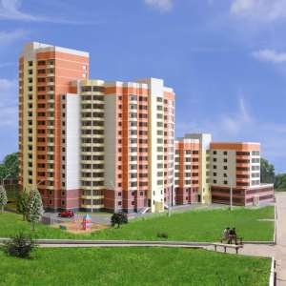
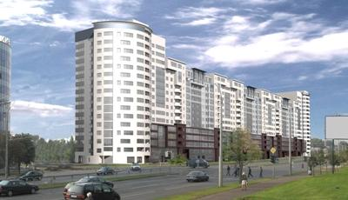
A lot of people in Belarus and Russia live in flats

Slide 4
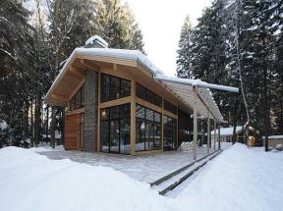
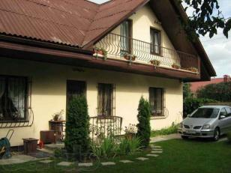
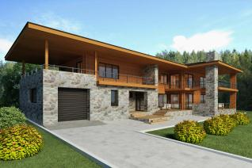
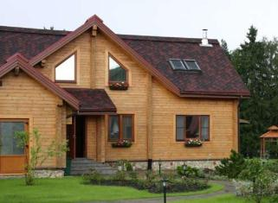
But some people prefer to live in private houses or cottages

Slide 5
A lot of people in Pakistan and Canada live in houses
Canada
Pakistan

Slide 6
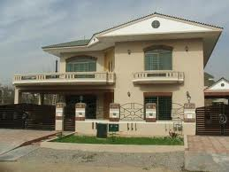
Houses

Slide 7
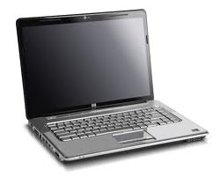
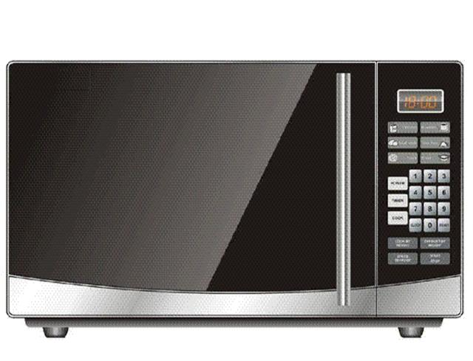
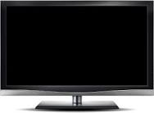
What Type Of Modern Conveniences Do We Have?
Our modern conveniences are televisions, microwaves, computers, dishwashers, stoves and fridges.

Slide 8
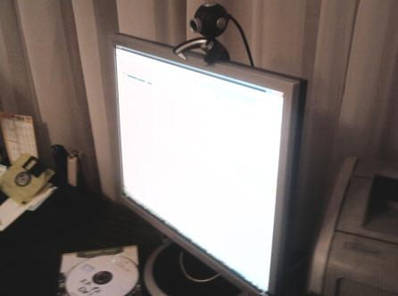
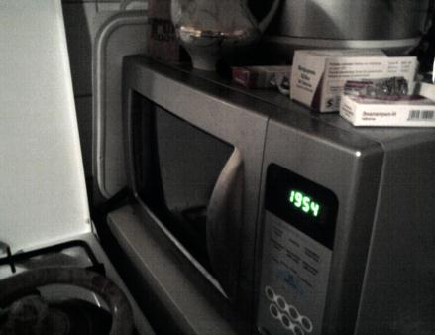
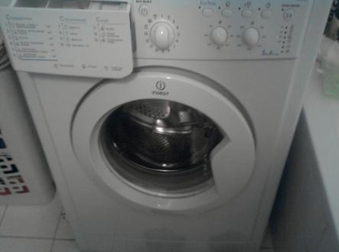
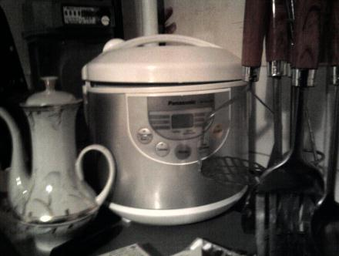
We have a lot of modern household
appliances that make our life easier

Slide 9
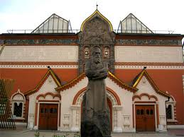
Interesting facts about houses
This house is in Moscow. It belonged to the Moscow merchant and industrialist Pavel Tretjakov (1832-1898). Now It’s a building of The Tretyakov Gallery which has a famous collection of national Russian art.

Slide 10
In Russia there are some rich houses like this one . They can afford everythin, so they are very few.

Slide 11
Mud houses in Pakistan In the past most of the people prefer to live in mud houses, in this area, because these houses are cold in summer and warm in winter. But it is very difficult to maintain them. Although by the passage of time such houses are rarely seen.

Slide 12
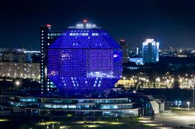
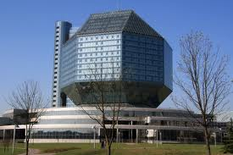
It is the National Library of Belarus. It is located in a new 72-metre (236 feet) high building in Minsk. The building has 22 floors. It was designed by architects Mihail Vinogradov and Viktor Kramarenko and opened on 16 June 2006. Its main architectural component has the shape of a rhombicuboctahedron.
The building can seat about 2,000 readers and features a 500-seat conference hall. The National Library of Belarus is the main information and cultural centre of the country. Its depository collections include 8 million items of various media.

Slide 13
Thanks For Watching!

