Slide 7
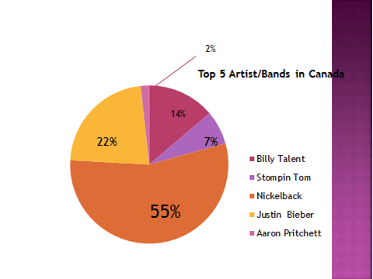

Slide 9
<- Number 1
Number 2 ->
<- Number 3
Number 4 ->

Slide 10
Links
http://www.youtube.com/watch?v=WA4iX5D9Z64 Taylor Swift
http://www.youtube.com/watch?v=mYPvAMrMzwI Psy
http://www.youtube.com/watch?v=AbPED9bisSc One Direction
http://www.youtube.com/watch?v=FlsBObg-1BQ Adele

Slide 12
Taylor Swift
<- Number 1
The Beatles -> Number 2
Flo Rida ->
Number 3
One Direction ^
Number 4
Train ->
Number 5

Slide 14
http://www.youtube.com/watch?v=-DCCQp4I9X8

Slide 15
http://www.youtube.com/watch?v=JYIERnzxrGc

Slide 16
http://www.youtube.com/watch?v=4KRfGExZYXQ

Slide 17
http://www.youtube.com/watch?v=9bZkp7q19f0

Slide 18
http://www.youtube.com/watch?v=Hg3_BzwWNDU

Slide 19
http://www.youtube.com/watch?v=4KRfGExZYXQ

Slide 20
http://www.youtube.com/watch?v=gcMn_Eu-XTE

Slide 21
References
http://cdn.idolator.com/wp-content/uploads/2012/08/14/Taylor-Swift-We-Are-Never-Ever-Getting-Back-Together-single-cover-art-400x400.jpg
http://www.viralblog.com/wp-content/uploads/2012/08/Psy-gangnam-style.jpg
http://i2.squidoocdn.com/resize/squidoo_images/-1/lens19792068_1348204819-------.jpg
http://wac.450f.edgecastcdn.net/80450F/1025kiss.com/files/2011/06/adele-set-fire-to-the-rain.jpg
http://images6.fanpop.com/image/photos/32600000/-3-taylor-swift-32676785-500-500.jpg
https://www.beatlesradio.com/Content/Images/uploaded/beatles_2406448b.jpg
http://www.billboard.com/photos/stylus/2511269-flo-rida-617-409.jpg
http://img2-3.timeinc.net/ew/i/2012/11/21/one-direction_510x317.jpg
http://www.daytonainternationalspeedway.com/~/media/BCA8D08CB398442982F04BF8682714A2.ashx?w=325

