Slide 1
Pakistani Local Cusine
By Sara
From
Army Burn Hall School for Girls
Abbottabad, Pakistan

Slide 2
In the past most of the people use to cook in clay pot, on a stove using wood as fuel.

Slide 3
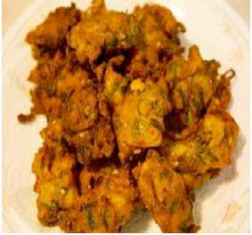
1- Kurri Pakora:
It is a traditional dish. Its an old popular dish of pakistan but hot favorite for all the times

Slide 4
Ingredients:
2 litres Lassi, Salt, red pepper, turmeric, 6 tablespoons cooking oil, 1 bulb garlic, 50 grams ginger, 100 grams onion
How to cook:
* Fry onion, garlic, and grinded ginger in cooking oil.
* Add salt, red pepper, and turmeric, and stir it for two to three minutes.
* Add chickpeas ﬂour in lassi in separate saucepan and mix it well.
* Pour lassi liquid in the mixture and leave it to boil.
* After it is boiled turn the stove off and add pakoras in it.
* Finally the kurri is ready.

Slide 5
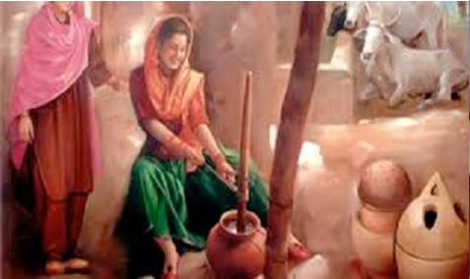
Note :Lassi is the traditional yogurt-based drink

Slide 6
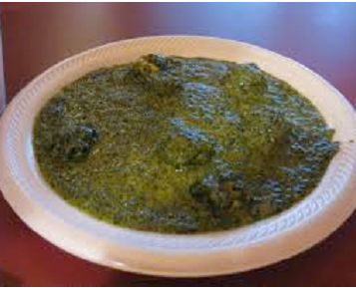
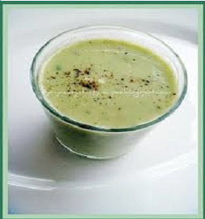
2-Lassi Spinach:

Slide 7
Ingredients:
1 kg spinach, 100 g onion, 100 g tomato, 50 g garlic, 50 g ginger, salt, red pepper, 6 tablespoons cooking oil and 1.5 litre lassi
How to cook:
* Boil spinach in a saucepan till most of water is evaporated.
* Fry onion, garlic, and ginger in cooking oil in a separate pan.
* Add salt, and red pepper in the fried onion mixture.
* Add tomato in the mixture and leave it to cook until the mixture appears
* Put boiled spinach in the brown mixture.
* Cook the paste over medium heat until dried out.
* Add lassi in the mixture, stirring continuously till it boils.
* After boiling, leave it to cook on low heat.
* Take it off from the stove and it is ready.

Slide 8
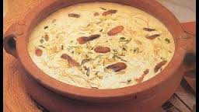
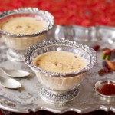
3. Sheer Khurma
It is a traditional Muslim festival breakfast, and a dessert for celebrations since old times.

Slide 9
Ingredients
Milk 1 ltr
Pinch of saffron
Vermicelli, broken into small pieces 75 g
Dry choara / dates 50-75 g
Ghee or butter 50-75 g
Sugar 125 g
Almonds 50 g
Pistachios 50 g
Raisins 25 g
Chiroli seeds, skinned 25 g
vermicelli

Slide 10
How to cook
Soak the dry dates in water for a few hours then cut into long thin slices.
Boil milk with sugar on low heat till it is reduced to 3/4 of its quantity.
Boil the nuts, blanch and slice them finely, clean raisins.
Roast the saffron and powder it.
Heat ghee or butter on low heat and fry the vermicelli till golden, about 1-2 minutes.
Add the dates, chiroli and all the chopped nuts and fry gently for a few minutes more.
Add the hot milk and cook again till desired consistency is obtained.
Add saffron and serve hot in teacups.

Slide 11
Try these yummms

