Slide 1
Local Customs and Traditions Through School Calendar
Miory Secondary School #1
Grade 8
Belarus

Slide 2
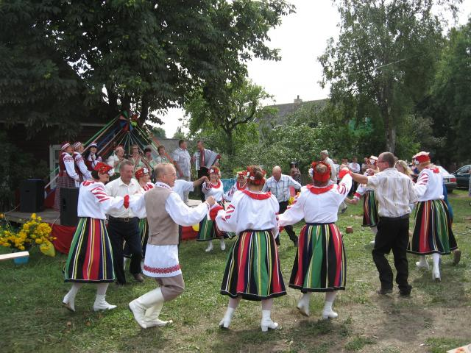
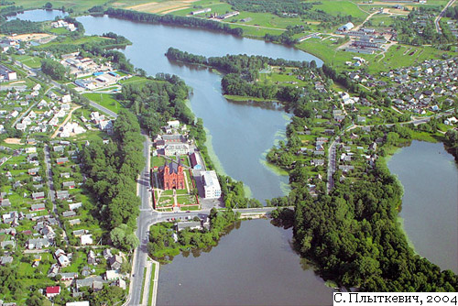
As we live in a small town our school calendar is closely connected with local traditions.

Slide 3
Keeping them unites us, makes our school an inseparable part of the community, makes us remember our roots, and identifies us.

Slide 4
Among autumn and winter traditions the most colorful are traditions connected with Christmas celebrations.

Slide 5
In our school we have a folklore club. During Christmas time they organize performances, fairs and other activities.

Slide 6
One of the popular events organized by the club is carol- singing (Kaliadavanne).

Slide 7
Children and young people go from house to house in fancy dress. They usually dress as a “goat”, a “bear”, a “horse” and have a “star” which symbolizes a Christmas Star. They sing Christmas songs, play jokes in people’s houses and people in their turn give them sweets, fruit and other delicious things

Slide 8
In old times, as our grandparents told us, carol-singers were given sausages, lard and money.

Slide 9
In old times there was a tradition to make a Christmas performance which is called Batleyka in Belarusian. It was a theatre performance based on the Biblical story of Jesus Christ’s Birth. We keep the tradition in our school and every year there is a Christmas fair with a Batleyka performance in its programme.

Slide 10
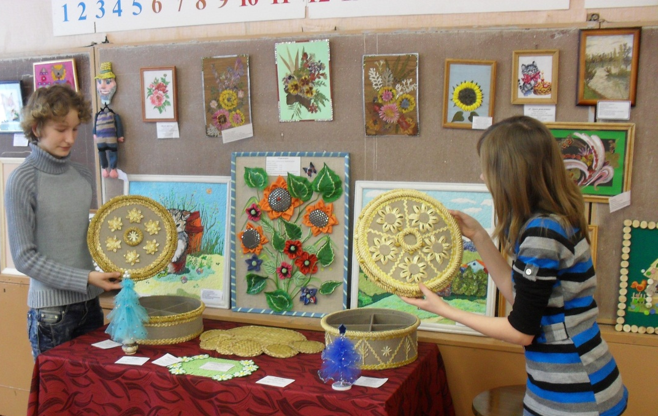
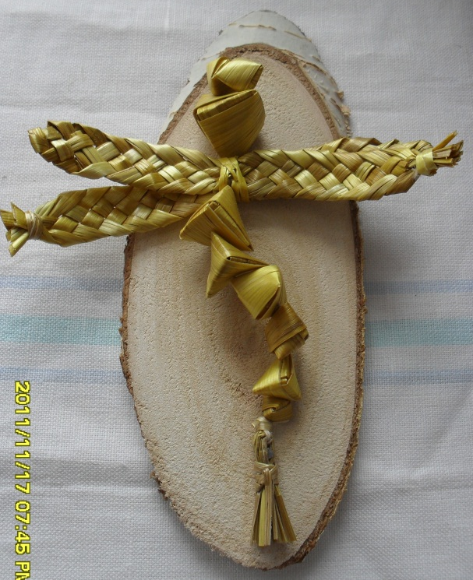
And one more thing. The “currency” at the fair is in the form of little paper stars given to the participants and winners of the funny contests organized by the club members. And things “sold” at the fair are hand-made by the students of the school. They are usually Christmas cards and little souvenirs.

