Slide 1

Sierra Leone
Jordan
United States
Campobello Island
Belarus
Ukraine
SPORTS-Mania

Slide 2
Top Sports
Canada- Hockey, Basketball, Rugby, Lacrosse, Canadian Football
Belarus- Football(Soccer), Tennis, Boxing, Hockey, Wrestling, Biathlon
Jordan- Basketball, Football, Table Tennis
Sierra Leone- Soccer
Ukraine- Football (Soccer)

Slide 3
Interviews from Canada
Sports Mania Interview
1. What sport do you play?
Basketball
2. Why do you play that sport?
I love it!
3. What is your jersey number?
7
4. How many players are on your team?
12
5. Would you consider yourself a good player? Yes or No?
Yes
6. What position do you play?
Guard
7. How many points, on average, do you usually make in one game?
5
8. What is the best score you have gotten?
I don’t know
9. Is this a team sport? If so, does your team usually win?
Yes. No
10. Do you have fun playing this sport?
Yes

Slide 4
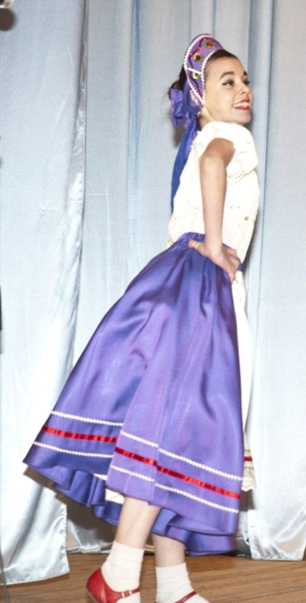
From Ukraine - Liza
Liza is our classmate. She is very artistic and sporty. It is difficult to say what she is better at – running or dancing.
We asked her some questions:
I go in for running
The best shown result was for 60 meters which I did in 9.56.
I do like running because I can show my force there.
I participated both in the district and regional competitions.
I like dancing and I`m pretty good at it.
I`ve participated both in the district and regional competitions. I took different places varying from the first to the third. And of course we were given certificates and prizes.

Slide 5
Interview from Belarus
Maksim Golub
1. What sport do you play? FOOTBALL
2. Why do you play that sport? I LIKE IT
3. What is your jersey number? 7
4. How many players are on your team? 19
5. Would you consider yourself a good player? YES
6. What position do you play? HALFBACK
7. How many points, on average, do you usually make in one game? 1
8. What is the best score you have gotten? 3
9. Is this a team sport? If so, does your team usually win? WE USUALLY WIN
10. Do you have fun playing this sport? YES

Slide 6
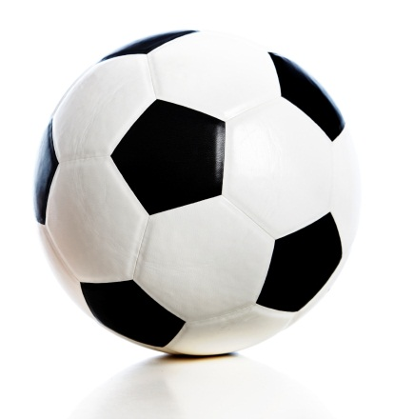

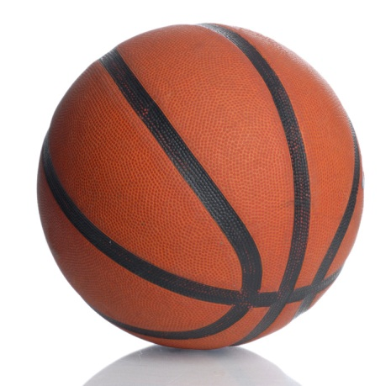
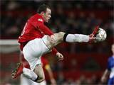

Interviews from jordan
Haytham al Shawa and Samer Adli
Favourite Sports: Basketball and Soccer
Favourite Athletes: Ronney,xavi , ra'fael nadal .
Xavi
Ronney
Ra’fael Nadal

Slide 7
Interview from belarus
Katya Mehannikova
1. What sport do you play? KARATE
2. Why do you play that sport? TO BE FIT, I LIKE TO TAKE PART IN COMPETITIONS
3. What is your jersey number?
4. How many players are on your team? 10
5. Would you consider yourself a good player? Yes or No? YES
6. What position do you play?
7. How many points, on average, do you usually make in one game? 4-5
8. What is the best score you have gotten? 6
9. Is this a team sport? If so, does your team usually win? WE OFTEN WIN AS A TEAM
10. Do you have fun playing this sport? YES, IT’S NOT ONLY SPORT, IT’S FRIENDSHIP

Slide 8

Favourite sport in Canada
The favourite sport in Canada is Hockey. Hockey is one of Canada’s national sports. It is where two teams compete to try and score on the other team’s goal. There is evidence of games played with “curved sticks” that dates back to over 4000 years ago.

Slide 9
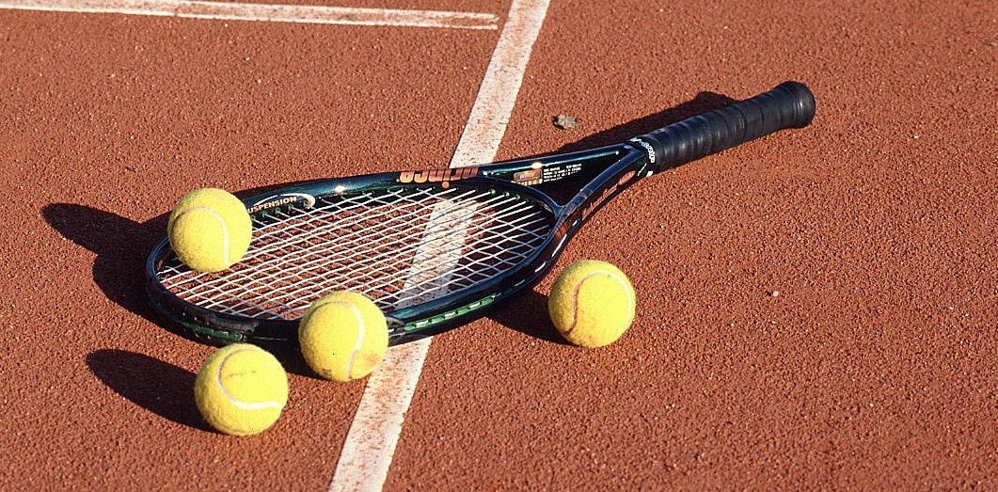
Favourite sport in belarus
The favourite sport in Belarus is tennis. Tennis is a game where either two or four people hit a tennis ball with rackets over a net. The origin dates back to early in the twelfth century when someone hit a ball with their hand. This then evolved into what we know as modern tennis with rackets and nets.

Slide 10
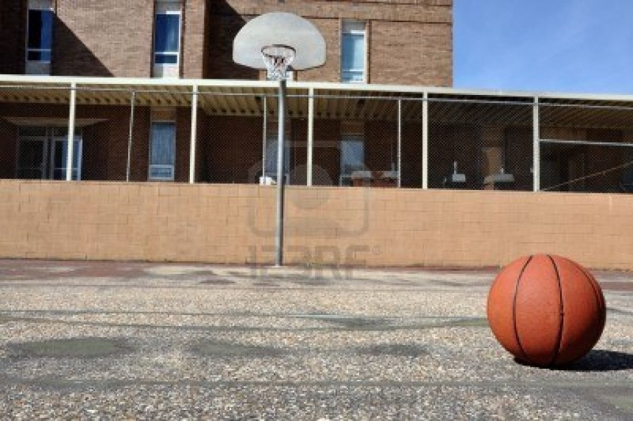
Favourite sport in Jordan
The favourite sport in Jordan is Basketball. Basketball is a sport played where two teams compete to try and make the most points. They have to shoot a ball into a net on the other team’s side. The sport was invented by Canadian, James Naismith in the late 1800s. It was originally played with two peach baskets and a soccer ball.

Slide 11
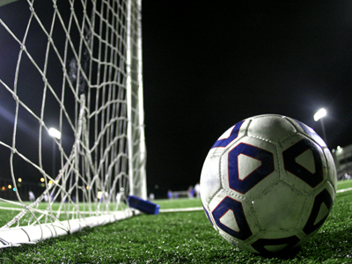
Favourite sport in ukraine and Sierra leone
Ukraine and Sierra Leone both had the same favourite sport of football (soccer). Football is where two teams try to kick a ball into the other team’s net. Soccer is the world’s most popular sport. Games involving kicking some sort of ball have been around for a long time. The modern rules were developed by trying to make similar games of football in England into one game in the mid 19th Century.

Slide 12
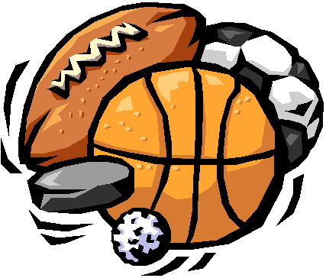
Sports around the world
Through this project I have found that many sports played here in Canada, are the same that are played in the other countries in the project. They are all a lot of fun and unique to every place that they are played.

Slide 13
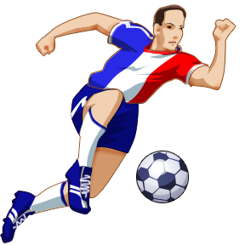
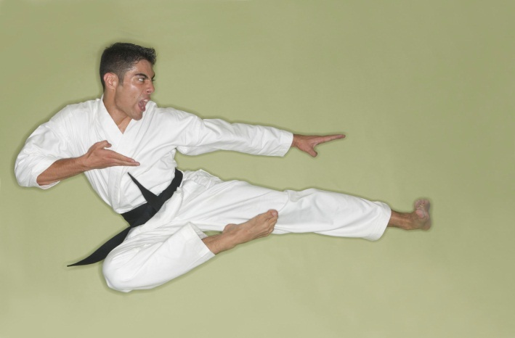
THANKS FOR WATCHING!
By CICS students and compiled by Jordan W.

