Slide 1
A greener world starts by you…

Slide 2
The environmental impact of transport is significant because it is a major user of energy, and burns most of the world's petroleum. This creates air pollution, including nitrous oxides and particulates, and is a significant contributor to global warming through emission of carbon dioxide, for which transport is the fastest-growing emission sector. By subsector, road transport is the largest contributor to global warming.
Environmental regulations in developed countries have reduced the individual vehicles emission; however, this has been offset by an increase in the number of vehicles, and more use of each vehicle.
Some pathways to reduce the carbon emissions of road vehicles considerably have been studied. By reducing transportation emissions globally, it is predicted that there will be significant positive effects on Earth's air quality, acid rain, smog and climate change.

Slide 3
The health impact of transport emissions is also of concern.
Carbon dioxide is essential for internal respiration in a human body. Internal respiration is a process, by which oxygen is transported to body tissues and carbon dioxide is carried away from them. Carbon dioxide is a guardian of the pH of the blood, which is essential for survival.
Apart from being an essential buffer in the human system, carbon dioxide is also known to cause health effects when the concentrations exceed a certain limit.

Slide 4
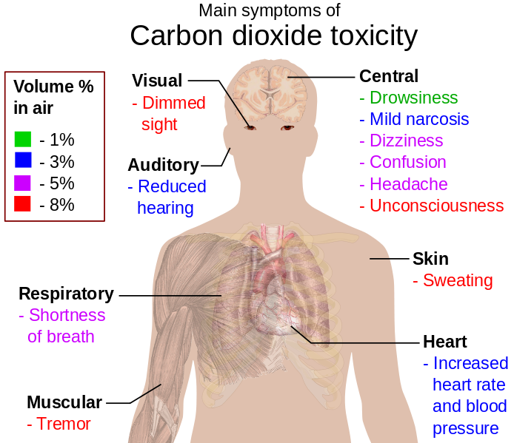
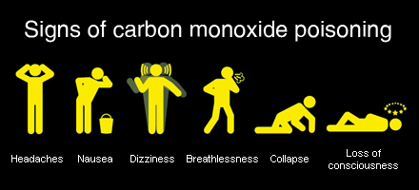

Slide 5
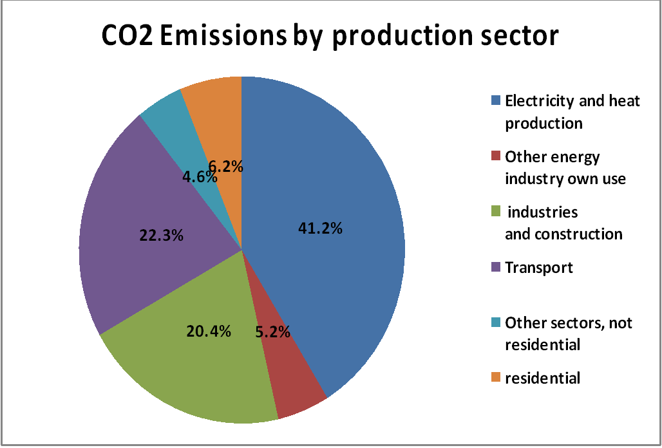
Road transport contributes about one-fifth of the EU's total emissions of carbon dioxide (CO₂). CO₂ emissions from road transport increased by nearly 23% between 1990 and 2010, and without the economic downturn growth could have been even bigger. Transport is the only major sector in the EU where greenhouse gas emissions are still rising.

Slide 6
In our country the main source of CO2 also represents the transport.
We have made a research and found that through our school yard was passing per day about 50-70 cars, and each car produces about 120-150 g/km CO2 or other greenhouse gases.
We have asked a number of 100 studentds to find out the main transports which is used by them.
What kind of transport are you using?
Car- 30%
Trolley -10%
Bus, Minibus- 40%
Bycicle- 0%
By feet- 20%

Slide 7
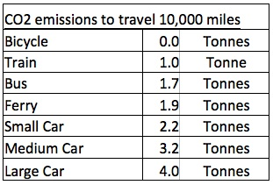
Because of the large number of cars passing through our yard, which pollute the air around the school, we decided to promote in our school the cycling instead of car, because the bike does not have negative impacts on the environment and has positive effects on health.

Slide 8
Informing the students about our project
For this we chose a target group which were riding bikes. These were in general students from 14 to 16 years. We went from class to class and made small presentations concerning the pollution of air in our environment. Some boys and only one girl agreed to come to school by bike during a week.

Slide 9
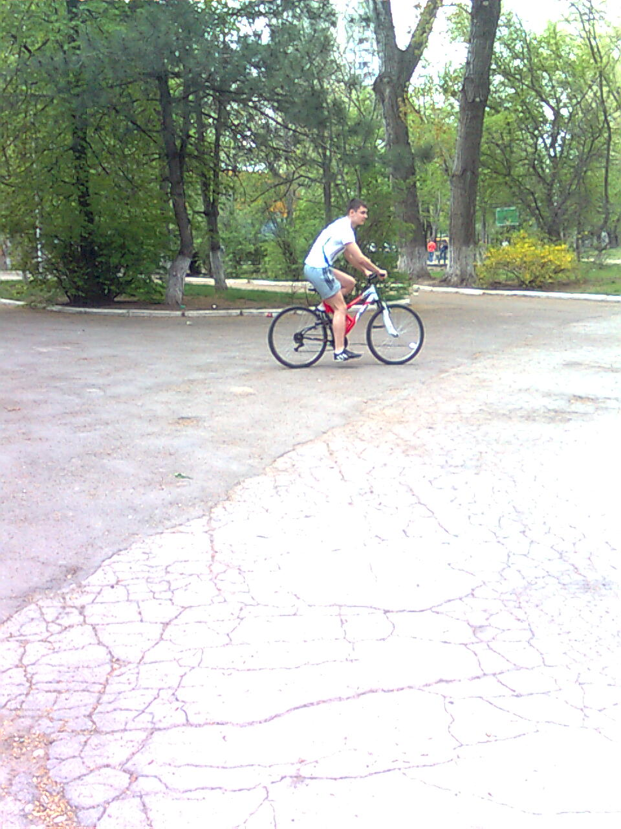
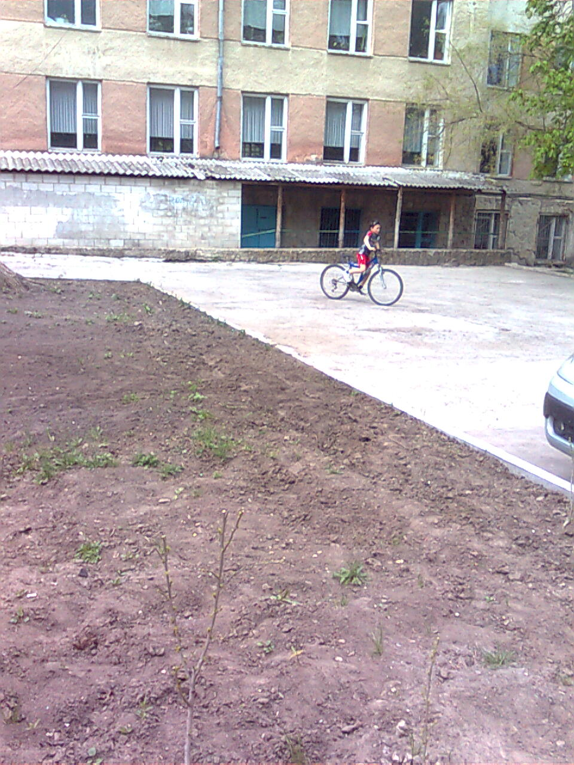
Students have accepted our challenge!

Slide 10
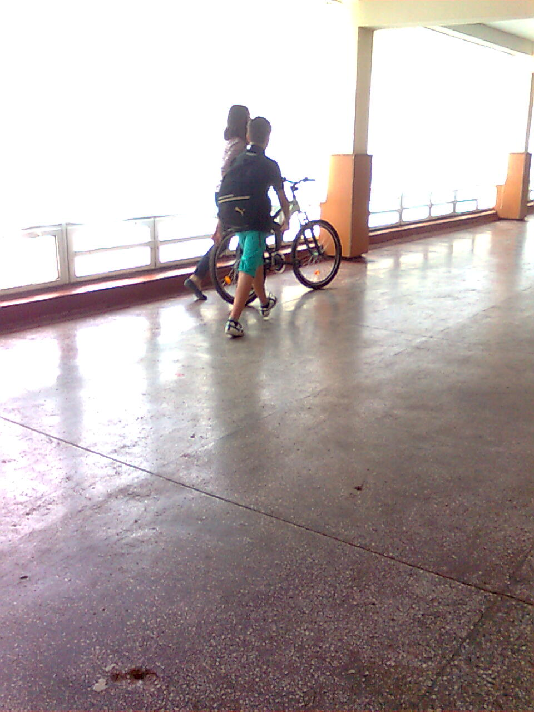
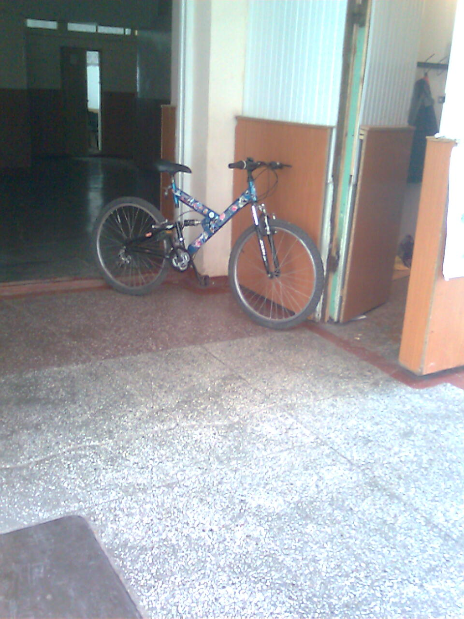
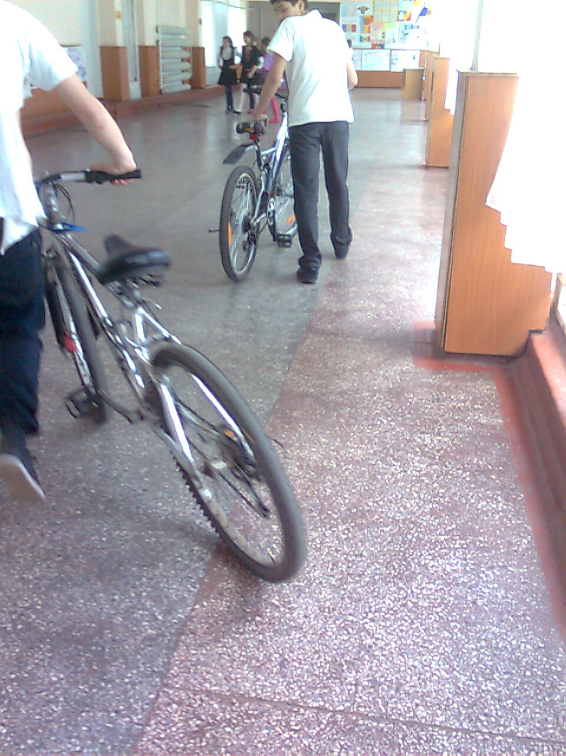

Slide 11
After this project, we made known one of the most serious problems of world (pollution). We tried to mobilize our high school students to come to school by bicycle to promote a healthy living environment. With a good feedback, the number of cars that come to our school decreased. But we all know that we have to work in this area. We urge all students to promote walking to school by the bike.

Slide 12
“Be the change that you wish to see in the world.”
(Mahatma Gandhi)
Valeria Vistovschi
Igor Turchin
Adrian Stamatin
Batrîncea Victoria

