Slide 1
School Museums
Secondary School No 23
Kurgan, Russia
May 2013

Slide 2
We Think
A museum is a unique carrier of historical memory of the mankind.
It develops the creative potential of personality.

Slide 3
The Goal of the Project
We would like to know about the kinds of school museums and their activities

Slide 4
Our School Partners
Natalia Kulakovich and her students from Radoshkovichi, Belarus.
Oxana Krailo and her students from Luchynets, Ukrain.
Olha Shkarupa and her students from Lisovi Sorochintsi, Ukrain.

Slide 5
Kinds of School Museums
The historic events of the Great Patriotic War are the focus of the school museums in Kurgan and Radoshkovichi.
Folk art and traditions are the focus of the school museums in Luchynets and Lisovi Sorochintsi.

Slide 6
Driving past Radoshkovichi, everyone has the opportunity to stop near the unusual monument to commemorate the brave pilots.

Slide 7
In honour to those pilots “The Museum of Air and Fire Attacks” was created in the boarding school of Radoshkovichi, where a great number of exhibits are represented.

Slide 8
Among them you can find the unique things, such as identifying military documents, helmets, remains of the plane, pilots` leather gloves, the pilot`s bag, the navigation slide rule, the parachute, badges, letters, photos, their friends` recollections and also printed editions telling us about the mortal deed.

Slide 9
It`s interesting that the guides of this museum are the students of the boarding school.

Slide 10
The main concepts of the museum`s activity are:
the organization of excursions
collecting information and researching it
communication and correspondence with the veterans and with other students

Slide 11
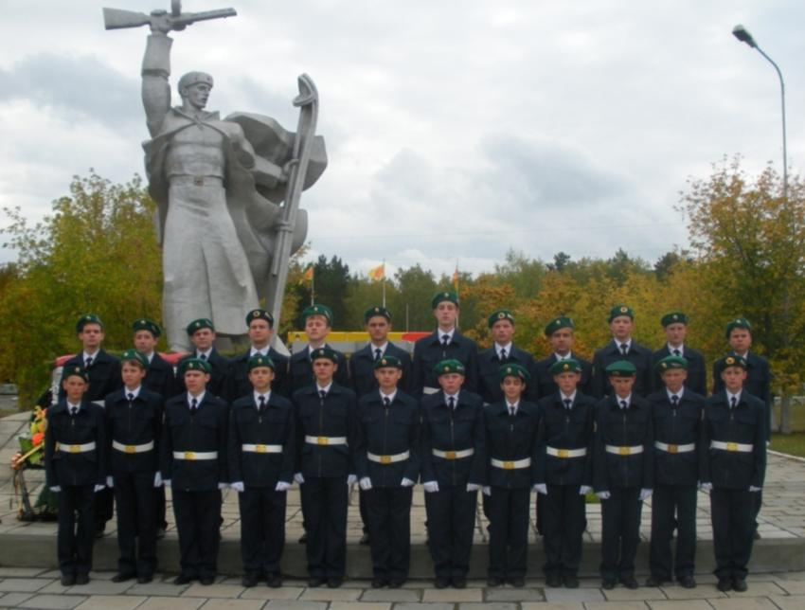
We remember the heroes of the Great Patriotic War
School No23 Kurgan, Russia

Slide 12
The school museum is devoted to the 32nd Ski Regiment. The beginning of the Great Patriotic War was very hard for our country. It suffered heavy losses in manpower and material. The country needed well trained fresh forces. That’s why in the August of 1941 the training of military skiers began.
The training regiment was deployed in a birch grove in the inhabited locality of Uval (a small hill) seven kilometers far from Kurgan. The personnel of the regiment lived in 20 earth houses for 250 men each. The training lasted for two months. About 20 thousand skiers were prepared in the regiment.

Slide 13
The Kurgan skiers bravely fought at the Kalinin, Leningrad, North-West fronts. They liberated the Ukraine, Byelorussia, the countries of Europe from Nazism. A lot of the skiers were killed in the battle of Rzhev.
In 1991 the ashes of the unknown soldier were brought from Rzhev to Kurgan and buried at the foot of the monument to the military skiers of the 32nd Ski Regiment . The monument was built in 1989.
Nowadays few veterans skier s are alive. The pupils visit them. On the eve of Victory Day the pupils make bus excursions. They tell the passengers about the 32nd Ski Regiment.

Slide 14
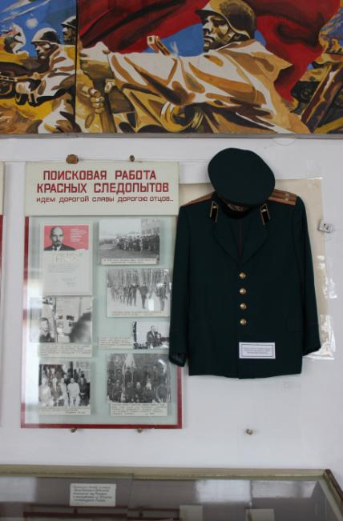
Inside the museum

Slide 15
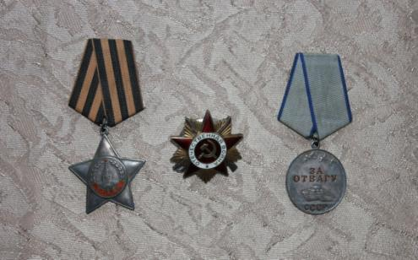
Orders and medals of the veteran skiers

Slide 16
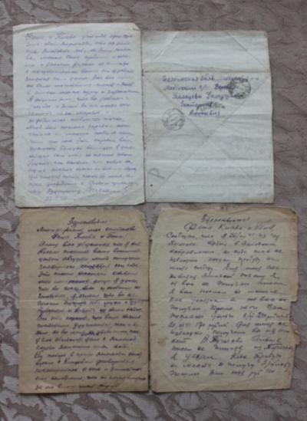
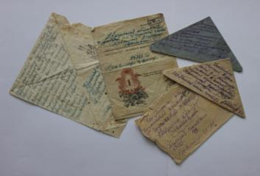
Letters from the front

Slide 17
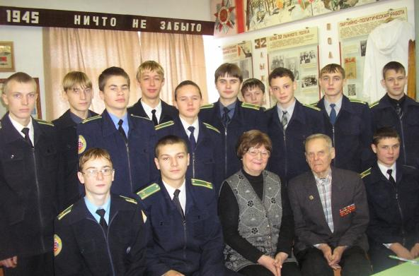
Meeting the veterans

Slide 18
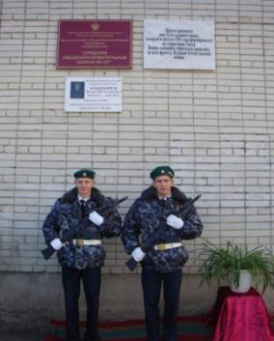
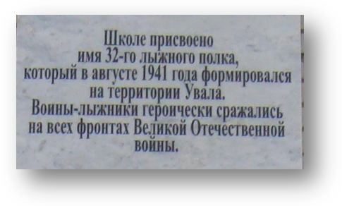
In 2009 School № 23 was named after the 32nd Ski Regiment

Slide 19
Our school museum
Created by students from
Luchynets school, Ukraine

Slide 20
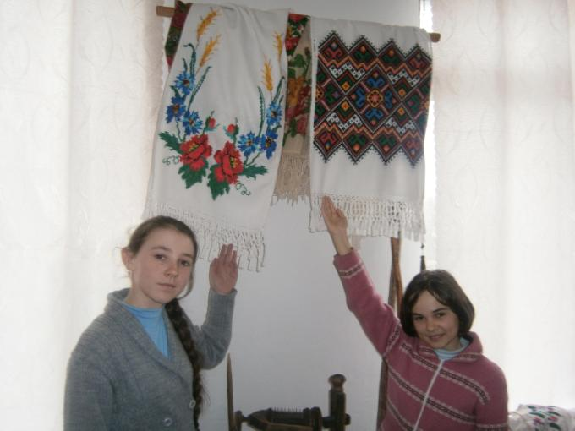
Our school has got its own school museum – the museum of folk art and traditions.

Slide 21
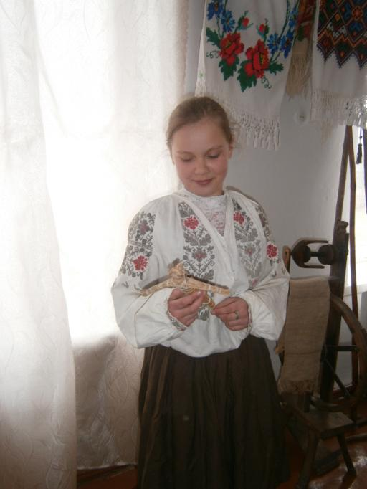
The exposition includes the original traditional pieces of clothes decorated with the embroidery

Slide 22
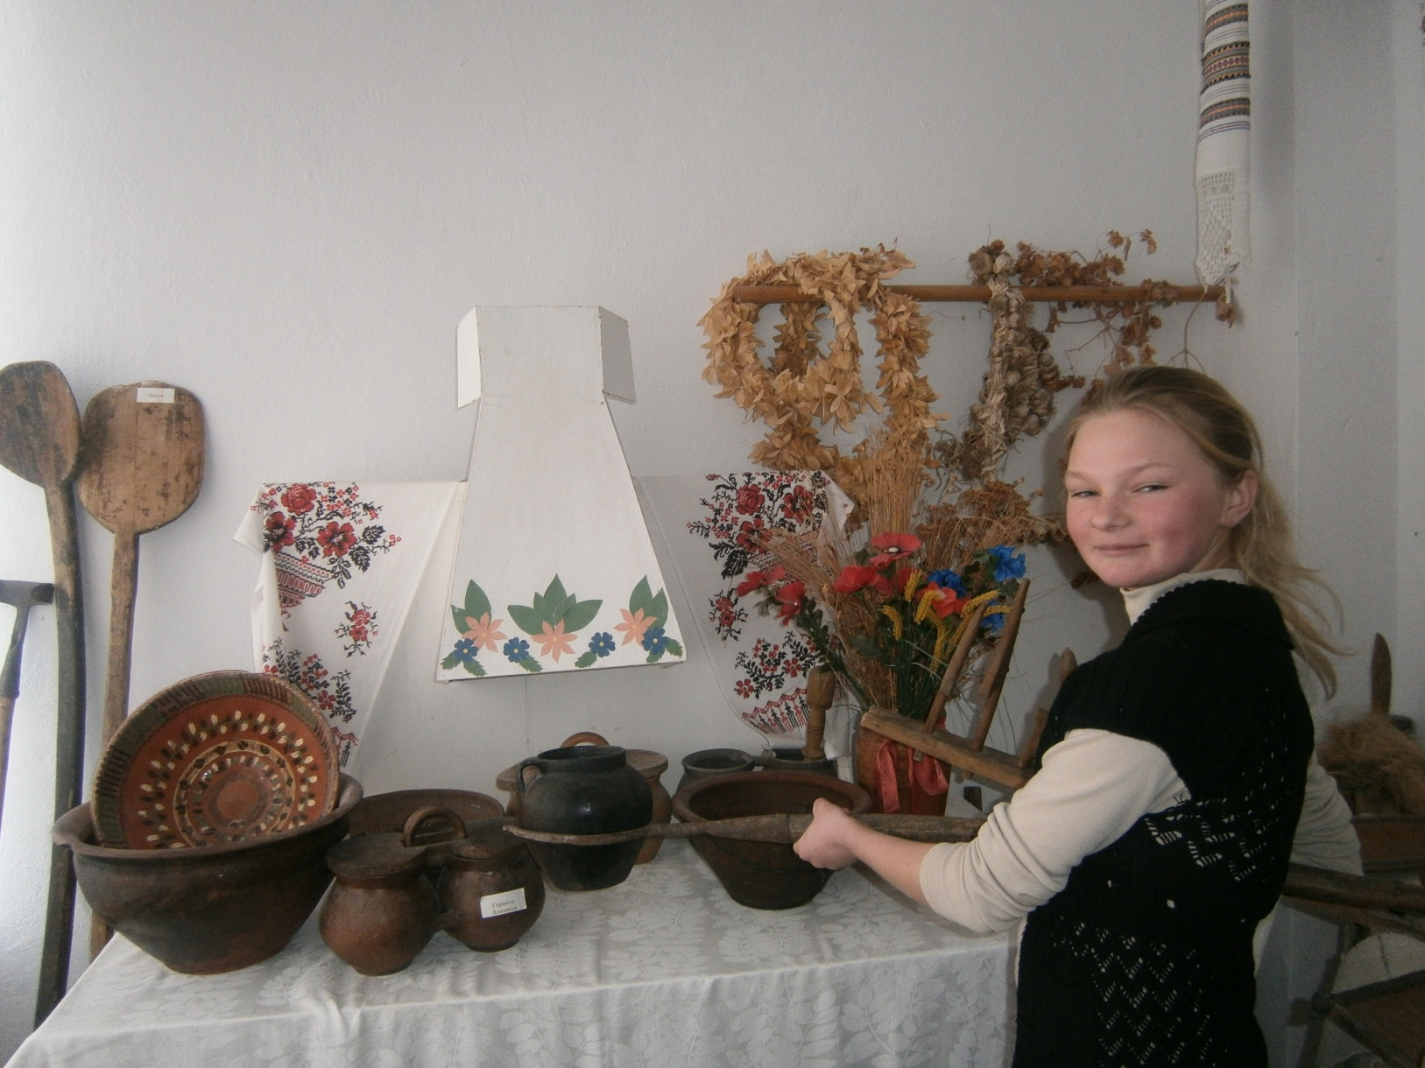
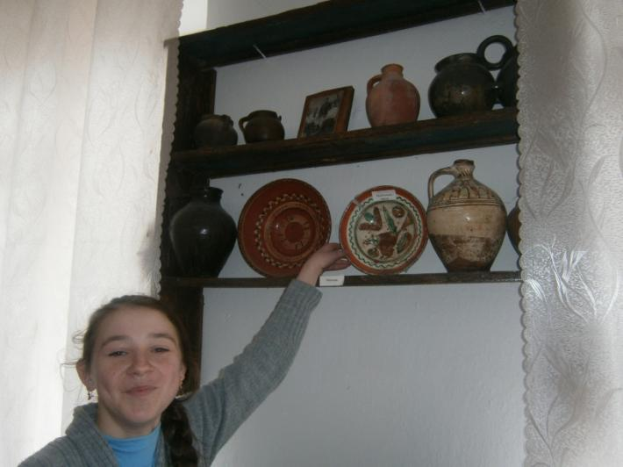
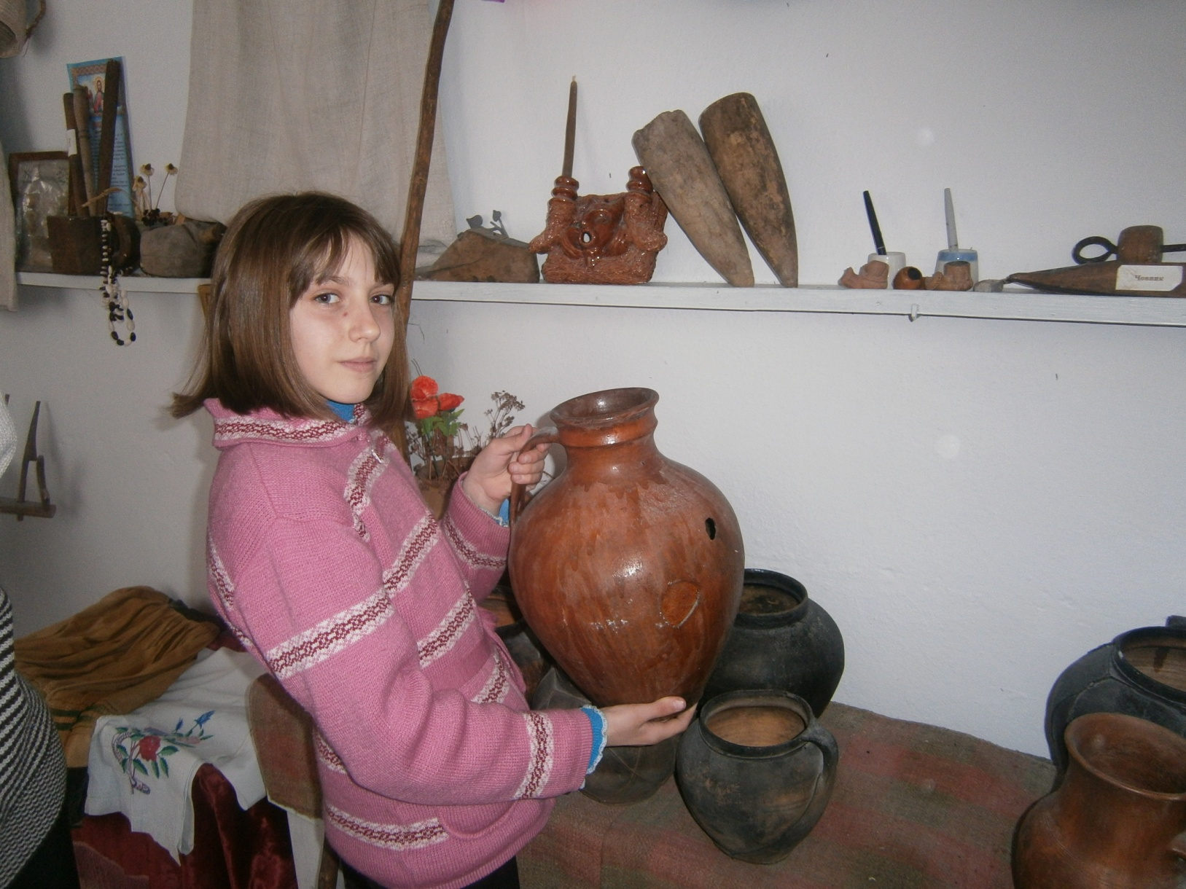
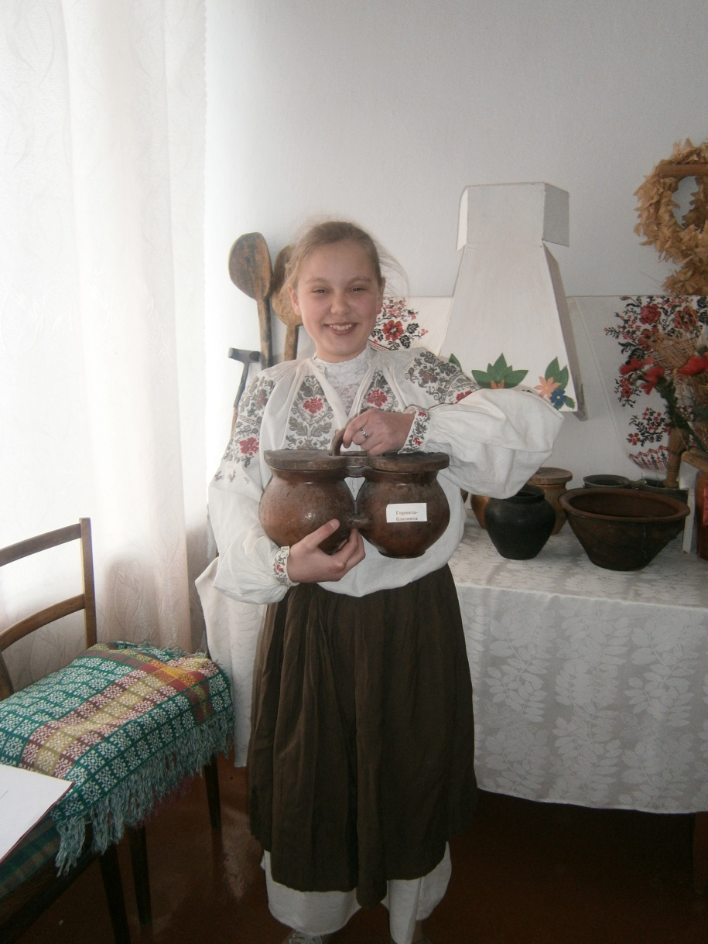
Also you can see the cooking utensils …

Slide 23
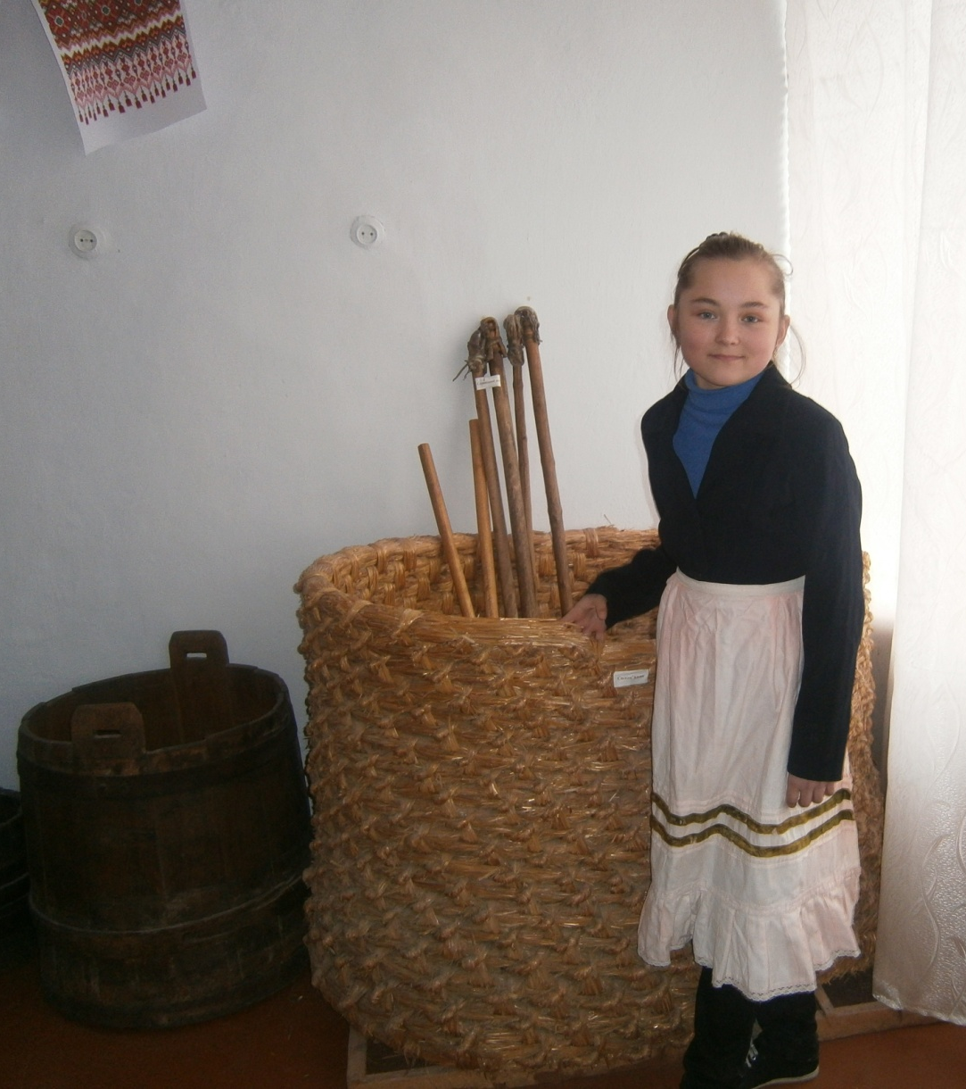
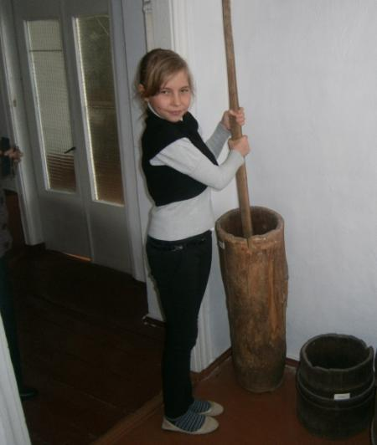
Ukrainian village inhabitants were mostly farmers so there are some tools and things they used for the farmer’s work

Slide 24
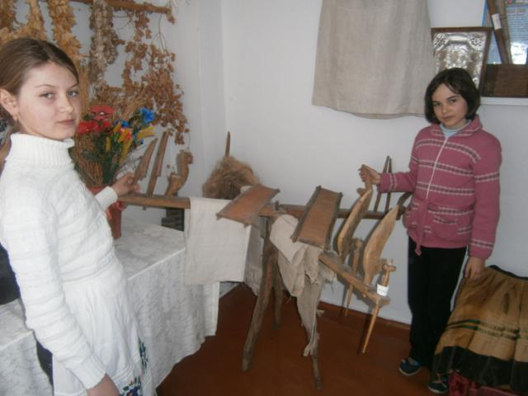
Now we can learn the routine life of our forefathers watching the real things from the past

Slide 25
We love our culture and try to keep it

Slide 26
School Museum
LISOVI SOROCHINTSI
UKRAINE

Slide 27
OUR SCHOOL MUSEUM IS DEVOTED TO OUR CULTURE AND TRADITIONS

Slide 28
OUR HISTORY TEACHER AND ALL PUPILS TOOK PART IN ITS CREATION

Slide 29
OUR HISTORY TEACHER SVITLANA KOZUB HEADS OUR MUSEUM

Slide 30
WE HOPE YOU ARE INTERESTED IN OUR MUSEUM

Slide 31
IT WAS A GREAT IDEA TO CREATE A MUSEUM AT SCHOOL!

Slide 32
Conclusions
The museums encourage students to love their native land. They develop important skills.
We would like to thank our partners for their projects. We enjoyed the global collaborative experience.

