Slide 1
THE VIEW FROM MY WINDOW
Ponikve, Slovenia
Spring 2013

Slide 2
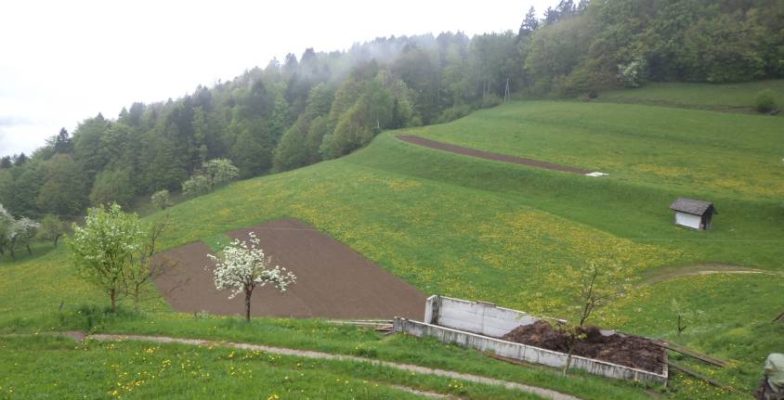
I live in a small village Ponikve, 20 km from town Tolmin. Ponikve is the largest village on the Šentviška Plateau (Šentviška planota), with the population of 195 .
All the land in the following pictures belongs to my family.

Slide 3
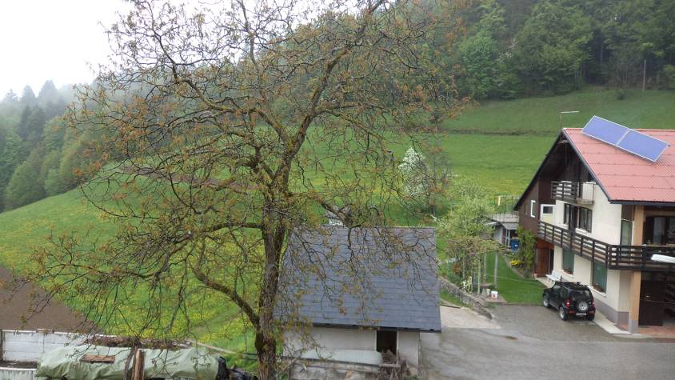
When I look through my window, I see a lot of green.

Slide 4
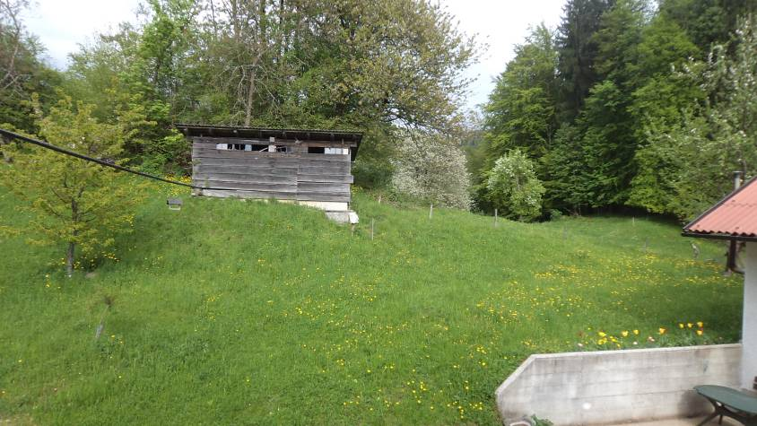
This is the first thing I see when I wake up. It makes me feel really calm and relaxed.

Slide 5
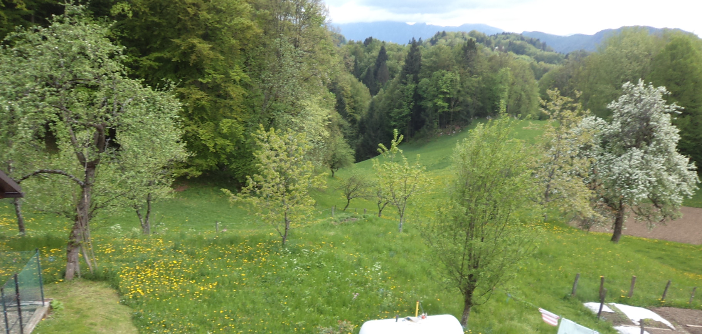
I can see trees, meadows and fields…. They say that green is the most calming colour. I think it‘s true since I feel better everytime I go out in nature.

Slide 6
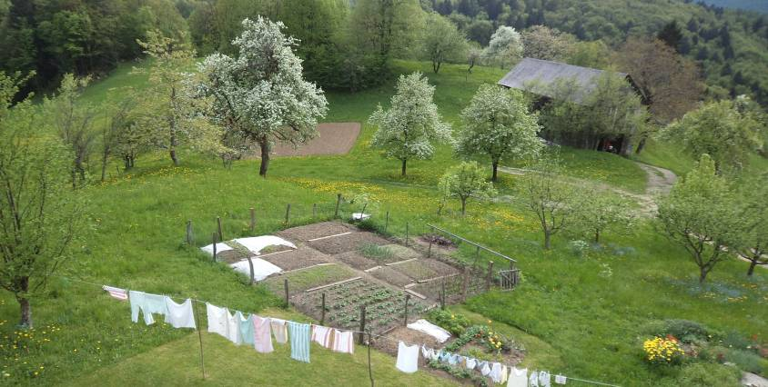
We also have a garden and a few fruit trees. It‘s great to have homemade spices, vegetables and fruit.They taste much better than the stuff from the store.

Slide 7
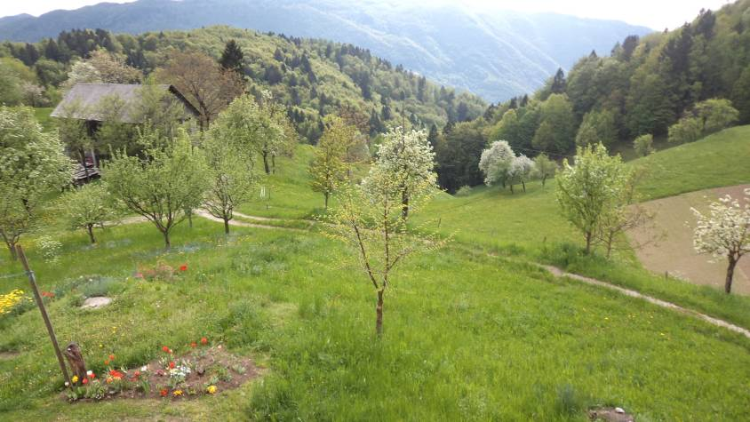
Also,we have the most marvelous view. You can see mountains, green hills and clear blue sky.

Slide 8
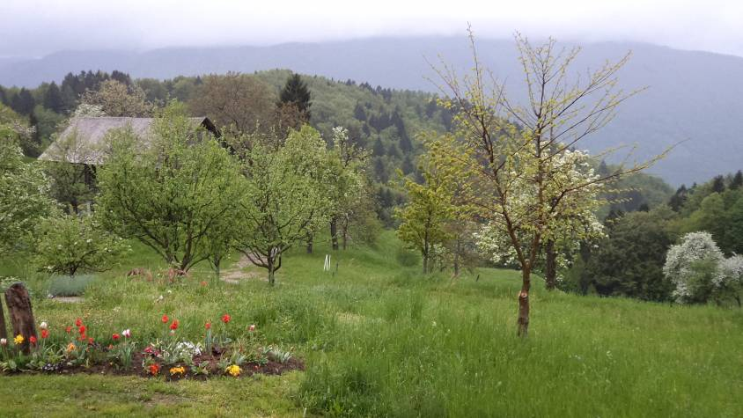
You can read more about Ponikve and the Šentviška Plateau here: http://www.sentviskaplanota.si/

