Slide 1
IEARN, January 2013 - May 2013
Computer Chronicles Learning Circle 1
Name of Project: Problems of young people
Sponsoring Teacher: Nadejda Salikhova
Project made by: Aigul Murtazina
Russia, Tatarstan, Almetyevsk city, School # 10

Slide 2
Social problems of young people in our country
drug addiction
negligent attitude to learning (missing school, the leaving of the school)
smoking
alcoholism
vandalism
dependence on computer (Internet, computer games)
Do not want to work
do not want to serve in army
youth crime
homelessness, poverty

Slide 3
Social problems of young people in our city
drug addiction
negligent attitude to learning (missing school, the leaving of the school)
smoking
alcoholism
vandalism
dependence on computer (Internet, computer games)
do not want to serve in army

Slide 4
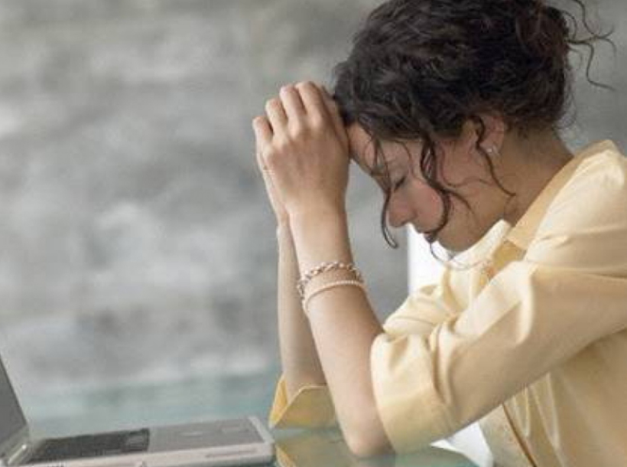
Social problems of students at school
late coming on lesson
quarrel between students
rudeness and crudeness (obscene language)
negligent attitude to learning
smoking at school
missing school

Slide 5
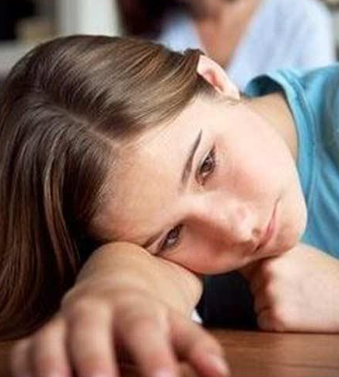
Social problems of students in families
children do not respect their parents
the growth single-parent families and children-orphans
children argue with parents
parents shout at their children
children feel are lonely in family
haven`t nobody to rely on
being dependent on parents

Slide 6
Government efforts in resolving the problems
investing projects aimed at the eradication of poverty
tightening the laws on the use of minors alcohol, drugs and cigarettes
solves the problem of employment
helps to low-income families, families with many children and incomplete families, also orphans

Slide 7
How Parents/Teachers resolved the problem
Inculcate good morals to children
Support the children and try to be with them in good relations
Use fair punishments and stimulations.
Make more children happy.

Slide 8
What young people should do to resolve their problems
They can obey teachers and parents, be for each other friends, but not enemies.
They can to become more independence, if they will be more dependable and conscientious attitude to themself
They can dream about their future and start to act
They can change word “problem” to word ”goal” and try to reach their goals.

Slide 9
We are happy future!

Slide 10
Social Problems in our School
By: Sloane Jesse & Sophia Reynolds
Mrs. Giessen's 4th Grade Class

Slide 11
INTRODUCTION
In our school, we really have no serious social problems such as drug abuse, physical fighting, or any other serious problems. We do, however, have frequent cases of quarreling, bad competition, popularity, and friendship loss. Also, we can have small cases of bullying at some periods, but it never lasts very long. We hope this presentation provides the required information.

Slide 12
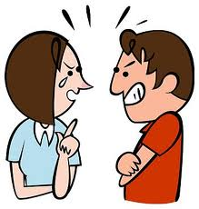
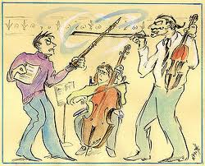
Quarreling & Bad Competition
Quarreling
When we quarrel, we usually do so because we think someone is spreading rumors or smaller things like someone stealing a pencil or borrowing a pen, paper, or other objects without asking.
Bad Competition
To us, bad competition means to compete in a bet or other form of contest. The most common figure of BC in our school is usually betting that we can make it through the week without talking to our friends. It might seem like this doesn't make a big problem, but if it goes too far, the results can be quite devastating.

Slide 13
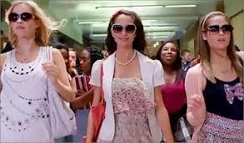
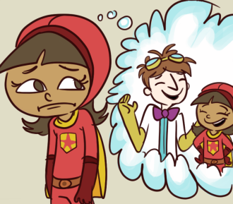
Popularity & Friendship Loss
Popularity
Popularity is honestly a minuscule problem in our school. Some people in our grade are considered popular, but most of the kids in our class do not support the fact that they are. People deny that they are popular, but they still know that they are.
Friendship loss
This probably sounds odd to you, but we will explain it as clearly as we can. It almost is exactly what the title states, and it is. You lose a friend because they go hang out with other people and don’t talk to you for very long periods of time. That is considered losing a friend.

Slide 14
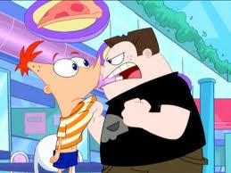
Bullying
Bullying
Bullying, like we mentioned in the introduction, is a relatively small problem, just like popularity. We recently had a bully but we will not mention his name due to privacy. Not only did they say inappropriate words, but he hurt people physically. In most of our time at Armstrong, it is the first time we have seen any physical fights.

Slide 15
Thank you! We hope we provided satisfactory information!
- Sloane J. & Sophia R.

Slide 16
“Social Concerns” Pupils of Year 5Pedmore CofE Primary School
Friends
Sometimes best friends can fall out because they’re best friends they usually find a way to sort things out.
Sometimes we might not have anyone to play with
Boys sometimes get into fights with each other – thankfully, it’s usually play fights and they usually make up afterwards.
Best friends sometimes drift apart & then you’re left out without a best friend anymore.

Slide 17
Friends/2
One minute you can be Playing really nicely with everyone and then suddenly you feel left out and you don’t know why.
Worries that if you’ve fallen out with a friend the mums might find out and take matters into their own hands.
Sometimes we worry about people not letting you into clubs – in school we call these gangs and they’re not allowed.
Sometimes people have seen a film that you haven’t and they leave you out if you can’t talk about it – sometimes the film is for older teenagers

Slide 18
Gadgets
Sometimes friends pressure you to play older games on X-Box Live like Call of Duty;
If you and a friend have a game on X-Box live that another friend doesn’t have then they can’t join in.
Sometimes others in class have a phone and they pressure other people to have a phone but their Mums say no.
Sometimes we worry about getting texts if these are unkind.

Slide 19
Moving up to high school
Going up to high school can be a worry because sometimes your friends are going to different schools.
You might have to leave your best friend from primary school – you might not be able to see them again
Sometimes you’re nervous about grammar school entrance exams.
You worry that at High School classmates might be wanting to be ‘cool’ and laughing at people who work hard at school work.
Worries about school work.

Slide 20
PRESENTATION FROM NIGERIA, KATSINA COLLEGE KATSINA:“SOCIAL PROBLEMS OF YOUNG PEOPLE”
“YOUTH PROBLEMS IN THE COUNTRY”
Poverty
Some extent of exams malpractice
Drop out from schools
Political thuggery
Drug abuse
These are some of the social problems of youth in the country

Slide 21
Young people’s social problems in our city includes:
. Violating laws and order
. Poverty
. Political thuggery
. Drug abuse
. Drop out from schools

Slide 22
Social problems in the school
. Some are disobedient to teachers
. Some are disobedient to their seniors
. Lack of seriousness of some students in their studies
. Truancy
. Late coming
. Quarrelling between students

Slide 23
Social problems of students in our families : The commonest problems in our families include : (1) Inability of some parents to send their wards/daughters to schools (2) Inadequate provision of learning materials to their wards/daughters (3) poverty.

Slide 24
Government efforts in resolving the problems:
Mobilization awareness campaign
The govt is pushing more money to eradicate poverty level
Evolving more laws regarding the use of drugs
Fighting against corrupt politicians

Slide 25
How Parents/Teachers resolved the problem:
They are enacting laws to control the situation
They are inculcating good morals to the students
They are becoming role model to the students
Conducting Parent Teachers Association meeting regularly

Slide 26
The young ones are assisted in resolving their problems as follows:
Introducing student’s centred learning
Guidance from parents / teachers.
BEST REGARDS AND WISHES FROM KATSINA COLLEGE COLLEGE KATSINA!
Nasir Danzaria
Nigeria

Slide 27
Scoala cu clasele I-VIII " Ghe. Lazar" Agiurgioaiei Luminita,Corbu, Romania
Large group had just finished and I was on summer vacation. Then I met a girl younger than me by two years who was abandoned by her mother since she was a year and a half. It was and is raised by her father as could be because not a place munca.Cu However it is registered and attending regular kindergarten. I was surprised when some children are not raised by both parinti.Eu thought to all children is like my family, like all girls have what they want, are protected and feel real princesses. I thought when you can feel it when he sees around other children or their mothers hand when he takes in his arms and kisses her. But when mom is sick and is not to hold her close to courageous? On celebration March 8 can not look into your eyes when my mother reciting poetry as well as her colleagues! . I was at home to know better and saw that has very few toys and clothes compared to mine. Este a very sociable girl, we played together and we hardly despartit. La next visit I provided toys, shoes, sweets and many of my lovely dresses that i could not wear them, but they made ​​them great joy. Now she feels a little princess. Victoria

Slide 28
This year, a few weeks before spring break I met and visited with my parents two sisters who lived in my grandmother because their parents did not have a house of their own. Had eight and seven ani. When I saw how poor some people are. They had no heat, electricity, had their room and even TV. The clothes were very old and broken.
We found that never went to kindergarten or school. Did not even have a toy. Grandmother does not have a job. Working on the neighbors that you have to give them food. However, they were very happy with my grandmother were very smiling, and glad to have a house to live. Do not understand how they can be so happy with so little, and I often, though parents strive to have everything I need, I sometimes feel unhappy!
It was a real lesson for me happiness when I saw that you do not need the most expensive Barbie doll that you can be a happy child.
Miruna

Slide 29
Thanks for being together in solving problems :
Nadejda Salikhova, School#10,Almetyevsk,Tatarstan,Russia
Stephanei Pedmore CofE Primary School, United Kingdom
Linda Giesen, Dallas, TX, United States
Nasir Danzaria,Nigeria,KATSINA COLLEGE
Agiurgioaiei Luminita,Corbu, Romania
BEST REGARDS AND WISHES!

