Slide 1
MY CITY AND ME
By: Mazen Beshtawi
Yafa Metwally

Slide 2
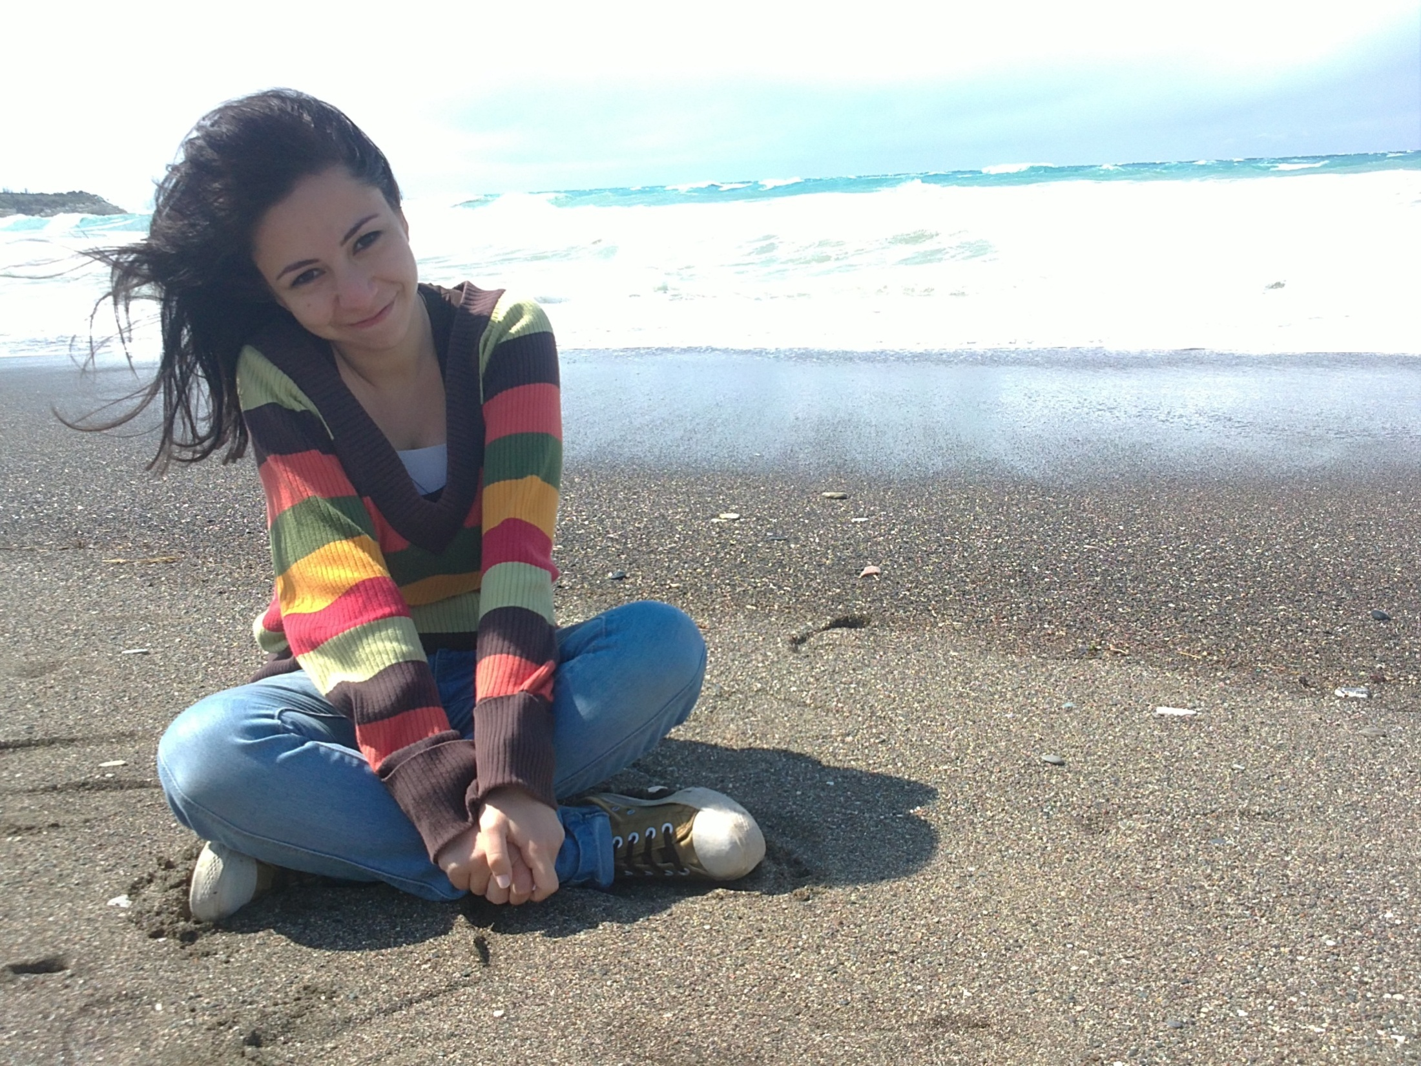
Hello everyone ..
my name is yafa .. and I'm 20 years old.

Slide 3
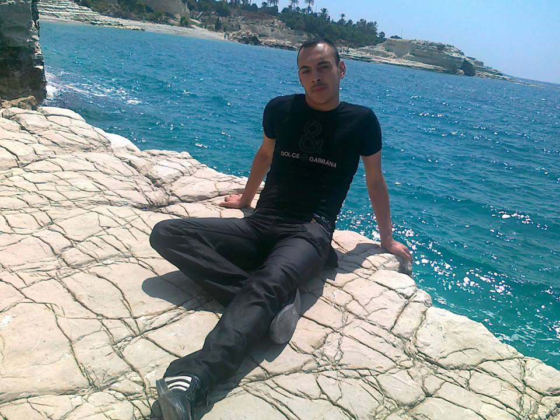
And I’m Mazen, I’m 25 years old.

Slide 4
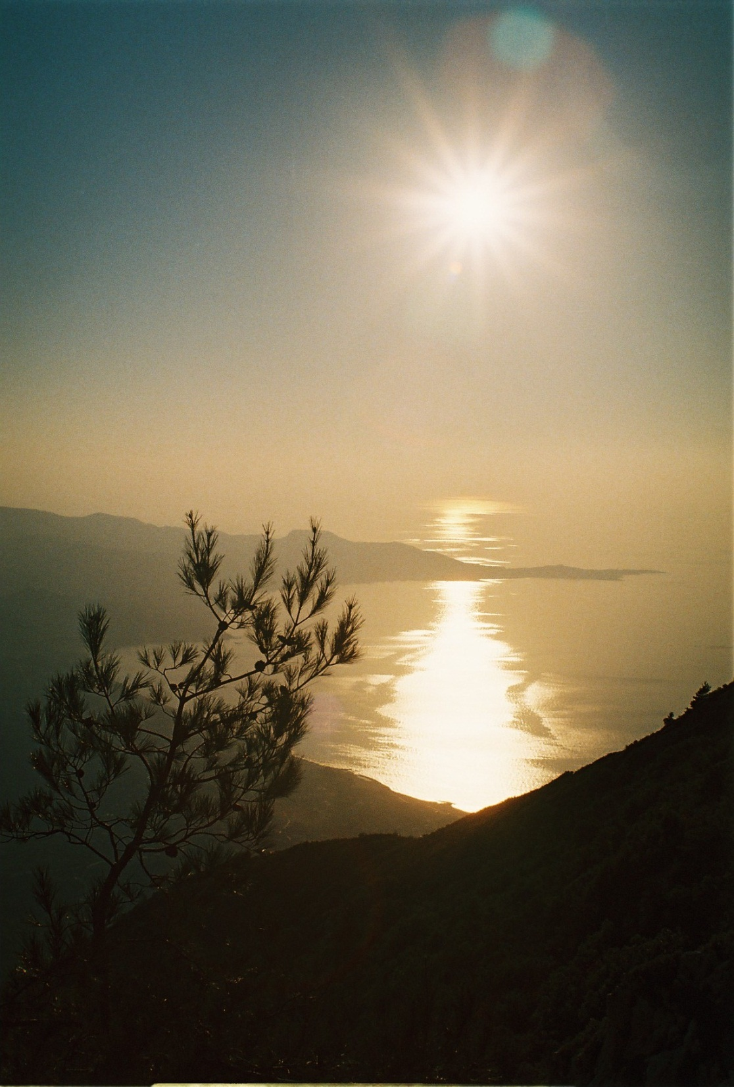
We live in a beautiful port city called Lattakia in Syria " which is the cradle of Alphabet".

Slide 5
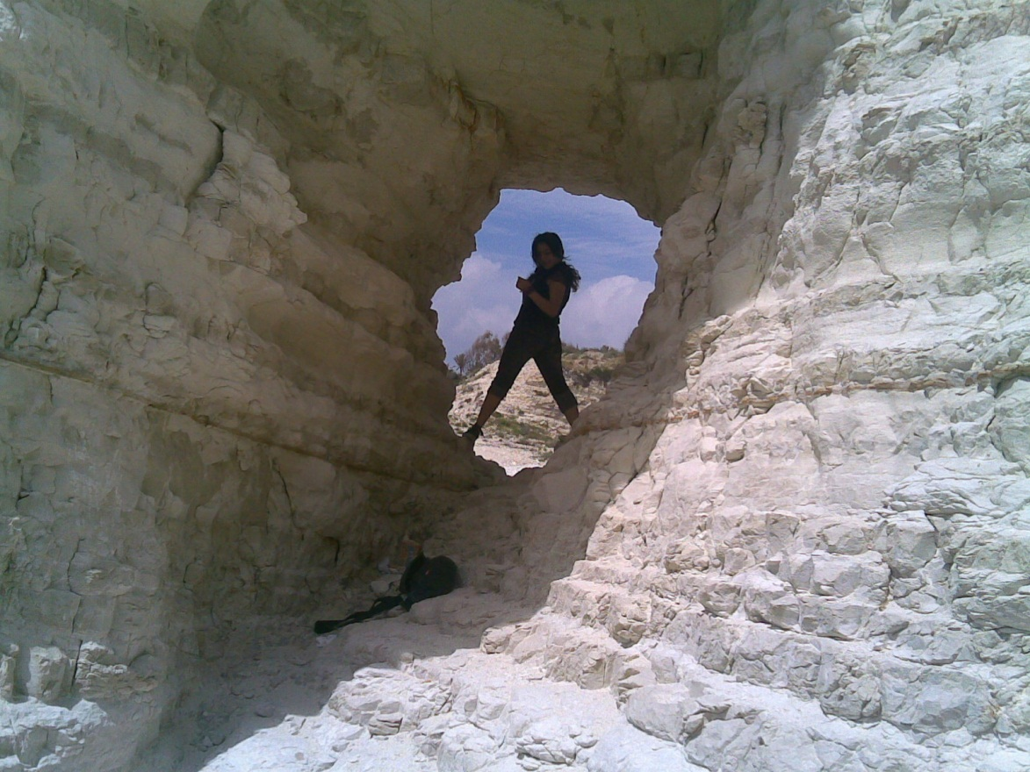
today we’re going to take you in a journey around Lattakia
to see how we spend our time as Syrian youth, we have so many places to show you.. So come along..

Slide 6
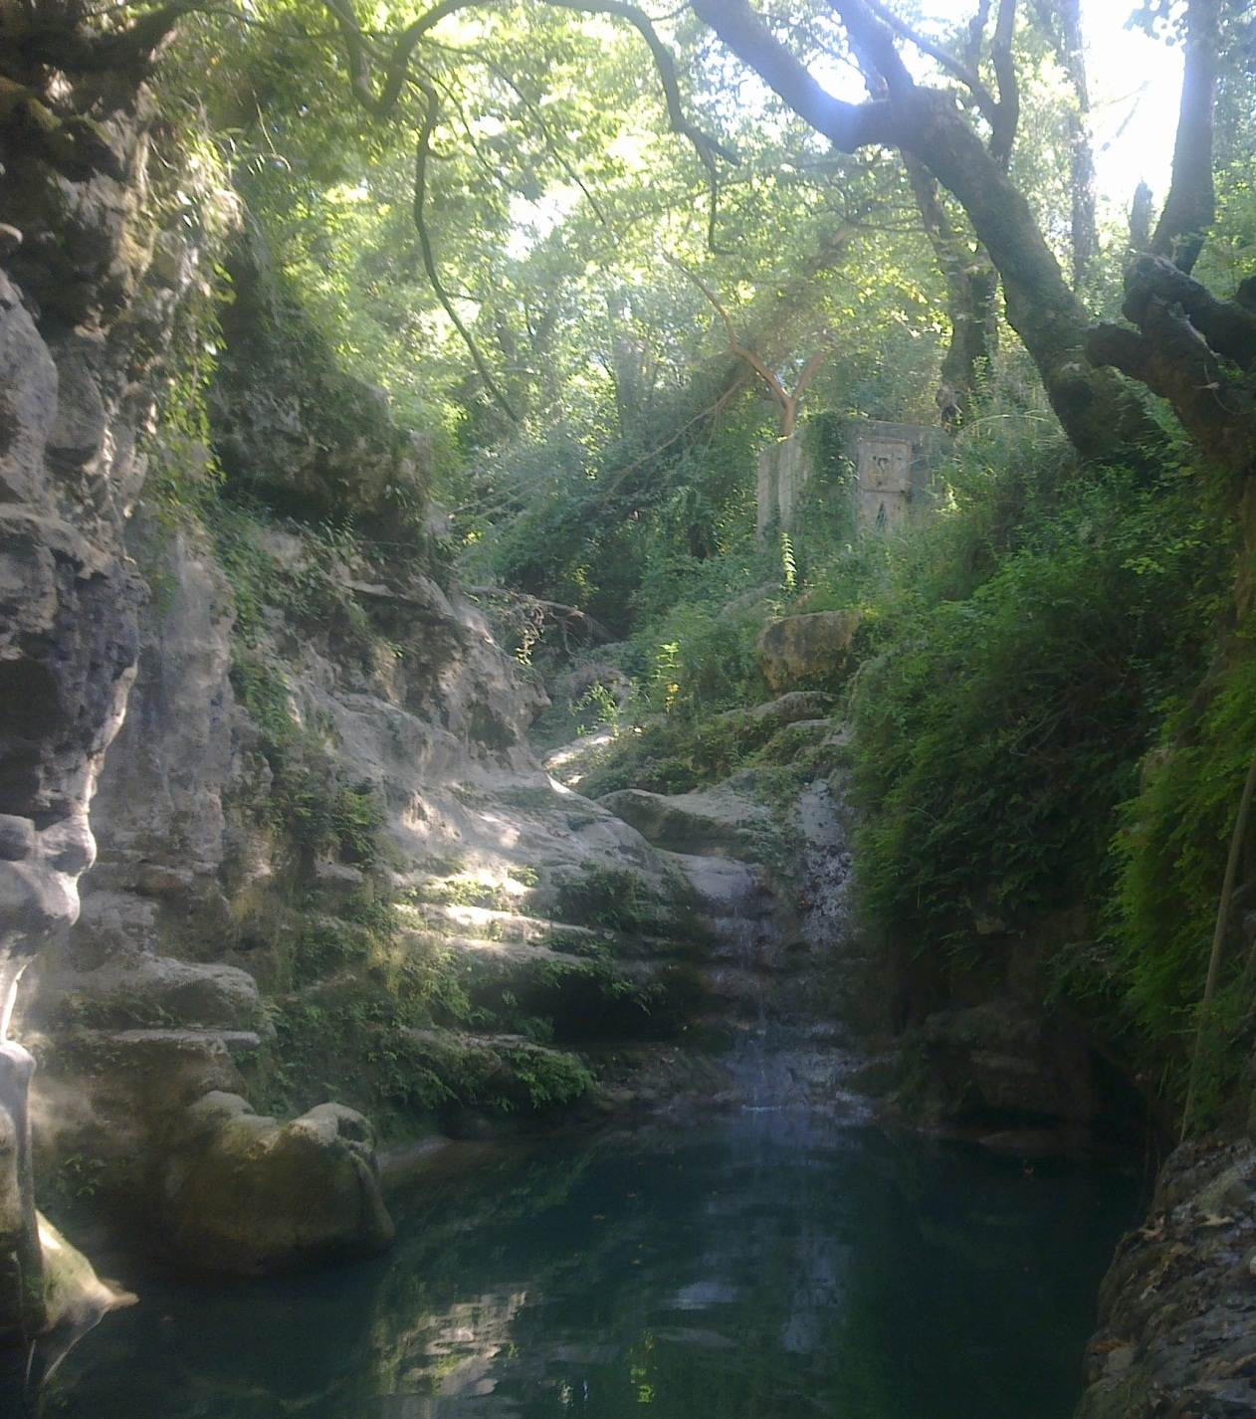
The nature around our city is amazing… much to see and much to do in the country side and mountains
Notes:
Zaghren is the name of the village and it is just one of many…

Slide 7
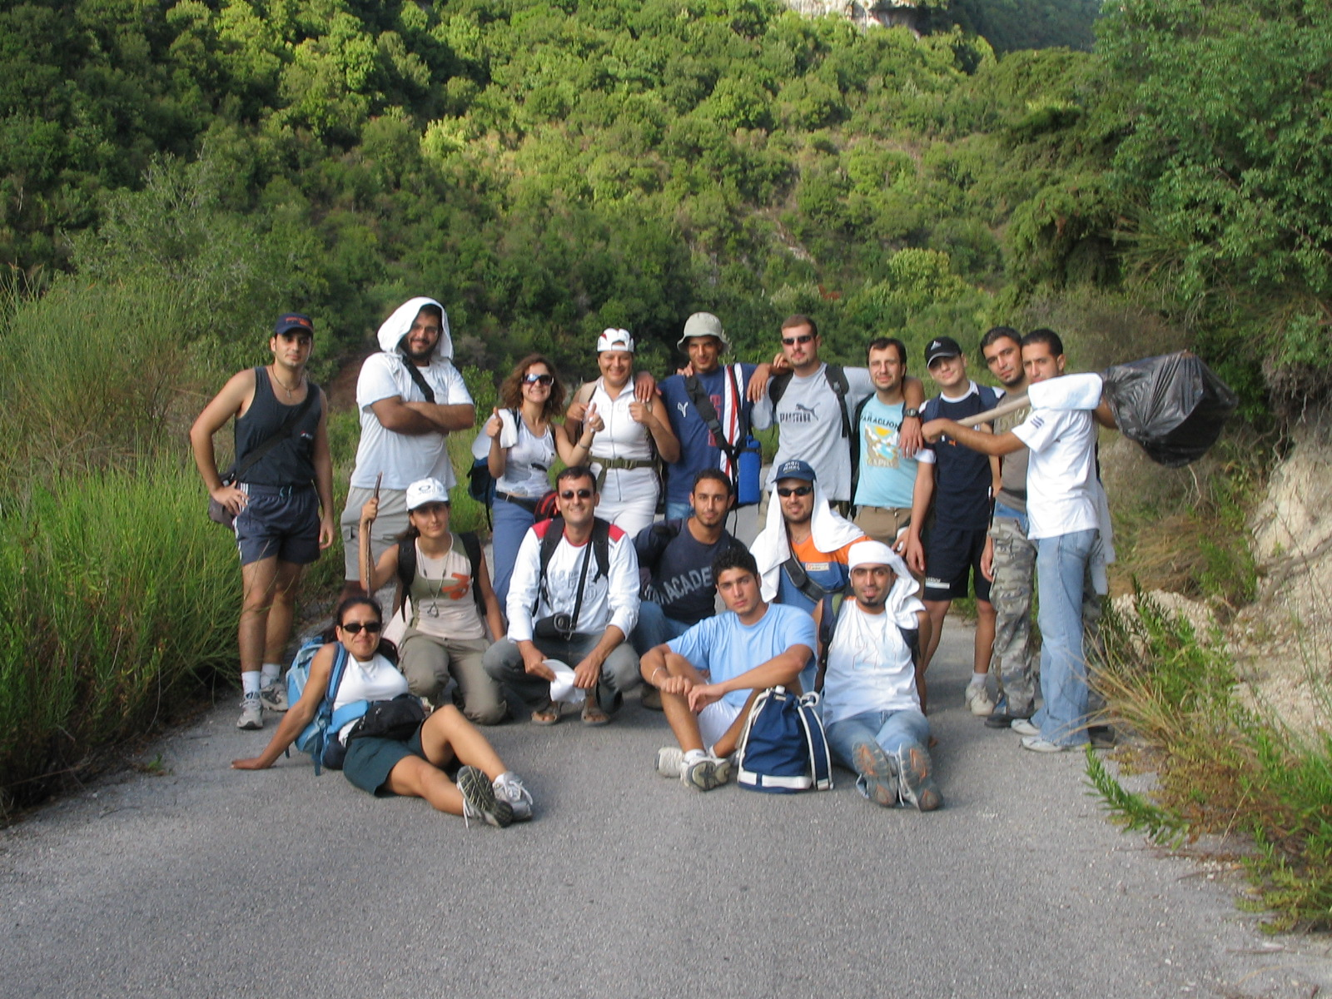
Backpacking
Notes:
It is near Kasab…Can we go now?

Slide 8
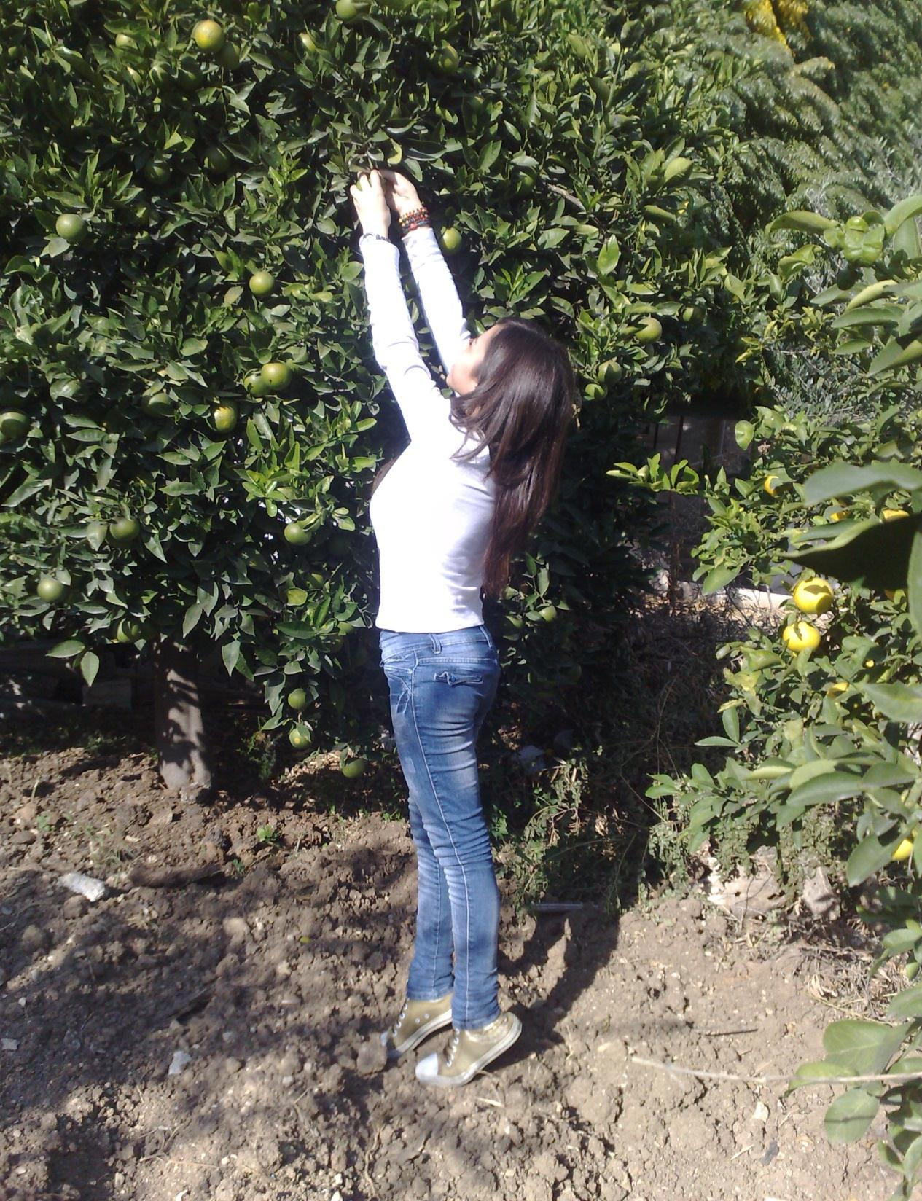
Notes:
Yes! The land of lemon and love

Slide 9
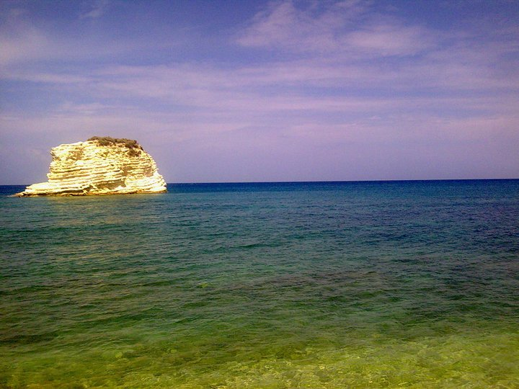
And the shores are great for swimming…

Slide 10
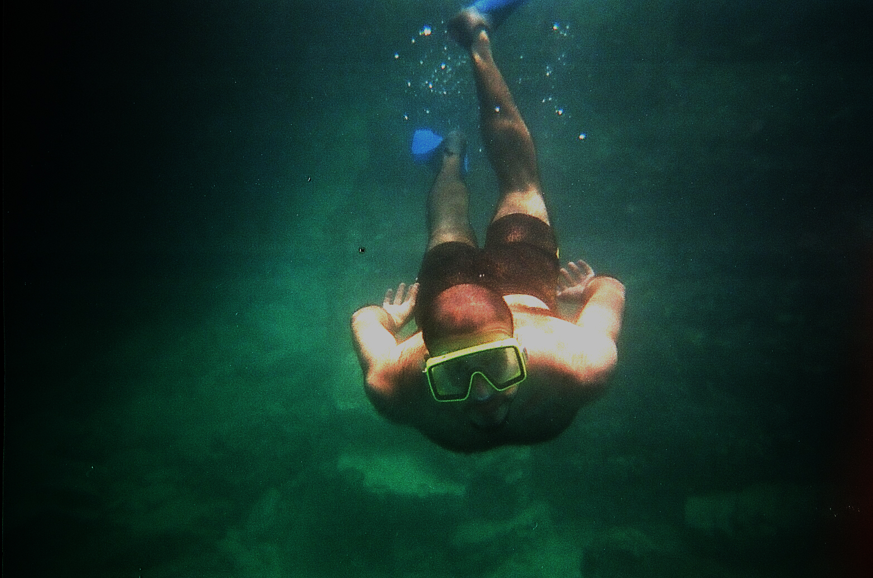
And diving.
Notes:
He is my brother!

Slide 11
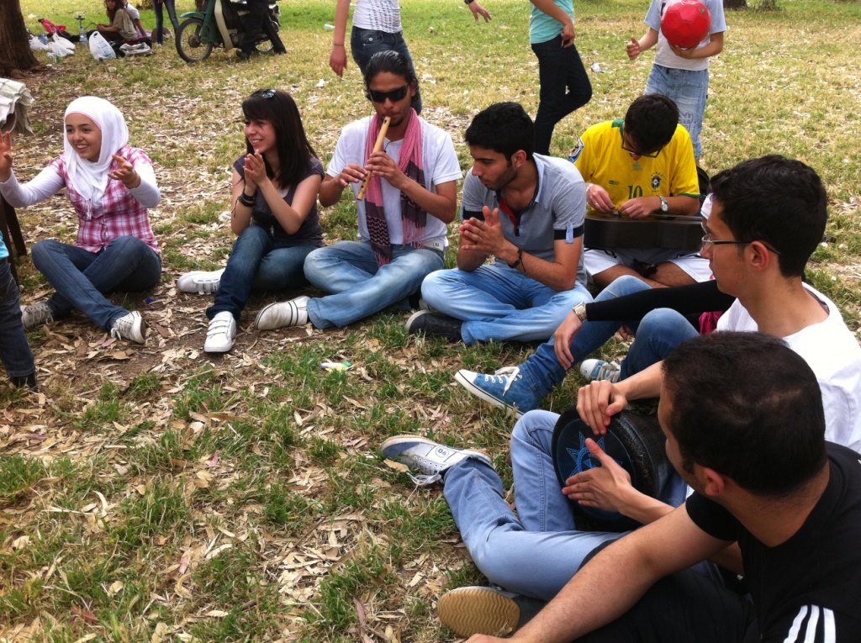
Back to the city, we do many outdoor activities, Some for fun…
Notes:
Momen Shaweesh is playing on our – Syrian – drum.

Slide 12
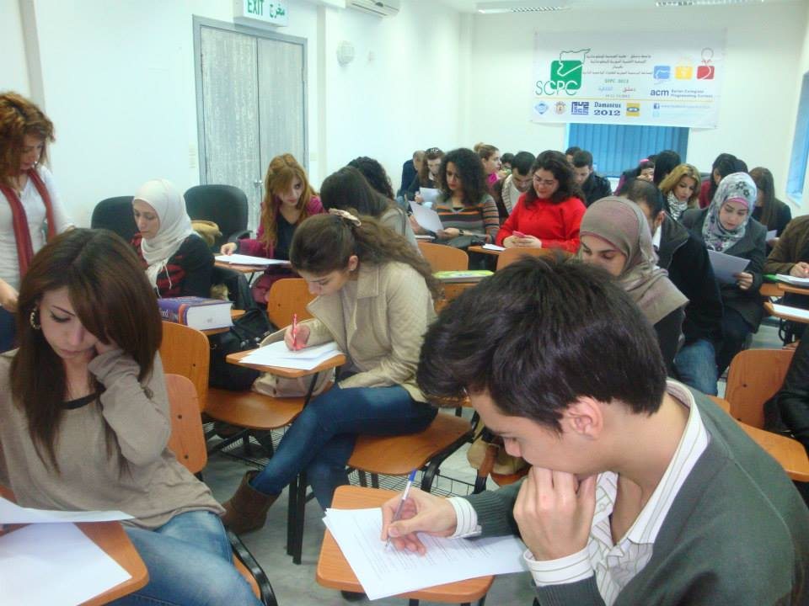
And a lot for education…
Notes:
Translation training Course…

Slide 13
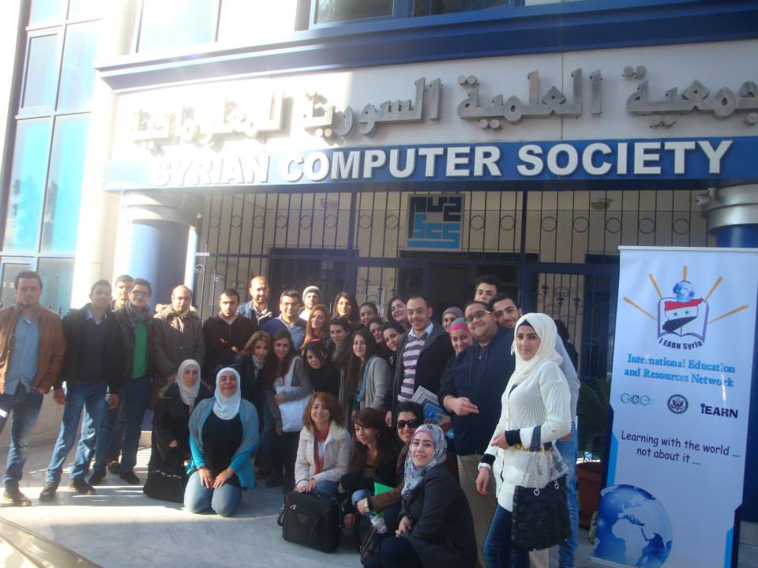
Notes:
Translation Training Course photo general

Slide 14
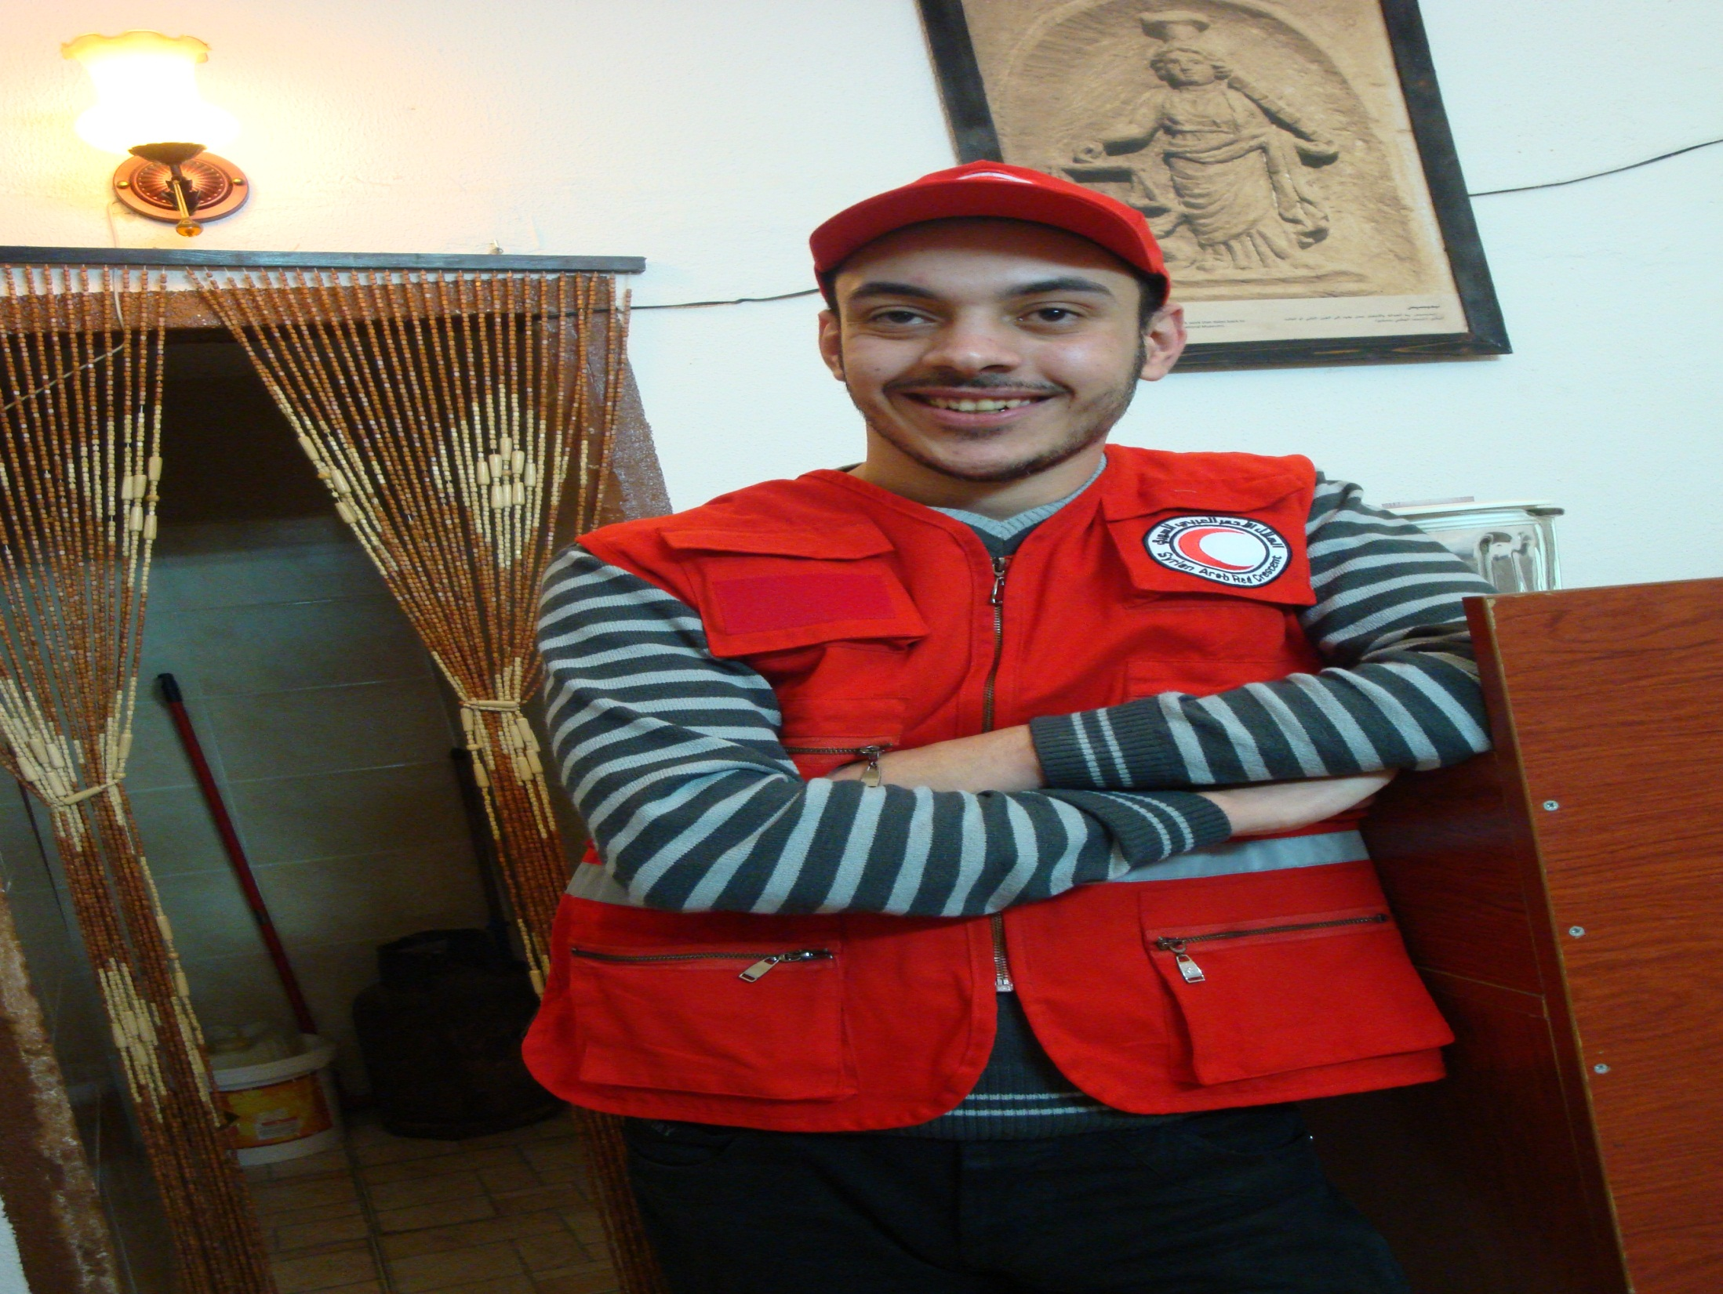
Plus voluntary work…
Notes:
Mazen Bishtawi at AlErzal Cafe

Slide 15
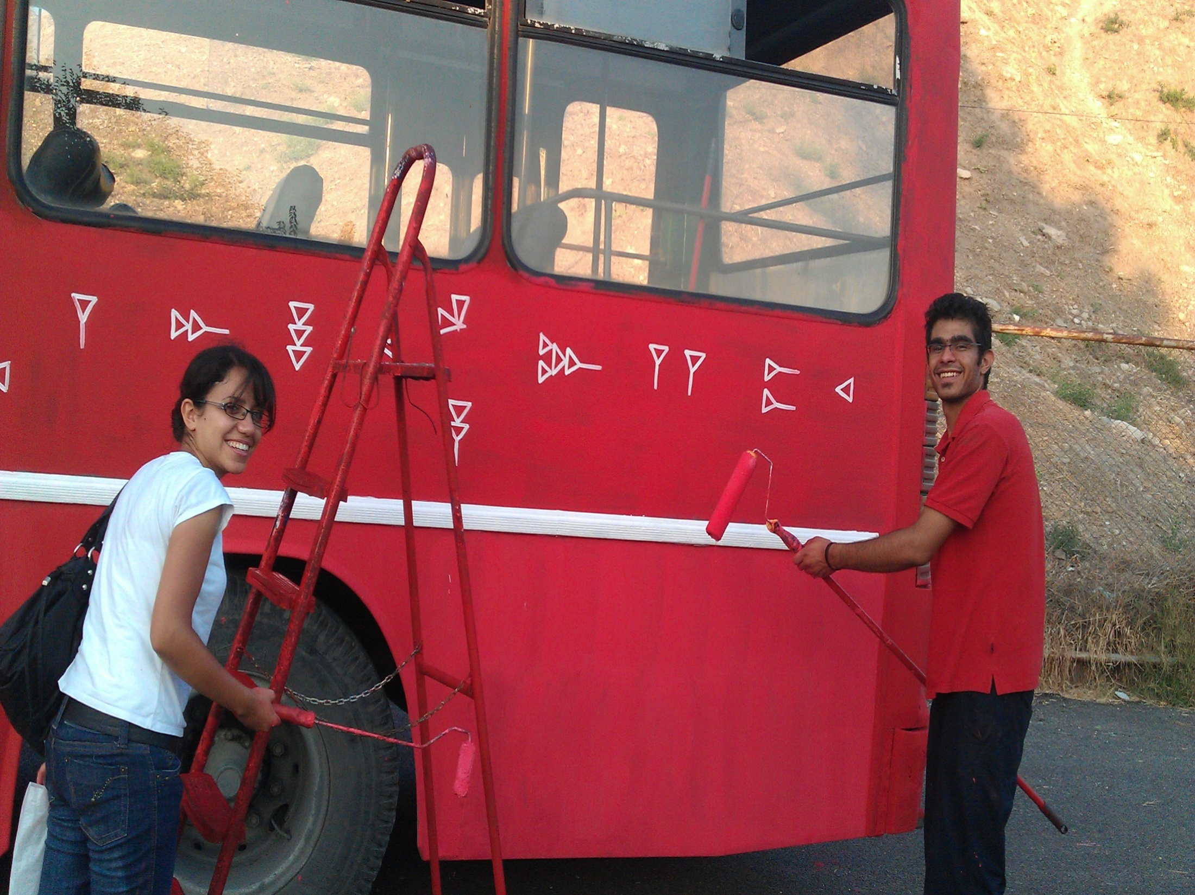

Slide 16
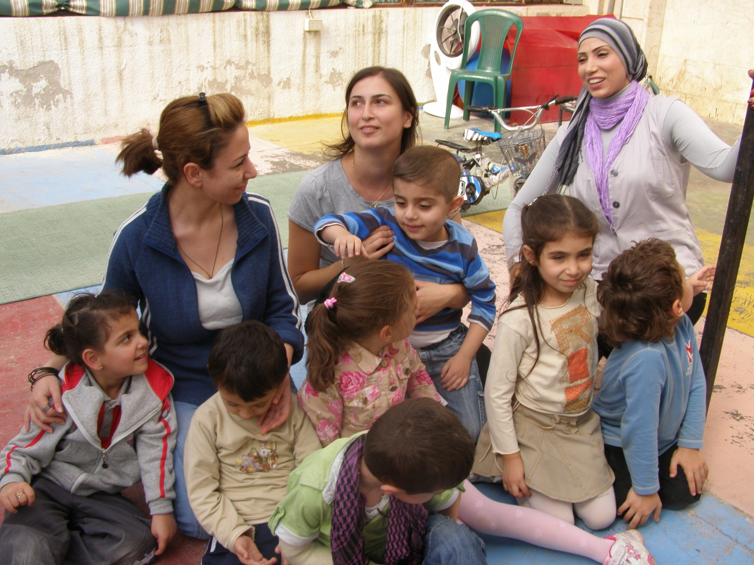
Notes:
I am not sure who is supporting who! The children’s smiles make my heart smile.

Slide 17
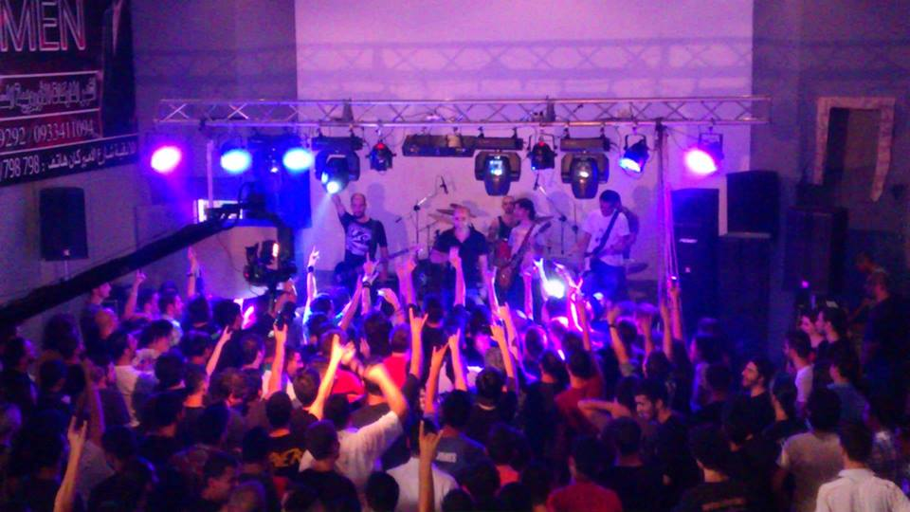
Music is a big part of our activities
Notes:
My brother's band…My brother again!!! By the way…I am Yafa…Mazen has 2 brothers

Slide 18
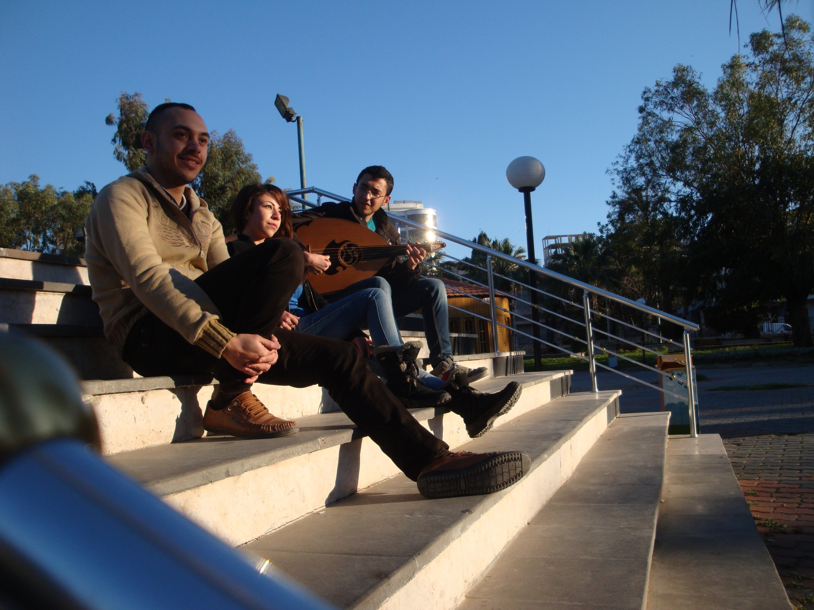
We take our music with us where ever we go.

Slide 19
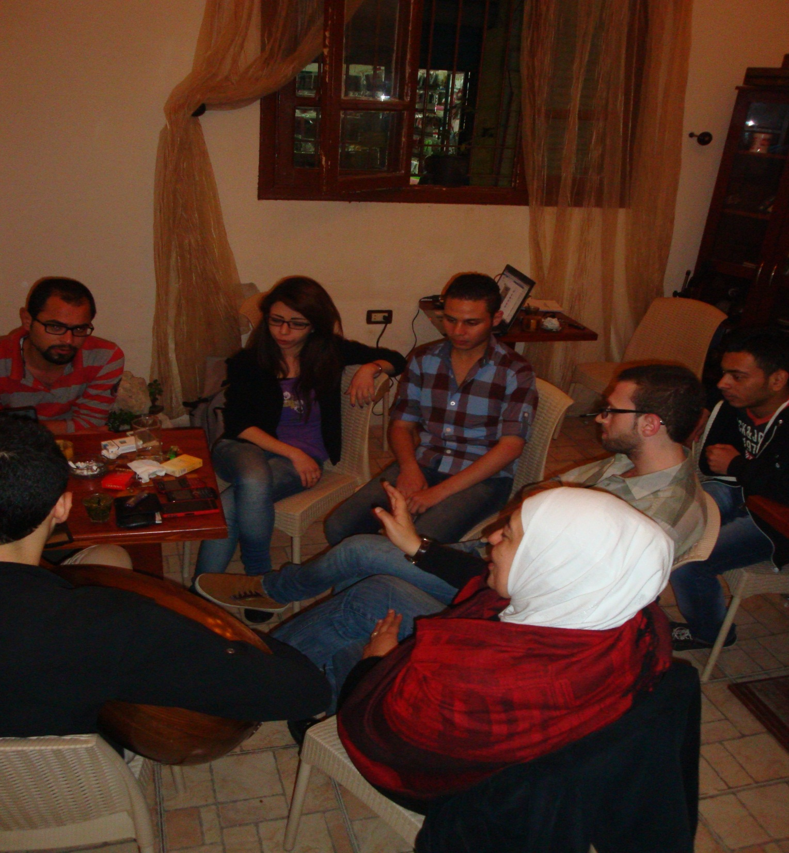

Slide 20
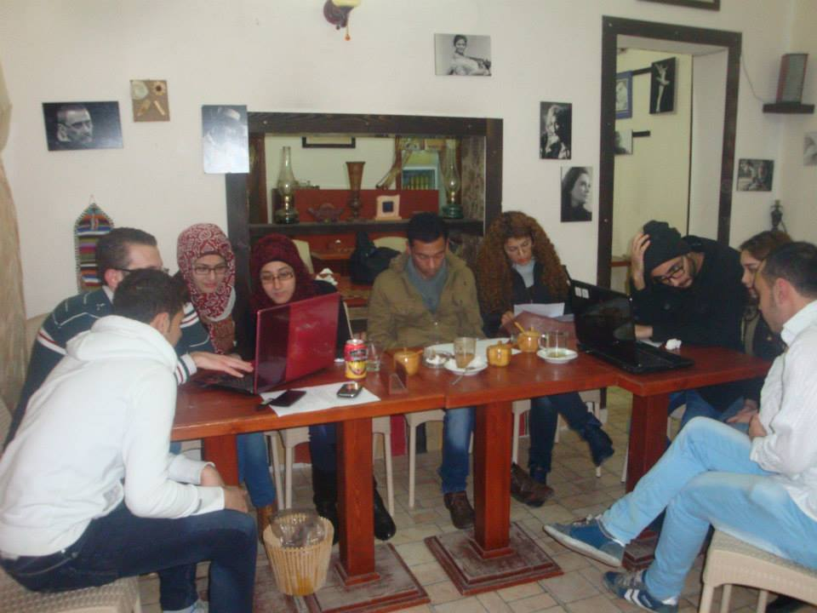
And usually we meet to study in a cultural cafe.

Slide 21
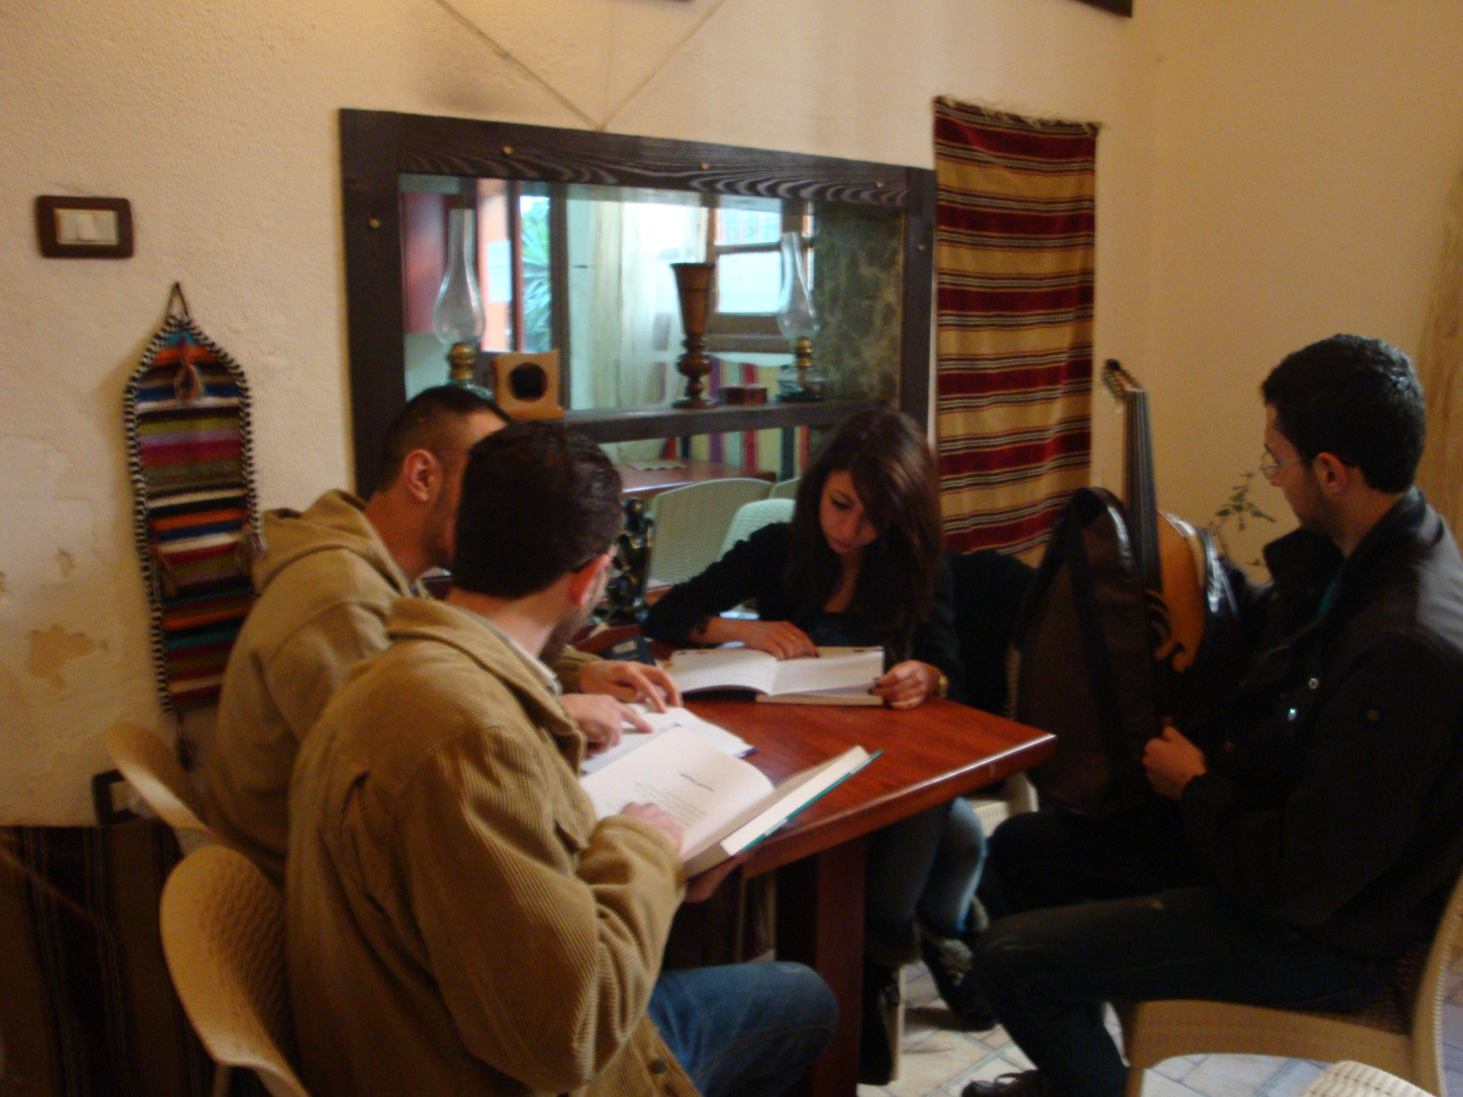

Slide 22
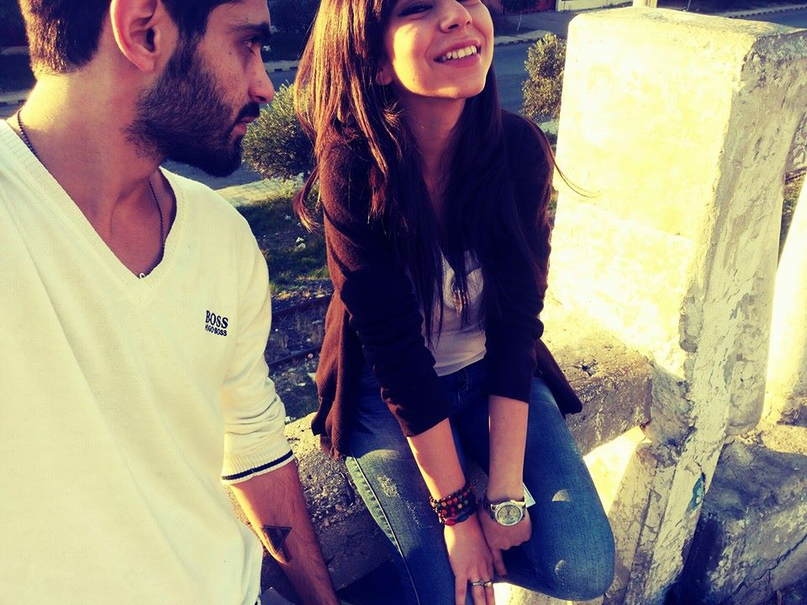
At weekends, after a long week we love to hang out..

Slide 23
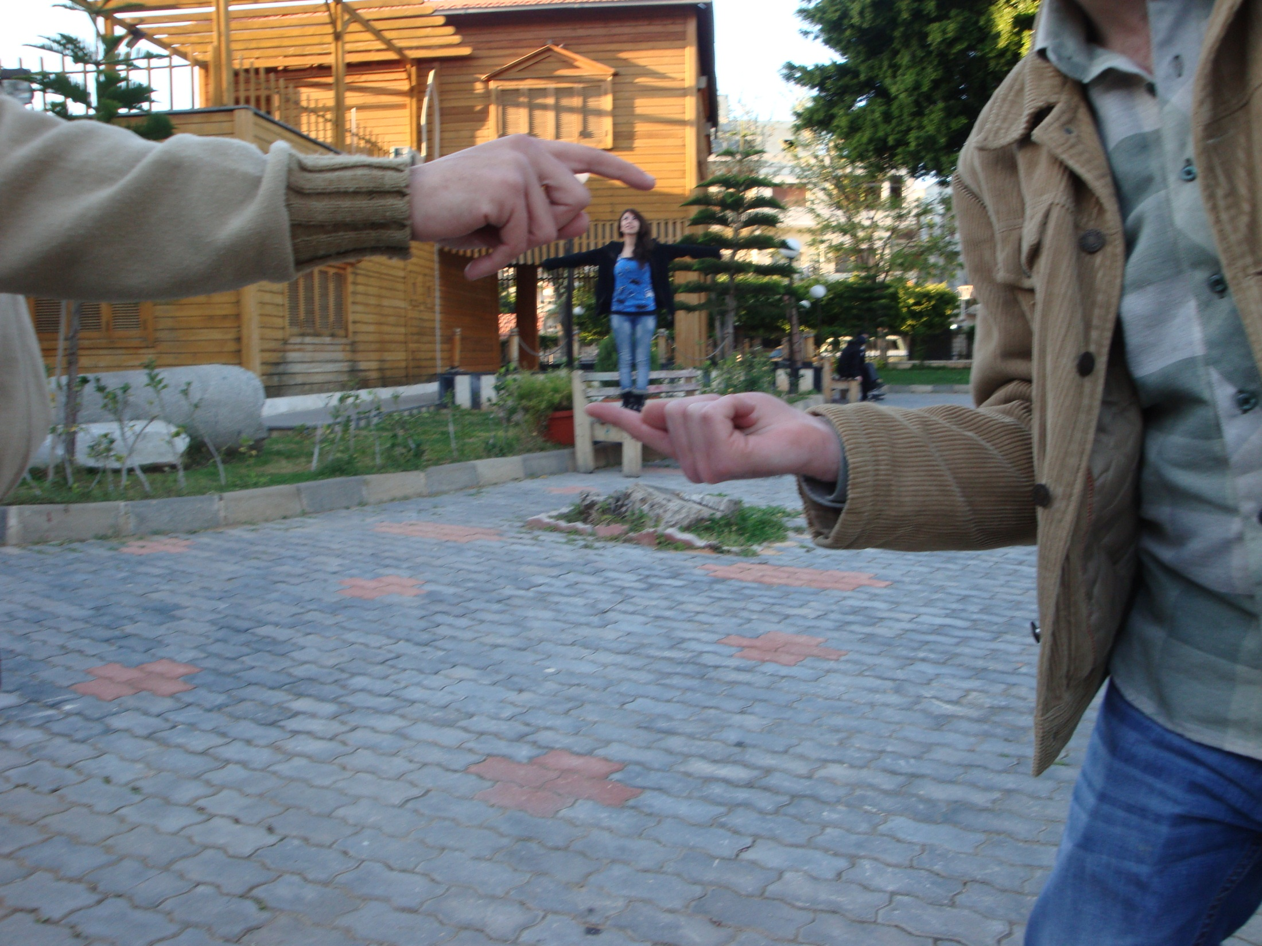
And just have fun.

Slide 24
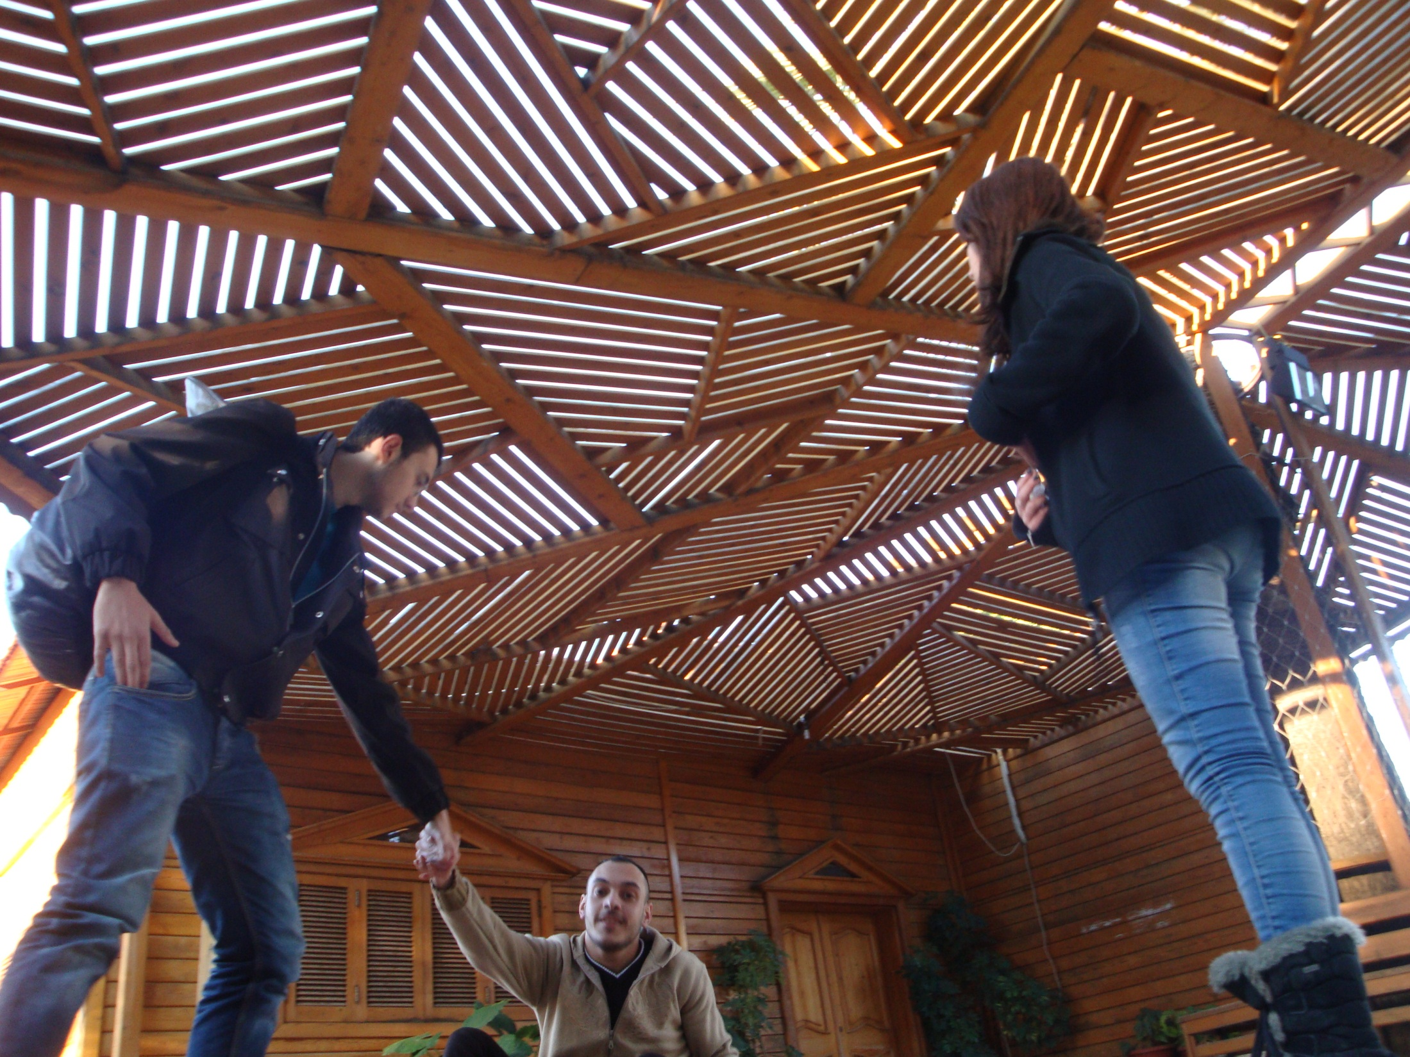

Slide 25
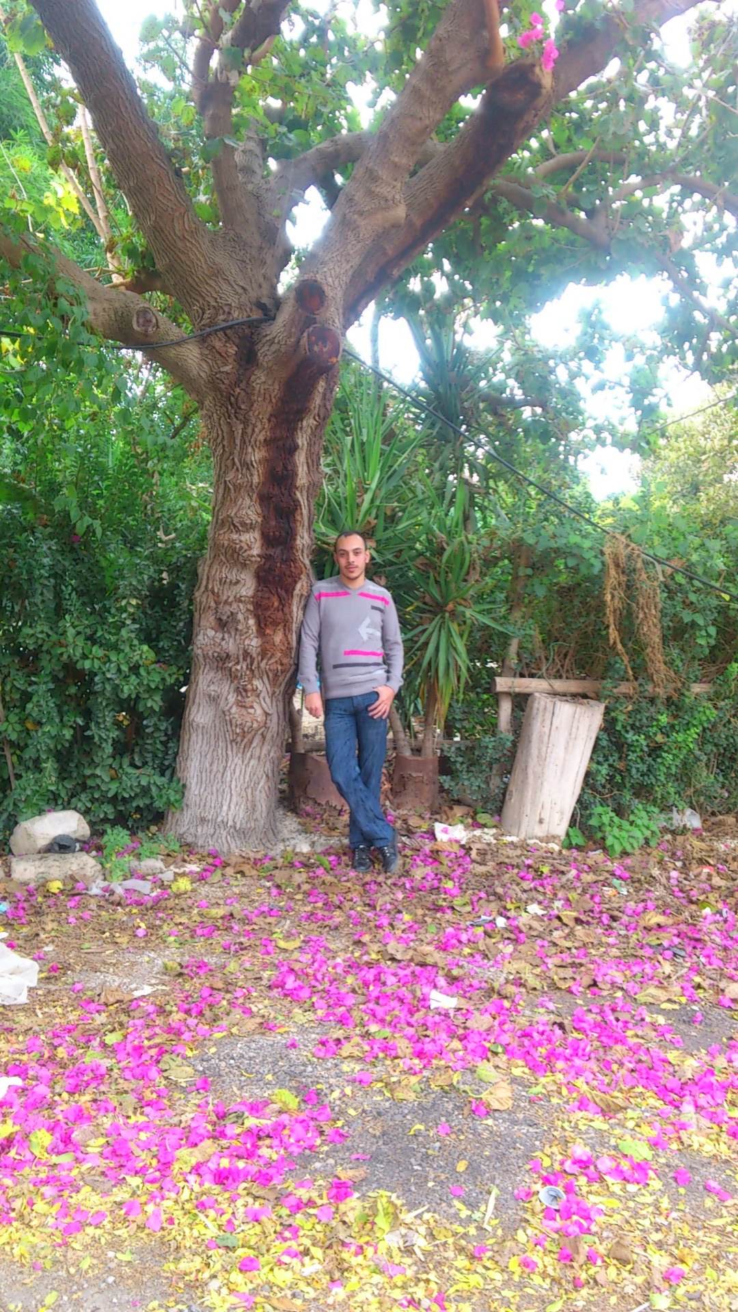

Slide 26
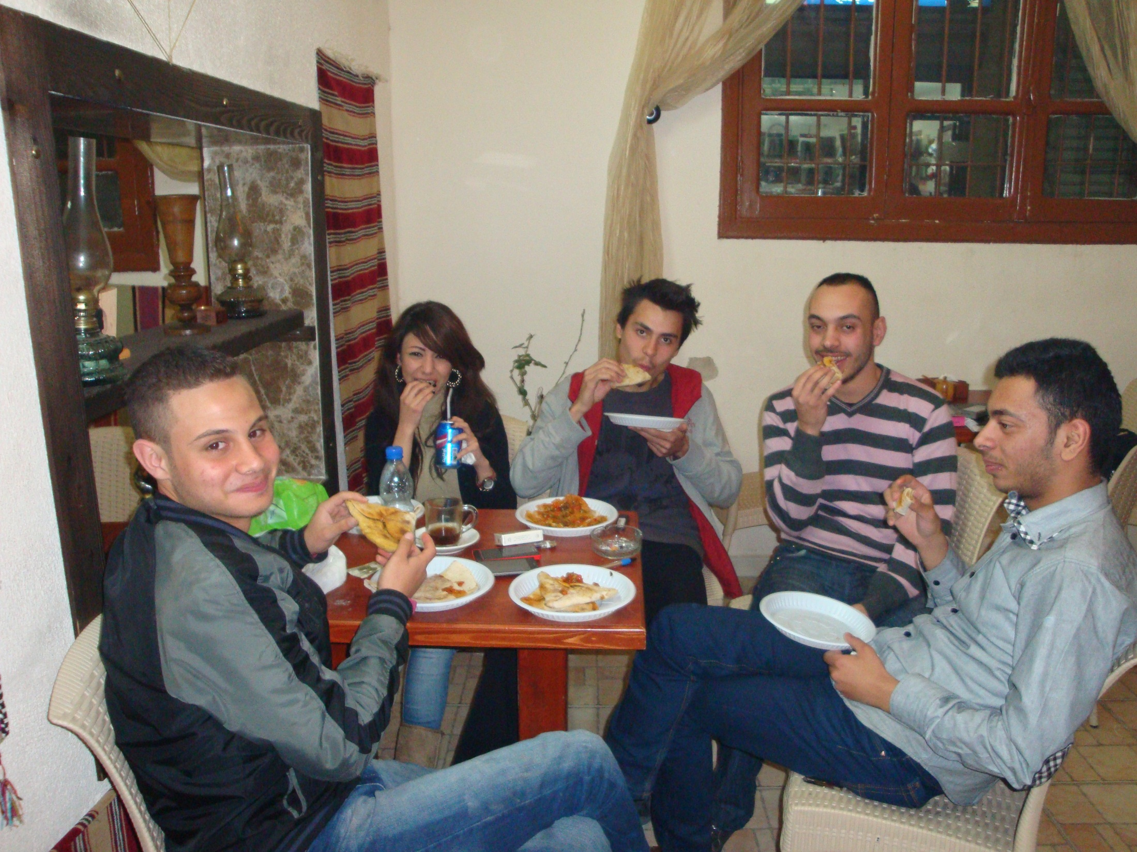
Join us..!!! ☺

Slide 27
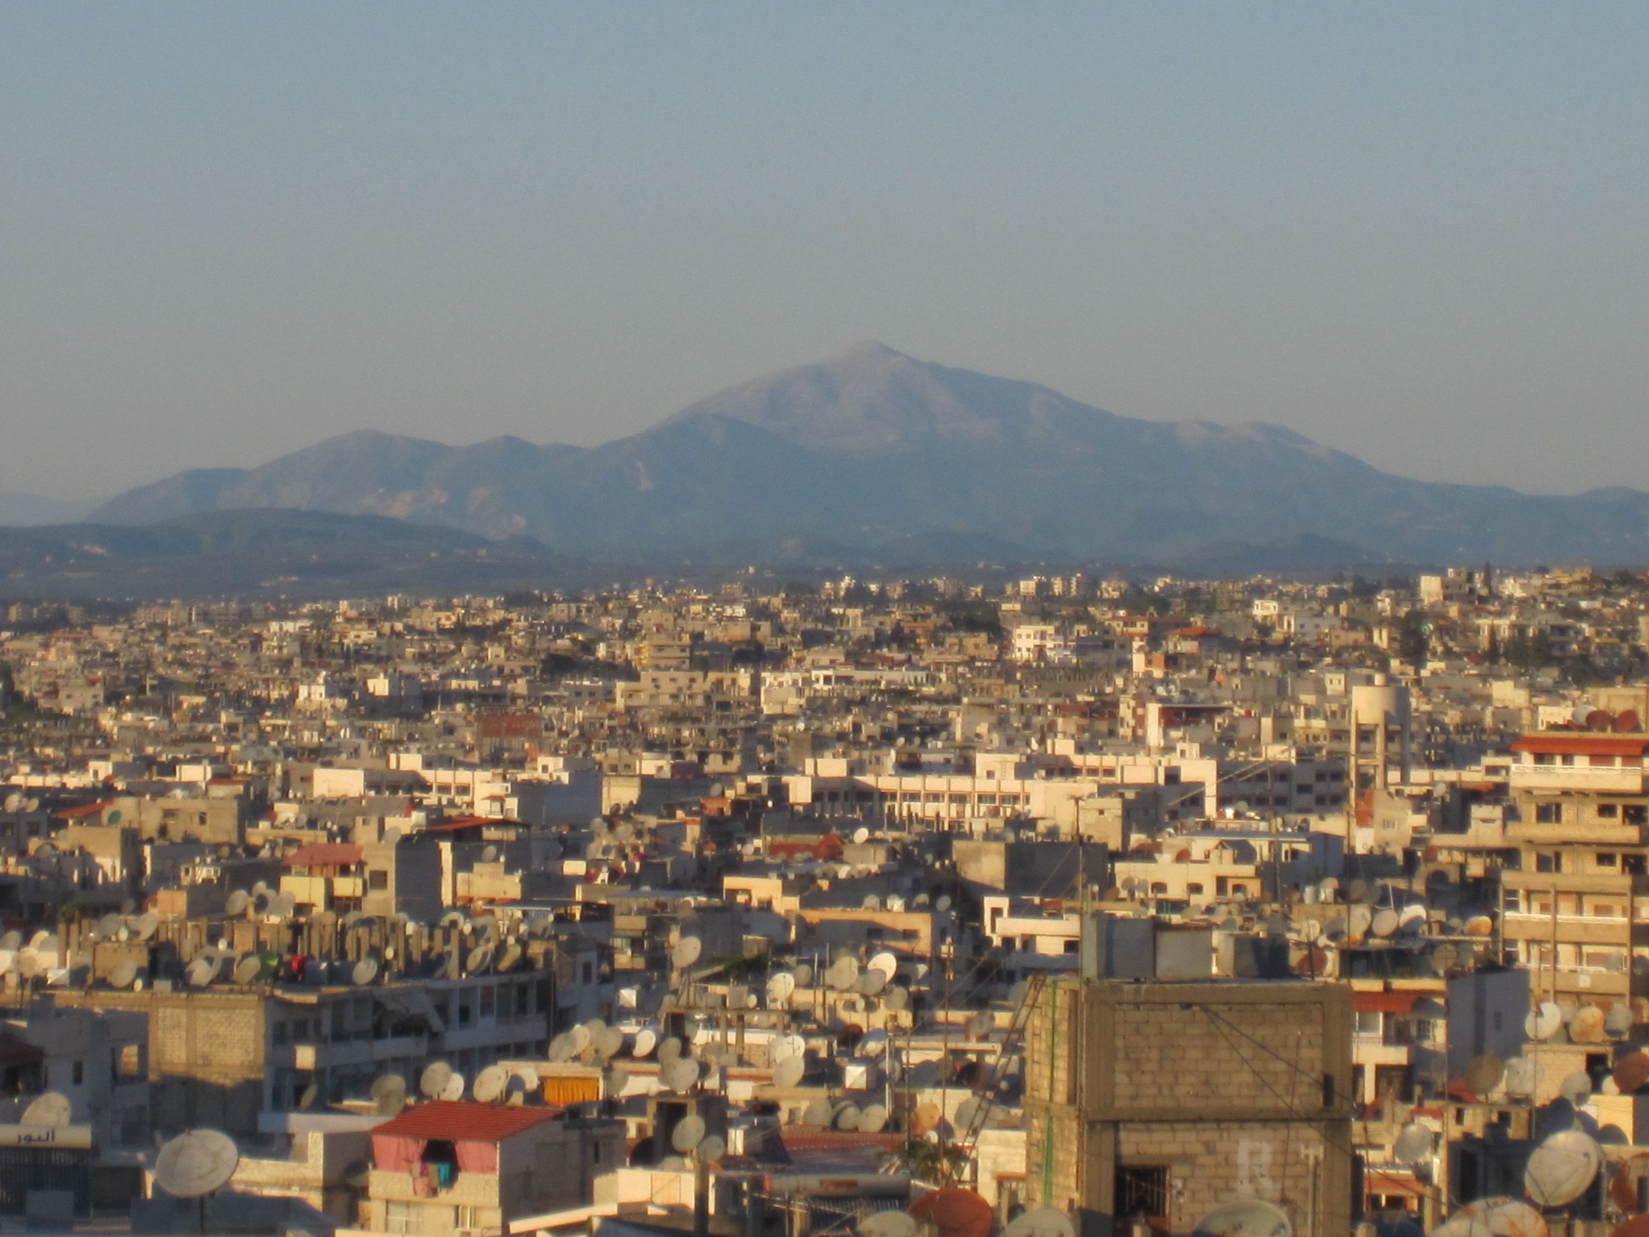
So we really hope you enjoyed this journey.

Slide 28
How about you .. how do you spend your time??!
we would love to know more about you .. hope to hear soon from you .. see you guys ☺
lattakia2222@gmail.com

Slide 29
Places & Perspective Learning Circle – High School – Spring 2014

