Slide 1
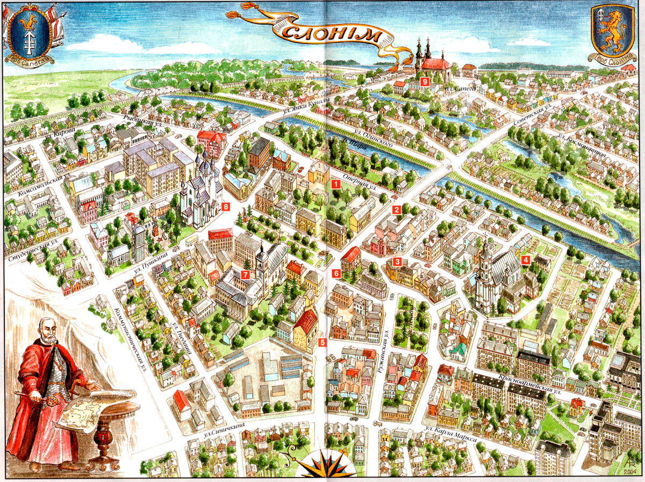
SLONIM
Places to edutain in Slonim
Kate Sinitsa, Kate Dyatlova
Slonim gymnasium 1
Belarus

Slide 2
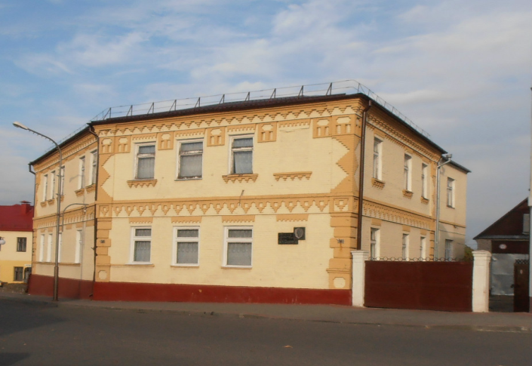
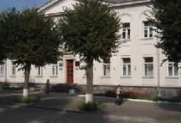
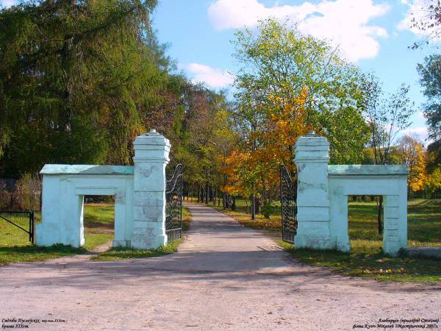
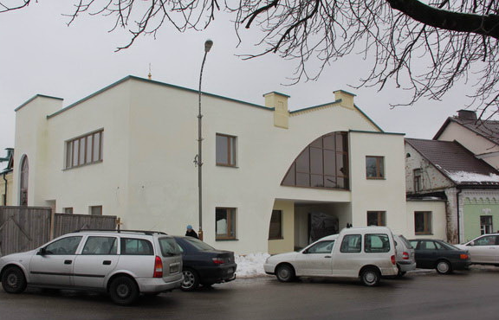
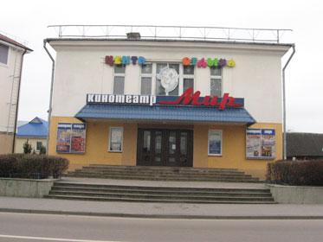
MUSEUM
SKARBNITSA
Please, choose the image to learn how children spend their free time
PARK
THEATRE
CINEMA

Slide 3
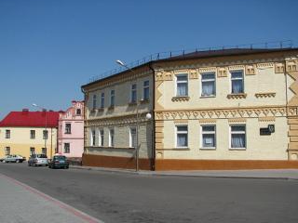
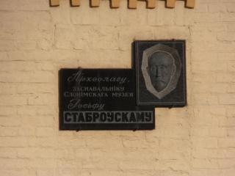
MUSEUM
Slonimsky Regional Museum of Local Lore named after I.I.Stabrovsky is one of the oldest regional museums in the area. The museum was founded by the archeologist and the regional specialist, the native of the farm Orlovichi of the Slonimsky district Iosif Iosifovich Stabrovsky. Being the nobleman, the colonel of the Russian army, the participant of the World War I, he devoted all his life to studying and collecting the history of the homeland. For the first time the museum was opened for visitors on September 20, 1929. Its exposition and funds included 5 thousand exhibits.

Slide 4
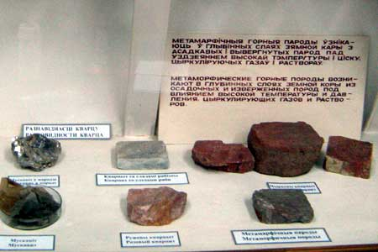
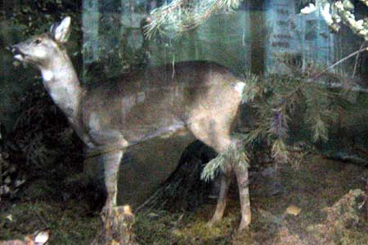
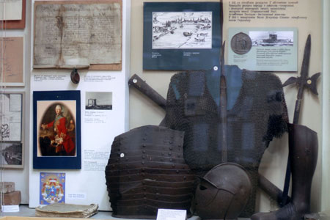
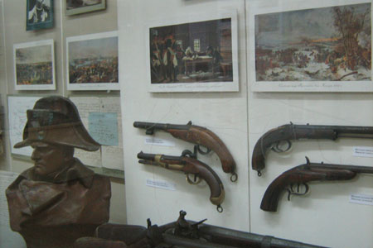
Now the museum exposition is available in 9 halls. It is represented by the departments of nature and history. In the department of nature one can find the physical and geographical characteristics of the region and minerals, the remains of ice age animals, the present-day flora and fauna of the region. In the department of history, there are the most interesting archaeological findings about Slonim and materials about the history of wars. The museum collection consists of 29,392 items (2012). The most valuable are archaeological, numismatic and ethnographic collections. The unique exhibits include a stone idol of the 10th century, the Statute of the Grand Dutchy of Lithuania (Poland, 1648), the bust of Napoleon by the French sculptor R. Kolombo (bronze, 1885).

Slide 5
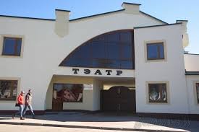
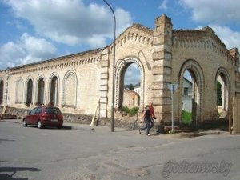
THEATRE
What was Oginsky's theater famous for? The scene was the main "achievement" of Slonimsky theater. Its mechanism, size and opportunities simply struck. The scene was adapted for baroque ballets and operas with plots of scenic transformations in which hundred (!) actors and supernumeraries could be involved. The big scene was designed state-of-the-art and allowed to embody the most difficult opera and ballet performances,dramatized horse fights and water enchanting performances. Imagine the considerable part of a scene was flooded with water from the next pond and one could see boats floating there. There were fountains illuminated with Bengal lights. Well-known masters from abroad were invited to create such stunning miracles.

Slide 6
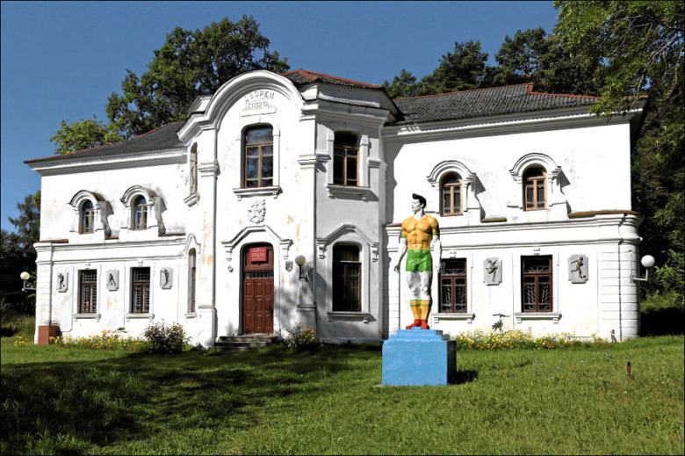
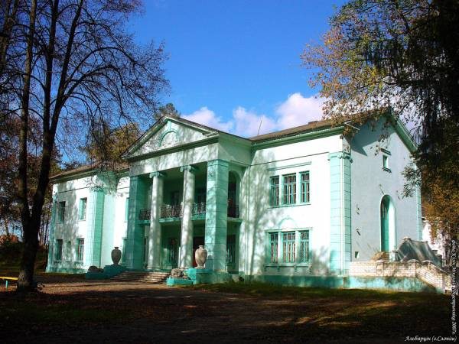
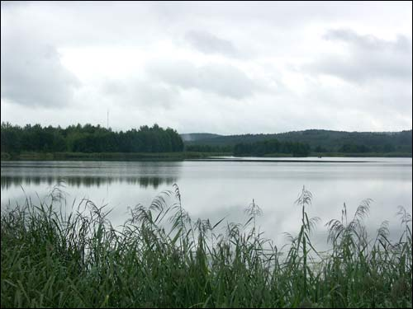
Slonimsky farmstead and park complex" Albertine" - the former manor of the counts Puslovsky is a monument of farmstead and park architecture of late classicism. It was created in the first half of the 19 th century in the former suburb of Slonim. It included the farmstead house, economic constructions, landscape park, a forest park with ponds. The farmstead house is the two-storeyed building of an asymmetric form. At the entrance there are two sculptures of lions. Voytekh Puslovsky - the first owner of this estate, had three sons: Albert, Magdalene and Tit. However Albert was the favourite of the father. The father worshipped the son therefore after Albert's tragic and very strange death, the estate was called after his name. This place is worth visiting.

Slide 7
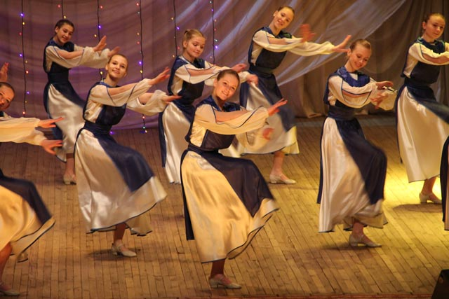
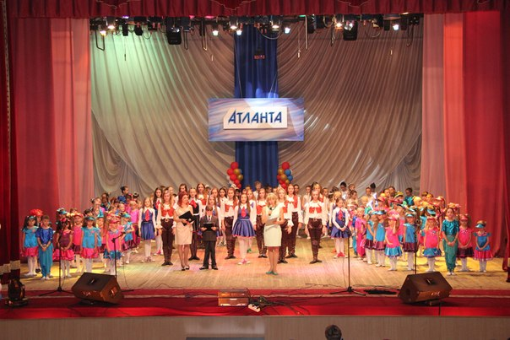
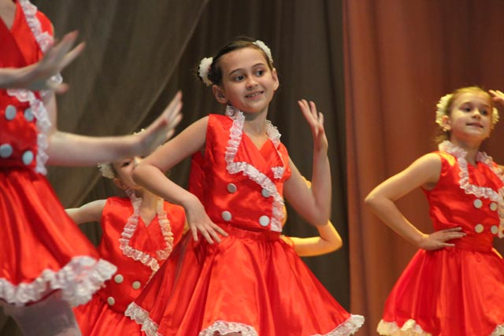
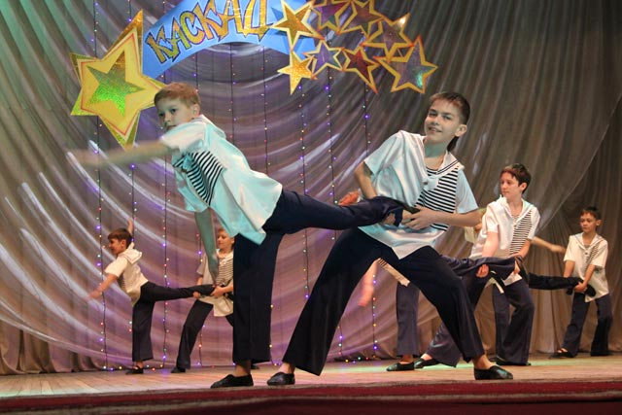
We’ve got an opportunity to develop our dancing skills. Many of our students attend two famous dancing groups – the show-ballet “Atlanta” and the theatre of pop and sport dance “Kaskad”.

Slide 8
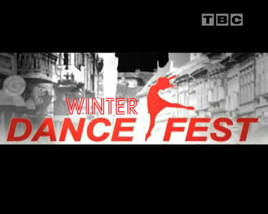
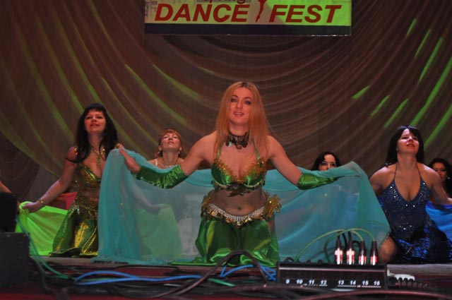
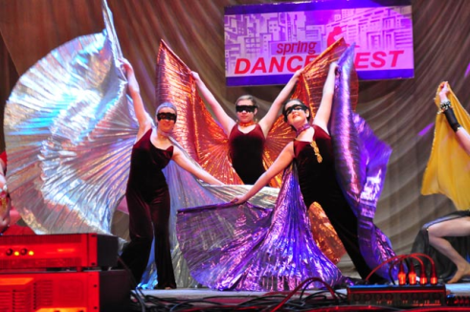
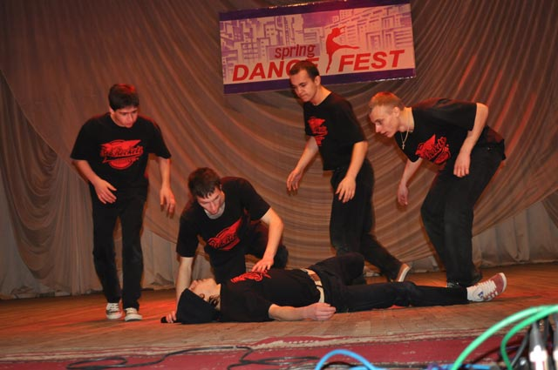
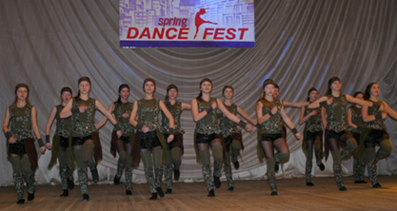
For the first time Slonim held a youth event this winter- the Festival of dance subcultures “Winter Dance Fest”. The main objective of the event is the development and promotion of contemporary youth subcultures.

Slide 9
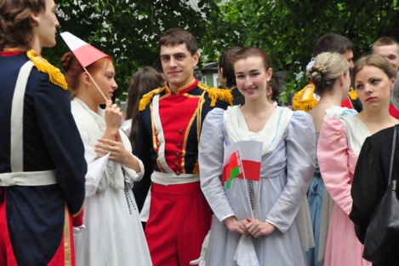
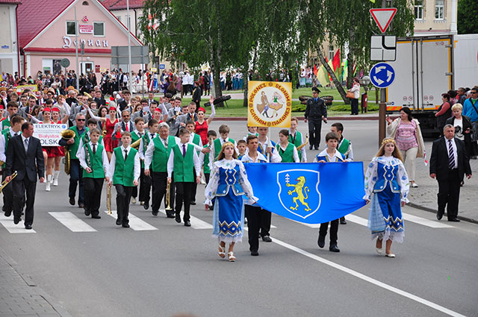
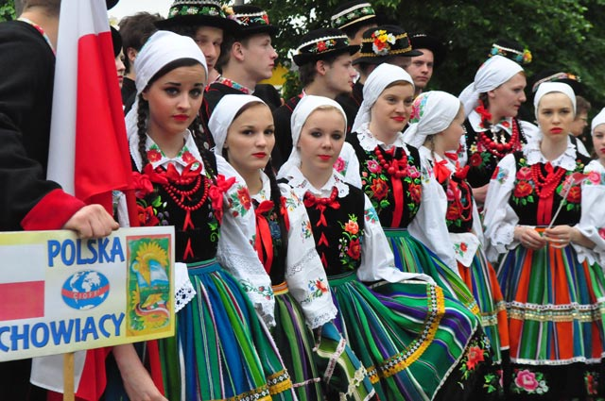
Slonim is proud of the fact that Michal Kleofas Oginski, the author of "A Farewell to the Homeland" polonaise often came to Slonim to visit his uncle. The festival of polonaise is held in our town in May. It usually bring together music bands, dancing ensembles, choirs and orchestras from Belarus, Lithuania and Poland. The music of Chopin, Bach, Mozart, Schubert, Oginsky and Tchaikovsky is performed. The festival features various vocal and instrumental interpretations of the polonaise.

Slide 10
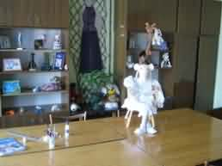
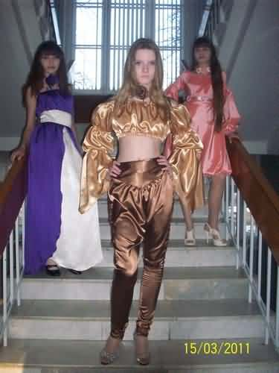
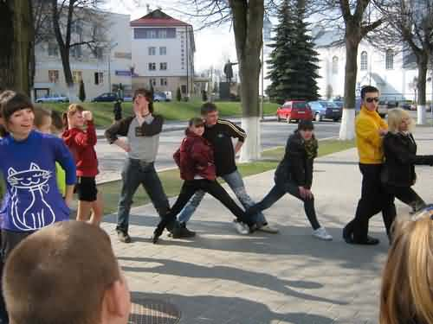
Children aged 7-17 can spend their free time in a creative and entertaining way in the Centre of Creation of Children and Youth. There are about 100 groups or circles which give children an opportunity to develop their abilities and talents in music, arts, dancing, to be involved in different volunteering projects.

Slide 11
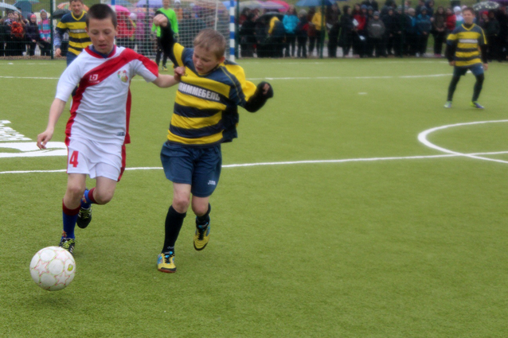
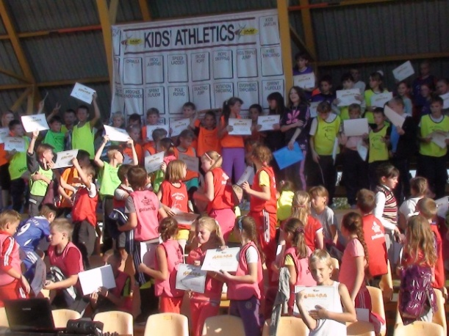
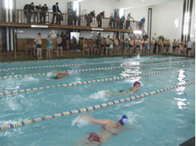
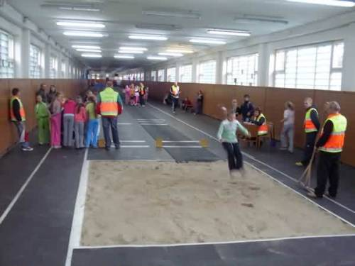
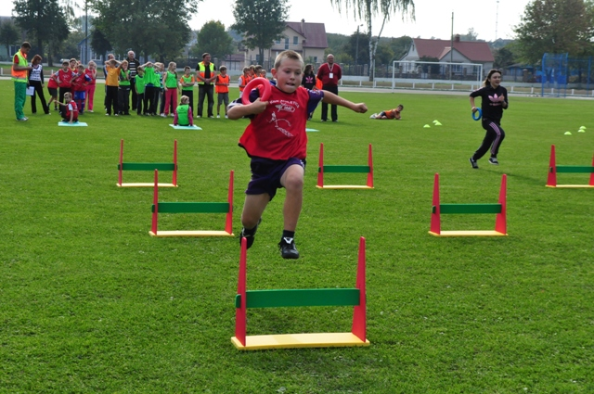
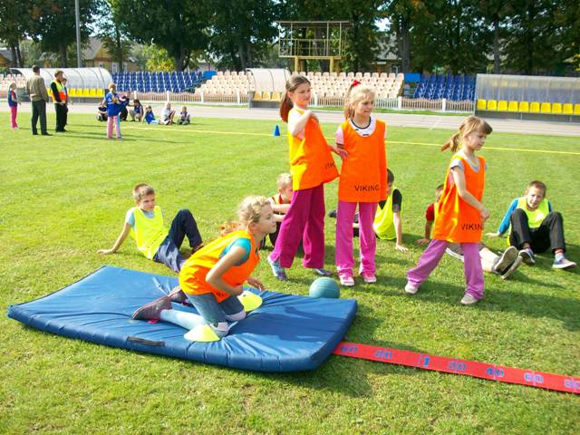
We are keen on sports. Playing different games, doing different kinds of sport at the town’s stadium, school sports grounds, in the swimming-pool helps us grow healthy and strong. Light athletics, football, handball, basketball, swimming, gymnastics are our favourite kinds of sport.

Slide 12
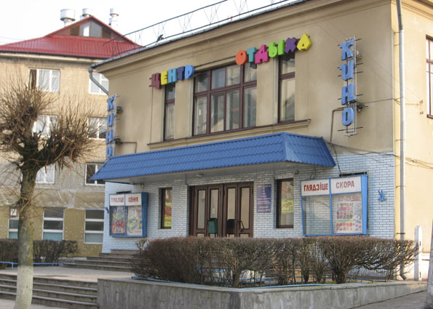
CINEMA
Teenagers and little children often go to our town’s “Mir” cinema. They can watch new films of different genres, 3D films in the hall on the first floor. They can celebrate their birthdays with their friends as on the second floor there is a special hall for celebrations and there are also a lot of slots and other entertainments.

