Slide 1
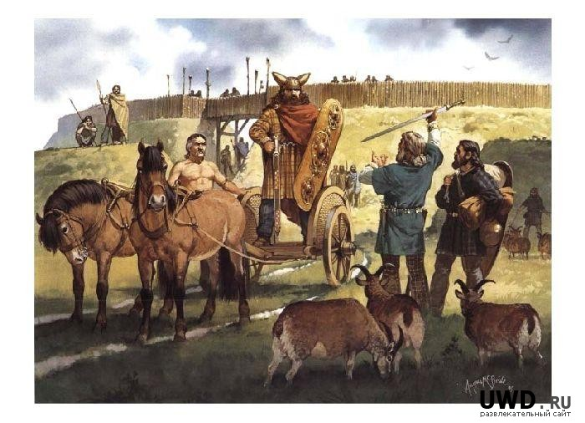
The Celts
Verkhnedvinsk
Vitebsk Region
Belarus
Grade 9
Verkhnedvinsk Gymnasium

Slide 2
Who were the Celts?
From around 750 BC to 12 BC, the Celts were the most powerful people in central and northern Europe. There were many groups (tribes) of Celts, speaking a vaguely common language. The word Celt comes from the Greek word, Keltoi, which means barbarians and is properly pronounced as "Kelt".
When did the Celts live in Europe? The Iron Age Celts lived here 750 years before Jesus was born. The Iron Age ended in AD43 (43 years after Jesus was born) when the Romans invaded Britain.
Why are the Celts called Iron Age Celts? The period of time in Britain immediately before the Roman period is known as the Iron Age. The name 'Iron Age' comes from the discovery of a new metal called iron. The Celts found out how to make iron tools and weapons. Before the Iron Age the only metal used in Britain to make tools was bronze, which is an alloy of copper and tin (hence the Bronze Age).
Where did the Celts come from? The Celts lived across most of Europe during the Iron Age. Several hundred years before Julius Caesar, they occupied many parts of central and western Europe, especially what are now Austria, Switzerland, southern France and Spain. Over several years, in wave after wave, they spread outwards, taking over France and Belgium, and crossing to Britain.
Northwest Europe was dominated by three main Celtic groups:
the Gauls
the Britons
the Gaels

Slide 3
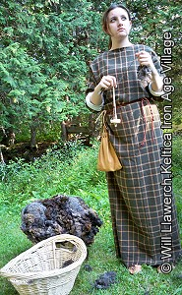
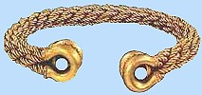
What clothes did the Celts wear?
The way they dress is astonishing: they wear brightly coloured and embroidered shirts, with trousers called bracae and cloaks fastened at the shoulder with a brooch, heavy in winter, light in summer. These cloaks are striped or checkered in design, with the separate checks close together and in various colours'
Diodorus Siculus (A Roman historian)
The Celts also loved to wear jewellery made from bronze, gold, tin, silver, coral and enamel.
Torc (neck ring)
Important people like chieftains, nobles and warriors wore a Torc (pictured right), a circular twisted metal neckband. It was made from gold, silver, electrum (gold-silver alloy), bronze and/or copper.

Slide 4
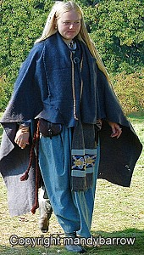
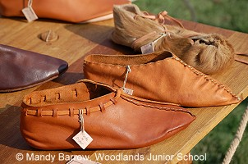
Bracae (trousers)
Bracae were worn underneath tunics
Tunics
Tunics were mainly worn by men. They were a simple 'T' shape and worn at any length from the knee to the ankle. Men would wear a tunic with a belt, a cloak and trousers.
Dresses
Women wore floor-length skirts or dresses made of wool or linen and wore shawls or cloaks.
Bratt (cloak)
Cloaks were made from wool and fastened by broaches and pins.

Slide 5
What did the Celts eat?
There were no supermarkets or shops to buy food so the Celts ate what food they could grow or hunt.
Plants
Vegetables e.g. leeks, onions, turnips, parsnips and carrots.
Wild nuts e.g. hazelnuts and walnuts.
Berries e.g. gooseberries, blackberries and blueberries.
Grains to make bread and also porridge
Herbs e.g. fennel, common sorrel, wild garlic, parsley
Leaves e.g. nettles and spinach
Animal
Wild animals e.g. deer, wild boar, fox, beaver, and bear.
Fish e.g. trout, mackerel, and salmon.
Domesticated animals e.g. chicken, goat, sheep and pigs.
Eggs from hens and wild birds eggs.
Insects
Honey from bees

Slide 6
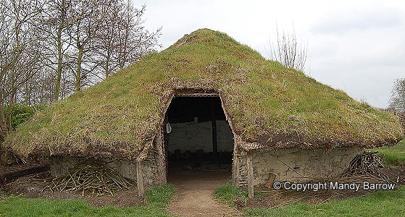
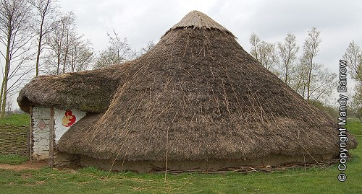
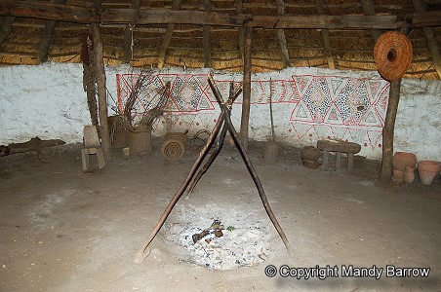
Celtic Houses
The Celtic tribes lived in scattered villages. They lived in round houses with thatched roofs of straw or heather. The walls of their houses were made from local material. Houses in the south tended to be made from wattle (woven wood) and daub (straw and mud) as there was an ample supply of wood from the forests.
The houses had no windows. The roof was made from straw with mud placed on top to keep the warmth in. The houses in the north were made with large stones held together with clay. The photograph below shows both types of houses.
The Celts would light a fire in the middle of the roundhouse for cooking and heating. It must have been very smoky inside. The smoke from the fire escaped through a hole in the roof. Animals were often kept inside the house at night.

Slide 7
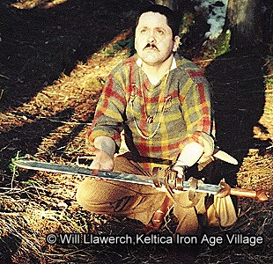
Celtic Religion
The Iron Age Celts of Europe and Britain were very superstitious people. Celtic Priests
Celtic priests, called Druids, were the link between the supernatural world and the ordinary human one. They were able to predict what would happen in the future by interpreting nature. It is likely that they knew how to read and write, and they certainly had a good grasp of mathematics. They knew something of medicine and law, and they could trace the stars and the planets. The main centre of the druids in Britain was Anglesey, in Wales.
Gods and Goddesses
The Celts believed in many gods and goddesses: over 400 in fact. Among them were:
Sucellos, the sky god, with a hammer that caused lightning,
Nodens, who made clouds and rain.
Many gods had no names, but lived in springs, woods and other places. Offerings to the gods were thrown into lakes, rivers and left by springs and wells.

Slide 8
The Celtic Year
Celtic festivals were held throughout the year. They measured time in Lunar (moon) months, and in order to bring the lunar and solar years into agreement would add an extra month to the year every three or four years.
The Four main Festivals of the Celtic year
Great feasts were held four times during the year - Imbolc, Beltain, Lughnasa and Samhain.
Imbolc - 1st February
Beltain - 1st May
Lughnasa - 1st August
Samhain - 1st November
Human Heads
The Celts made many sculptures of human heads in stone or wood. They believed that the human soul lived inside the head. They believed that capturing someone's soul gave you really powerful magic, which is why they collected the heads of their enemies killed in battles.
Roman historians say the Celts cut off the heads of their ancestors, and even their enemies, and worshipped the skulls. They nailed the heads over the doors of their huts.

Slide 9
" In exactly the same way as hunters do with their skulls of the animals they have slain, they preserved the heads of their most high-ranking victims in cedar oil, keeping them carefully in wooden boxes." Written by Diodorus, a Roman historian
After Life
The Celts believed that the human soul had an afterlife, so when a person died they were buried with many things they would need for the after life.
Warriors were often buried with a helmet, a sword or dagger, shield and in some cases, even a chariot.

Slide 10
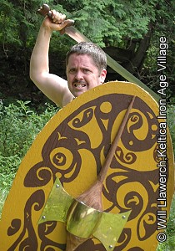
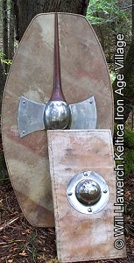
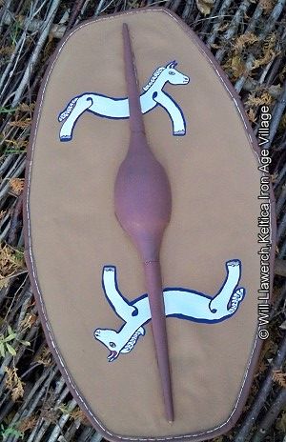
Weapons and Warriors
"[The Celts] wear bronze helmets with figures picked out on them, even horns, which made them look even taller than they already are...while others cover themselves with breast-armour made out of chains. But most content themselves with the weapons nature gave them: they go naked into battle...Weird, discordant horns were sounded, [they shouted in chorus with their] deep and harsh voices, they beat their swords rhythmically against their shields.” Written by Diodorus, a Roman historian
Celtic warriors carried long, or oval shaped shields, spears, daggers and long slashing swords made of iron.
The Celtic warrior's deadliest weapon was his long sword, which he whirled around his head and brought crashing down on the enemy.

Slide 11
Resources
http://www.primaryhomeworkhelp.co.uk/celts.htm
http://www.romanobritain.org/4-celt/clb_celts_and_celtic_life.htm
http://en.wikipedia.org/wiki/Celts
http://blog.histouries.co.uk/2011/03/02/celtic-britain-the-origin-of-the-celts-daily-life-druids-religion-and-warfare-in-celtic-society/

