Slide 1
Summary of festivals

Slide 2
FINAL ANALYSIS
COMPUTER CHRONICLES LEARNING CIRCLE
FINAL PROJECT ANALYSIS OF
IMPORTANT FESTIVALS
MRS NAIMA ABDUL SAMMAD
PAKISTAN

Slide 3
WHAT ARE FESTIVALS?????

Slide 4
FESTIVALS
FESTIVALS ARE THE SPECIAL OCCASIONS WHICH ARE CELEBRATED IN EVERY COUNTRY IN DINTINGUISHED WAY ACCORING TO THE CUSTOM OF THAT CERTAIN COUNTRY…
EVERY CELEBRATION BRINGS PEACE HARMONY AND UNITY AMONG THE NATIVES.CELERATION TIME IS QUITE RELAXING FOR EVERY INDIVIDUAL.

Slide 5
SIMILARITIES OF FESTIVALS
PAKISTANIES AND JORDANIANS ARE CELEBRATING EID MILAD UN NABI ON 12TH OF RABI UL AWWAL EVERY YEARS IN COMMENORATION OF GREAT PROPHET(SAW).
INDEPENDENCE DAY OF EACH COUNTRY IS CELEBRATED WITH GREAT FERVOUR.
CHRISTMAS & VALENTINE DAYS ARE CELEBRATED NATIONALY IN JORDEN,USA & PARTIALLY IN PAKISTAN.

Slide 6
FESTIVALS OF PAKISTAN

Slide 7
IMPORTANT FESTIVALS OF IEARN PARTNER COUNTRIES
USA
Independence day
Birthdays
Thanksgiving day
Holloween
Christmas day
Kwanzaa
JORDEN
Hakaya festival
Rabi ul awwal festival
Amman international theater festival
Aqaba traditional arts festival
Azraq festival
Jerash festival

Slide 8
IMPORTANT FESTIVALS CONTD….
SLOVINIA
Martinove
Valentine’s day
Pine wedding
Ist of May
Mother’s day
Folklore
Wine harvest
ABRAHAM
TAIWAN
Chinese new year
Moon festival
Dragon boat festival

Slide 9
IMPORTANT FESTIVALS CONTD……
UKRAINE
Dignity and Freedom day
Woodstock summertime festival
Molodist cinema event
Lviv cheese and wine festival
Odesssa international festival
Katya tashuta festival

Slide 10
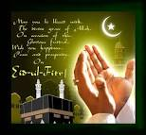
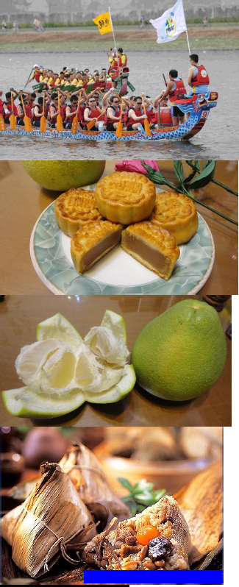
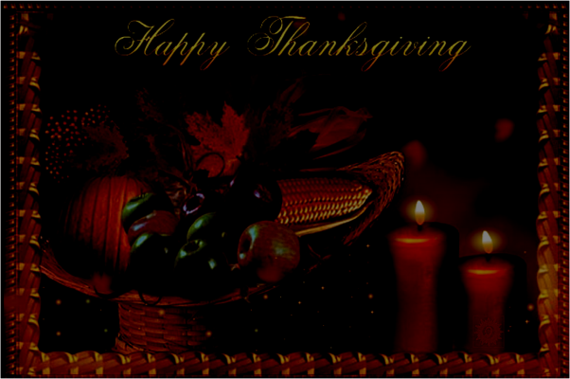
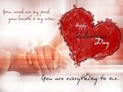
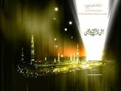
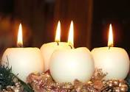
CLICKS OF IMPORTANT CELEBRATIONS

Slide 11
CONCLUSION
Every country is celebrating great occasions in its best capacity.Celebrations in each country are very joyous for all and sundry…..
Every country has its separate prestige and way of celebrations.All are doing well and we are so pleased to get familiar with everyone across the globe.

Slide 12
So kind of you Berry kramer and Iearn team
Thanx Khuzama , Andreja , jean Smith , Margeret and Natalya
we are glad to know about your festivals

