Slide 1
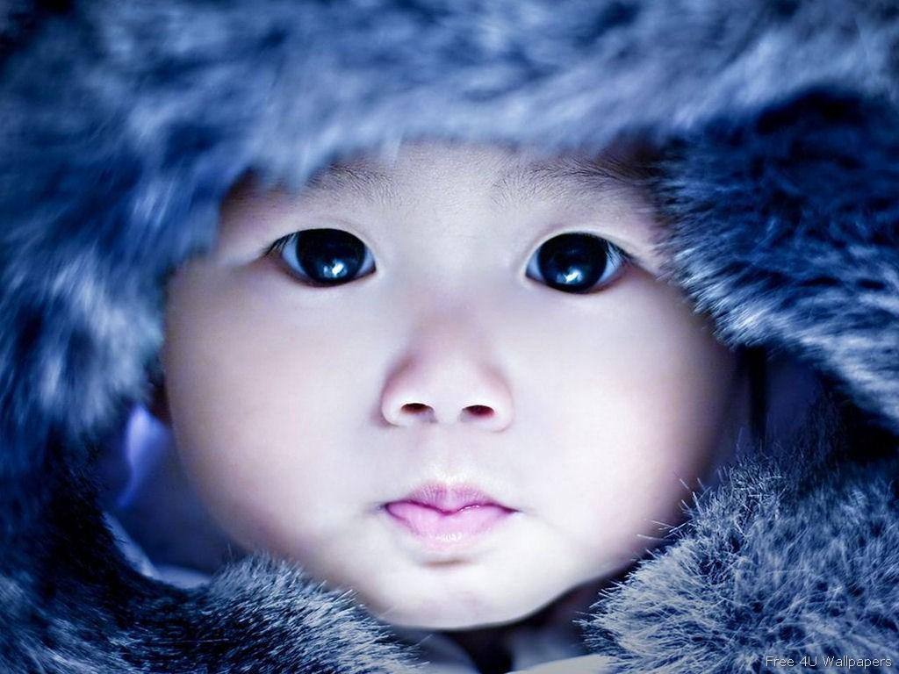
The Eskimo-Early people’s symbols

Slide 2
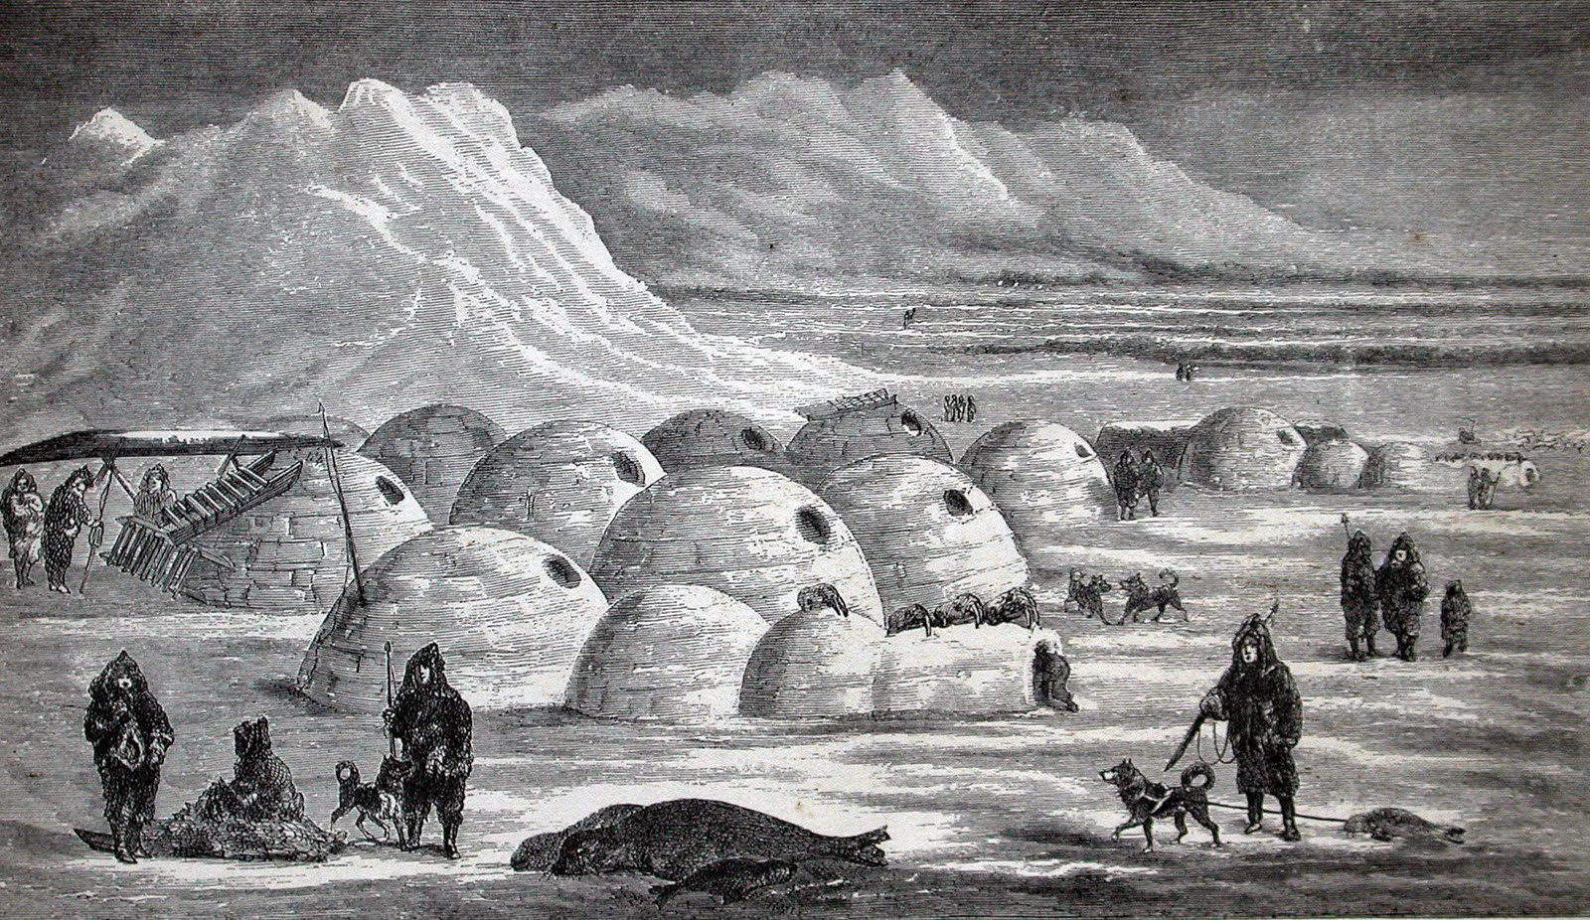
Goal:to descover eskimo’s world and give them more value

Slide 3
1Were do they came from? 2Their home 3Traditions 4Their food 5Myths and misconceptions about the Eskimo 6Dwellings 7Clothing 8Family life 9 Religion

Slide 4
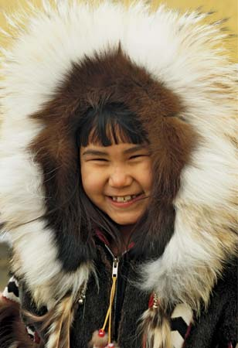
1(a)Story:
kimo, any member of a group of peoples who, with the closely related Aleuts, constitute the chief element in the indigenous population of the Arctic and subarctic regions of Greenland, Canada, the United States, and far eastern Russia (Siberia).
The self-designations of Eskimo peoples vary with their languages and dialects. They include such names as Inuit, Inupiat, Yupik, and Alutiit, each of which is a regional variant meaning “the people” or “the real people.” The name Eskimo, which has been applied to Arctic peoples by Europeans and others since the 16th century, originated with the Innu (Montagnais), a group of Algonquian speakers; once erroneously thought to mean “eaters of raw flesh,” the name is now believed to make reference to snowshoes.

Slide 5
1(b)Origin
Two principal competing etymologies have been proposed for the name "Eskimo," both derived from the Innu-aimun (Montagnais) language, an Algonquian language of the Atlantic Ocean coast. The most commonly accepted today appears to be the proposal of Ives Goddard at the Smithsonian Institution, who derives it from the Montagnais word meaning "snowshoe-netter" or "to net snowshoes." The word assime·w means "she laces a snowshoe" in Montagnais. Montagnais speakers refer to the neighbouring Mi'kmaq people using words that sound very much like eskimo. The second proposal, from Jose Mailhot, a Quebec anthropologist who speaks Montagnais, published a paper in 1978 which suggested, alternatively, that the meaning is "people who speak a different language". French traders who encountered the Montagnais in the eastern areas, adopted their word for the more western peoples.
The primary reason some people consider Eskimo derogatory is the questionable but widespread perception that in Algonkian languages it means "eaters of raw meat." One Cree speaker suggested the original word that became corrupted to Eskimo might indeed have been askamiciw (which means "he eats it raw"), and the Inuit are referred to in some Cree texts as askipiw (which means "eats something raw").
In 1977, the Inuit Circumpolar Conference meeting in Barrow, Alaska, officially adopted "Inuit" as a designation for all Eskimos, regardless of their local usages.The Inuit Circumpolar Council, as it is known today, uses both "Inuit" and "Eskimo" in its official documents.

Slide 6
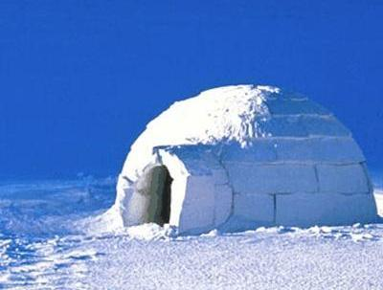
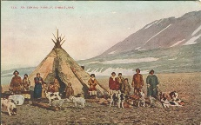
2 Most Eskimo wintered in either snow-block houses called igloos or semisubterranean houses built of stone or sod over wooden or whalebone frameworks. In summer many Eskimo lived in animal-skin tents

Slide 7
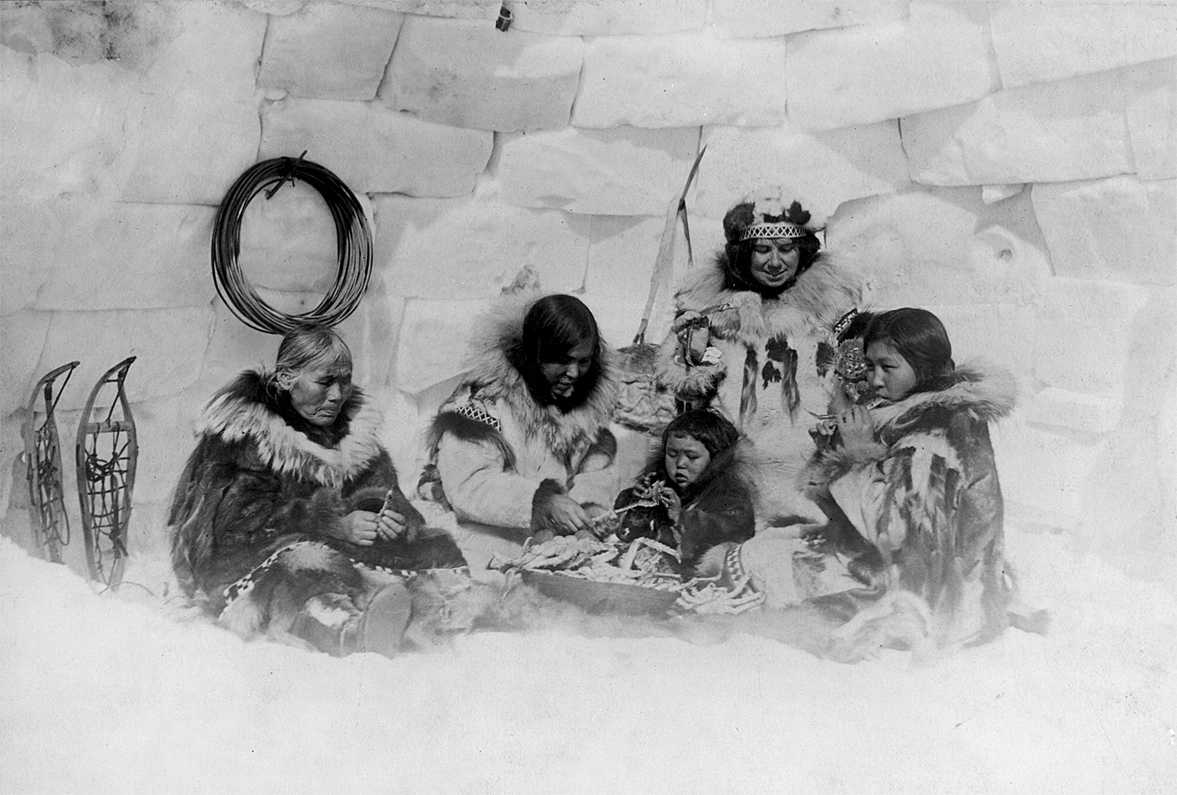
Traditional Way of Life
For those Eskimos far removed from population centers, life in the harsh Arctic remains little changed from that lived by their ancestors hundreds of years ago. Traditionally Eskimos were hunters and gatherers. They lived in groups that moved from one area to another, according to the season. They depended largely on products obtained from the seal and caribou for food, clothing, heat, and light. There were no chiefs. Leadership was mainly advisorythat is, the person most skilled in a particular activity, such as hunting or fishing, was consulted when advice on that activity was needed.

Slide 8
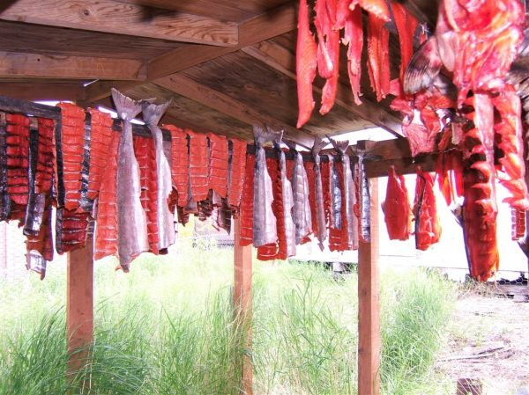
4 Food
The traditional Eskimo diet varied with the seasons. Seals, whales, and other sea mammals were hunted in the winter months. The meat was eaten cooked, raw, or dried. In summer and fall the major food sources were caribou, small game, fish, and berries.
A traditional Eskimo delicacy was akutok (often called Eskimo ice cream), made from arctic berries, seal oil, and caribou meat. Strong hot tea and hard biscuits, made with flour bought from a trading post, were served in nearly every home.

Slide 9
5 There are common erroneous ideas about the Eskimo. These include: * "They have thousands of words for snow." Eskimo–Aleut languages have about the same number of distinct word roots referring to snow as English does, but the agglutinative structure of these languages allows almost infinite combinations of prefixes and suffices to these roots - so 'snow' can form as many 'words' as any other root. * "They live in igloos." The word "igloo" or iglu simply means "house". The snow house identified with the people was built as a temporary shelter during hunting seasons in the late winter and spring. It expressed an important survival skill in making use of what materials were available. The snow house is built today in emergencies or for fun as part of the transfer of traditional knowledge between generations.

Slide 10
6 Dwellings In some parts of Greenland and in treeless regions of arctic Canada, such as Baffin Island, the Eskimos built snow houses for winter homes. These domed houses, built of blocks of fresh-cut snow, are commonly known as igloos. (The Eskimos themselves call any kind of shelter an igloo, not just snow houses.) In other parts of Canada and Greenland, and in Alaska, some Eskimos built winter homes of turf and stone. Others packed thick layers of earth over frames of driftwood or whalebone. The homes usually had one room, with sleeping benches covered with caribou hides. In summer, almost all Eskimos lived in tents made of seal or caribou skins sewn together with sinews.

Slide 11
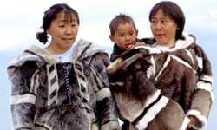
7 Eskimo clothing was made from animal skins. Traditionally, men, women, and children dressed much alike. They wore waterproof sealskin boots, hooded fur jackets called parkas, and fur trousers made of pelts from seal, caribou, fox, or polar bear. Waterproof jackets were made from seal gut. An Eskimo mother carried her baby in a pouch on her back under her parka.

Slide 12
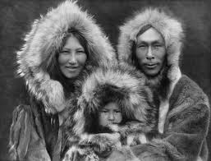
Family Life
Married couples were the nucleus of an extended family. Parents, brothers, unmarried sisters, or other relatives often shared the same household. All members worked together to survive the Arctic winters. Men were responsible for providing food. Women made clothes and prepared food. During the winter months families entertained themselves by telling and acting out stories handed down from generation to generation. Often they danced to drum music.

Slide 13
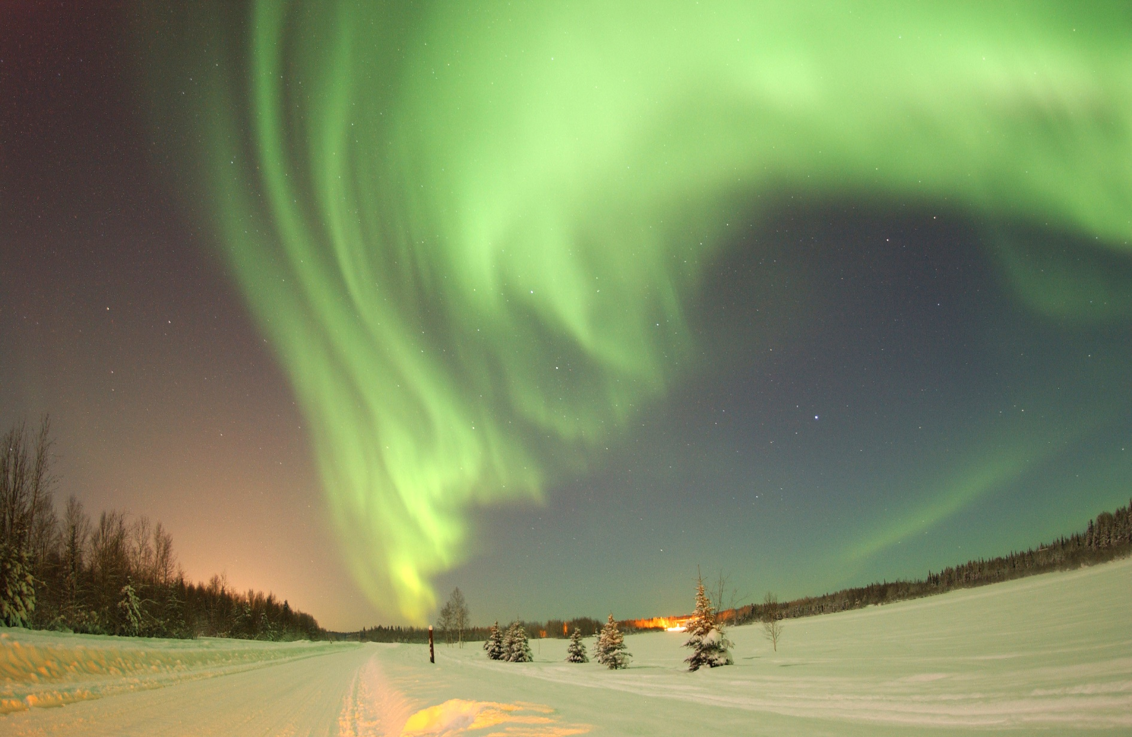
9 Religion
During the 20th century most Eskimos converted to Christianity. In remote regions, some families retained the ancient Eskimo belief that certain men and women, called shamans, have the ability to call upon supernatural spirits for aid in curing illness, ensuring good hunting, and controlling the weather.

