Slide 1
Our Favourite Music
Belarus, Canada, the USA,
Spain, Pakistan
Prepared by
Students of the 7th form
Gymnasium No.1
Starye Dorogi
Belarus
Teacher
Natasha Belozorovich
2014

Slide 3
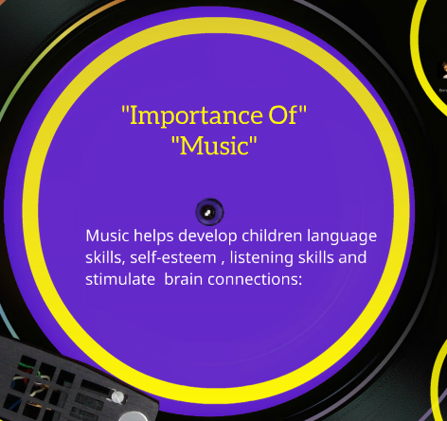

Slide 4
Our Favourite Kinds of Music

Slide 5
Belarus
Four people like classical music
Two people like chanson .
Two people like rock music .

Slide 6
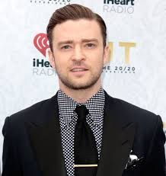
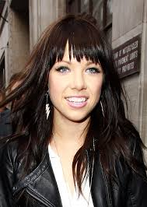
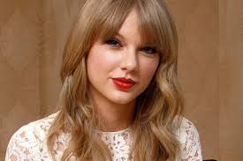
Canada, NB
Pop

Slide 7
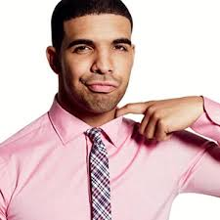
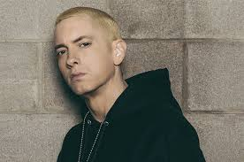
Canada, NB
Rap

Slide 8
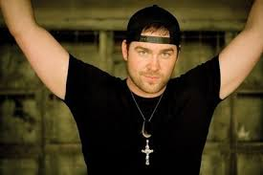
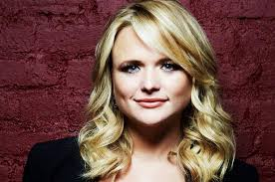
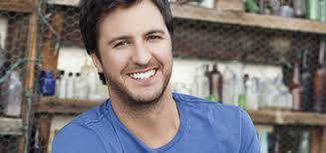
Canada, NB
Country

Slide 9
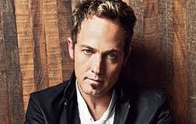
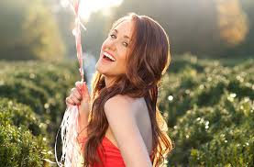
Canada, NB
Gospel

Slide 10
Indie Music
Canada, NB
Indie music (independent music) is a music genre originated in the U.K. (United Kingdom) in the 1950`s.
Some bands of this genre include:
1. Arctic monkeys
2. Arcade Fire
3. Death Cab for cutie
4. Vampire weekend
5. Two Door Cinema Club
6. The Kooks
7. The XX
8. Florence and the Machine
9. The Killers
10. Foster the People
Notes:
Indie music (independent music) is a music genre originated in the U.K. (United Kingdom) in the 1950`s.
Some bands of this genre include:
1. Arctic monkeys
2. Arcade Fire
3. Death Cab for cutie
4. Vampire weekend
5. Two Door Cinema Club
6. The Kooks
7. The XX
8. Florence and the Machine
9. The Killers
10. Foster the People

Slide 11
Canada, NB
Rock Music
Rock music (rock and roll) is a genre originated in the U.S.A. (United States) in 1950`s.
Some bands of this genre include:
1. Led Zeppelin
2. Aerosmith
3. The Beatles
4. Green Day
5. Kiss
6. Metalica
7. Red hot Chili Peppers
8. Falling In Reverse
9. Black Veil Brides
10. Bring me the Horizon
Notes:
Rock music (rock and roll) is a genre originated in the U.S.A. (United States) in 1950`s.
Some bands of this genre include:
1. Led Zeppelin
2. Aerosmith
3. The Beatles
4. Green Day
5. Kiss
6. Metalica
7. Red hot Chili Peppers
8. Falling In Reverse
9. Black Veil Brides
10. Bring me the Horizon

Slide 12
Canada, Wilson Beach
Students in our school enjoy Heavy Metal, Classic Rock, and Pop.
Younger students in our school enjoy singers like Selena Gomez, Ariana Grande, Demi Levato, Iggy Azalea, Taylor Swift and Nikki Minaj.

Slide 13
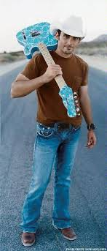
Country music is very popular here
The USA
Brad paisley a huge country star born and raised really close t our school only a few miles away!
Blake Shelton married to Maranda Lambert also a very popular too.
Brad Paisley
Blake Shelton

Slide 14
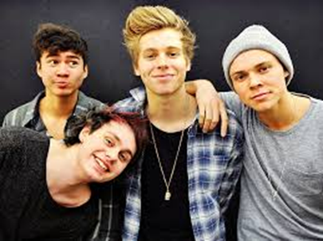
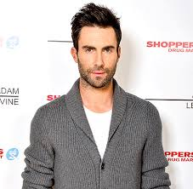
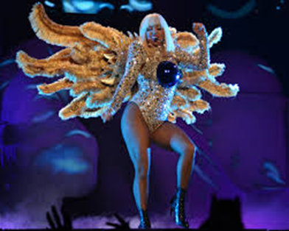
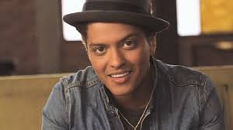
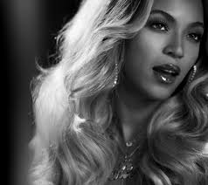
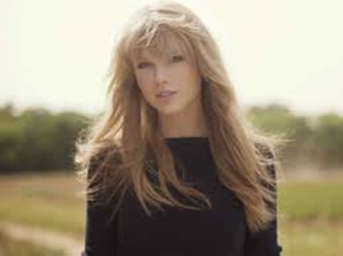
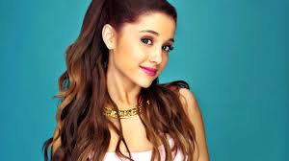
Pop Music
The USA

Slide 15
Spain
TXARANGO

Slide 16
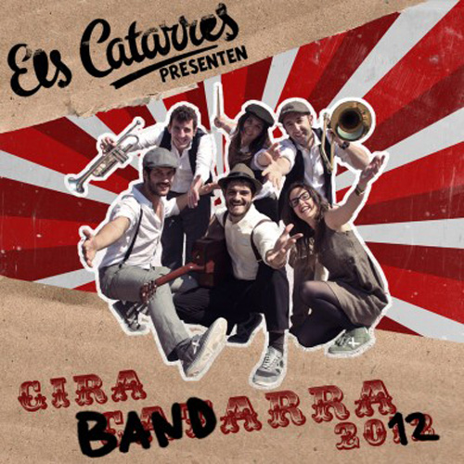
Our favourite group of music is Catarres.We love music in catalan, because it is our language¡
Spain

Slide 18
Our Favourite Singers

Slide 19
Egor Creed
Belarus
Famous Egor once posted on You tube his first role of love in the network.

Slide 20
Famous songs
New Year songs, Puzzle , Inspiration , Out of time , Smile.

Slide 21
Interesting facts
Egor creed-rising star in the rap and pop music. Originally, as a rapper he has achieved little popularity in his home town Penza. And afher a while, when he was noticed by Timati, he began to conquer the whole Russia.

Slide 22
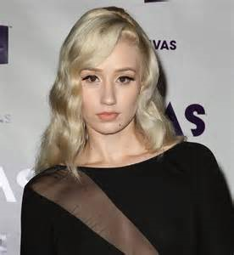
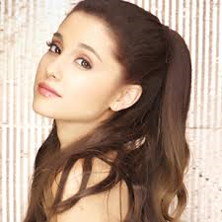
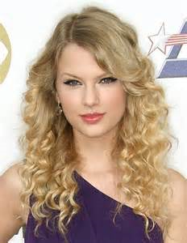
Singers that girls like
Canada, NB
Ariana Grande
Nikki Monaj
Jessie J
Iggy Azalea
Charlie XCX
Taylor Swift
Meghan Trainor

Slide 23
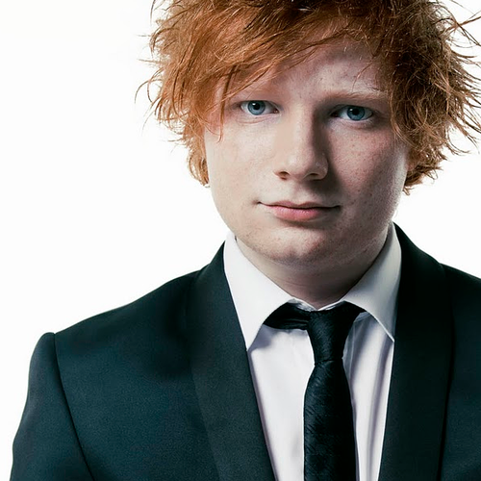
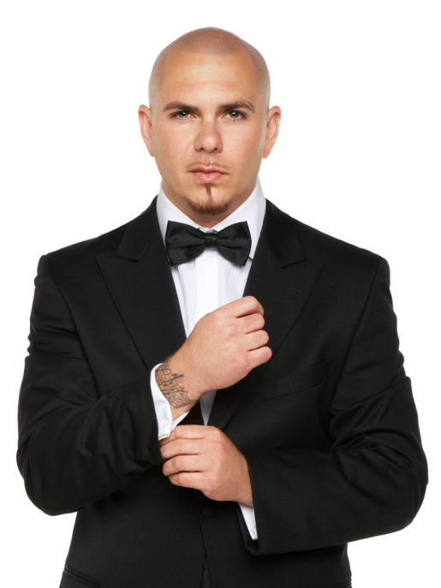
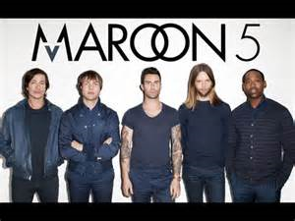
Singers that boys like
Canada, NB
Ed Sheeran
Hedley
Maroon 5
Marianas Trench
Eminem
Pitbull
Red Hot Chili Peppers

Slide 24
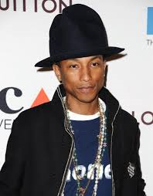
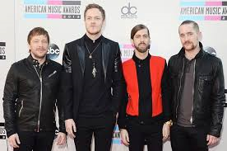
Singers that both genders like
Canada, NB
- Sam Smith
Daft Punk
Pharrell Williams
One Republic
Imagine Dragons
Macklemore and Ryan Lewis
Robin Thicke

Slide 25
Songs that girls like
Canada, NB
Shake it off
I`m all about that bass
Bang Bang
Stay with me
Boom Clap
Problem

Slide 26
Songs that boys like
Canada, NB
- Rap God
How you remind me
Burn it to the ground
Turn down for what
Light Em Up
o

Slide 27
Songs that both genders like
Canada, NB
Anaconda
Sing
Happy
Best Day of my Life
Rude
Am I wrong

Slide 28
Our class voted who were the best female singers. This is what we picked.
Canada, NB
Iggy Azalea | 5
Nicki Monaj | 0
Taylor Swift | 6
Ariana Grande | 0
Jessie J | 0
Charlie XCX | 0
Meghan Trainor | 0
Other | 5

Slide 29
Our class voted who were the best male singers. This is what we picked.
Canada, NB
Ed Sheeran | 7
Hedley | 0
Maroon 5 | 0
Marianas Trench | 0
Eminem | 2
Pitbull | 4
Red Hot Chili Peppers | 0
Others | 3

Slide 30
Singers our school enjoys
Canada, Wilson Beach
Most of the students in our school like Rock Rap, and Country. Favorite country singers are Luke Bryan, Toby Keith, Sam Hunt and Brantley Gilbert. Eminem is another rap singer students in our school enjoys.

Slide 31
Favorite Bands
Canada, Wilson Beach
Florida Georgia Line
Lady Antabellum
Zac Brown Band
AC/DC
Hollywood Undead
All Time Low
Pierce The Veil
Eminem (singer)
Nickleback
Country Bands
Rap and Rock Bands

Slide 32
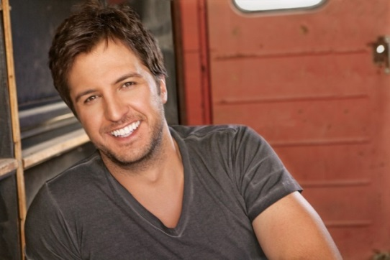
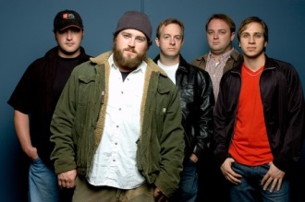
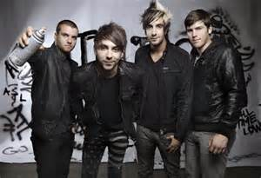
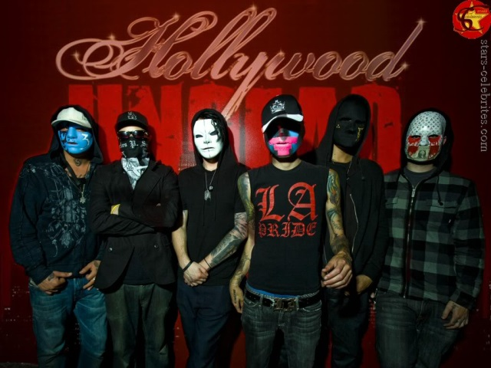
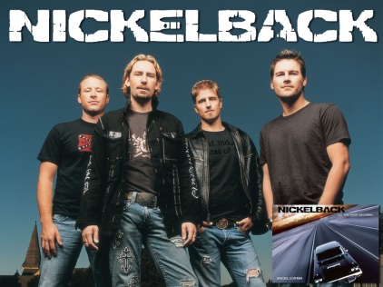
Eminem, Zac Brown Band, Luke Bryan, Lady Antebellum, All Time Low, Hollywood Undead, and NickleBack
Canada, Wilson Beach

Slide 33
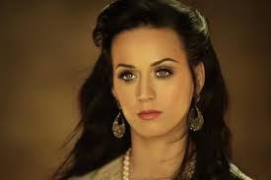
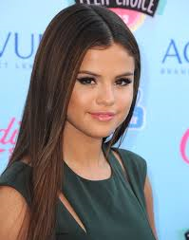
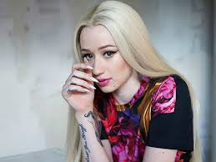
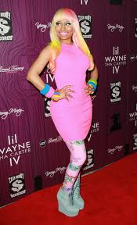
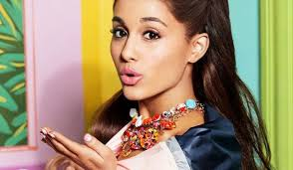
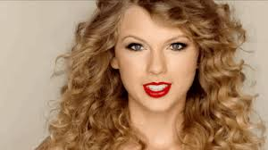
Demi Lovato, Iggy Azeala, Selena Gomez, Katy Perry, Taylor Swift, Nikki Minaj, and Ariana Grande
Canada, Wilson Beach

Slide 34
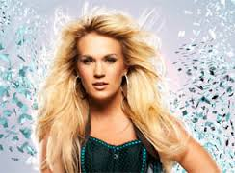
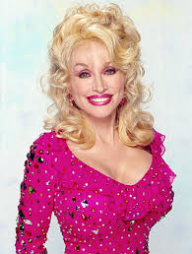
Female country artist
The USA
Carrie Underwood
Dolly Parton
These are just a few country artist
-Maranda Lambert
-Carrie Underwood
-Cassie Muscraves
- Dolly Parton (an older artist)

Slide 35
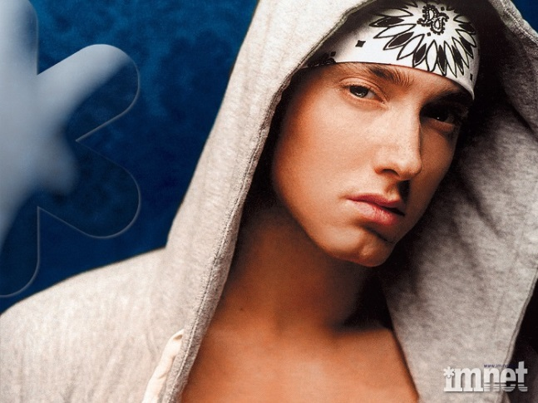
Eminem Rap Singer and Artist
Canada, Wilson Beach
Eminem was born on October 17 1972 his real name is Marshall Bruce Mathers the 3rd his other stage name is Slim Shady. He is also apart of a group called D12. Eminem or Marshall is a well known American rapper, singer, recording producer, and artist/song writer.

Slide 36
Lady Antebellum
Canada, Wilson Beach
Lady Antebellum is a country/pop group. They are originally from Nashville Tennessee and were formed in 2006. They became popular in in 2007 when they sang on the Jim Brickman show. They have released 5 albums including 1 Christmas album.

Slide 37
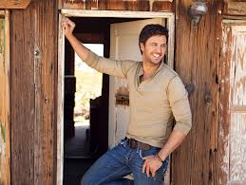
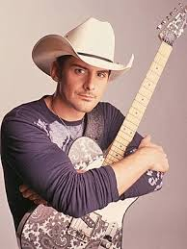
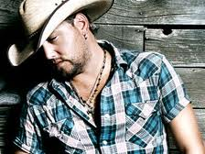
Male country artist
The USA
Luke
Bryan
Brad Paisly
Jason Aldean
-Darias Rucker
-Blake Shelton
-Luke Bryan
-Jason Aldean
-Brad Paisley ( These are only some of them)

Slide 38
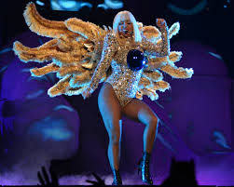
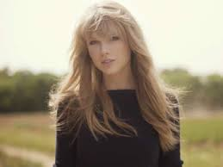
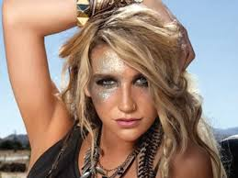
Female Pop artist
The USA
-Ariana Grande
-Lady Gaga
-Taylor Swift
-Kesha
-Beyonce

Slide 39
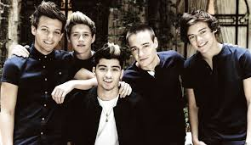
Male pop artist
The USA
Bruno Mars
Adam Leveane
5 Seconds of summer
One Direction

Slide 40
STORY OF TXARANGO
Spain
Our favourite music is Catalan rock (txarango).
Txarango is a famous group of Catalan music. Txarango has two albums: “EL LLARG VIATGE” AND “SOMRIU”
EL LLARG VIATGE- consists on 14 songs: reggae, cúmbia, dub and pop.
Place of Origin: Ripoll , Catalonia.
Years active Since: 2010.

Slide 41
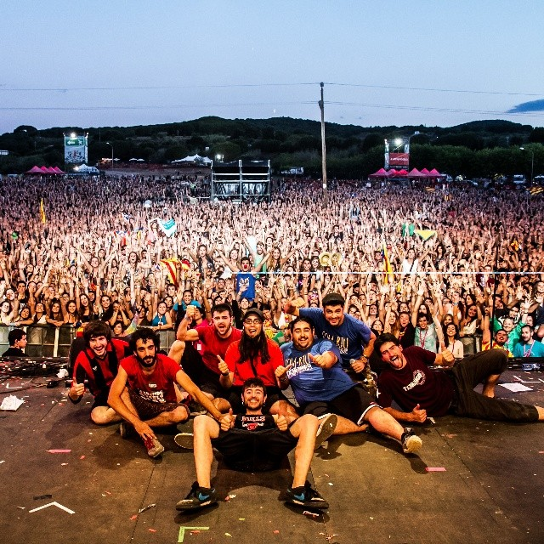
MEMBERS OF TXARANGO: Alguer Miquel , Marcel Lázara 'Tito' , Sergi Carbonell 'Hipi' , Joaquim Canals , Àlex Pujols , Pau Puig , Ivan López i Jordi Barnola. .
Spain

Slide 42
SONGS OF TXARANGO LLARG VIATGE
Spain
BENBINGUTS
EN CARABANA
UN PAM DE NAS
SUEÑA COMO UN NIÑO
DANSA DEL VESTIT

Slide 43
COM DUES GOTES D’AIGUA
Spain
Com tu, com jo, la mateixa sang fills d'una mateixa panxa. Com tu, com jo, la mateixa sang energia que ens enganxa.
like you, like me, the same blood, children of the same mother . like you, like me, the same blood, energy that stick us .

Slide 44
EN CARABANA
Spain
M'he enrolat al circ i ara hi vaig en caravana i ara a cada poble un clown hi fa parada m'he enrolat al circ i ara hi vaig en caravana i ara a cada poble un clown hi fa parada
I am working in the circus and now I go in caravan and now in each village a clown stops I am working in the circus and now I go in
caravan and now in each village a clown stops

Slide 45
Photo of group (Els Catarres)
Spain
Group was formed in 2010 and the
29 of november they published their first CD.

Slide 46
Spain
I wanted to sing , sing and even to lose the voice due to the passion of just a moment where the only thing that matters to me is the present .
Jo volia cantar, cantar i si cal perdre-hi la veu en la passió d'un sol moment on l'únic que m'importa és el present. .
English
Catalan

Slide 47
Roser Cruells
Spain
This is your bass
She is Roser

Slide 48
Èric Vergés
Spain
This is his guitar.
He is singer.
He is Èric

Slide 49
Jan Rivera Prats
Spain
He is Jan
This is his accordion

Slide 50
Our favourite group of music is Catarres.We love music in catalan, because it is our language¡
Spain

Slide 51
The logo of Catarres is:
Spain

Slide 52
The most popular song is Vull estar en tu.(I want to be with you)
Spain

Slide 53
The videoclip most popular of catarres is jennifer https://www.youtube.com/watch?v=y0bx_PVZA8Y
Spain

Slide 54
Pakistan

Slide 55
Pakistan

Slide 57
Musical Instruments We Can Play

Slide 58
Instruments played in our school
Canada, Wilson Beach
In our school some students enjoy playing the acoustic or electric guitar, piano, violin, drums and the bass. Some students in our school also like to sing.

Slide 59
INSTRUMENTS
Spain
Voice, Guitar, Piano, Bass, Drums Percussion, Tenor Saxophone & Trumpet.

Slide 60
Thank you
for your great projects!

