Slide 1
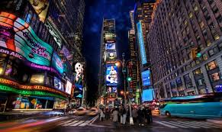
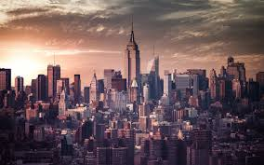
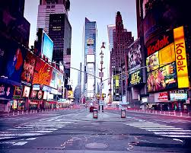
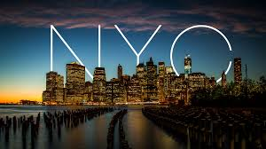
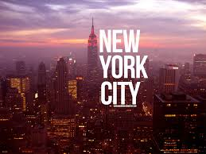
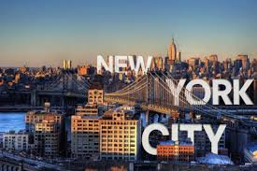
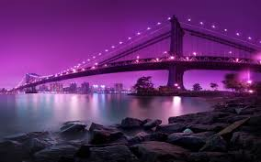
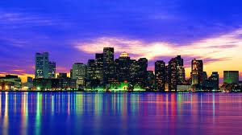
The Things to Do In New York City
By Ciara Beck

Slide 2
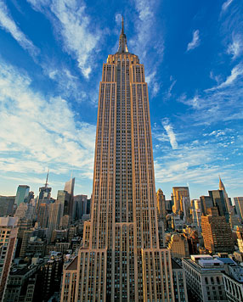
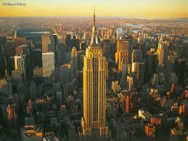
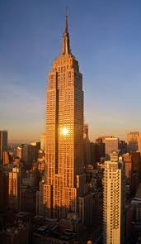
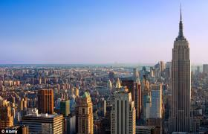
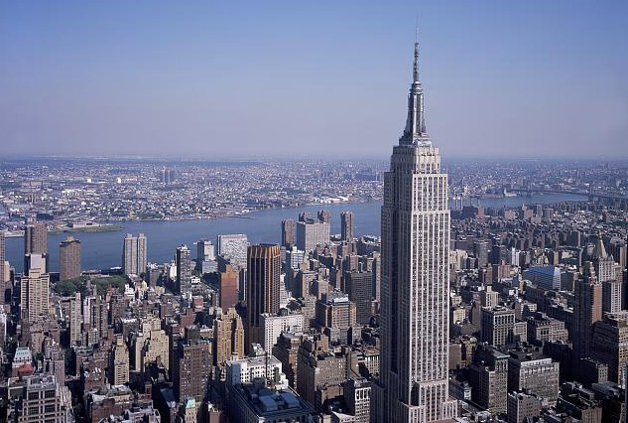
Empire State Building
If you go to the Empire State Building you could go up to the top and look out over the whole city of New York.

Slide 3
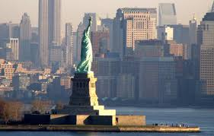
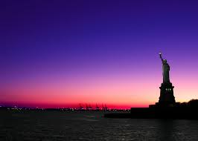
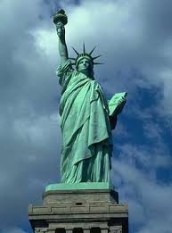
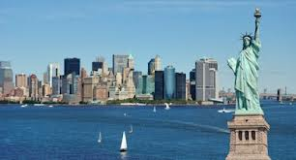
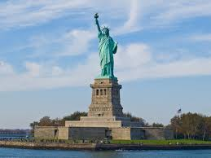
Statue of Liberty
You can go in the Statue of Liberty.
There are tours for you to learn about the
statue. They have a museum you can see.
You can have a nice picnic with a view
of the city.

Slide 4
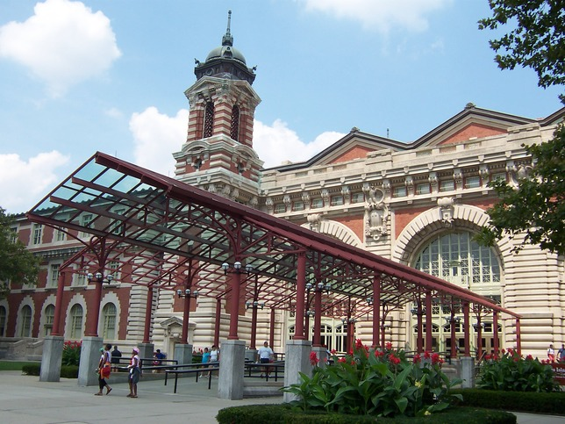
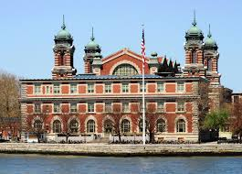
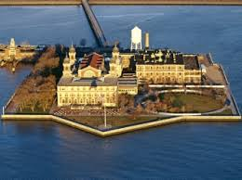
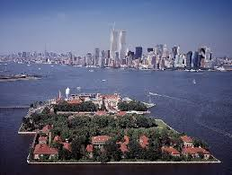
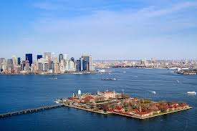
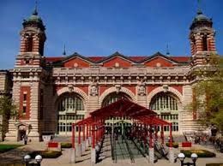
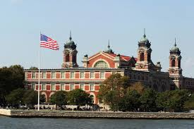
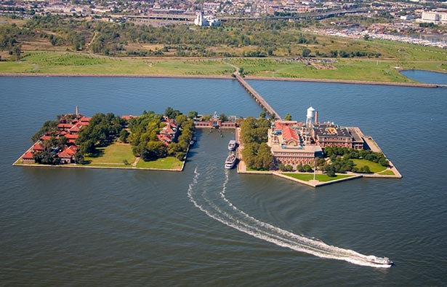
Ellis Island
There are indoor activities you can do on Ellis Island. You can see where people entered the U.S. There are guided tours given by Park Service Rangers or volunteers. These are for all ages even younger kids.

Slide 5
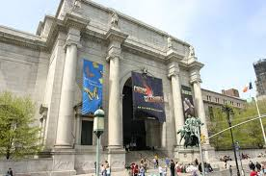
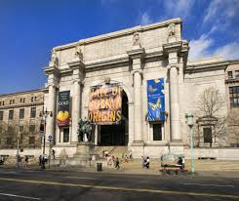
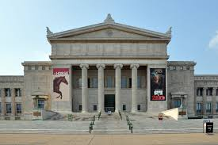
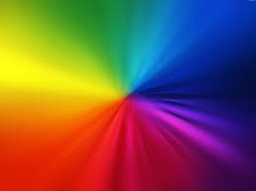
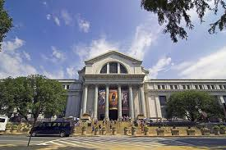
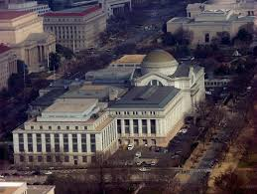
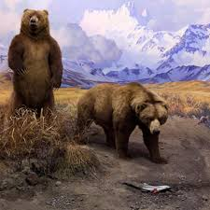
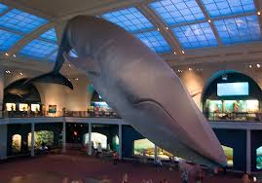
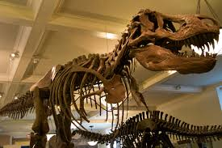
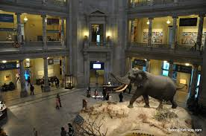
The Museum of Natural History
In the Museum of Nature History there are public tours
If you go on the website for The Museum of Natural History, they have a calendar, to tell the special events that are coming up.
There are some exhibits of stuffed animals that look real.
If someone is hungry there is a food court
Before you leave to go home there are shops that you can go to get a souvenir.

Slide 6
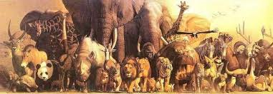
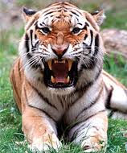
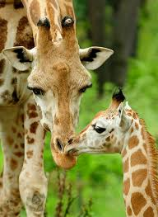
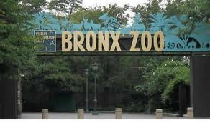
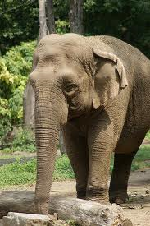
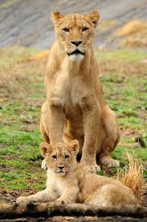
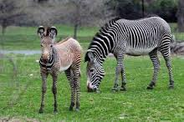
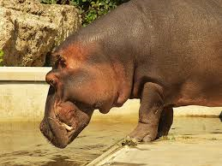
Bronx Zoo
You can see animals in their natural habitat.

Slide 7
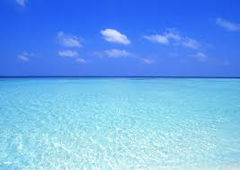
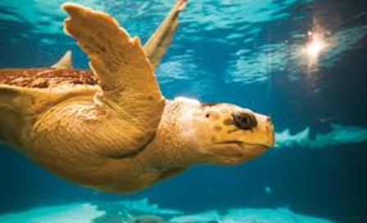
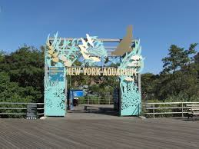
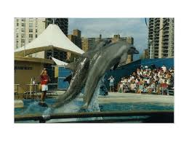
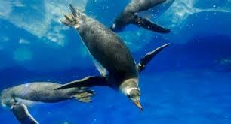
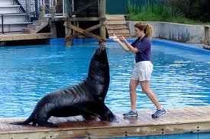
New York Aquarium
You can see the fish and see ocean life in their natural habitat.

Slide 8
Central Park Zoo
The zoo is a small zoo in the middle of a large park in the center of the city. You can see animals up close.

Slide 9
Central Park
You can have a picnic in the park. There is a small lake with row boats. There is an ice skating rink. If you have a pet you can play in the park with them. There is even a carousel for children.

Slide 10
Macy's Fourth of July Fireworks
These are some of the pictures that were taken at the Macy’s Fourth of July Fireworks
Famous singers sing
There are fireworks with background music.

Slide 11
Macy’s Thanksgiving Parade
These are some of the pictures that were taken at the Macy’s Thanksgiving Parade
There theater performers
There arecartoon balloons.
And famous singers singing.
Floats and Bands

Slide 12
The Last Person at the end of the parade is…. Santa

Slide 13
The Christmas Tree Lighting in Rockefeller Center
The tree lighting is always in the beginning of December
Famous singers sing Christmas songs and then they light up the tree.

Slide 14
The Christmas Spectacular at Radio City Music Hsll
A holiday show where the Rockettes dance. The show has a scene from the Nutcracker, lots of dancing Santas, the birth of Jesus with real animals.

Slide 15
The Empire State Building on the holidays
On Valentines day On St. Patrick’s day On The 4th of July
On Thanksgiving Near Christmas

Slide 16
Times Square Ball Drop on New Years Eve
These are some of the pictures that were taken at the Times Square Ball Drop On New Years Eve
Famous singers sing
There is a countdown to the New Year
And then more famous singers sing

Slide 17
The End
IT IS THE CITY THAT NEVER SLEEPS

