Slide 1
Places from Our
Perspectives

Slide 2
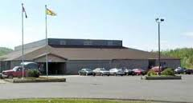
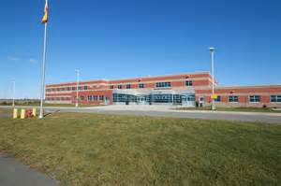
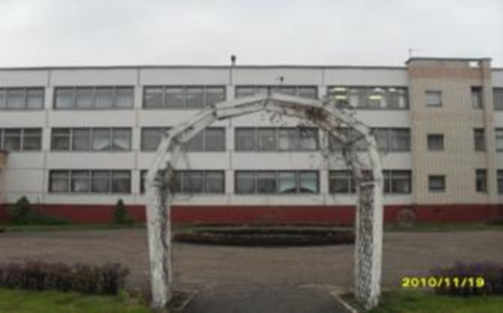
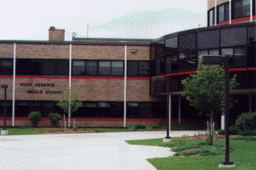
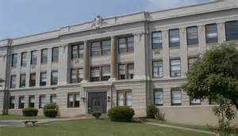
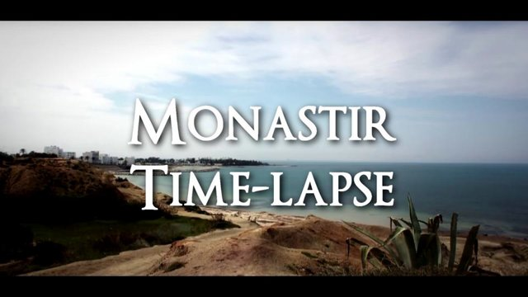
Hartland, NB, Canada
Belarus
Campobello, NB, Canada
A collaborative project by students from:
St. Stephen, NB, Canada
West Virginia, USA
Tunisia
Kyiv, Ukraine

Slide 4
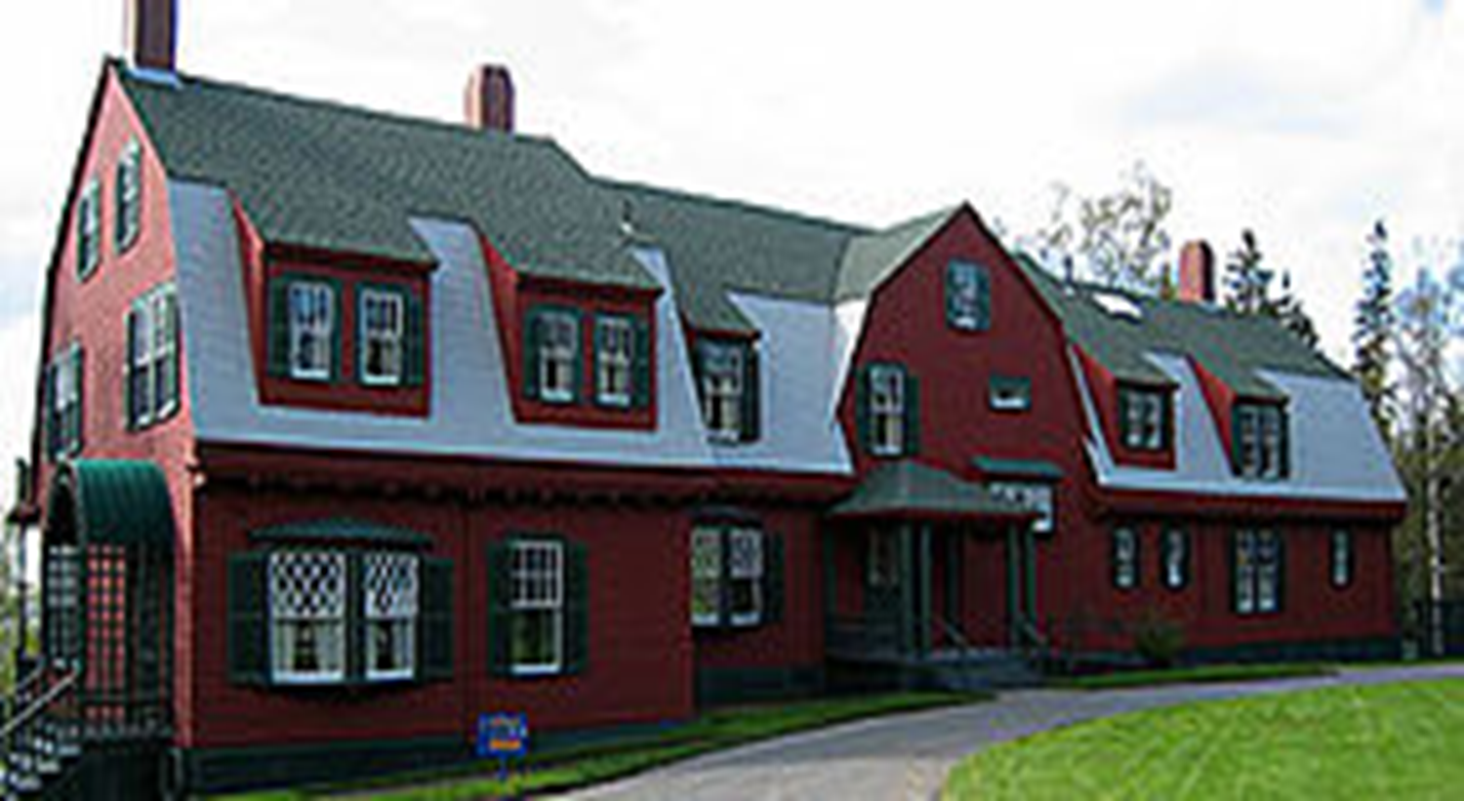
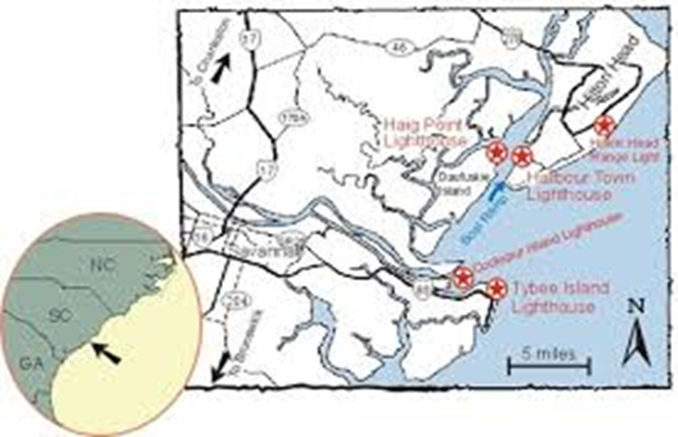
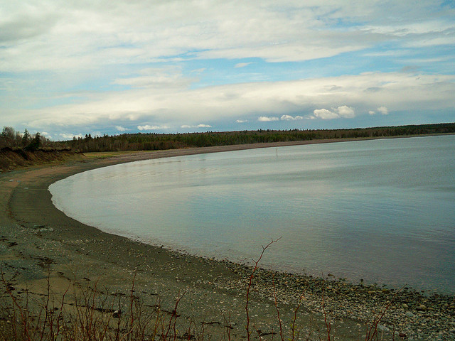
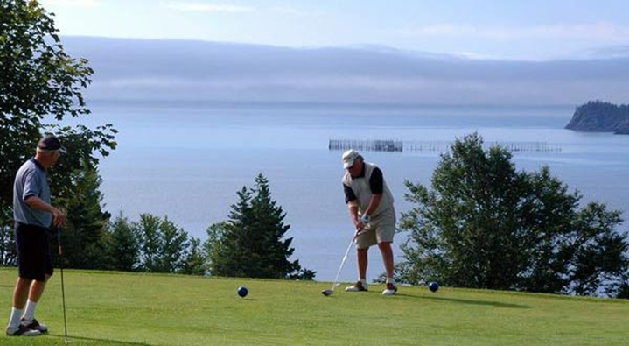
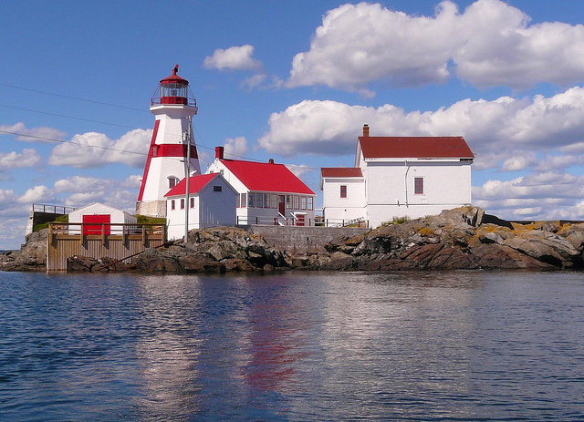
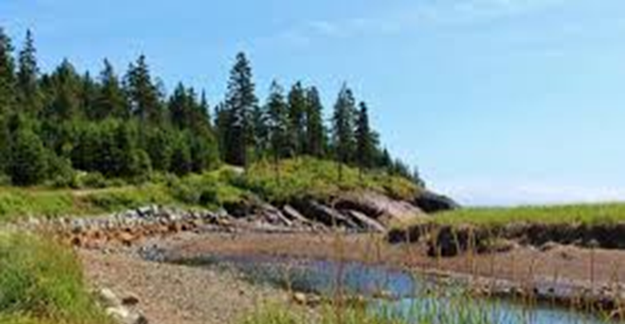
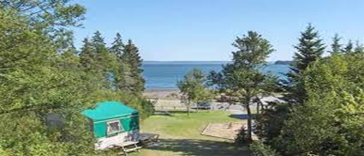
Roosevelt International Park
Herring Cove Provincial Park
Head Harbour Light House

Slide 5
Herring Cove is a hiker’s delight offering 6 unique trails of varying lengths. Hike the Carriage Road through a forest of ancient spruce, across log bridges and around a small pond, or follow an old logging road once used by the Roosevelt’s.
Herring Cove’s 425 ha (1,049 acres) Park features 88 campsites, hiking trails, beach1-mi. long beach, 9-hole golf course,

Slide 6
Roosevelt’s
Roosevelt’s preserves the house and surrounding landscape of the family summer retreat of Franklin D. Roosevelt and his family, located on Campobello Island in the Canadian Province of N.B.
A few years later Franklin was stricken with poliomyelitis at the age of 39. He rarely returned, but Eleanor Roosevelt loved the cool summer weather and visited a lot with her children, and later she came alone in the summer. After Franklin’s death in 1962, the park was turned into a tourist attraction and a nature park.

Slide 7
Head Harbor light house is located at the southern tip of Campobello Island, N.B. It has been around since 1929. It is the most visited light house by tourist. It used to be the best navigation tool around for the boats to find their way through the passage during the night or in the fog. The lighthouse isn’t used much anymore because now we have computers , GPS and digital maps. Head Harbour light was the first light house in Canada.

Slide 8
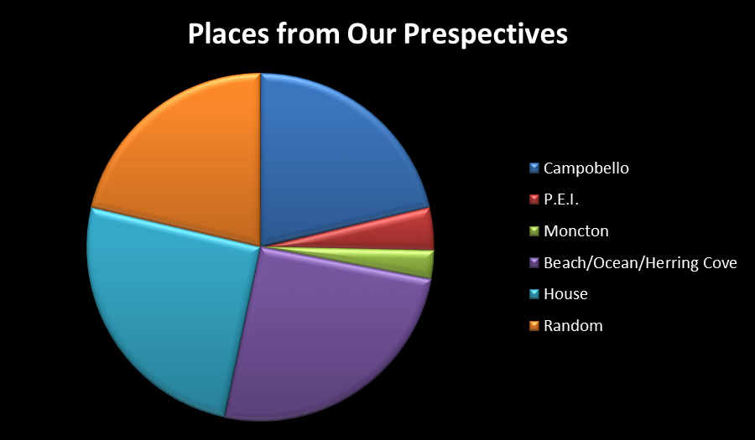

Slide 10
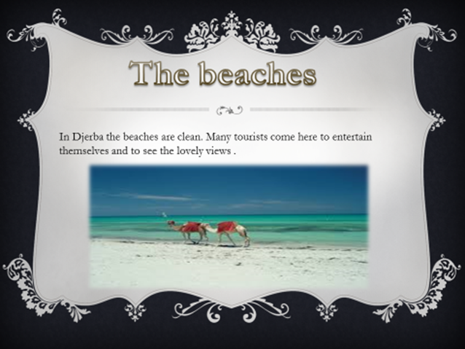

Slide 12
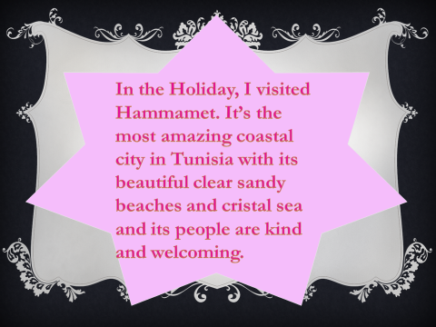

Slide 13
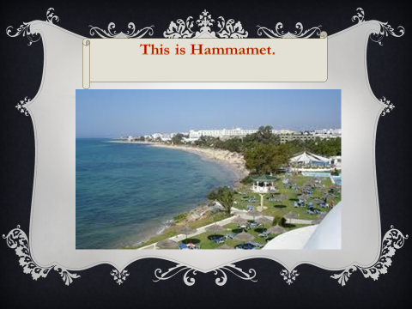

Slide 22
Places We Like
By
St. Stephen Middle School

Slide 26
Toronto Teams
In Toronto there are 5 teams. Hockey, baseball, football, basketball and soccer. The teams are:
-Toronto Maple Leafs
-Toronto Blue Jays
-Toronto Argonauts
-Toronto Raptors
-Toronto FC

Slide 28
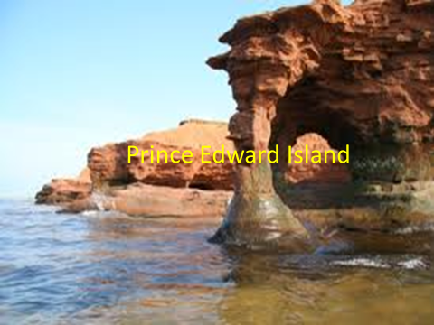

Slide 35
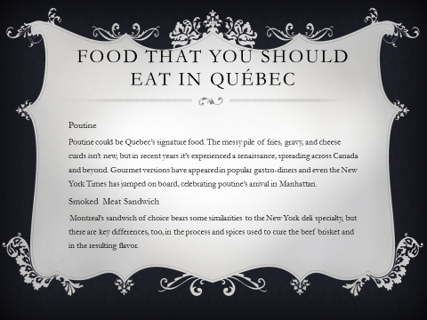

Slide 37
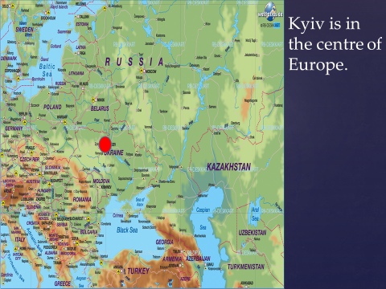
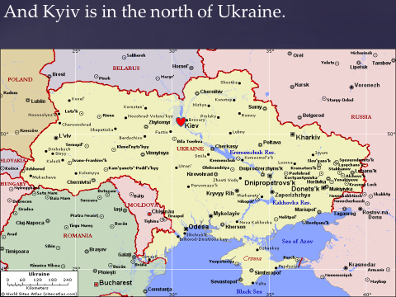

Slide 39
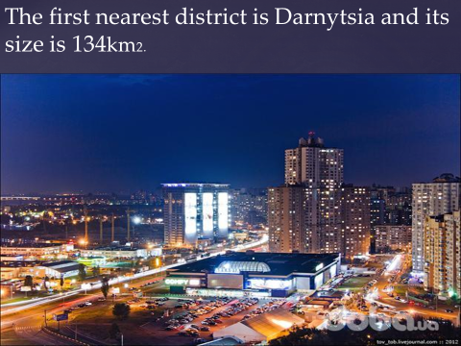
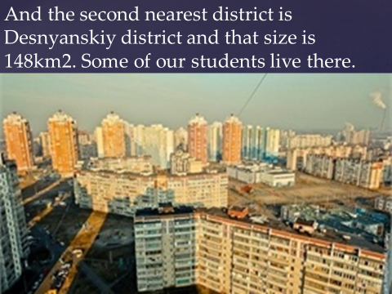

Slide 41
Belarus

Slide 57
Power Point put together by Mrs. Denbow and CICS Middle School Students

