Slide 1
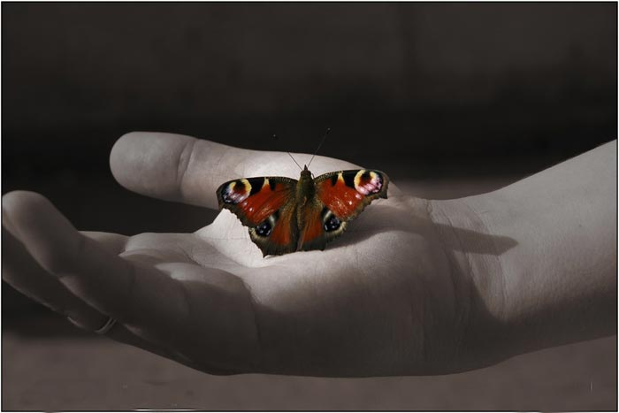
Will Beauty Save the World?
Belarus
Miory school
9-th grade
Masha Shuk
Anastasiya Riabusheva
Dasha Kovaliova
Ilya Mizer
Nikita Trubilo
Roman Shendo
Igor Korsak

Slide 2
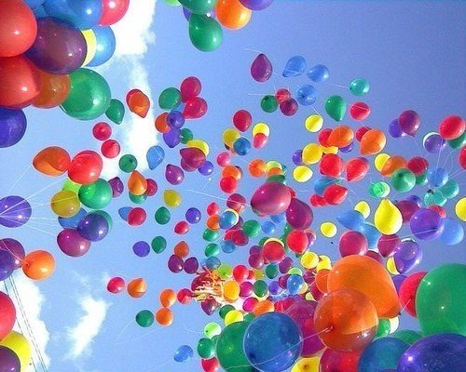
We’ve made a survey to know what our classmates think. Here are the results:

Slide 3
«Will beauty save the world? Answering this question I want to speak about nature. There are many beautiful things in nature. For example, flowers, trees, lakes, rivers and other. People don’t care about all of them. I think that nature can save the world. Flowers are very beautiful. They attract people to the parks. And people breath fresh air which trees make. Lakes give us water. And they give water to animals and plants too. Nature is an important thing that helps our world to exist. It also helps us to exist. And that’s why I agree that the beauty of nature will save the world.» Anastasia Riabusheva.

Slide 4
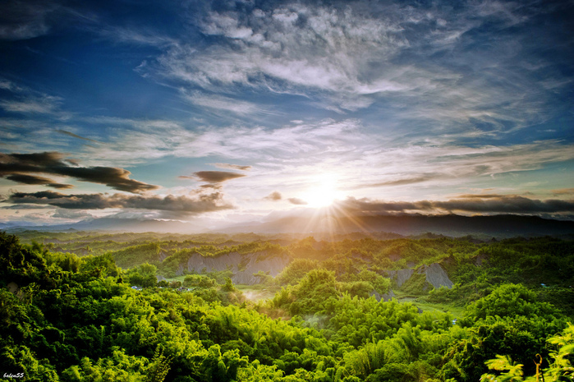
«I personally believe that people with beautiful souls will save the world, because kind people protect the nature, do charity and volunteer work. I suppose their good actions will change our life for the better.» Masha Shuk.

Slide 5
«People are different and for different people beauty means a different thing. That’s why perhaps beauty could save the world.» Dasha Kovaliova.

Slide 6
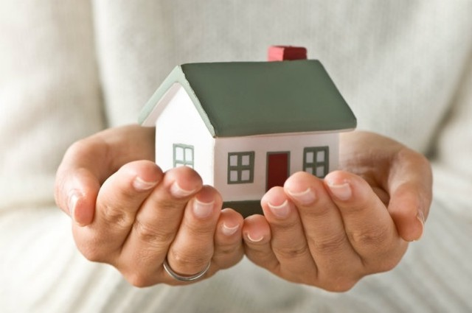
«I think that beauty won’t save the world. We often judge people by appearance. Very often we see beautiful people, but their actions don’t correspond with their appearance. In big comfortable house with beautiful furniture the family can be unhappy, if they have problems.» Ilya Mizer.

Slide 7
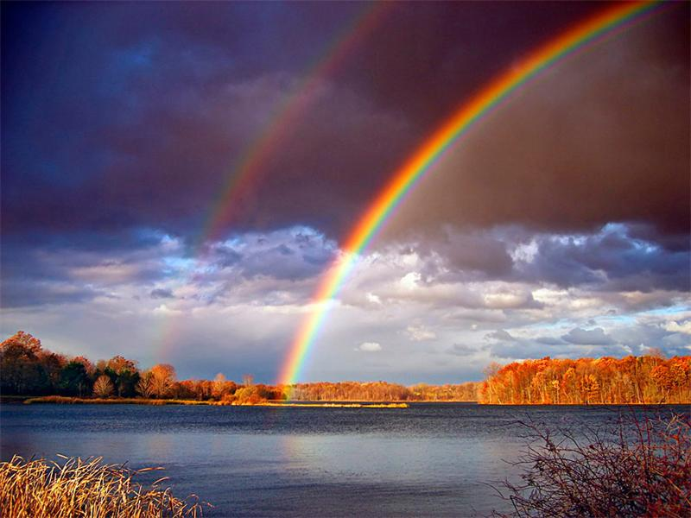
«I think beauty will save the world, because if there were no beauty, there would be no love and everywhere in the world wars would develop progressively. I think that a world without beauty could not exist, so my opinion is that beauty will save the world.» Nikita Trubilo.

Slide 8
«To my mind beauty won’t save the world if thinking about appearance, because it is not an important thing in the world. What is important in a person is his character. People should work on their inner beauty, their character.» Roman Shendo.

Slide 9
Much has been written about beauty in great works, they say a lot about it in lofty words. It is talked about, argued desperately, dreamed softly. It is admired. I think not many of us are able to give a precise definition of beauty. But looking at something beautiful everyone experiences the same feelings. His sole is at this moment filled with warmth and light.

Slide 10
Poets, writers, artists and musicians have allowed us to come a little closer to the understanding of what beauty is. But each of us should strive to their own beauty within and around themselves. This would require a daily basis to realize the secrets and mysteries of beauty.

Slide 11
Let’s look closer at ourselves and people around us and then we’ll see something beautiful in our monotonous life and after all beauty will save the world. Igor Korsak

Slide 12
We asked our friends from Pakistan Beaconhouse School System Jubilee Campus and their teacher Shaista Khurshid. Here is what they think
http://www.dailymotion.com/video/x2c52cm_will-beauty-save-us_school

Slide 13
And Students From Shri Shikshayatan, Kolkata School and their teacher Uma Parasuramani share their thoughts here https://www.slideshare.net/secret/pJ45mEYRoGOe2

Slide 14
What is your idea of the problem? Do you think that beauty will save the world? You can share your ideas in our blog mitalin. blogspot.com or send them vikuha152009@rambler.ru

