Slide 1
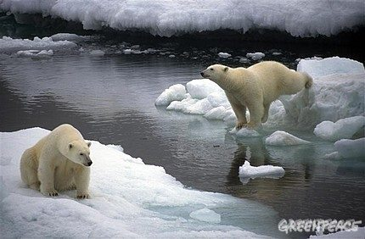
Change!

Slide 2
1. The causes of global warming
Mei-shiuan Shen

Slide 3
The effect of global warming is obviously the rise of the temperature, but why does the temperature rise?
‘Greenhouse Effect’ plays an important role in this situation.

Slide 5
What is “Greenhouse Effect”
People are usually use greenhouse effect to keep the temperature on agriculture.
Which reasons causes greenhouse gases ?

Slide 6
What causes global warming
a. Air pollution since the Industrial Revolution: Such as
using fossil fuels to generate energy
cars and motorcycles pollute the air with gases like carbon dioxide
Nitrogen.

Slide 7
b. Damage to the rainforest:
Because of the Industrial Revolution. Many countries are in need of a large amount of wood .
Some rainforest vanished because of the deforestation. The rainforest can neutralize the atmosphere from greenhouse gases. After they get destroyed, it accelerates global warming.

Slide 8
c. Livestock Industry:
The Livestock Industry produces 51 percent of greenhouse gases .

Slide 9
2.Global Warming and Climate Change
Jin-cheng Li

Slide 10
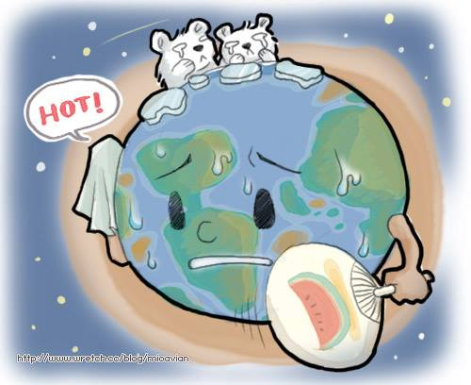
The temperature of the Earth surface
has been increasing, and the Earth
adapts to it through more intense
natural adjustment method, so the severe weather changes help slow down the increasing temperature.
The change of temperature which we experience now will exceed what we can imagine and suffer. In fact, climate change which is caused by people is the most imperative issue we need to focus on.

Slide 11
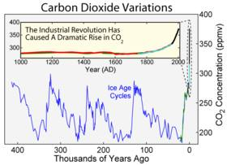
IPCC report shows that the global warming has been increasing rapidly since Industrial Revolution.
Thus, scientists are worried that human-induced climate change makes the process of change which may originally take tens of thousands of years dramatically happen within two hundred years.

Slide 12
3.Evidence of climate change in Taiwan
Yi-ting Cai

Slide 13
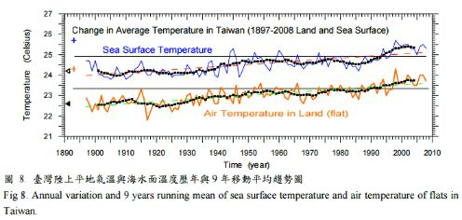
The average temperatures on land and at sea in Taiwan keep rising

Slide 14
The average rainfall intensity has significantly increased for the past 10 years
The intensity of
heavy rain increases

Slide 15
The Frequency of typhoons with extreme heavy rainfall in Taiwan over the past few decades

Slide 16
The days with rainfall reduce, and the days of drought increase

Slide 17
4.The impact of climate change on Taiwan
Wan-ting Wu

Slide 18
Over centuries, Taiwan's average temperature has increased 1.3℃,which is twice the global average, higher than neighboring Japan and China. Specifically:

Slide 19
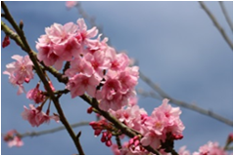
The impacts that the Earth surface temperature increase has caused：
a. High-altitude forest area greatly reduces.
b. The growth cycle of a plants changes
(Cherry blossoms in the autumn rather than at the seasons change between the winter and spring ↓ )
c. Tropical butterflies and birds have a tendency in flying to high-altitude areas.

Slide 20
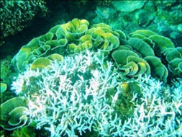
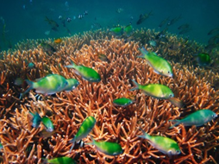
The impacts that water temperature increase has caused:
a. It causes coral bleaching and coral reefs lesions.
(Coral bleaching in Kenting‘s seafloor↓)
b. It results in lower range of Formosan Landlocked Salmon survival and hatching rate reduction.

Slide 21
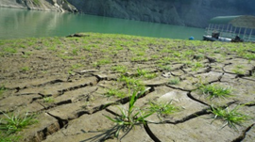
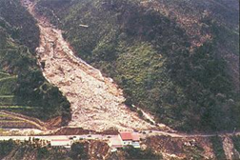
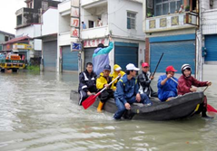
The impact that rainfall variability increase has caused:
a. Light rain reduces→Lengthening the time of drought expanding the range of drought
b. Heavy rainfall increases → landslides and floods
(Mudslide in Nantou area↑) ( Floods in Pingtung area↑)

Slide 22
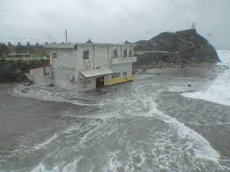
The impact that the rise of sea level rise has caused:
a. Seawater intrusion→It endangers the safety of coastal residents and fish farming(Lanyu was hit by the Typhoon Morakot→)

Slide 23
5.What has our government done for the climate change?
Peng-Jun Guo

Slide 24
Advocacy
For example:
a. Invite everyone to join the activities
b. Hold activities
c. Issue advocacy manual
d. Combine non-government organizations to make the best use of the community resources
Because of the politics, the people, and other reason, result carbon tax, oil and electricity price are increasing can’t work. Therefore, the government uses advocacy rather than force.

Slide 25
Besides the politics and the people, there are other difficulties for the policy.
a. The influence of climate change is not clear.
b. The situation of socio-economic development is not built.
c. The evaluation which combines the climate change with the situation of socio-economic development needs to be made.
Therefore, these factors make the policy more difficult to implement.

Slide 26
6.What can we do to slow down the global warming?
Peng-Jun Guo

Slide 27
a. In terms of eating, a day without meat, or eat local-produced food, both can reduce greenhouse gas.
b. Riding a bike or going
carpooling can reduce
greenhouse gas, too.

Slide 28
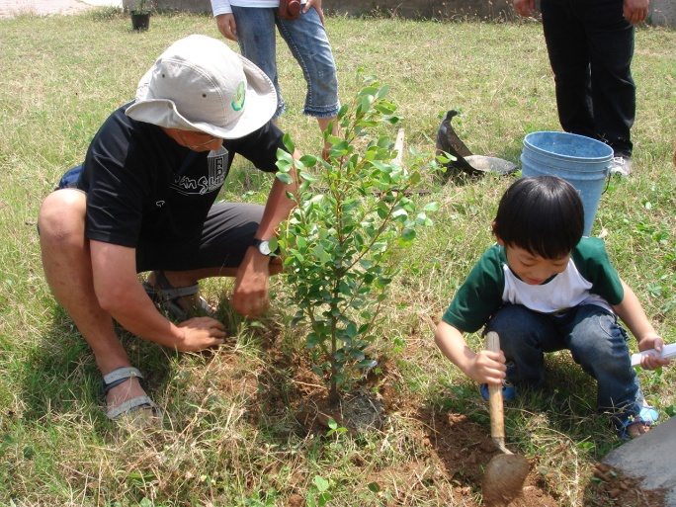
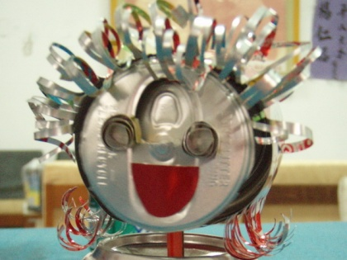
c. Planting trees can reduce
carbon dioxide and increase
oxygen.
d. Recycling is also a good way to
avoid waste of resources.
e. Turning off lights when you leave can also reach the goal of energy saving.

Slide 29
Conclusion

Slide 30
Thanks for your listening!

