Slide 1
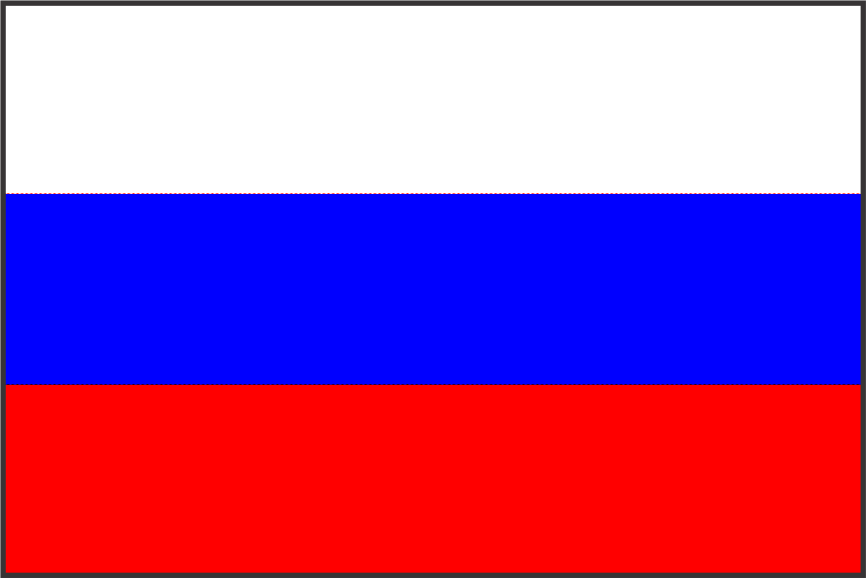
Sponsoring Teachers: *Nabira Naveed *Mark Cullen *Elena Mishatkina
MY IDENTITY
NATIONAL MONUMENTS
Places and Perspectives
Sponsoring Schools: *THE EDUCATORS Islamabad, Pakistan *University Prep, Seattle, WA, US *Lyceum 6, Tambov Russia

Slide 2
Goal of the Project
To enable students to identify and analyze national monuments and buildings to discover how they represent their country, ideas and institutions.

Slide 3
Questions
What are monuments?
Why monuments are important for a country?
How the monuments represent a country?
How many monuments are in your country?
Investigate origin and history of each Monument.
Which monuments in your country are the oldest and most important referring to their past history?
How old is the most ancient one?
Which are the latest monuments build in your country?
Which monuments have you visited yet?
Which type of architecture is used and who designed it?
Which monuments are tourists’ attractions?
To what extent people in your country are interested in visiting historical places with tourism attraction?
From what countries do the tourists come?

Slide 4
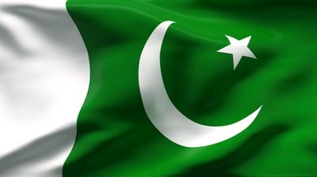
Monuments
Of
pakistan

Slide 5
What are monuments?
A monument is a type of structure that was explicitly created to commemorate a person or important event, or which has become important to a social group as a part of their remembrance of historic times or cultural heritage, or as an example of historic architecture. The term 'monument' is often applied to buildings or structures that are considered examples of important architectural and/or cultural heritage.

Slide 6
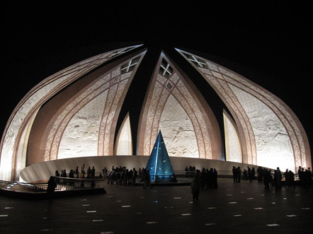
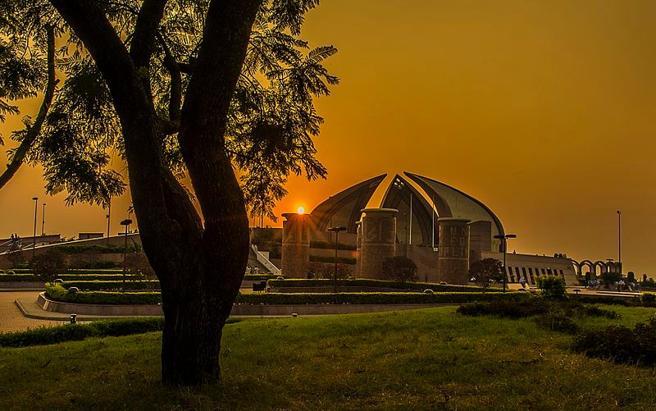
Pakistan Monument
Construction Started: May 25, 2005
Completed: March 23, 2007
Architect: Arif Masoud
The blooming flower shape of the monument represents Pakistan's progress as a rapidly developing country. The four main petals of the monument represent the four provinces (Balochistan, Khyber-Pakhtunkhwa, Punjab, andSindh), while the three smaller petals represent the three territories (Gilgit-Baltistan, Azad Kashmir and the Federally Administered Tribal Areas). The Monument has been designed to reflect the culture and civilization of the country and depicts the story of the Pakistan Movement, dedicated to those who sacrificed themselves for future generations.

Slide 7
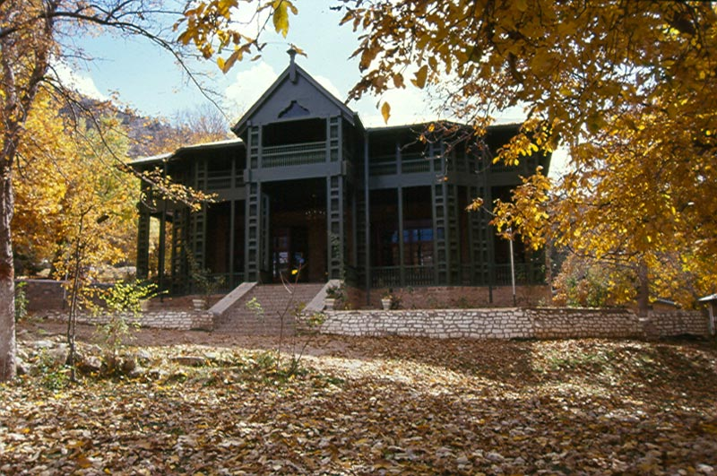
Quaid e Azam Residency, Ziarat,Pakistan
Location: Ziarat Balochistan
constructed in 1892
History: Originally designed as a sanatorium

Slide 8
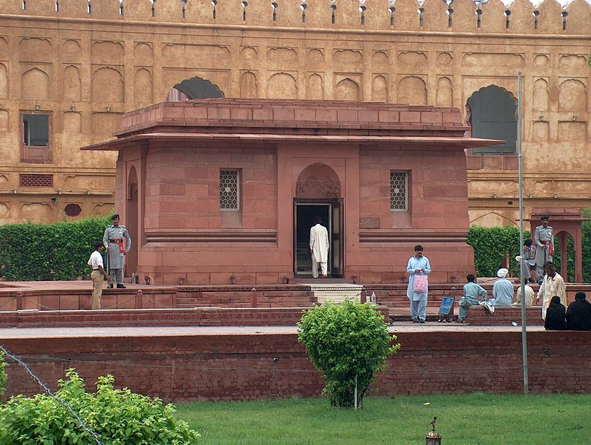
Allama Iqbal’s Tomb
Location: Lahore
Architecture style: Mughal
Architect: Nawab Zain Yar Jang Bahadur
Brief history: Allama Iqbal was one of the major inspirations behind
the Pakistan Movement, and is revered in Pakistan as The Thinker of Pakistan or The Poet of the East.

Slide 9
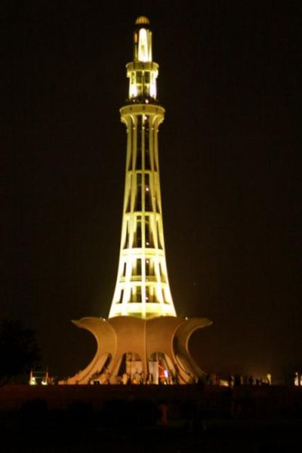
Minar -e Pakistan
Minar e Pakistan literary means literally "Tower of Pakistan
Construction: 1960
Architecture style: The tower reflects a blend of Mughal, Islamic and modern architecture.
Designed and supervised by Nasreddin Murat-Khan
History: Made in the remembrance of Resolution passed on March 23, 1940 at the same place.
It is one of the most visited monument in Pakistan.

Slide 10
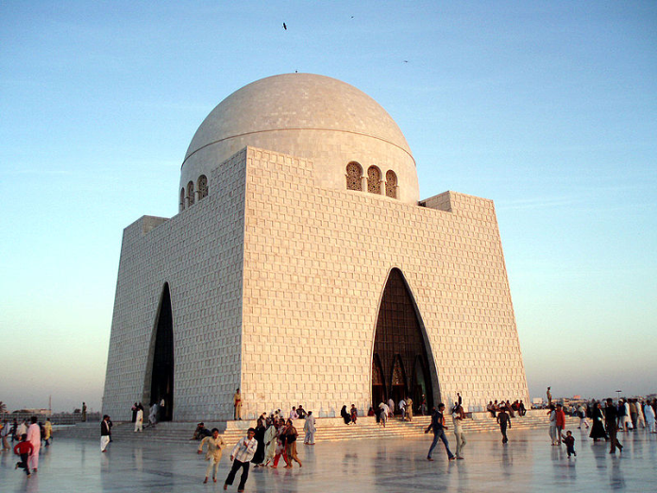
Tomb Jinnah
Location: Karachi
Architect: Yahya Merchant
Established: June 2, 1970,
History: The Mausoleum building was built in the memory of Founder of Pakistan.

Slide 11
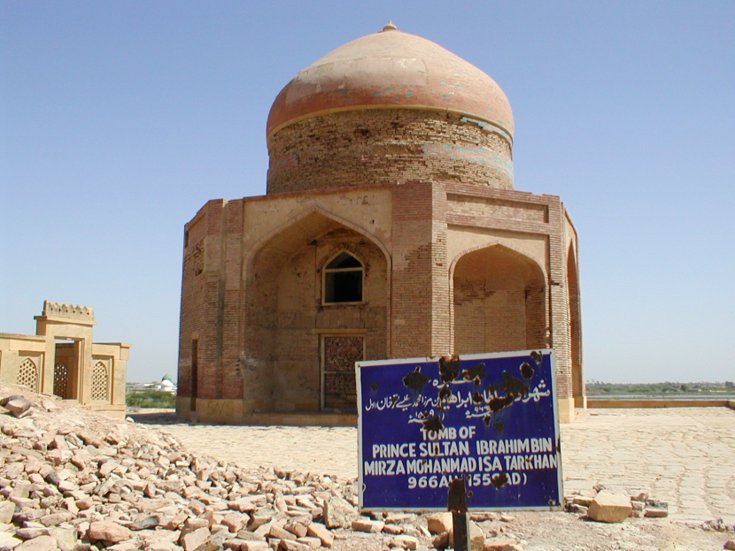
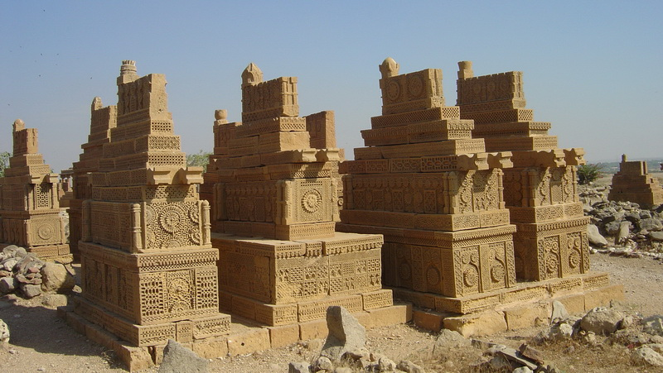
Makli Hill
Location: Thatta
Official Name: Historical Monuments at Makli, Thatta
Common Name: Makli Grave yard
Construction: The impressive royal mausoleums are divided into two major groups, those from the Samma (1352–1520) and from the Tarkhan (1556–1592) period.
Today, Makli Hill is a United Nations Educational, Scientific and Cultural Organization (UNESCO) World Heritage Site that is visited by both pilgrims and tourists, but in strong need of conservation and maintenance.

Slide 12
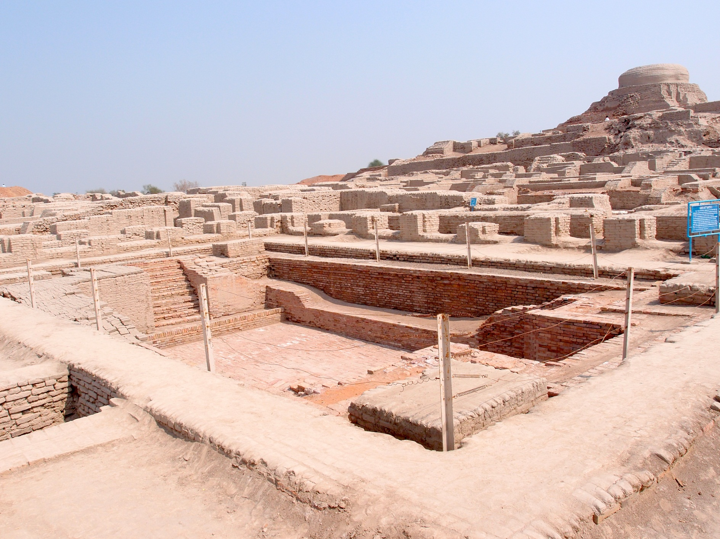
Mohenjo Daro

Slide 13
Mohenjo Daro
Mohenjo daro (Mound of the Dead) is an archeological site in the province of Sindh, Pakistan.
Built around2600 BCE,
it was one of the largest settlements of the ancient Indus Valley Civilization, and one of the world's earliest major urban settlements, contemporaneous with the civilizations of ancient Egypt, Mesopotamia, Crete, and Norte Chico .
Mohenjo-daro was abandoned in the 19th century BCE, and was not rediscovered until 1922.
Significant excavation has since been conducted at the site of the city, which was designated a UNESCO World Heritage Site in 1980.

Slide 14
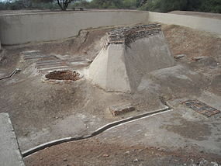
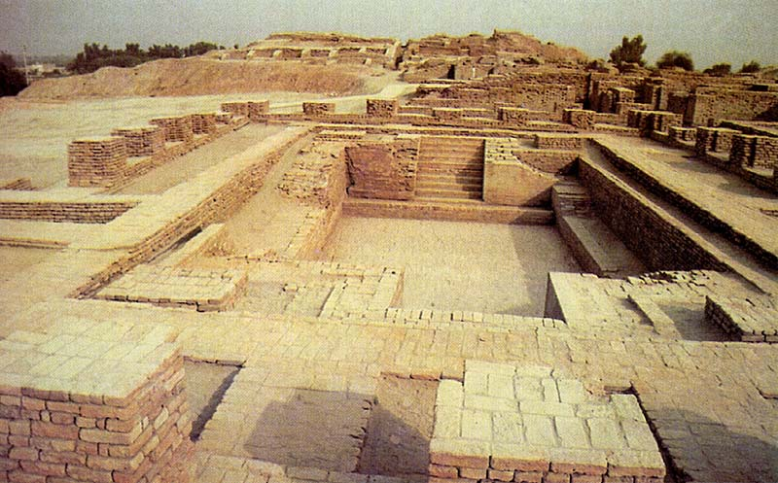
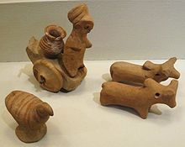
Harappa

Slide 15
Harappa
The Indus Valley Civilization (also known as the Harappan culture) has its earliest roots in cultures such as that of Mehrgarh, approximately 6000 BCE.
The two greatest cities, Mohenjo-daro and Harappa, emerged circa 2600 BCE along the Indus River valley in Punjab and Sindh
rediscovered in the 1920s

Slide 16
Badshahi Mosque
Badshahi mosque is one of the few significant architectural monuments built during Emperor Aurangzeb's long rule from 1658 to 1707. It is presently the fifth largest mosque in the world and was indisputably the largest mosque in the world from 1673 to 1986 when the Faisal Mosque was constructed in Islamabad. Although it was built late in the Mughal era in a period of relative decline, its beauty, elegance, and scale epitomize Mughal cultural achievement like no other monument in Lahore.

Slide 17
Faisal Mosque
Completed in 1986, the Faisal Mosque (also known as Shah Faisal Masjid) is an exceptionally large and unique mosque in Islamabad. Designed by a Turkish architect who won an international competition for the honor, Faisal Mosque is shaped like a desert Bedouin's tent and functions as the national mosque of Pakistan.

Slide 18
Saint Patrick's Cathedral Church, Karachi
St. Patrick’s Cathedral, the seat of the Roman Catholic Archdiocese of Karachi, is situated on Shahrah-e-Iraq, formerly known as Clarke Street, located near the Empress Market in Karachi, Pakistan.

Slide 19
Saint Patrick's Cathedral Church, Karachi
History: The first church in Sindh was initially built on the grounds of this cathedral in 1845, and was called St. Patrick’s Church. It was in April 1881 that the present cathedral was opened, since the Christian community grew in number, and the need for a larger place of worship became apparent. The Pakistan Post Office issued special commemorative stamps on the occasion. Pope John Paul I sent special greetings and blessings on the occasion.
In November 1991 the cathedral was visited by Mother Teresa of Calcutta. Cardinal Joseph Cordeiro of Karachi also spoke on the occasion.

Slide 20
Katas Raj Temple
Hindu temple
Situated in Chakwal
900 years old Temple
Built during the reign of Hindu kings

Slide 21
Gurdwara Janam Astan Nankana Sahib
Gurdwara Nankana Sahib is a prominent gurdwara in Sikhism, built by Maharaja Ranjit Singh in the 19th century to mark the birthplace of the founder of Sikhism, Guru Nanak Dev. It is situated on the site of his parental home in Rāi Bhoi Kī Talvaṇḍī, now called Nankana Sahib, near Lahore, Punjab, Pakistan.

Slide 22
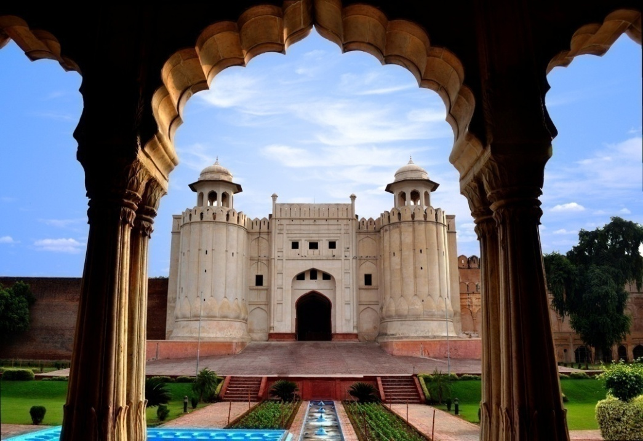
Lahore Fort
The Lahore Fort, locally referred to as Shahi Qila is a citadel in the city of Lahore, Punjab, Pakistan. It is located in the northwestern corner of the Walled City of Lahore in Iqbal Park, which is one of the largest urban parks in Pakistan. The trapezoidal composition is spread over 20 hectares.
The existing base structure of the Fort was built during the reign of Mughal Emperor Akbar between 1556–1605 and was regularly upgraded by subsequent Mughal, Sikh and British rulers.

Slide 23
Derawar Fort
Derawar Fort is a large square fortress in Derawar Fort in Bahawalpur, Punjab, Pakistan. The forty bastions of Derawar are visible for many miles in Cholistan Desert. The walls have a circumference of 1500 metres and stand up to thirty metres high.
The fort was built by Hindu Rajput, Bhati of Jaisalmer. It remained in the hands of the Rajput Bhati royal family of Jaisalmer until captured by the Nawabs of Bahawalpur in 1733.

Slide 24
Rani Kot Fort
Hyderabad
836 A.D
Imran bin musa
Constructed with gypsum and lime cut sandstone

Slide 25
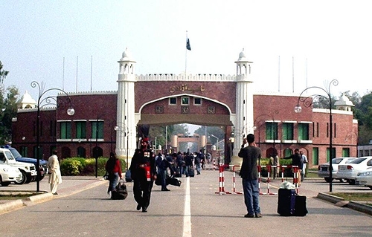
Bab-e-Azadi
The Bab-e-Pakistan Gateway of Pakistan is a national monument in Lahore, Punjab, Pakistan which is being built on the site of one of the major Muslim refugee camps which operated in the aftermath of independence of Pakistan. The memorial was proposed in 1985, by the late Governor Ghulam Jilani Khan, and was approved immediately by the President Muhammad Zia-ul-Haq. The monument is designed by a Lahore-based architect Amjad Mukhtar, who is a graduate from National College of Arts, Lahore.

Slide 26
Gandhara
Gandhāra was an ancient kingdom of Peshawar extending to the Swat valley, and potohar plateau regions of Pakistan as well as the Jalalabad district of northeastern Afghanistan.

Slide 27
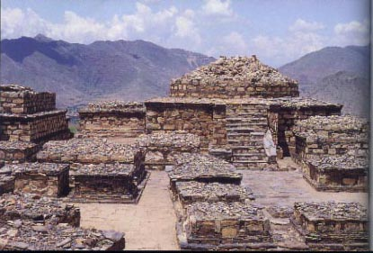
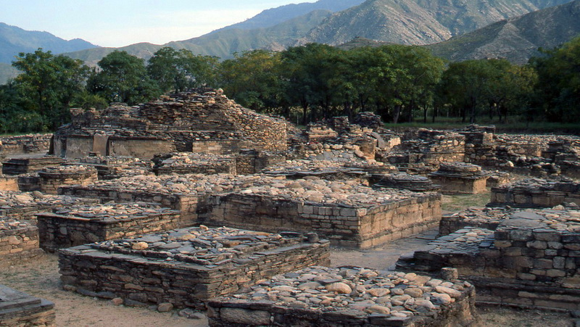
Gandhara

Slide 28
Tomb of Jahangir

Slide 29
Tomb of Jahangir
The Tomb of Jahangir is amausoleum built for Emperor Jahangir who after his death at Rajauri in 1627,was buried on the banks of the River Ravi in the large walled garden of Empress Nur Jahan and this tomb was
Built and completed by Emperor Shah Jahan in 1637 AD, at the cost of ten Lakhs Rupees,the tomb, along with the adjacent Akbari Sarai and the tomb of Asif Khan, is on the tentative list as a UNESCO World Heritage Site.
The interior of the mausoleum is an elevated sarcophagus of white marble, the sides of which are wrought with flowers of mosaic in the same elegant style as the tombs in the Taj Mahal at Agra, India.
On two sides of the sarcophagus the ninety-nine attributes of God are inlaid in black. Carved Jali screens admit light in various patterns facing toward Mecca.

Slide 30
Tomb of Dai Anga-Lahore

Slide 31
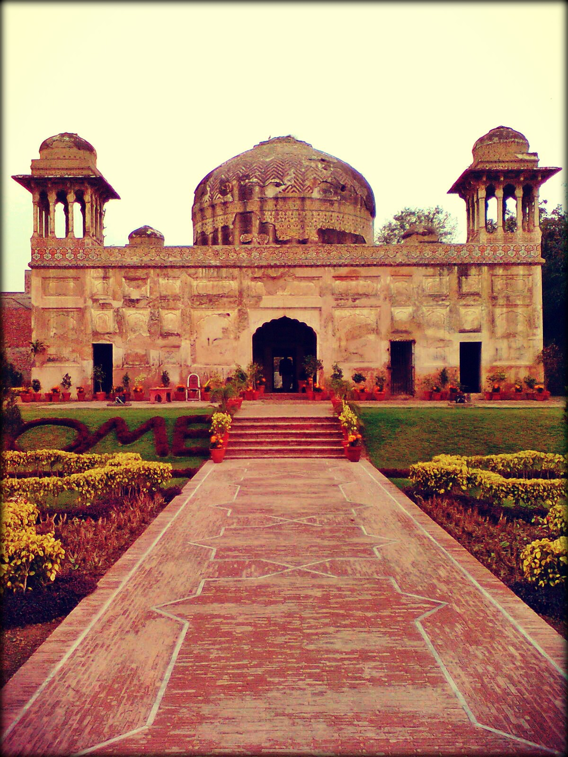
Tomb of Dai Anga-Lahore

Slide 32
Tomb of Dai Anga-Lahore
Tomb of Dai Anga along with the mosque,situated near the railway station of Lahore was built by Zeb Un Nisa aka Dai Anga,a wet nurse of Mughal King Shah Jehan and well respected in the royal family in 1635 AD, before she went to perform Hajj.
Her family was closely associated with the Mughal Empire. Her husband Murad Khan served Emperor Jahangir as Magistrate of Bikaner, and her son Muhammad Rashid Khan, was the best archers in the kingdom, and died fighting in the service of Shah Jahan's eldest son Dara Shikoh.
The exterior of the mosque has been embellished with fine tile work similar to that seen at the mosque of Wazir Khan in Lahore. The interior also displayed fine frescoes previously; unfortunately these have largely been replaced by cheap modern ceramic tiles.

Slide 33
Tomb of Bibi Jawindi-Uch Sharif

Slide 34
Tomb of Bibi Jawindi-Uch Sharif
The Tomb of Bibi Jawindi is one of the five monuments in Uch Sharif, Punjab, Pakistan which are on the tentative list of the UNESCO World Heritage Sites.
The shrine was built in 1493 by an Iranian prince, Dilshad,for Bibi Jawindi who was the great granddaughter of Jahaniyan Jahangasht, a famous Sufi saint. The site is located in the south-west corner of Uch, a historical city founded by Alexander the Macedonian.
The tomb of Bibi Jawindi is an important site for visitors and is considered one of the most ornate monuments in Uch. Both the interior and exterior of the building are richly decorated with Islamic scriptures, carved timber, and bright blue and white mosaic tiles known as faience.
Over the centuries, the tomb was badly disintegrated due to environmental conditions and during torrential floods in 1817, half of the structure washed away. Today only the remaining half of the structure is still standing.

Slide 35
Masjid Wazir Khan-Lahore

Slide 36
Masjid Wazir Khan-Lahore
The Wazir Khan Mosque, described as 'a mole on the cheek of Lahore' is famous for its extensive faience tile work and was built during the reign of the Mughal Emperor Shah Jehan.
It was built by Hakim Shaikh Ilm-ud-din Ansari, a native of Chiniot, who rose to be the court physician to Shah Jahan and a governor of Lahore. He was commonly known as Wazir Khan, a popular title bestowed upon him (the word Wazir means 'minister' in Urdu and Persian).
Within the inner courtyard of the mosque lies the subterranean tomb of Syed Muhammad Ishaq, known as Miran Badshah, a divine who settled in Lahore during the time of the Tughluq dynasty. The tomb, therefore, predates the mosque.
A movie "Khuda Ke Liye (For God Sake)" based on what Islam allows and what people think what Islam allows, was filmed in this very Mosque.

Slide 37
Noor Mahal-Bahawalpur

Slide 38
Noor Mahal-Bahawalpur
Built in 1872 like an Italian chateau on neoclassical lines, Noor Mahal (palace) belonged to the Nawab of Bahawalpur princely state, during British Raj. Mr. Heennan, an Englishman who was the state engineer, designed the building.
The design encompasses features of Corinthian and Islamic styles of architecture with a tinge of sub continental style.
According to a legend, Nawab Sadiq Muhammad Khan IV, had the palace made for his wife; however, she was only there for one night, as she happened to see the adjoining graveyard from her balcony, and refused to spend another night there, and so it remained unused during his reign.
The building was declared a “protected monument” in September 2001 by the Government of Pakistan's Department of Archeology, and it is now open for general public.

Slide 39
Shah Jehan Mosque-Thatta

Slide 40
Conclusion
We as a nation, are proud of our cultural heritage and civilization.
Our beautiful, alluring and ancient historical places attract the foreign visitors from all over the world.

Slide 41
Continue……
When the foreigners visit our historical places:
We earn foreign exchange.
We get introduction and cultural identity.
The world come to know that we are not extremist but we have soft taste and we are well mannered and loveable people.

Slide 42
Monuments
Of
USA

Slide 43
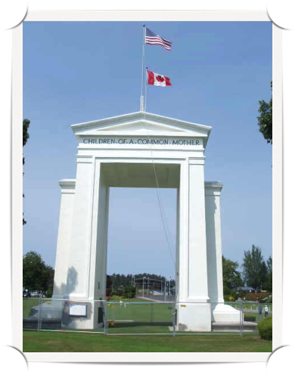
The Peace Arch By Hayley, Hanna, Ellie, and Aidan
The Peace Arch represents 100 years of unity between America and Canada.
In 1914, international fundraising efforts were spearheaded by Samuel Hill, and the Peace Arch was opened to the public in 1921.
A monument designed by Harvey Willey Corbett, on the American side there is an inscription that reads, "Children of a Common Mother."

Slide 44
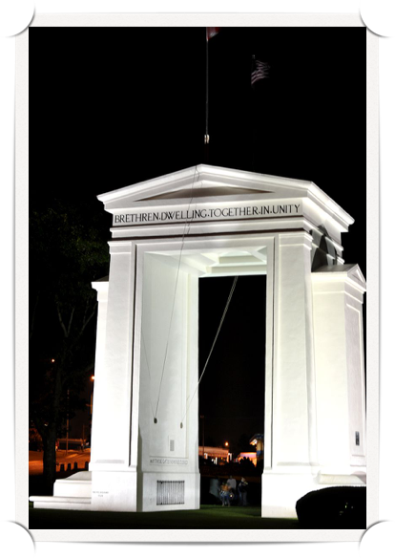
Peace Arch Facts
Never closed, the Peace Arch stands in a park on the border of America and Canada, the longest undefended border in the world.
The Peace Arch is located in Blaine, Washington.
On the Canadian side there is an inscription that reads, "Brethren Dwelling Together in Unity". This represents the fact that both American and Canadian ancestors are from England.

Slide 45
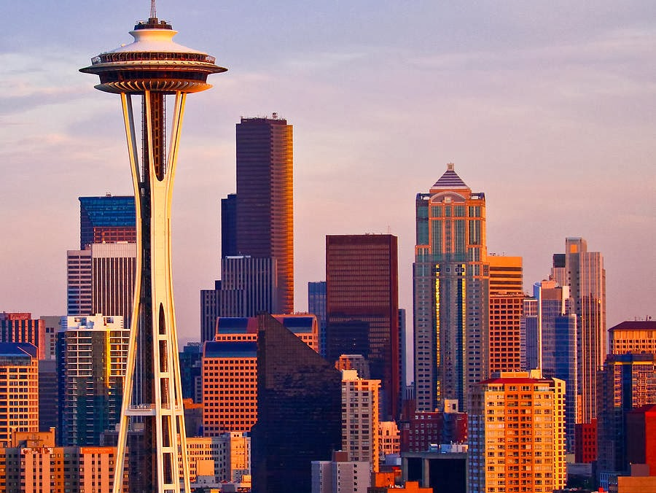
Seattle’s Space Needle
By Jiwoo, Quinn,
and Anvie

Slide 46
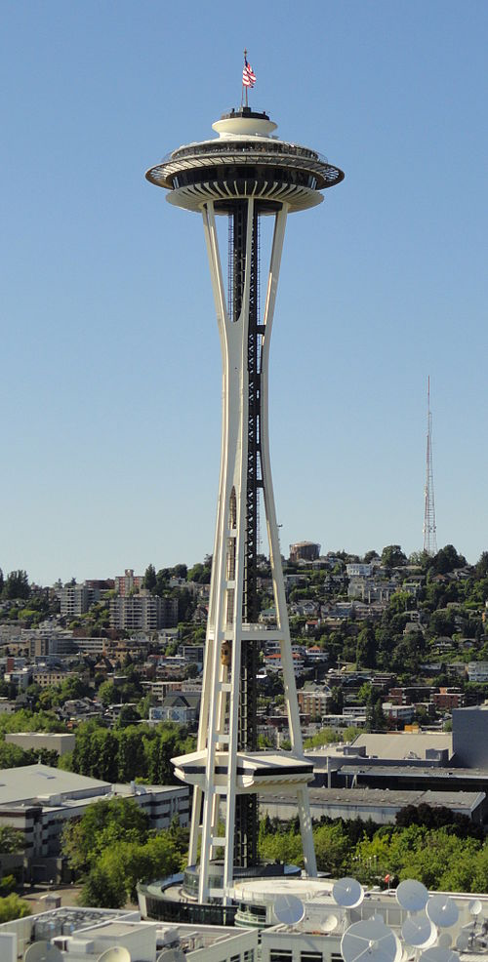
The Space Needle is an observation tower in Seattle, Washington, a landmark of the Pacific Northwest, and an icon of Seattle.
Built in 1961, the Space Needle was given a record-breaking goal of being built in a little over a year, to be featured at the opening of the World’s Fair.

Slide 47
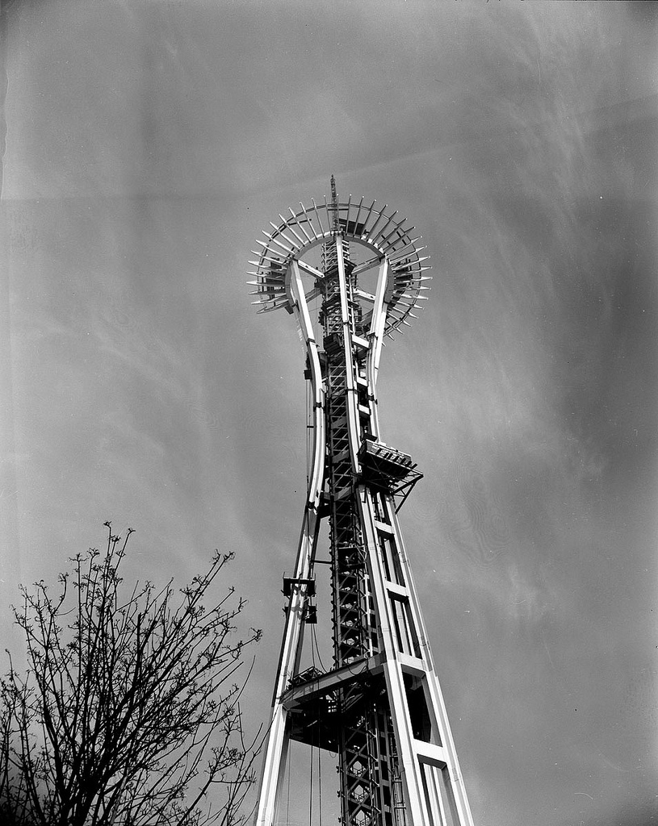
Space Needle Construction and Structure
The Space Needle was built in 400 days. At the time it was the tallest structure west of the Mississippi River.
It is 184m/605’ tall.
The original blueprints were drawn on a napkin.
There are 842 steps from the basement to the observation deck.

Slide 48
The concrete foundation is 30 feet deep.
The diameter of the SkyCity Restaurant is 94.5 feet.
The original name for the Space Needle was The Space Cage; and the name of the restaurant was The Eye of The Needle.
The first Space Needle manager, Hoge Sullivan, was afraid of heights!

Slide 49
The Elwha Dam By Ashlyn, Alex, Connor, Jackson
Before
After
-It was located in Clallam County, Washington.
-The Elwha Dam was built in 1911 and was108 feet tall.
-The Elwha Dam was taken down when it was no longer needed to produce electricity.
-The demolition started September17, 2011 and was completed in March 2012.
- Now salmon can swim upstream to their spawning grounds for the first time in 100 years!

Slide 50
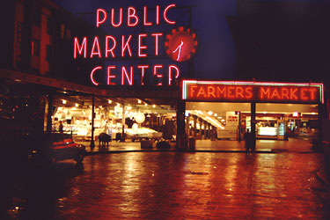
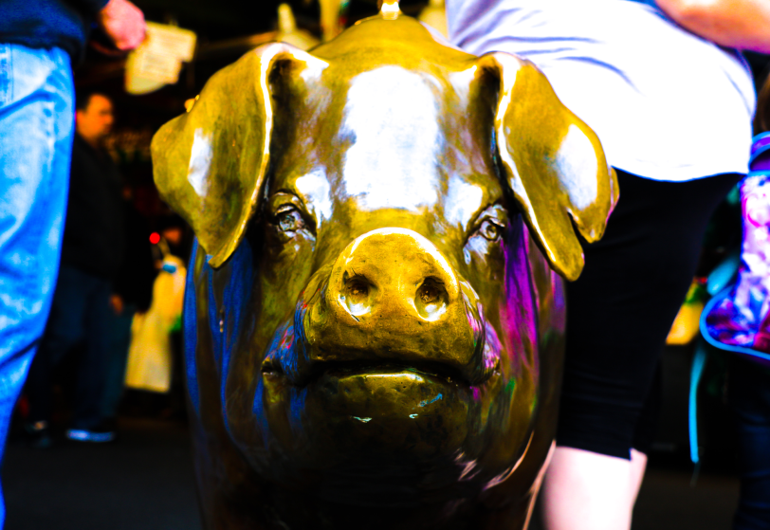
PIKE PLACE MARKET
In 1971, Pike Place Market was going to be shut down for condos, but a man named Victor Steinbrueck created a rally called "Save the Market" and raised money to save it.
Over 150 million dollars worth of goods are sold at the market every year.
Over a dozen languages are spoken or written in the market.
By Jackson, Jane, Amelia, and George
"City Attractions." Pike Place Market. N.p., n.d. Web. 22 Apr. 2015. <http://www.seattle.gov/TOUR/pikep.htm>.
With ten million visitors a year, Pike Place Market is one of the most visited places in Seattle.
Pike Place Market is a place where there are shops, waterfront restaurants, street performers, and vendors.
The Pig is really a piggy bank for fundraising for the Market.

Slide 51
Bibliography
Works Cited
"Canada-Peace Arch." The Jet Packer. N.p., n.d. Web. 21 Apr. 2015. <http://thejetpacker.com/wp-content/uploads/2010/02/Canada-Peace-Arch.jpg>.
Jaillet, Jim. Here Is the Peace Arch on the American Side. Digital image. Seattle Blog. N.p., 4 Aug. 2009. Web. 21 Apr. 2015. <http://blog.seattlepi.com/ramblinman/2009/08/04/blaine-wa-and-peace-arch-park/>.
Peace Arch. Digital image. File:Peace Arch.JPG EditWatch This Page. Wikipedia, 6 July 2010. Web. 21 Apr. 2015. <http://commons.m.wikimedia.org/wiki/File:Peace_Arch.JPG>.
"Sam Hill." Www.peacearchpark. USCPAA, Summer 2003. Web. 21 Apr. 2015. <https://www.peacearchpark.org/Sam_Hill.html>.
Wilma, David ,. "Hill, Samuel (1857-1931)." HistoryLink.org- the Free Online Encyclopedia of Washington State History. Washington State Department of Transpotation, 18 Jan. 2003. Web. 20 Apr. 2015. <http://www.historylink.org/index.cfm?DisplayPage=output.cfm&file_id=5072>.
Bot, Fresco. "Space Needle." - Wikipedia, the Free Encyclopedia. N.p., 12 Apr. 2015. Web. 20 Apr. 2015. <http://en.m.wikipedia.org/wiki/Space_Needle>.
"Fun Facts - Space Needle." Space Needle. N.p., 20 Apr. 2015. Web. 21 Apr. 2015. <http://www.spaceneedle.com/fun-facts/>.

Slide 52
By Michelle Nijhuis, for National Geographic PUBLISHED August 27, 2014. "World's Largest Dam Removal Unleashes U.S. River After Century of Electric Production." National Geographic. National Geographic Society, n.d. Web. 21 Apr. 2015. <http://news.nationalgeographic.com/news/2014/08/140826-elwha-river-dam-removal-salmon-science-olympic/>.
United States National Park Service. "Elwha River Restoration." National Parks Service. U.S. Department of the Interior, 02 Apr. 2015. Web. 21 Apr. 2015. <http://www.nps.gov/olym/learn/nature/elwha-ecosystem-restoration.htm>.

Slide 53
The Statue of Liberty
The Statue of Liberty was
a gift of friendship from
France to the USA in
1886.
The statue's full name is
“Liberty Enlightening the
World.”
The head of the statue was
displayed at the World's Fair
in Paris in 1878.
-

Slide 54
It became a symbol of freedom, especially for new immigrants.
The statue is made of copper, so at first it was the color of a penny.
It was exposed to rain and wind, so it rusted and turned green.

Slide 55
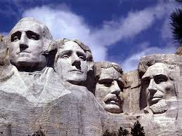
Mt. Rushmore by Cole, Claiborne, Jude, Will
Mt. Rushmore was hand made by four hundred carvers.
It took 14 years to create the sculptures on Mt. Rushmore.
3,000,000 people visit it every year.
The four president faces on the rock represent the first 150 years of American history. They are (l-r) George Washington, Thomas Jefferson, Theodore Roosevelt, and Thomas Jefferson.
Lincoln Borglum and his son Gutzon Borglum designed Mt. Rushmore.

Slide 56
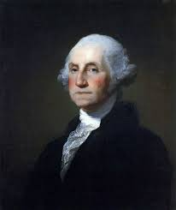
George Washington
George Washington was one of the Founding Fathers of the United States.
He was the first president of the United States.
He also was involved in the drafting of the Constitution.

Slide 57
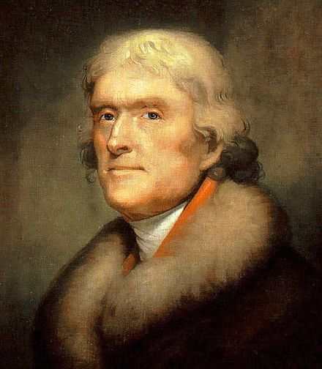
Thomas Jefferson
Thomas Jefferson was the author of the Declaration of Independence (1776).
He was also the third president of the United States.
He sent out the Lewis and Clark Expedition.

Slide 58
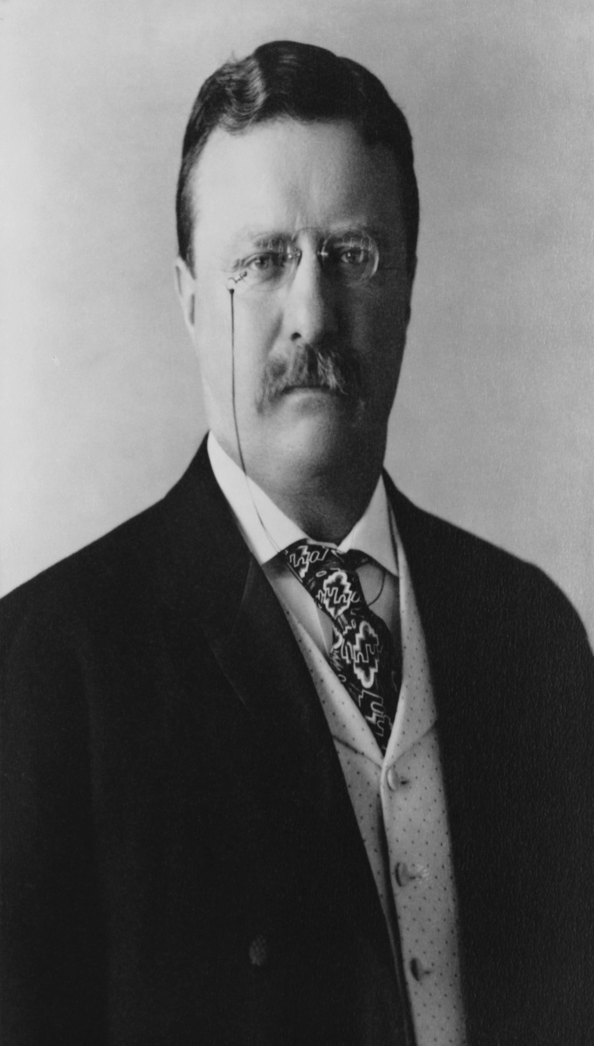
Theodore Roosevelt
Theodore Roosevelt was 26th president of the United States (1901-1909).
He was vice president in 1901 but then president William McKinley was assassinated so Roosevelt became president.
Theodore was the first of only three sitting presidents to have won the Nobel Prize.

Slide 59
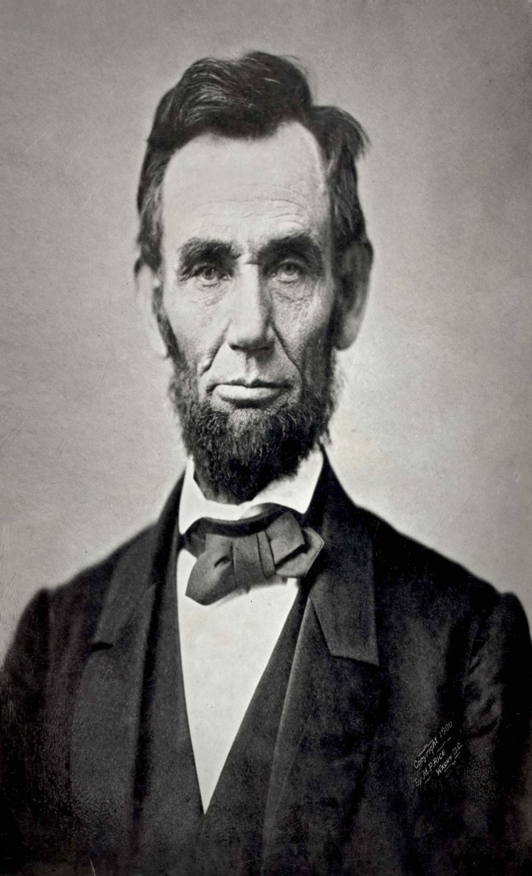
Abraham Lincoln
Abraham Lincoln, 16th president of the United States, served from March 1861 until his assassination in April 1865.
In 1863 his Emancipation Proclamation abolished slavery.

Slide 60
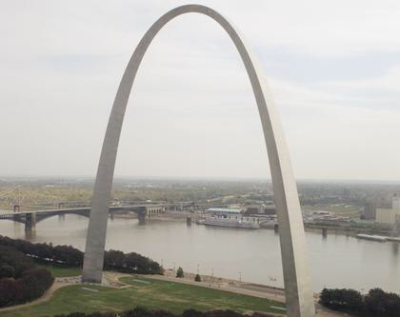
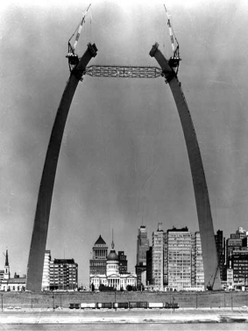
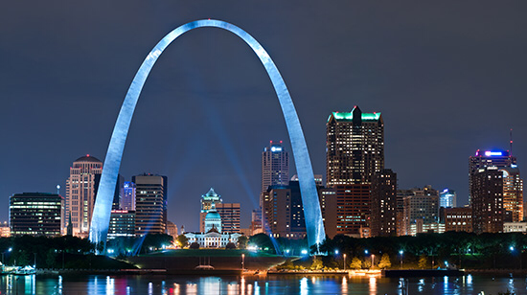
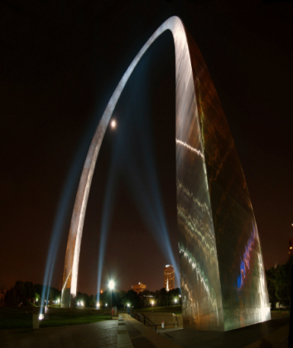
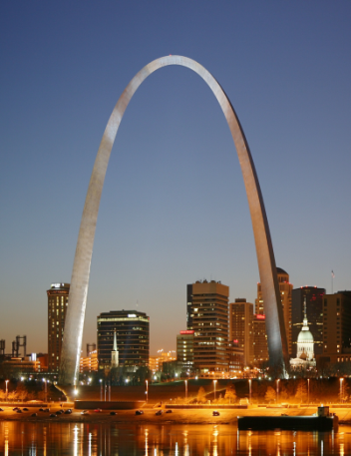
The Gateway Arch
By: Griffin, Molly, Laila, August
The Building Of The Gateway Arch Started On February 12, 1963.
It Was Opened In 1965.
The Two Architects Are Eero Saarinen & Hannskarl Bandel.
The Gateway Arch Is Located In St. Louis, Missouri.

Slide 61
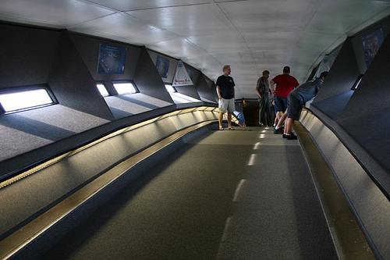
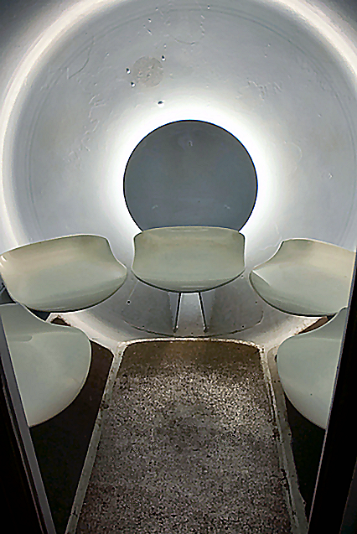
Gateway Arch
The formal name is “Jefferson National Expansion Memorial.”
This refers to westward expansion and settlement in the 1800s.
The Gateway Arch is 630 feet tall.
People can go up into the Arch.
The Gateway Arch was designed from 1947-49.
The Gateway Arch is made out of stainless steel.
Inside at the top of the Gateway Arch.
This is the car that takes you up the arch.

Slide 62
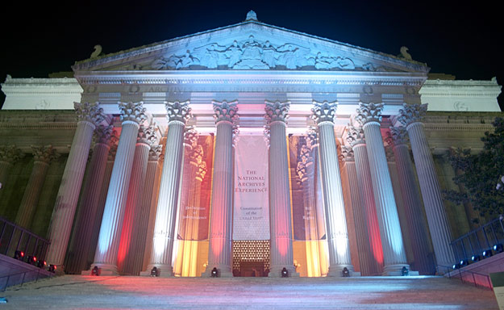
National Archives
By Grace, Kate, Allie, Destri, Declan, And Wally
Its full name is National Archives and Records Administration (NARA).
It was built in 1934 and opened in 1935.
It is heavily guarded because the documents are very important to our country's history.

Slide 63
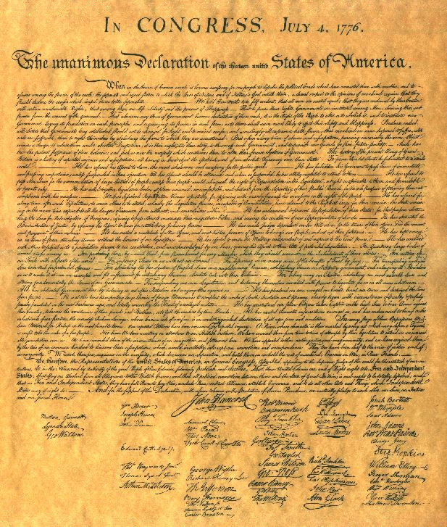
WHAT DOCUMENTS ARE IN IT?
Declaration of Independence
Bill of Rights
Constitution
Bill for Alaska
Edison's Lightbulb Patent
Elvis' Letter to President Nixon
Louisiana Purchase
Apollo 11 Flight Plan
Letter From Jackie Robinson
Declaration of Independence

Slide 64
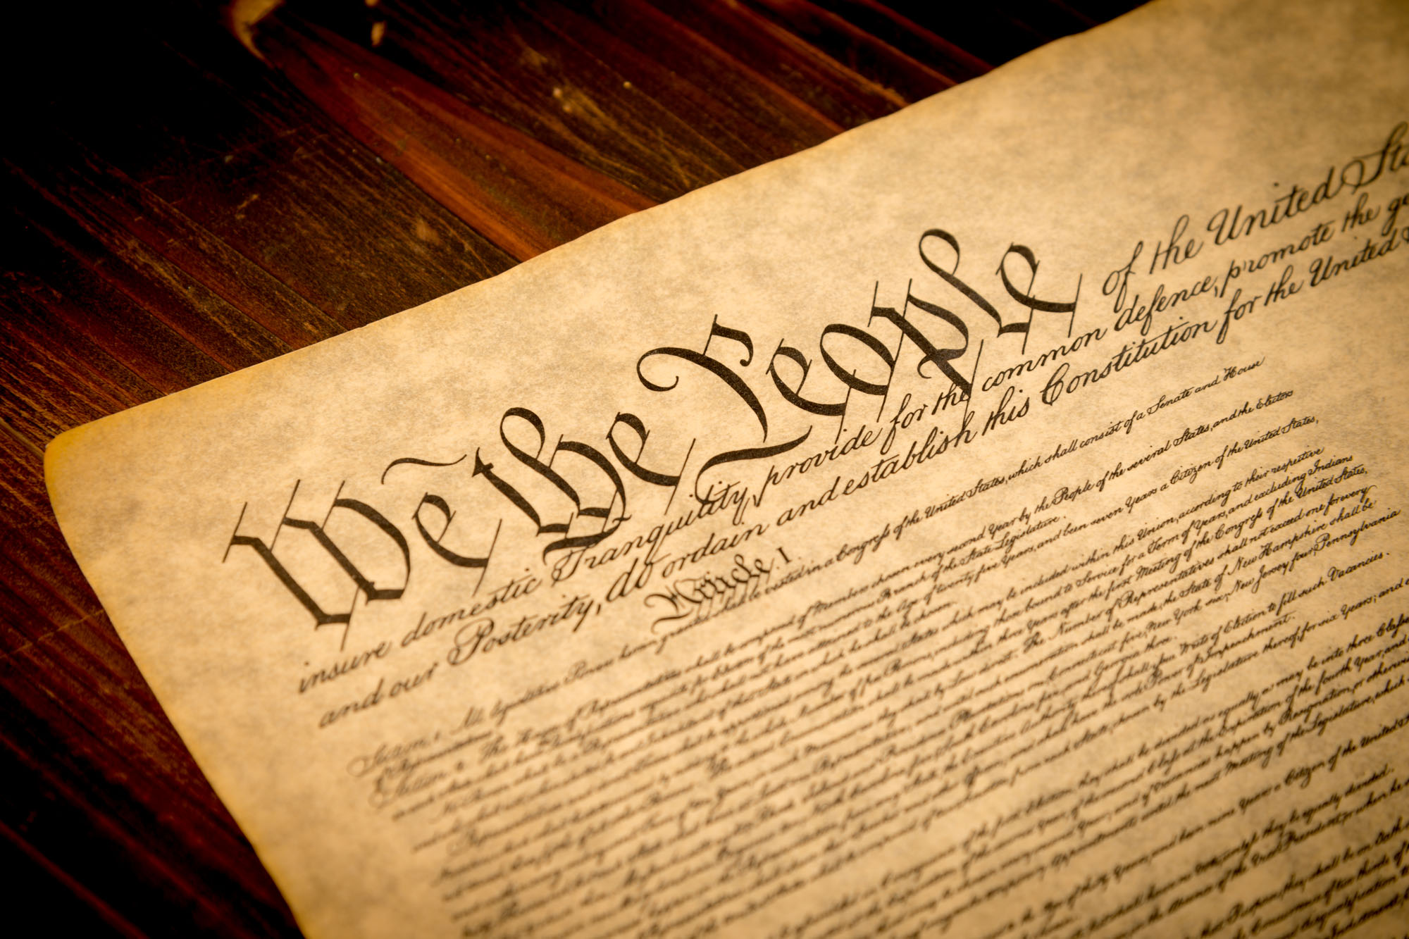
THE CONSTITUTION AND BILL OF RIGHTS
The Constitution helped create America's first national government.
It established the first basic rights that U.S. citizens have, no matter how they look, or how much money they have.
The Bill of Rights states the first 10 amendments in the U.S. Constitution.
The Constitution

Slide 65
Bibliography Mt. Rushmore
"New Britain Museum of American Art." New Britain Museum of American Art. N.p., n.d. Web. 20 Apr. 2015.
N.p., n.d. Web. 20 Apr. 2015.
N.p., n.d. Web. 2015.
"Theodore Roosevelt." - Wikipedia, the Free Encyclopedia. N.p., n.d. Web. 20 Apr. 2015.
"Thomas Jefferson." - Wikipedia, the Free Encyclopedia. N.p., n.d. Web. 20 Apr. 2015.
United States. National Park Service. "Carving History." National Parks Service. U.S. Department of the Interior, 19 Apr. 2015. Web. 20 Apr. 2015.

Slide 66
Bibliography – Gateway Arch
"About the Gateway Arch." About the Gateway Arch. N.p., n.d. Web. 20 Apr. 2015. <http:// www.gatewayarch.com/About.aspx>. Gateway arch: sunset. Digital image. N.p., n.d. Web. 20 Apr. 2015. <http://www.archsociety.com/ news.php?extend.127.3>.
Inside at the top of the Gateway Arvh. Digital image. N.p., n.d. Web. 20 Apr. 2015. https://www.flickr.com/ photos/mpjai_2/1474582018/

Slide 67
Bibliography – National Archives
Declaration of Independence. Digital image. Founding.com. N.p., 2012. Web. 21 Apr. 2015. <http://www.founding.com/the_declaration_of_i/>.
The National Archives Museum in Washington D.C. Digital image. The National Archives Museum. N.p., n.d. Web. 21 Apr. 2015. <http://www.archives.gov/museum/visit/>.
Shutterstock. The Constitution. Digital image. New York Post. N.p., 24 Jan. 2014. Web. 21 Apr. 2015. <http://nypost.com/2014/01/24/why-the-constitution-cant-stop-satan/>.

Slide 68
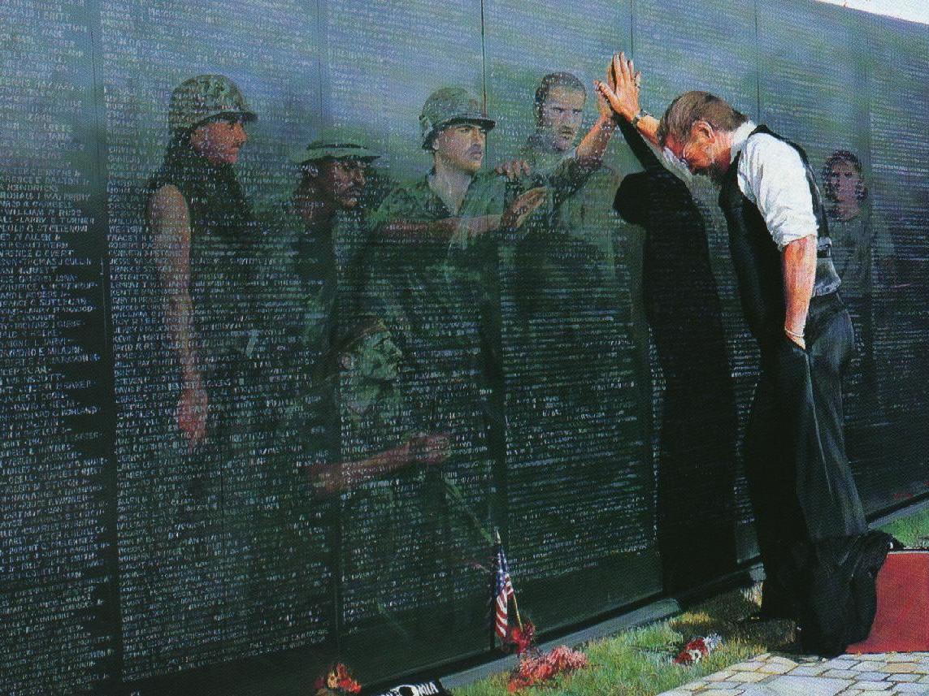
Vietnam Memorial
By Isabel B, Eleanor Grace P, Colton, Ollie W., Anders

Slide 69
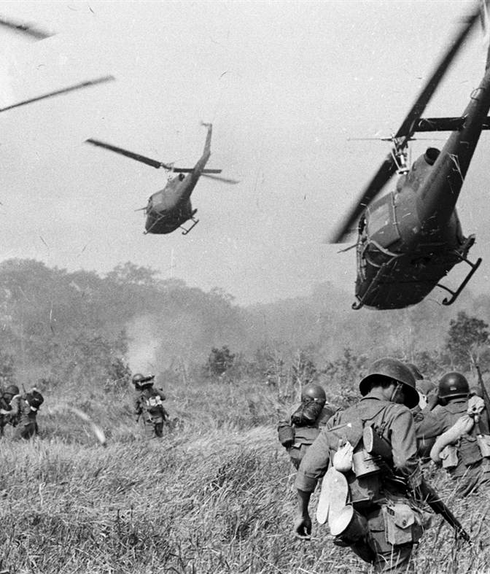
Vietnam War
The Vietnam War was fought between North Vietnam and the government of South Vietnam and the United States.
South Vietnam was supported by the United States.
The North Vietnamese (also called Vietcong) were fighting to reunify Vietnam under communist rule.

Slide 70
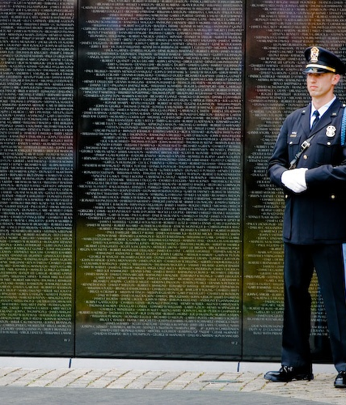
Vietnam Memorial
The Vietnam Memorial wall is in Washington D.C. and it covers 3 acres.
It was dedicated on November 13, 1982.
The glass panels are made so that when you look at them, the past and the present come together - your reflection and the names of the 58,286 US soldiers whoi died.

Slide 71
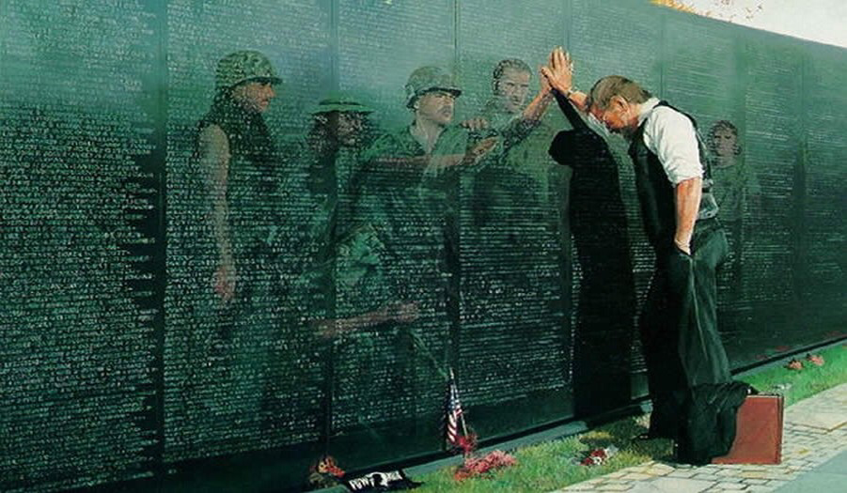
The Vietnam Memorial Wall
The Vietnam Memorial is a memorial for Americans who died in the Vietnam War.
Construction started on March 26, 1982 and finished on November 13, 1982.

Slide 72
MAYA LIN
- Maya Lin was the architect who designed the memorial.
- Her name is along the top of the memorial.
- She was 20 years old when she designed the memorial.
- Her parents fled China during the Cultural Revolution.

Slide 73
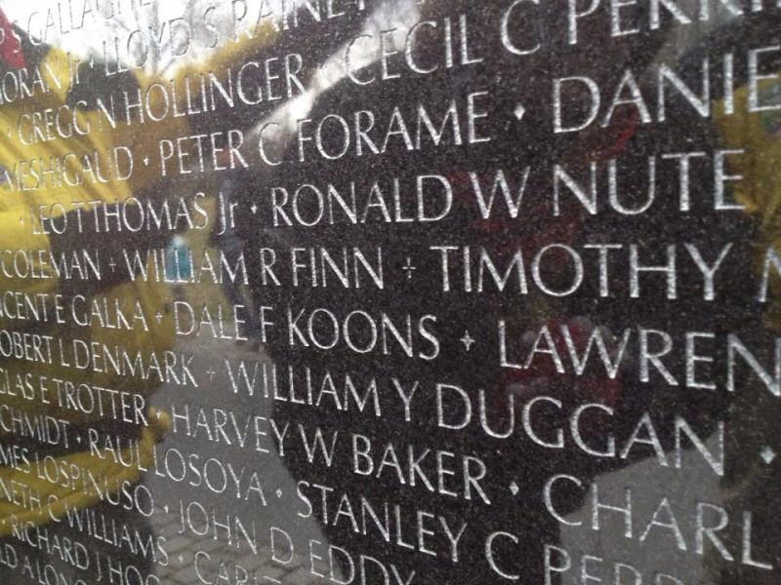
On the wall, there are over 58,000 names of the people who died in the war.
The wall is 493 feet and 6 inches long.
Maya Lin’s design was picked out of 1,441 other entries.
The Vietnam Veterans Memorial Fund raised nearly $9,000,000

Slide 74
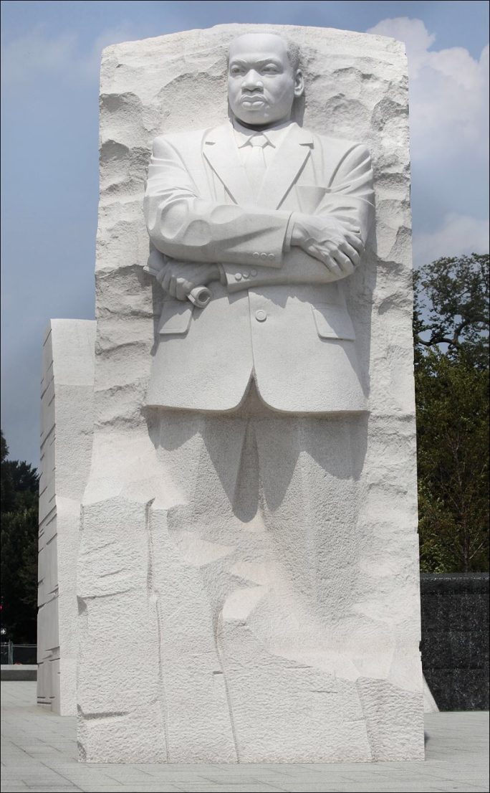
The Martin Luther King, Jr., Memorial
It is dedicated to Martin Luther King, Jr., for his leadership of the Civil Rights Movement.
It opened on October 10, 2011.
The MLK monument is 30 feet tall and is located on the Mall in Washington, D.C.
There was a competitive design process with over 900 applicants from 52 countries.

Slide 75
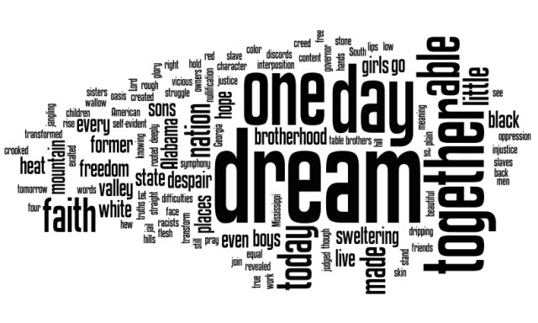

Slide 76
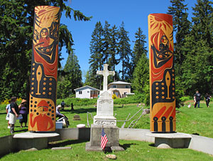
Native American Memorials
Chief Sealth was born in 1780, and died on
June 6, 1866.
Her was Chief of the Duwamish tribe when the first settlers European/US settlers arrived in what is now Seattle.
He was buried in the Suquamish Grave burials.
He gave a speech that convinced people to settle here.
That is why, to this day, this city is called Seattle.
This is a picture of Chief Sealth's grave.

Slide 77
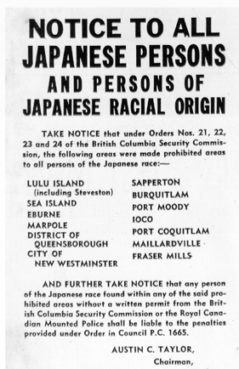
Japanese Internment
In World War II, the US government placed between 110,000-120,000 people in Japanese-American internment camps because they thought that they were not to be trusted because they were of Japanese ancestry, even if they had lived in the US for many generations.
In 1988, Congress attempted to apologize for the action by awarding each surviving internee $20,000.
The relocation of Japanese-Americans into internment camps during World War II was one of the most flagrant violations of civil liberties in American history.

Slide 78
Japanese Internment Memorial/ Panama Hotel
The Panama Hotel was built as a “workingman’s” hotel. It represents the Japanese internment and how Japanese/Americans were treated unfairly during WWII. For example, the picture below shows two women hiding Japanese valuables in their basement because they want to show their patriotism to the USA.
Many Japanese-Americans lost their homes and their businesses.
"HISTORIC PANAMA HOTEL TEA." HISTORIC PANAMA HOTEL TEA. Historic Panama Hotel, n.d. Web. 20 Apr. 2015.

Slide 79
Bibliography – Vietnam Memorial Wall
Faas, Horst. Vietnam War. Digital image. NBC. AP, n.d. Web. 20 Apr. 2015. <http://www.nbcnews.com/slideshow/news/35-years-after-the-fall-the-vietnam-war-in-pictures-36859810>.
Teeter, Lee. Vietnam memorial with men. Digital image. Bill's Vietnam Memorial Page. Bill's Vietnam Memorial Page, n.d. Web. 20 Apr. 2015. <www.wjpbr.com>.
Thinklink. Vietnam War Memorial. Digital image. Thinklink. Thinklink, n.d. Web. 21 Apr. 2015. <http://www.thinglink.com/scene/451361317354209280>.
"Vietnam Veterans Memorial." - Wikipedia, the Free Encyclopedia. Web. 21 Apr. 2015. <http://en.m.wikipedia.org/wiki/Vietnam_Veterans_Memorial>.

Slide 80
Bibliography – MLK Memorial
•United States. National Park Service. "History & Culture." National Parks Service. U.S. Department of the Interior, 20 Apr. 2015. Web. 20 Apr. 2015. <http://www.nps.gov/mlkm/learn/historyculture/index.htm>.
•"Martin Luther King, Jr. Memorial." - Wikipedia, the Free Encyclopedia. N.p., n.d. Web. 20 Apr. 2015. <http://en.m.wikipedia.org/wiki/MLK_Memorial>.
•"Mlk Memorial 21." CBS Atlanta. N.p., n.d. Web. 20 Apr. 2015. <http://atlanta.cbslocal.com/2012/01/16/martin-luther-king-memorial-gallery/mlk-memorial-21-3/>.
•"City Walking Guide." 5 Interesting Facts About the Martin Luther King Jr Memorial Fun Facts Kids Map Picture. N.p., n.d. Web. 20 Apr. 2015.
Rudra, Geetika.
•"MLK Memorial May Be Unfinished for Anniversary." ABC News. ABC News Network, 13 Aug. 2013. Web. 20 Apr. 2015.

Slide 81
Ushistory.org. "Japanese-American Internment." Ushistory.org. Independence Hall Association, n.d. Web. 21 Apr. 2015. "The Japanese American Internment." Abagond. N.p., 19 May 2010. Web. 21 Apr. 2015. "Japanese Internment." Lib.washington.edu. N.p., n.d. Web.

Slide 82
Monuments
Of
Russia

Slide 83
Monuments
Russia
Lyceum 6

Slide 84
Why are monuments important for a country and city?
Dima S

Slide 85
Why are monuments important for a country and city?
Monuments are not created just to be created. They are constructed on purpose. The purpose is to keep some great people and their deeds in memory of coming generations.
In Russia there are monuments to poets (Pushkin, Yesenin), writers (Tolstoy, Dostoevsky), to scientists (Pavlov, Lomonosov), to heroic people like Gagarin or soldiers;
There are also monuments to animals
Recently some small monuments appeared, their purpose is to bring a good mood to people
There are also some natural wonders that are protected, they are monuments, too.

Slide 86
In My Town
In Tambov there are so many different monuments such as:
Memorial "Tambov farmer“, Memorial complex "Eternal
flame“, Monument to S. V. Rachmaninoff in Tambov and
others.

Slide 87
Memorial "Tambov farmer"
Memorial with an interesting name "Tambov Farmer", or as it is popularly called a "Tank", was manufactured and installed in honor of the city's people and their generosity. These people started to collect money, when the Great Patriotic war started (1941-1945). Thanks to the money collected by ordinary people, four hundred tanks, warplanes and torpedo boats were constructed and sent to the war against fascism.

Slide 88
Tatar shaft
Tatar shaft - ground shaft, which was part of a line of fortifications built to protect the Russian state from the raids of Crimean and Nogay Tatars in the XVII century. In the partially preserved the form passes through the territory of the modern Tambov, Lipetsk, Voronezh and Belgorod regions. Protected as a historical monument.

Slide 89
Visited Monuments In Tambov, My Native City

Slide 90
Zoya Kosmodemyanskaya
Name of the Hero of the Soviet Union Zoya Kosmodemyanskaya is one of the squares of Tambov. In 1947 there was a monument to the young partisan, created by sculptor M.G.Manizer. In spring 2007, in the park, in the framework of the "Face of the City", began construction work carried out.

Slide 91
Eternal flame
May 9, 1970, the day of the 25th anniversary of the Great Victory over the Nazi invaders, in Tambov Cathedral Square a monument of Eternal Glory Tambov’s soldiers who sacrificed their lives for our country was opened Fire was lit Eternal Glory to fallen soldiers.

Slide 92
Bust to V.S. Petrov
The memorial bust of twice Hero of the Soviet Union V.S. Petrov was established in 1953. The monument - sculptor L.E. Kerbel and architect I.A. Frenchman.
The Square named after Petrov , twice a Hero of the Soviet Union, the Major Yegorov Petrova. The Pedestal with the bust Petrov is set in the center of the park in 1953.

Slide 93
Gavriil Derzhavin Monument (Made By Maria)
Gavriil Derzhavin - Russian poet and dramatist of the Enlightenment, a statesman of the Russian Empire, senator, privy councilor. In 1994, July 16th, the monument to Gavriil Derzhavin was built on Derzhavinskaya street by sculptor K. Malofeev and architect A. Kulikov. (made by Maria)

Slide 94
Monument to Sergey Rachmaninov
This Monument was built in 2006 by sculptors Rukavishnikov and Buchaev. It was built to famous Russian musician Sergey Rachmaninov. His grandfather was an Edelmann of Tambov Provinz and Sergey spent a lot of time in Tambov.
http://Tochka-na-Karte.ru/photo/Tambov/3097-Pamjatnik-Sergeju-Rahmanin…

Slide 95
Aseev Palace
It used to be a house of the merchant`s family. Now there` s a museum and popular place in our city
In Winter
In Summer
In Autumn

Slide 96
Some monuments represent the country and its history and glory

Slide 97
Mamaev Kurgan
Mamaev Kurgan - the hill on the right bank of the Volga River in the central region of the city of Volgograd. Today Mamaev Kurgan is known primarily for the memorial ensemble " Heroes of Stalingrad Battle " with the main monument " The Motherland Calls !". On Mamaev Hill , there are several communal and individual graves in which lie the remains of more than
35 000 people.

Slide 98
Fountain of Friendship of Peoples
Fountain "Friendship of Peoples " - is one of the main symbols of VDNH in Moscow. Large octagonal pond in the center of which was erected a fountain was built on the site of small pavilions.

Slide 99
Peter and Paul Fortress
Peter and Paul Fortress - Fortress in St. Petersburg , located on Hare Island , the historic core of the city. The fortress was founded May 16, 1703 joint plan of Peter I and the French engineer Joseph Lambert de Guerin. Nowadays fortress is a part of the Museum of the History of St. Petersburg.
http://niskgd.ru/mix/p35/125549888.jpg

Slide 100
Some monuments are well – known all over the world
Saint Basil's Cathedral. The building is now a museum. The building is shaped as a flame of a bonfire rising into the sky,[ a design that has no analogues in Russian architecture..

Slide 101
Moscow underground
It is the most beautiful metro, and each station reminds of some facts from the history of Russia

Slide 102
Our country is huge and some questions are difficult to answer.. It is impossible to tell a story of each one but each of them is amazing and interesting to see. Welcome to Russia!

Slide 103
Funny Monuments
Funny monuments are created to cheer a person up. Some of them remind of some sayings or habits, some illustrate proverbs.
Lost purse
Let the ducklings go.
Do not destroy the branch you are sitting on!
A plumber

Slide 104
Nature Monuments
There are 7 monuments standing on the plateau, they are 34 metres high, they used to be mountains.

Slide 105
Stone Mushrooms

Slide 106
A Valley Of Geysers

Slide 107
Lena Columns

Slide 108
The Orda Cave
The cave is full of rock structures, the water is so clear that divers can see over 45 metres ahead

Slide 109
Tourists Attraction
Monuments in Moscow, St Petersburg are the main tourist attractions, but also unique ancient churches in Kizhi, lake Baikal, caves in Ural mountains and more others attract tourists from all over the world. Walking along the Red Square in Moscow you can hear a lot of different languages spoken.
Russian people go to different parts of Russia and the world such as Turkey, Egypt, Italy, Sweden, Czech Republic, Germany, Greece, China, the USA, France and many others.

Slide 110
Authors
Anton, Vlad, Gleb, Julia, Dmitry, Liza, Elena, Ilya, Katya, Maria, Vladimir, Kristina, Sergey, Daria, Irina, Irina Ch., Dima S.

Slide 111
Links
https://yandex.ru/images/search?img_url=http%3A%2F%2Fwww.dergavin.ru%2Fcms.ashx%3Freq%3DImage%26%26imageid%3D2a13cebd-2106-4b0c-98c6-1a34651eaa11%26key%3D..&uinfo=sw-1366-sh-768-ww-1349-wh-667-pd-1-wp-16x9_1366x768&_=1429461476558&suggest_reqid=891879591142635932214762790200972&viewport=wide&text=%D0%BF%D0%B0%D0%BC%D1%8F%D1%82%D0%BD%D0%B8%D0%BA%20%D0%B4%D0%B5%D1%80%D0%B6%D0%B0%D0%B2%D0%B8%D0%BD%D1%83%20%D0%B2%20%D1%82%D0%B0%D0%BC%D0%B1%D0%BE%D0%B2%D0%B5%20&pos=0&rpt=simage – Derzhavin Monument
https://yandex.ru/images/search?img_url=http%3A%2F%2Ftambovgrad.ru%2Fmodules%2Fphoto%2Fimages%2F23.jpg&uinfo=sw-1366-sh-768-ww-1349-wh-667-pd-1-wp-16x9_1366x768&_=1429461476558&suggest_reqid=891879591142635932214762790200972&viewport=wide&text=%D0%BF%D0%B0%D0%BC%D1%8F%D1%82%D0%BD%D0%B8%D0%BA%20%D0%B4%D0%B5%D1%80%D0%B6%D0%B0%D0%B2%D0%B8%D0%BD%D1%83%20%D0%B2%20%D1%82%D0%B0%D0%BC%D0%B1%D0%BE%D0%B2%D0%B5%20&pos=4&rpt=simage&pin=1 - Derzhavin Monument (2)
https://yandex.ru/images/search?img_url=http%3A%2F%2Frating-news.ru%2Fimage_cache%2F15%2F2015%2F02%2F05%2F10a5c%2Fgallery_promo20945899.jpg&uinfo=sw-1366-sh-768-ww-1349-wh-667-pd-1-wp-16x9_1366x768&text=%D0%B2%D0%B5%D1%87%D0%BD%D1%8B%D0%B9%20%D0%BE%D0%B3%D0%BE%D0%BD%D1%8C%20%D1%82%D0%B0%D0%BC%D0%B1%D0%BE%D0%B2&redircnt=1429466012.1&noreask=1&pos=3&rpt=simage&lr=13&pin=1 – Eternal Flame
http://tambovia.ru/sobornaya.html - eternal flame (2)
http://www.2do2go.ru/uploads/full/3034bf564ae3a4aabaecb46b38c5fe42_w960_h2048.jpg
http://cpacibodedu.ru//uploads/posts/2014-02/9580509759dcba26cccb8d8dd1f1dee5.jpg
http://niskgd.ru/mix/p35/125549888.jpg
http://Tochka-na-Karte.ru/photo/Tambov/3097-Pamjatnik-Sergeju-Rahmanin
http://img-fotki.yandex.ru/get/16153/12966475.19a/0_c4f61_623cad_orig.jpg
http://mtdata.ru/u27/photo15B7/20034958657-0/original.jpg
http://www.msktambov.ru/wp-content/uploads/skiv/2014/10/0_e9d58_b9bf4f50_XXL.jpg
http://img-fotki.yandex.ru/get/6417/122263170.1d/0_9a4f1_a5ebe2d5_XXXL.jpg
http://im3.asset.yvimg.kz/userimages/nizami/2gKJm9iWfC84nXmQO7g9Mhj5HFCcx6.jpg
http://cdn2.getyourguide.com/img/tour_img-206027-48.jpg
http://cs312324.vk.me/v312324586/573c/wpILzNH--uQ.jpg
http://s00.yaplakal.com/pics/pics_original/6/7/6/5325676.jpg
http://s00.yaplakal.com/pics/pics_original/8/6/6/5325668.jpg
http://www.archdesignfoto.com/wp-content/uploads/2009/02/p35.jpg
http://in-te-res.ru/wp-content/uploads/2009/05/afn.jpg
http://ru.fishki.net/picsw/042009/28/pamyatn/pamyatn_35.jpg
http://i.moskovia2010.ru/u/33/a39024e0d211e2bb4c9eff816c674f/-/repphoto_943_9064%5B1%5D.jpg
http://ru.fishki.net/picsw/042009/28/pamyatn/pamyatn_02.jpg
http://s00.yaplakal.com/pics/pics_original/9/4/6/5325649.jpg
http://s00.yaplakal.com/pics/pics_original/1/6/6/5325661.jpg
http://s00.yaplakal.com/pics/pics_original/0/2/7/5325720.jpg

Slide 112
THANK YOU

