Slide 1
Walk from Our School
THE EDUCATORS School Islamabad , Pakistan

Slide 2
THE EDUCATORS School
Our School Was established in 2011
It has three sections Preschool, Primary and Secondary school
Our school building is not very big
Our school is situated in I-8/4 most expensive sector of Islamabad here prices of building and houses are very high
There are many places near our school, like there are schools, hospital, Education Offices, Parks, Mosques, Highway, Interchange, Bridges, restaurants, Bakery, Banks etc

Slide 3
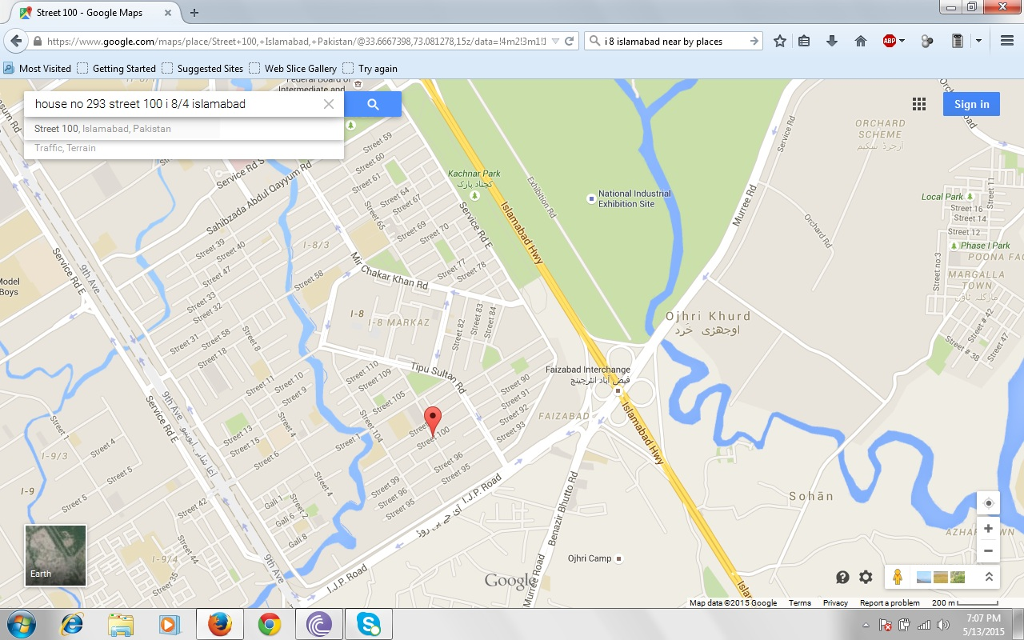
Our School Location

Slide 4
what types of businesses are within 1km of your school?
There are different kinds of businesses like there are banks, Schools, Markets, Plazas, Hospitals, Office

Slide 5
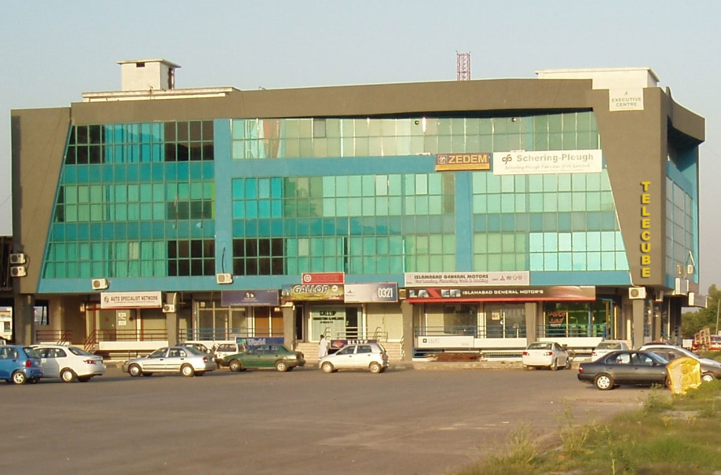
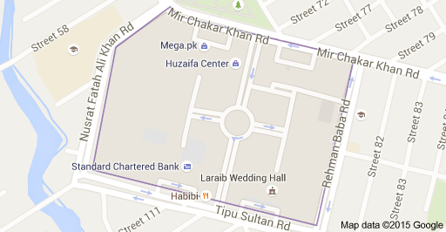
Markets and Plazas
I-8 Main Market
The square area in second picture is the I-8 Main Market and It is Called I-8 Markaz

Slide 6
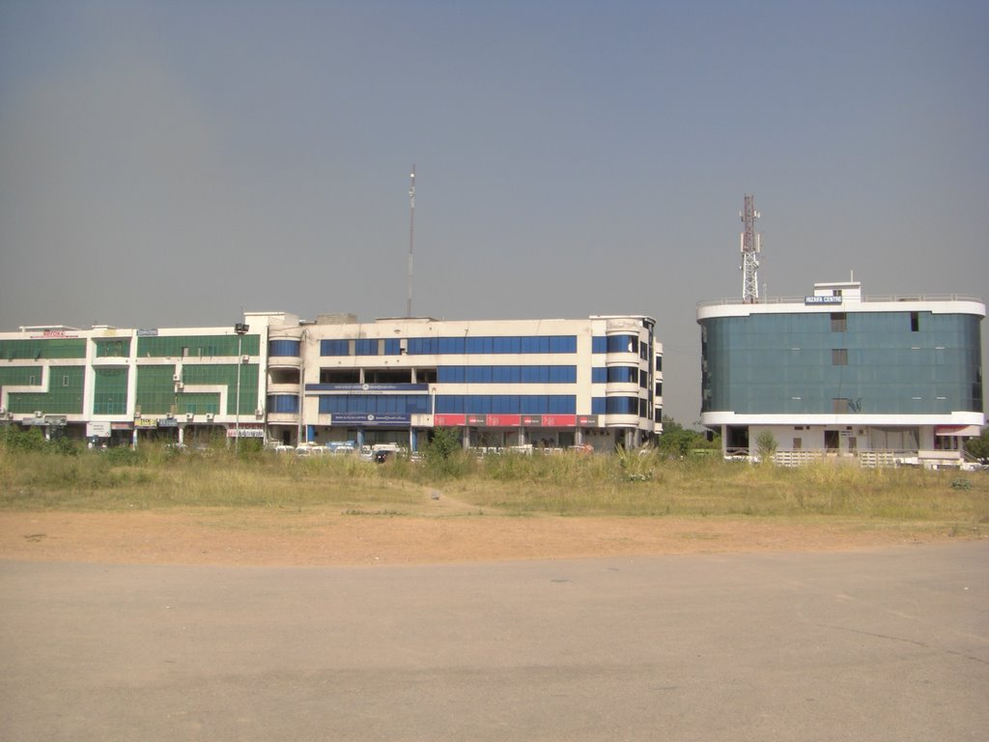
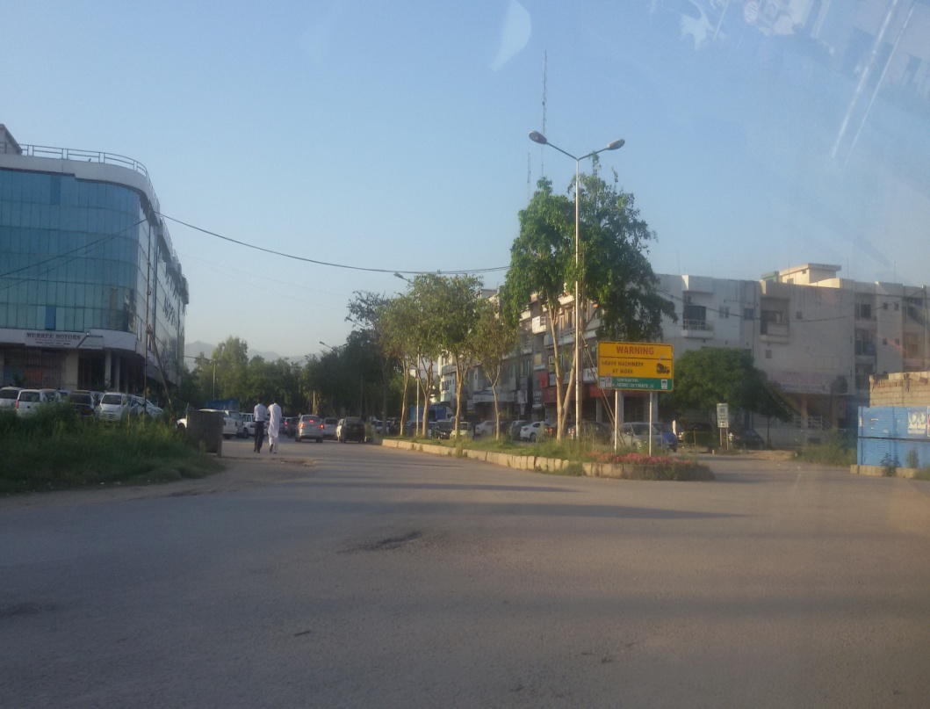
Markets and Plazas
Shopping Malls and Shops in I-8 Main Market

Slide 7
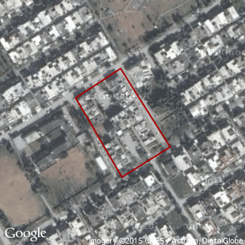
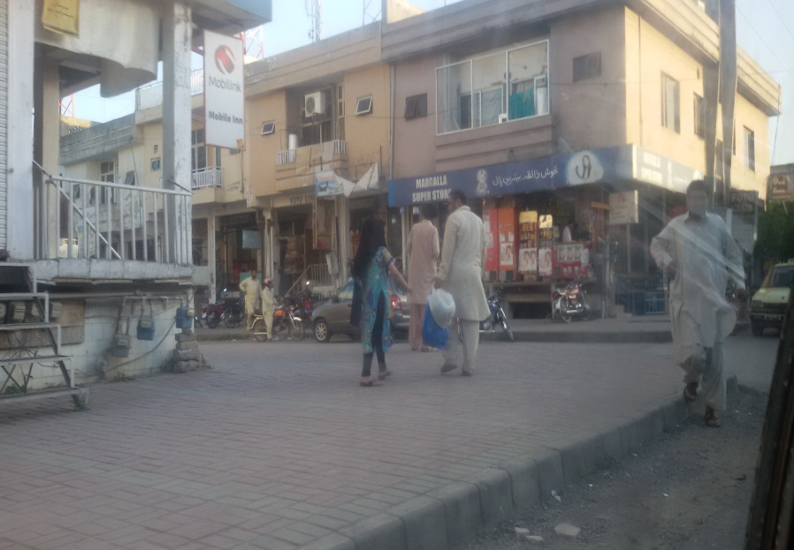
Markets and Plazas
Pakeezah Market
Pakeeza Market is next to Dhok Bābu Irfān and is located in Punjab, Pakistan. Pakeeza Market has a length of 0.4 kilometers.
area: yes
created_by: Potlatch 0.10b
is_in: I-8/1, Islamabad
landuse: retail
place_name: Pakeeza Market

Slide 8
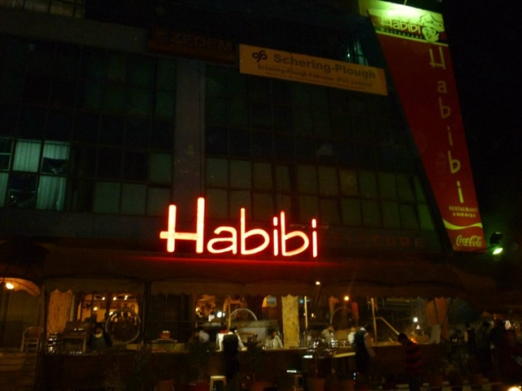
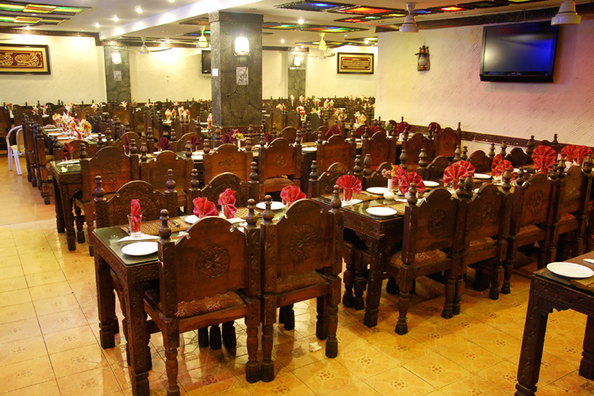
Restaurants
Habibi Restaurant
It’s a very yummy restaurant. It offer all the Pakistani traditional foods. Their specialty is Bar B Q and Kabli Pulao .

Slide 9
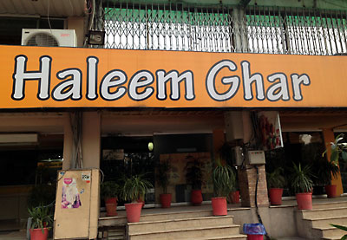
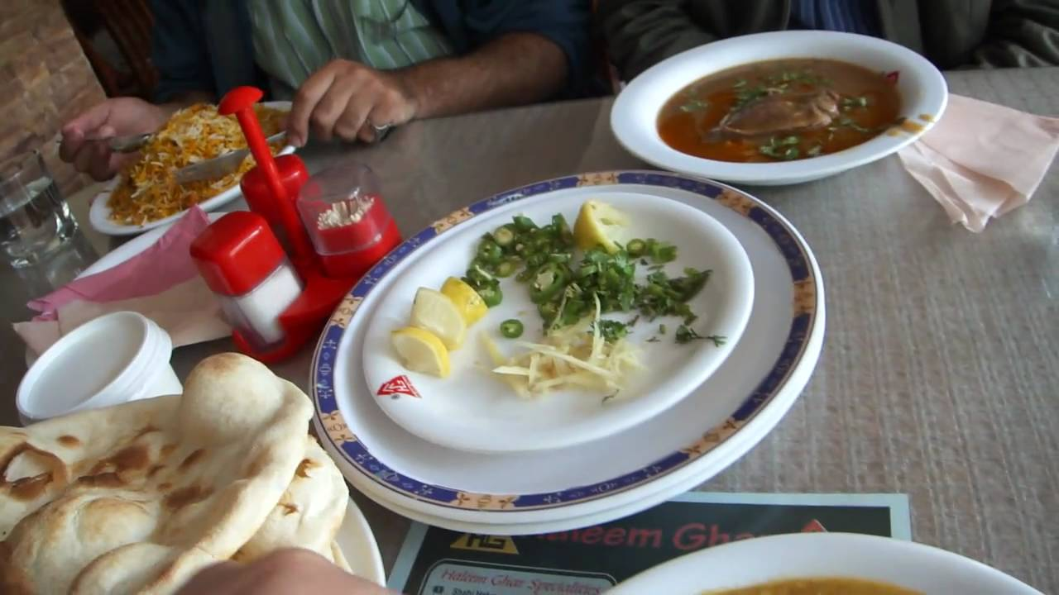
Restaurants
Haleem Ghar
It’s a small restaurant and their specialty is Haleem which is Yummy tooo.

Slide 10
Areas Near our school
Islamabad is World second most beautifull Capital Cities of the world and our school is in Islamabad too so the area near our school is greeeen and cool

Slide 11
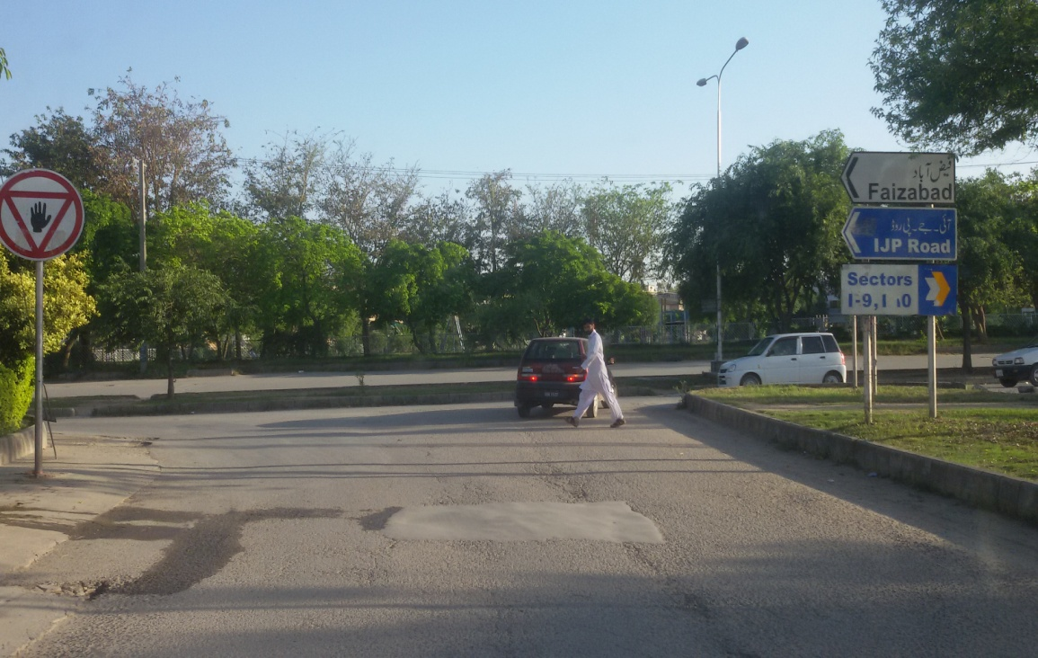
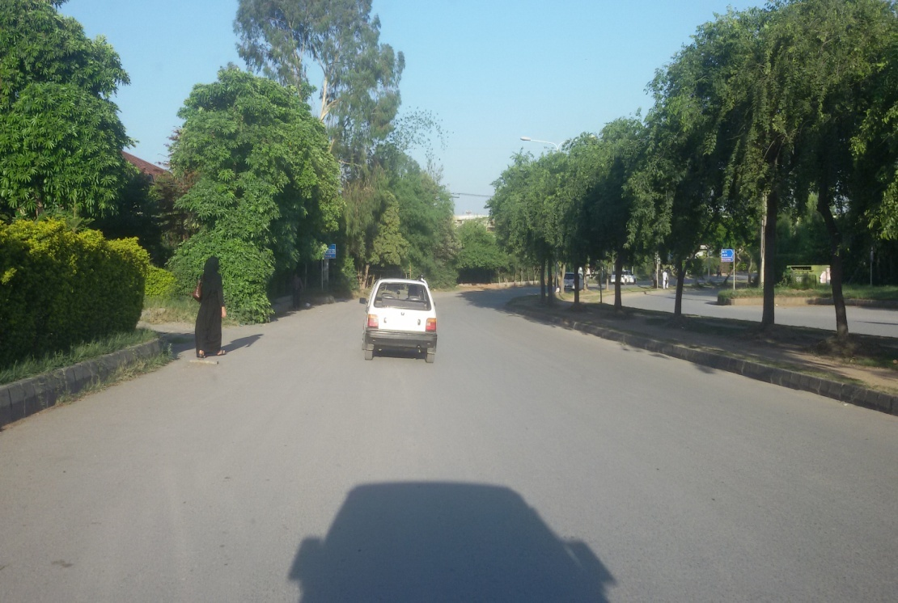
Area Near our School

Slide 12
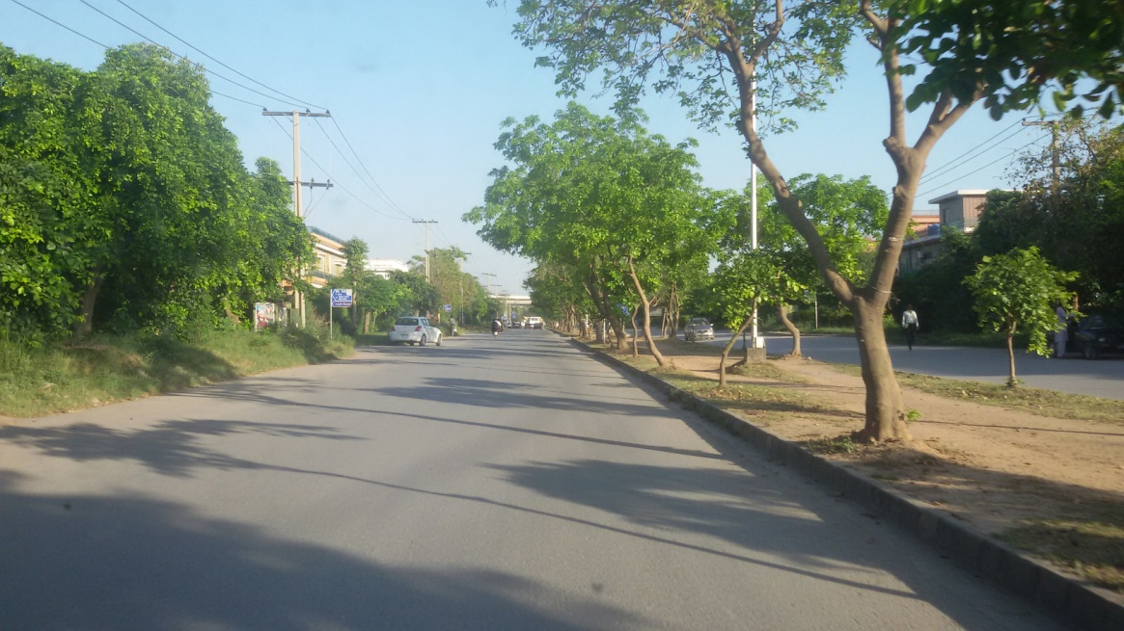
Area Near our School
Road Outside our Street

Slide 13
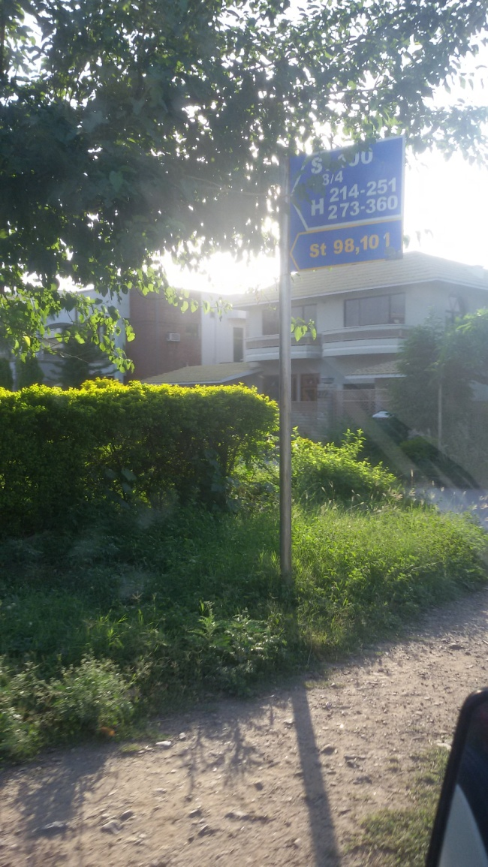
Area Near our School
Our School Street Start

Slide 14
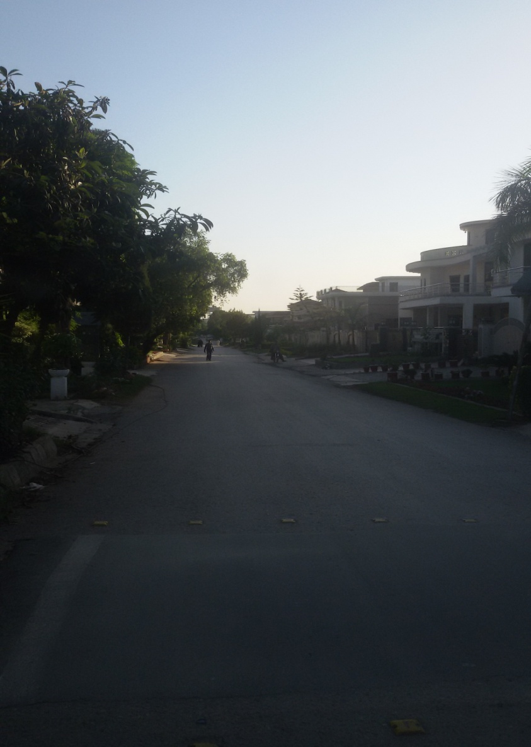
Area Near our School
Our School Street

Slide 15
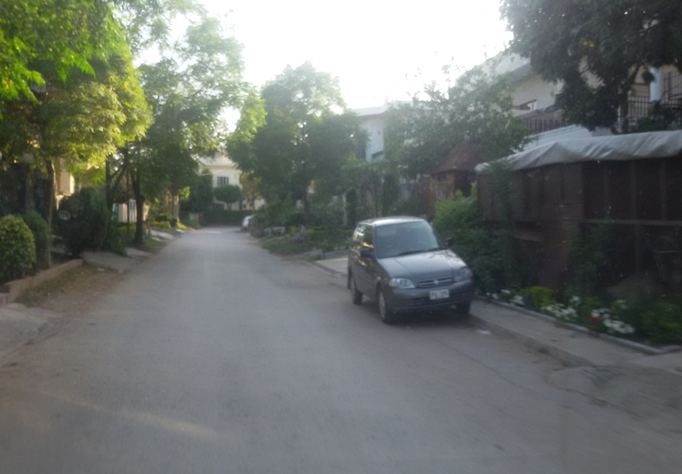
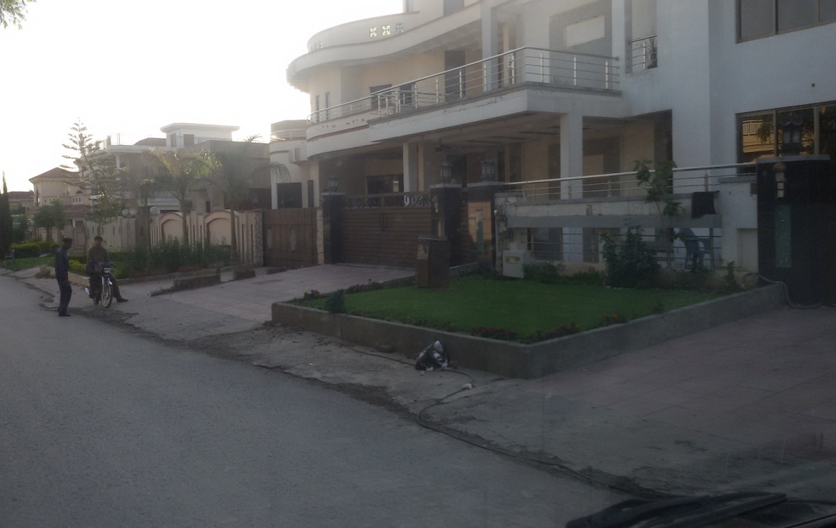
Area Near our School
Houses in our Street

Slide 16
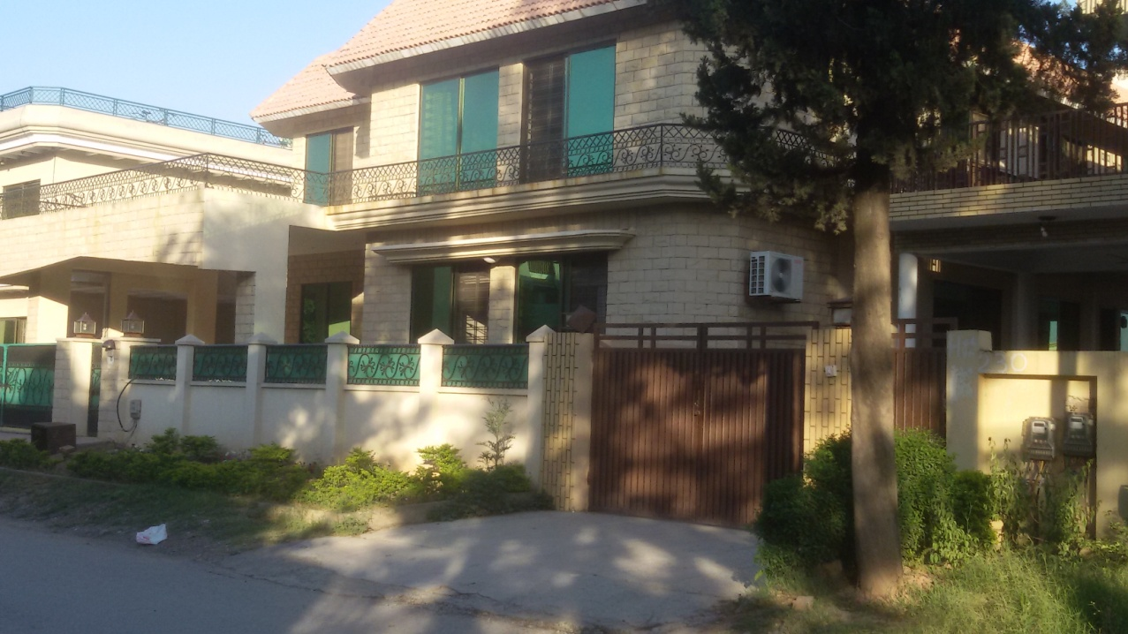
Area Near our School
Houses in our Street

Slide 17
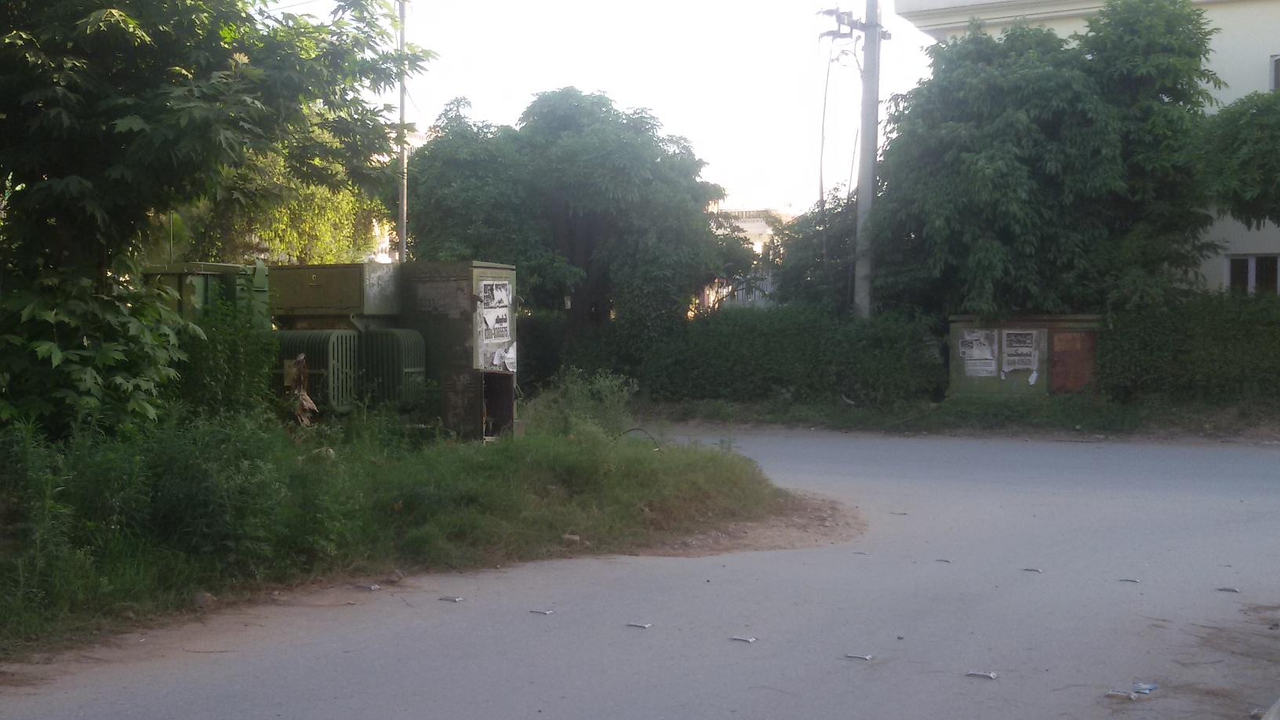
Area Near our School
Our School Street End

Slide 18
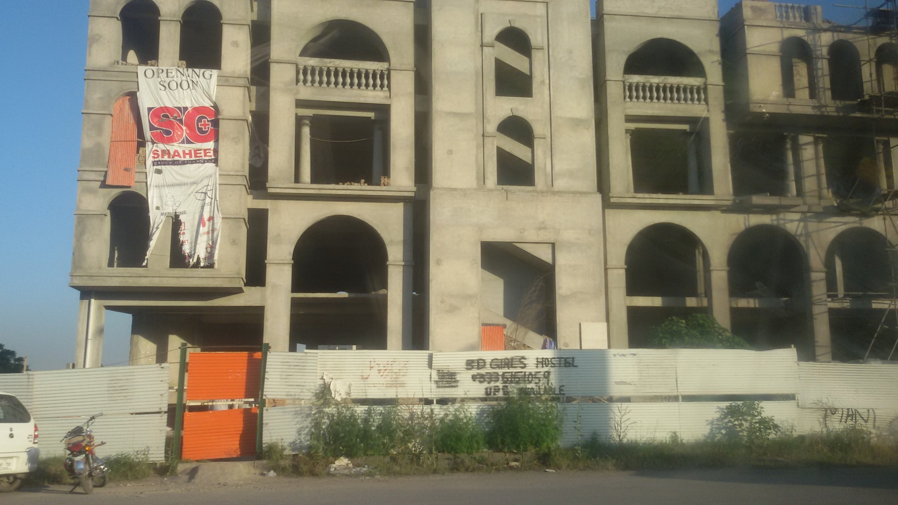
Area Near our School
A Building Being Built

Slide 19
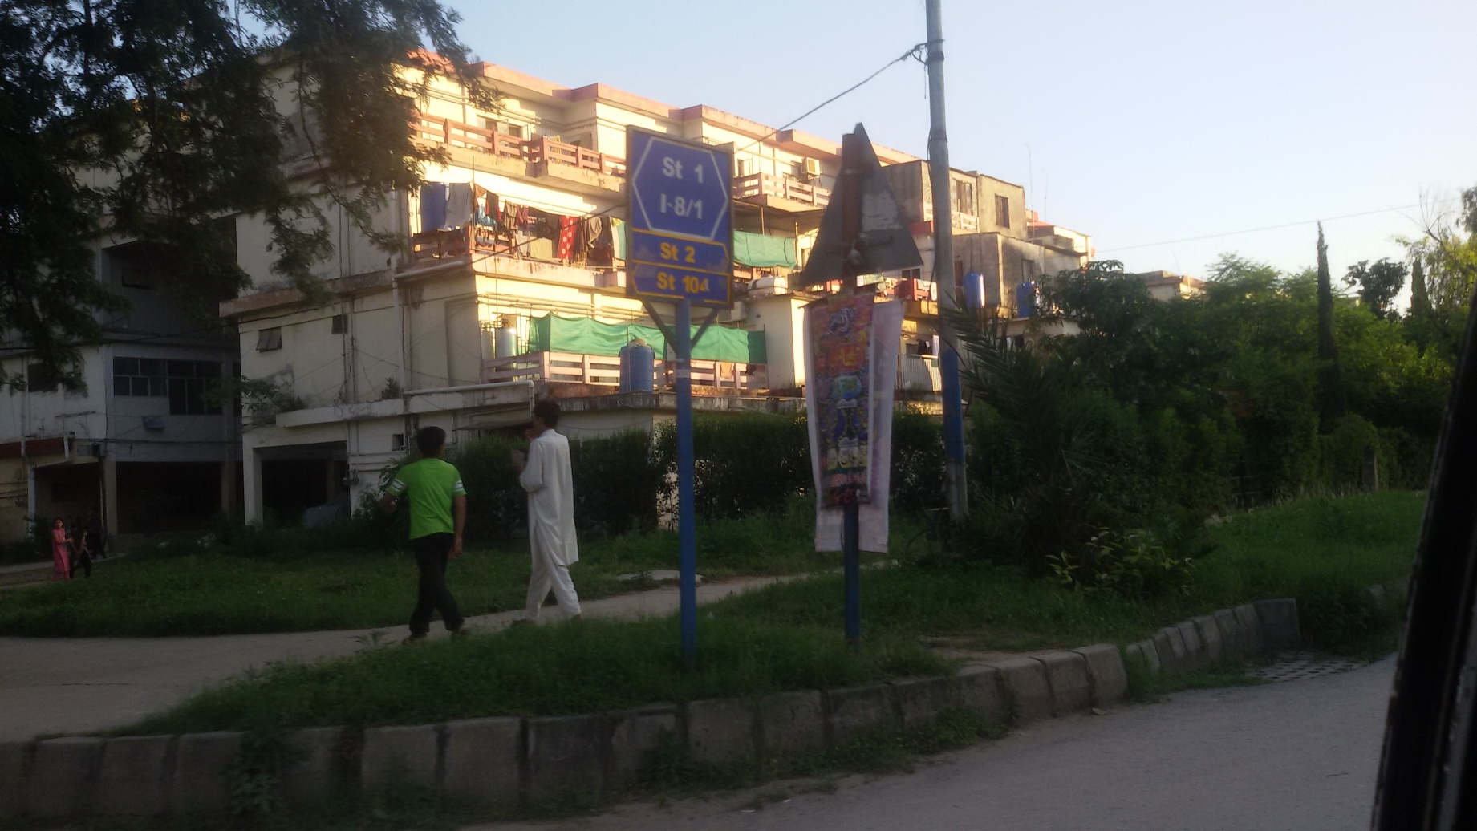
Area Near our School
Apartments

Slide 20
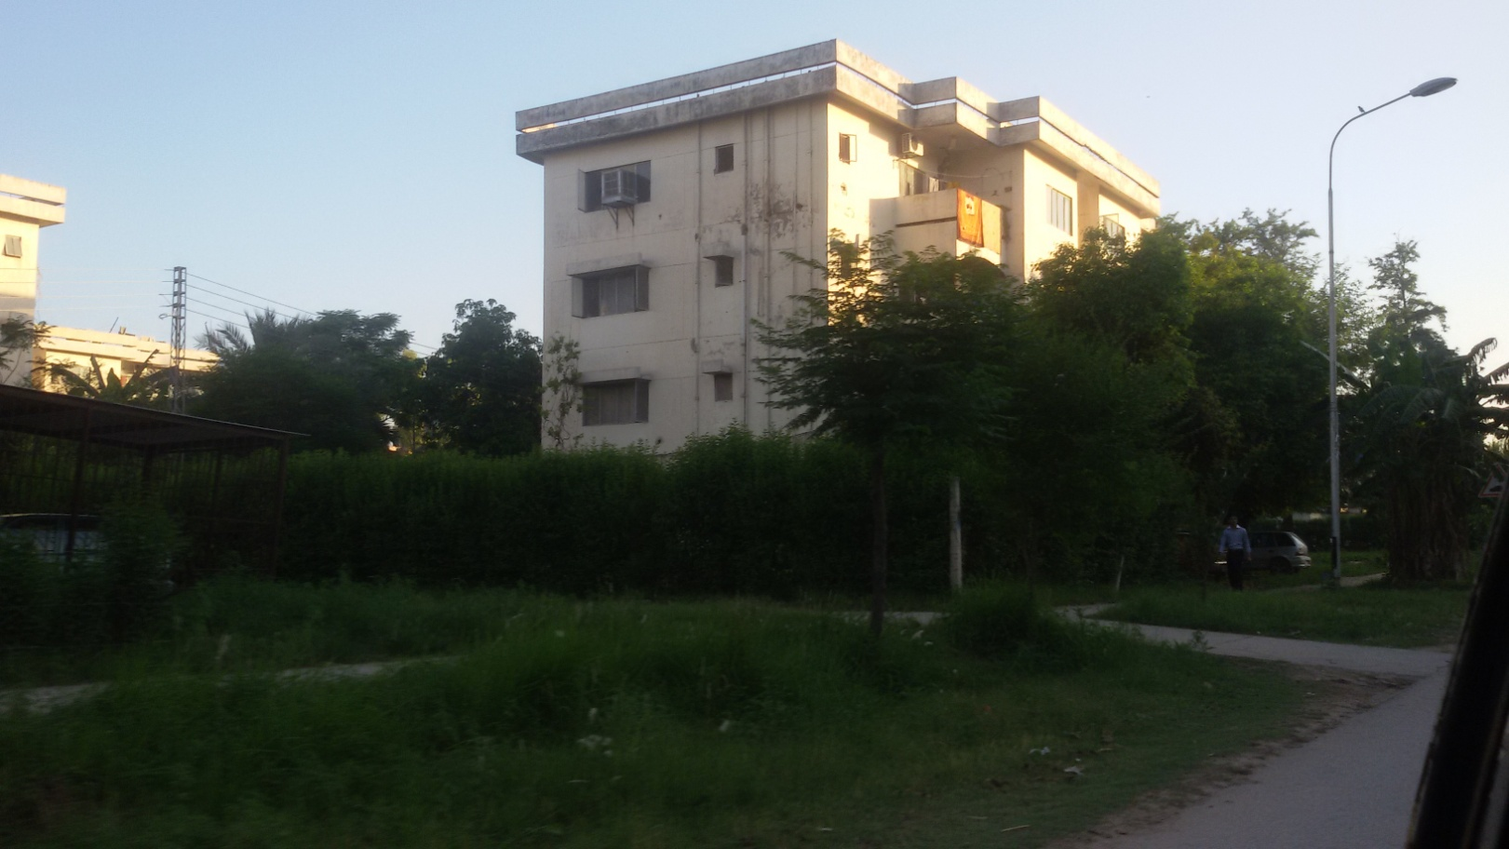
Area Near our School
Apartments

Slide 21
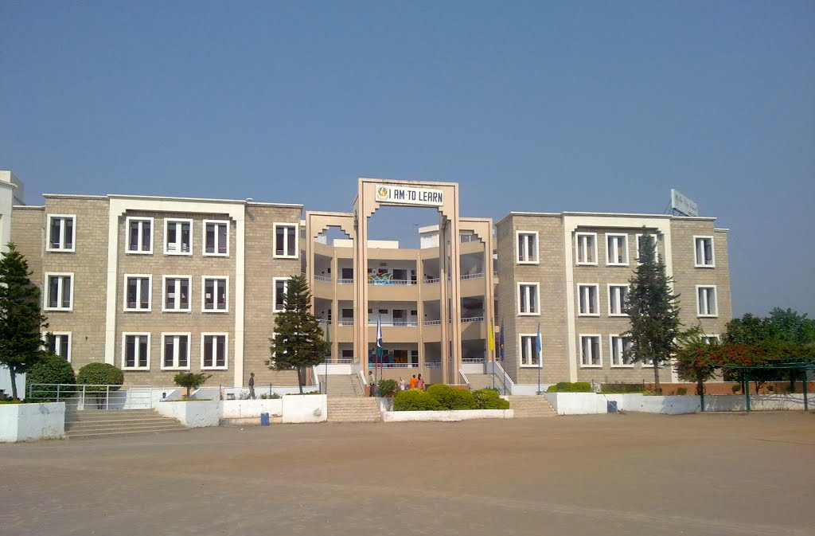
Other Schools in our School’s Surroundings
THE City School
The City School (abbreviated as TCS) is one of the private English medium school systems in Pakistan which operates more than 190 schools in 53 cities across Pakistan. It offers preschool, primary education, secondary education and preparation for local SSC and the international GCE. Most of its students opt to take the international GCE O and AS/A Level examinations organized by the CIE of UCLES.

Slide 22
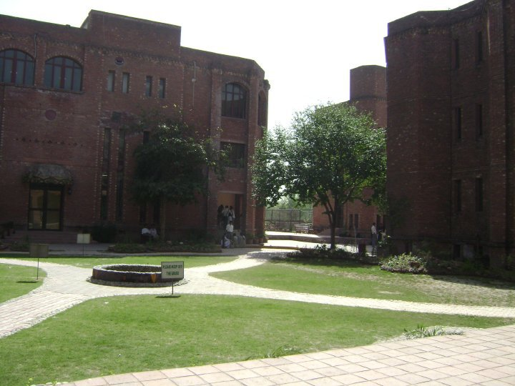
Other Schools in our School’s Surroundings
Beaconhouse School
The Beaconhouse School System is one of the largest private school networks in the world. Established in November 1975 as the Les Anges Montessori Academy for toddlers, Beaconhouse has since grown into a global network of private schools, institutes, and universities, giving education to over 241,000 students from pre-school to post-graduation

Slide 23
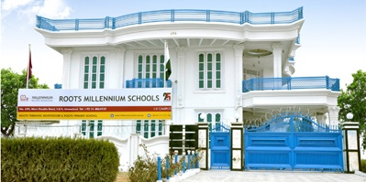
Other Schools in our School’s Surroundings
Roots Millennium School
Roots Millennium Schools is a part of Roots School System founded in 1988 by Mrs. Riffat Mushtaq. Roots millennium schools is established by her son Chaudhry Faisal Mushtaq and is operating purpose built state of the art campuses in 20 cities of Pakistan. It is a private school system too

Slide 24
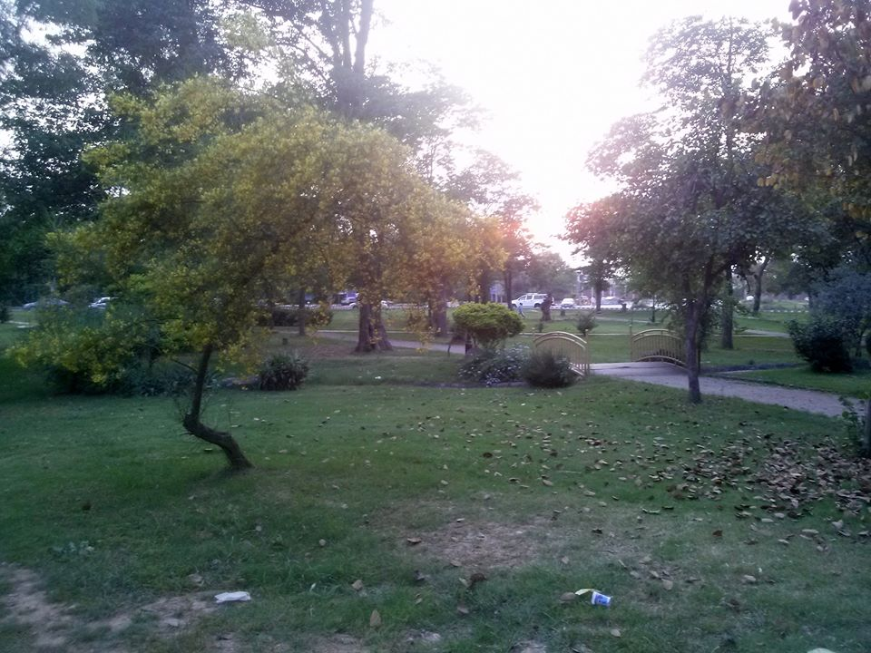
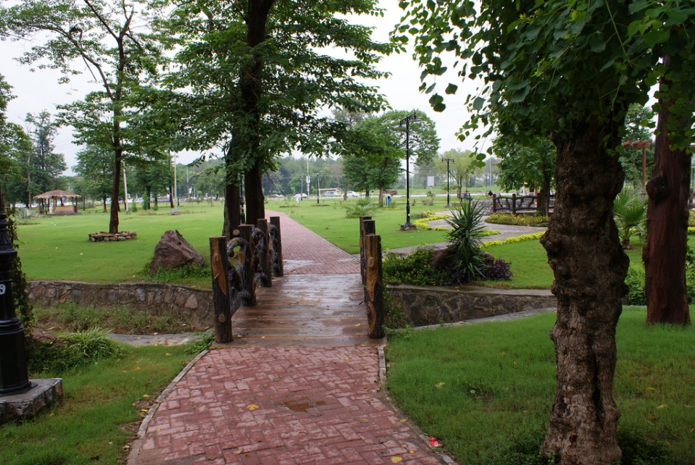
Park Near Our School
Kachnar Park
Kachnar park is so beautiful. It has a jogging or walking track which is 6 kilometers long. Every evening people from different vicinity come her jog and exercise.

Slide 25
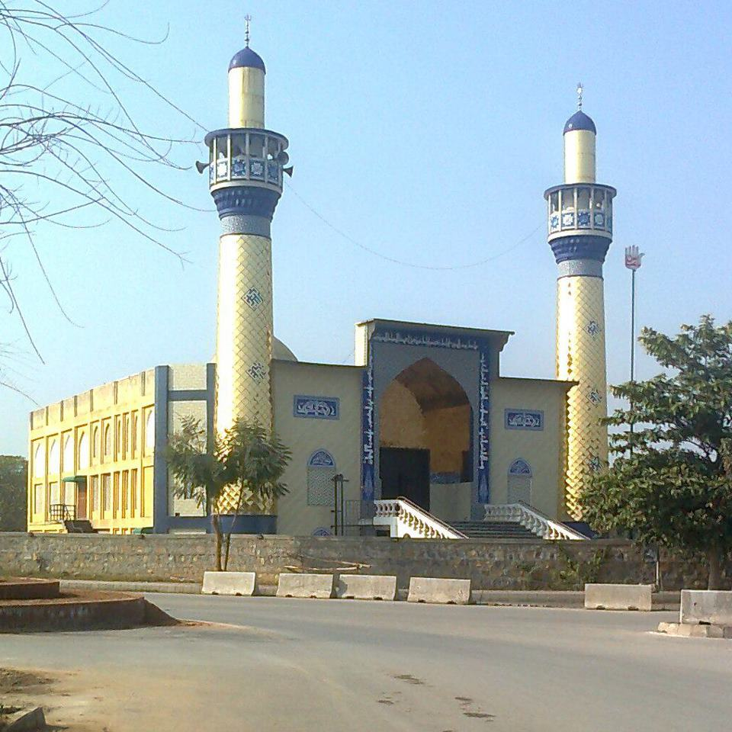
Religious Places
Mosque
There is a beautiful mosque near our School. Mosque is a Muslim Worshipping Place. In this Mosque one Sect of Muslims called Shias worship here.

Slide 26
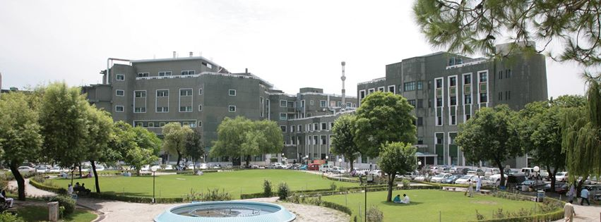
Hospital
Shifa International Hospital
Shifa International Hospital is a tertiary care organization that is committed to provide cost effective quality medical care to all patients, ensuring ethical practice of medicine.

Slide 27
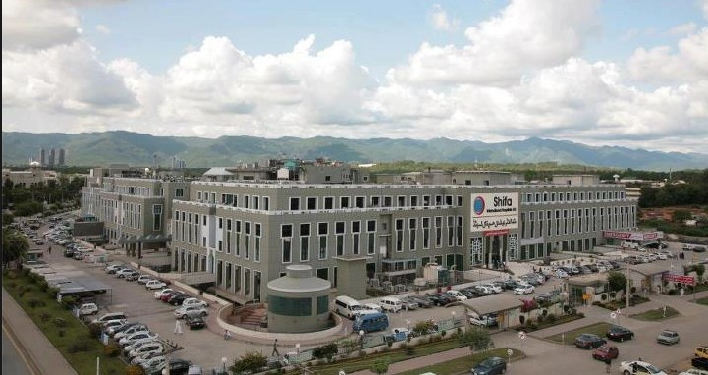
Hospital
Shifa International Hospital

Slide 28
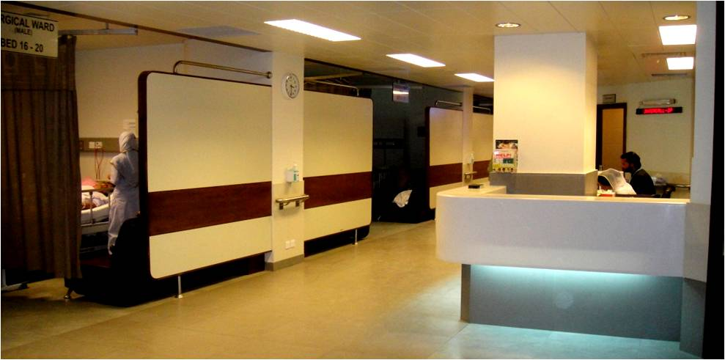
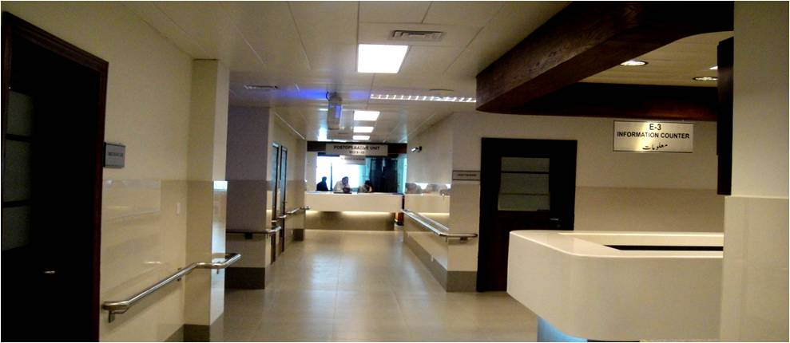
Hospital
Inside Shifa International Hospital

Slide 29
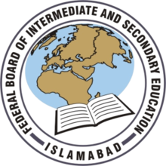
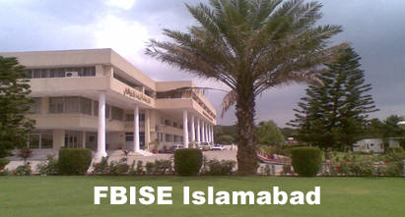
Office
Federal Board of Intermediate and Secondary Education Office
Formed | 1975
Preceding Board | Ministry of Education (Pakistan)
Jurisdiction | Federal government of the Pakistan
It is the Intermediate Education Governmental body in Pakistan and overseas Pakistani schools. It is authorized with financial and administrative authority to organize, manage, regulate, develop and control intermediate and secondary education in general and accomplish examinations in the institutions affiliated with it.

Slide 30
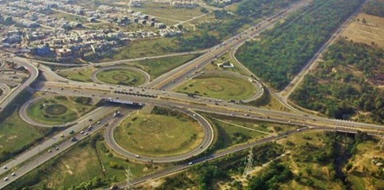
Interchange
Faizabad Interchange
Faizabad Interchange is the main gateway between the twin Pakistani cities of Rawalpindi and Islamabad, Pakistan. It was the first modern highway interchange of Pakistan made during the late 1990s to better solve the traffic problem on Murree Road and Islamabad Highway.

Slide 31
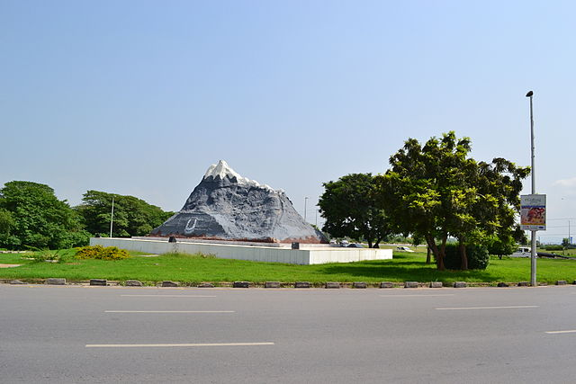
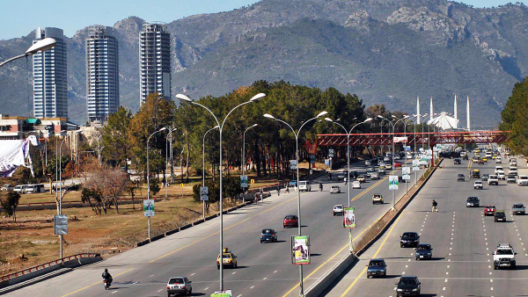
Islamabad Highway
Islamabad Highway
Islamabad Highway also known as Islamabad Expressway or Faisal Avenue (named after Saudi King Faisal) is one of the main highway of Islamabad, Pakistan that connects it to Rawalpindi. It stretches from Faisal Mosque (on Northern end) to Rawat (on Southern end) linking to GT Road with a length of about 28 kilometers. Its width varies from three lanes to five lanes. It has three interchanges, each at Jinnah Avenue crossing, Zero Point Interchange and Faizabad Interchange.

Slide 32
We Love our school but there are 2 things that we we would like to change. One is the Location and other is the size of building of our school

Slide 33
Thank You

