Slide 1
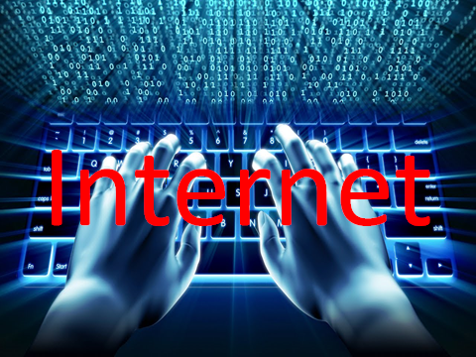

Slide 2
Internet in Education
The Internet is a source for contemporary society education and training, both for students and for parents and teachers.
Beyond this there are also undeniable role issues responsibility for the use and computer resources offered by the Internet.

Slide 4
Hierarchy advantages of using the Internet
Learn new and useful things.
It develops logical thinking and reaction speed have fun.
Meet new people.
Communicate with different people.
It does not offer any advantage.

Slide 12
Hierarchy disadvantages of Internet use
It occupies much time.
It wearies pupils.
Pupils do not meet often enough friends.
Do not do enough sports.
It makes the pupils more nervous than usual.

Slide 18
Safer Internet Day 2009
This film produced by the European Commission has been created to raise awareness of cyberbullying. It explores how young people's online information can be copied and distorted and the impact this can have on victims. The film also guides young people to report if they have any issues and reminds them that bullying is wrong - wherever it is perpetrated, whether online or offline.

