Slide 1
MONEY MATTERS
Belarus, Russia, Moldova, Pakistan
Prepared by
Students of the 8th form
Gymnasium No.1
Starye Dorogi
Belarus
Teacher
Natasha Belozorovich
2015

Slide 2
1. What money are there in your country? (make photos, describe them: coins, banknotes, what is represented on them)

Slide 3
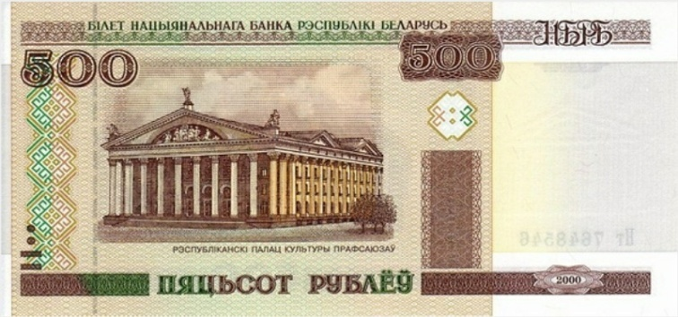
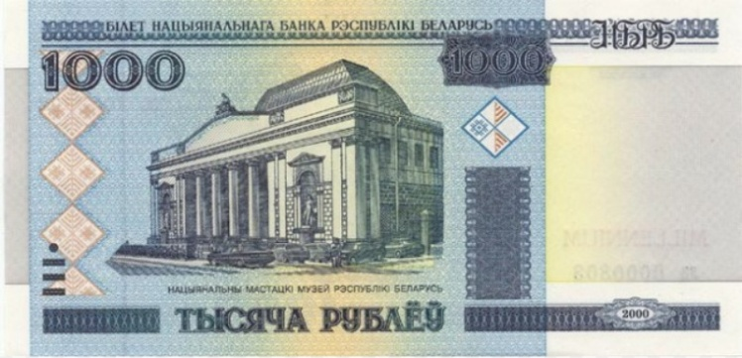
Belarus
Opera and Ballet Theatre
Republic Palace of Culture
National Art Museum

Slide 4
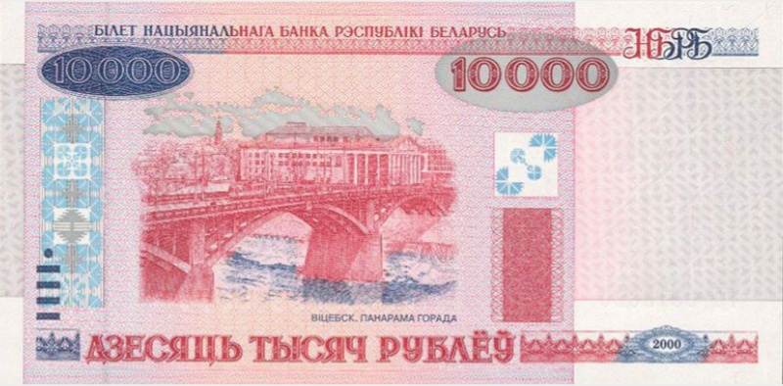
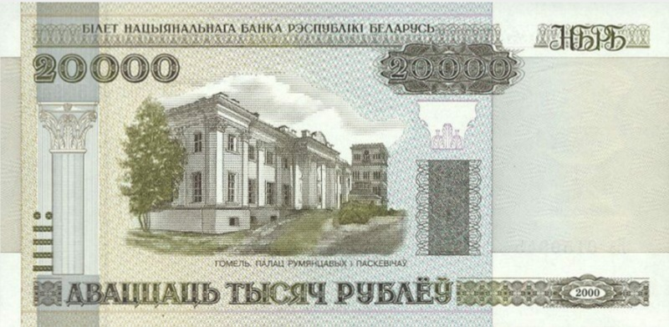
Palace of Rumyanzhevi Pashkevichi (Homel)
Palace of sport (Minsk)
Vitebsk

Slide 5
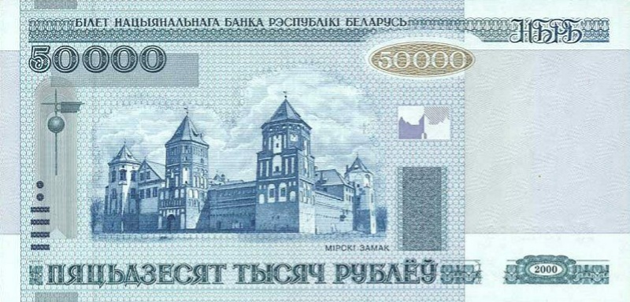
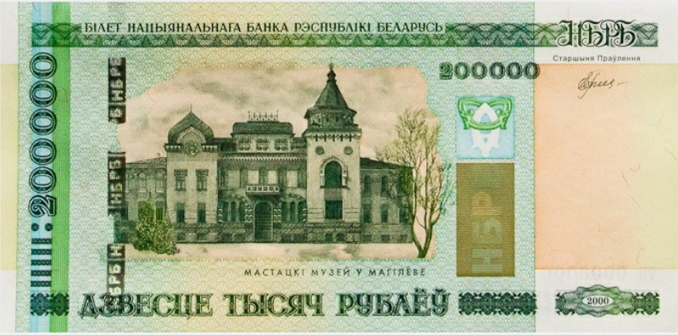
Mir Castle
Radziwill Palace Fortress in Nesvizh
Art museum in Mogilev

Slide 6
The national currency of the Russian Federation is the ruble. There are banknotes of 1, 2, 5, 10, 50, 100, 500, 1000, 5000 rubles In monetary circulation of the country. beautiful and important places of our country are Depicted On Russian banknotes.
Russia
The front side of a 10 ruble-banknote depicts the bridge over the Yenisei river and the Krasnoyarsk chapel. And the reverse side depicts a view of the dam of Krasnoyarsk hydroelectric power station.
The front side of a 50 ruble-banknote depicts the sculpture in the background of the Peter and Paul fortress in the city of St. Petersburg.
On the other side of money there is a General view of the Rostral columns and the Stock Exchange in St. Petersburg.

Slide 7
the front side of a 100 rouble-banknote depicts the Quadriga of Apollo, which is located on the portico of the Bolshoi theatre. And the reverse side of a 100 rouble-banknote depicts a General view of the building of the Bolshoi theatre in Moscow.
the front side of a 500 rouble-banknote depicts the monument to Peter the great, which is located in the city of Arkhangelsk. And on the other side there is a view of the Solovetsky monasterynear the city of Arkhangelsk.

Slide 8
the front side of a 1,000 ruble-banknote depicts the monument to Yaroslav the Wise and at the background there is the Yaroslavl Kremlin. On the reverse side of the banknote there is the Church of St. John the Baptist in Yaroslavl and the bell tower in the city of Yaroslavl.
the front side of a 5,000 ruble-banknote depicts the monument to the Governor-General of Eastern Siberia N. M.Muraviev-Amursky. And the other side of the banknote depicts the bridge across the Amur river in the city of Khabarovsk.

Slide 9
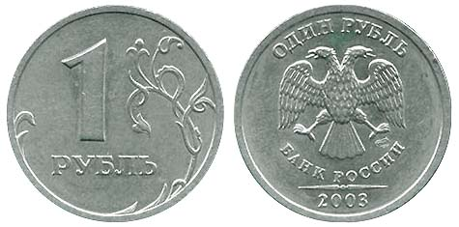
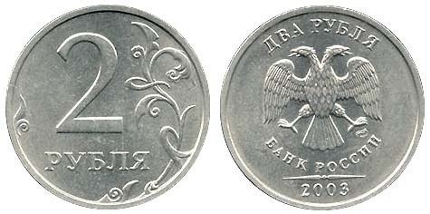
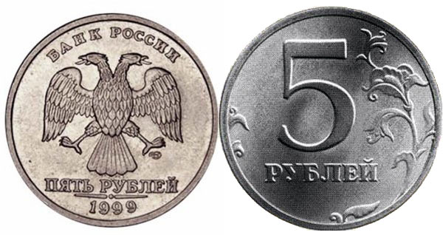
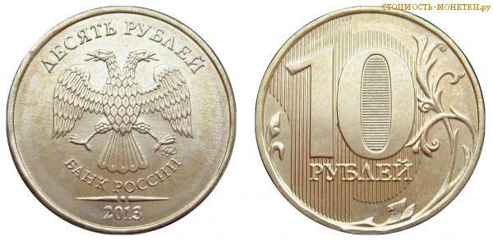
COINS

Slide 10
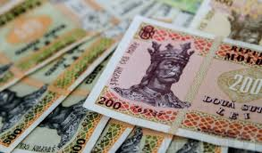
Moldova
Monetary unit of Moldova is Moldovan leu
(plural - lei). 1 leu equals to 100 bans. There
are banknotes of 1000, 500, 200, 100, 50, 20,
10, 5 and 1 leu.
A distinctive feature
of all Moldovan banknotes
is that their fronts depict
the same images.
They are a portrait of the
most famous ruler of Moldova Stephen III the Great,
and a white circle within which the first line of the
famous ballad “Miorita” is printed .

Slide 11
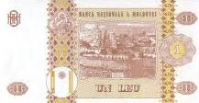
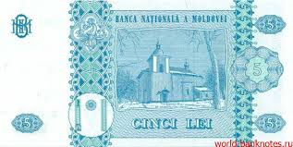
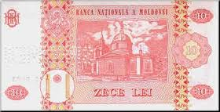
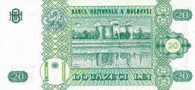
The backs are different. You can see the most famous sights on the banknotes backs.
Capriana Monastery Church in the town of Orhei
Hirjauca monastery Soroca Fortress

Slide 12
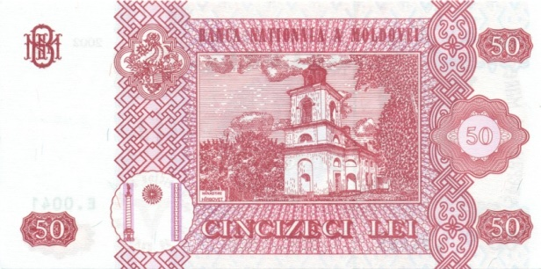
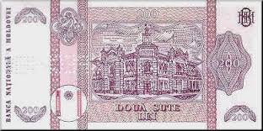
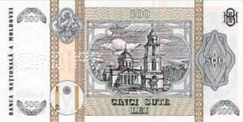
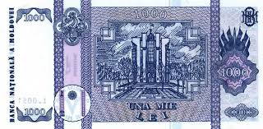
Hirbovati Monastery Bender Fortress
Chisinau City Hall Chisinau Cathedral of Christ’s nativity
President Administration Building

Slide 13
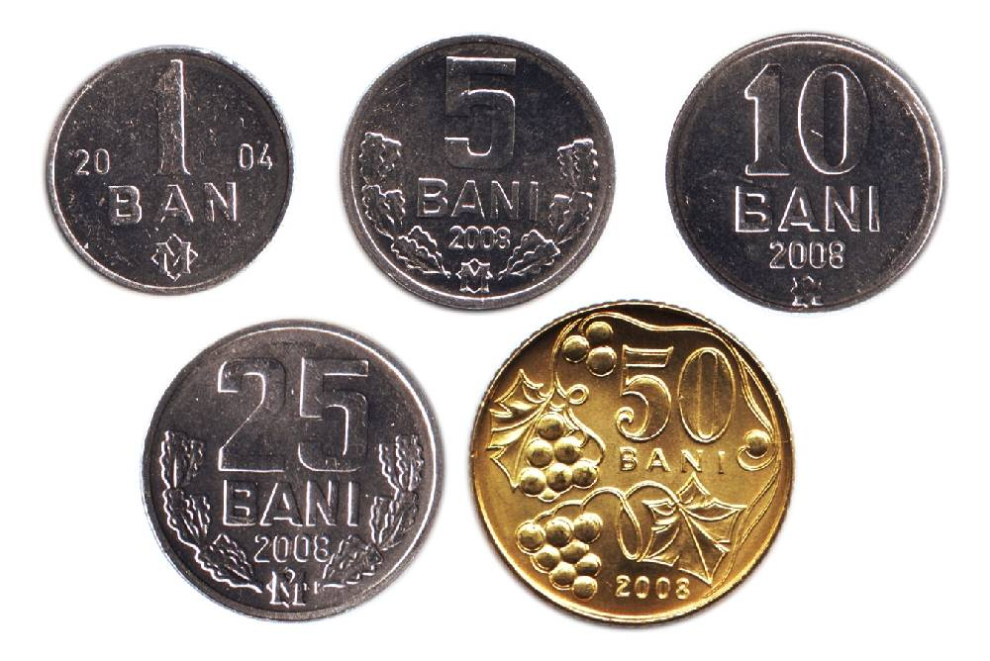
Coins
Coins in circulation are 50, 25, 10, 5 and 1 ban.

Slide 14
Pakistan
The name of Pakistani currency is RUPEES
(sign:Rs;Code:PKR)
The issuance of the currency is controlled by the state bank of pakistan,the central bank of the country.
The most commonly used symbol for the ruppees is”Rs”.

Slide 15
10 Rupees
There is khyber pass photo printed on the back side of 10 rupee’s note. Khyber pass is a mountain pass connecting Afghanistan and Pakistan.

Slide 16
20 Rupee
On the back side of 20 rupee’s note there is a photo of ruins of mohen-jo-daro in sindh.
Mohen-jo-daro is one of the largest settlement of the ancient Indus valley civilization and one of the world’s earliest major urban sattlement.

Slide 17
50 Rupees
On the back side of 50 rupees there is a picture of karakorme mountains. Karakorme is a large mountain range spaning the borders between Pakistan, India and China, located in the region of gilgit baltistan (Pakistan), ladakh (India) and sardan zinjing (China).
It is one of the greater range of asia . It include K2 that is the second highest peak in the world 8611m.

Slide 18
100 Rupees
On the back side of 100 rupee’s note there is a picture of “Ziarat” (Quaid-e-Azam residency) located in blochistan Pakistan.
It is where Quaid-e-Azam Muhammad Ali Jinnah spent the last two months of his life. It is most famous landmarkof the city.

Slide 19
500 Rupees
On the back side of 500 rupee’s note there is a picture of badshahi mosque located in Lahore which was commissioned by the sixth Mughal Emperor Aurangzab.
The real name of mosque as written in calligraphy on marble above the entrance gate is read as “Masjid Abdul Zafar Muhy-ud-din Muhammad Alamgir Badshah.

Slide 20
1000 Rupees
On the back side of 1000 rupee’s note there is a picture of Islamia Collage University located midst of Pishawar, Khyber-Pakhtunkhwa.
Islamia Collage University is a public research university.
It was founded by the personal initiatives led by Sir S.A. Qayyum and Sir George Roos-Keppel in 1913.
It is one of the oldest institute of higher education in Pakistan.

Slide 21
5000 Rupees
On the back side of 5000 rupee’s note there is a picture of Faisal Mosque located in national capital city of Islamabad.
The Faisal Mosque is the largest mosque in Pakistan.
It was completed in 1986.
It was design by a Turkish architect “Vedat Dalokay”.

Slide 22
2. Make a survey in your class: Do you have pocket money? How much pocket money a week do you have? How do you spend them?

Slide 24
How much pocket money a week do you have?
Belarus
Moldova
Russia (Korolev)
Russia (Tombov)

Slide 25
How do you spend it?
Belarus
Moldova

Slide 26
3. What proverbs about money do you know? Draw one proverb and explain it.

Slide 27
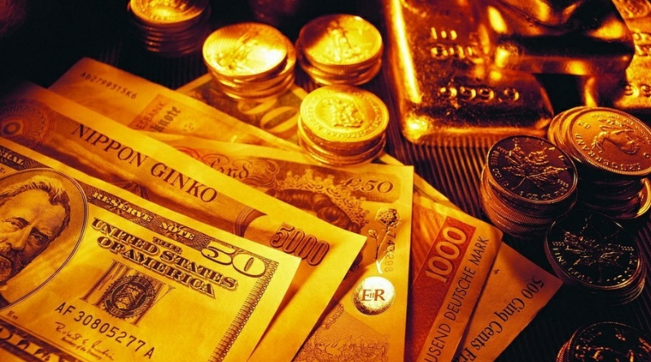
Proverbs about money
-Money begets money.
-Money is a good servant but a bad master.
-Money often unmakes the men who make it.
-Money spent on the brain is never spent in vain.
-Muck and money
go together.
-Time is money.

Slide 28
Money can't buy happiness.
Money can’t buy manners.
Money can buy a lot of false friends.
Money talks, but all it ever says, is “goodbye.
The best things in life are free.
With money you can buy a clock but not time.
Money does not grow on trees.

Slide 29
Копейка рубль бережет — Take care of the pence and the pounds will take care of themselves.
Береги хлеб для еды, а деньги для беды.- Save bread for food and money for trouble.
Больше денег – больше хлопот.- More money – more trouble.
Денег палата, да ума-то маловато. – There’s a lot of money but there’s little mind.
Дружба дружбой, а денежки врозь. – Friendship is important but money must be separated.
Почет дороже денег. – Honour is more important than money.
Хлебу – мера, деньгам – счет. A measure is for bread, counting is for money.

Slide 30
Money begets money
I think, if you put up money in some profitable production, then the money will come back to you with subsidiary money.

Slide 31
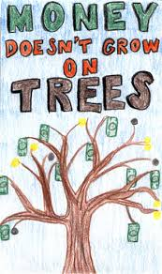
Money does not grow on trees.
It's not easy to get money. We have to
work hard to make money. We can't
just walk around and pick it like
fruit from the trees.

Slide 32
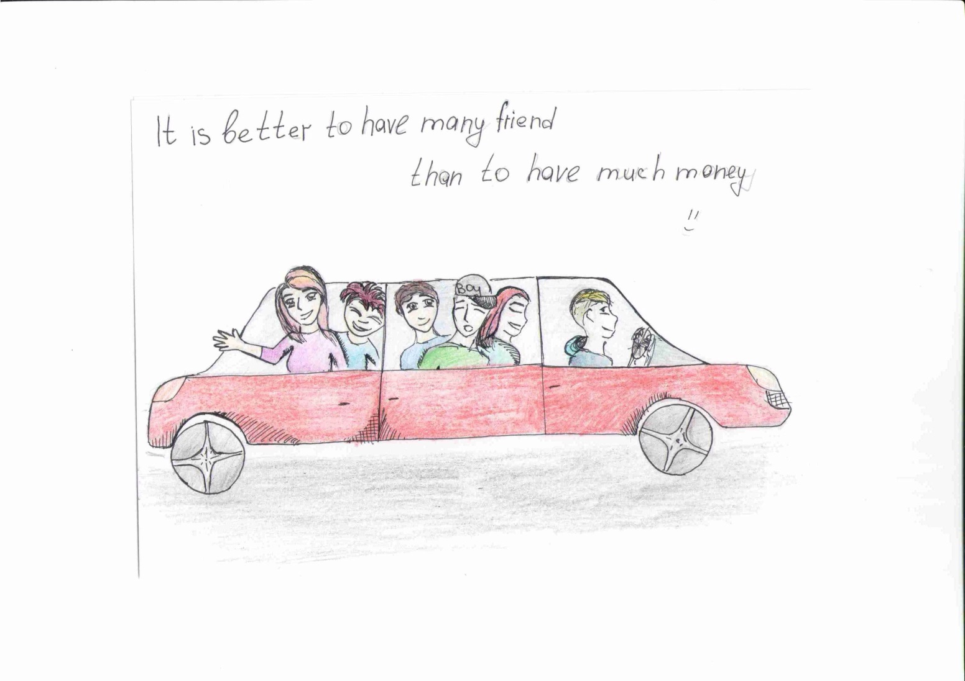
One hundred friends can provide much more help than a hundred rubles. Real friendship is endless and of course invaluable.

Slide 33
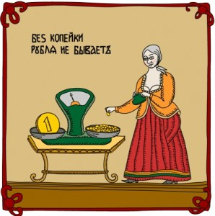
Without a coin, there is no rouble

Slide 34
4. Write some interesting facts about your country money.

Slide 35
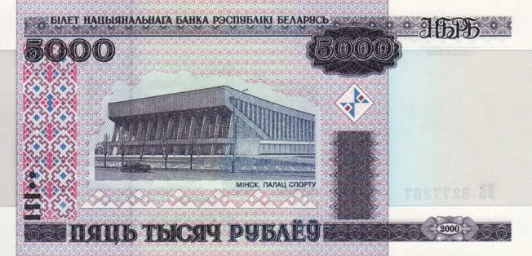
Belarus
In Belarus we don’t have coins.
The most expensive
Belarusian ruble was sold
for 2000$.
Before 1992 we had
banknotes which were
called «hares».There
were images of animals,
which live in Belarus.
Since the 1st of June in 2016 we will have new banknotes and coins due to denomination in 10000 times.

Slide 36
Moldova
The first coins appeared in the region of Moldova in the IV-th century, B.C.
By the end of the XlV-th century there were many foreign currencies in circulation on the territory of Moldova, as it's mentioned in historical documents: silver rubles, silver hrivnas, marks, Venetian ducats, Hungarian zloty, Tatar zloty, Turkish zloty, asprias, Genoese sommes, grosi.
The first Moldavian currency was the grosi introduced by Petru Musatin in 1377-1378.
The Moldovan leu was introduced on the 29-th of November, 1993. So on the 29th of November, 2015, it celebrated its 22-nd birthday.

Slide 37
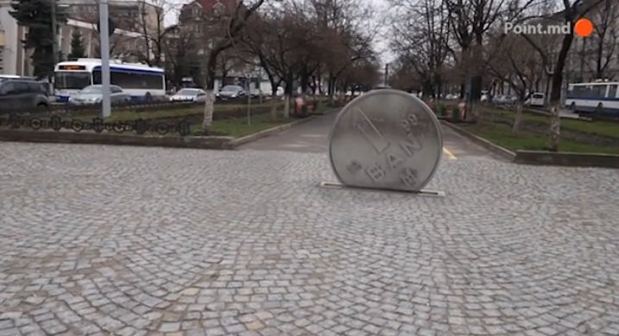
A very unusual monument to the smallest coin of “1 Ban” is installed in Grigorii Vieru Avenue.
The coin is “irregular” as the
coat-of-arms in the reverse is
placed upside down. It is a very
valuable find for numismatists.
Such coins are said to bring the
owner good luck.
The installation is believed to
become not only an art object
but a money mascot of the city.

Slide 38
Russia
The name "copeck" comes to us from the reign of Ivan the terrible, when they made coins with his portrait and with a spear, which he ordered to call "spear-armed money."
Before there was paper currency, there was only metallic money. In the times of Lomonosov there was an interesting fact: when he was given the awardof 2000 rubles, the total weight of this award amounted to nearly a ton, so he had to hire a cart to take his money home.

Slide 39
The Russian coin – semi-Denga (mite) is recognized as the smallest by weight and the most value in the world. She was equal to a penny, and weighed 0.17 g.
The biggest in size the silver coin was minted during the reign of Catherine I in 1725. Its size was 18 by 18 cm, thickness 5 mm. The weight was serious: 1 kilo 636 grams.In the history of modern Russia the largest silver coin weighing 3 kilograms was released in 1999.

Slide 40
5. What is charity? Is it important to make an act of charity? Why do people do it? How do you understand the saying "charity begins at home"? Have you ever worked as a volunteer for a charity or made a donation? What did you feel?

Slide 41
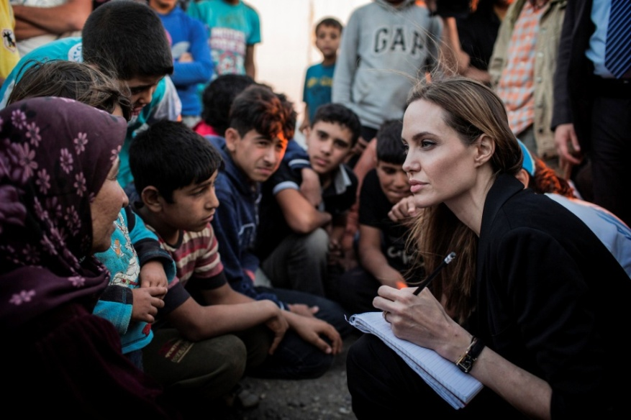
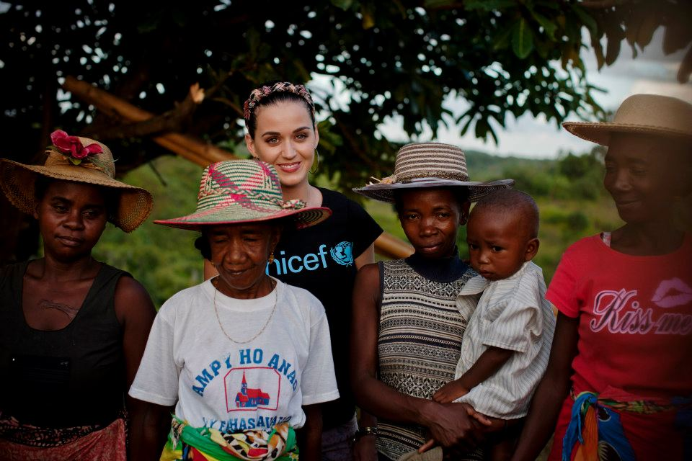
Belarus
CHARITY – unselfish help for people, who need help.
Make an act of charity is very important because if you help people they
don’t feel lonely. After all there is no little succor.

Slide 42
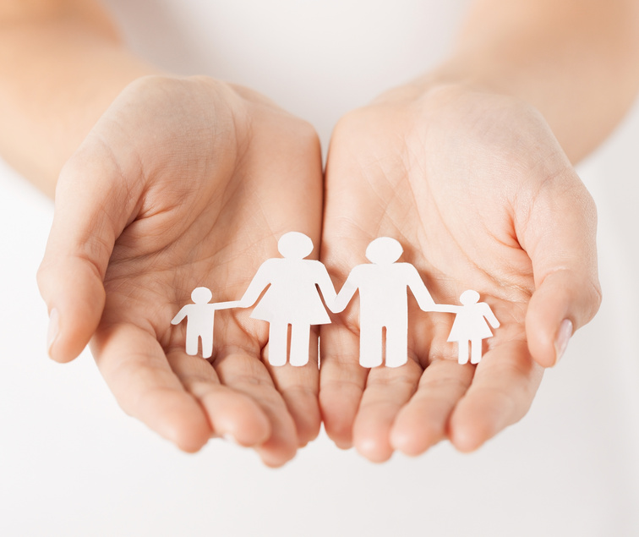
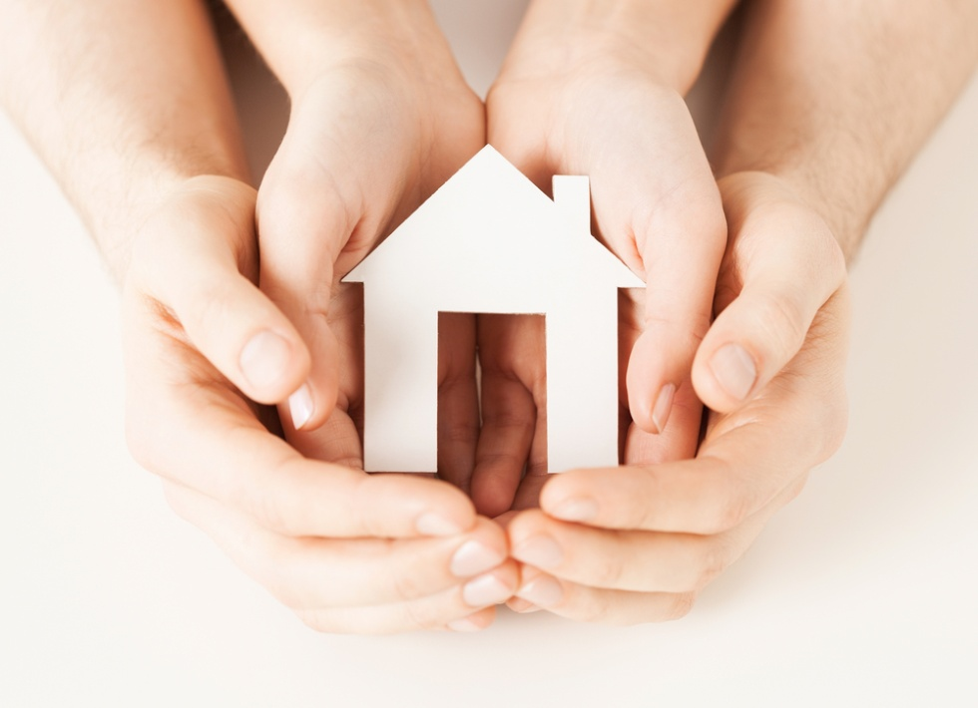
“Charity begins at home”
Since childhood we help our relatives and get “Thank You!” and smile and we feel happiness. Firstly a person should be responsible for the needs of his own family and friends.

Slide 43
Russia (Korolev)
Holding an act of charity it is a very important thing because in our country there are many children with deadly diseases, poor people and also many destroyed buildings. We think saying "Charity begins at home" means that at first you need to help your parents and relatives and then you need to help other people.
We participate in charity events such as sending Christmas gifts for children in the cities destroyed by war, gifts for elderly people, children in orphanages.

Slide 44
Russia (Tombov)
Charity is a way to distribute money to poor people. I think it is important to do acts of charity because it brings people closer together. We help the sick, the homeless, poor people.
I understand it is so that people who are volunteers go from house to house and collect money. I have never worked as a volunteer, but I gave the money to charity.I felt that I gave the money into the right thing. "The rich is not the one who has a lot of money, but the one who can give it to the poor".

Slide 45
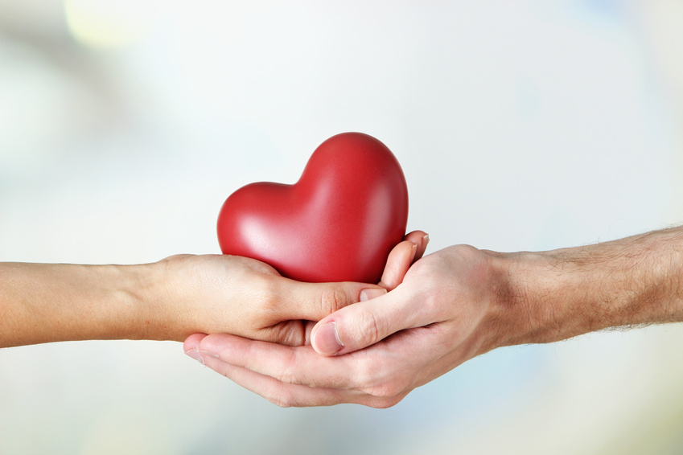
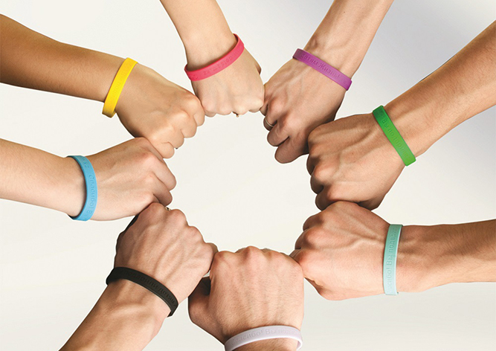
Moldova
Charity is an act of
donating things (like money,
food, furniture, clothes, toys, etc.)
to people in need, groups of
people, institutions.
Alexandra Adahovskaya says:
“I think it is very important to make
an act of charity in our modern
world as there are a lot of
people, both grown-ups and
children, who are in need of
help and support.

Slide 46
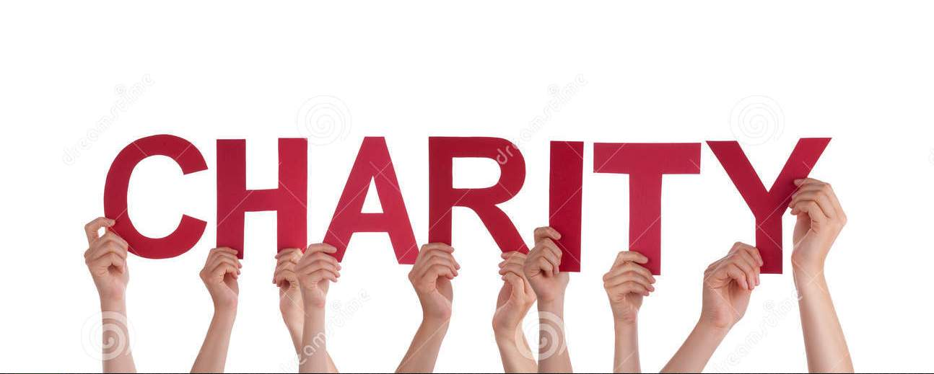
Charity Begins At Home
Any “charity begins at home”, an English proverb
says. I agree with it because all the members
of the family can teach each other the acts of
charity by sharing everything. They should help
each other as well as try to help people who need
their assistance.

Slide 47
Charity Begins At Home
Like all my classmates I have participated as a
volunteer in a charity campaign called “The
Heart on the Palm”. We brought toys and
clothes for orphanage houses in Moldova.
We also collected sweets and cakes for the
children so they could enjoy Christmas. I was
proud of my lyceum and
my friends who were
able to help a little
in that charity act.”

Slide 48
