Slide 1
Perfect Picnic Spots in Your Hometown

Slide 2
This project was accomplished due to the teachers collaboration:
1. Victoria Craciun, Gymnasium no.99 village Truseni, Moldova
2. Margarita Astakhova, Secondary School 8a-3-12, Korolyov, Russia
3. Elena Bogoeva, Petru Movila Lyceum, Chisinau, Moldova
4. Natasha Belozorovici, Gymnasium no.1, Starye Dorogi, Belarus
5. Tariq Mehmood, The Trust High School, Lahore, Pakistan

Slide 3
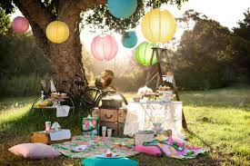
How often do you to go out for a picnic?
How many picnic spots are there in your hometown? List them., add pictures.
What is the most pleasant place you go out more frequently. Why?
Have you joined /organized any charity campaign to maintain any of them clean? What were your actions?
How do you raise your community awareness to maintain those spots clean?
Have you managed to increase the number of environmentally literate visitors?

Slide 4
We all love to go for picnics during our holidays. A picnic brings about excitement, exhilaration and breaks the monotony in our lives.
Planning a picnic is fun and entertaining, especially with friends and family. There are many different ways to plan a picnic.
Picnics are the best way to enjoy the simple pleasure of life and spent time with family and the best friends.

Slide 5
Usually people go out for picnics when the weather is fine , every four seasons of the year. But most of them enjoy spending time out-of doors, when it is warm and nice outside. There are o lot of places for picnics to go to in every city, town or even village. People might enjoy their picnics in a park, on the bank of a river, near a lake, in a glade in the nearby forest…

Slide 6
People living in Kishinau, Moldova, spend their picnics in parks. The most famous ones are the Dendrarium and the Botanical Gardens, both full of greenery being perfect places for volleyball and badminton.

Slide 7
People living in Korolyov, Russia, spend their picnics in the “Elk’s Island”Park area, where there is a lake, and they can swim in it.

Slide 8
Starye Dorogi inhabitants, Belarus, like to spend their picnics in parks too.

Slide 9
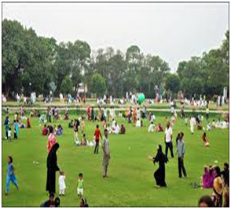
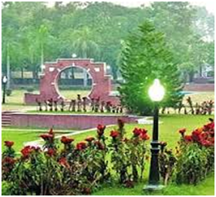
Lahore, Punjab inhabitants (Pakistan) enjoy their picnics in
Bagh e Jinnah and Joyland park.

Slide 10
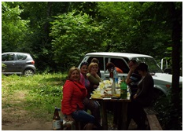
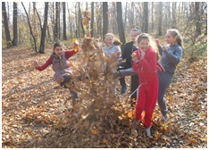
People from village Truseni prefer to spend their holidays outside the village in the nearby forest files. There are plenty of glades full of colorful flowers, blooming from early spring to early autumn.

Slide 11
The most popular picnic area in Korolyov, Russia,is their river Klyazma.
In Starye Dorogi, people also like to have picnics and walk along the river, Solianca .

Slide 12
The “Elk’s Island” Park in Korolyov , Russia.
Budenichi is the most popular lake in Starye Dorogi, Belarus
The lake in Valea Morilor area, Chisinau, Moldova.

Slide 13
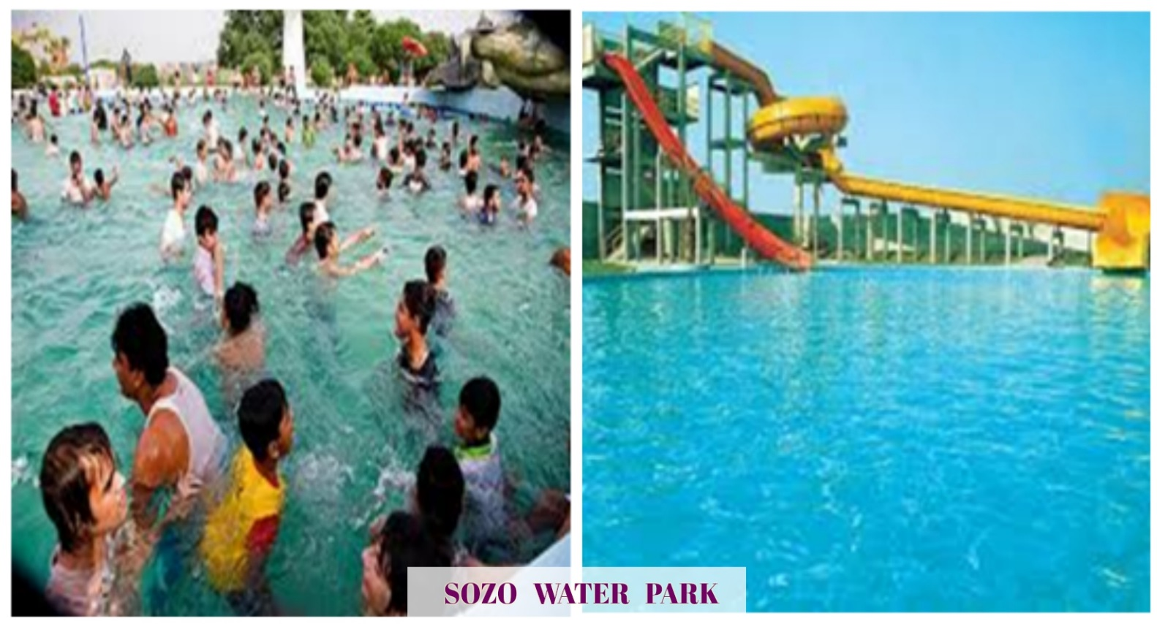
2Famous Picnic Spots in Lahore, Pakistan
SOZO WATER PARK is one of the few water-themed amusement parks in the city. It is a point of interest. There are three pools in this park.
SHALIMAR GARDEN a perfect place to spend a picnic surrounded by hundreds of fountains throwing up water and a plenty of fruit trees in it.

Slide 14
There are a lot of events organized in Starye Dorigi (Belarus) parks : competitions, karaoke, concerts, exhibitions and many others during public holidays. They have fun, eat ice-cream, play with friends, participate in different games.

Slide 15
During the winter time picnic spots look like this.

Slide 16
Every living thing has an impact on its environment. Therefore a human impact on the environment is inevitable. By simply existing, all species - including ourselves - will imprint their mark on the world around them. We all try and do our best to become go-green persons. It is known, environmental education starts at home, continue at school and lasts throughout entire life.

Slide 17
To raise pupils’ awarness for maintaing the picnic sports clean, they participate in or organize different eco- activities : create posters on environmental problems, write essays trying to persuade classmates to keep green areas clean.

Slide 18
Teachers, students, school pupils and many adults come to take part in cleaning. They get special equipment: gloves and rubbish bags.
April cleaning up day in Korolyov, Russia.
Subotnik in Starye Dorogi, Belarus

Slide 19
Despite the measures taken to protect our picnic spots, there are still persons who do dot care about their native places. They don’t clean up and leave rubbish after them. Therefore, pupils together with their teachers and different NGO organize charity campaign for cleaning the woods and other places from rubbish
Truseni, cleaning charity compaign ”Eco Mania” (Moldova)
Kishinau (Moldova), cleaning up the Central Park.

Slide 20
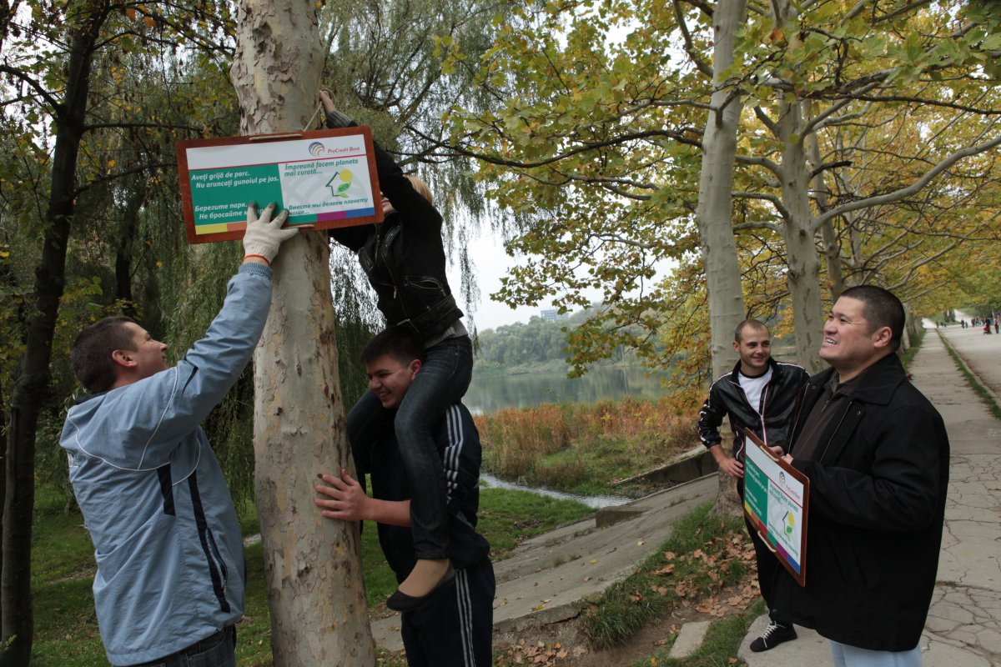
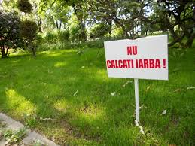
To increase the number of literate visitors, environmental warning signs are spread in the areas.

