Slide 1
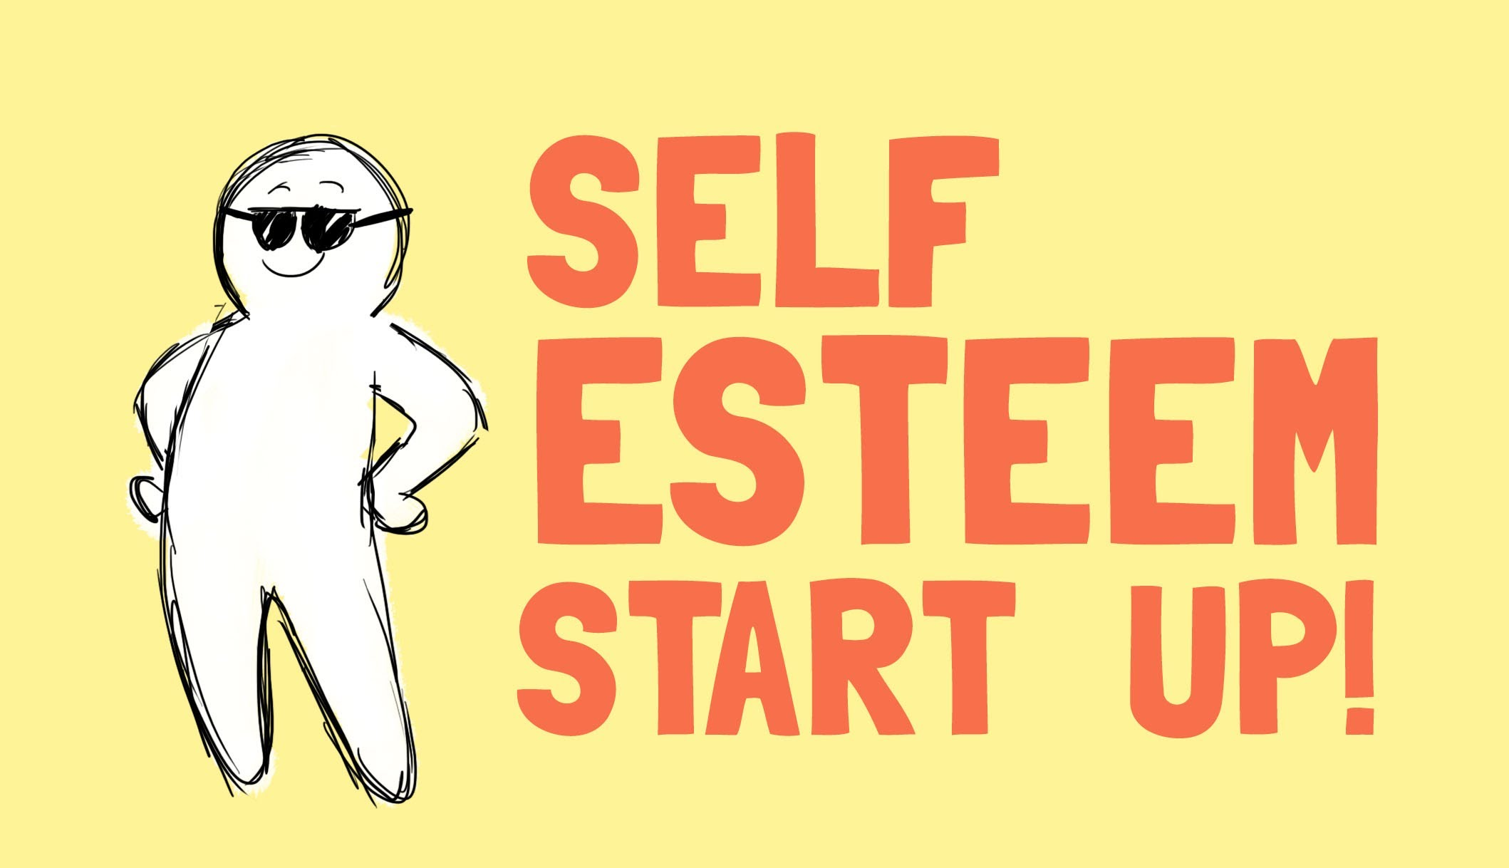
Self-improvement Self-esteem
Balatina theoretical Lyceem

Slide 2
What is Self-Esteem?
Most people's thoughts and feelings about themselves fluctuate somewhat based on their daily experiences. The grade you get on an exam, how your friends treat you, ups and downs in a romantic relationship can all have a temporary impact on how you feel about yourself. Your self-esteem, however, is something more fundamental than the normal ups and downs associated with situational changes. For people with good self-esteem, normal ups and downs may lead to temporary fluctuations in how they feel about themselves, but only to a limited extent. In contrast, for people with poor self-esteem, these ups and downs drastically impact the way they see themselves.

Slide 3
Our work
In order to motivate the students we created a facebook page where our students posted their attitudes and thought about self-esteem :
https://www.facebook.com/iearnbalatina1/?ref=aymt_homepage_panel
they also posted their ideeas on youtube:
https://www.youtube.com/watch?v=ORXhA89MopQ&feature=youtu.be

Slide 4
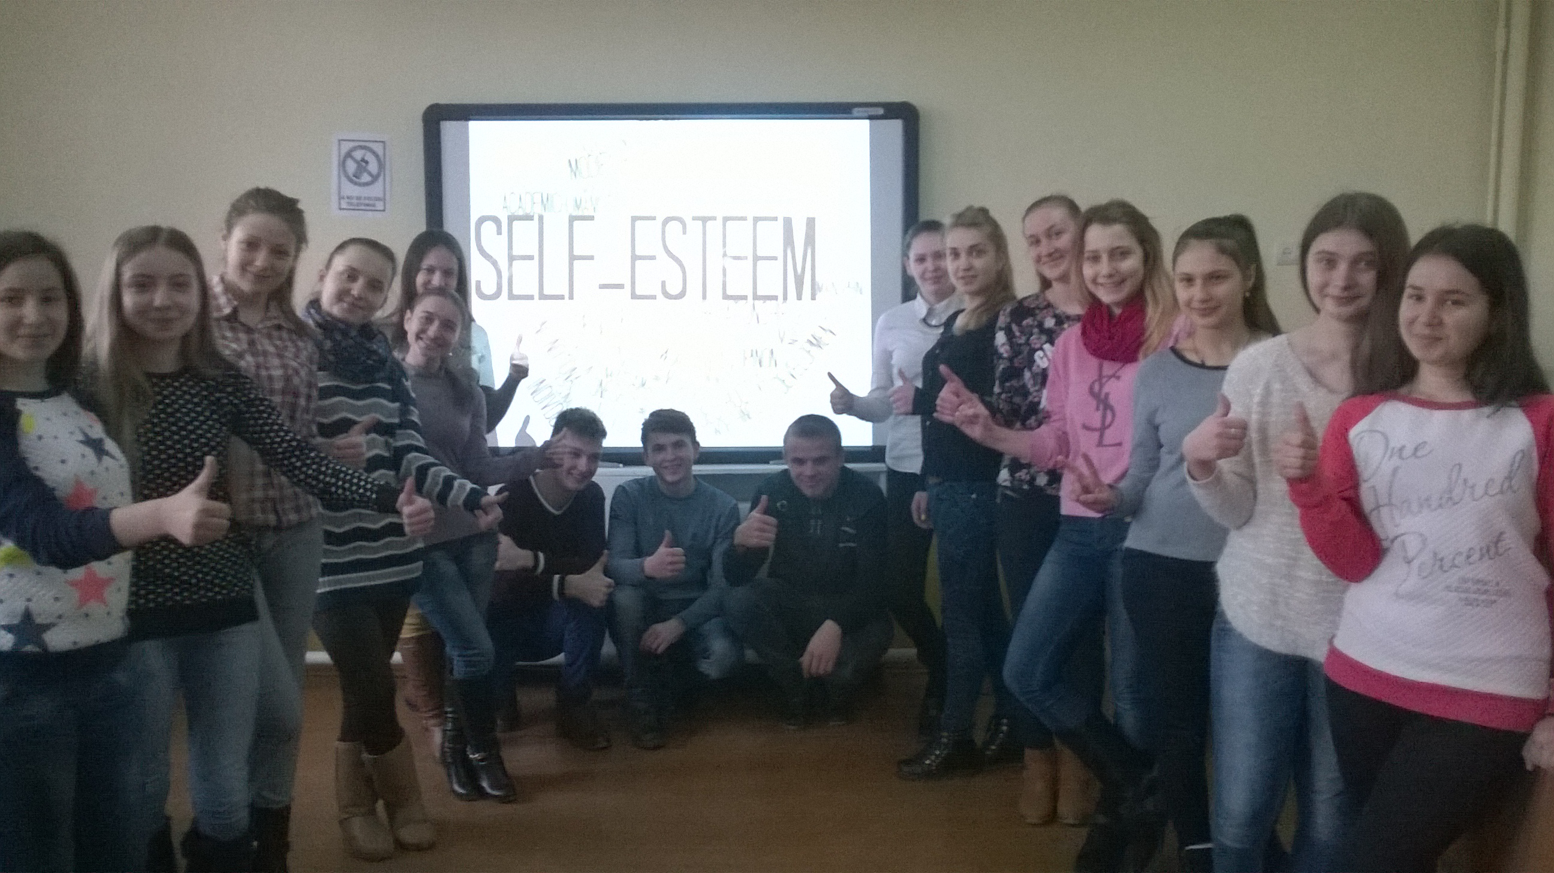

Slide 6
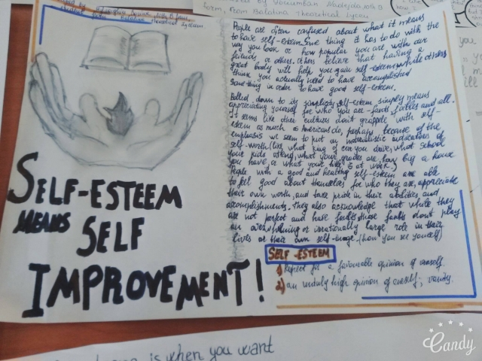

Slide 7
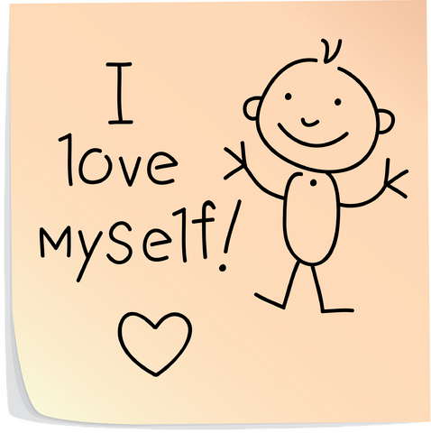
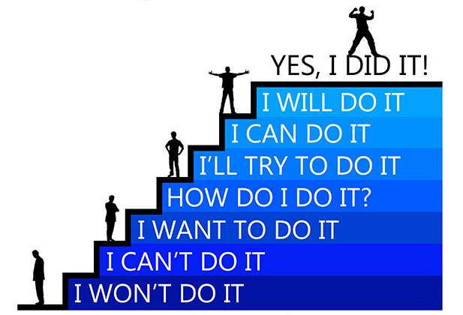
love yourself
Take care of youself
Like your sense of humour
Like your bady
Think that you are the best
Sleep
Self esteem

Slide 8
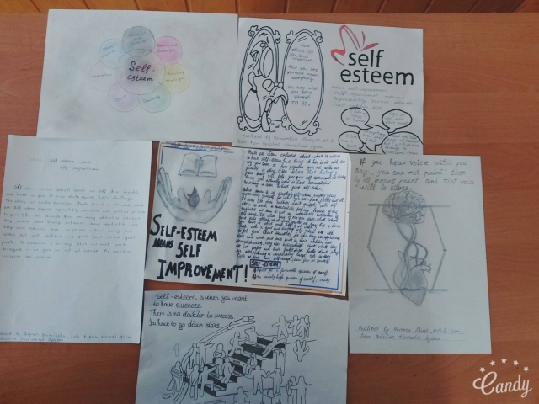

Slide 9
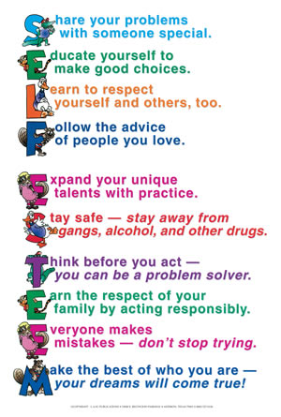

Slide 10
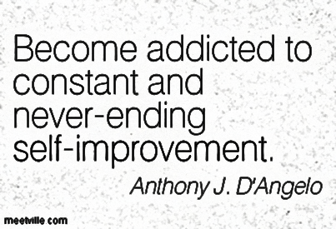
Self
improvement
Work hard in what you like
Fight with hardships
Change your style
Read books
Try new things
get more organized
relax more

Slide 13
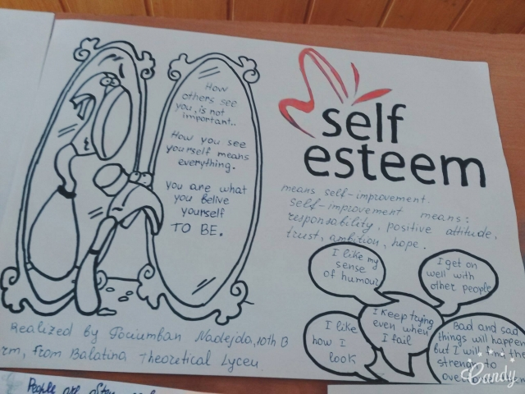
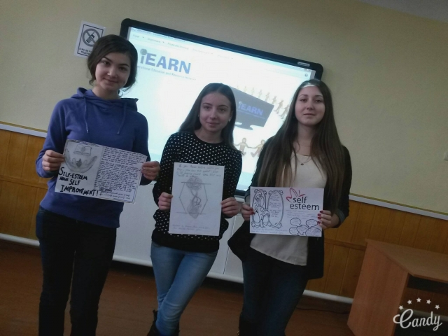

Slide 15
It doesn’t matter who you are, or where you come from. The ability to triumth begins with you!!! Always!!!

Slide 19
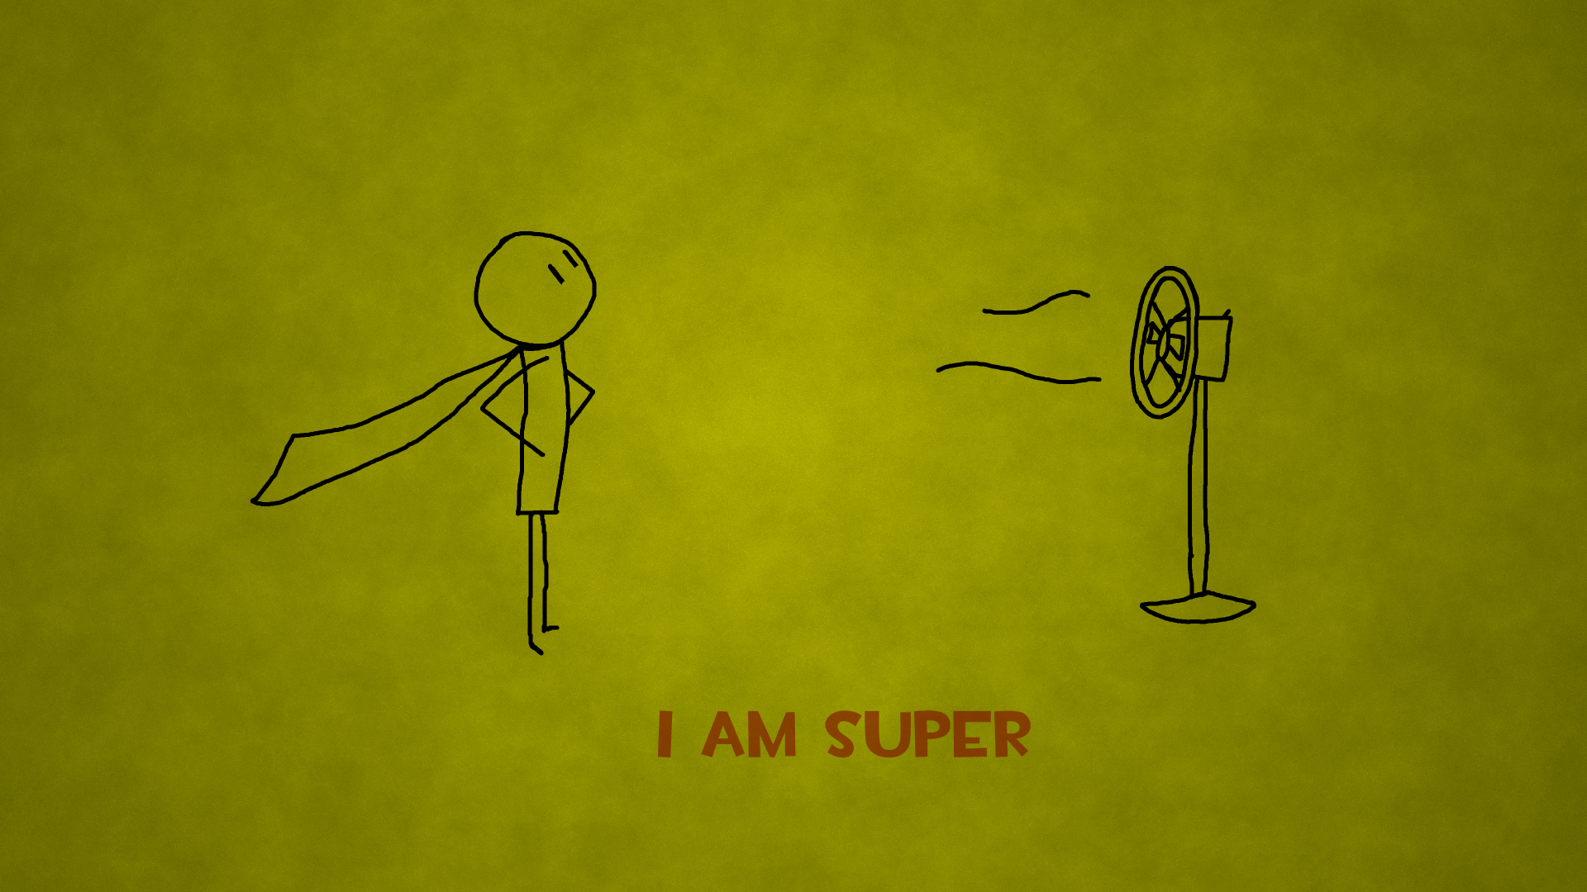
The minute I stopped caring about what other people thought of me and started doing what I wanted to do is the minute I finally felt FREE!!!

Slide 20
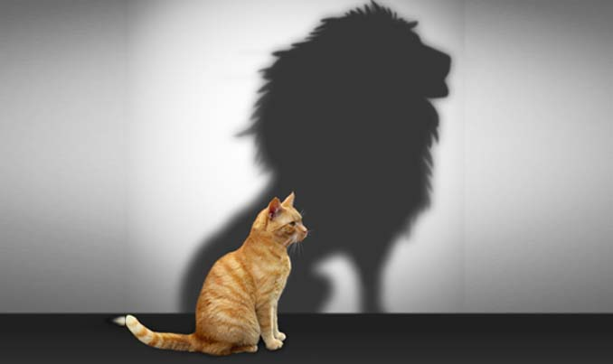
Self-confidence means self-esteem!!!

Slide 21
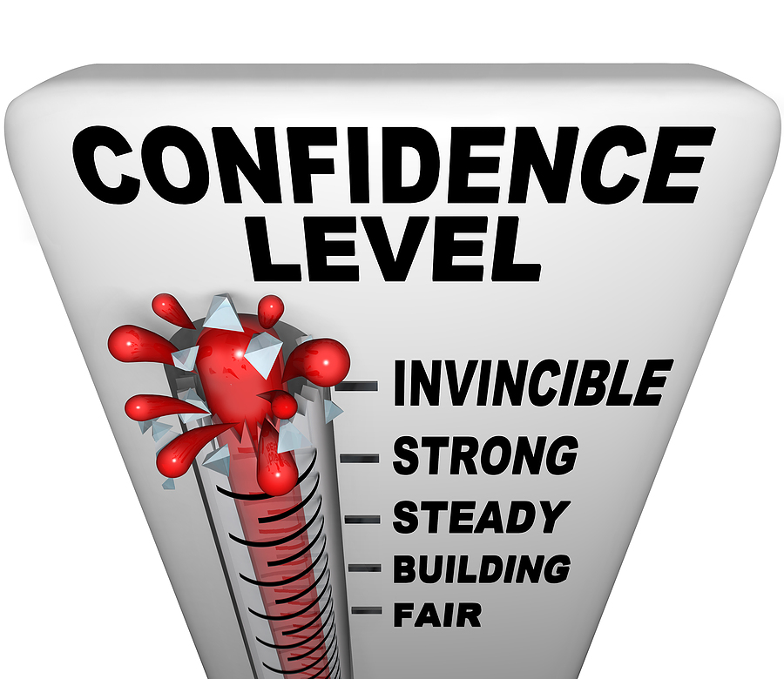

Slide 22
