Slide 1
SONGS IN OUR LIFE
COMPUTER CHRONICLES
MIDDLE SCHOOL
2015-2016
BARANOVICHI GYMNASIA №1
Form 6 «G»

Slide 2
What kind of music do you like?
POP AND
POP-ROCK MUSIC

Slide 3
When do you listen to it?
…..after school and when I am going home
……every day
in the evening
at the weekend

Slide 4
What do you think is the purpose of music?
To express emotions
Entertainment
To cure our souls
To have fun

Slide 5
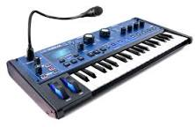
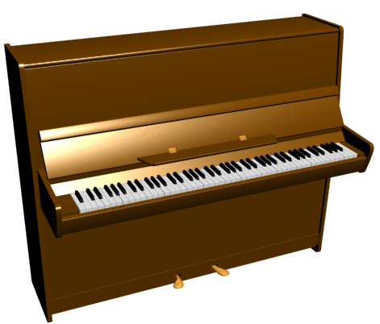
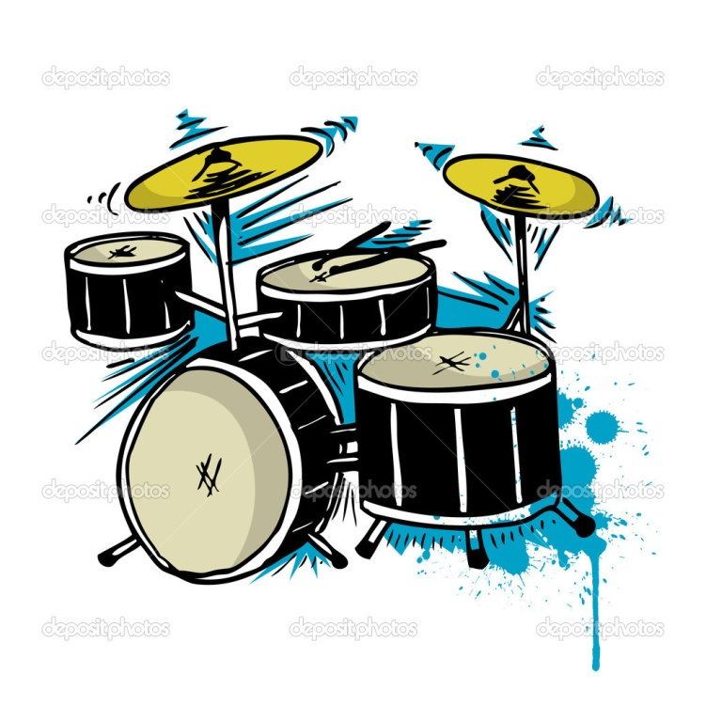
Do you play any musical instrument?

Slide 6
Where are your favorite bands or musicians from?
RUSSIA BELARUS THE USA BRITAIN SPAIN GERMANY

Slide 7
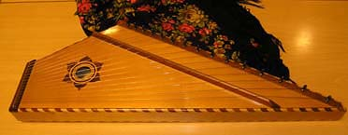
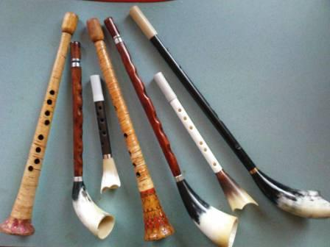
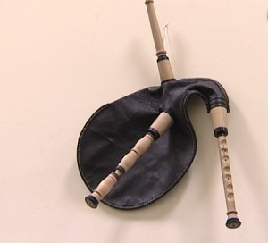
Name a national instrument of your country
Uniqueness of musical culture of Belarus is concluded in national instruments such as a zhaleyka, a duda, gusli, cymbals and many others.

Slide 8
What should be the songs in the modern society about?
FRIENDSHIP FAITH
TOLERANCE LOVE TRUST FATE

Slide 9
What songs do you sing on different occasions in your country?
We sing different songs on different occasions. On birthdays we sing International HAPPY BIRTHDAY SONG or «I play the accordion..» Пусть бегут неуклюже…»

Slide 10
«I play the accordion..» Пусть бегут неуклюже…»
May people run clumsily through puddles May the water flow like a river down the street, And may people passing by not understand why I am so happy on this sad day.
And I play the accordion for all to see Sadly (my) birthday Is only once a year
Suddenly a magician arrives in a blue helicopter A shows (us) movies for free. He wishes a happy birthday And he's likely to give me 500 ice-creams (as a present)
And I play the accordion for all to see Sadly (my) birthday Is only once a year Sadly (my) birthday Is only once a year

Slide 11
What songs do you sing on different occasions in your country?
For Christmas we sing Christian songs.
During «Kalyady» (Orthodox Christians celebrate it from January, 7 to January,19) or «Svyatki» groups of merry young boys and girls in smart clothes go from house to house in Belarusian villages and towns and sing «Kalyadnye songs». Each person in the processions of «Kalyadovschyki» (carol singers) has a role according to his character and temperament: one of them bears the star, others sing carols, amateur musicians play the accordion or beat the tambourine, amateur actors are disguised as Goats,Bears, Storks, Horses, Gypsies and Old Men. Hosts and hostesses usually treat them to delicious things and thank to them for well-wishing and carol-singing.

Slide 12
КАЛЯДА
Ой, калядачкі, бліны-ладачкі, Ой, люлі-люлі, бліны-ладачкі. (2 р.) Ой, калядачкі, вы хутчэй-хутчэй! Ой, люлі-люлі, вы хутчэй-хутчэй! (2 р.) Каляда, каляда, каляда, каляда! Напячэм бліноў мы з дражжэй-дражжэй, Ой, люлі-люлі, мы з дражжэй-дражжэй! (2 р.) А калядныя бліны - ладныя, Ой, люлі-люлі, бліны ладныя! (2 р.) Мы калядачкам нарады будзем Ой, на ігрычшы ды хадзіць будзем, Ой, люлі-люлі, ды хадзіць будзем (2 р.) Каляда, каляда, каляда, каляда!

Slide 13
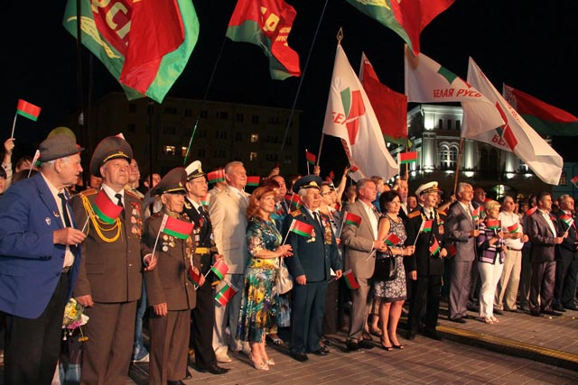
What songs do you sing on different occasions in your country?
On Independence Day we sing National Anthem. This tradition is called «Let`s sing the anthem together» – all people who want to sing the anthem come to the central square in every Belarusian town and city at 11 p.m and sing it together. There is an online broadcasting on TV.

Slide 14
What songs do you sing on different occasions in your country?
On Victory Day –May, 9 we sing war songs. Victory Day commemorates victory in the World War 2 (known as the Great Patriotic War). During the war, 25 per cent of the population of Belarusw died. The occasion is marked with a large parade in Minsk Victory Square led by the war veterans.

Slide 15
«Katyusha»
Apple trees and pear trees were a flower,
River mist was rising all around.
Young Katusha went strolling by the hour
On the steep banks,
O'er the rocky ground.
By the river's bank she sang a love song
Of her hero in a distant land.
Of the one she'd dearly loved for so long,
Holding tight his letters in her hand.
Oh, my song, song of a maiden's true love,
To my dear one travel with the sun.
To the one with whom Katusha knew love,
Bring my greetings to him, one by one.

Slide 16
«Katyusha»
Let him know that I am true and faithful,
Let him hear the love song that I send.
Tell him as he defends our home that grateful,
True Katusha our love will defend.
Apple trees and pear trees were a flower,
River mist was rising all around.
Young Katusha went strolling by the hour
On the steep banks,
O'er the rocky ground.

Slide 17
School № 4, Soligorsk, Belarus. Karina
MUSIC IN MY LIFE
Well, I’d like to say that music has a big role in my life. On average I listen to music 6 days a week.
And now some words about music. I listen to a lot of different music, but I especially love lyrical songs of foreign performers. As I already told you I very often I listen to music, because I almost can’t live without music. Generally I listen to Russian, English and American performers. To my mind the purpose of music is the following. When you listen to music you plunge into the unusual inner world. Everyone has a special world in which you can be anyone. Music helps to have a rest, gives moral and spiritual pleasure, motivation or awakens something inside you. By the way I’m learning to play the guitar now.

Slide 18
Now some facts about the national instrument.
Uniqueness of musical culture of Belarus is concluded in national instruments such as a zhaleyka, a duda, cymbals and many others.
Each musical culture of the world possesses a unique sounding. By the sounding of certain national instruments we can distinguish these cultures.
So, I want to tell you about cymbals.

Slide 19
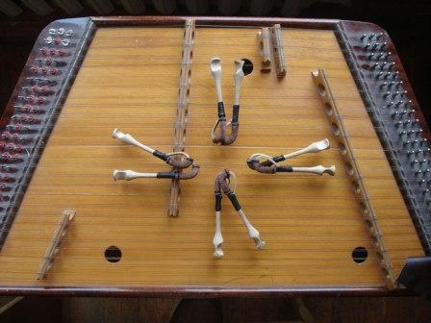
«Cymbaly»
Cymbaly are a symbol of Belarusian musical culture. There are various versions of the appearance of this instrument in Belarus. One of them says that cymbals appeared on the territory where the Balts and the Slavs lived, in the 7-8 centuries in connection with the occupation of these lands by the German feudal lords.
Cymbaly are a string percussion musical instrument which represents a trapezoid sound board with tense strings. The sound is elicited by beats of two wooden stick or beaters with the extending blades on the ends.

Slide 20
What songs do you sing on different occasions in your country?
On Birthday we sing cheerful songs about this holiday, for Christmas we sing Christian songs about Christ’s birth, for the New Year we sing songs about the New Year and many other songs, for the Independence Day we sing our national anthem and songs about our independence, on the Victory Day – the anthem of Belarus and songs about the victory in World War 2, etc.

Slide 21
Now I’d like to write the anthem of our city:
Над палескай зямлёй Беларускіх палёў Горад крылы ўзняў чысціні, I сваёю душой Шчырай і маладой Ён стварае гісторыі дні. Быццам кліча ў палёт Яркіх зор карагод, Рудніковыя свецяць агні. Шахты працай жывуць, Песню славы пяюць, Як вясновай парой жураўлі.

Slide 22
The anthem of Soligorsk
Прыпеў :
Салігорск малады, Ты квітней праз гады, Узыходзь вяснавою парой. Салігорск малады, Як жа любы нам ты, Беларусь ганарыцца табой.
Салігорскі народ Кожны дзень, кожны год Славы сцяг ганарова нясе. У кожным граме руды Рук нястомных сляды. Тут жывуць і працуюць усе. Малады, як зара, Славен ты нездарма, Заставайся навекі такім. Каб пачуць кожны змог Новых звон перамог У галасах тваіх горных машын.

Slide 23
School № 4, Soligorsk, Belarus. Karina
The anthem of our city is about the beauty of our place and our people.
And finally I wanted to express my opinion on about what it is necessary to write music in modern society.
To my mind in modern society the computer and all gadgets replaced friendship and love and therefore I think that the songs need to be written about love and about friendship.
I hope this essay is interesting for you.

Slide 24
School № 4, Soligorsk, Belarus. Angelina
To begin with, I’d like to say that listening to music is a popular pastime nowadays. Now I’d like to tell you about my favourite music. I prefer melodious and quiet music. I can’t say when I listen to music, but I try to listen to it most of my free time. My favourite group is Band ‘Eros there from Russia. I think the purpose of music is to convey to the listener the whole meaning of the song and ideas to arouse in him feelings of songs displayed. I know how to play on a piano and a little know how to play the accordion. I know some national instruments of Belarus such as “duda”, “zhaleyka”, horn, lyre, violin and dulcimer. To my mind the songs in the modern society about tolerance. We sing the hymn of Belarus on many holidays because it always will be reminded of our nation and the ancestors of what a beautiful country we live.

Slide 25
Now I like to show you lyrics of Belarus anthem:
Мы, беларусы — мірныя людзі,
Сэрцам адданыя роднай зямлі,
Шчыра сябруем, сілы гартуем
Мы ў працавітай, вольнай сям’і.
Слаўся, зямлі нашай светлае імя,
Слаўся, народаў братэрскі саюз!
Наша любімая маці-Радзіма,
Вечна жыві і квітней, Беларусь!

Slide 26
Belarus anthem
Разам з братамі мужна вякамі
Мы баранілі родны парог,
У бітвах за волю, бітвах за долю
Свой здабывалі сцяг перамог!
Слаўся, зямлі нашай светлае імя,
Слаўся, народаў братэрскі саюз!
Наша любімая маці-Радзіма,
Вечна жыві і квітней, Беларусь!

Slide 27
Belarus anthem
Дружба народаў — сіла народаў —
Наш запаветны, сонечны шлях.
Горда ж узвіся ў ясныя высі,
Сцяг пераможны — радасці сцяг!
Слаўся, зямлі нашай светлае імя,
Слаўся, народаў братэрскі саюз!
Наша любімая маці-Радзіма,
Вечна жыві і квітней, Беларусь!
So as you can see there is a huge variety of music. Different people like listening to different music. But we all like music because listening to it we can learn a lot, we can relax and just have a nice time.

Slide 28
Nastya Z., 7 “V”, Soligorsk, Belarus
To begin with, I’d like to say that I love music. I like rock very much. I listen to it every time I can. My favourite groups and singers are from different countries such as the USA, Germany and Great Britain. I think the purpose of music is to entertain and set a good mood. I don’t play any musical instrument, but I want to learn to play drums. “Duda” is the name of our national instrument. It’s a fife. To my mind, songs in the modern society should be about how not to give up if you have difficulties. We usually sing the anthem of Belarus and the anthem of our city on special occasions in our country.

Slide 29
Vera, 7 “V”, school № 4, Soligorsk, Belarus
Hello. I’d like to tell you about my favorite music.
I can’t say which kind of music I like because it all depends on the mood. I listen to music almost all the time.
My favorite musical bands are thw Beatles and Homie. My favorite singers are Lana Del Rey, Sam Smith and Eminem.
In my opinion the purpose of music is world peace and love to the neighbour.
I also play a musical instrument. It is a guitar.
Also my motherland has a national instrument. It is a duda (a pipe).
To my mind songs in the modern society should be about trust and tolerance.
In Belarus we sing different songs on different holidays, for example on birthdays we sing “Happy Birthday”, at Christmas “Merry Christmas and a Happy New Year”, at the New Year ”Jingle Bells”, on the Independence Day we sing our anthem.
As you can see I like music very much and my motherland has very good and friendly music.
I hope my information was interesting for you.

Slide 30
Nesha, 7 “B”, school №4, Soligorsk, Belarus
If we ask people what kind of music they like, all of them give different answers. Tastes differ. But all the people will agree that our world will be dull without music. We enjoy music because it influences our mood and imagination, arouses deep emotions, helps us get new energy and optimism. I like to listen to pop music after my hard day at school and at weekends.
If you want to know my preferences in pop music, among singers or pop groups, I would like to name Lana Del Rey(USA) and Ani Lorak (Ukraine). I like to listen to different songs, to watch different singers, to hear something new.
But unfortunately I don’t play any musical instrument. I can name some Belarusian musical instruments such as bagpipe , gusli, pipe, zhaleyka (kind of wind instrument ) and cymbals. I enjoy listening to some of these instruments.
I think that songs in the modern society should be devoted to peace , love , friendship and trust. I usually sing songs according to different occasions and my mood. I like Belarusian songs. “Alesya” is one of my favourite songs. It is a very beautiful song about the girl Alesya, who lives in the woodland.

Slide 31
Mountain View Middle School the USA
What kind of music do you like?
I like alternative music and punk pop music.
When do you listen to it?
I listen to it all the time, in the car, at home, after school, and even while I sleep.
Where are your favorite bands or musicians from?
My MOST favorite band, Fall Out Boy, is from Illinois. All Time Low is from Baltimore, Panic! At the Disco is from Las Vegas, and 21 Pilots is from Ohio.
What do you think is the purpose of music?
The purpose of music is to tell people things, about different topics. All music has a meaning behind it, and there’s not only one purpose. Music is to entertain, it can help people, too.

Slide 32
Mountain View Middle School the USA
Do you play any musical instrument?
I play piano
Name a national instrument of your country (some instruments).
Some instruments that are in my country are the piano, flute, violin, clarinet, guitar, and many many others.
What should be the songs in the modern society about?
Love, tolerance
What songs do you sing on different occasions in your country?
On birthdays, we sing happy birthday. On Christmas, we sing different Christmas carols, like We Wish you a Merry Christmas, Jingle Bells, Oh Holy Night, and many others.

Slide 33
Mountain View Middle School the USA
What kind of music do you like?
I like all music except for Justin Beiber, Kids Bob, and empty rap songs.
When do you listen to it?
I listen to it while writing, in the car, and I use it for my alarm in the morning.
Where are your favorite bands or musicians from?
Fall Out Boy is from Illinois. Panic! At the Disco is from Las Vegas, and twenty one pilots is from Ohio. Ministry of Magic is from London and Vocaloid is from Japan.
What do you think is the purpose of music?
The purpose of music is to portray an idea, something the artist would like to prove, or explain, or say. It can also be to entertain, inform, or persuade the audience.
Do you play any musical instrument?
I play the flute.
Name a national instrument of your country (some instruments).
There aren’t many national instruments, but we are the origin of country music and bluegrass.
What should be the songs in the modern society about?
Real love, self assurance, help for others.
What songs do you sing on different occasions in your country?
On birthdays, we sing happy birthday. On Christmas, we sing different Christmas carols, like Carol of the Bells Father Christmas.

Slide 34
Mountain View Middle School the USA
BY Jason
What kind of music do you like?
I like rap music and rock.
When do you listen to it?
I listen to rap at home and rock in the car
Where are your favorite bands or musicians from?
My favorite musician is eminem and I think he is from detroit
What do you think is the purpose of music?
The purpose of music is to express your fellings for every one to love and enjoy and some people can relate to the songs so it makes them fell better
Do you play any musical instrument?
No but I sing.
Insrument that is my country are the chelo, saxsaphone, drums.
What should be the songs in the modern society about?
Love, tolerance, coming back, sesaons, our world today and that we can fix it.
What songs do you sing on different occasions in your country?
On christmas we sing jingle bells,carol of the angles which is many christmas songs, on our birthday we sing happy birth day.

Slide 35
Mountain View Middle School the USA
Song by Emma
https://drive.google.com/file/d/0B-xYj1j4KhuwMHR2M1NCdGpwNms/view?invite=CJaBlbwH&ts=568d6d1e&pref=2&pli=1

Slide 36
ALTONA MIDDLE SCHOOL THE USA
Links to the survey:
Link #1: https://docs.google.com/a/svvsd.org/forms/d/10muEjeg-nWwudbCWyhripNzsAOGyytavncaPvgJouYY/viewform
Link #2: https://docs.google.com/spreadsheets/d/1iyWmRV39WjKqUfWfRWPPNtTs7bDEURNzMxqYRbif2Cw/edit#gid=1577331436
https://vimeo.com/145814668 HAPPY BIRTHDAY SONG
https://vimeo.com/145814954 STAR SPANGLED SONG
https://vimeo.com/145814939 JINGLE BELLS SONG

Slide 37
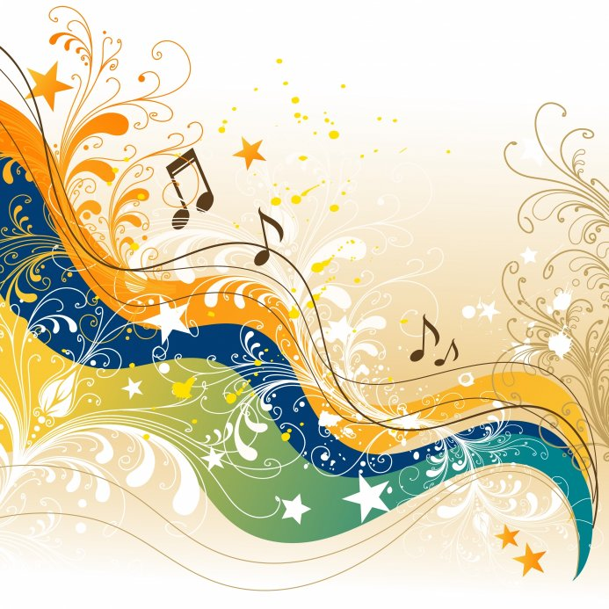
MOUNT LITERA ZEE SCHOOL HOWRAH India
https://www.wetransfer.com/downloads/e30ce50dc54fdea2c7c08b301f33238f20151121113413/69cde84ebd224cf480b41e0921482b6b20151121113413/4ea09d

Slide 38
GYMNASIUM №2 , DROCHIA, MOLDOVA
https://iearn.org/cc/space-25/group-414/gallery/media-58691

