Slide 1
The Reflection of Medford’s Architecture
A presentation created by the Valley School of Southern Oregon

Slide 2
About our school
Situated in Downtown Medford, the Valley School is located in a small business complex called Cobblestone Village. Previously, the school was a Mexican restaurant known as Marigold’s, and the many booth style chairs and sofas are extremely comfortable. Also, our school is based on S.T.E.M., (Science, Technology, Engineering, and Math) so we go on a lot of field trips and contribute to numerous fun projects.

Slide 3
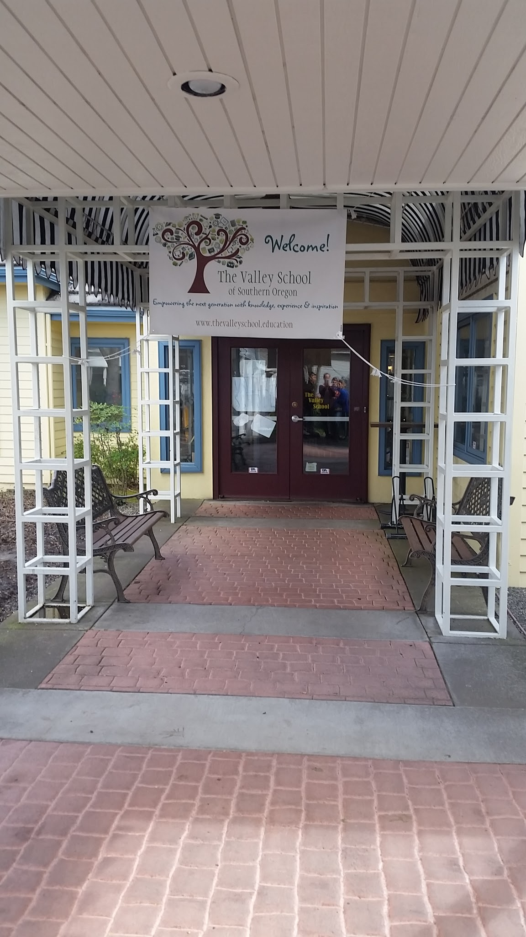
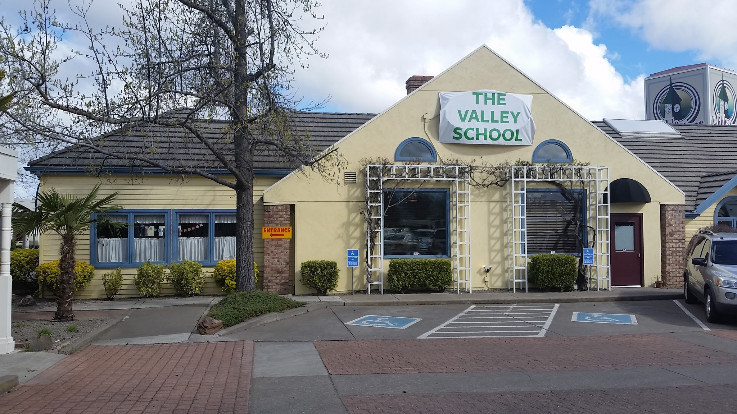
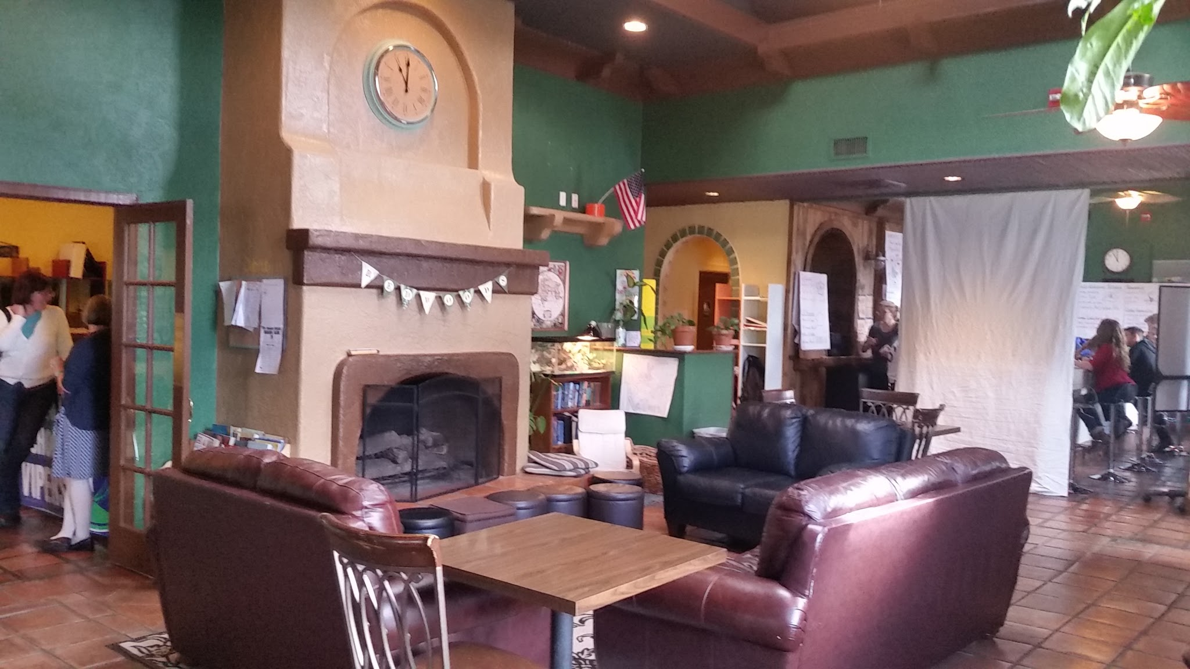
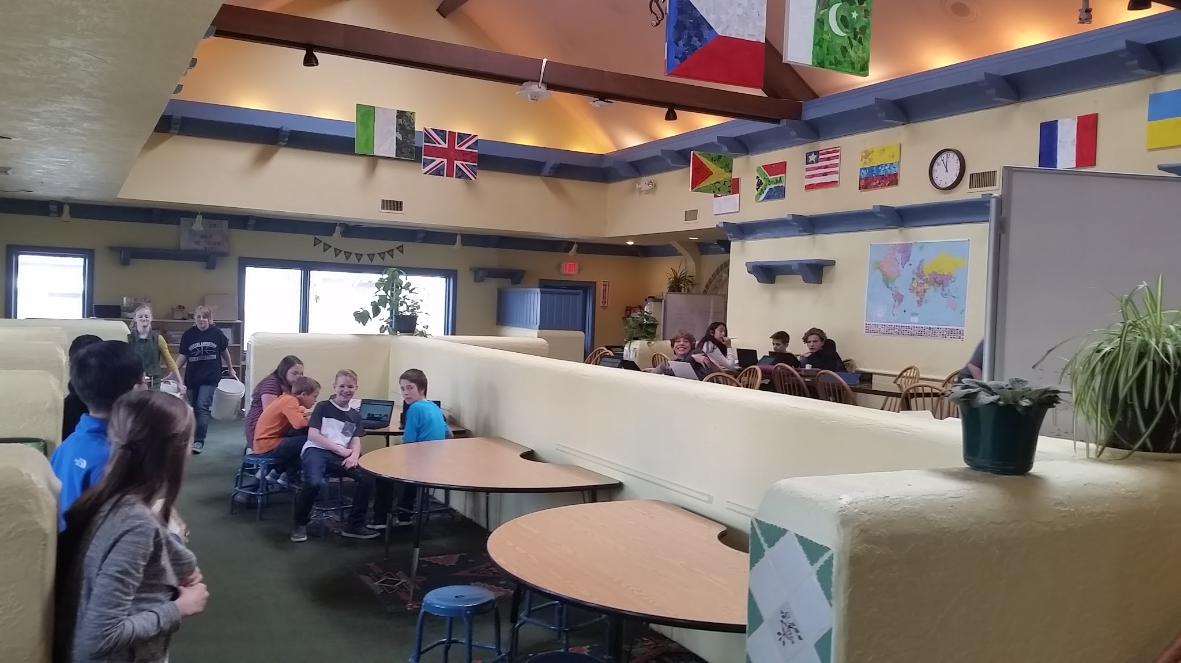
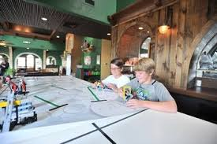

Slide 4
About our city
We live in Medford, a beautiful city located in Southern Oregon. It is part of Jackson County and the Rogue Valley. Our city has many local attractions, such as a large public library, numerous delicious restaurants, a geological history, hiking trails, lakes and rivers, a trampoline park, a go kart race track, an ice skating rink, and many other things.

Slide 5
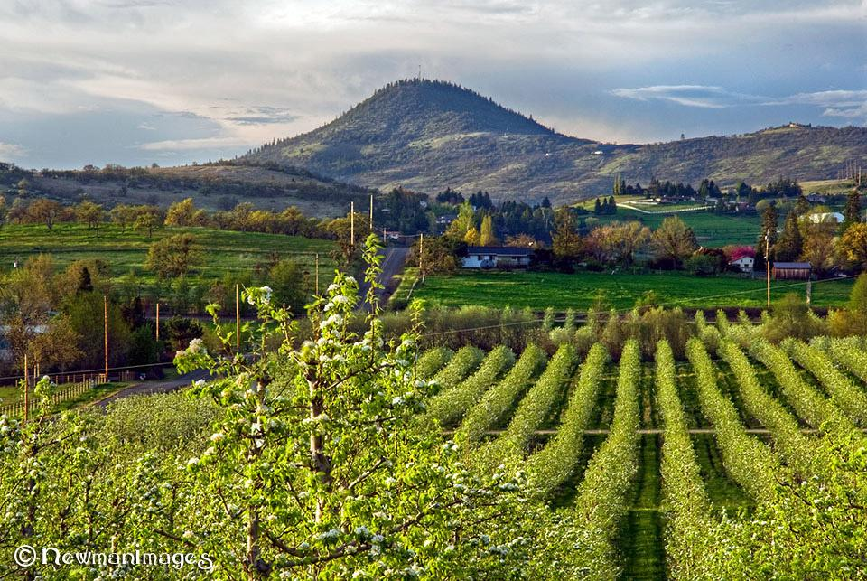
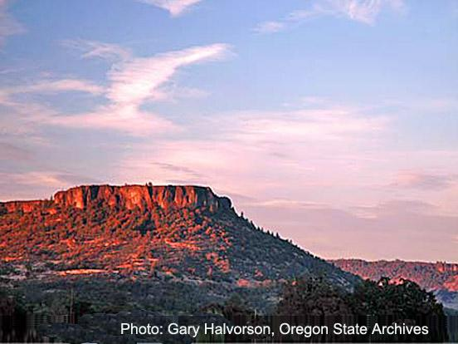
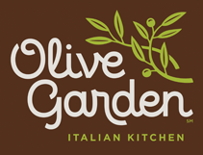
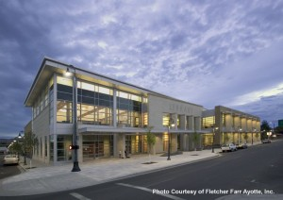
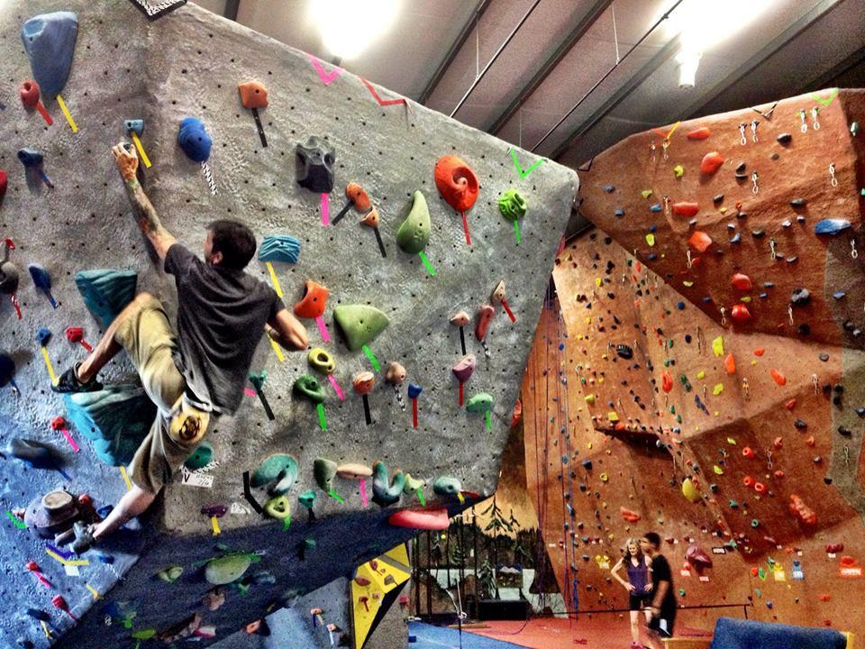

Slide 6
About our country
America is the third largest country in the world and the third largest populated country in the world. America is filled with many beautiful geological attractions, cities, landmarks, and monuments. The president of our country is currently President Barack Obama, and we currently have the largest air force in the world.

Slide 7
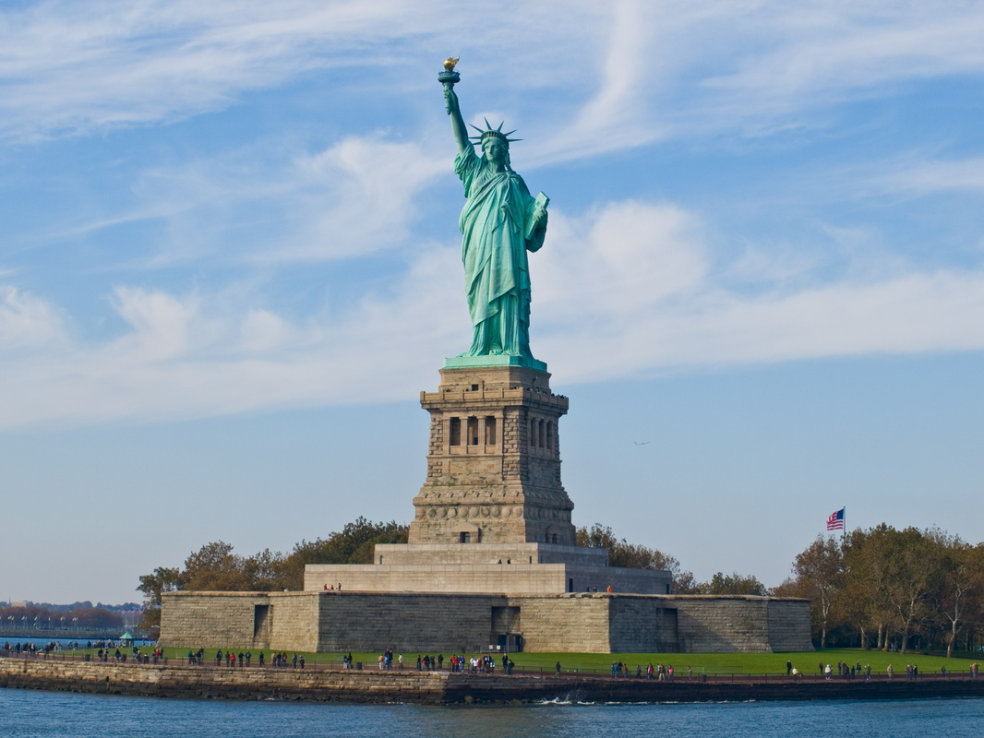
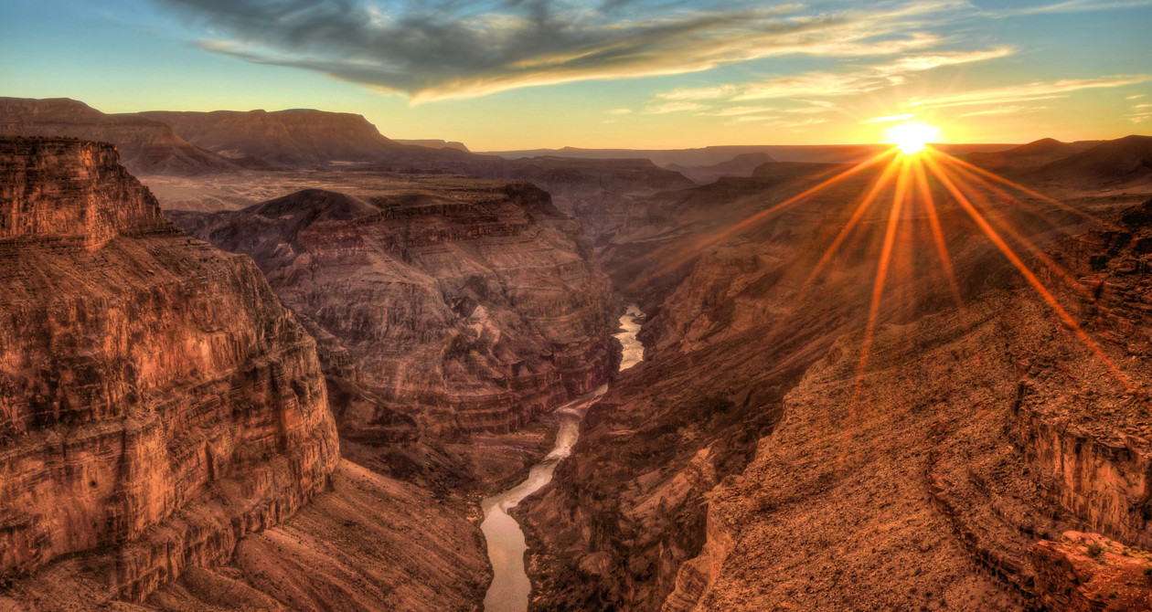
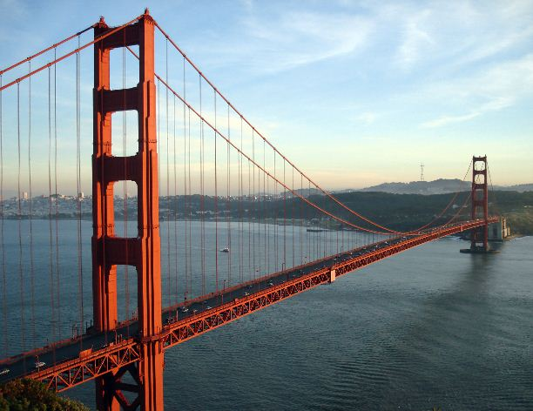
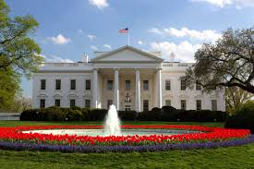
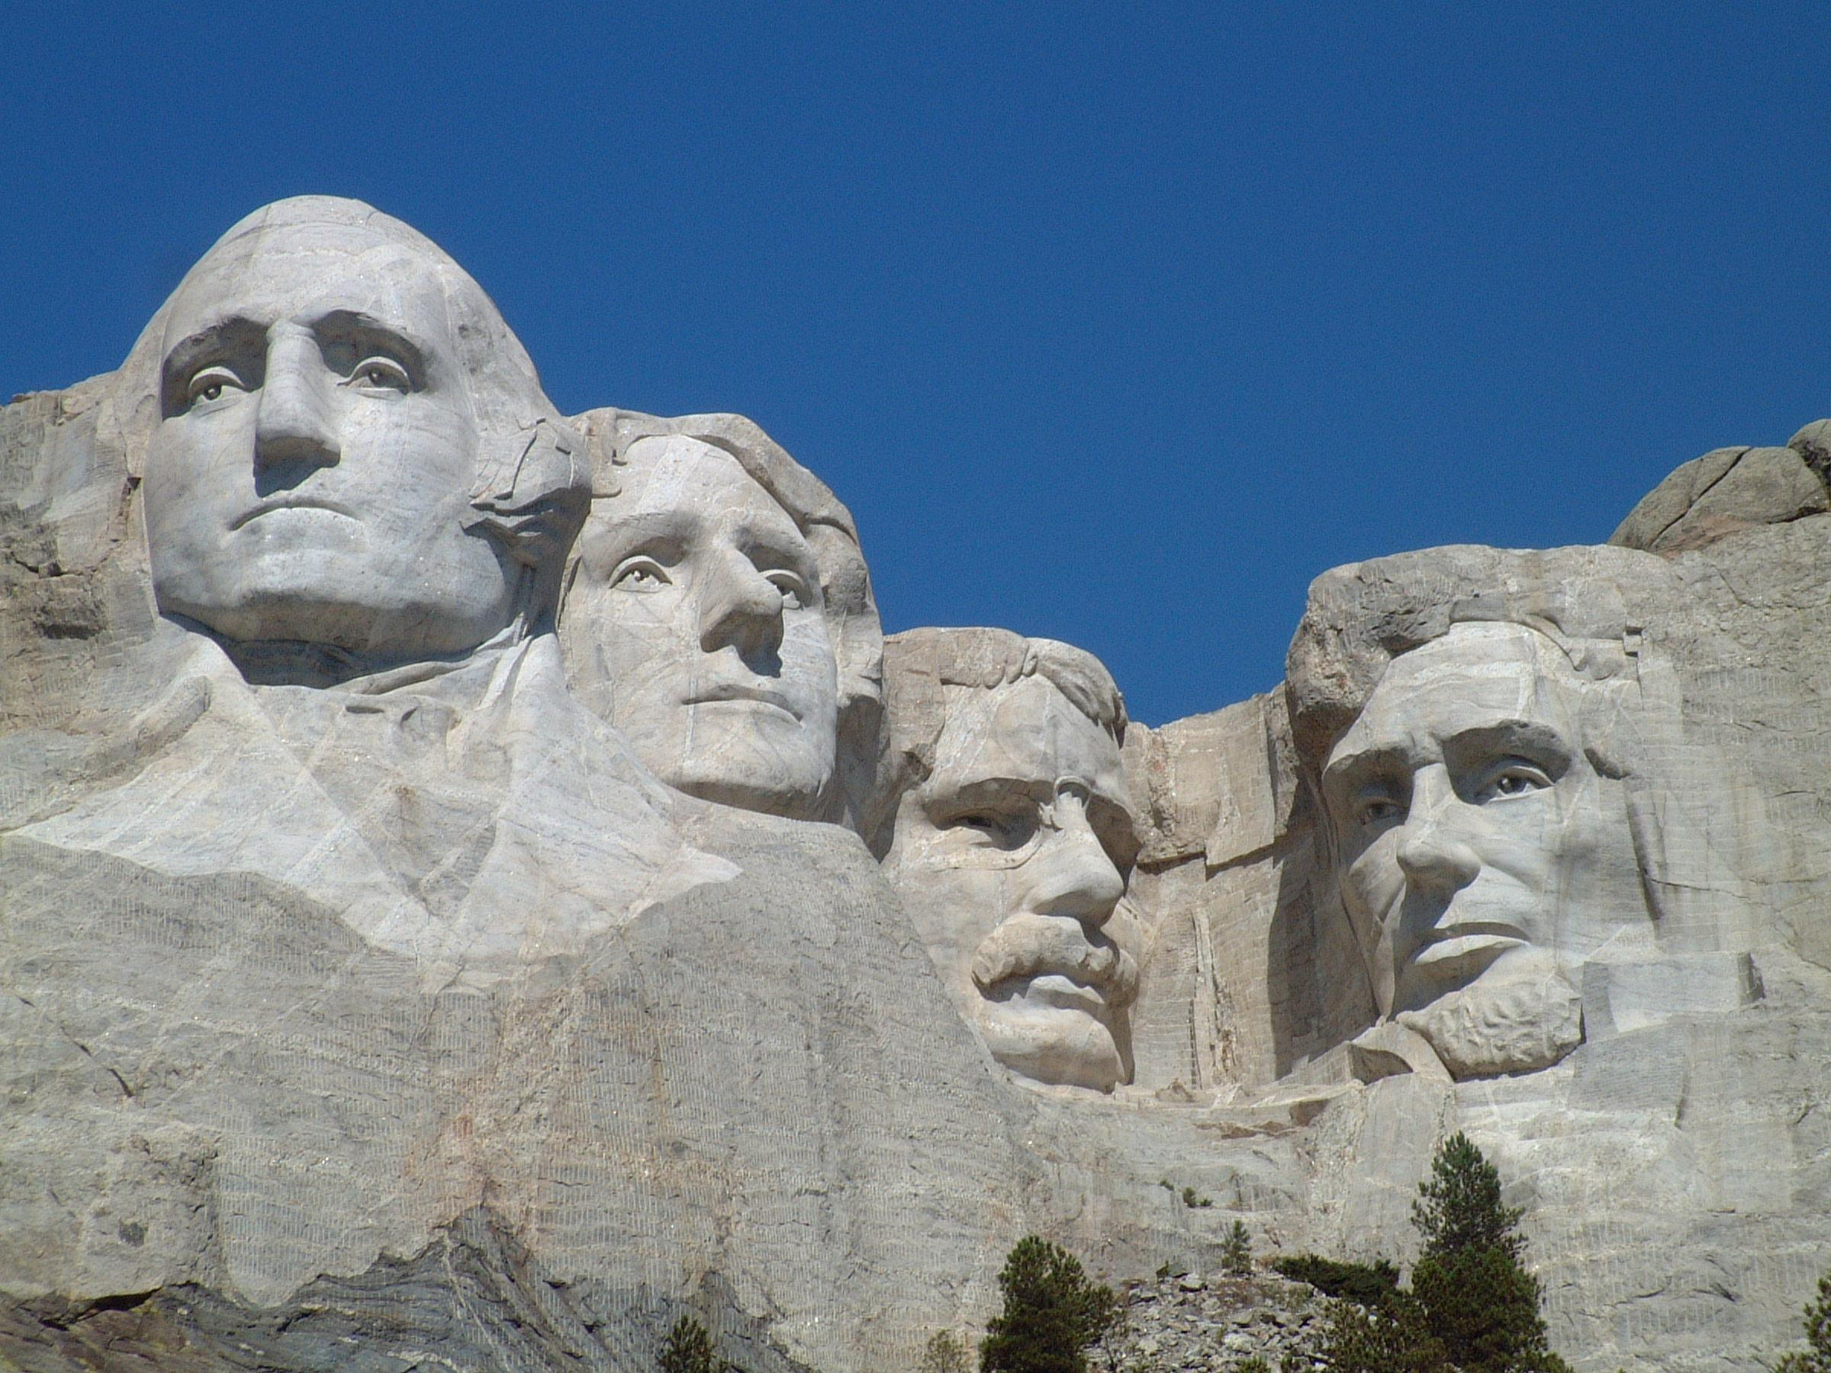

Slide 8
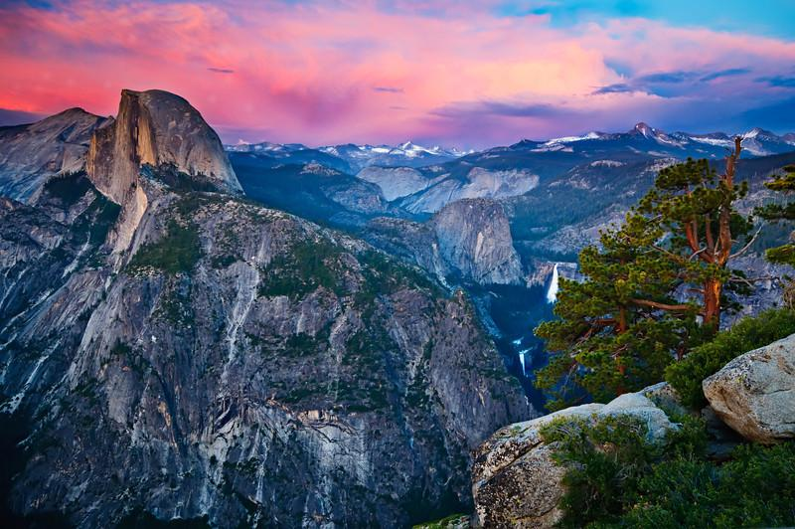
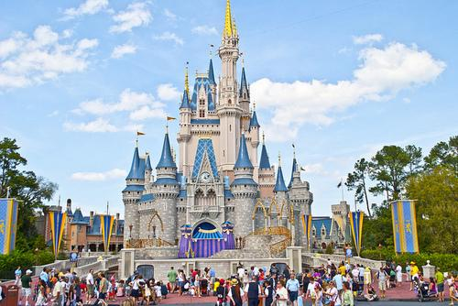

Slide 9
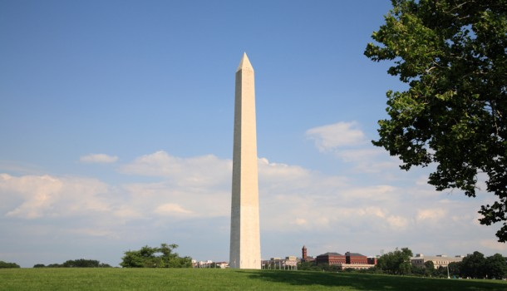
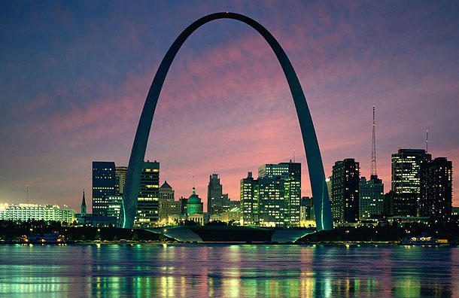
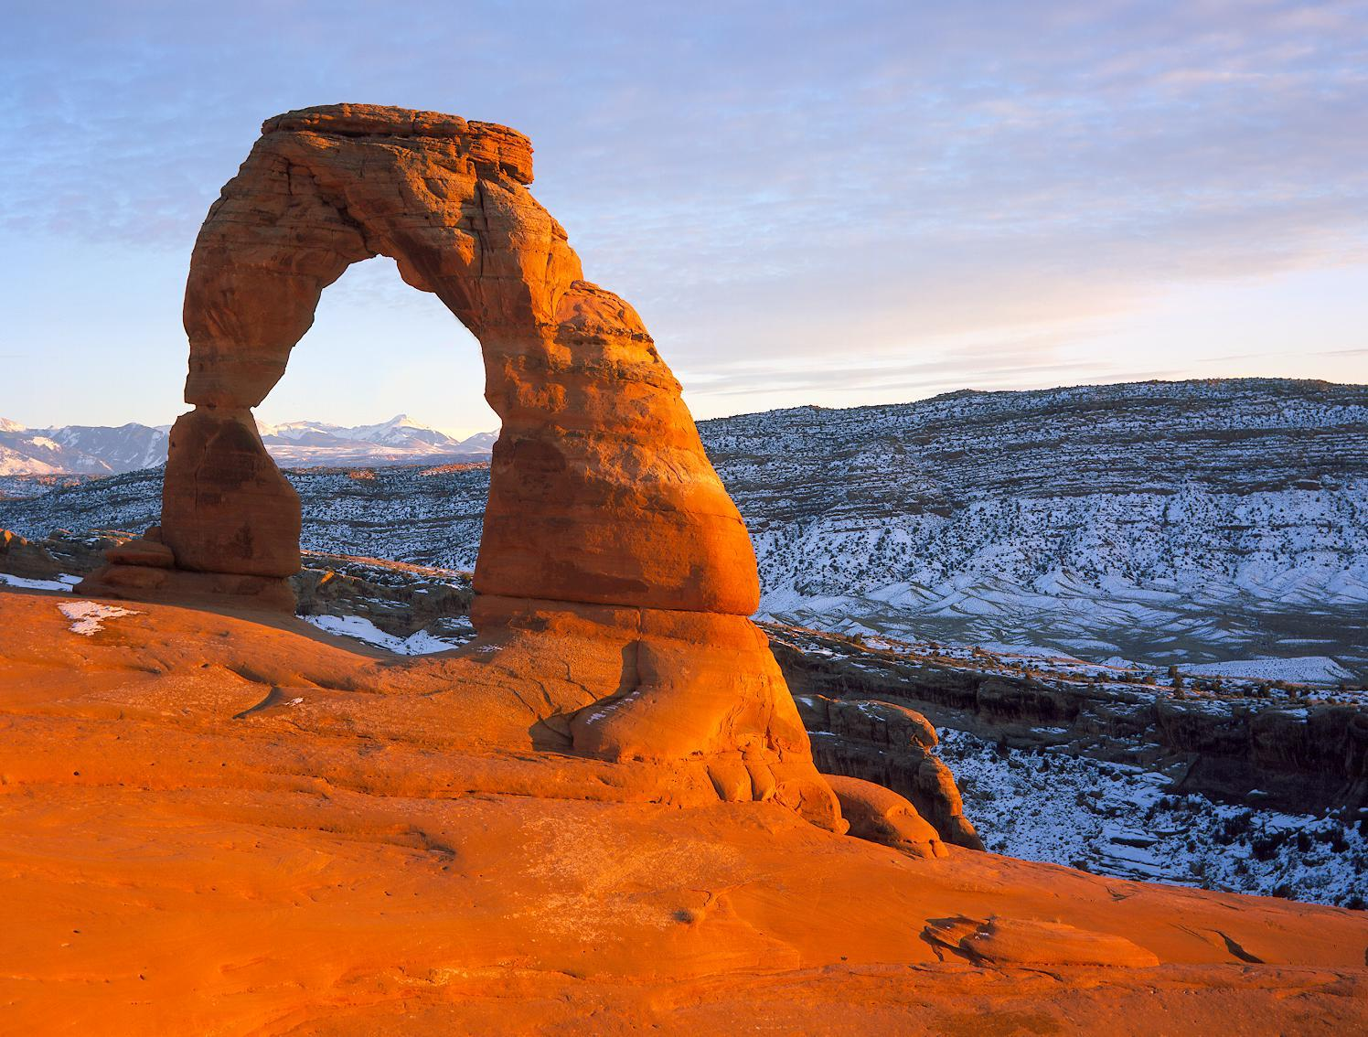
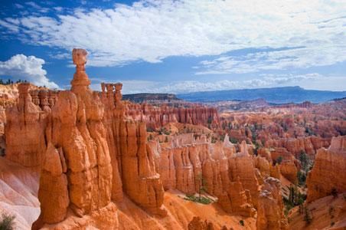

Slide 10
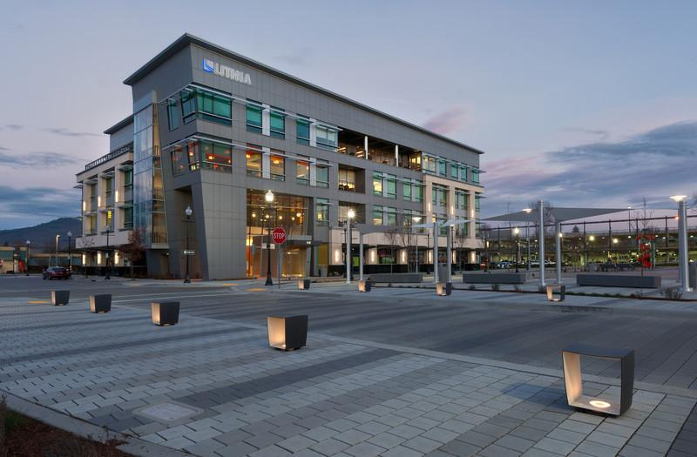
New buildings in Medford

Slide 11
IN-N-OUT BURGER is a fast food restaurant famous throughout the United States of America. A new IN-N-OUT BURGER just recently opened in Medford, Oregon, and it is the only one in the entire state. This restaurant is so popular because their French Fries are cut fresh and they have a special homemade dipping sauce.

Slide 12
Medford, Oregon
Rogue Air is a trampoline park, which is a massive room filled with giant trampolines, basketball hoops, and diving boards. It is the only trampoline park in all of Southern Oregon, and it provides over 20,000 sq. ft. of fun, indoor activity.

Slide 13
Oldest buildings in Medford
One of the oldest known buildings in Medford is the Sophenia Ish Baker House. This famous building was constructed in 1895 and is important because it has survived for over a century just before it became subdivided. Another old building is the Barnum Hotel. This building was constructed in 1914. It was listed on the National Register of Historic Places in 1984.

Slide 14
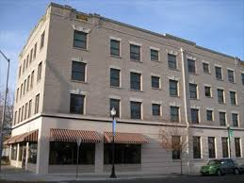
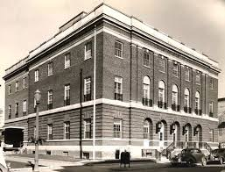
The Barnum Hotel

Slide 15
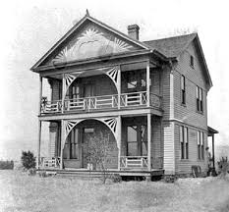
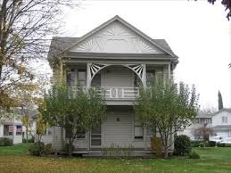
The Sophenia Ish Baker House.

Slide 16
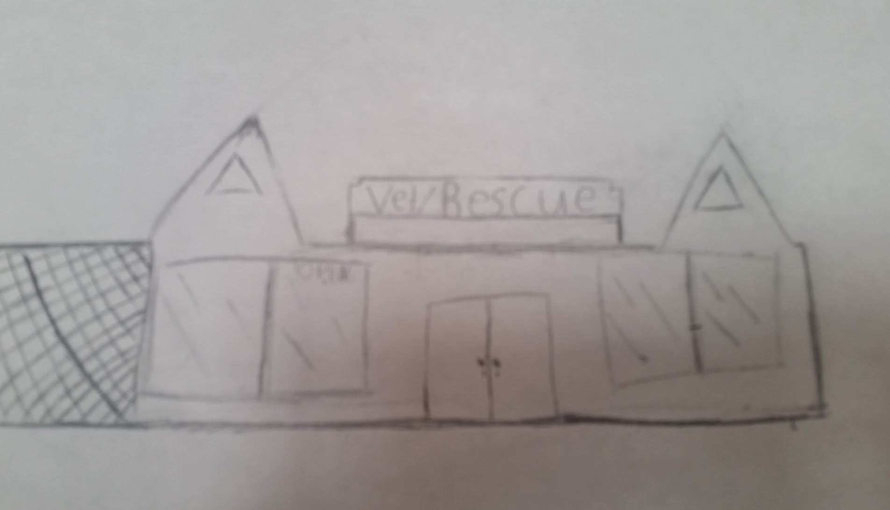
Creating Our Buildings
We have noticed as a school that there are several empty lots near the school property. Medford does not have many buildings that other large cities have. It would be a good idea to instill a veterinarian's office in one of these lots. The Valley School decided that a building for helping animals would be helpful because many homeless pets are living on the streets of Downtown Medford, close to where the school is.

Slide 17
The End!
Thank you for watching our presentation! We hope you enjoyed it!

