Slide 1
FOOD SHORTAGE
By: Allie, Ira, Jordan, Dane and Charlie

Slide 2
CAUSES
Some causes of food shortage are droughts, overpopulation, poor transportation and limited access to resources.

Slide 3
AREAS EFFECTED
Areas that may have a higher risk for food shortages are places with very troubled transportation, places with a dry climate, place that are over populated.

Slide 4
GLOBAL WARMING
When the temperature is too hot, certain animals and plants that humans rely on to survive may not grow or they may migrate to another location making them harder to find reducing food supply.
Climate change is increasing the risk of severe 'food shocks' where crops fail and prices of staples rise rapidly around the world.
The way food is produced with climate change can drive the prices of food

Slide 5
LOCAL FOOD SHORTAGES
Seattle has food shortages too. Many kids in the summer time will not have enough food to eat because they are used to being supplied food by their school. So when summer time comes around the corner they won't have that access anymore and the carefree break they were dreaming of turned into months of worrying about hunger and not having enough food.

Slide 6
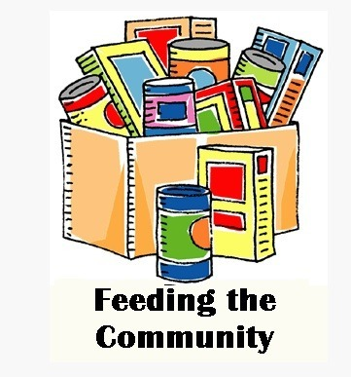
SOLUTIONS
Solutions to overcome food shortages mare better ways of transportation and organizations to supply food for people who are in need of food.

Slide 8
Image URLs
http://ecointernet.org/2014/05/17/on-overpopulation-and-ecosystem-collapse/
http://www.zmescience.com/ecology/climate/glowing-population-food-shortages-897868/
http://www.businessinsider.com/venezuelas-food-shortage-keeps-getting-worse-2015-8
http://247wallst.com/commodities-metals/2011/02/22/the-ten-nations-which-suffer-most-from-the-global-food-crisis/

Slide 9
FOOD SHORTAGE BY CATHERINE :
In the Bronx where we live there aren't any food shortages but there are food deserts.
This community does not have access to fresh produce. The Bronx is able to get food
but it’s difficult to get fruit and vegetables.

Slide 10
"Food deserts," as such neighborhoods are called, are typically low­income areas that
have virtually no supermarkets. Studies have shown that these "deserts" are associated
with higher levels of obesity and malnutrition, which can affect entire communities,
including small children.”( food shortage on getting fresh produce and have a better
nutrition)
http://www.refinery29.com/2015/05/87956/new­york­health­food­deserts

Slide 11
