Slide 1
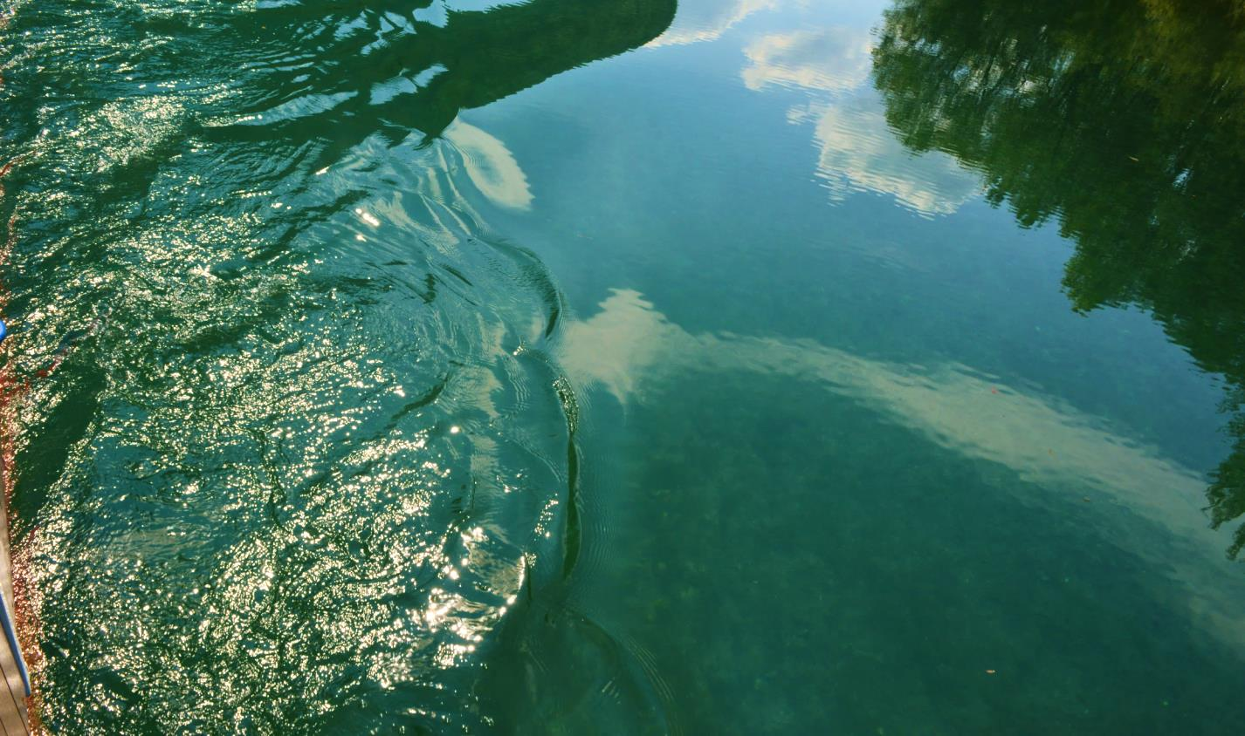
THE SOČA RIVER

Slide 2
The majestic source of the Soča looks like a magical abstract painting.

Slide 3
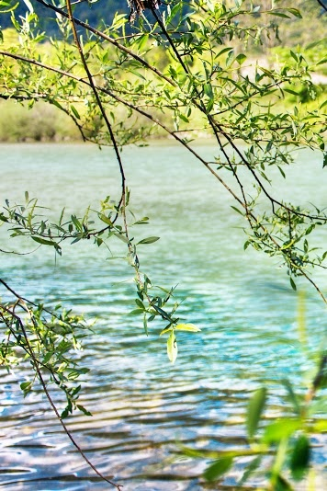
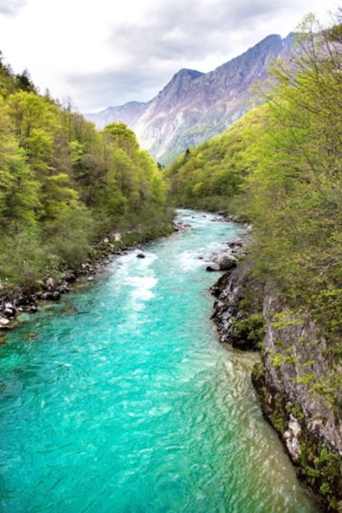
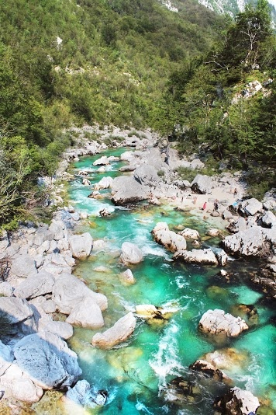
The river flows quietly and freely through the valley.

Slide 4
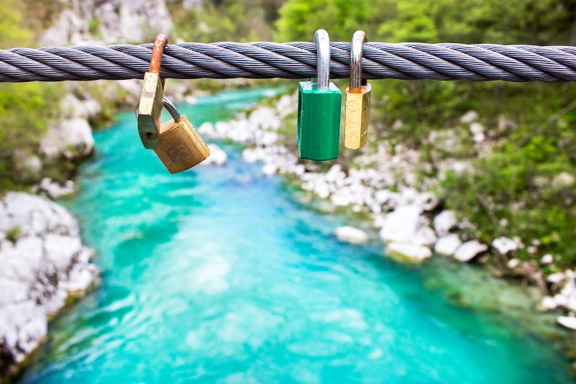
There is the source of the river,
our emerald river.
We swim in it
so we are all fit.
This is our beautiful river!

Slide 5
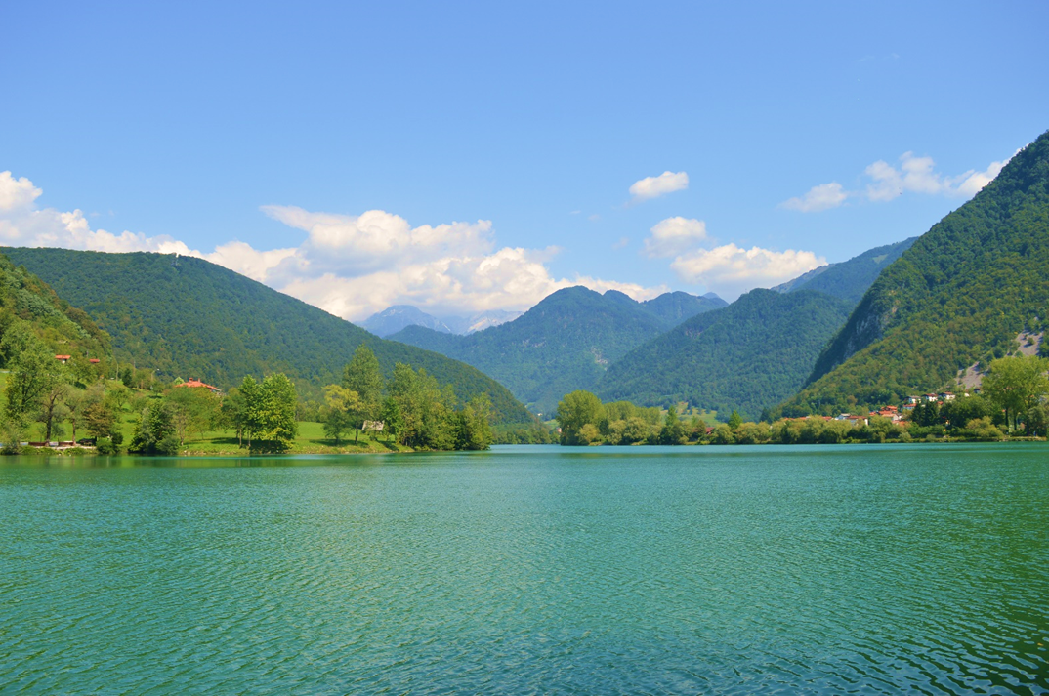
There are many fishing tournaments organised on the Soča attracting sports fishermen from all over the world. The fisherman who catches the longest fish gets a red ribbon and the winning fish is named Miss Soča. Judges mesure the size of fish and pronounce the winner of the event. Unfortunately, not all fishermen practise "catch&release“ fishing and sometimes they don't return their catch to the water but rather cook and eat it.

Slide 6
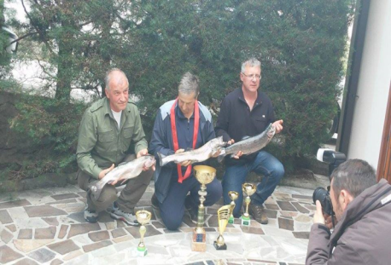
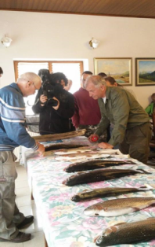
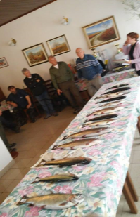
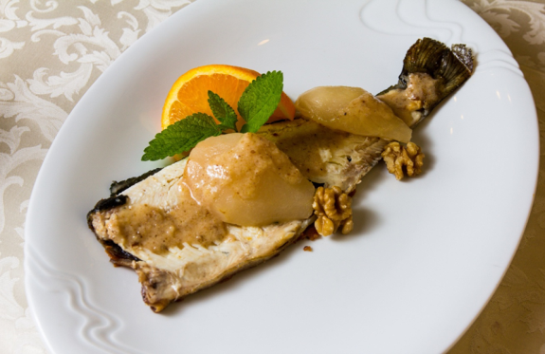
The judges are measuring the fish while the cameraman is filming the event. Fishermen are nervously waiting for the results
Here are all the fish there have been caught. The winners are about to be announced.
The winners of 2016 contest for the longest and most beautiful trout from the Soča. The winning fisherman (in the middle) is holding the fish which has won the Miss Soča title.
BIG TROUT CONTEST
Trout can be cooked in different ways. In this picture trout is served with pears and walnuts. This trout is for people who prefer sweet dishes. It can be made also with figs or herbs. Recipes are, however, a carefully kept secret.

Slide 7
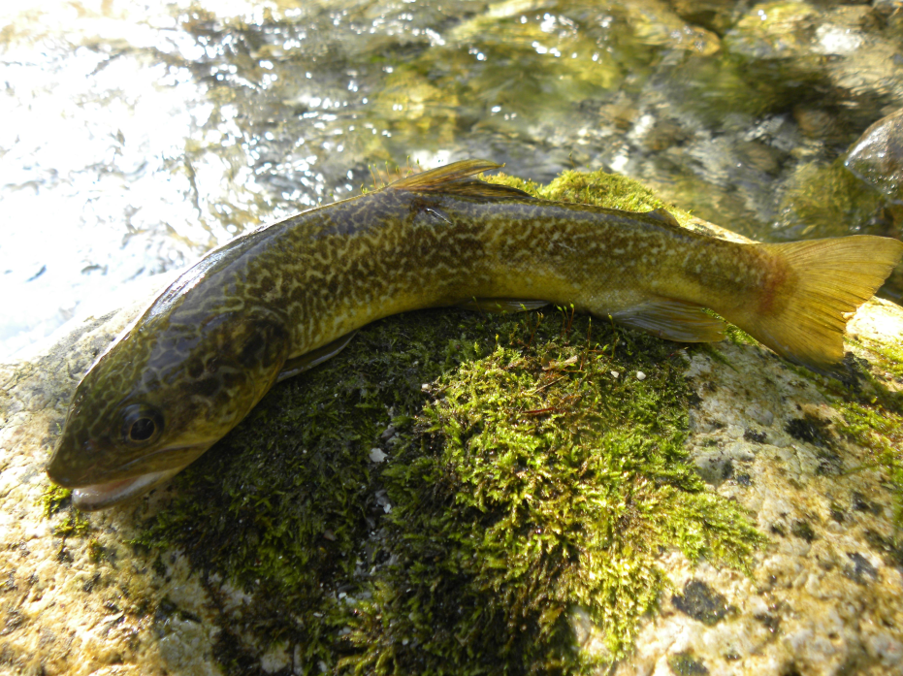
MARBLE
TROUT,
Latin
Salmo trutta
marmoratous

Slide 8
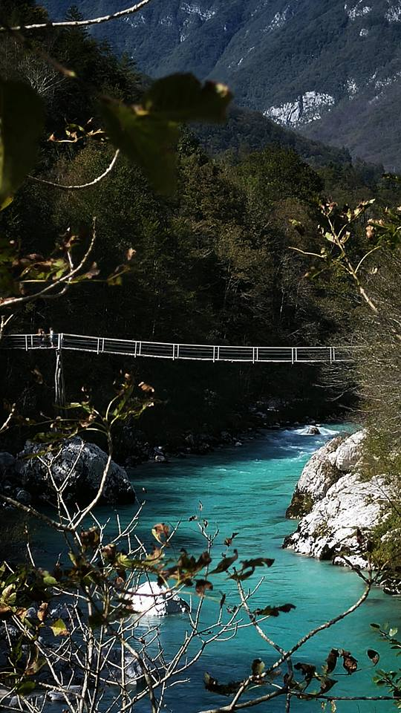
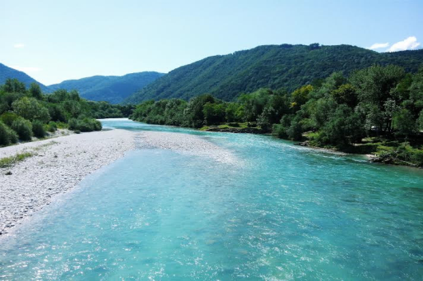
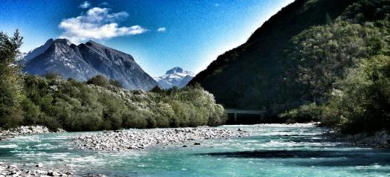
The Soča

Slide 9
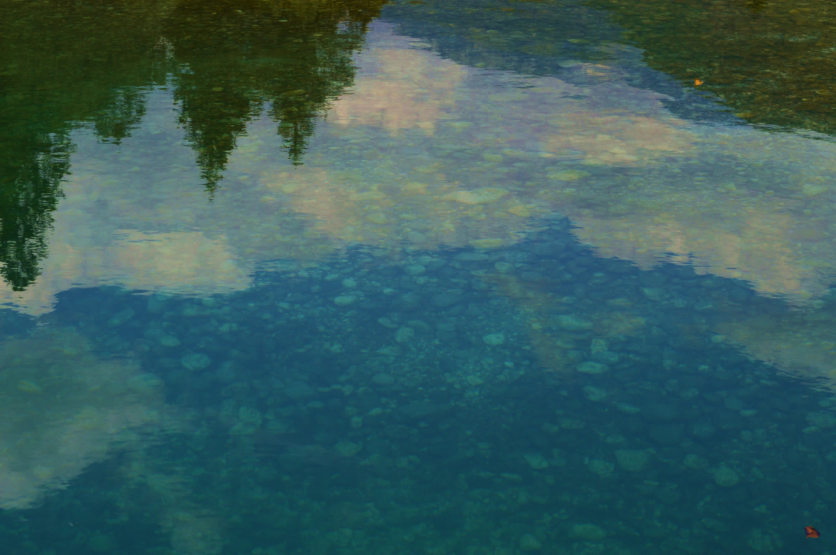
There once was a man who liked a river.
He liked to row his boat up the river.
There he saw a man
Who looked like a madman.
So he decided never to go back to the river.

Slide 10
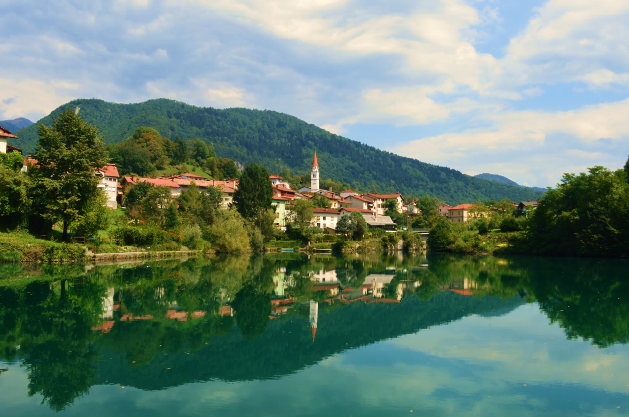
The Soča at Most na Soči

Slide 11
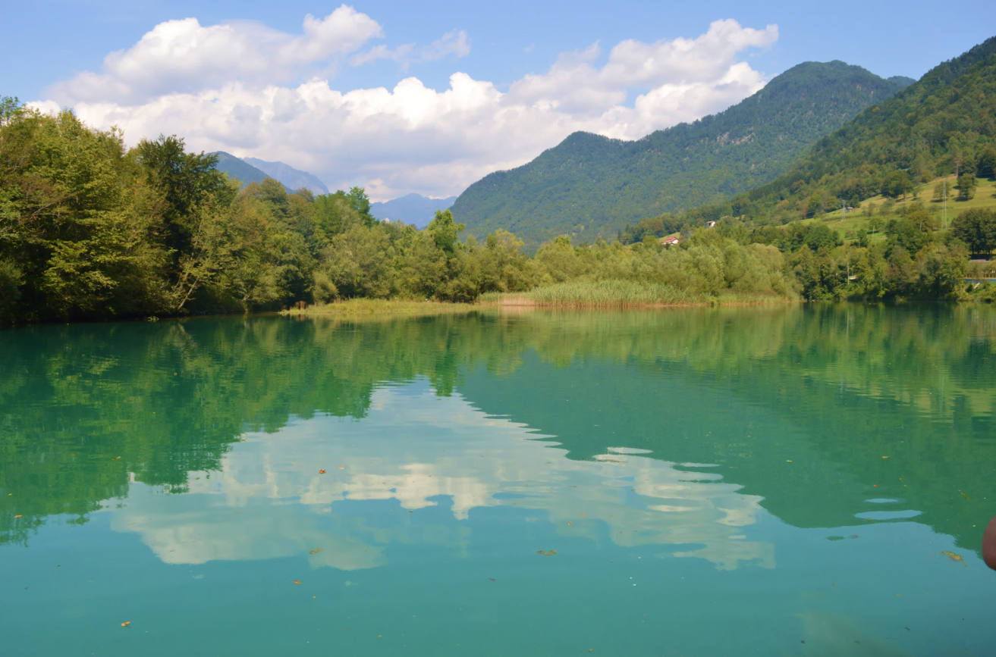
The River Soča runs between hills,
goes under bridges, goes past mills.
We swim in it
so we are all fit.
We live with the Soča between hills.

Slide 12
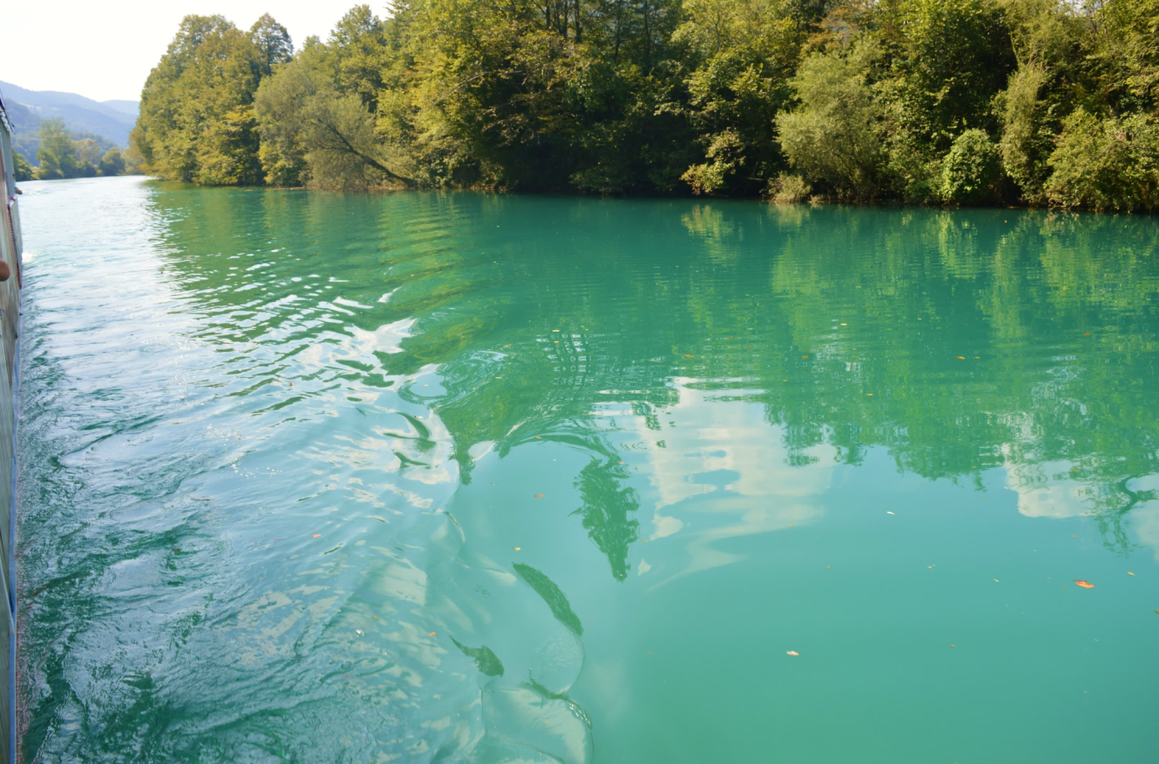
Rivers are really something special and important for our life. We really can't imagine our lives without them. Let’s preserve our rivers and
KEEP THEM FLOWING FOR GENERATIONS TO COME!

Slide 13
Mentor: Zvonka Dalić Rink, English teacher
Edited by: Lana Trost
Photos and texts: 1. a, Gimnazija Tolmin, Slovenia:
Anesa Adrovič, Tadej Humar, Jasna Kavčič, Staš Manfreda , Anika Mugerli, Anja Pavšič, Ana Svetičič, Uroš Šturm and Lana Trost

