Slide 1
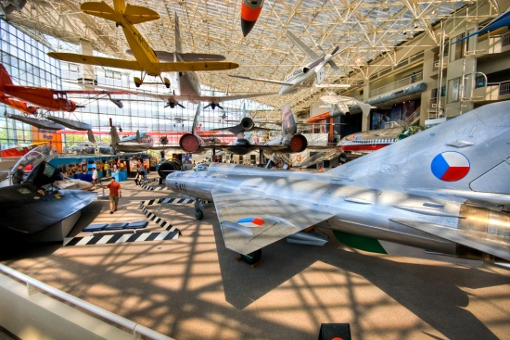
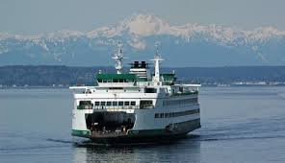
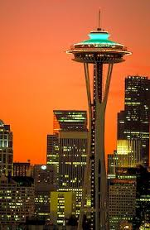
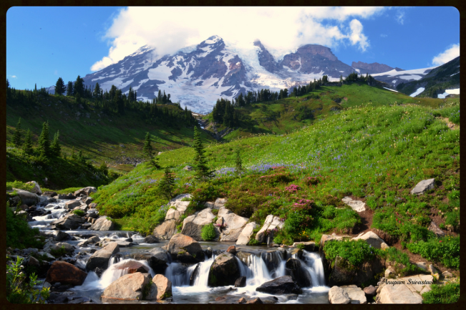
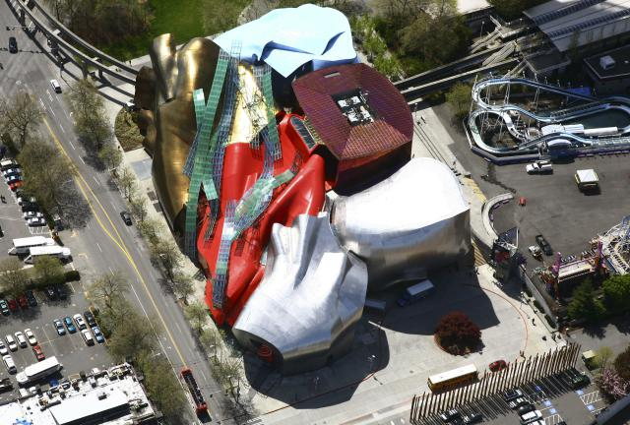
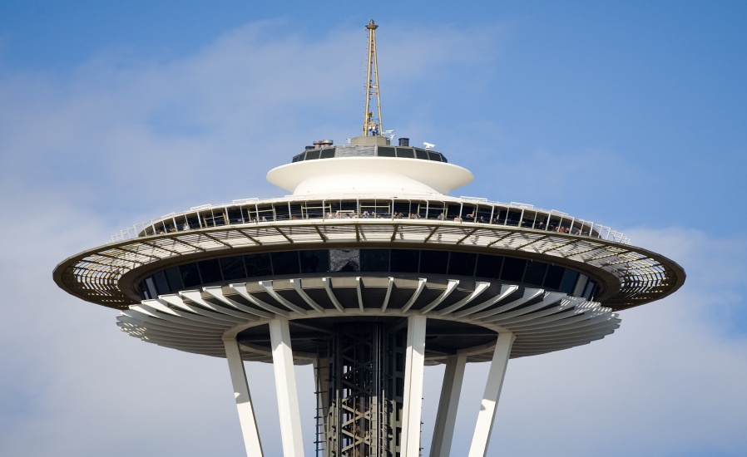
Seattle area 3 day trip ideas
Lynnwood Elementary
5th grade students
WA , USA

Slide 2
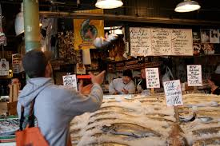
Day 1: Pike Place Market by Bea
In DownTown Seattle there's this place called Pike Place Market! I thought that place was pretty Cool!! Cause there’s a part where they sell fish!! They do this little show where they throw fishes around! And it’s actually pretty funny watching them try to catch fish!

Slide 3
Seattle Space Needle by Bersabeth
It was build for he 1962 World’s Fair and has become a symbol of Seattle.
SkyCity at the top of Space Needle is one of the most expensive restaurants in Seattle and it rotates 360 degrees every hour.
Also the space needle is a very beautiful place at night because the space needle has a light that is blue and maybe green.
When I went all the way up in the space needle I saw Mount Rainier and Puget sound and so much more, but when you start to go to the top with the elevator you kinda feel like you would fall on the ground.

Slide 4
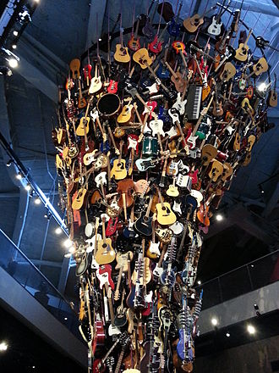
The EMP Museum
The Experience Music Project museum is right next to the Space Needle. It was founded by Microsoft co-founder Paul Allen in It has a lot of fun exhibits.
“It has the largest collections in the world of rare artifacts, hand-written lyrics, personal instruments, and original photographs celebrating the music and history of Seattle musicians Nirvana and Jimi Hendrix”
View from Space Needle
Guitar Tower

Slide 5
Day 2 Take a ferry
There are many places you can take a ferry around
Puget Sound (see next slide).

Slide 6
Washington State Ferries Map
This map shows all the places that the Washington State Ferries can go to.
You can take a car on the ferry, or just go on as a passenger. When you take the ferry in Anacortes, you can go to the San Juan Islands and some ferries will even take you to Sidney BC in Canada.

Slide 7
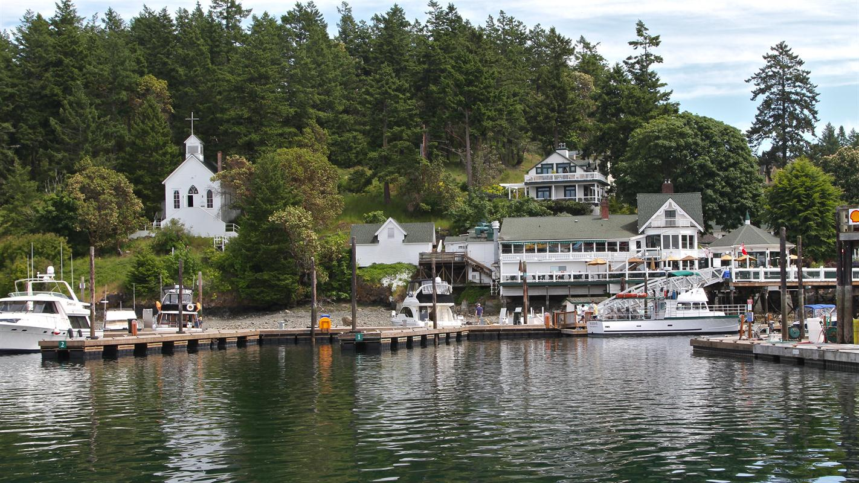
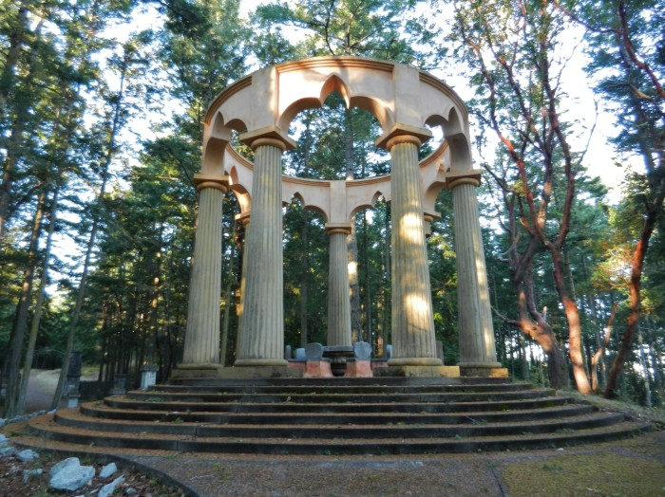
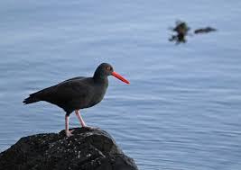
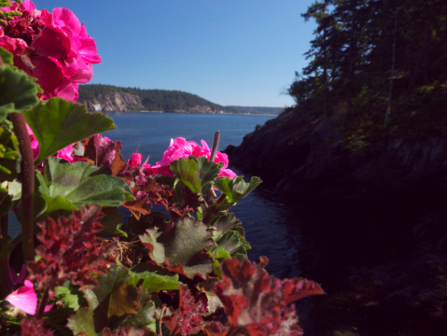
San Juan Island by Mudabrah
Roche Harbor is a sheltered harbor on the northwest side of San Juan Island.
Roche Harbor Mausoleum

Slide 8
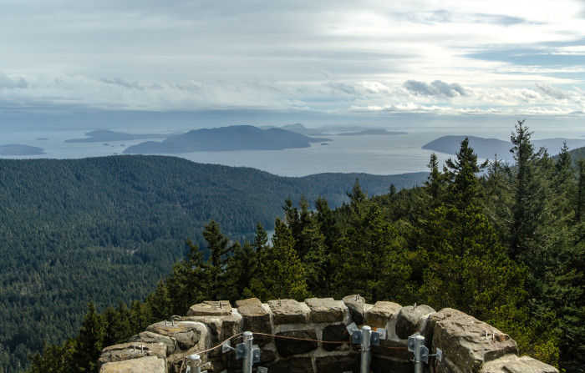
Tower on Mt Constitution
Flickr / Jonathan Miske
This tower is on top of Mt Constitution on Orcas Island. I was an observation tower, not used for this any more. You can hike or drive to the top through Moran State Park and climb to the top. On a nice day you can see the beautify view above.

Slide 9
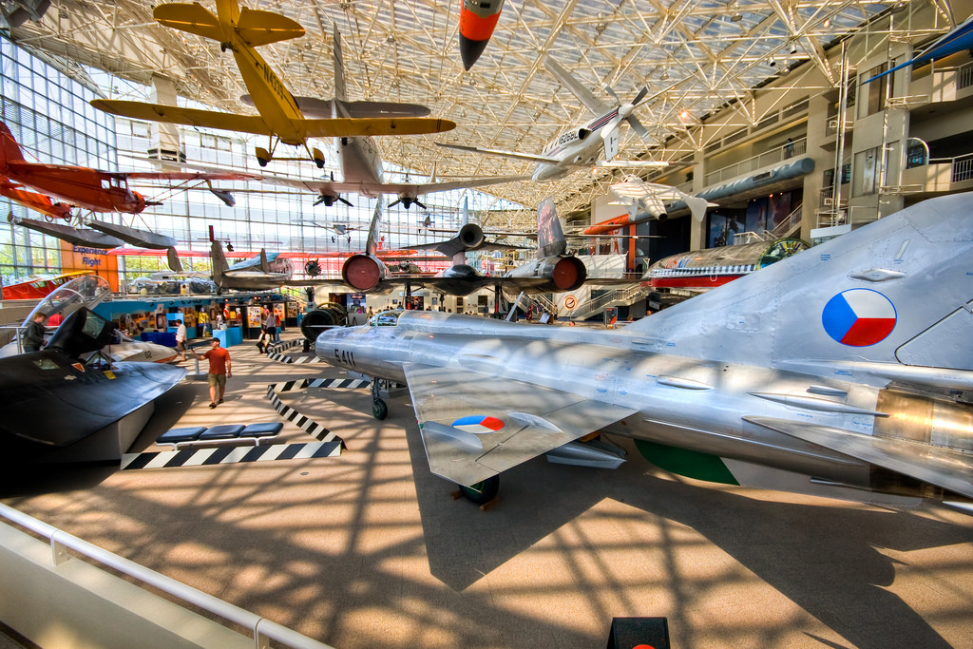
Day 3: Visit the Museum of Flight by Lillian, Kedus and Rameez
I want to take my visitor there because I have been there before and it was fun.
There were airplanes and the first ever made plane.
There are statues of people who flew airplanes. It was very fun and interesting.
I think if anyone likes planes, then they would like the Museum of Flight. It will take you 22.4 miles to get there, if you're in Lynnwood.
The museum of Flight is in Renton

Slide 10
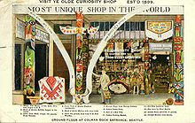
Ye Old Curiosity Shop, Seattle by Jackson
Ye old curiosity shop in Seattle was founded in 1889 by Joseph Stanley. He collected weird things to display.
The store is right by the water so when you go you can also see a cool view on a nice day.
It has a lots of old interesting things about Seattle history. Also it's free.
It takes about 35 mins to get there from Lynnwood WA.

Slide 11
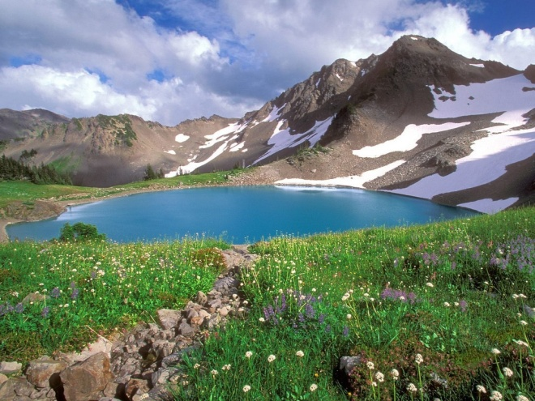
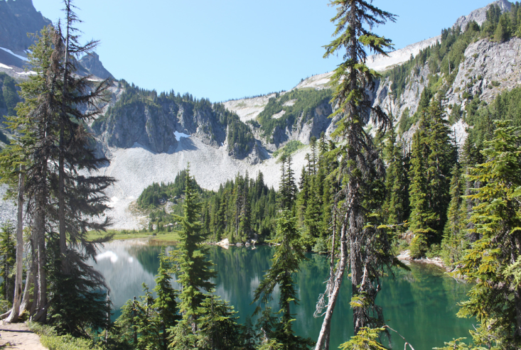
Or if the weather is nice, go hiking!
Olympics National Park
Mt Rainier National Park

