Slide 1
ENVIRONMENTAL ISSUES
Global Learning Circles 2
INSTITUTO LUX
Leon, Guanajuato, México

Slide 2
TÍTULO DE LA PRESENTACIÓN
Participating in this project was very motivating for my students.
Looking at the surveys my students discovered that teens around the world have many things in common; they were suprised to read about their lifestyles and hobbies because they found lots of similarities.
As a teacher, it was a great way to engaged them in using the language with a purpose such as interacting with kids their age in different countries.

Slide 3
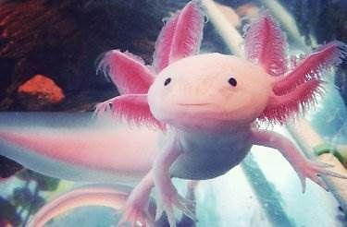
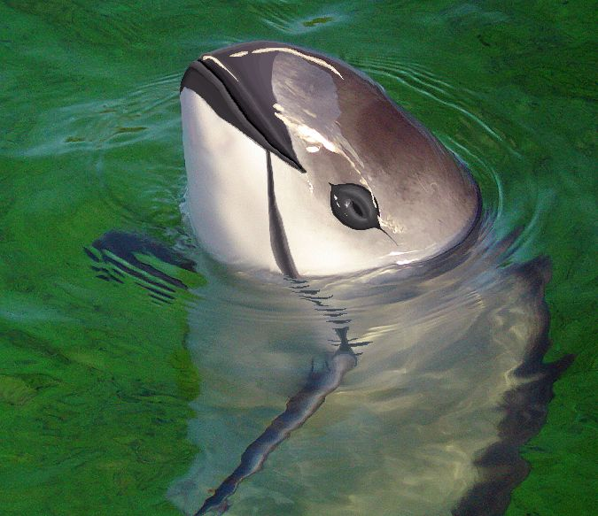
The proposal we presented fo this project was about two animals form our country facing exctintion, a topic most of us are worried about. At the same time, we had the opportunity of participating with three other schools putting their ideas for projects into practice.

Slide 4
Getting response to our project concerning the possibility of certain endemic animals dissapearing was exciting for them because they are aware now that many people share the same concern, so hopefully, solutions to environmental problems like animal exctintion would be addressed and eventually solved.

Slide 7
Taking part in projects of other teachers created a sense of Community that we valued immensly.
Finally, we would like to thank all the facilitators,teachers and students who gave us the opportunity to learn in a fun, intersting way.
Thank you from INSTITUTO LUX.

