Slide 1
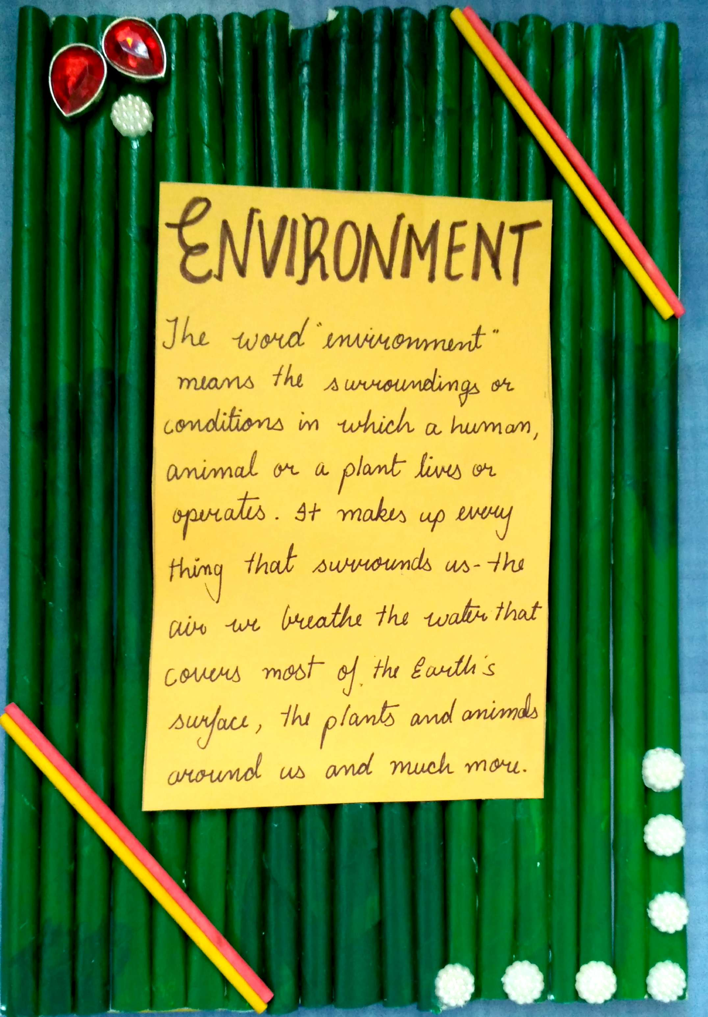
GLOBAL ISSUE ENVIRONMENT – by Ms.Vedika , Grade 9 , St.Peter’s High School , Telangana , INDIA

Slide 2
GLOBAL ISSUE ENVIRONMENT – by Ms.Vedika , Grade 9 , St.Peter’s High School , Telangana , INDIA

Slide 3
GLOBAL ISSUE ENVIRONMENT – by Ms.Vedika , Grade 9 , St.Peter’s High School , Telangana , INDIA

Slide 4
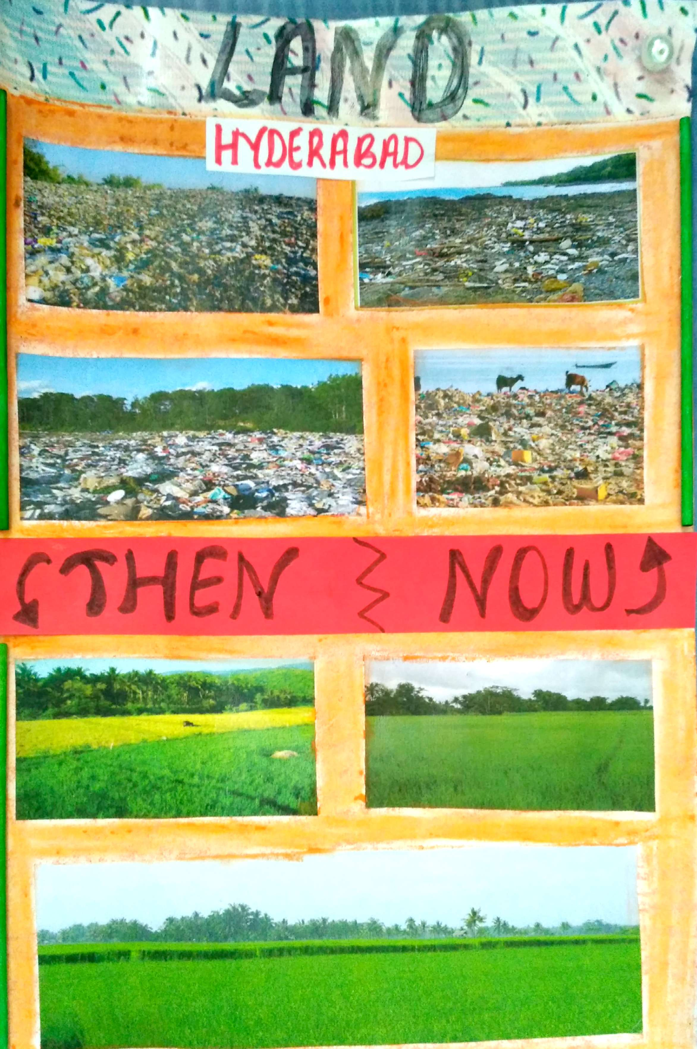
GLOBAL ISSUE ENVIRONMENT – by Ms.Vedika , Grade 9 , St.Peter’s High School , Telangana , INDIA

Slide 5
GLOBAL ISSUE ENVIRONMENT – by Ms.Vedika , Grade 9 , St.Peter’s High School , Telangana , INDIA

Slide 6
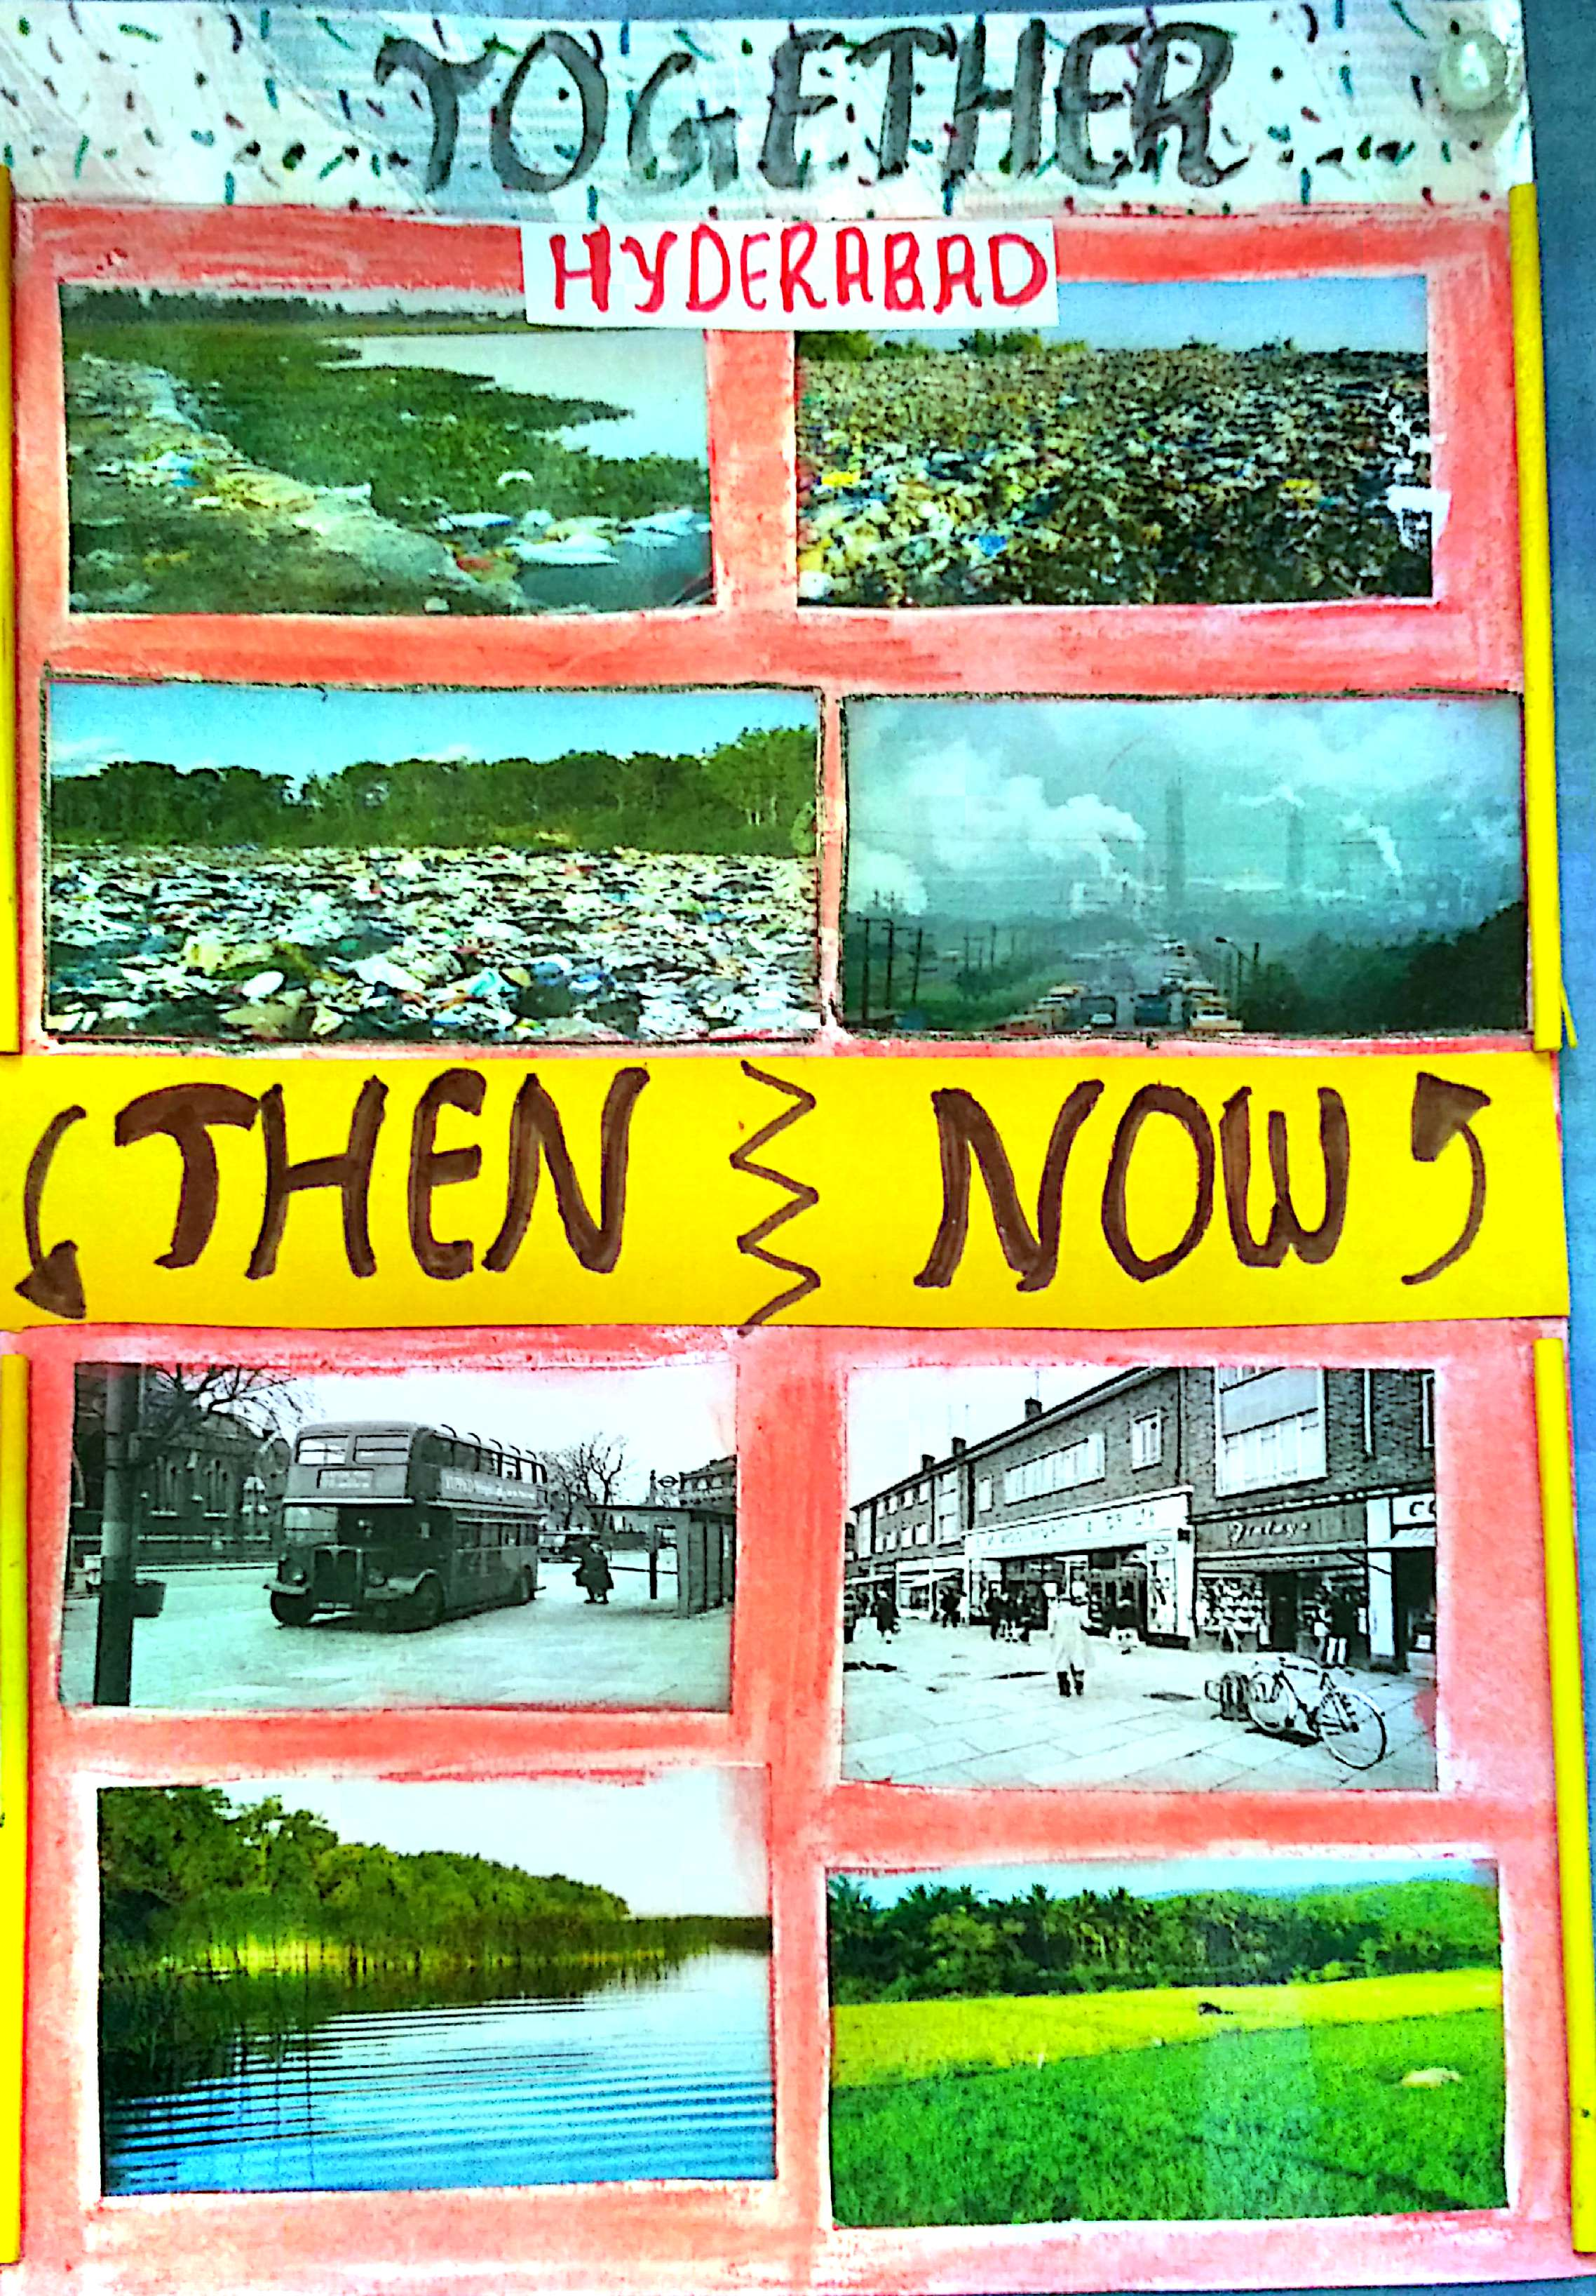
GLOBAL ISSUE ENVIRONMENT – by Ms.Vedika , Grade 9 , St.Peter’s High School , Telangana , INDIA

Slide 7
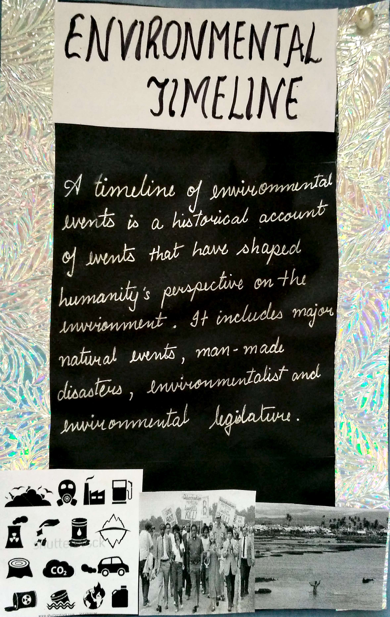
GLOBAL ISSUE ENVIRONMENT – by Ms.Vedika , Grade 9 , St.Peter’s High School , Telangana , INDIA

Slide 8
GLOBAL ISSUE ENVIRONMENT – by Ms.Vedika , Grade 9 , St.Peter’s High School , Telangana , INDIA

Slide 9
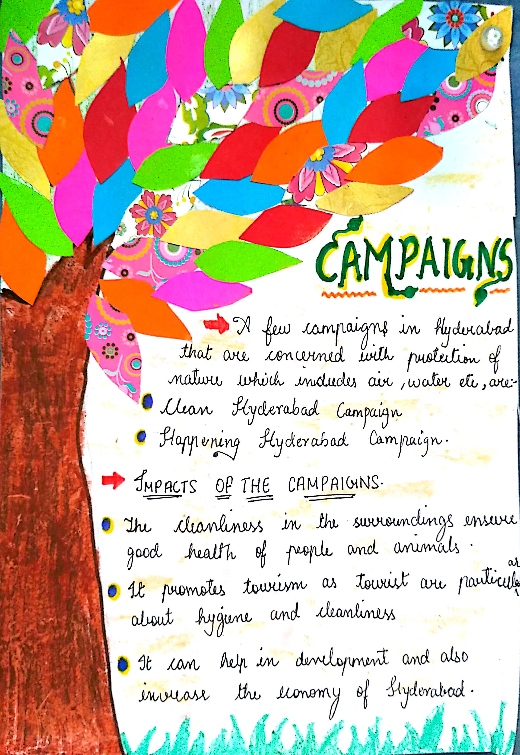
GLOBAL ISSUE ENVIRONMENT – by Ms.Vedika , Grade 9 , St.Peter’s High School , Telangana , INDIA

Slide 10
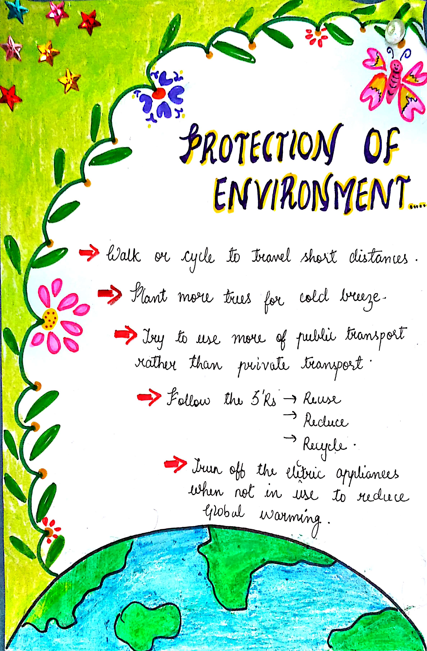
GLOBAL ISSUE ENVIRONMENT – by Ms.Vedika , Grade 9 , St.Peter’s High School , Telangana , INDIA

Slide 11
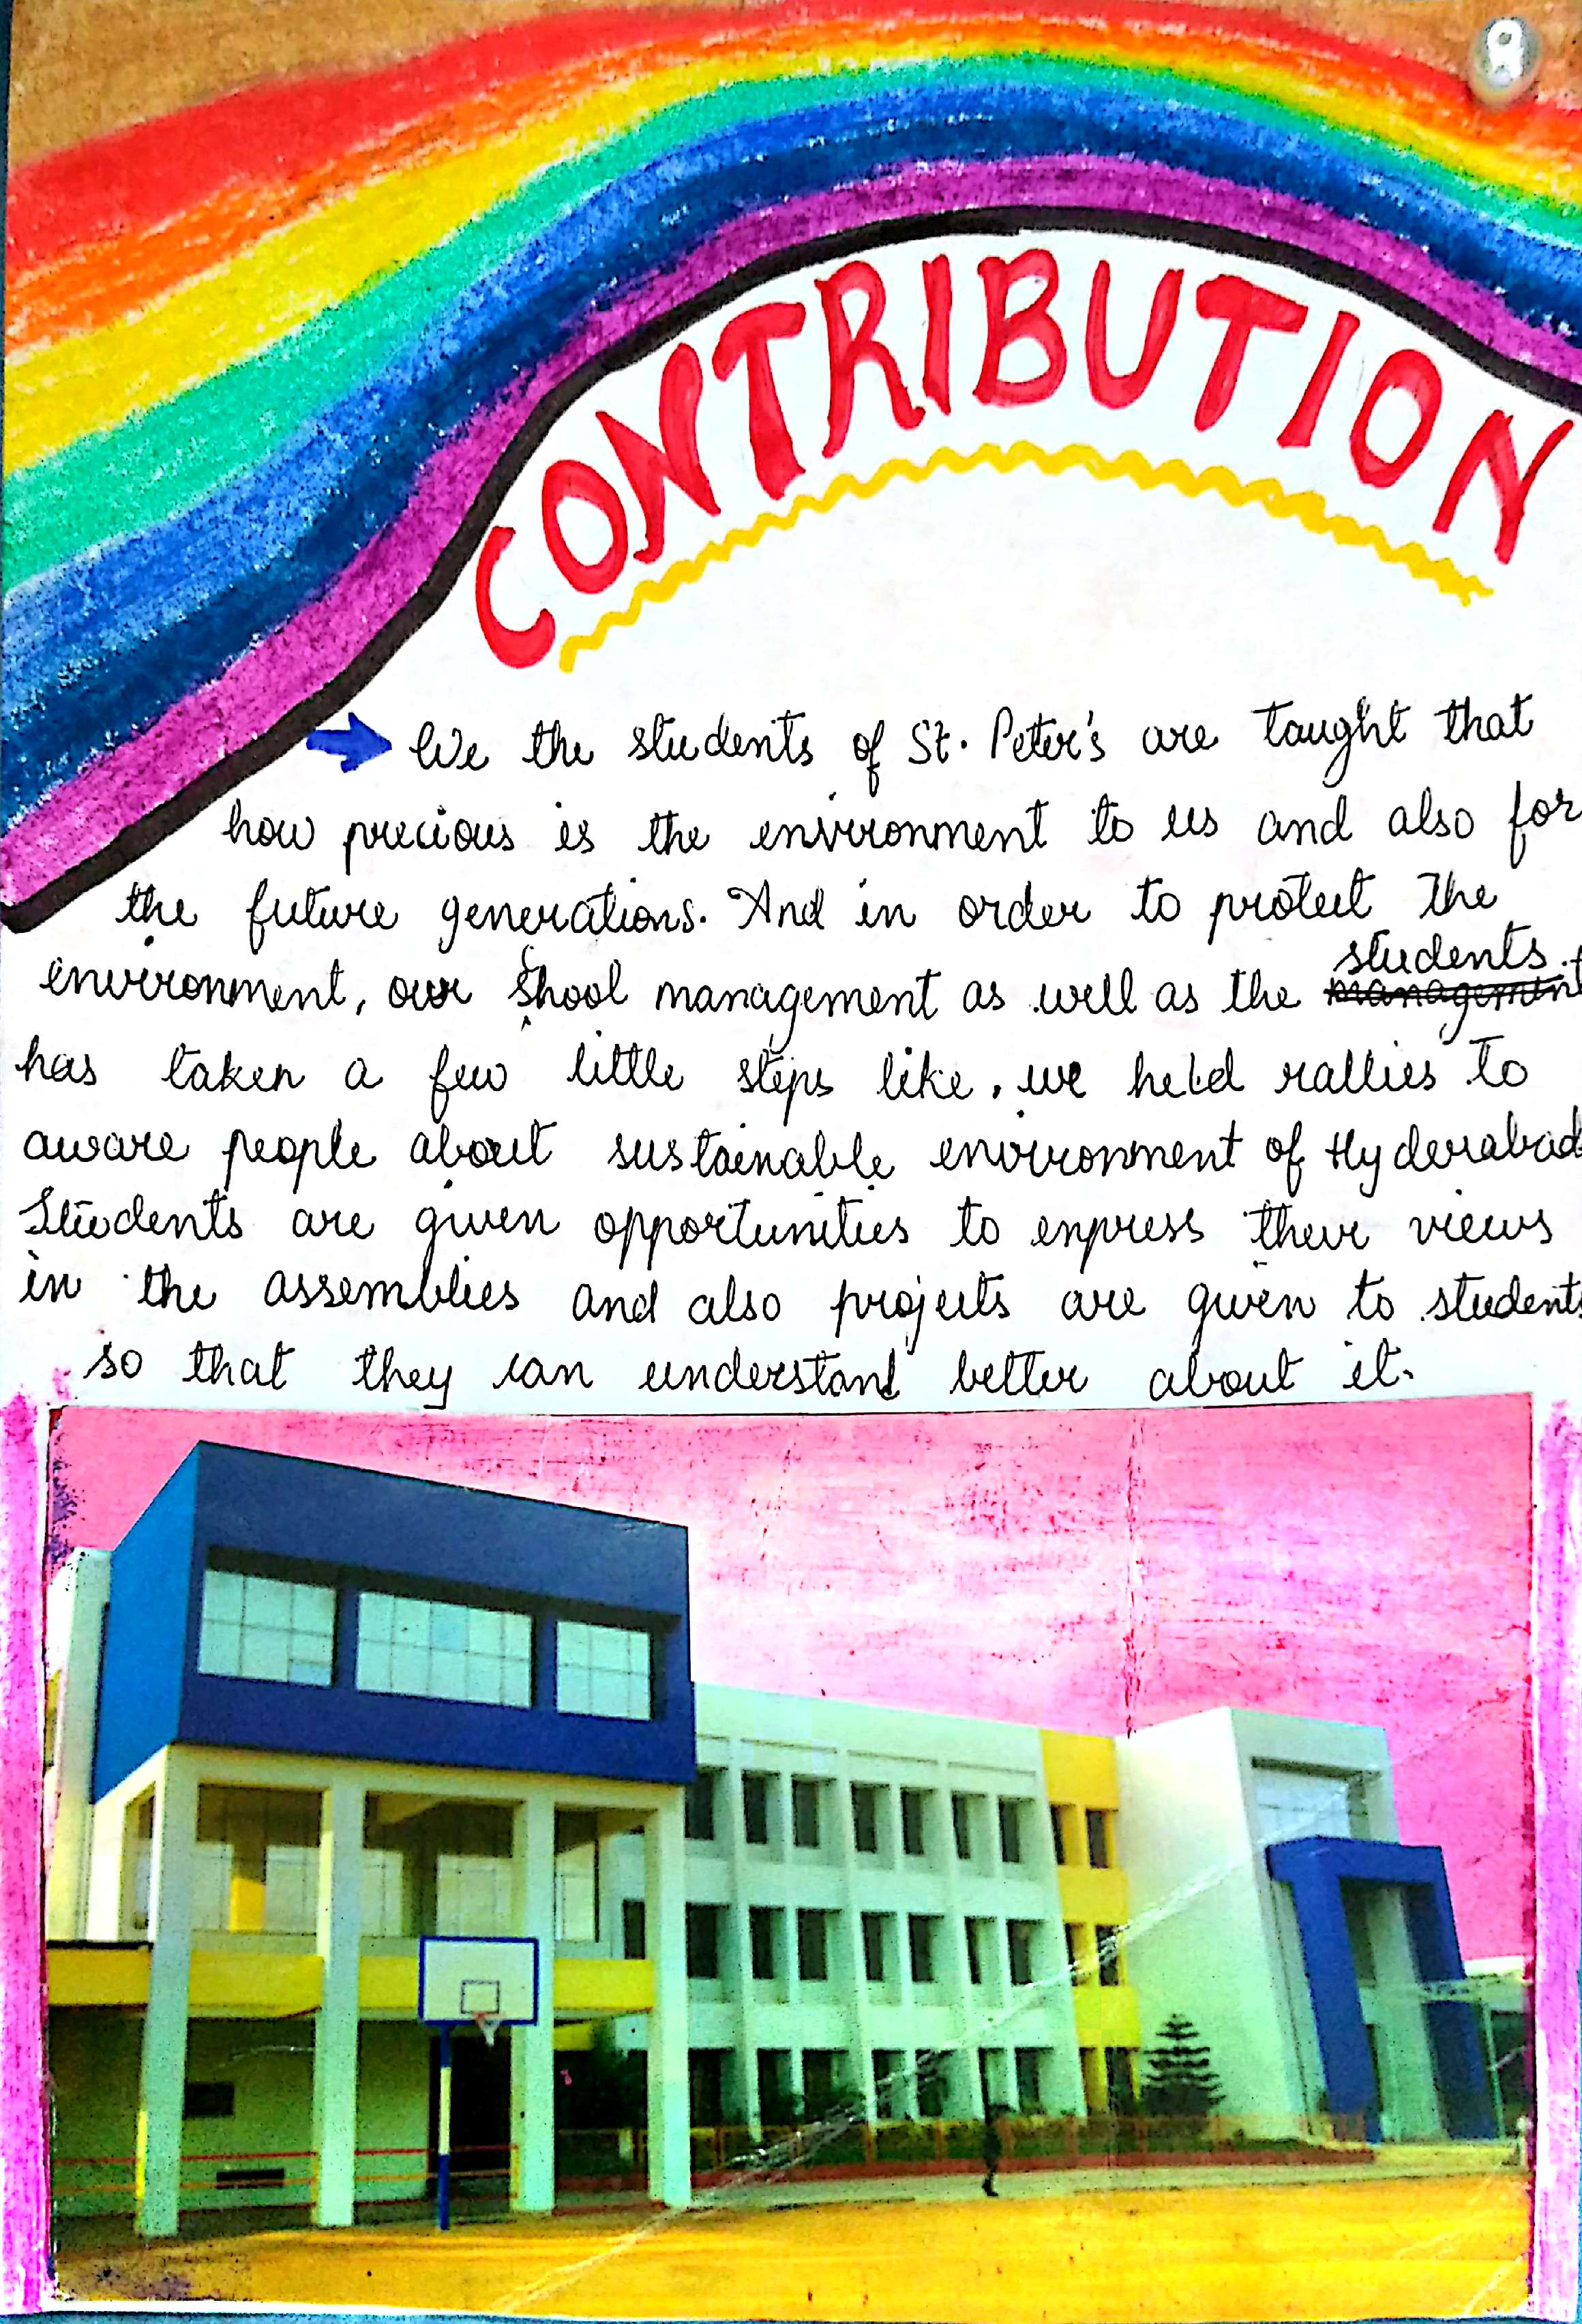
GLOBAL ISSUE ENVIRONMENT – by Ms.Vedika , Grade 9 , St.Peter’s High School , Telangana , INDIA

