Slide 1
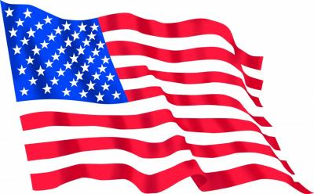
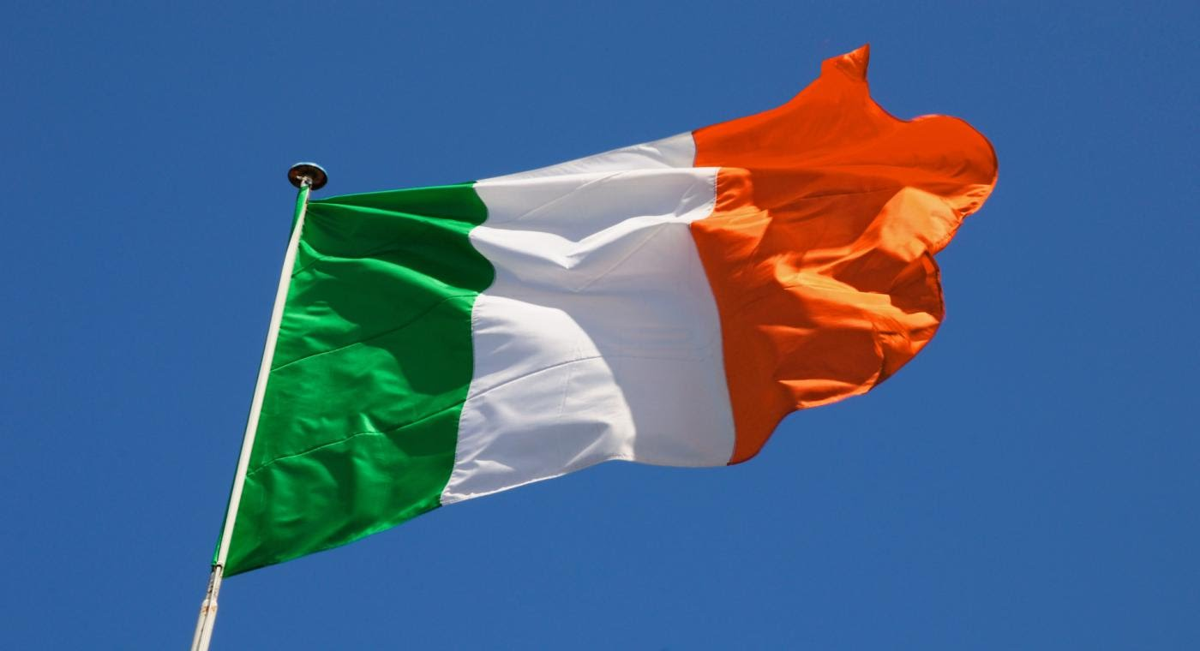
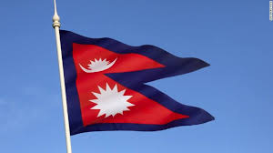
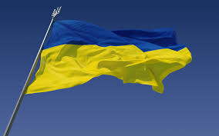
National Symbols
Snovsk Gymnasium
Ukraine
2017

Slide 2
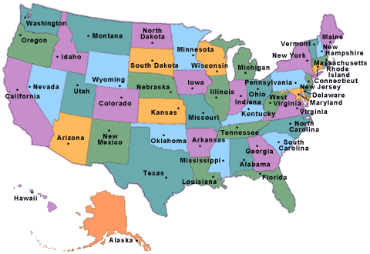
Top 10 Famous American National Symbols

Slide 3
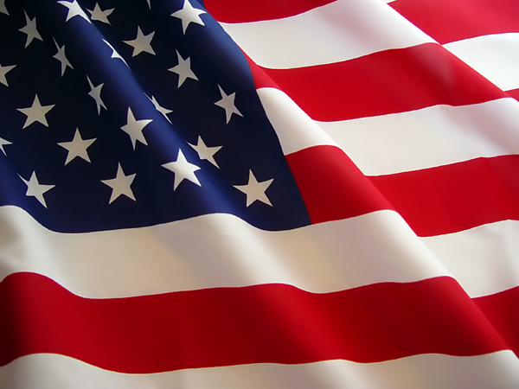
The United States Flag
The colors of the pales (the vertical stripes) are those used in the flag of the United States of America; White signifies purity and innocence, Red, hardiness and valour, and Blue, the color of the Chief (the broad band above the stripes) signifies vigilance, perseverance & justice.

Slide 4
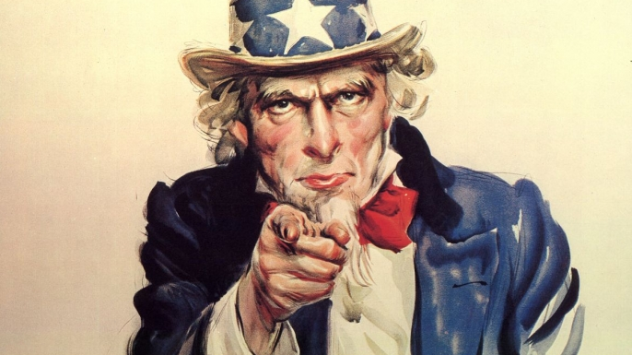
2. Uncle Sam
Uncle Sam (initials U.S.) is a common national personification of the American government or the United States in general. That, according to legend, came into use during the War of 1812 and was supposedly named for Samuel Wilson. Its actual origin is obscure. Uncle Sam represents a manifestation of patriotic emotion.
The first use of Uncle Sam in formal literature (as distinct from newspapers) was in the 1816 allegorical book "The Adventures of Uncle Sam in Search After His Lost Honor" by Frederick Augustus Fidfaddy, Esq. An Uncle Sam is mentioned as early as 1775, in the original "Yankee Doodle" lyrics of the American Revolutionary War. It is not clear whether this reference is to Uncle Sam as a metaphor for the United States, or to an actual person named Sam. The lyrics as a whole celebrate the military efforts of the young nation, besieging the British at Boston.

Slide 5
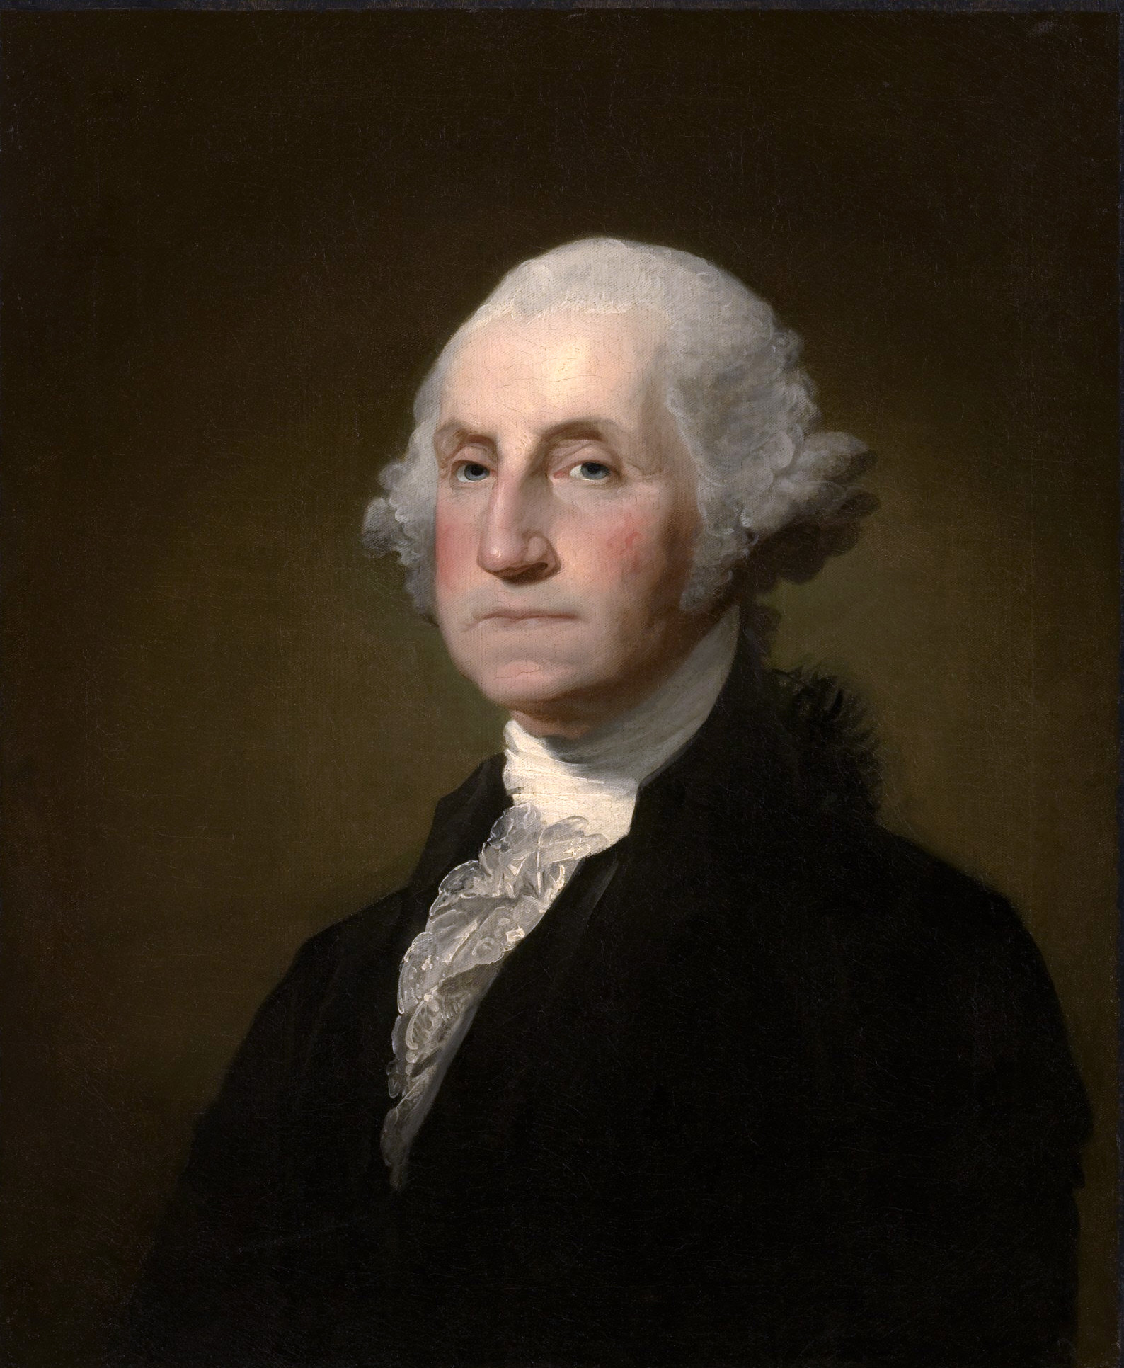
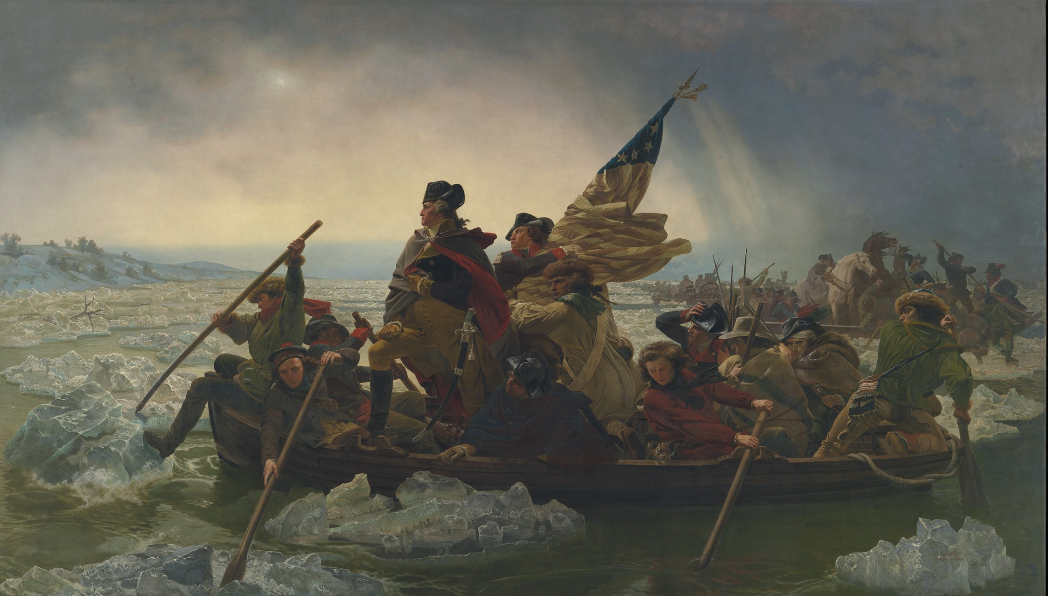
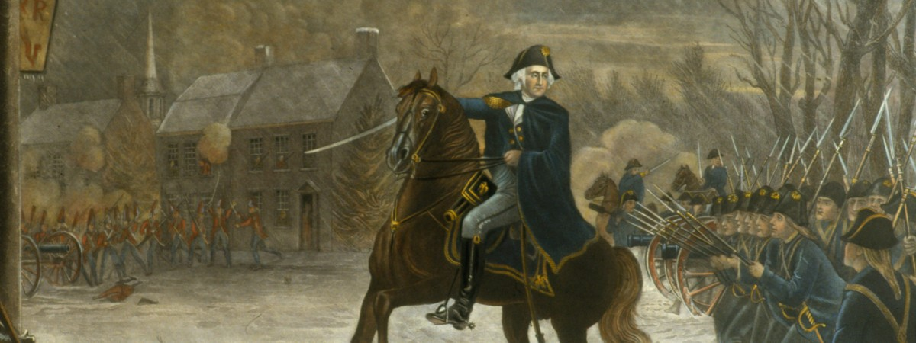
3. George Washington
George Washington was born on February 22, 1732 [O.S. February 11, 1731 – December 14, 1799) was an American politician and soldier who served as the first President of the United States from 1789 to 1797 and was one of the Founding Fathers of the United States. He served as Commander-in-Chief of the Continental Army during the American Revolutionary War, and later presided over the 1787 convention that drafted the United States Constitution. He is popularly considered the driving force behind the nation's establishment and came to be known as the "father of the country," both during his lifetime and to this day.

Slide 6
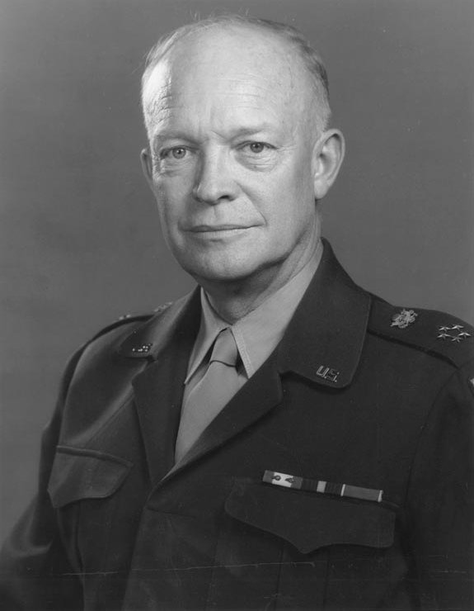
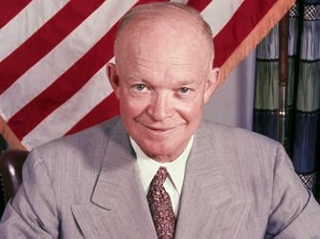
Dwight D Eisenhower was probably the most famous American general in World War II. He became the 34th president of the United States of America.
4. Dwight D Eisenhower
Dwight D. Eisenhower - D-Day Pre Invasion Address to Soldiers (Order of the Day). Soldiers, Sailors, and Airmen of the Allied Expeditionary Force: You are about to embark upon the Great Crusade, toward which we have striven these many months.

Slide 7
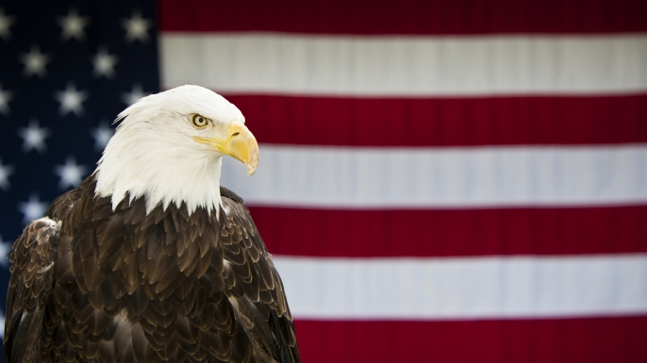
5. Bald Eagle
The bald eagle is important in various Native American cultures, and as the national bird of the United States. It is prominent in seals and logos, coinage, postage stamps, and other items relating to the U.S. federal government. Bald eagles were once hunted, but now it is illegal to hunt them in the United States.

Slide 8
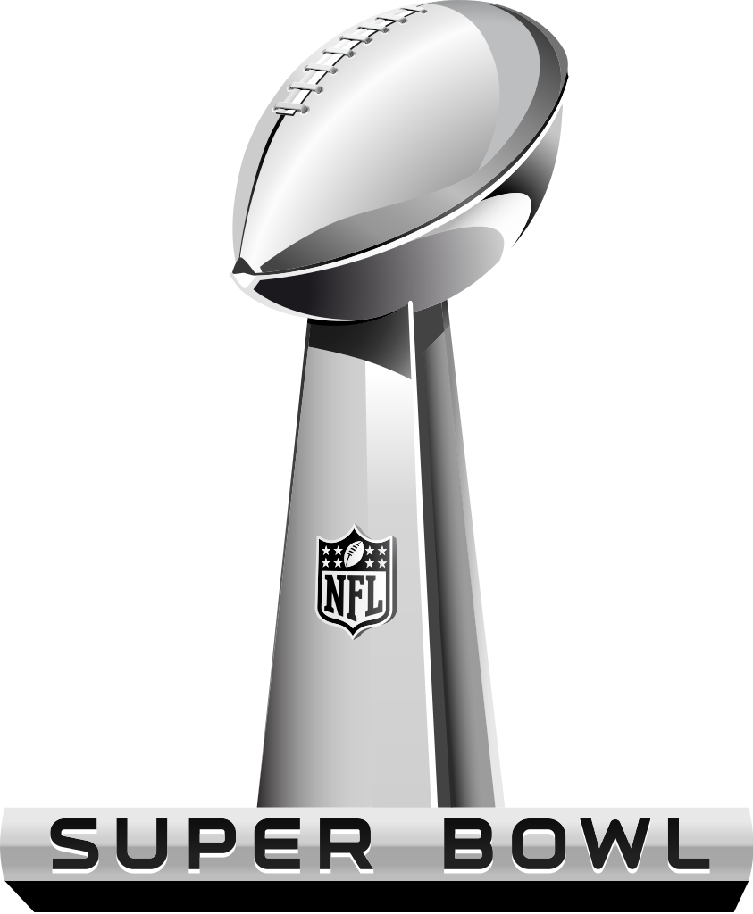
6. Super Bowl
The Super Bowl is probably the most recognized sporting contest in the United States because athletes from the two best football teams compete against each other to determine who is best. Did you know that 1 million chicken wings are eaten on Super Bowl Sunday in February each year?

Slide 9
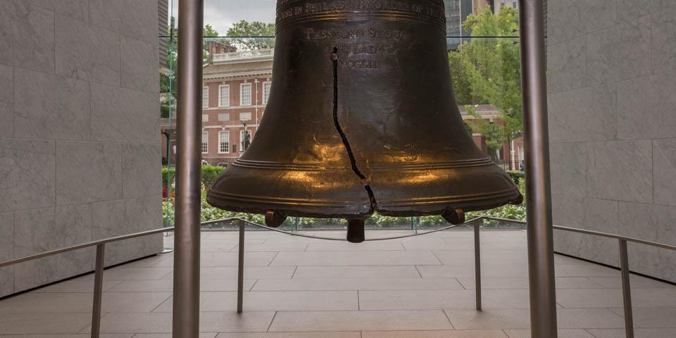
7. Liberty Bell
The Liberty Bell is an American symbol of freedom. It is located in Philadelphia, Pennsylvania. The bell first cracked when rung after its arrival in Philadelphia, and was twice recast by local workmen John Pass and John Stow, whose last names appear on the bell.

Slide 10
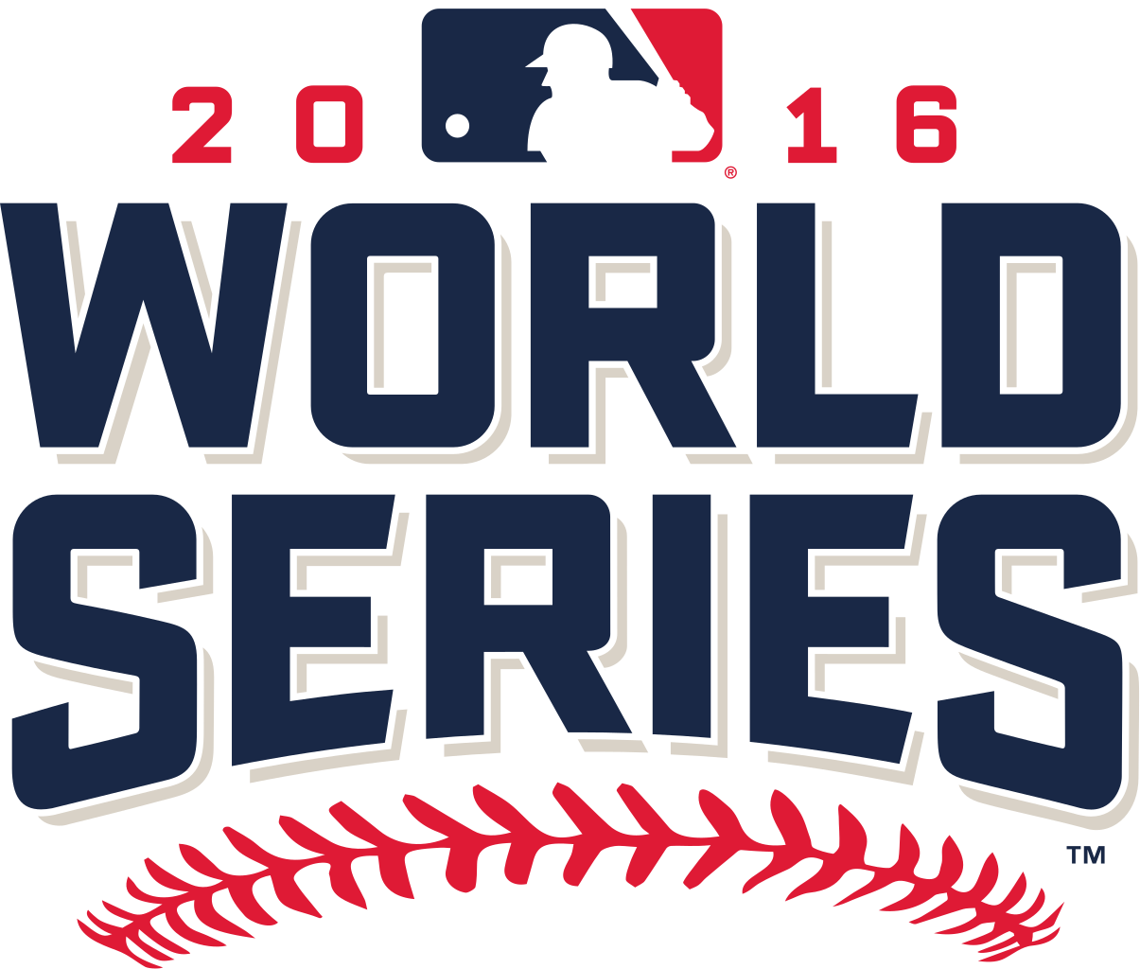
8. The World Series of Baseball
The World Series is the annual championship series of Major League Baseball in North America, contested since 1903 between the American League champion team and the National League champion team. The winner of the World Series championship is determined through a best-of-seven playoff.

Slide 11
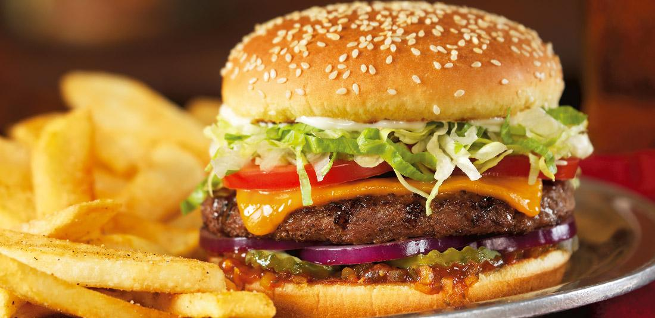
9. National Food
Hamburgers, hot dogs, apple pie, and Chicago-style pizza.
Our favorite American food is the hamburger. Taylor ham is popular in New Jersey because it is made in New Jersey.

Slide 12
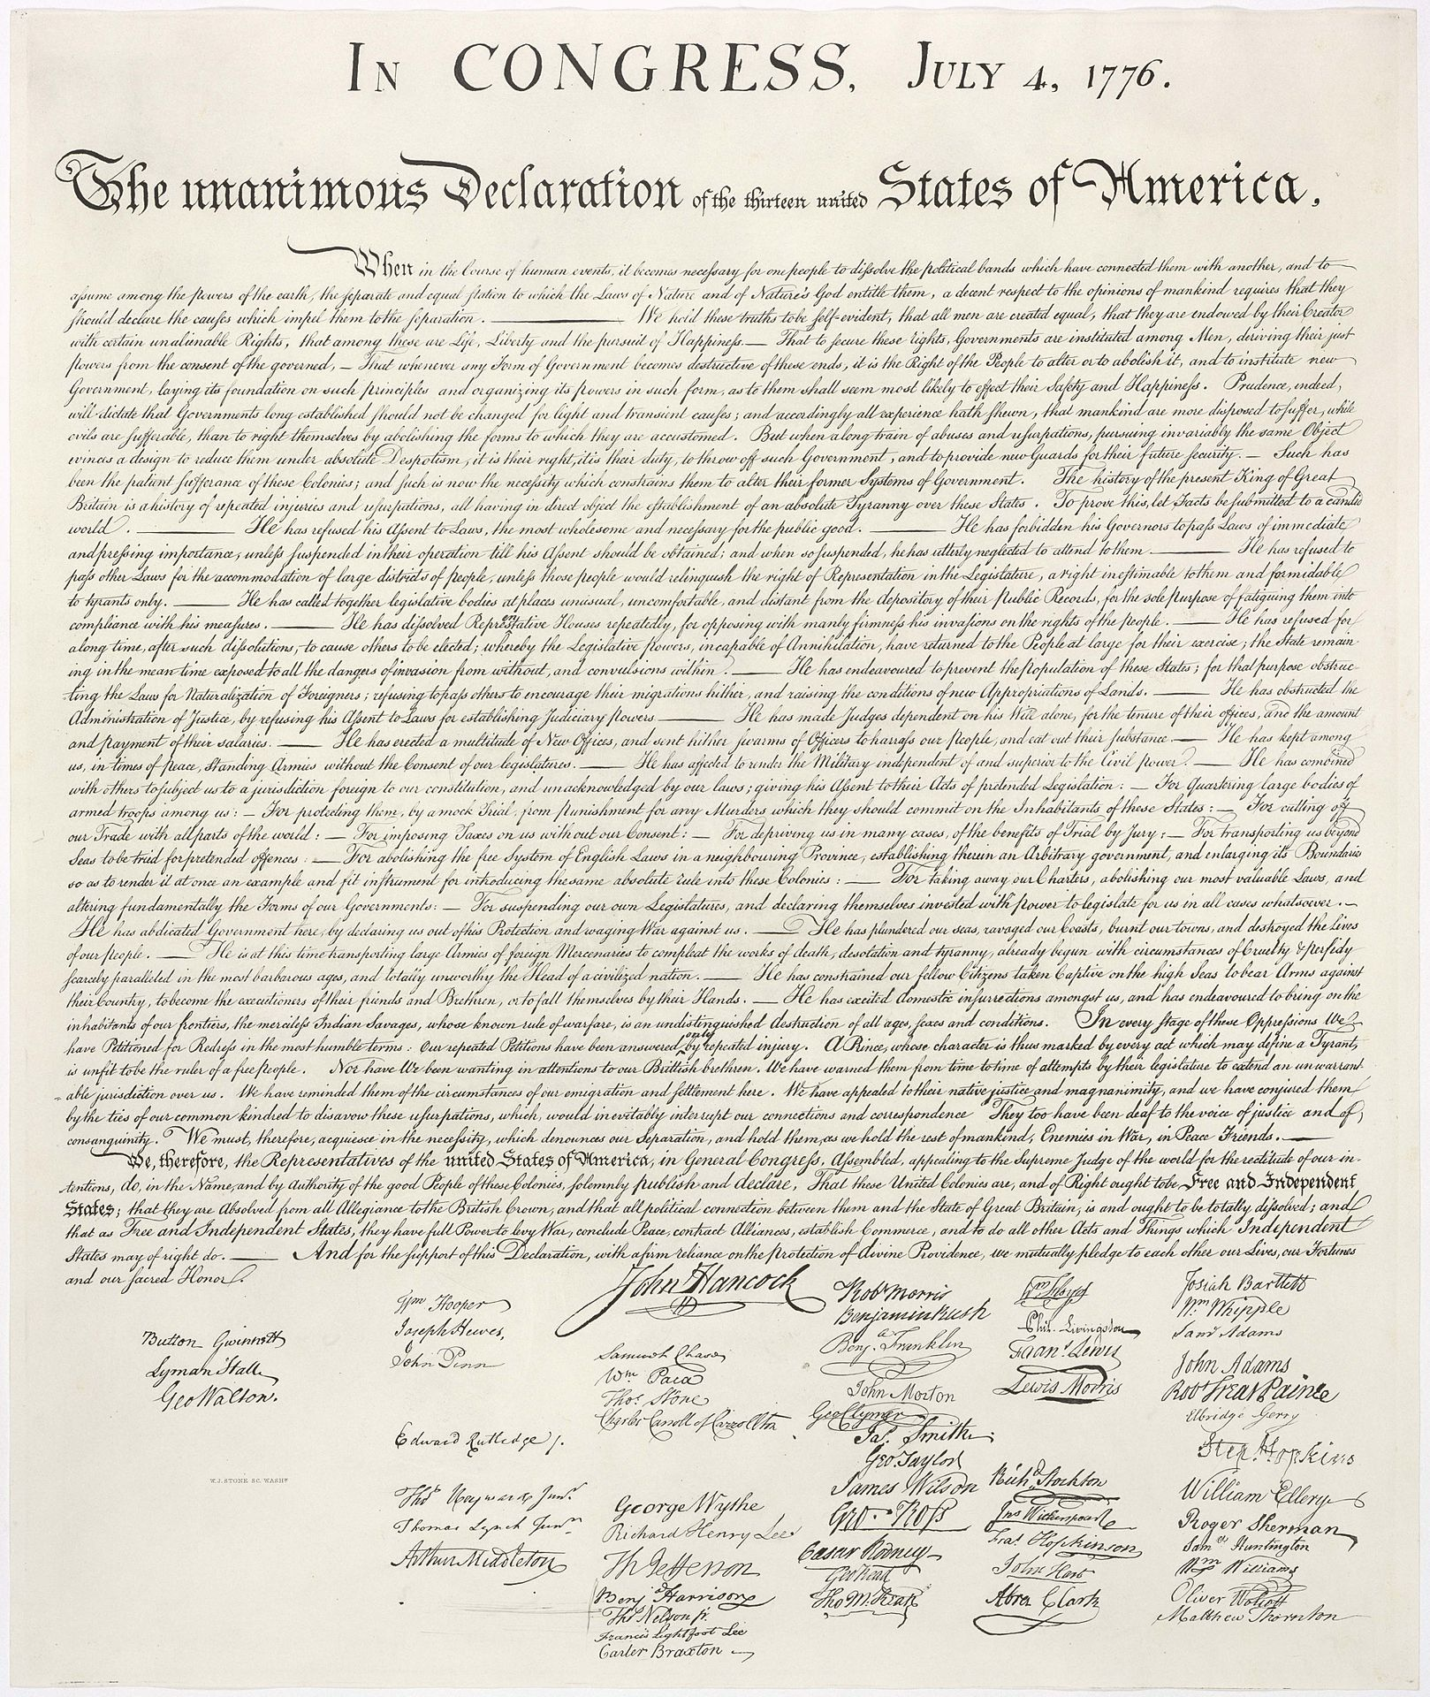
10. Declaration of Independence
Declaration of Independence is probably the most famous American document. It was written in the year 1776, but wasn’t signed until August 2, 1776. The Declaration of Independance was signed by many amazing founders of the United States. It declares our independence from England. The Declaration is now on display in Washington, DC.

Slide 13
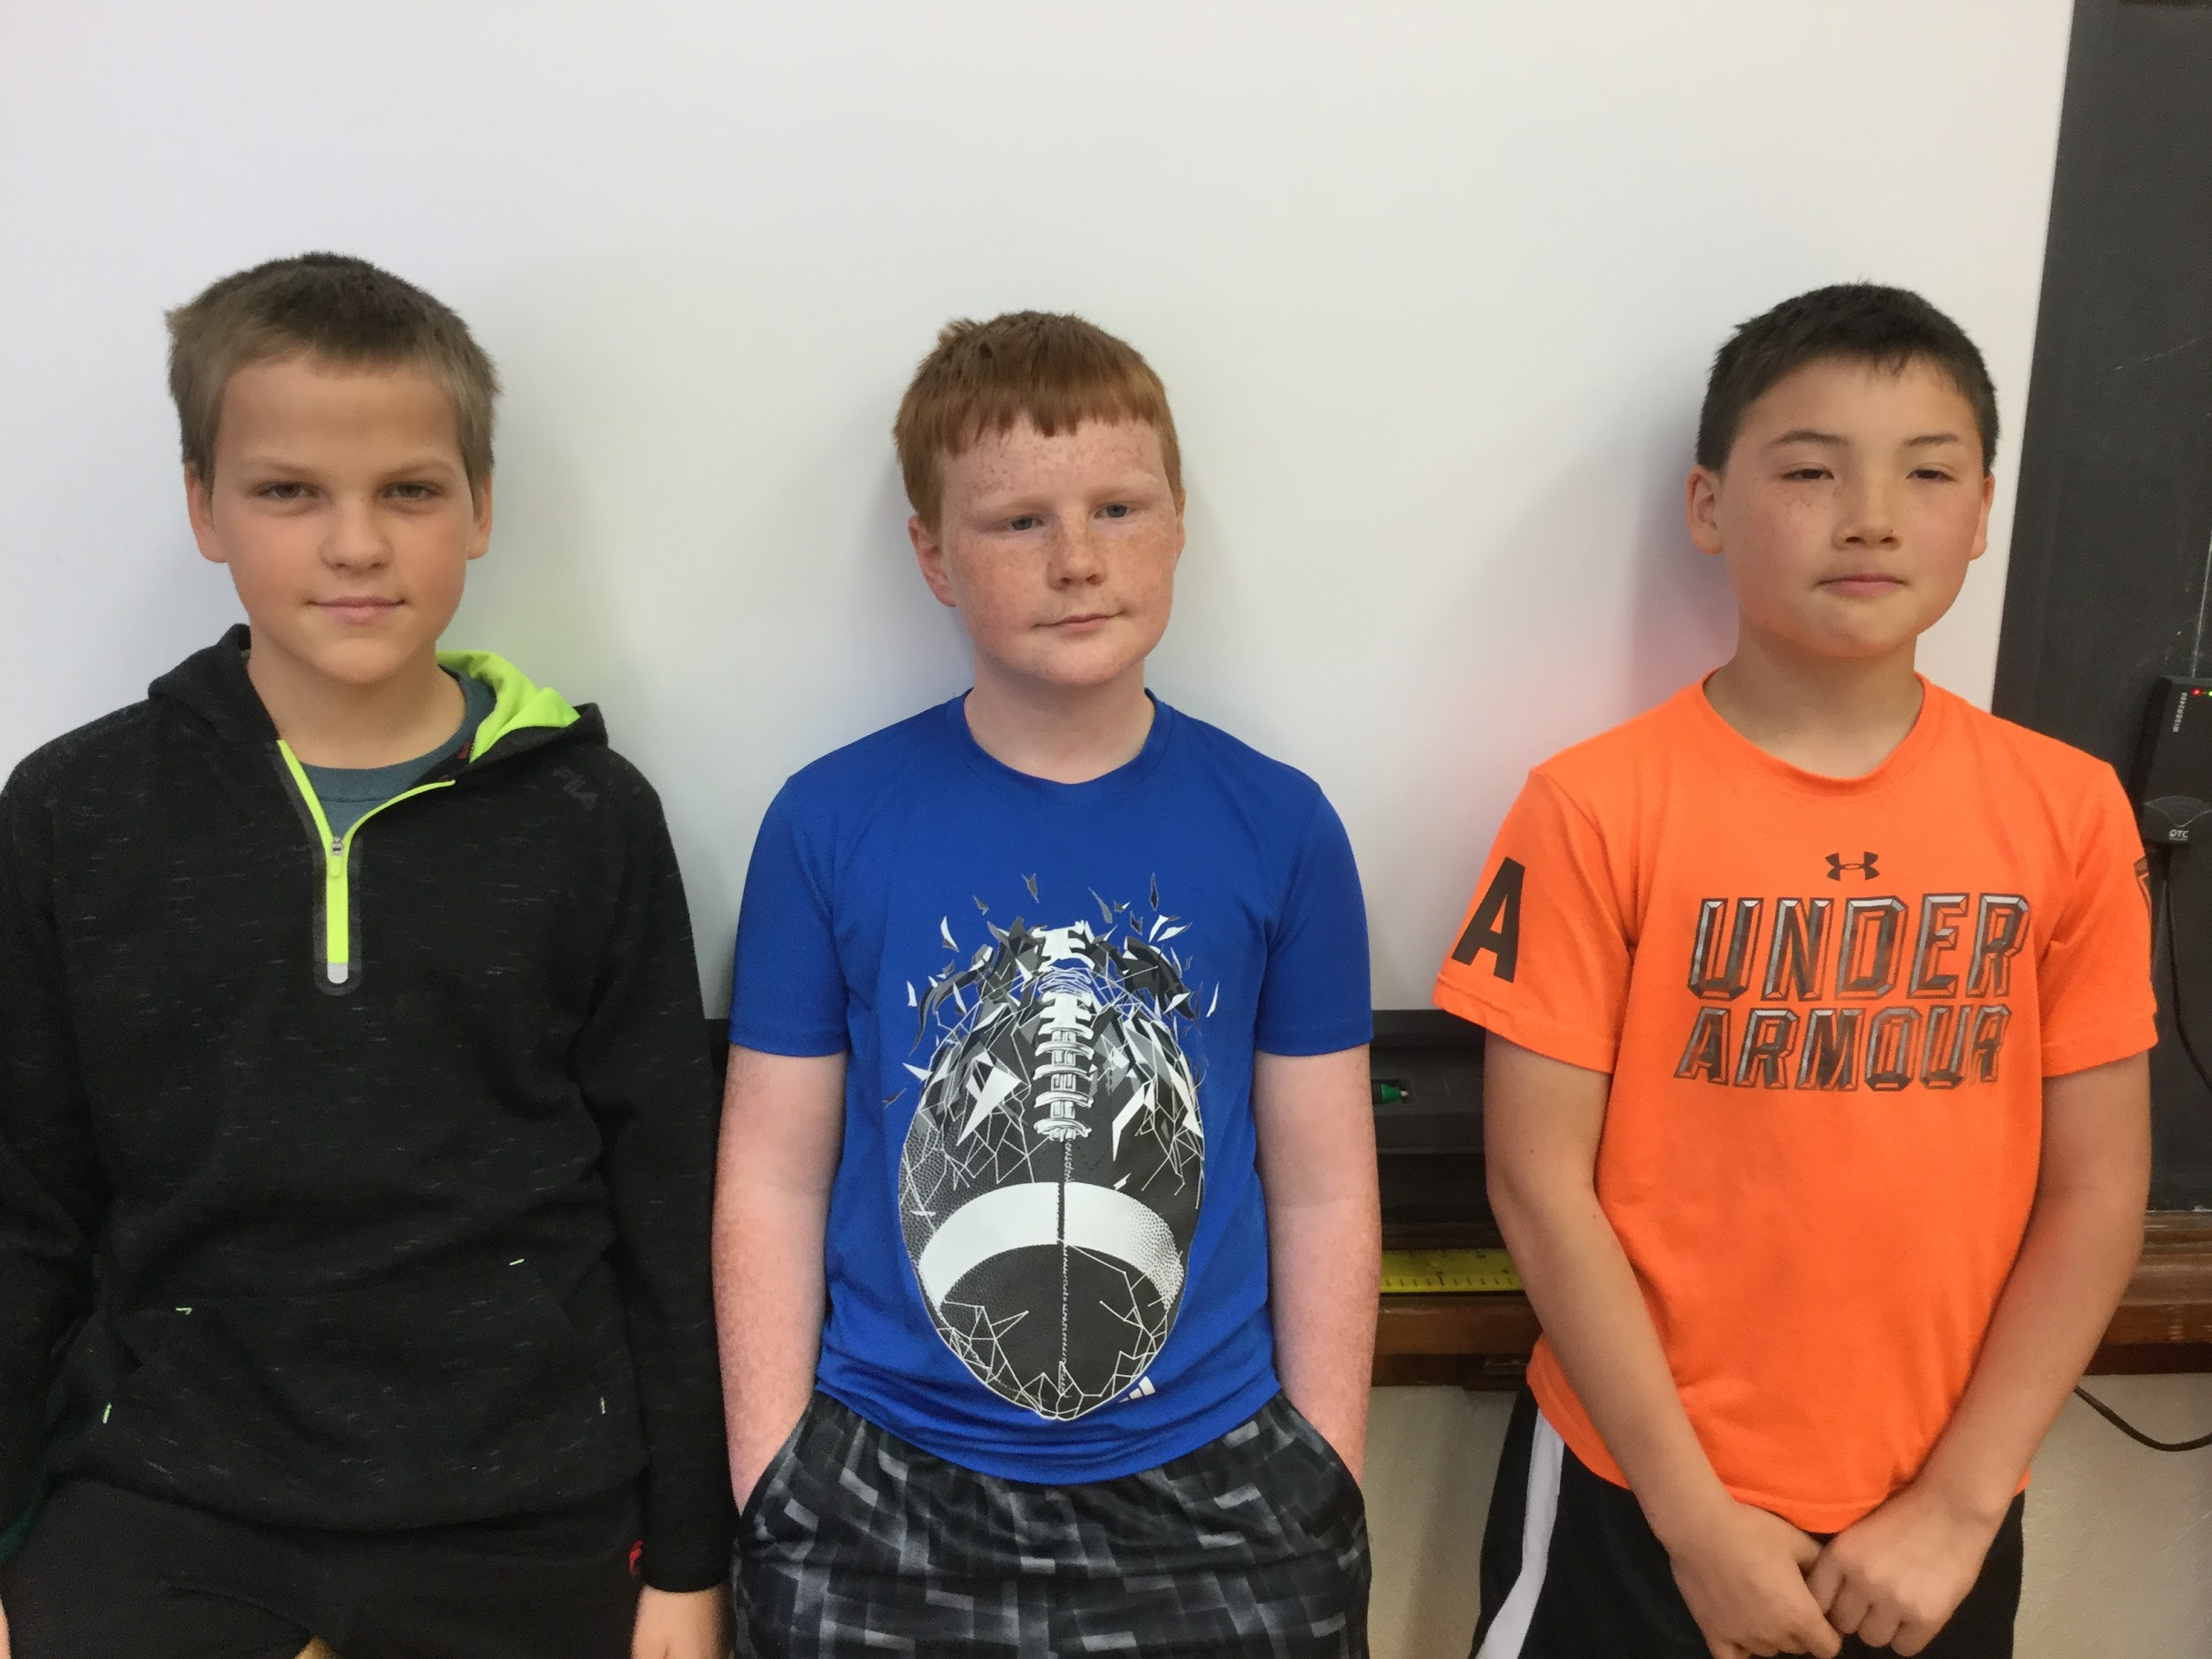
Creators
Ben H. Joshua E. and Aaron L.

Slide 14
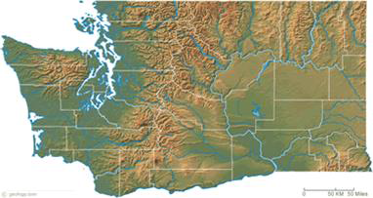
Washington State Symbols
Lynnwood Elementary 4th Grade students
WA, USA
Places and Perspectives Spring 2017

Slide 15
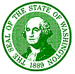
Washington State Seal
The first State Seal was designed in 1889 by a jeweler named Charles Talcott. He made the first state seal using a silver dollar, an ink bottle and a postage stamp.

Slide 16
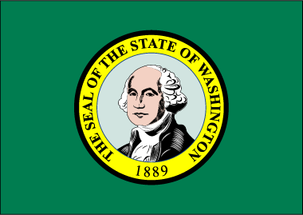
Washington State Flag
The state flag is green with the state seal in the middle. The state is named after our first president George Washington.

Slide 17
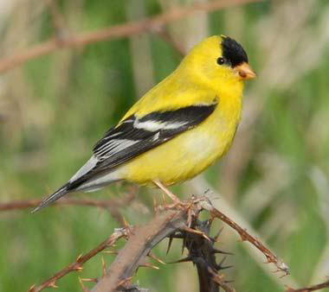
State Bird: Yellow Goldfinch
The goldfinch is a little bird with a yellow body and black wings. The color are not as bright in the the winter. It is interesting to note that the Legislature decided to leave the final choice to school children. In 1951, children voted for the goldfinch and the Legislature made it unanimous.

Slide 18
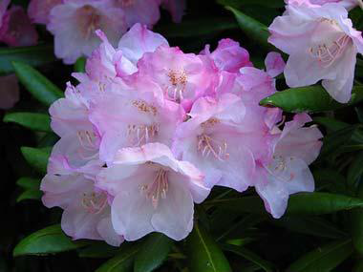
State Flower:Coast Rhododendron
The coast rhododendron was officially designated as the Washington state flower in 1959. But it was actually selected as the state flower in 1892 by the women of Washington for the 1893 World's Fair in Chicago.
The coast rhododendron is found mostly near the Pacific coast, but it can also be found in the Cascade Mountains in Oregon, Washington and British Columbia. There are many kinds of rhododendron in Washington state.

Slide 19
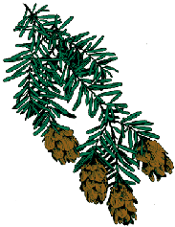
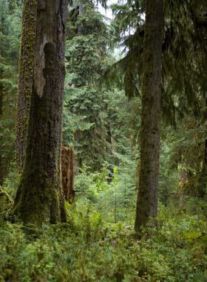
State Tree:Western Hemlock
State Tree Western Hemlock In 1946, an Oregon newspaper teased Washington for not having a state tree. The Portland Oregonian picked out the western hemlock, but Washington newspapers decided to choose their own and selected the popular western red cedar. State Representative George Adams of Mason County pleaded with the Legislature to adopt the western hemlock. The hemlock, he said, would become "the backbone of this state's forest industry." Adams' bill passed the Legislature and was signed into law in 1947.
Western hemlock trees in Olympic National Park, Washington - photo by Tom Green on Flickr

Slide 20
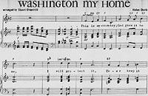
State Song: “Washington, my home”
The state song, "Washington, My Home," was written by Helen Davis, arranged by Stuart Churchill, and became the official state song in 1959.
It is often performed at ball games in our state or by marching bands in schools.

Slide 21
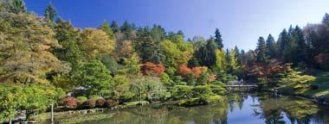
“Washington,My Home” Written by Helen Davis, arranged by Stuart Churchill
Lyrics:
◻This is my country; God gave it to me; I will protect it, ever keep it free. Small towns and cities rest here in the sun, Filled with our laughter, "Thy will be done."
◻REFRAIN:
◻Washington my home; Where ever I may roam; This is my land, my native land, Washington, my home. Our verdant forest green, Caressed by silvery stream; From mountain peak to fields of wheat. Washington, my home.
◻There's peace you feel and understand In this, our own beloved land. We greet the day with head held high, And forward ever is our cry. We'll happy ever be As people always free. For you and me a destiny; Washington my home.
Washington state arboretum - photo by Marcel Ray on Flickr
Source:
Washington State Legislature

Slide 22
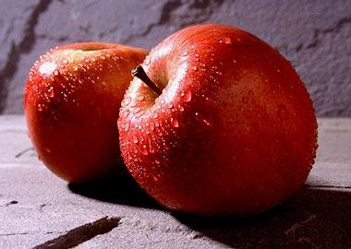
State Fruit: Apple
Washington is the nation's top apple-producing state, so it is appropriate that the apple was named a state symbol in 1989, the centennial year. The apple trees of Washington represent one of the largest industries in the state. The Washington apple is certainly one of the most recognized symbols of the state worldwide.
Photo of Washington apples by Scott Bauer, courtesy USDA Agricultural Research Service Image

Slide 23
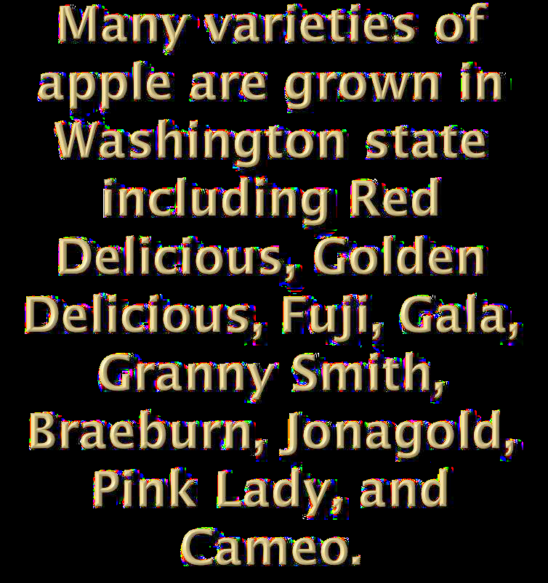
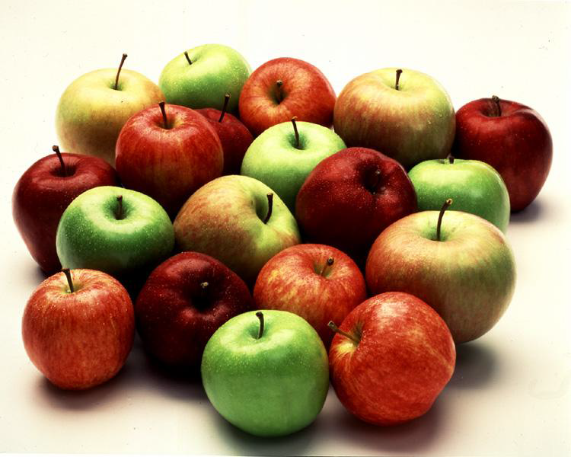
Apple Facts
◻Washington has led the country in apple production since 1910.
◻Over 60% of Washington apples come from the Yakima Valley.
◻Washington supplies half of America's fresh apple needs.
◻Washington apples are sold in more than forty countries.
◻75% of the Washington apples that are produced are sold fresh. The other 25% are sent to processors to be canned, frozen, made into juice, juice sweeteners, and dehydrated products.

Slide 24
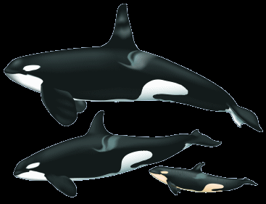
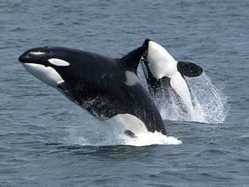
State Marine Mammal: Orca
As a result of two years of research and persuasion by second graders from the Crescent Harbor Elementary School in Oak Harbor, the Legislature designated the orca, Orcinus orca, as the official marine mammal of the state of Washington in 2005. Many people visit Washington state to watch orcas; the orca is a significant symbol for the Native American culture; there are pods of orcas that migrate annually through Puget Sound; and the orca is easily recognizable because of its distinct markings. The designation is intended to promote orca awareness and to encourage protection of the natural marine habitat.
Orca Family drawing
simply-san-juan.com
classbrain.com

Slide 25
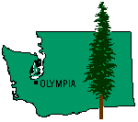
“The Evergreen State”
On November 11, 1889, Washington became the 42nd state to enter the Union. It is the only state in the Union that is named for a president.
Washington was nicknamed "The Evergreen State" by C.T. Conover, pioneer Seattle realtor and historian, for its abundant evergreen forests.

Slide 26
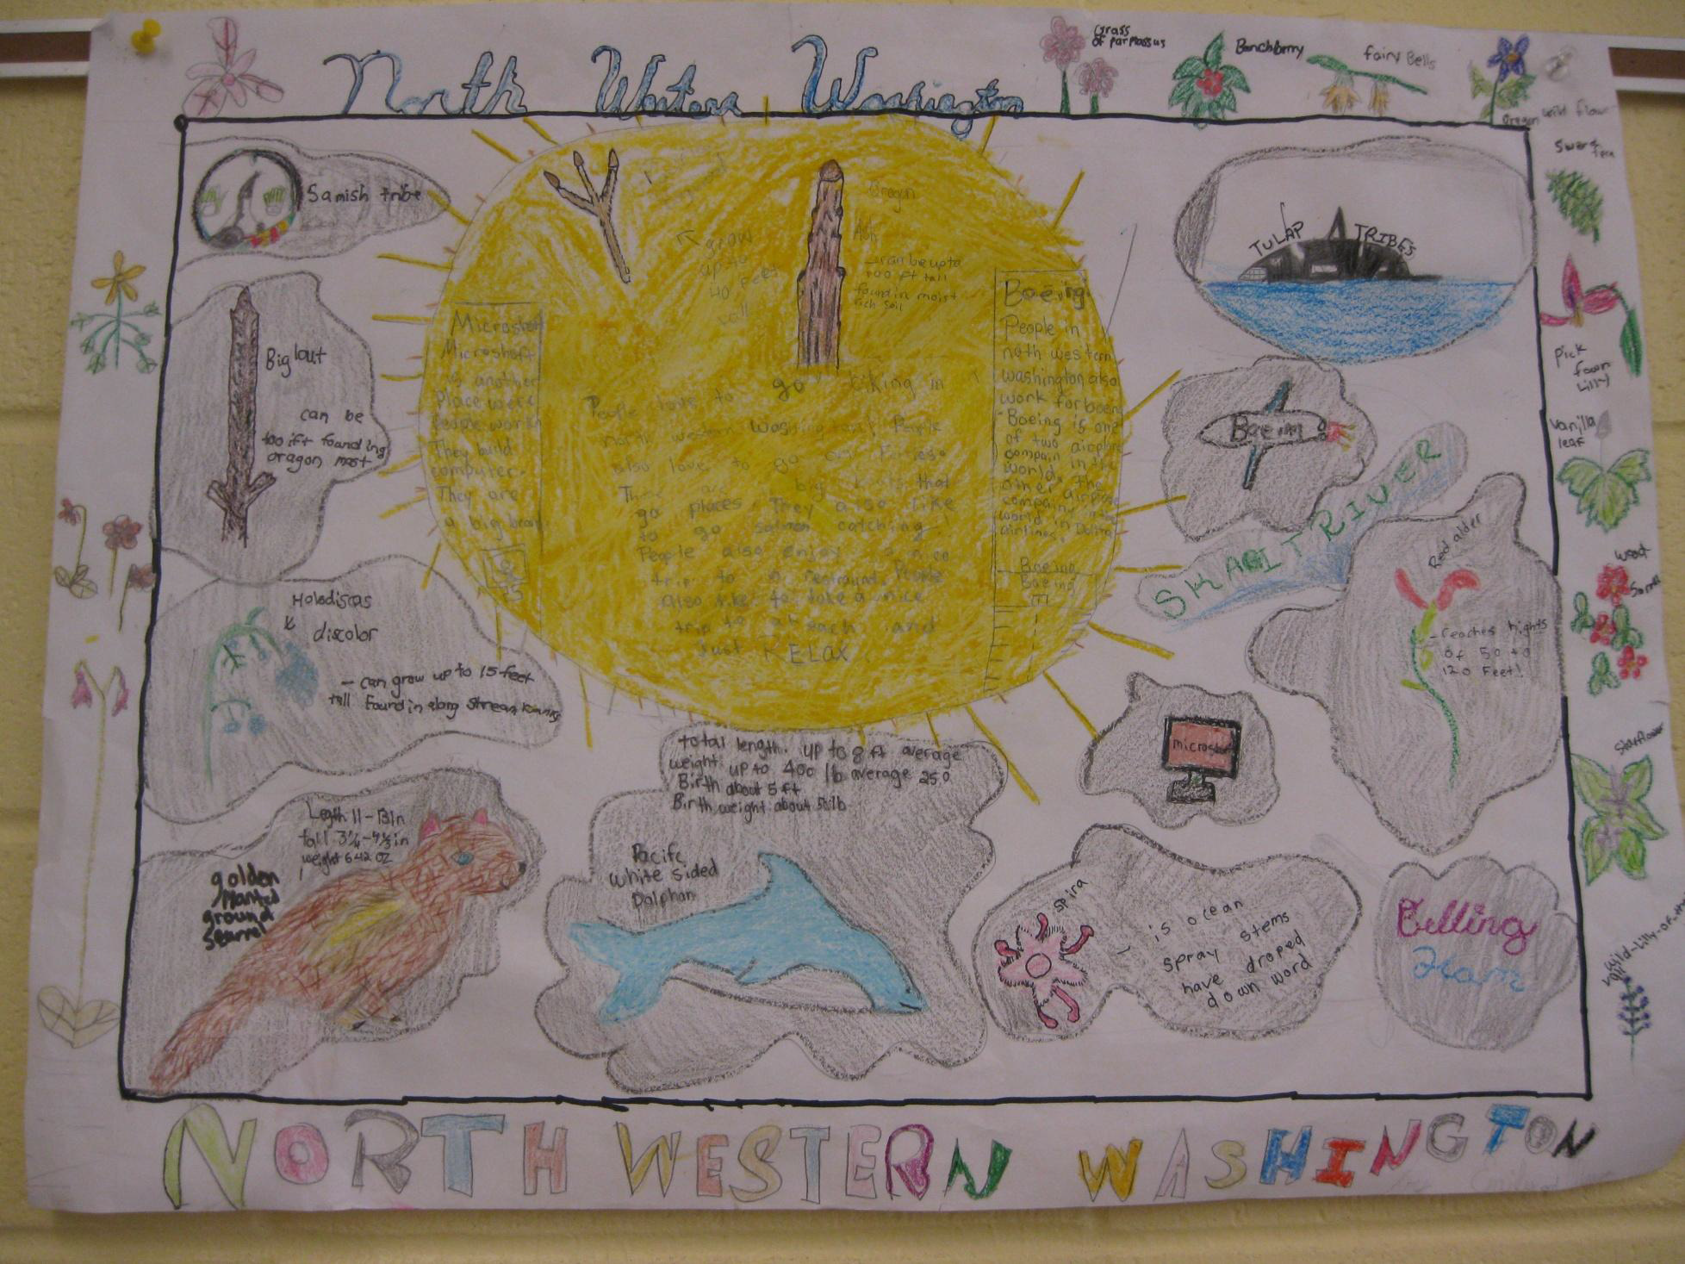

Slide 27
We live in a beautiful region with a variety of plants and animals
◻Native Americans have been living here for a very long time even before the white men came and the orca was an important symbol
◻Many students were involved in drawing this poster. We feel it is a good representation of what is found in our region and our state symbols.

Slide 30
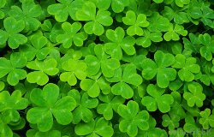

Slide 31
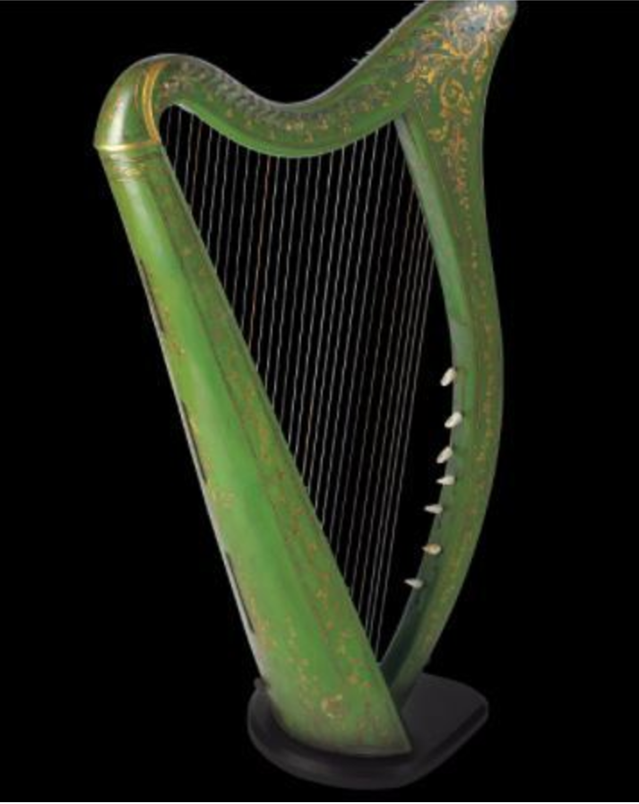

Slide 32
National symbols of Nepal
Sponsoring teacher:
Sponsor school :Kavya School
City :Kathmandu
Country: Nepal

Slide 33
National flag national flag of our country is only the triangular shaped flag in the world. It has three different colour. It was made after our country was unified by late king Prithivi Narayan Shah. It is unique also because of the sun and moon of the flag sun and moon in the flag says that till the sun and moon exist in the universe our country remains.
RED= BRAVERY OF NEPALI SOLDIERS .
BLUE= Thinking of Nepalese are vast like sky and oceans
WHITE= PEACE AND HAPPINESS OF NEPAL

Slide 34
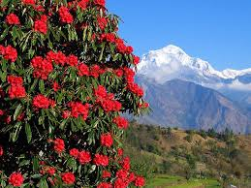
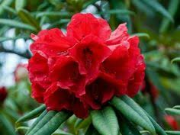
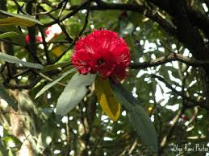
rhododendron
Laligurans is regarded as the national flower of Nepal . It grows at the height of 1400-3600m. It has special place in the life and culture of the Nepalese people. It is red in colour. Red is the most auspicious colour in Nepali culture. It is used for making juice and medicine.
In the month of March and April, rhododendron blankets the hills with magnificent beauty and draws the attention of thousands of trekkers.

Slide 35
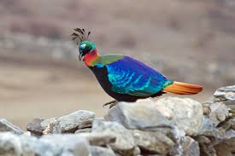
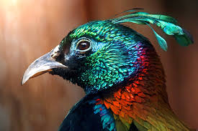
Danphe
Danphe (lophophorous) is our national bird. It is found in the Himalayan region of Nepal. They can endure the cold weather. They live up to 2500m and above 4500m. They have nine colored plumage throughout their body. That is why we often call them Naurangi Danphe. They possess long metallic green crests. They are very beautiful birds.

Slide 36
National Anthem
Every nation has its own national anthem and so has Nepal. It is the pride and identity of our country. We all should respect our national anthem. Respect to our national anthem means respect to our motherland. All formal national festivals, ceremonies and programmes of honour begin the national anthem. Thus, when our national anthem is sung, we should stand up in a disciplined way with our right hand on our left chest to show our tribute to it.

Slide 37
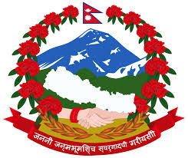
Coat-of-Arms
It is one of the symbols of our identities. It is used to legalize documents in government offices. After the political changes in Nepal, the coat-of-arms has also been changed and brought into use from 15th Poush 2063 B.S. It was designed jointly by three people: Himalaya Gautam , Krishna Shrestha and Navindraman Rajbhandari. It represents all the important features of Nepal.

Slide 38
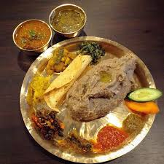
NATIONAL DISH
OUR NATIONAL DISH IS dhido and gundruk. Gundruk is made up of spinish and dhido is made up of the paste of flour of the corn and millet. It is easy to prepare, cheaper, taster and healthier. If you visit us once you taste it.

Slide 39
National Symbols
of Ukraine

Slide 40
Ukrainian flag
The national flag first appeared in 1848.
The flag has two stripes : a blue one above a yellow one.
The colours are symbolic –yellow for wheat in the field and blue for the sky above them.

Slide 41
The national Emblem
The Ukrainian emblem is a trident.
It is the most ancient and dignified of all the Ukrainian symbols.
The classic shape of the Ukrainian trident was found on the coins of Volodymyr the Great ,who ruled in the 10th century.
Then ,it was a mark of authority, and a symbol of the ethnic groups which made up the Ukrainian nation.

Slide 42
The National Anthem
The song called “Ukraine’s Will and Glory Have Not Yet Perished”
Its lyrics were written by Pavlo Chubynskyi and it was published in 1863.
The catchy melody and patriotic words made this song very popular among Ukrainians.
Article 20 in the Constitution of Ukraine of 1996 defines it as the state anthem.

Slide 43
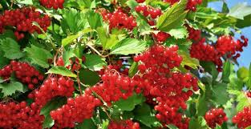
Kalyna is a national plant
Guelder-rose or kalyna is a national plant of Ukraine. It is a symbol of life, blood, fire. Ukrainians believe that kalyna connects the living and the hereafter. Kalyna also symbolizes maternity: bush – mother, blossom and berries – children. It is a symbol for home, parents, family.
Kalyna is a Ukrainian symbol for timeless unity of Ukrainian nation – those who live, those who passed away, and those who will be born. Kalyna personifies Ukraine as a symbol of motherland. Ukrainian saying states: “Without willow and guilder-rose there is no Ukraine”.

Slide 44
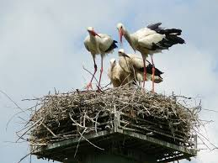
National Bird
Stork is considered to be the national bird of Ukraine. It is a symbol of parental love, family welfare and patriotism. As far as stork is believed to be a sacred bird, it`s nest, built on the roof of the house, brings fortune and happiness to its hosts.
There is one Ukrainian legend, according to which, stork originated from human, who had sinned against God and was turned into a bird.
In Ukraine children are told storks bring babies to their parents. According to the legend many years ago people believed that embryo`s souls were hidden in swamps and only storks were able to bring them to their upcoming parents.

Slide 45
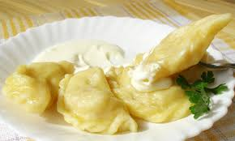
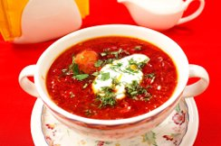
National Dishes
Varenyky are made with different fillings-
cherries, cottage cheese, potatoes, cabbage
Borshch- vegetable soup, made with cabbage,beetroots, potatoes.
Sometimes with mushrooms or beans

