Slide 1
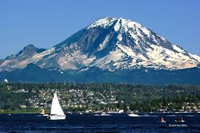
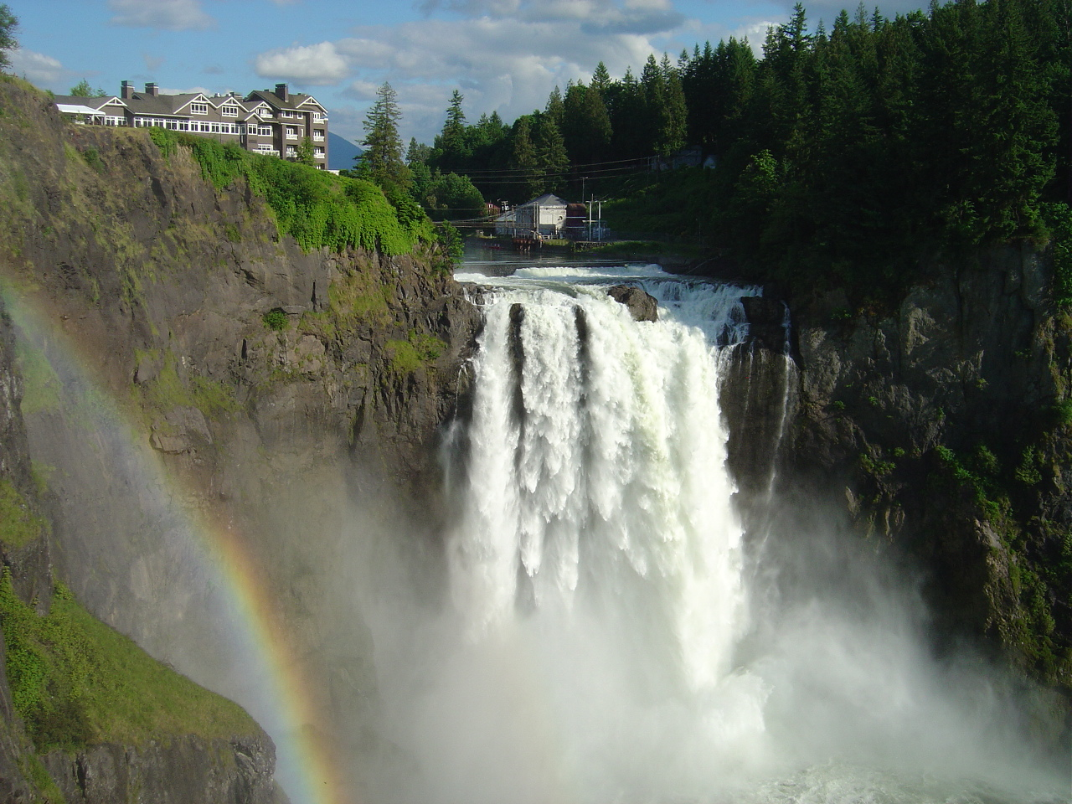
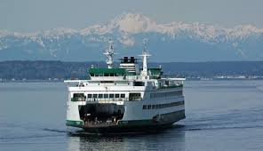
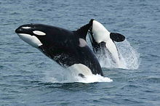
Natural Wonders in Washington State
Lynnwood Elementary 5th grade students
WA, USA

Slide 2
Snoqualmie Falls and Snoqualmie Lodge

Slide 3
Snoqualmie Falls and Snoqualmie Lodge
Snoqualmie Falls and Snoqualmie Lodge are located in Western Washington. You drive up I 90 to get to this site on the western side of the Cascade mountains.
It is spectacular now after all the rain we’ve had this winter
It is interesting to know that is is also a sacred site for the local Native Americans of the Snoqualmie Tribe.

Slide 4
Washington State Ferry
When the weather is nice, you can see the
Olympic Mountains in the background when
you take the ferry..

Slide 5
Orcas
If you are lucky, sometimes you see orcas when you are on the ferry
This picture is taken from Wikipedia
http://en.wikipedia.org/wiki/Killer_Whale

Slide 6
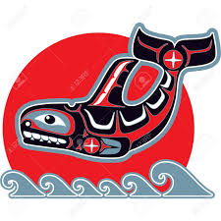
Orcas
The orcas or killer whales are not really a whale, but a separate species.
They are white and black and very pretty.
They also have special significance to the Native Americans of the Northwest Coast.

Slide 7
Mount Rainier
Mount Rainier is the Tallest Mountain in Washington State at 14,411 ft (4,392 m) and is located 80 miles south of Seattle in the Mt Rainier National Park. It is a nice place to go hiking in the summer
When the weather is nice, we can see it in the distance and it seems to float in the background of Seattle.

Slide 8
Mount Rainier
Seattle on a clear day with Mt Rainier in the background
Mount Rainier is a volcano like many peaks in the Cascade mountains. It is covered in snow year round.
This mountain also has a special significance to the Native Americans who call it TAHOMA.
http://www.summitpost.org/mt-rainier-seattle/531804

