Slide 1
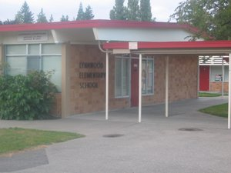
Interesting and Unique Places to visit in Seattle and Washington State
by students of Lynnwood Elementary School 5th graders Spring 2017

Slide 2
Seattle Space Needle by Miles
The space needle was built for the 1962 April 12 world fair.
Over 20,000 people go on the elevator every day.
The space needle is 605 feet tall. it is the 5th biggest building in Seattle.
I like it because it has an awesome view and has a 4.3 review restaurant on top.
https://en.wikipedia.org/wiki/Space_Needle

Slide 3
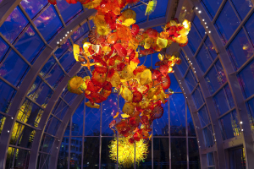
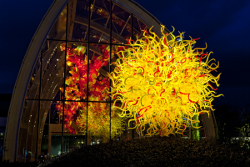
Museum of Glass by Angel B.
The first place I would take my visitor is the Museum of Glass. The glass has history and glass is really amazing to look at. The Museum of Glass is fun and can be relaxing because how the glass can be fun is how it’s made.
How the glass can be relaxing is that the museum of glass is quiet so that's how the museum of glass is relaxing. A fact is the museum has glass and the glass is fragile.
https://glassquarterly.wordpress.com/2012/05/18/opening-museum-of-glass-announces-exhibition-tied-to-chihuly-center/

Slide 4
Woodland Park Zoo by Maddox
The zoo is fun cause i heard a baby giraffe is going to be born in June.
Another reason the zoo is fun cause the zoo has amazing animals. It is relaxing because if you go to the giraffe cage the giraffe is quiet and that's why the zoo is relaxing and fun . Fun and a fact is giraffe has a blue tongue. Another fact is some of the animals can swim.
Click on the link and learn about the giraffes at Woodland Park Zoo in Seattle.
VIDEO: Lead keeper Katie Ahl welcomes us to the giraffe barn where she explains the special enrichment and diet that goes into caring for a pregnant giraffe. (https://www.youtube.com/watch?v=ZCGPkiqKVo0)

Slide 5
Museum of Flight by Max
I would like to visit the Museum of Flight. The first reason is because I really like airplanes and I am interested in that type of things.
Also because I have never been there and really want to go but didn't have a chance. Another reason is because I like to see different types of planes and they would fun to look at. The last thing is because it is close by us and I just like airplanes.
You can take a virtual visit by going to http://www.museumofflight.org/Explore-The-Museum/Virtual-Museum-Online
http://www.museumofflight.org/

Slide 6
Future of Flight Aviation Center & Boeing Tour by Laprincia
The Future of Flight Is a Boeing Museum that is not to be confused with The Museum of Flight. William Boeing was an Aviation Pioneer, who built the Boeing Airplane company.
I would go to The Future of Flight because the museum has facts about the airplanes used in World War 1.
https://www.viator.com/Seattle-attractions/Boeing-Space-and-Flight-Center-tours-tickets/d704-a1318?pref=02

Slide 7
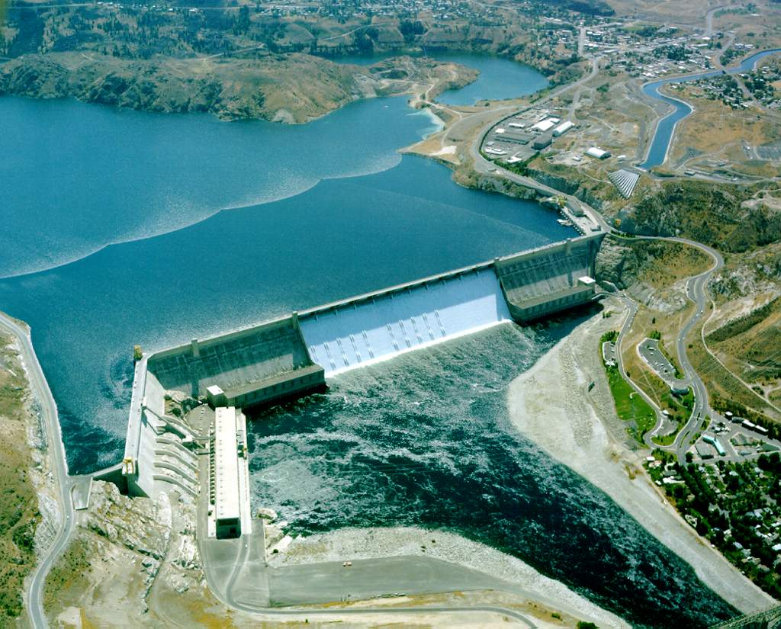
Grand Coulee Dam by Maxim B
I suggest to see the Grand Coulee Dam. The reason I want to go there is because it is really high. And it was built in 1933 for a powerhouse to build energy. The anther one is it is really cool to look at from up high. And the other one is because it has a lot of water going through is and makes a lot of energy. And last thing is I think it make the most energy in Washington. They have a cool lazer show in the evening.
https://en.wikipedia.org/wiki/Grand_Coulee_Dam
Picture by U.S. Bureau of Reclamation - http://users.owt.com/chubbard/gcdam/html/photos/exteriors.html, Public Domain, https://commons.wikimedia.org/w/index.php?curid=19544

Slide 8
Nordic Heritage Museum by Maddox
I would take them to the Nordic Heritage Museum because it has cool facts about Scandinavia.
On the ships coming to America they had to stick a sharp metal object in their eyes to check for diseases. The Nordic people also had to send their kids to other people’s farms to live in a small hut and work all day. Also the Scandinavian settlers were very poor and could only afford a small building for living space. I also liked the courses that they gave and i also liked the gift shop because they had cool things to buy.

Slide 9
Pacific Science Center by Rameez
The Pacific Science Center is next to the Seattle Space Needle. It is a fun place to go for nerds.
You can learn a lot about science. It’s cool and funny because nerds start talking all nerdy.
It has cool science projects you could try at home and look at.
And they have special exhibits.
https://www.viator.com/tours/Seattle/Pacific-Science-Center-Exhibit-Admission/d704-34057P1?pref=02

Slide 10
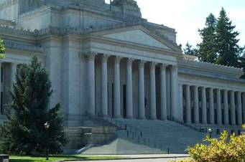
Olympia Legislative Building by Rowan
I chose Olympia because it would show the student the history of our state. Did you know that Olympia was declared capital of Washington before it was a town. The legislative building ways 94,250 tons!. The legislative building cost $7.3 million and 21 cents to build!.
The legislative building is the 5th tallest masonry building in North America.

